Slide 1
ASICs - Status
Ivan Perić
University of Heidelberg
Germany

Slide 2
DCD Status
DCDB
DCDBv4 pipeline and standard versions submitted in 2013
Single chip and the tests on EMCM are ongoing (see talk E. Prinker)
The first results are good – all circuits tested and work
Similarly as in previous chips, we have several sensitive ADCs pro chip which are distinguished by small missing code regions and higher noise
The problem can be related to transistor mismatch and a poor ROUT of current sources – can be fixed on the next chip
Irradiation of DCDBv4 (pipeline) is planned at KIT-Karlsruhe
A few things in DCD can be improved – we are planning a new DCD submission for November 2014 or February 2015
Improvements:
Fix JTAG DIN sampling moment to rising CLK edge (to be conform with the standard)
Enlarge several transistors in ADC (comparator) for better matching, improve the ROUT of the current sources
Further changes will be determined from measurement results

Slide 3
Chip #1 Test all ADCs

Slide 4
Chip #1 Test all ADCs
…
ADC characteristics
Noise of the first ADC
Deviation from mean for every input
DNL: code difference for two consecutive inputs
(first ADC)
INL of the first ADC
Deviation from linear fit for every input
INL (peak to peak for all inputs)
Gain (nA/LSB)
Average noise (LSB)
DNL (peak to peak for all inputs)
All ADCs:
Noise vs. ADC position
INL vs. ADC position
DNL vs. ADC position
Gain vs. ADC position

Slide 5
Chip #1 Test all ADCs
Several bad ADCs (out of 128 tested)
Bad ADCs

Slide 6
Chip #1 Test all ADCs
…
Noise of a bad ADC: ~1.3LSB (145e @ gq 650pA/e)
ADC gain 73nA/LSB (~112e @ gq 650pA/e)
INL of a bad ADC: ~5.3LSB
Noise floor: ~0.58LSB (64e @ gq 650pA/e)
3LSBs
336e

Slide 7
Chip #2 Test all ADCs
Another chip: no bad ADCs – probably due to more careful optimization of bias parameters
Question, why are some ADCs hard to optimize?
ADC gain 72nA/LSB (~110e @ gq 650pA/e)
Noise: ~0.55LSB (60e @ gq 650pA/e)
275e
220e

Slide 8
ADC unit-cell
The ADC-unit has two current-memory cells based on two U-I converters A and B
Depending on the input current amplitude (too low or too high), a reference current (4 μA per cell) will be added or subtracted
The comparison is done in the following way:
Two copies of the current stored in A are made – this is done with the two, layout-identical, UI converters CL and CH that are connected to the same voltage as A
The threshold currents are added
14u
CL
TooLow
12u+/-4u
10u
A
CH
TooHi
12u+/-4u
B

Slide 9
Unit-cell characteristics
The purpose of the comparators is to assure that the reference currents are subtracted/added in the way so that the result current occupies two times smaller range
Only so, we can multiply the output current by two
IOut
-8u
-4u
-2u
IIn
8u

Slide 10
ADC unit-cell schematics
In this figure, the transistor scheme of TooHi comparator is shown together with the bias currents
Low
PFB
PFB
24u
24u
12u
RefFB
RefFB
Sc1(5)
Sc1(6)
Ith=10u
RefIn
RefIn
TooLow
24u
24u
24u
24u
Sc2
Sc2
Sc2
Sc2
Original
Copy

Slide 11
Offset
Let us now assume that we have by 2 μA higher current in the NMOS inside the copy U-I converter
The relative current error is ~8.3%
Low
PFB
PFB
24u
24u
12u
RefFB
RefFB
Sc1(5)
Sc1(6)
Ith=10u
RefIn
RefIn
TooLow
24u
24u
24u
26u
Sc2
Sc2
Sc2
Sc2

Slide 12
Unit-cell characteristics with offset
The TooHigh-threshold is shifted
IOut
-8u
-4u
-2u
IIn
8u

Slide 13
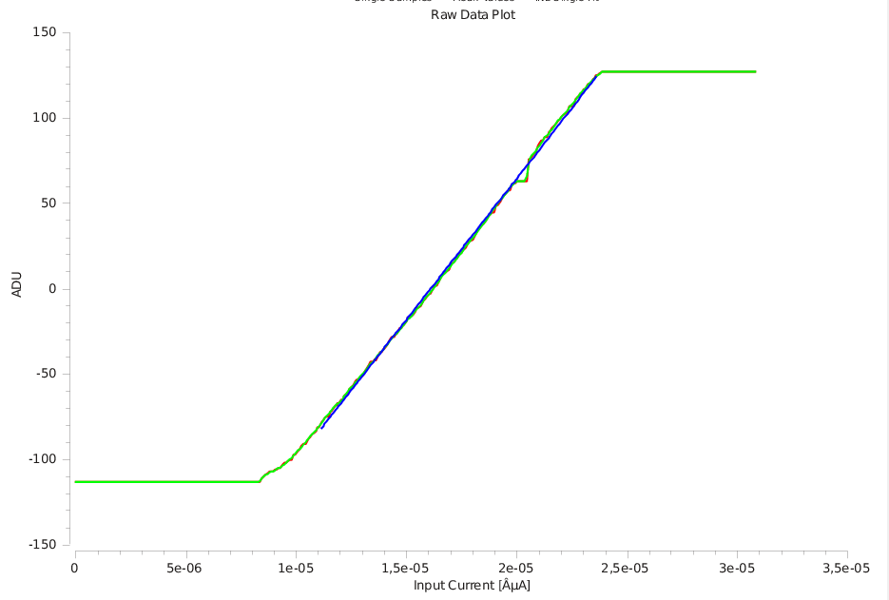
Bad characteristics causes missing codes
This causes missing codes around 64
There are three other mismatch combinations
CHI NMOS too weak (0)
CLO NMOS too strong (0)
CLO NMOS too weak (-64)
They produce missing codes around indicated values
IOut
-8u
-4u
-2u
IIn
8u

Slide 14
Origin of offset
Why does the current offset happen?
Possibility 1: transistor mismatch – fix in the next chip: make the layout in a better way e.g. the transistors bigger
Low
PFB
PFB
24u
24u
RefFB
RefFB
RefIn
RefIn
TooLow
24u
24u
24u
26u
Sc2
Sc2
Sc2
Sc2

Slide 15
Origin of offset
Possibility 2: poor current source output characteristics (low ROUT)
Notice: two output nodes are not on perfectly same potential
Original UI converter connected to amplifier input, copy UI converter to RefIn
Fix in next chip: resize the current source to have better ROUT
Low
PFB
PFB
24u
24u
RefFB
RefFB
RefIn
RefIn
TooLow
24u
24u
24u
26u
Sc2
Sc2
Sc2
Sc2

Slide 16
Possible adjustments
Adjustments in this chip
1. Adjust the RefIn carefully to match with the amplifier input potential
2. Reduce the Sc2 (NMOS current source-) setting
3. Increase Sc1 (threshold-) setting
Low
PFB
PFB
24u
24u
3
12u
RefFB
RefFB
Sc1(5)
Sc1(6)
Ith=10u
RefIn
RefIn
TooLow
24u
24u
24u
26u
Sc2
Sc2
Sc2
Sc2
1
2

Slide 17
SWITCHER Status
SWITCHER
Irradiation of latest SWITCHER has been done at KIT (dose 30 MRad)
The chip works after the irradiation
Bumping issue: bumping so far done in HD-lab, this works well for prototyping but is slow for production
Bumping with the required pitch (150 μm) is not offered by the vendor (AMS/IBM)
Solution: Company Pactec can place underbump metallization (ENIG) and solder bumps on single dies (price < 66 Eur/chip + 7.3 kEUR ~ 16k EUR)
Backup solution: ordering of wafers from AMS MPW runs and bumping at IZM (probably possible in 2015 – still to be confirmed)
SWITCHER submission planned in 2015
Improvements: faster clear driver
Separated control of the termination resistance for serial input (should be always on) and for the other fast inputs

Slide 18
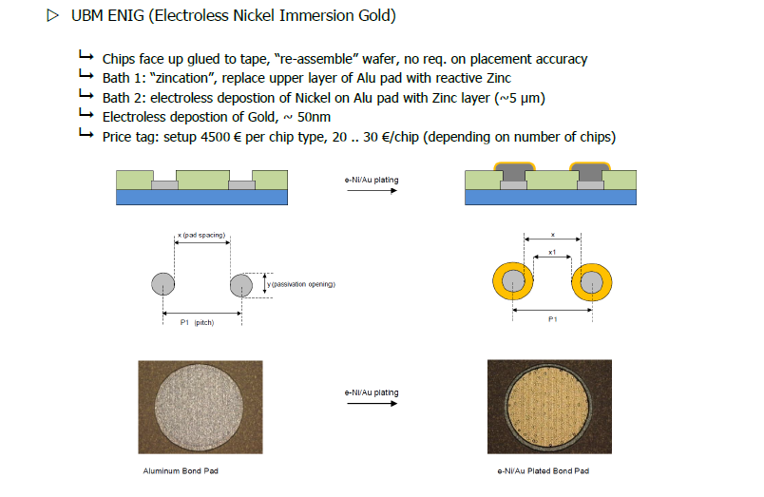
UBM EING technology
Pactec technology (from L. Andricek talk on DEPFET Workshop in Seeon 2014)

Slide 19
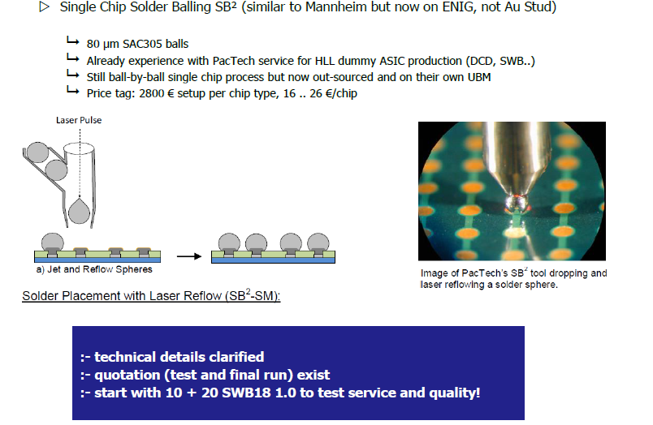
Single chip bumping
Pactec technology (from L. Andricek talk on DEPFET Workshop in Seeon 2014)

Slide 20
Backup slides

Slide 21
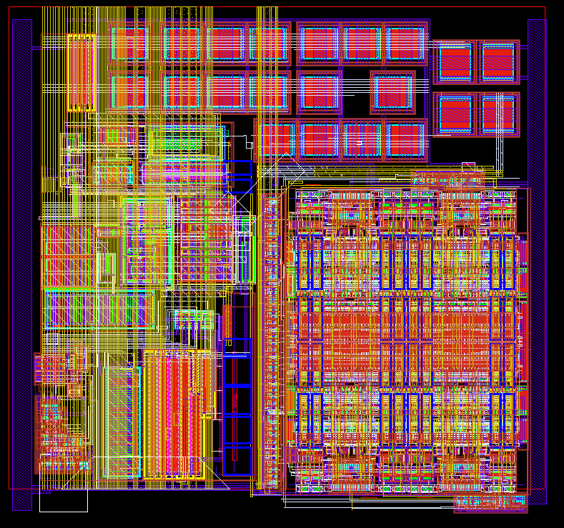
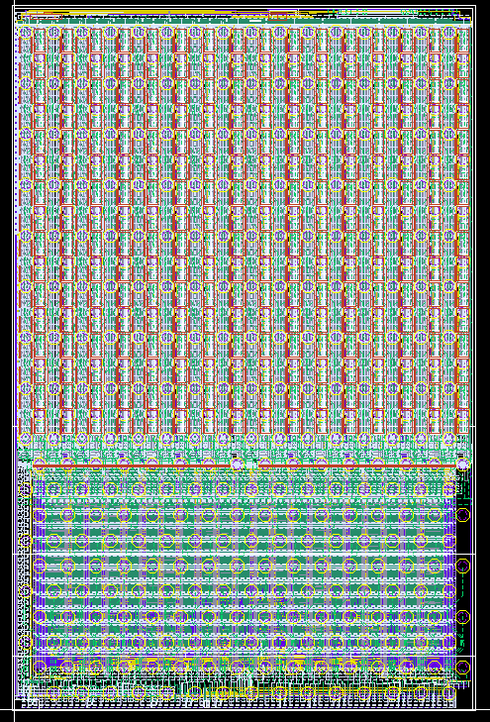
DCDBPip
TIA
ADC
200 µm
5 mm

Slide 22
Pipelined vs. Cyclic ADC
Algorithm:
Copy here copy there
Compare with threshold add reference
Add two outputs (duplicate)
Pipeline ADC
Memory cell
ADC1
ADC2
MSB cell
LSB cells
1
1
1
1
2
1
1
1
1
1
1
1
1
1
1
1
1
1
1
1
1
1
1
Hi
Lo
Cyclic ADC approach
- Algorithm performed cyclically (ping pong wise)
by two memory cell pairs
- Two ADCs per channel
- 200ns sampling rate/ADC
- ADC clocked with 100MHz
- Pipeline ADC approach
- Algorithm performed as in production line by 8 memory cell pairs
- One ADC per channel
- 100ns sampling rate when clocked with 50MHz
- Designed for 50 ns sampling rate

