Slide 1
Laser studies on PXD-5 (Kristof Schmieden)

Slide 2
Outline
System setup & DUTs
Parameter scans
Clear performance
Internal amplification (²⁴¹ Am γ-source)
Capacity of the internal gate
Charge collection homogeneity
Summary

Slide 3
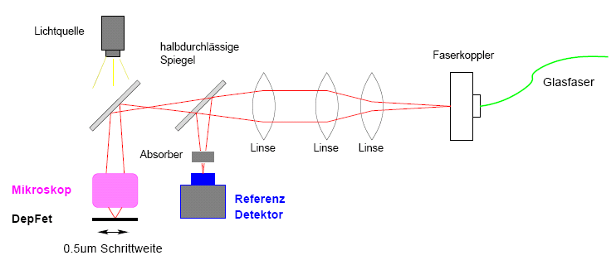
Specs
Laser:
λ = 680 nm
Spot diameter Ø = 2.6 µm (FWHM)
Backside illumination
Correction of temperature effects by reference detector
DUTs:
Rec Tesla Small (old layout, but ME, 33 x 23.75 µm²)
CoCG L B (32 x 24 µm²)
Robert Kohrs – Bonn University 2

Slide 4
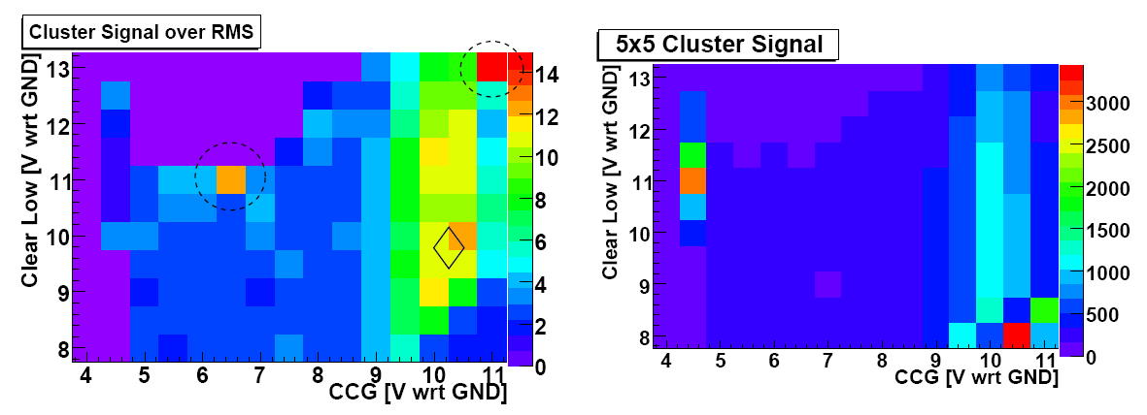
Rec Tesla Small (PXD-5)
Best Signal / Noise : Cl low = 9.7 V
CCG = 10.2 V
(V Source = 7V, Cl hi = 21.8 V)

Slide 5
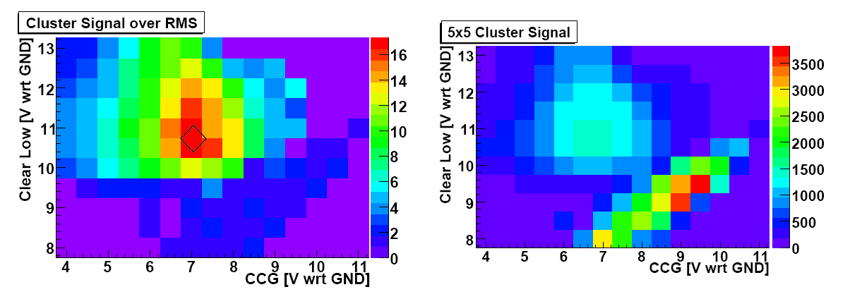
CoCG L B
Best Signal / Noise : Cl low = 10.8 V
CCG = 7.2 V
(V Source = 7V, Cl hi = 21.8 V)

Slide 6
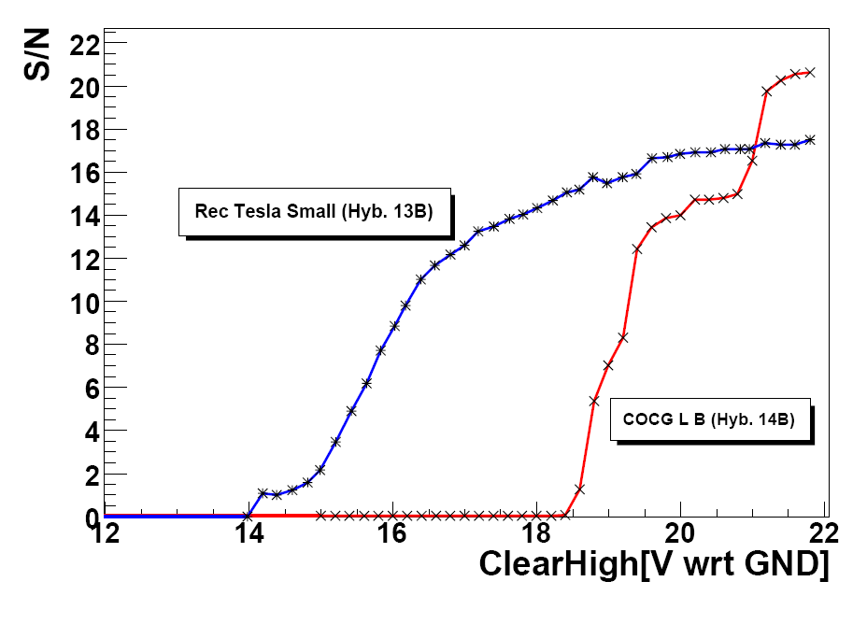
Clear performance
ΔV_{min} = 9.9 V
ΔV_{min} = 10.4 V

Slide 7
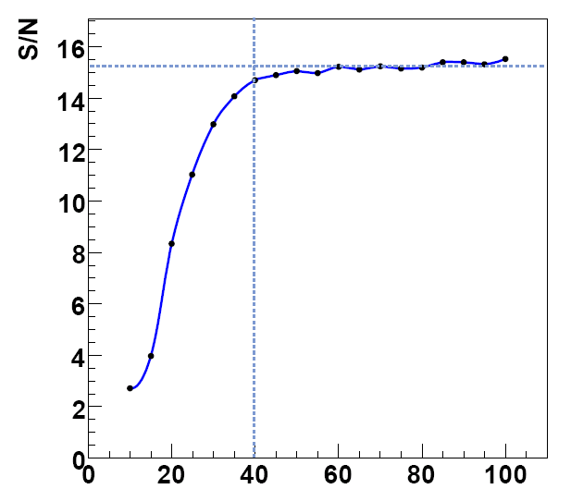
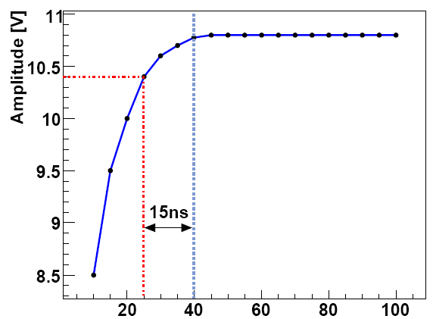
Clear timing
Required for complete clear
Clear duration [ns]
Clear duration [ns]
Minimal regular step size of current system 20 ns

Slide 8
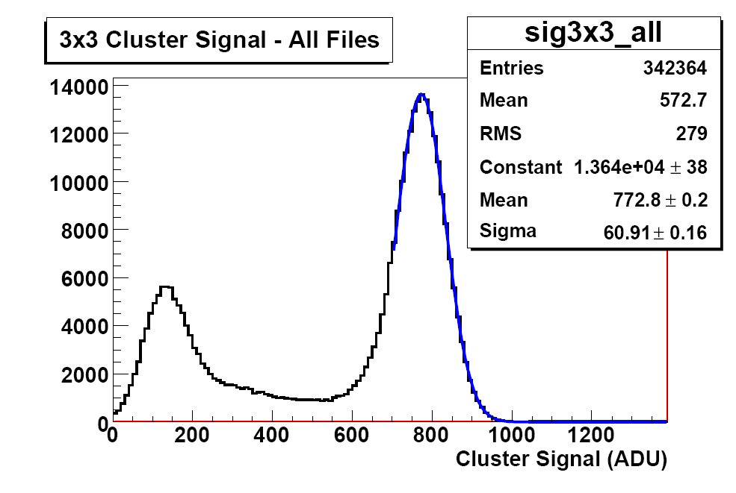
Internal amplification PXD5 CoCG L B
g_{Q} = (361 ± 7) pA/e-

Slide 9
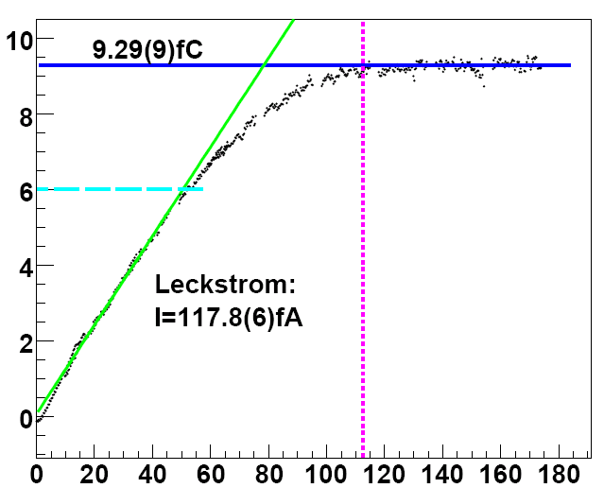
Capacity of the internal gate
Accumulated Charge [fC]
PXD5 CoCG L B
Leakage current:
Integration interval [ms]

Slide 10
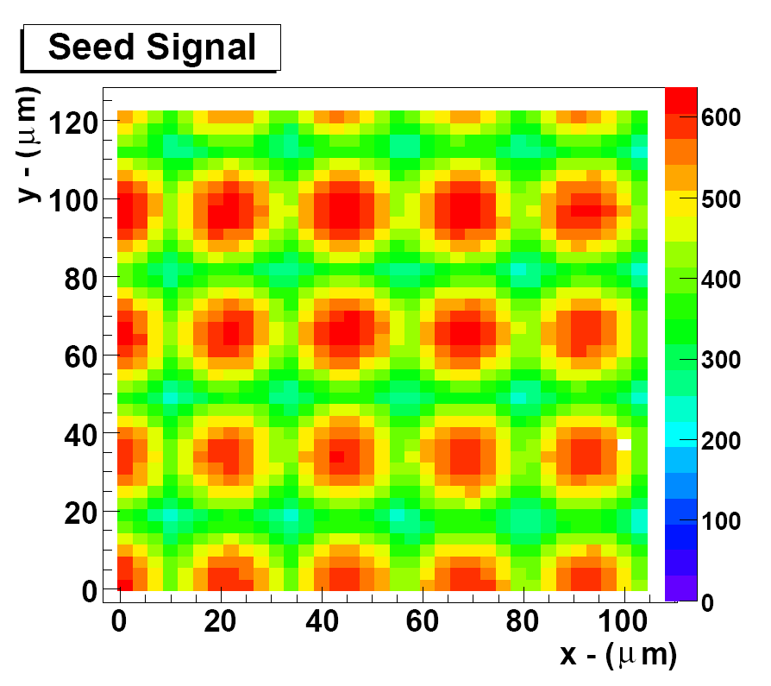
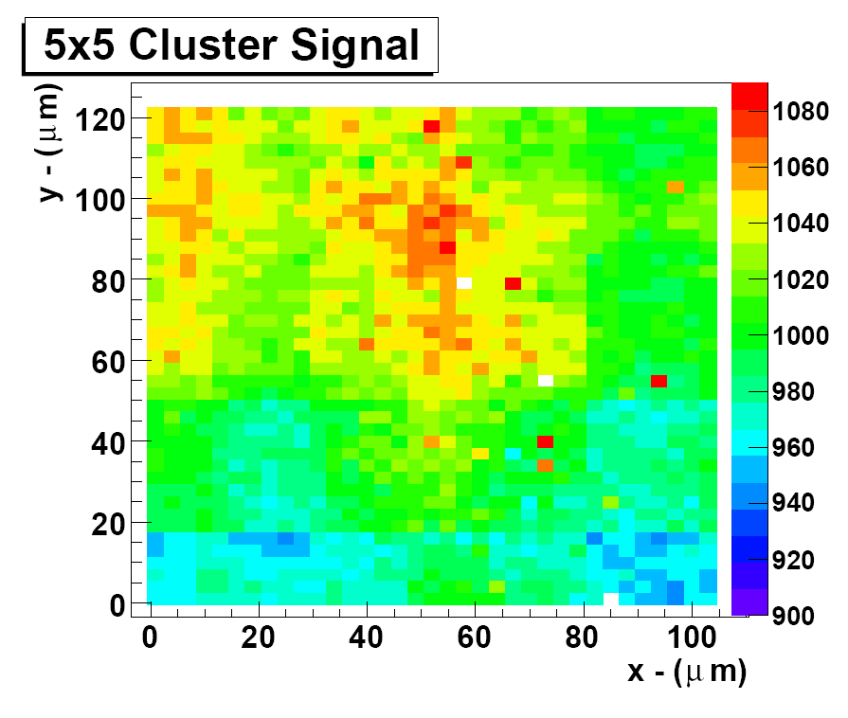
Homogeneity

Slide 11
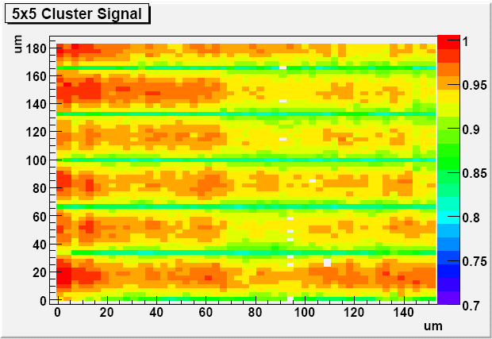
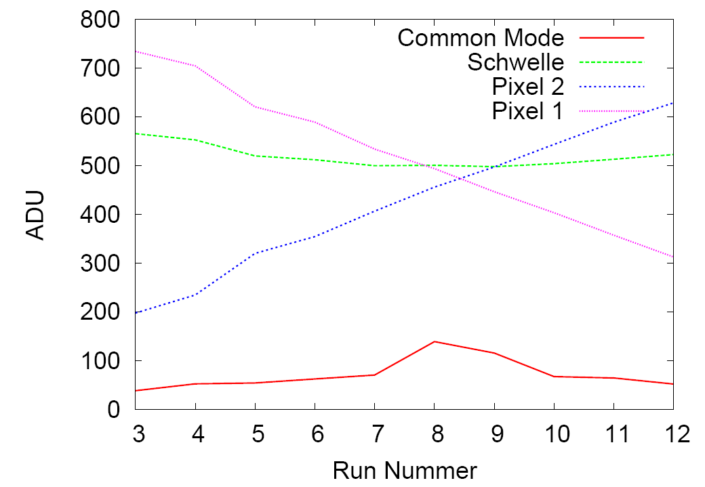
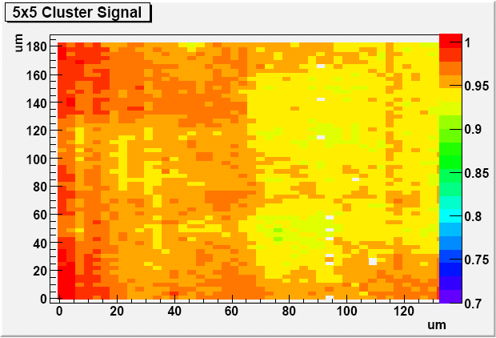
Inaccurate Common Mode Correction

Slide 12
Summary
Clear performance
Still ΔU_{clear} = 10.4V needed for optimal S/N
Clear duration with existing setup (Switcher 2, 64 x 128 pixels matrix) around 20 ns.
Internal amplification
Up to 20% higher than with Rec Tesla Small design.
Large differences in gQ observed for matrices with identical design
Capacity of internal gate
58000 e- should be more than sufficient.
Homogeneity
No systematic structures (in-pixel, large area) observed.
Method is susceptible to intensity changes (temperature, detector surface , …) → x-check with testbeam data!

Slide 13
Temperature correction

Slide 14
