Slide 1
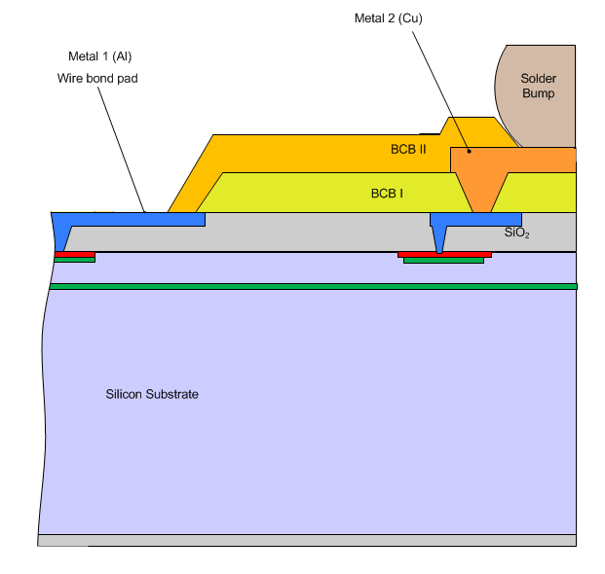
Sensor metal system
:- 1 µm Alu ~30 mOhm/sq
:- 4 µm Cu ~4.5 mOhm/sq
:- Alu wire bond pad
:- Cu as UBM
:- Cu also as RDL
:- all diodes via bumps
:- one wire bond at edge

Slide 2
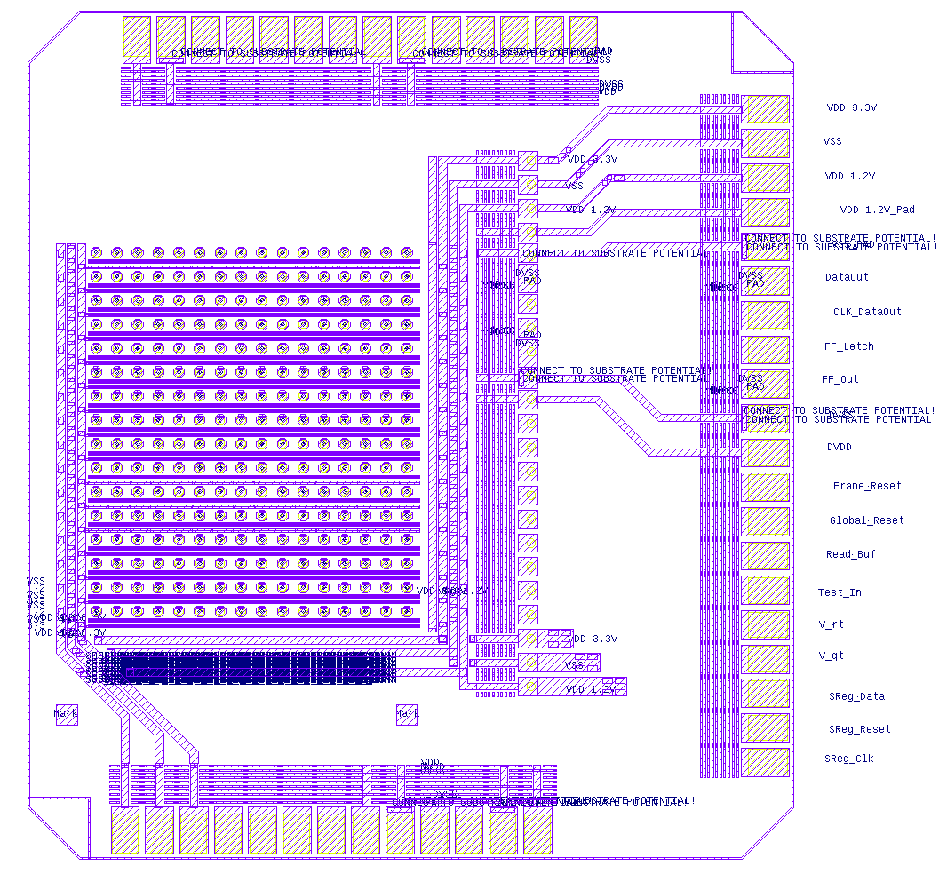
Current understanding of ASIC foot print
:- ~1.8x2 mm²
:- ENIPIG UBM
:- SAC bumps in center
:- wire bond pads at edge
Questions:
:- are there redundant bumps?
:- do we need access to the
wire bond pads for operation?

Slide 3
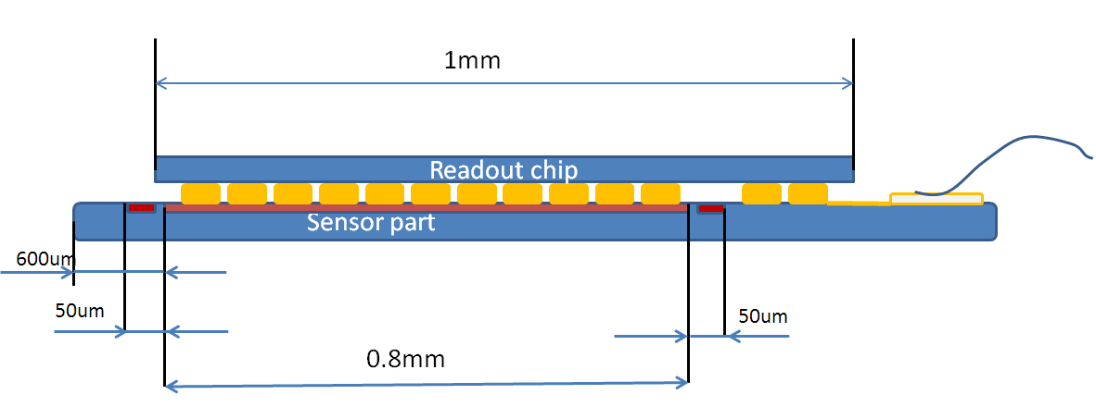
Ideal from our point of view
:- use sensor as substrate
:- attach sensor/ASIC arrangement to support PCB/ceramic
:- one wire bond pad for sensor
:- operation of ASIC via bumps

Slide 4
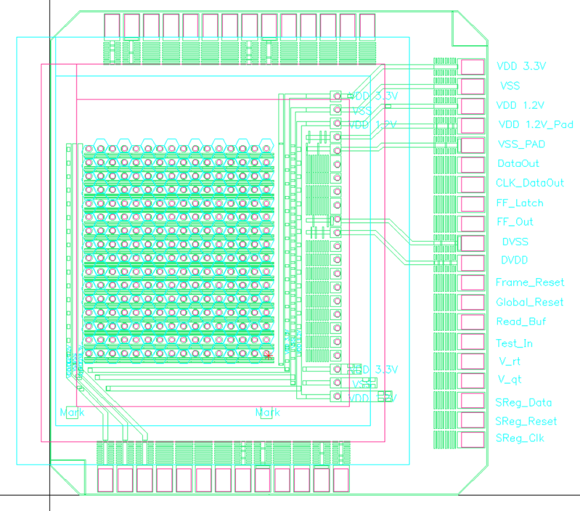
If not ..
:- wire bonding from both sides ☹
:- assembly gets really small .. ☹

Slide 5
Flip-chip and assembly
Flip-chip:
:- sensor as substrate on hot plate, flat …
:- chips face-down in tray
:- pick-up and align
:- no alignment marks necessary, alignment by bump-to-land
:- basically standard
Challenges:
:- very small chips → new tool, smaller vacuum channel
:- maybe even new substrate holder, depends on size of sensor chip
:- small pitch needs testing …
Assembly to support PCB/ceramic
:- design of ceramic, who??
:- off-module interconnection?
:- wire bond on Alu (or, if ASIC as base, to ENIPIG)
:- need cooling???

