Slide 1
Project Meeting at MPI/HLL
Status of the Readout ASIC
Timing Test Concept
Test Set-up
Next Steps

Slide 2
Status Readout ASIC
Submission Date: 19. May 2014 at MOSIS
Preliminary delivery Date: 18. July 2014 at CERN
Components
16-by-16 Matrix of Pixel Readout Electronics
Active Quenching and Recharging Circuit
Hit-Counting and -Serializing
Fast Trigger with Wired-OR Configuration of every row and subsequent of every column
Slow Trigger for Validation
Only for 1 row (until now)
4 adjustable Reference Voltages as Threshold Condition
Control Register for Static Signals
Pixel Masking
Counting Depth (1 or 2 Bit)
Reference Voltage for Slow Trigger
Switches of 2 Pixels to extra Test Pad
Pad Ring

Slide 3
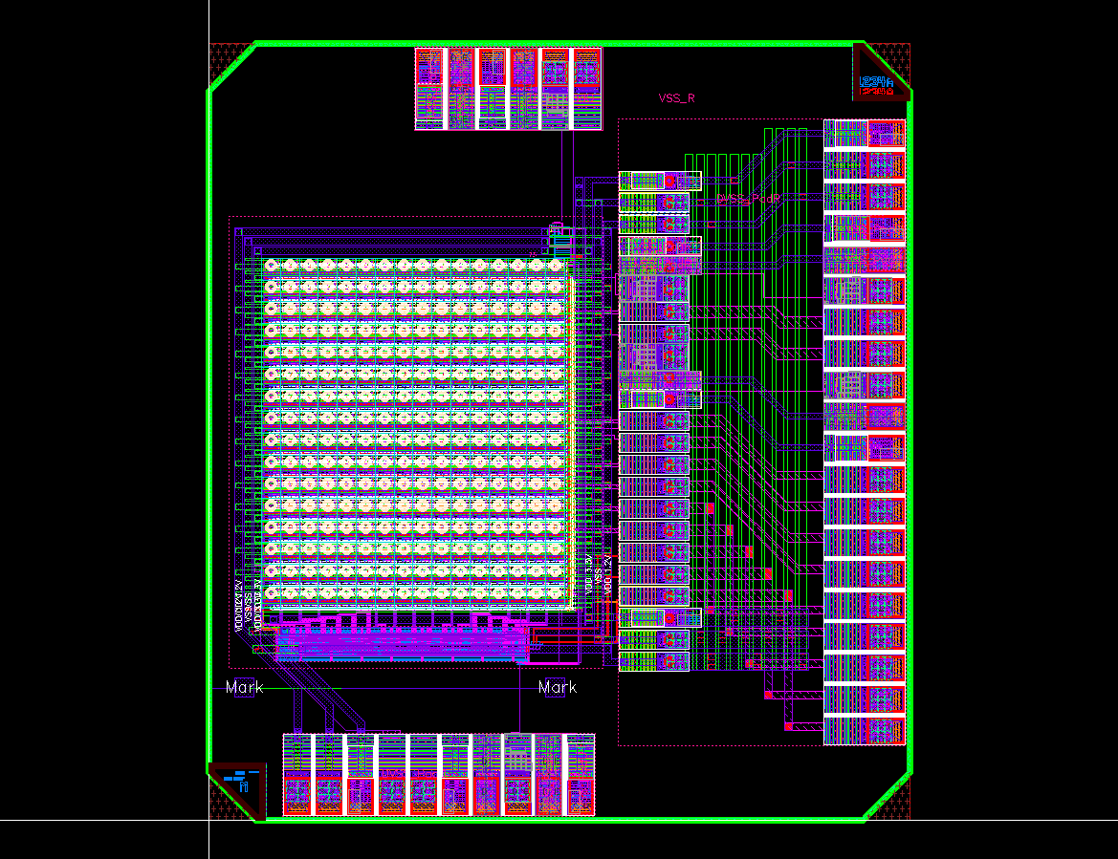
Layout Readout ASIC
Wire-Bond Pads for Testing
Bump-Pads to Sensor
Wire-Bond
Pads
Slow Trigger
16x16 Pixel Matrix
Control Register
for static Signals
Fast Trigger

Slide 4
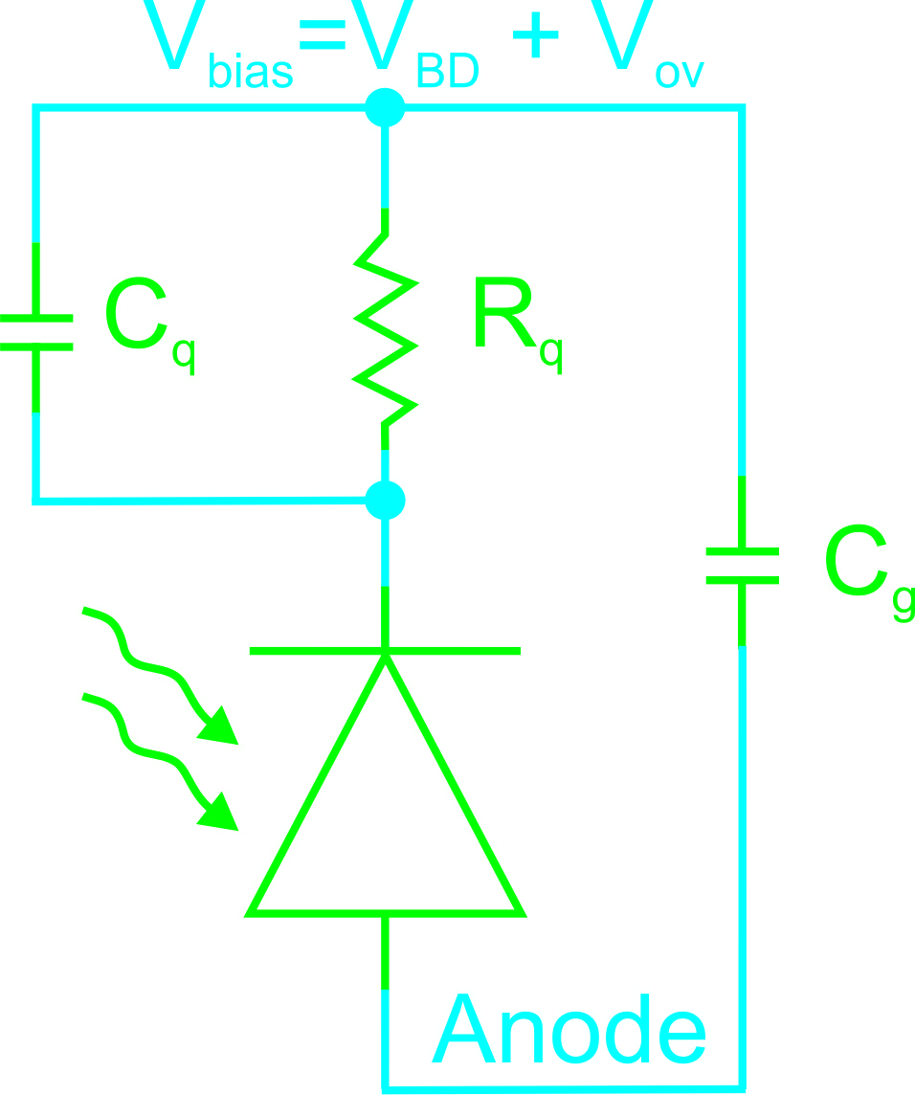
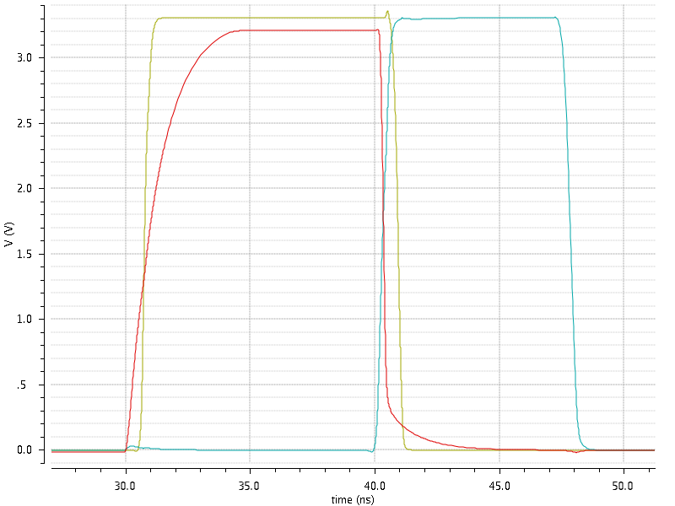
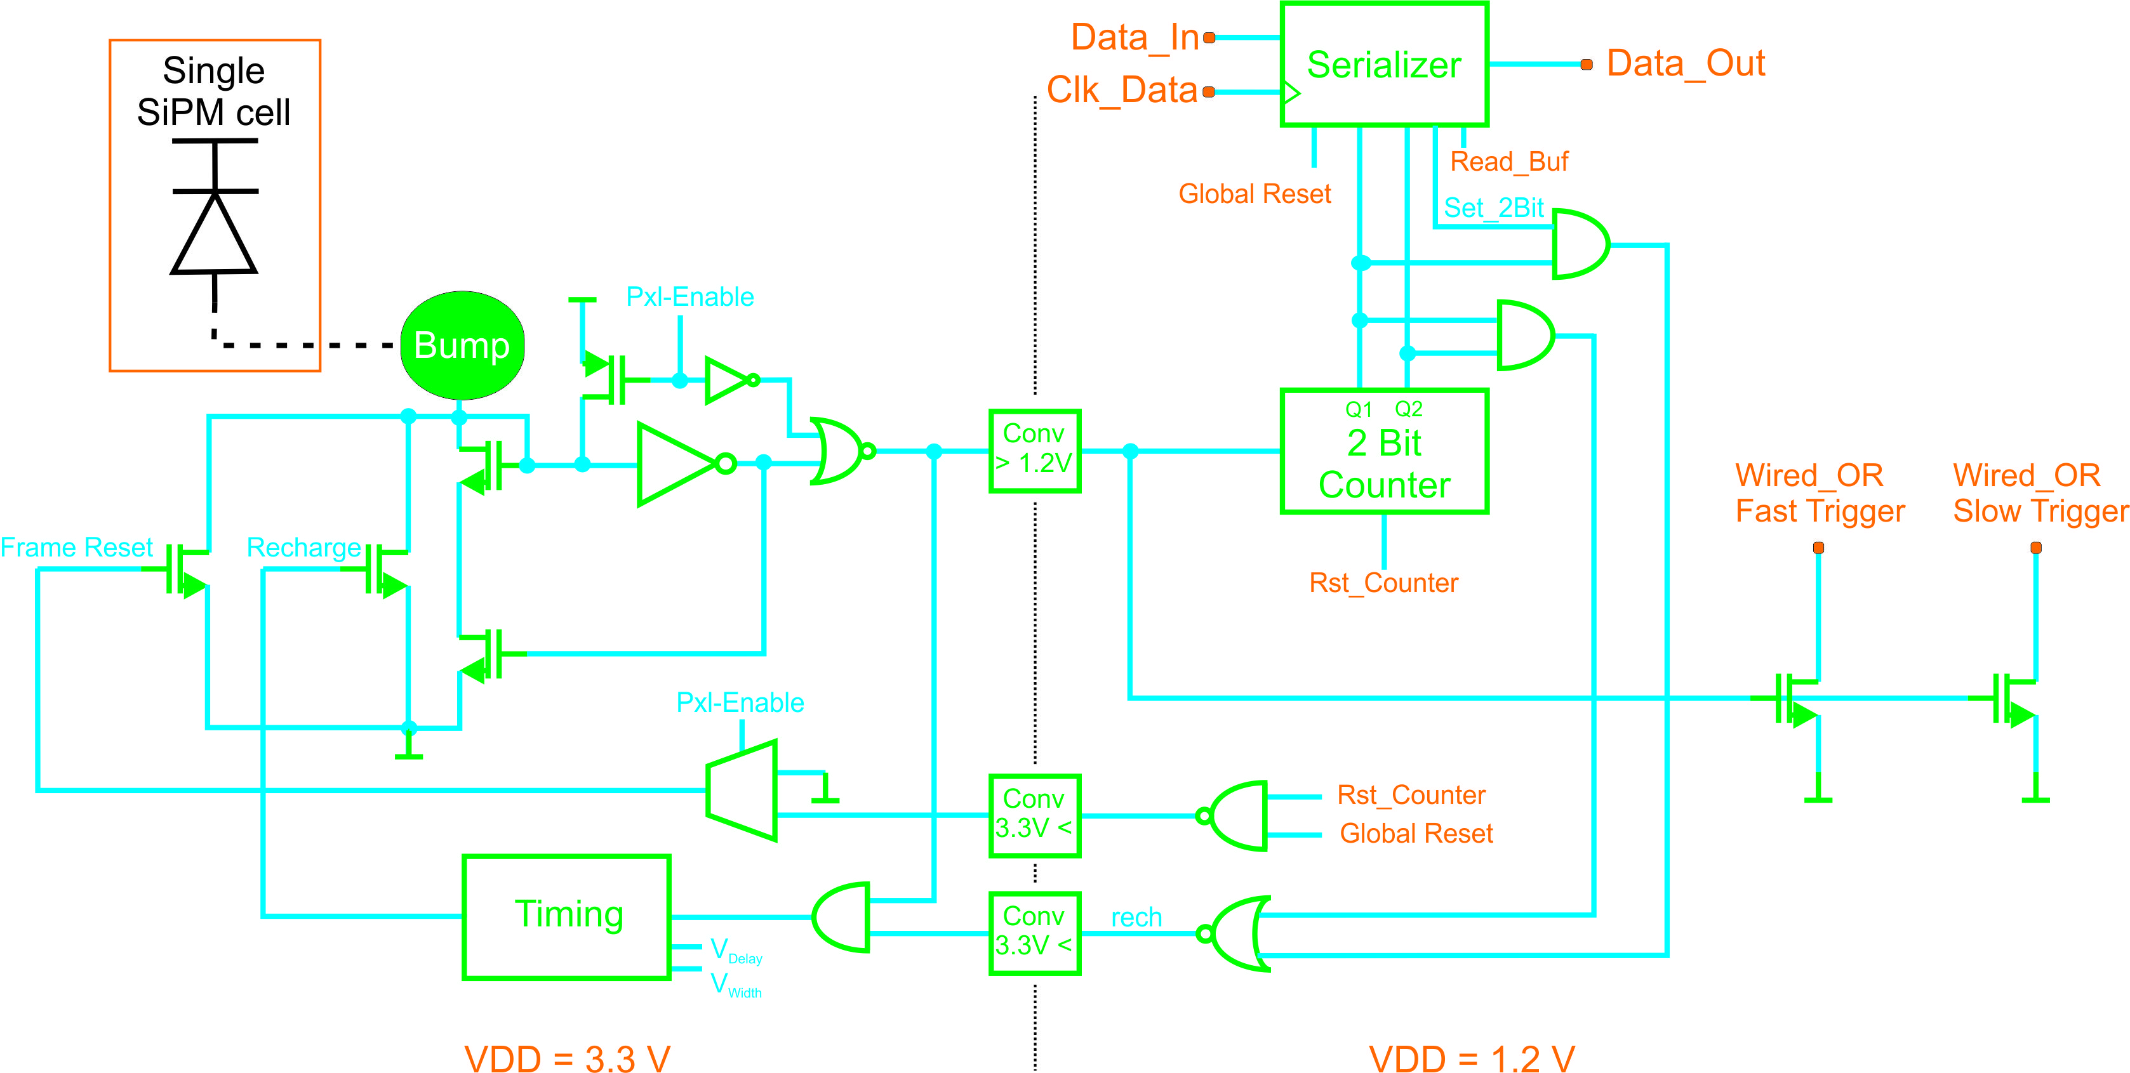
Pixel Electronics
SiMPI-Modell (simplified)
C_{g}=65f
C_{q}=10f
R_{q}=1.2k
V_{bias}=V_{BD}+V_{OV}=36V+3.3V
Out
Anode
Recharge
Anode
Out
Recharge

Slide 5
Pixel Electronics
SiMPI-Modell (simplified)
C_{g}=65f
C_{q}=10f
R_{q}=1.2k
V_{bias}=V_{BD}+V_{OV}=36V+3.3V
Anode
Out
Recharge

Slide 6
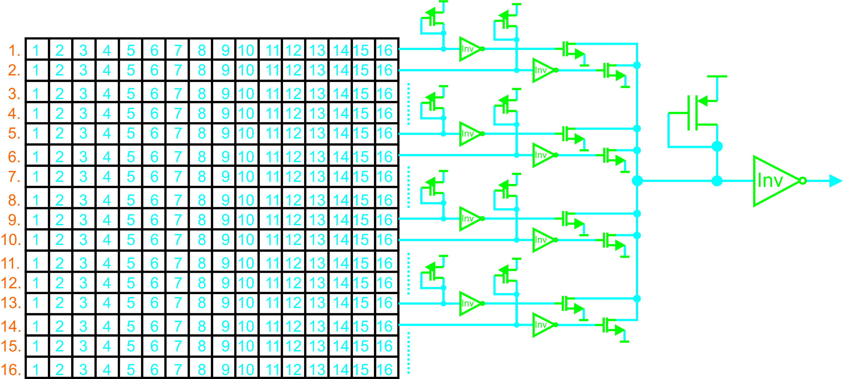
Fast Trigger Concept
Wired-OR Connection:
Step: of every Row
Step: of every row-wise Wired-OR Connection (final)
1.
2.
Trigger

Slide 7
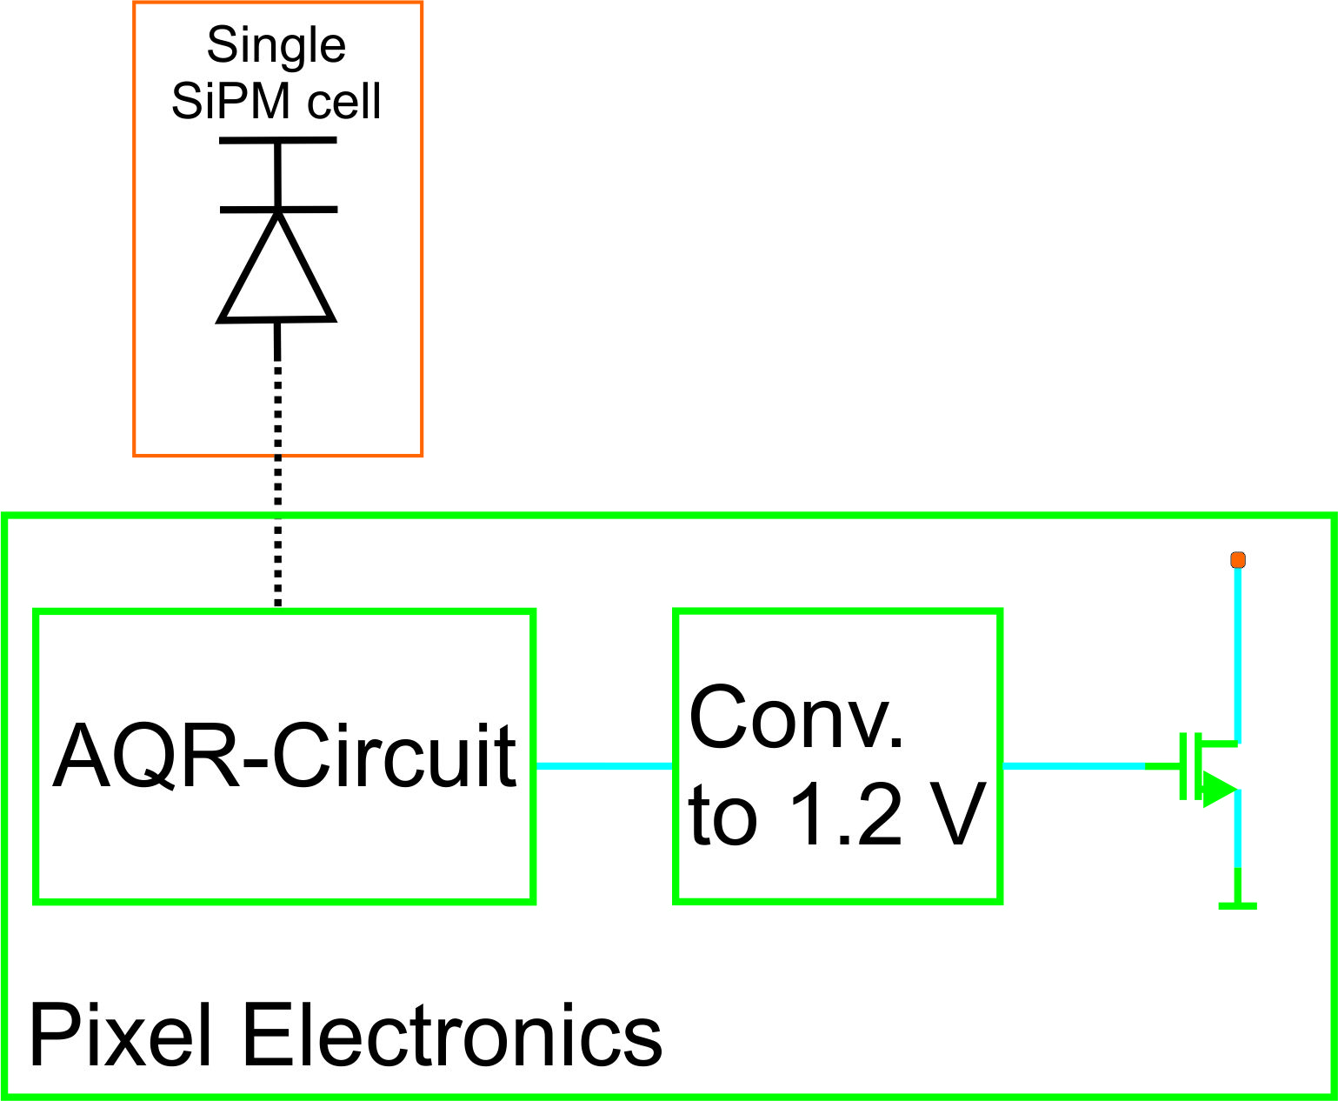
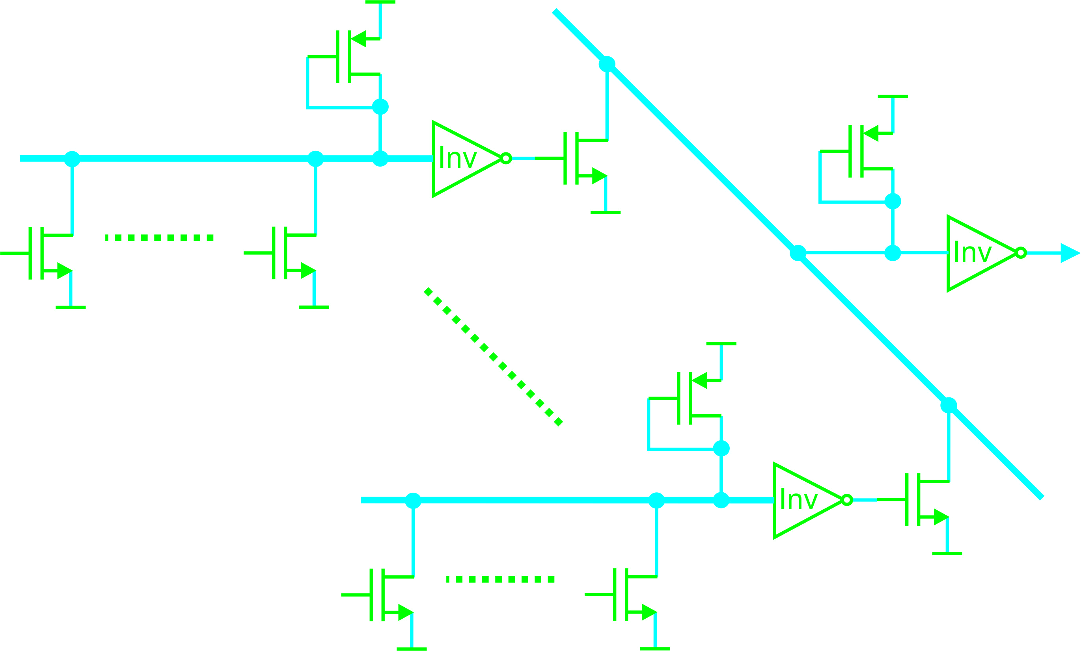
Delay Times – Fast Trigger
Time Delay from Event
until Output triggers
Decision: 1 TDC for Matrix or for every Row

Slide 8
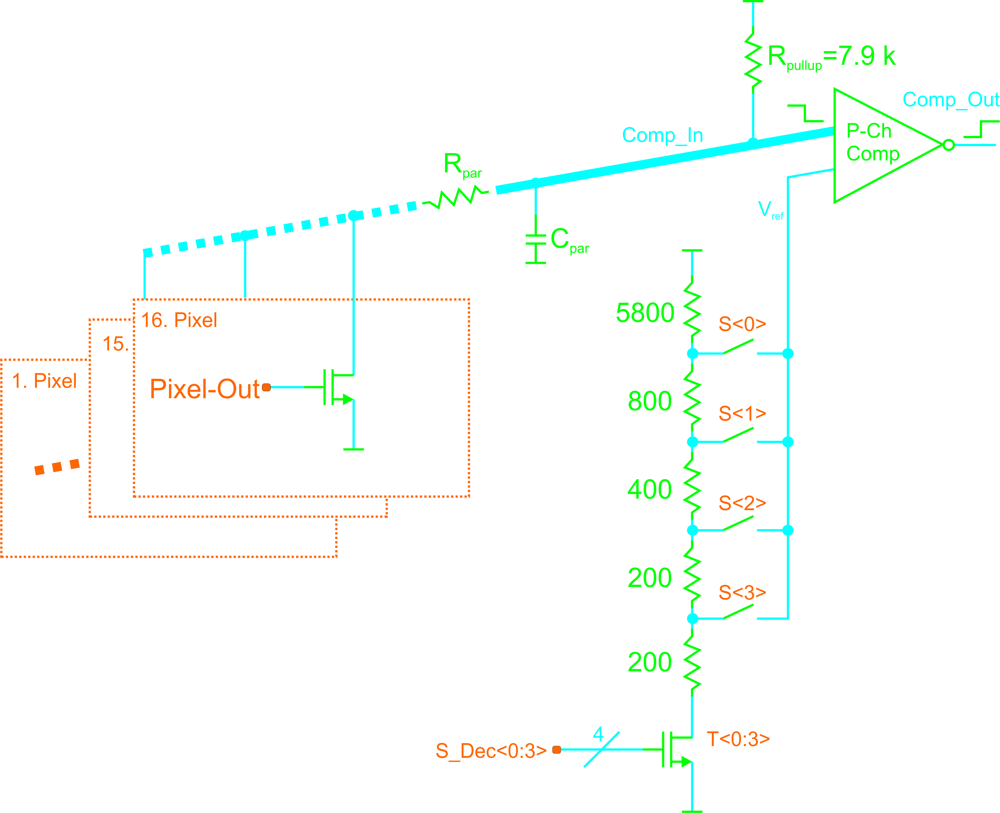
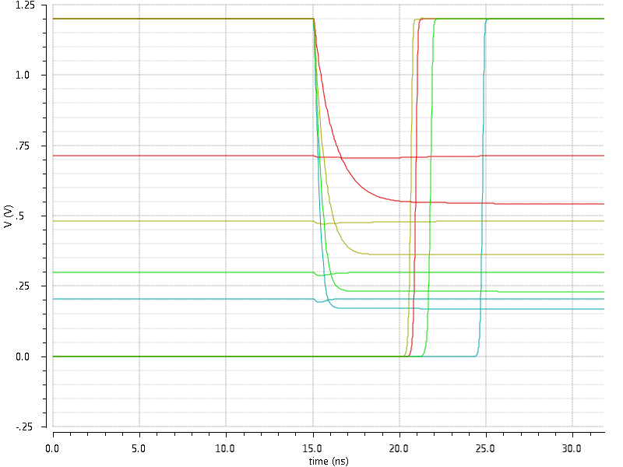
Slow Trigger Concept
Realization for 1st Row in Matrix
Adjustable Threshold for Trigger Condition (1-4 Pixel)
Comp_In
Comp_Out
Ref: 1 Pixel
Ref: 2 Pixel
Ref: 3 Pixel
Ref: 4 Pixel

Slide 9
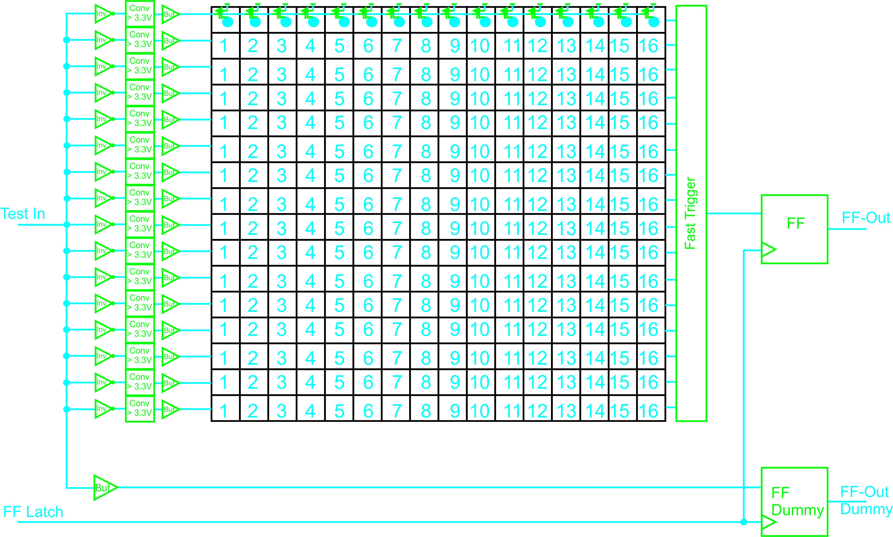
Timing Test Concept

Slide 10
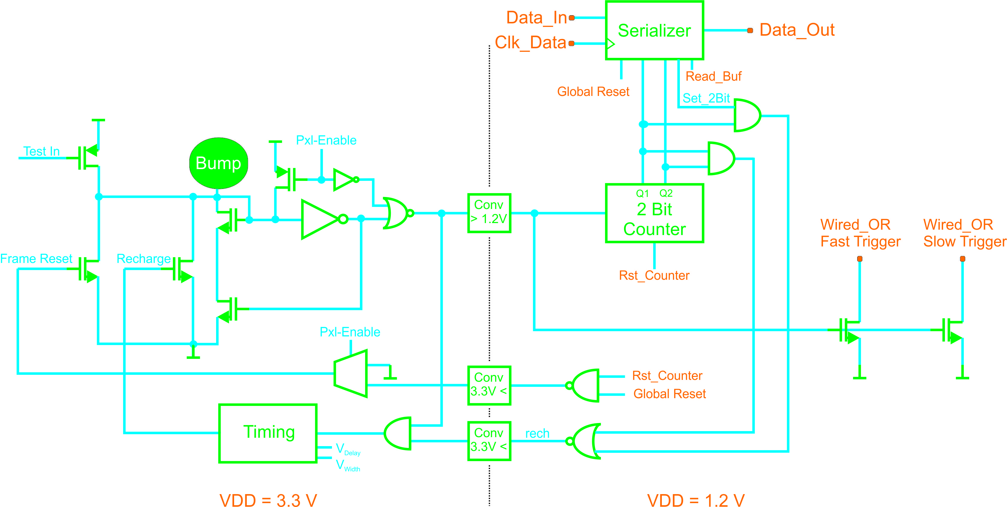
Pixel Electronics – with Test Input
Timing Test of every Pixel possible due to Masking

Slide 11
Timing Test
DUT
Trigger
TestIn
FF
FF Out
Latch
Reset
FF-
Dummy
FF Out Dummy
TestIn
Latch
n∙∆t
t_{d}
Trigger
Latch
1
Frequency distribution of FF Out and FF Out Dummy
t_{d}
0.5
0
∆t
N∙∆t

Slide 12
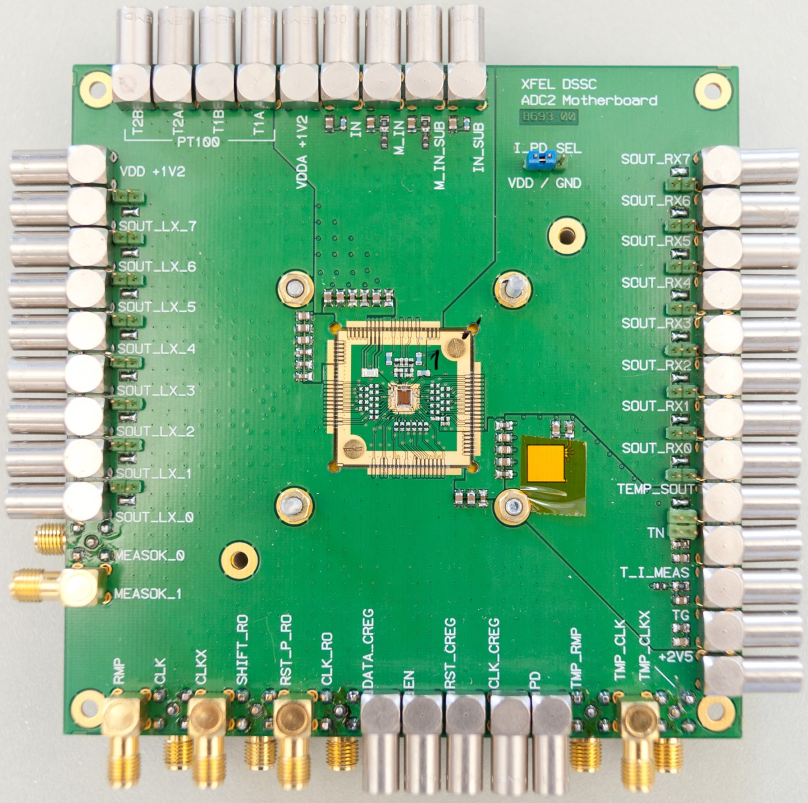
Test Set-up
Usage of an existing Testboard
Hybrid removable
1. Hybrid-Version only with Test ASIC
2. Hybrid-Version with Sensor and ASIC
Installation of Test Set-up will be done by the summer student Alessio Borgheresi (22.07.-11.09.)
Oscilloscope is ordered
DTG and Logic Analyzer exist

Slide 13
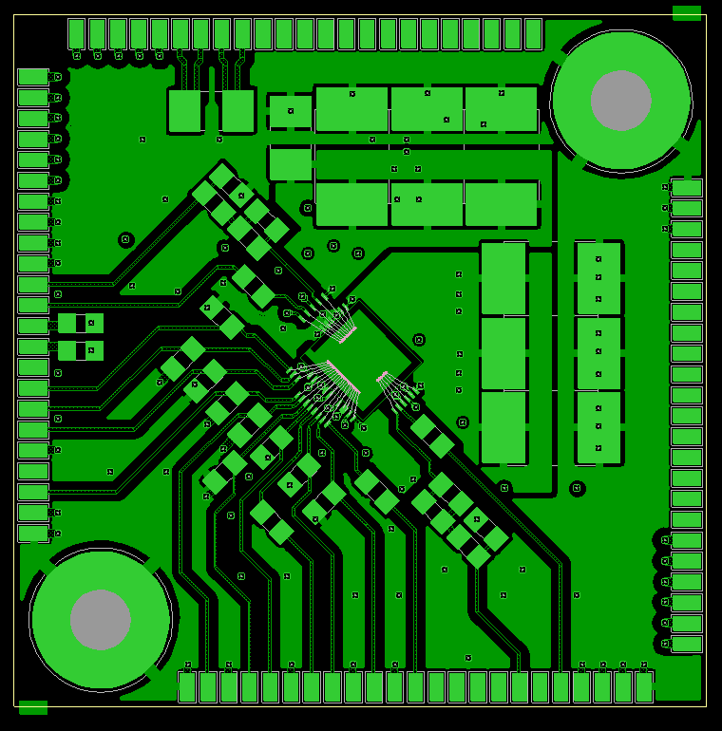
1. Hybrid-Version
PCB Layout designed
Costs: ≈800 €
Delivery Date: End of July
4-Layer Design

Slide 14
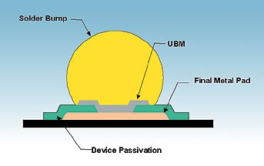
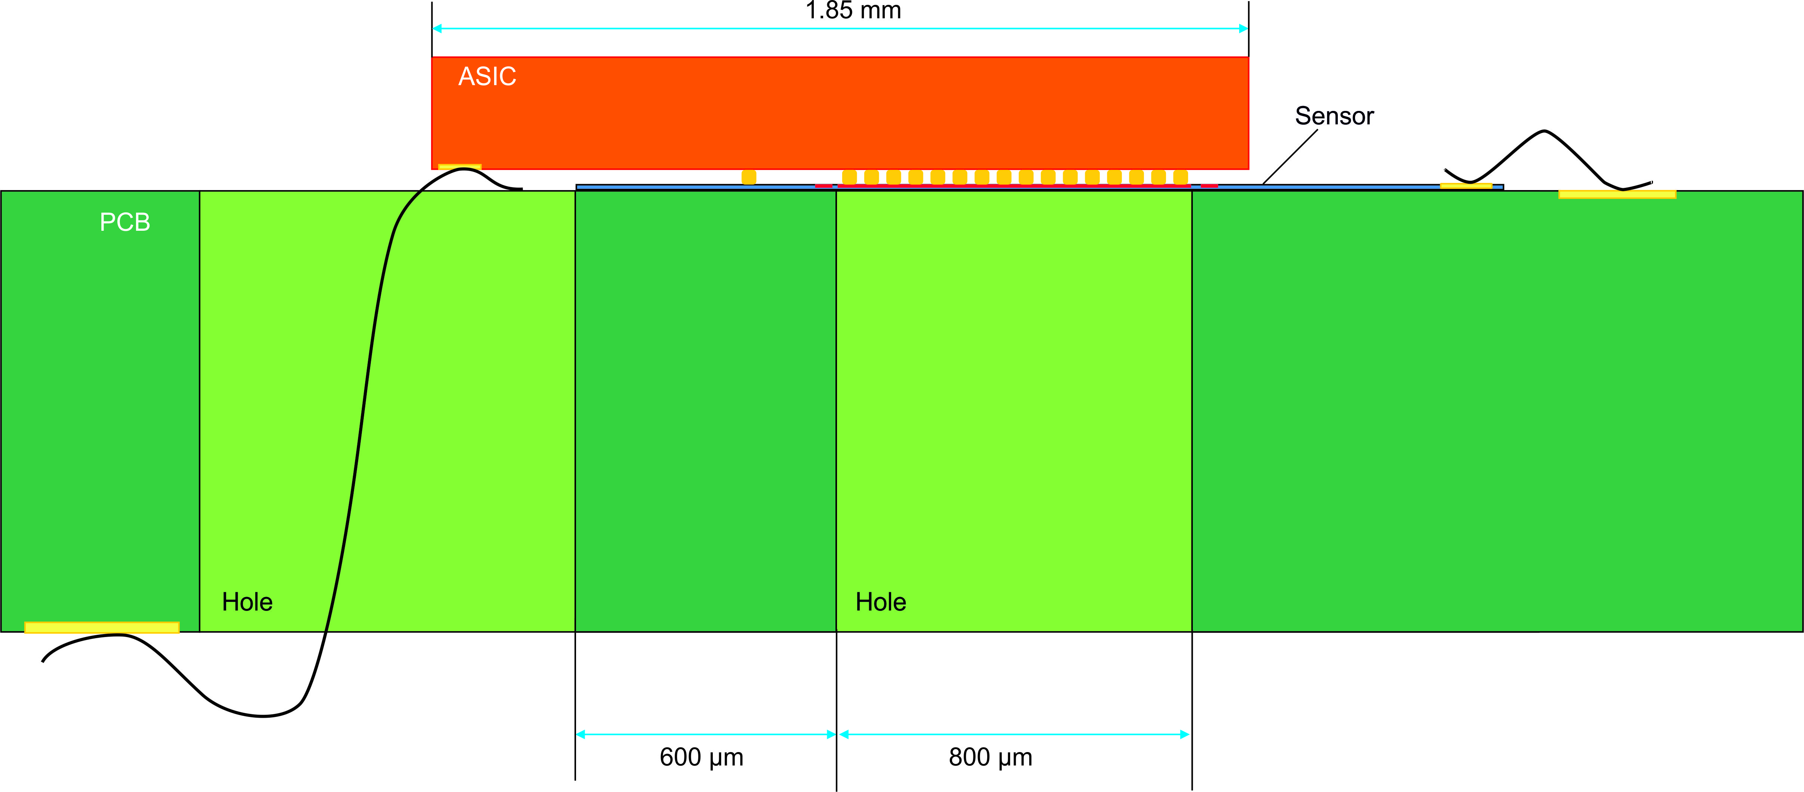
Interconnection with Sensor
20 ASICs will be send to PacTech
For UBM and solder balling of 30-µm balls
PacTech needs at least 10 setup chips
Costs: ≈10k €
≈5300 € for electroless Ni/Pd/Au under bump metallization
≈4500 € for single chip solder balling SB² on Ni/Pd/Au UBM
For connecting with an Interposer or Sensor
max. 10 ASICs with solder balls would be available for Flip-Chip Bonding with Sensor chips at HLL

Slide 15
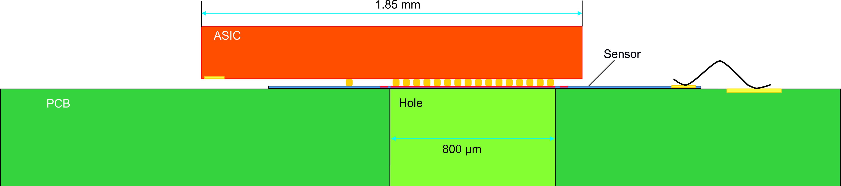
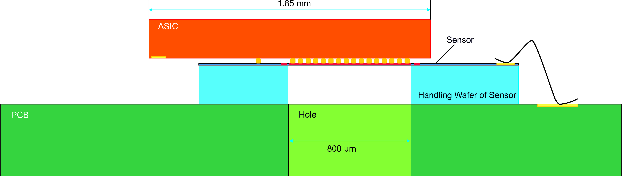
2. Hybrid-Version
Layout Design can start when we have detailed Sensor Information

Slide 16
Questions
Sensor Schedule
Detailed mechanical Structure of the Sensor
Sensor Connnection
Sensor Tests
Status: Design of Teststructures (Dummies with Daisy-chain structure) for Pac Tech and Flip-Chip-Bonding (Assembly at HLL)
Future Plans for analog and digital SiMPIs

Slide 17
Next Steps
ASIC Test
Design of 2. Hybrid
ASIC + Sensor Test
Hiring of PostDoc
Further Design Activities
TDC
Validation Logic for total Matrix
Multiplexing of Hit Matrix
Sequencer
2nd ASIC Submission in May 2015

Slide 18
End
Thank you!
Project Wiki-Page: fec-sipm.desy.de

