Slide 1
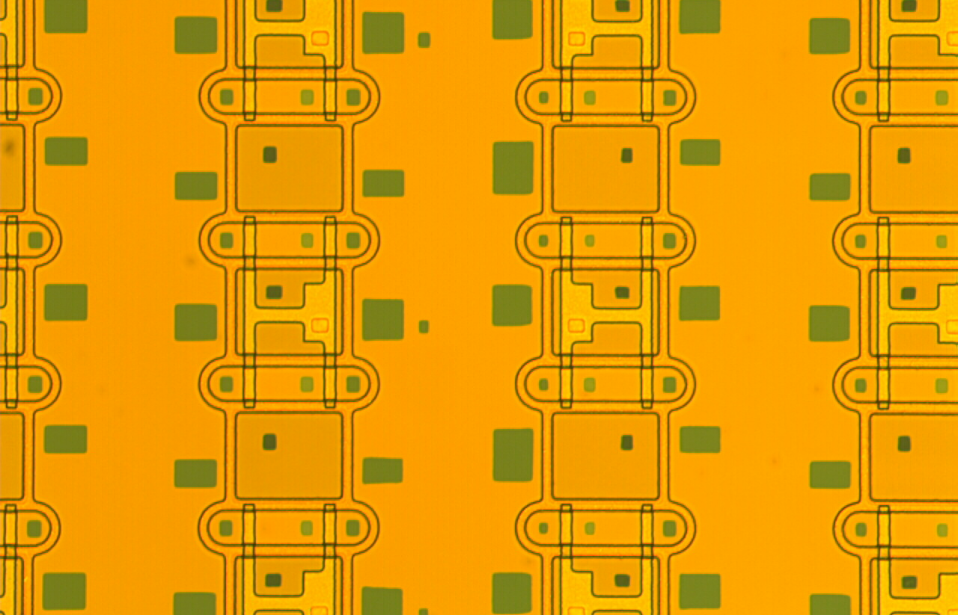
PXD
DEPFET Sensor Production
Belle II Schedule
AIM Decision
EPICS
H-.G. Moser, 18th B2GM, June 2014

Slide 2
PXD9 Production
Calender Days
Batch 1
Batch 3
Batch 4
Batch 2
Production steps
Batch 1 phase 1 finished:
Batch 2 lost after 80% of phase 1
Batch 3 phase 1 finished
Batch 4 phase 1 finished (June 2014)

Slide 3
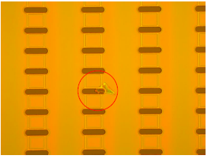
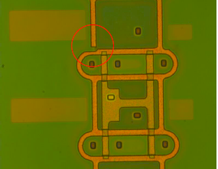
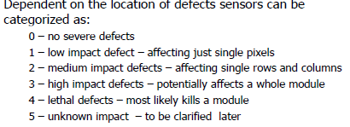
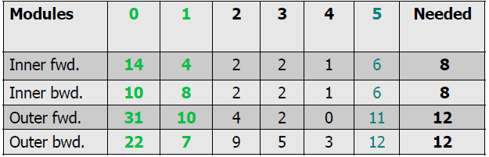
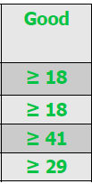
Yield after phase 1
Search for possible defects (optical scan, automatic & manual)
So far this is encouraging
Still, more production steps with possible losses ahead
Need perfect QA,
eliminate possible losses,
use grade 2 & 3 for prototyping and tests (irradiations, beast)

Slide 4
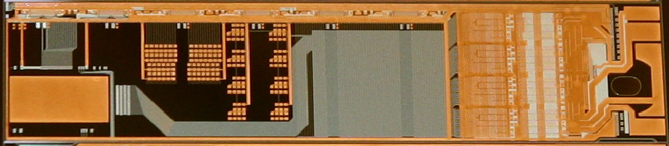
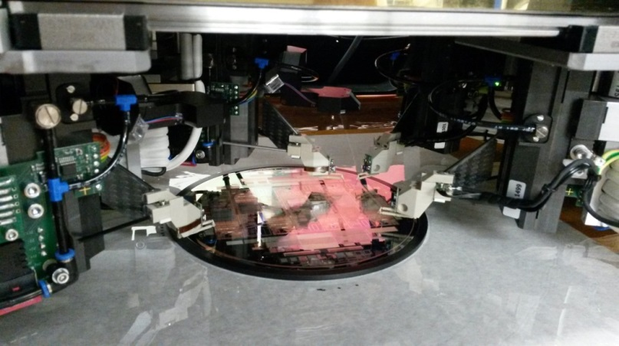

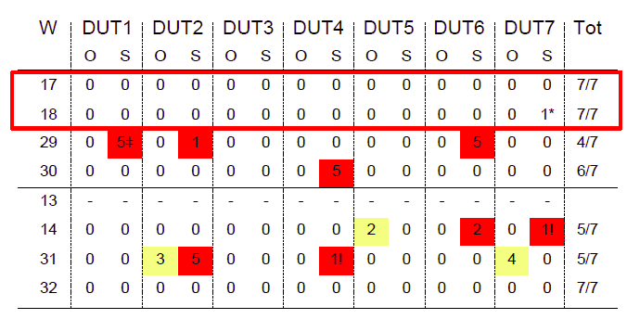
Test of metal system processing with EMCM
Test vehicle to optimize yield of metal system without the time consuming
(and expensive) phase 1
=> EMCM: Electrical Dummy to be tested like a real module
Allows tests of the electrical performance
- routing errors (despite automatic checking tools)
- cross talk, voltage drops, RC delays
EMCM3: several (optimized)
process variations
Wafers 17 and 18 show best results,
Essentially 100% yield
Confirmation batch (EMCM4) processed
Tests started, so far confirm good results of EMCM3

Slide 5
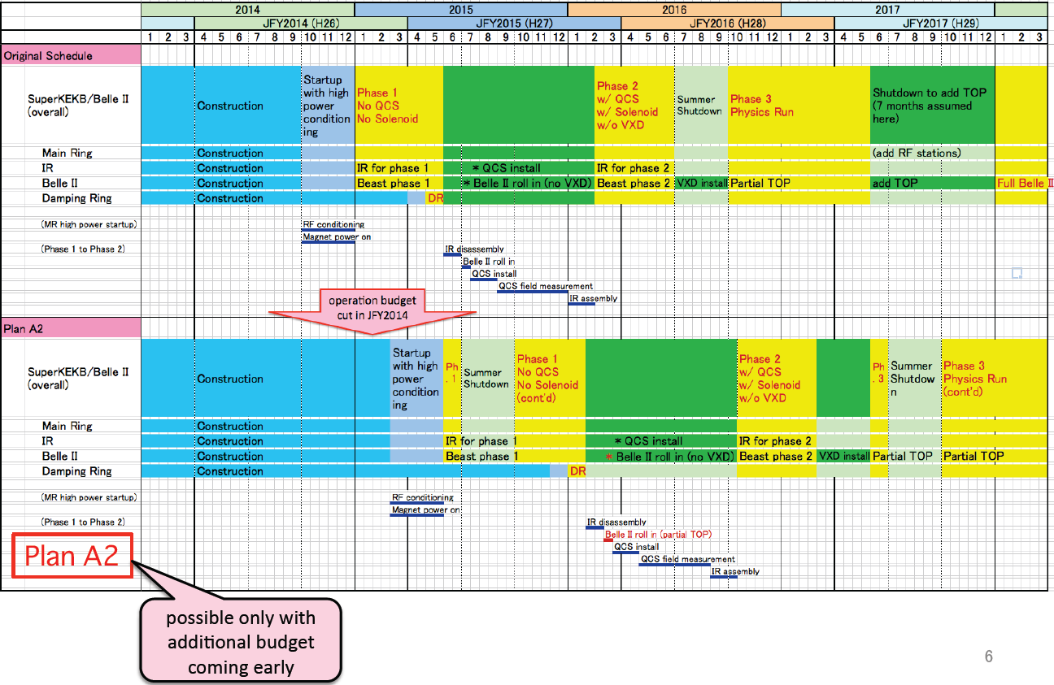
Schedule: Plan A2 (default)
+ 8 months
+ 8 months
=> Already obsolete (T. Browder)

Slide 6
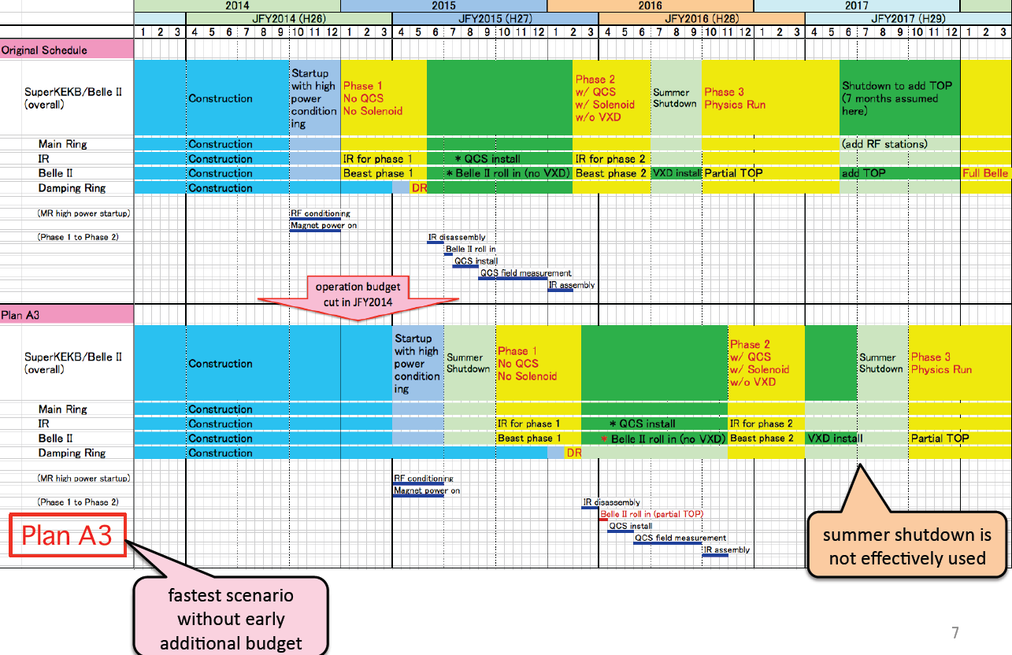
Plan A3
+ 9 months
+ 9 months
Belle II proposal

Slide 7
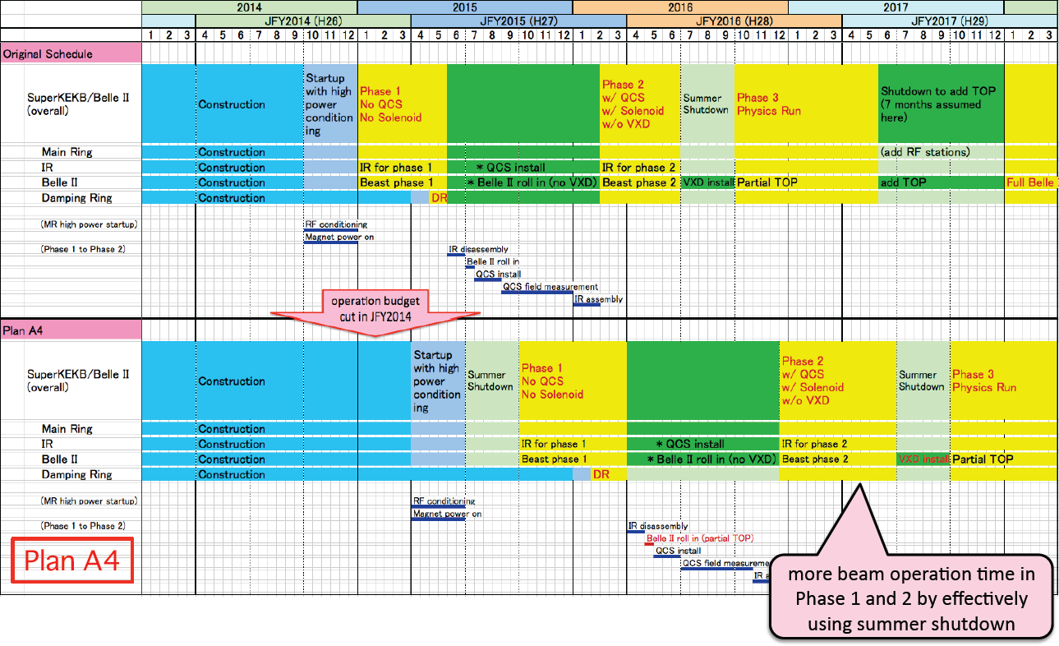
Plan A4
+ 10 months
+ 12 months

Slide 8
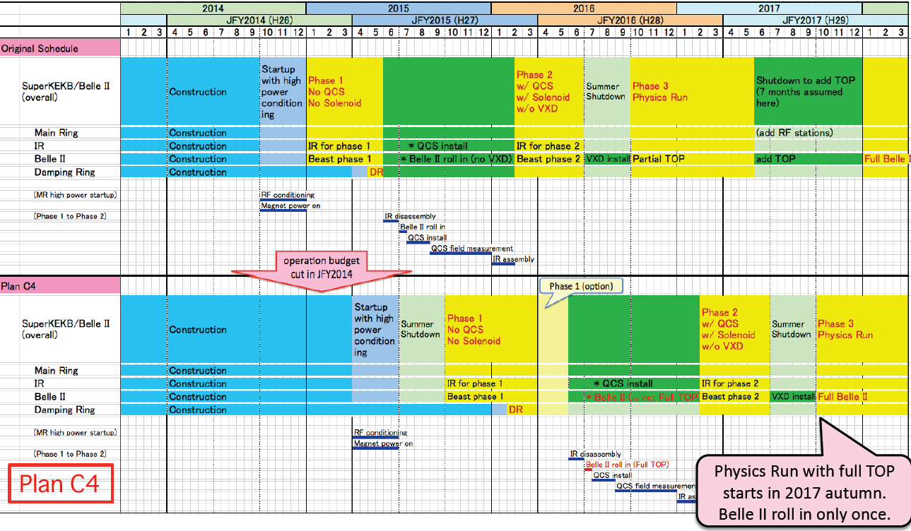
Plan C4
+ 12 months
+ 12 months

Slide 9
Schedule: Summary
Plan | Beast II PXD @ KEK | ΔT months | Installation VXD | ΔT months
original | Feb. 2016 |  | July 2016
A2 | Oct. 2016 | +8 | Mar. 2017 | +8
A3 | Nov 2016 | +9 | Apr. 2017 | +9
A4 | Dec 2016 | +10 | July 2017 | +12
C4 | Feb 2017 | +12 | July 2017 | +12
Assuming: PXD/SVD integration parallel to Beast II run
Minimum delay: 8 (9?) months
Though unlikely A2 is still default till EB decision
TOP may be complete in A2 - but do not plan on this (TC)

Slide 10
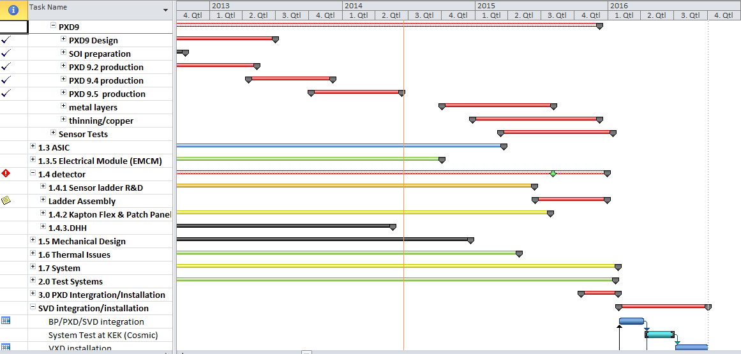
PXD Schedule
After BPAC: shifted PXD delivery to KEK from September 15 to February 16 (synchronize with SVX integration, already outdated).
Phase 2 processing delayed to October 2014 (wait for EMCM electronic test).
Still compatible with present, outdated schedule (contingency: 8 months)

Slide 11
Milestones
PXD9 Production start | July.12
cable prototypes | November 12
EMCM fabricated | Mai 13
Services available | December 13
Mechanical & Cooling Mockup ready | April14 | August 14
PXD6 large matrix assembled | December 13
PXD/SVD sector test | January14
DAC and DHH available | March14 | August 14
Power supplies available | March 14
Metal layer processing starts | April 14 | October 14
All production ASICs available | September 14 | March 15
assembly tooling finished | October 14
First Belle II DEPFET sensors available (cut & tested) | November 14 | April 15
IBBelle (CO2 cooling) constructed | December 14
ladder 0 (prototype) assembled | December 14 | June 15
all sensors available | August 15 | January 16
all ladders assembled | August 15 | January 16
PXD ready for integration | September 15 | February 16
Some delays due to late
start-up of phase 2 sensor processing

Slide 12
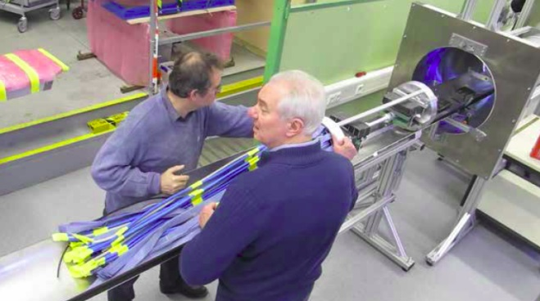
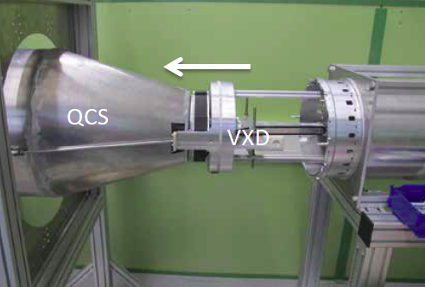
AIM
Satellite Meeting June 17 & 18
Demonstration of RVC (ok after ½ year under vacuum at KEK)
Demonstrations using mock-ups of standard and alternative installation (AIM)
-> New: demonstration of emergency de-installation (EDI)
Decision:
AIM becomes baseline
Our homework: increase clearance for cables around RVC/QCS
=> replacement of ½ of Infiniband data cables by thinner CAT5 cables

Slide 13
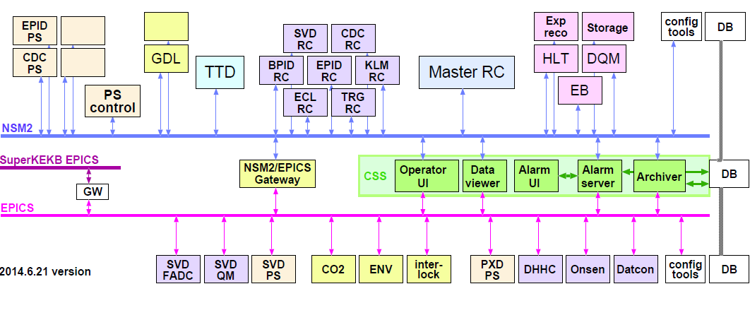
EPICS
EPICs will be used in Belle II (SVD, PXD, …..), in addition to NSM2
CSS will be used as common access to EPICs and NSM2 (top layer)
NSM2/EPICS gateway for direct communication

Slide 14
Summary
PXD: phase I of sensor production competed
good yield of phase I
inter-metal insulation problems solved -> start phase II in October
Schedule: delay by at least 8/9 months due to funding shortage
AIM: accepted as baseline
EPICS: will be used in Belle II
Other Topics:
Background: cannot be resolved by reducing magnetic field
(1.5 T still baseline, 1.2 T as ‘backup’)
Grounding scheme and rules
New monthly meeting on integration work and logistics

