Slide 1
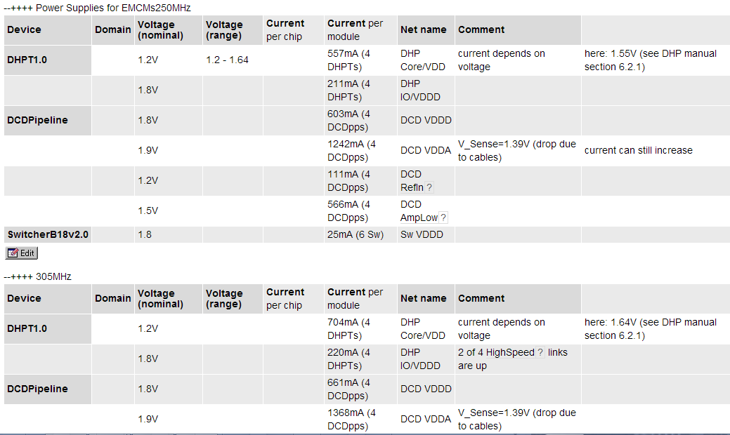
VDD DHP has ~700 mA over a single bond wire. Fuse current is ~ 800 mA, recommended is ~200mA
Multiple bonds needed (larger pad). Thicker bond wires may help.
Layout change for PXD9 needed (use obsolete FCK and RST bonds ?)

