Slide 1
Belle II PXD Overview
(An attempt to describe the)
Interfaces between ASICs and the Experiment and DEPFET sensor

Slide 2
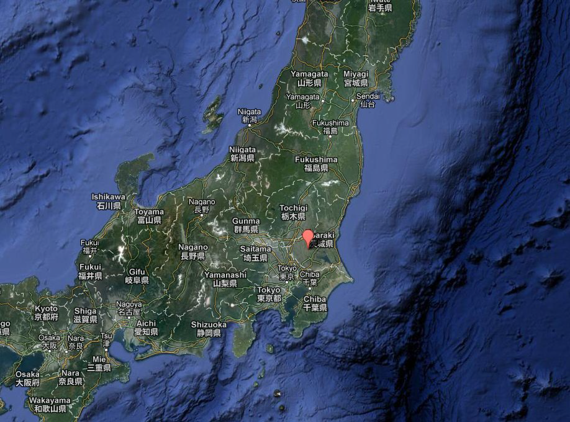
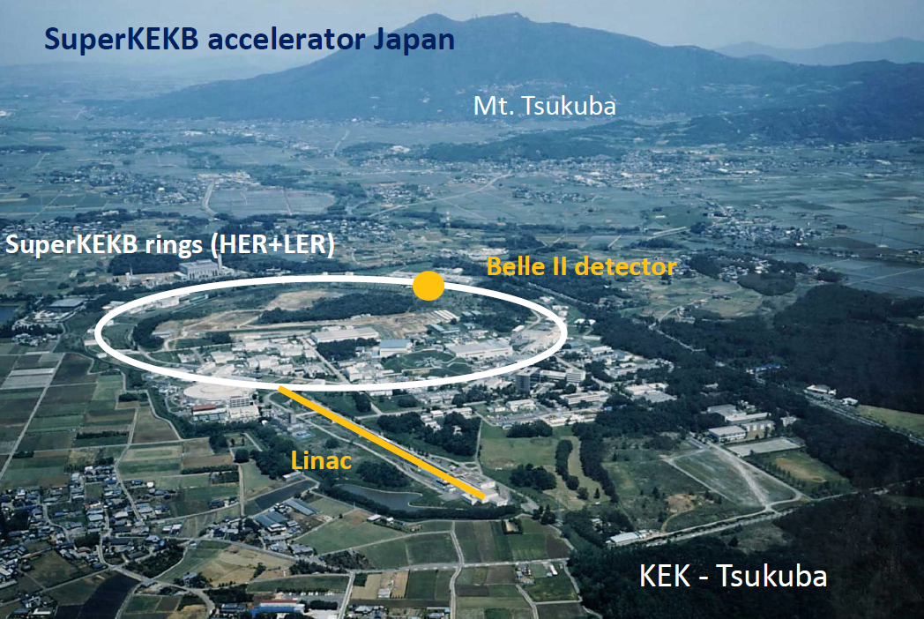
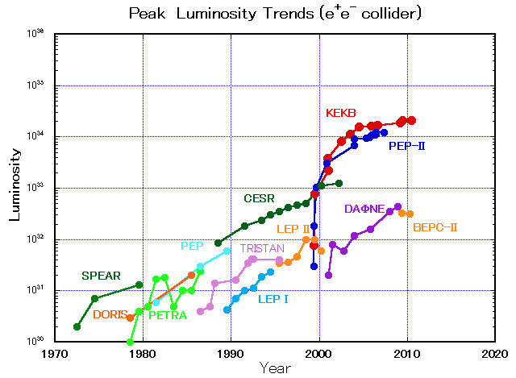
What is KEKB and SuperKEKB?
SuperKEKB
KEKB:
:- small, but powerful e+/e- collider (~3km circ.)
:- holds the world record in peak luminosity
:- status: shut down - under upgrade
:- → SuperKEKB with 40x higher Lumi.

Slide 3
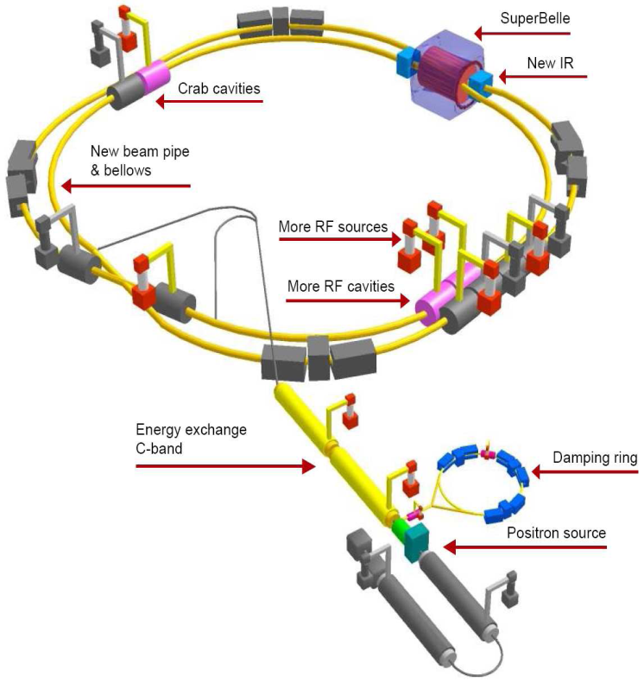
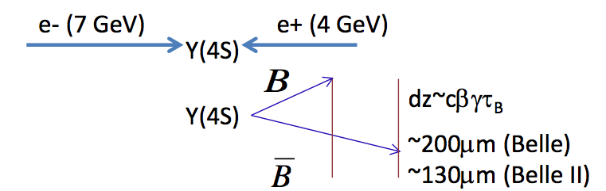
KEKB to SuperKEKB
Belle-II
Smaller beam size & more current:
→ 40x higher luminosity, goal: 8x10³⁵ cm⁻²s⁻¹
→ probe New Physics at “intensity frontier”
→ 20x-40x higher background
Radiation damage and occupancy
Fake hits and pile-up noise
→ 10x higher event rate
→ Detector upgrade
Replace inner layers of the vertex detector with a pixel detector, upgrade outer layers
Replace inner part of the central tracker with a silicon strip detector
…

Slide 4
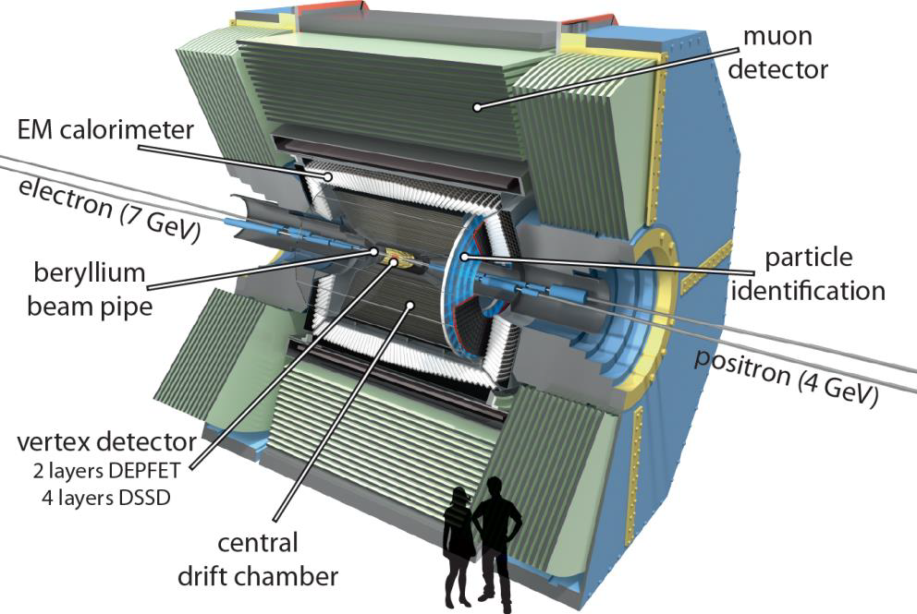
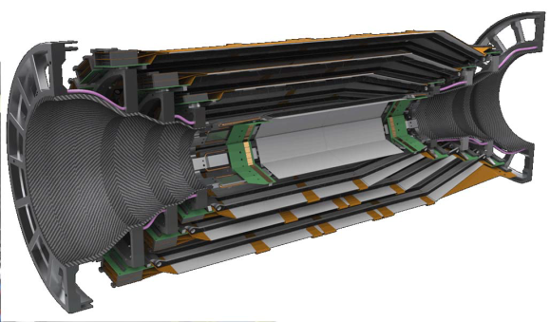
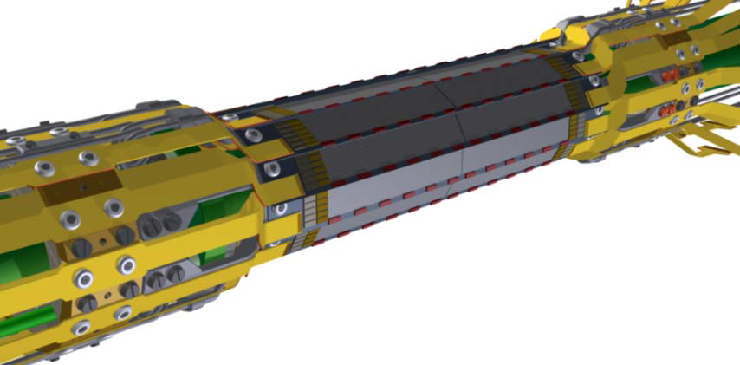
From Belle to Belle II
Beam pipe: R=10mm
SVD
Silicon Vertex Detector
4 layer double sided Si strip detector
R=3.8, 8.0, 11.5 and 14 cm
PXD
Pixel Detector
2 layer Si Pixel at R=1.4 and 2.2 cm
DEPFET active pixel sensor technology

Slide 5
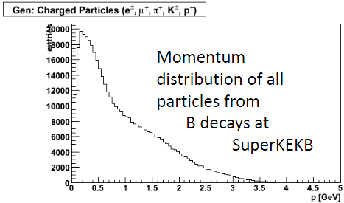
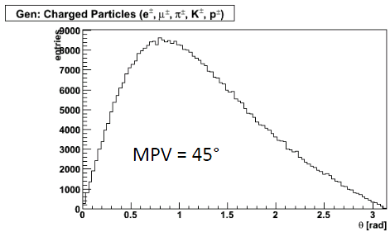
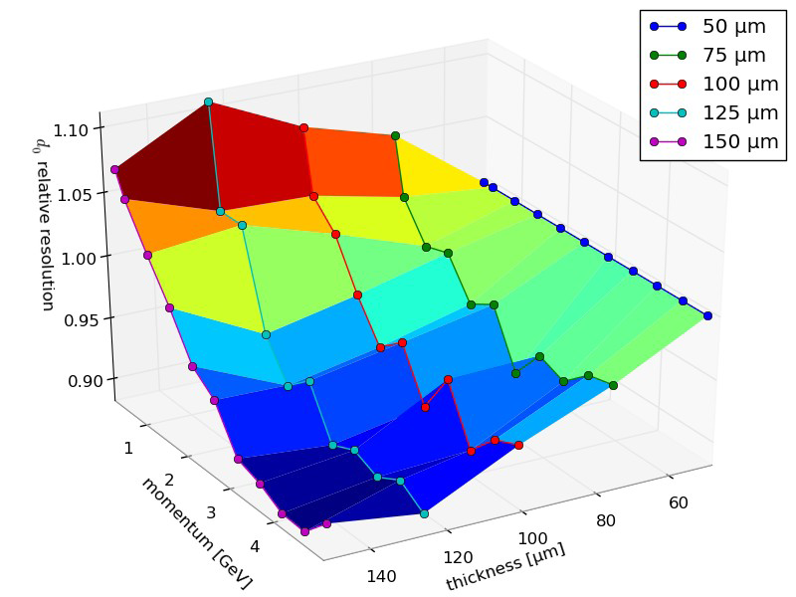
Towards a pixel vertex detector for Belle II
Physics driven requirements
Find best technically feasible compromise:
:- for central und forward region
:- signal/noise of the sensors
:- # of r/o channels
:- occupancy
:- single point and impact parameter res.

Slide 6
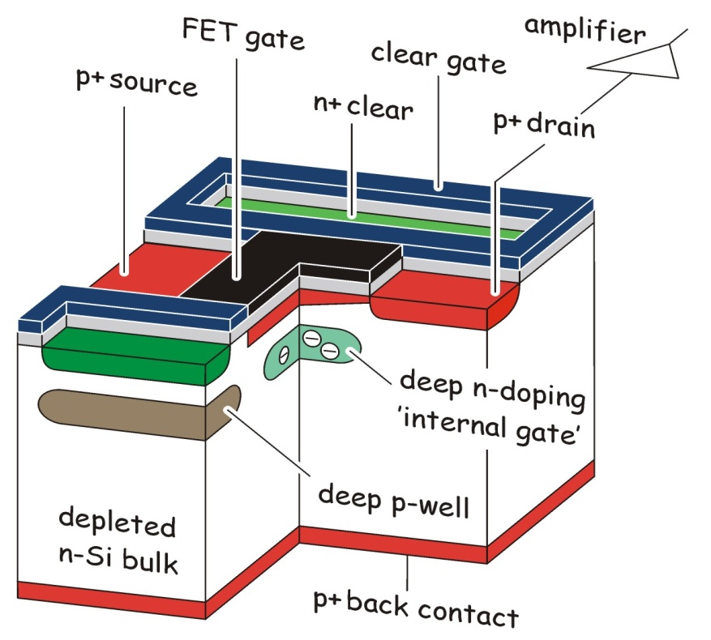
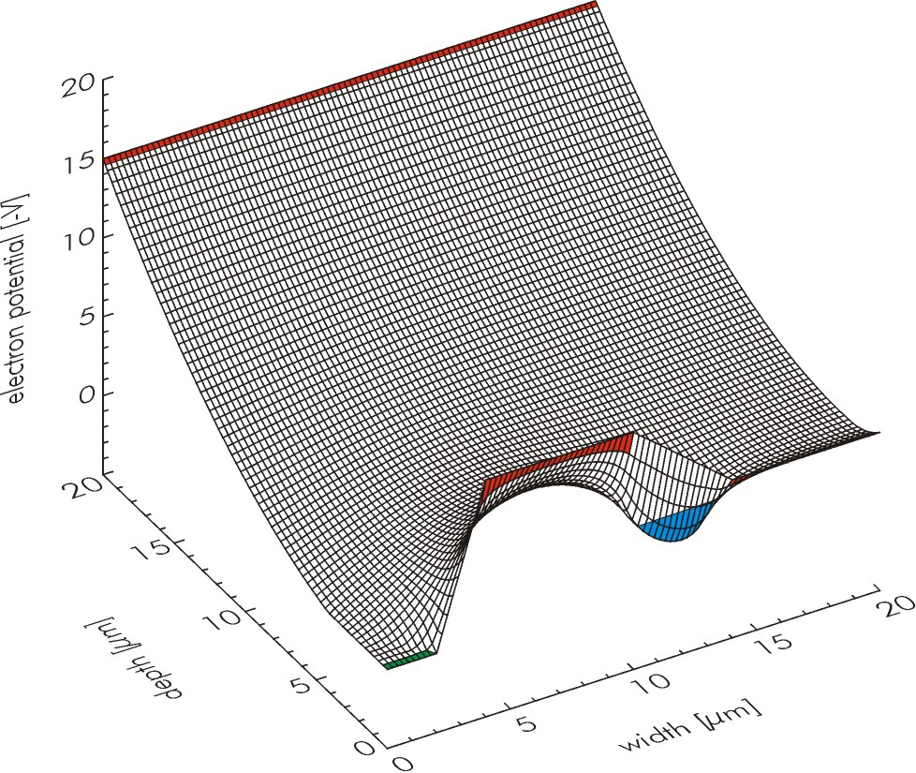
DEPFET Active Pixels
Source
Drain
Gate
fully depleted sensitive volume, mip: ~ 80 e-h pairs/µm
internal amplification
Charge collection in "off" state, read out on demand

Slide 7
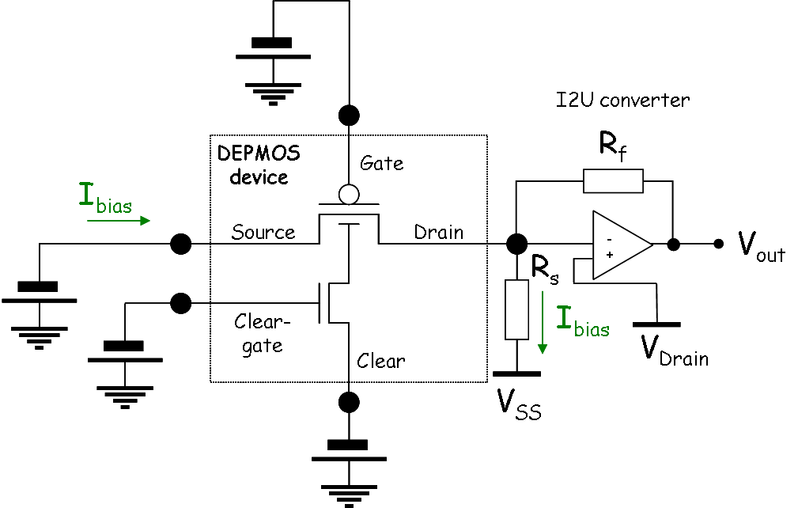
DEPFET Active Pixels
fully depleted sensitive volume, mip: ~ 80 e-h pairs/µm
internal amplification
Charge collection in "off" state, read out on demand

Slide 8
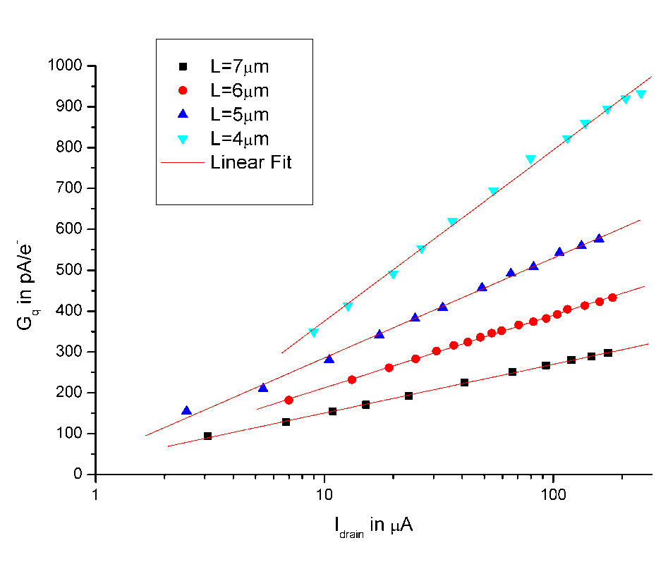
Internal Amplification – the signal
Clear
(L: nominal gate length)
I_Drain
Clear
step
g_{q} (pA/e-)
Photon events
~1700 signal electrons
Drain current I_{D} (µA)
time
(Ideal transistor theory - neglecting short channel effects)
Belle II: ~400pA/e expected
Full mip signal in 75 µm sensor: ~ 2µA

Slide 9
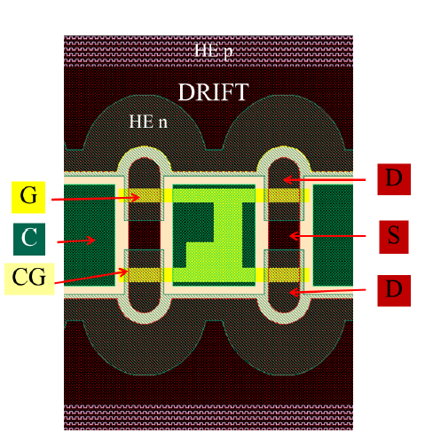
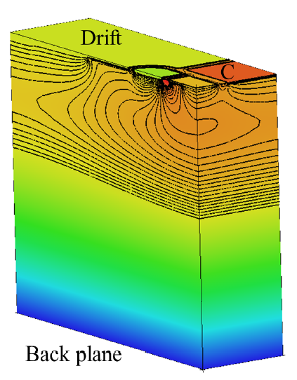
Belle II DEPFET pixel cell
Drain
Source
Basic cell is a DEPFET double pixel
Common source for two gates/drains
Clear implant between double pixels
Gate L=5µm, W/L=2
Scaling of pixel size with drift regions

Slide 10
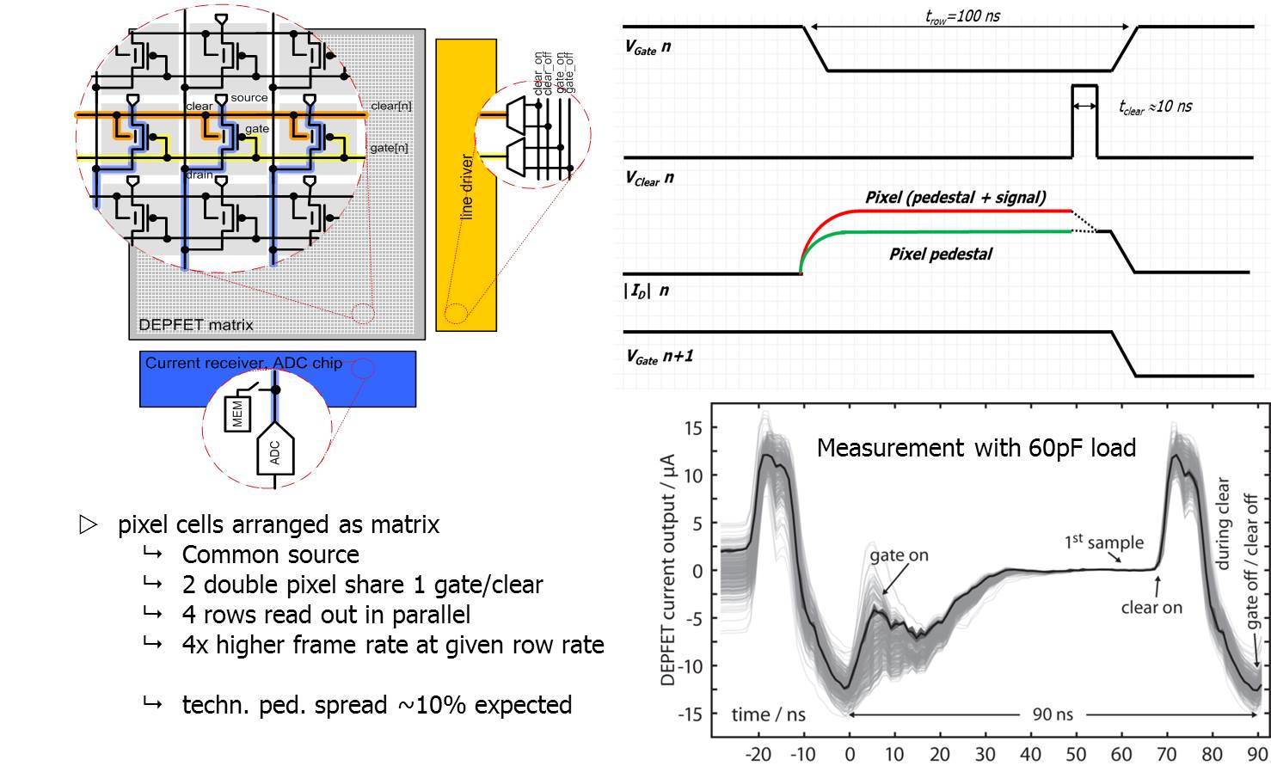
Matrix arrangement and read-out sequence

Slide 11
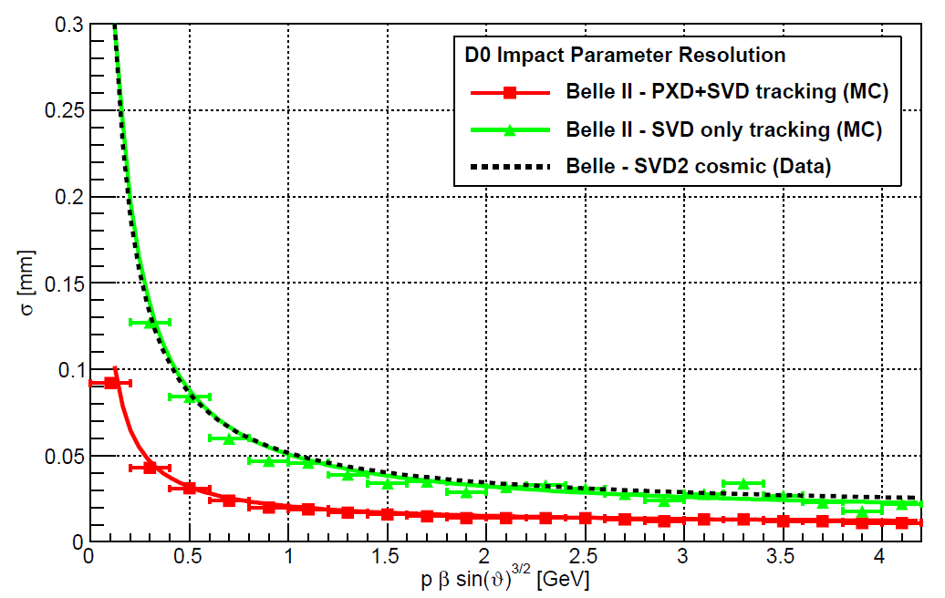
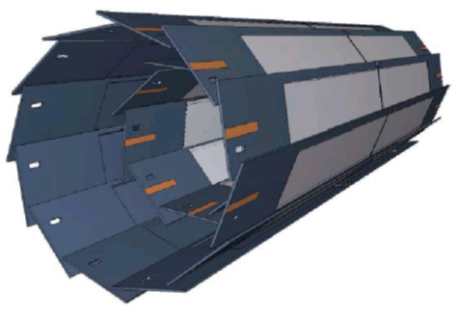
The Result – Belle II PXD
 | L1 | L2
# modules | 8 | 12
Distance from IP (cm) | 1.4 | 2.2
Thickness (μm) | 75 | 75
#pixels/module | 768x250 | 768x250
#of address and r/o lines | 192x1000 | 192x1000
Total no. of pixels | 3.072x10⁶ | 4.608x10⁶
Pixel size (μm²) | 55x50 60x50 | 70x50 85x50
Frame/row rate | 50kHz/10MHz | 50kHz/10MHz
Sensitive Area (mm²) | 44.8x12.5 | 61.44x12.5
vertex resolution significantly improved
Angular coverage 17°<θ < 155°
Z. Drasal

Slide 12
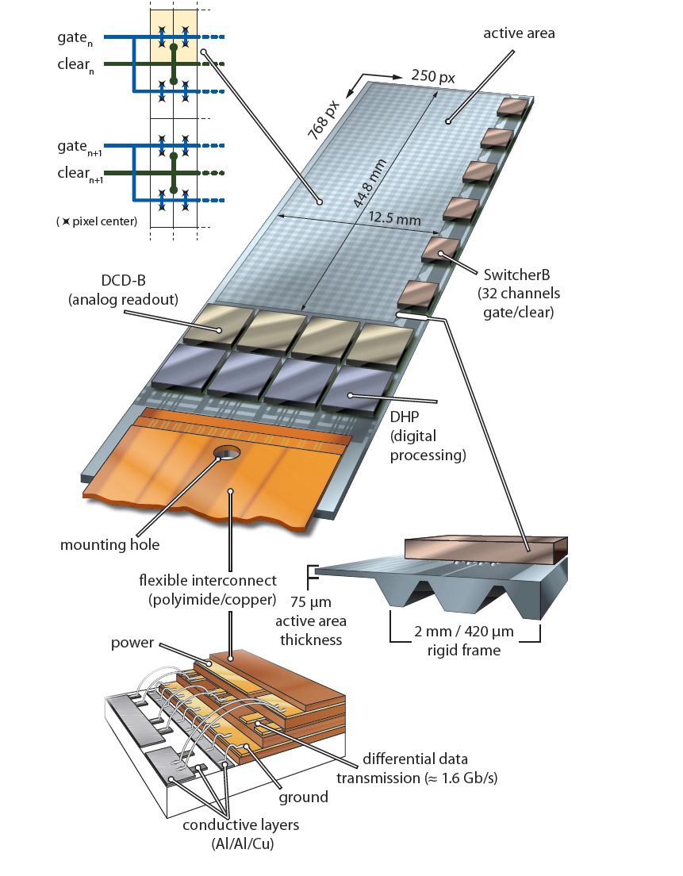
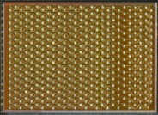
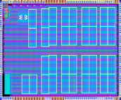
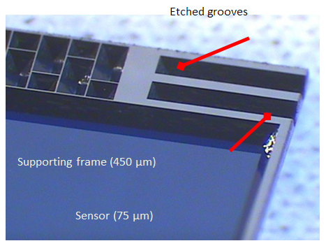
DEPFET all-silicon module
DCDB (Drain Current Digitizer)
Analog front-end
SwitcherB - Row Control
AMS/IBM HVCMOS 180 nm
Size 3.6 × 1.5 mm²
Gate and Clear signal
32x2 channels
Fast HV ramp for Clear
Amplification and digitization of DEPFET signals.
256 input channels
8-bit ADC per channel
92 ns sampling time
new version w/ 50ns sampling time under test
UMC 180 nm
Key to low mass vertex detectors
highest integration!
Thin sensor area
EOS for r/o ASICs
Thin (perforated) frame w/ steering ASICs
DHP (Data Handling Processor)
First data compression
IBM CMOS 90 nm (TSMC 65 nm)
Size 4.0 × 3.2 mm²
Stores raw data and pedestals
CM and pedestal correction
Data reduction (zero suppression)
Timing and trigger control
Drives data link

Slide 13
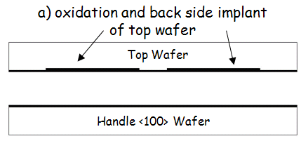
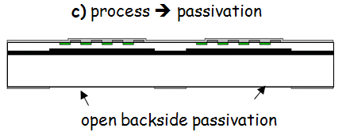
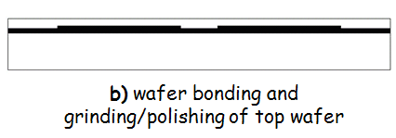
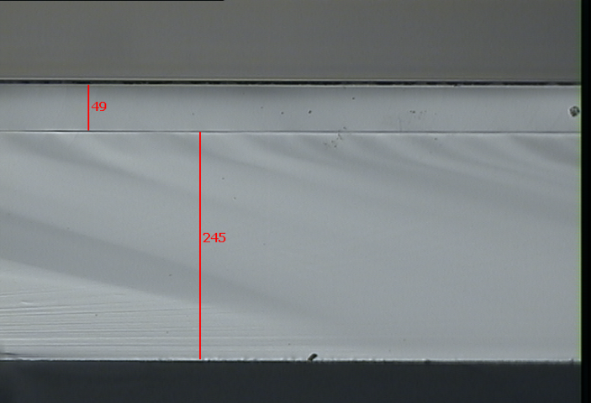
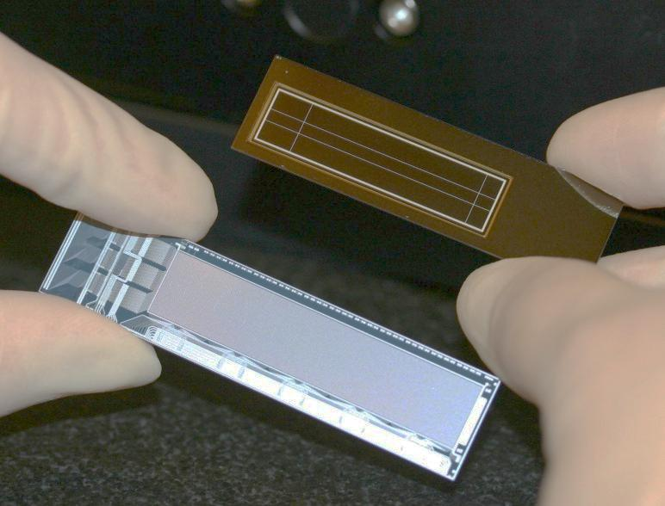
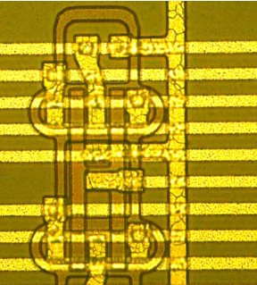
DEPFET Prototype Fabrication and “Thinning” – PXD6
50 µm
400 µm
Top side of prototype run
(“PXD6”)

Slide 14
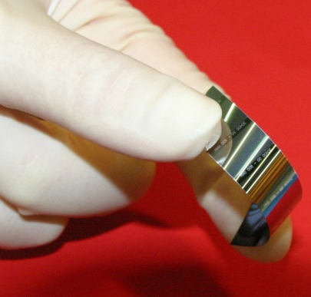
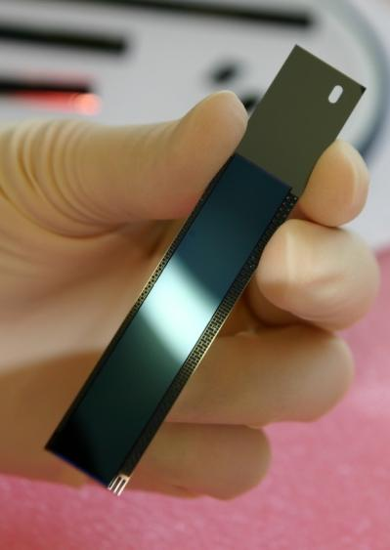
All-Silicon Module
Belle II mechanical sample
50µm Si, unsupported
Half-ladders (modules) are laser-cut
Modules are supported by a monolithic silicon frame
Two inner (outer) modules are assembled to inner (outer) ladders
50µm Si in Silicon frame

Slide 15
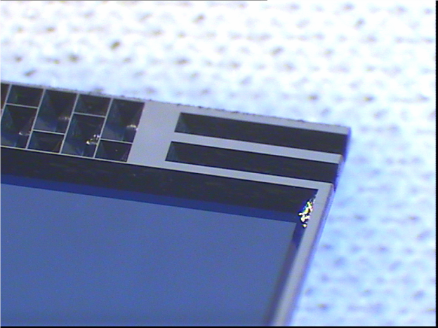
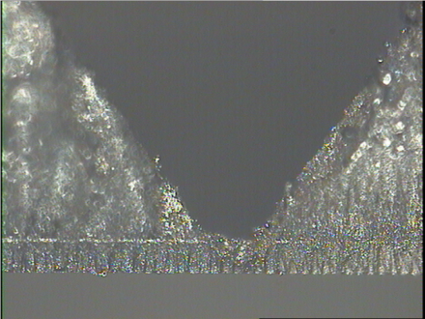
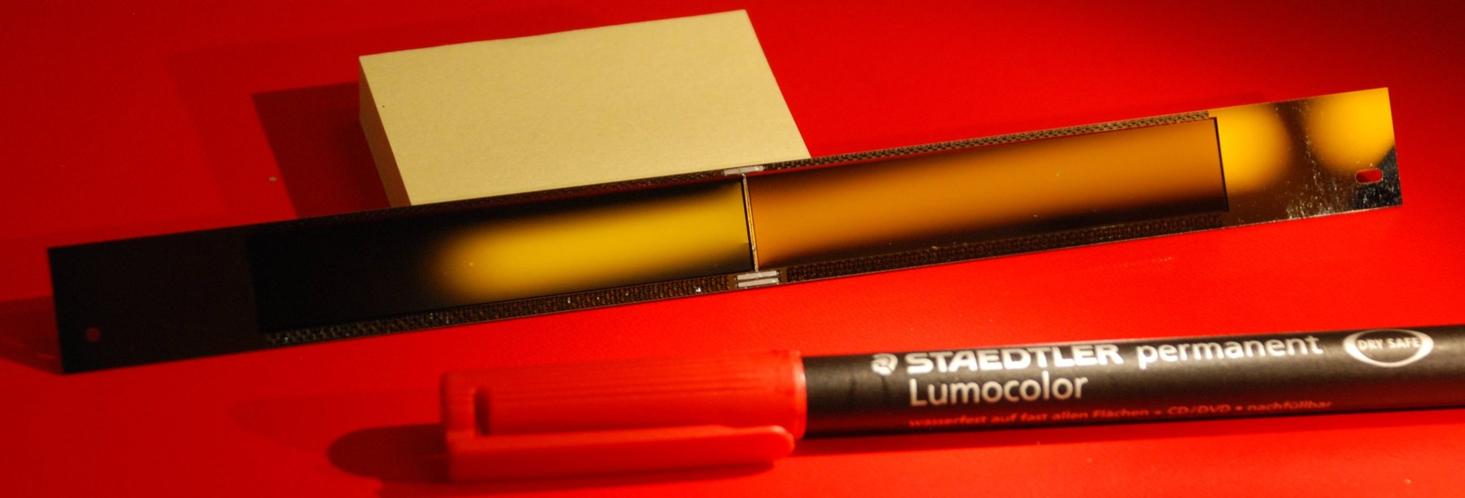
Micro joint between half-ladders
butt-joint between two half-ladders
reinforced with 3 ceramic inserts
2x300µm dead area per ladder

Slide 16
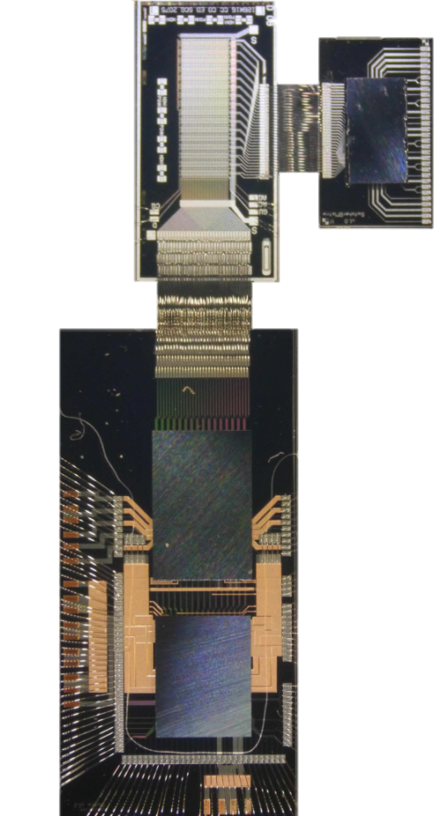
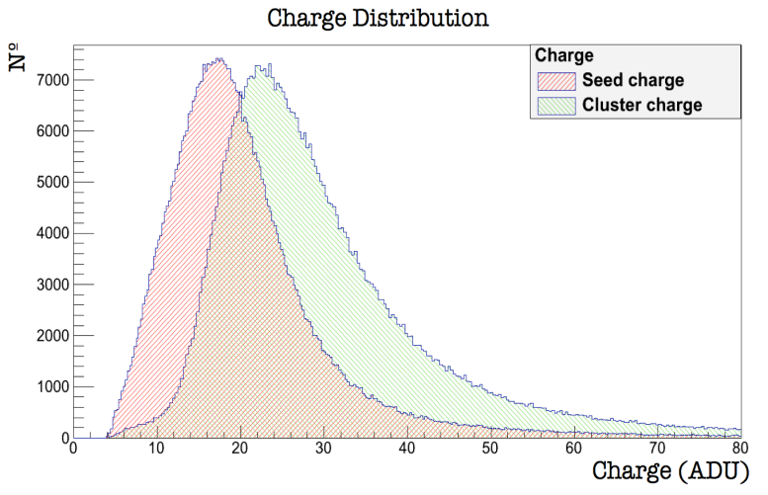
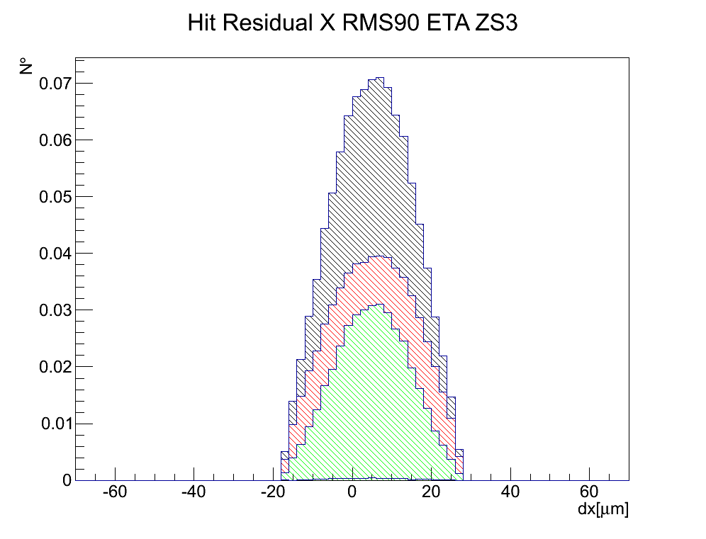
Sensor and r/o electronics: Beam tests with the full system
PXD6 Belle II design
Thin (50 µm) sensor 32x64 pixels
Pitch 50x75 µm²
SwitcherB and DCDB at full speed
Belle II prototype power supply
DCDB readout at 320 MHz → 100 ns row time
99% Efficiency
S/N for MIPs: 20-40 depending on gate length
50µmthin DEPFETs
SWB
DCD
~10 µm resolution
Cluster 3x3 signal
MIP Perpendicular incidence
DHP
g_{q}≈450 pA/e⁻

Slide 17
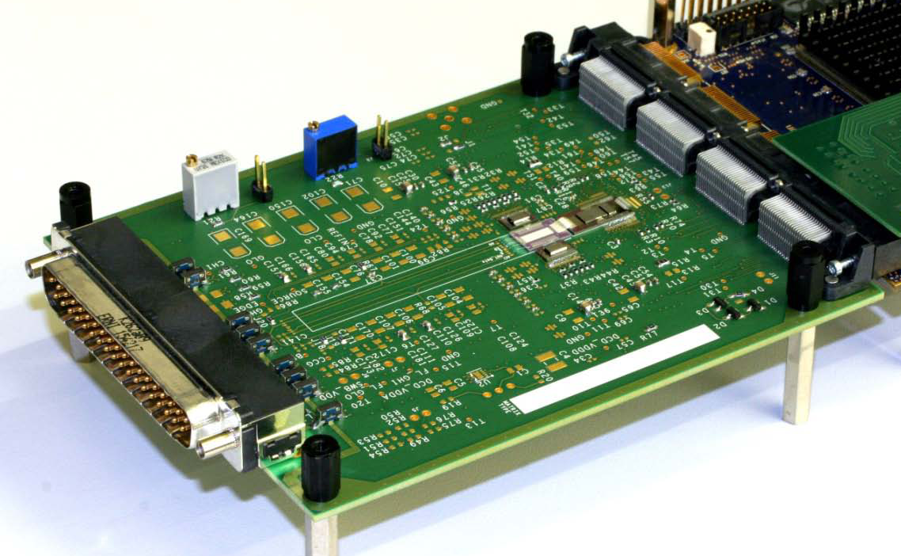
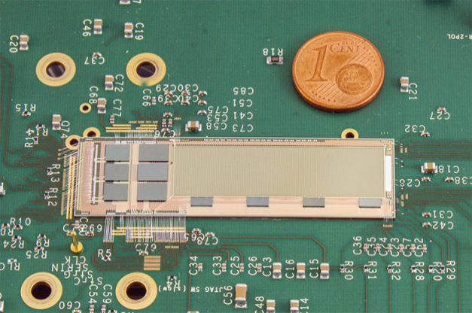
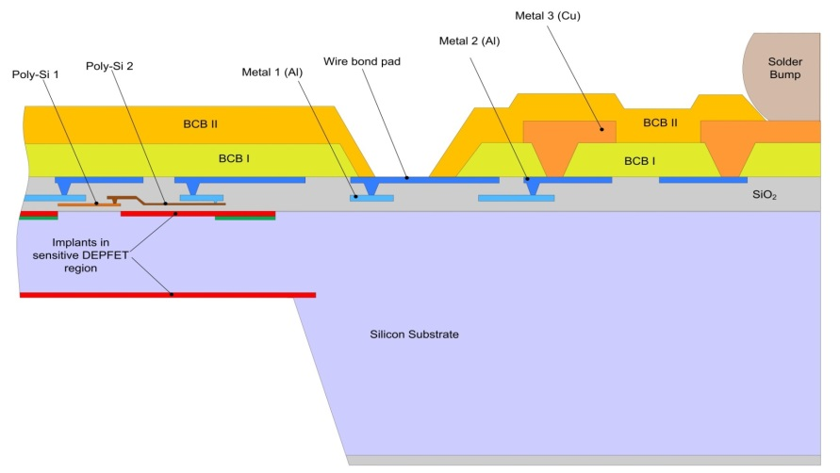
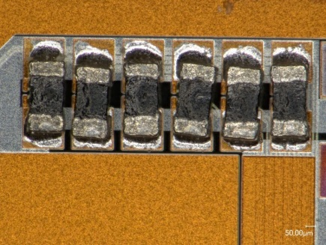
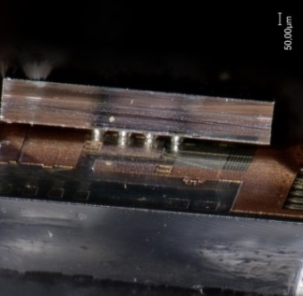
Towards a real ladder
Transition from test systems to integrated modules
PCB for the various matrices ….. “hybrids”
first bump bonded chip on PXD6 prototype matrices
2 metal layers, not the final geometry, simple 3rd metal
need still support PCB for I/O
not perforated balcony
Belle-II PXD Module (two modules form a ladder)
three metal layers, Cu as LM only on periphery
MCM: 4 DCD, 4 DHP, 6 Switchers → ~3000 bonds/module
Cu as UBM, bumps partly on thinned perforated frame
passive components soldered to substrate
I/O and power over Kapton cable
01005 term. res

Slide 18
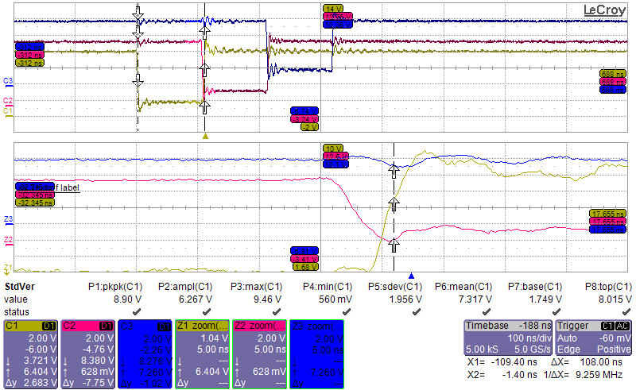
Test vehicle E-MCM
Extensive test program
Interconnect technology
Powering, control, DAQ
Signal integrity, timing …
…
Lessons learned are being applied to
final module layout
100ns/div
5ns/div

Slide 19
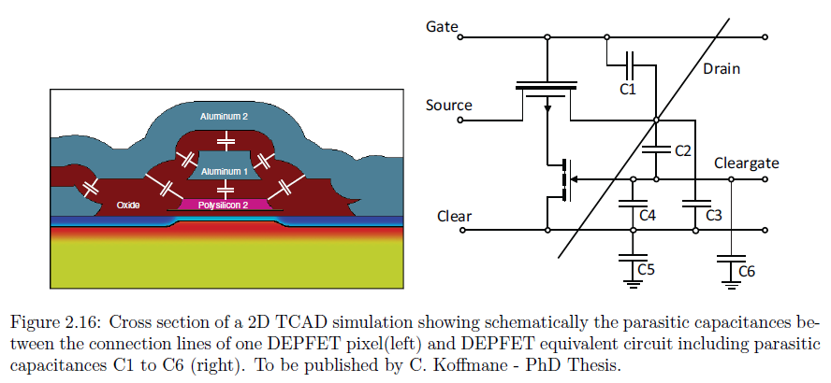
Capacitive load for the ASICs

Slide 20
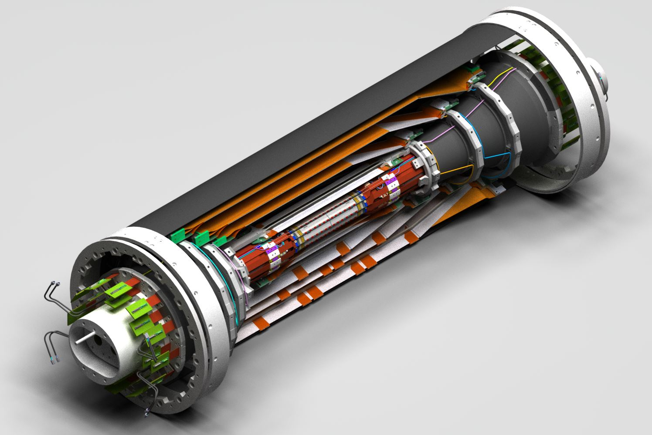
The System

Slide 21
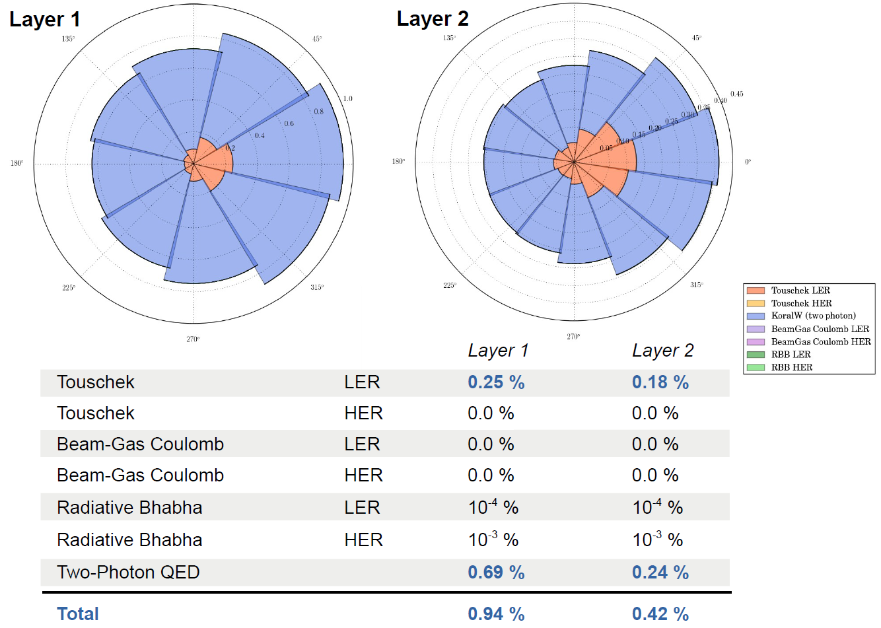
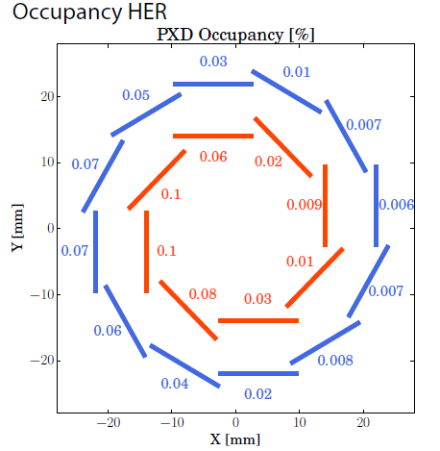
Background - occupancy
Extensive study by MPP group: main contribution QED background (4 fermion final state), e+/e- ~ few MeV range
Add ~0.14% synchrotron radiation
(Moll/Ritter/Soloviev)
Andreas Moll, Seeon 2012

Slide 22
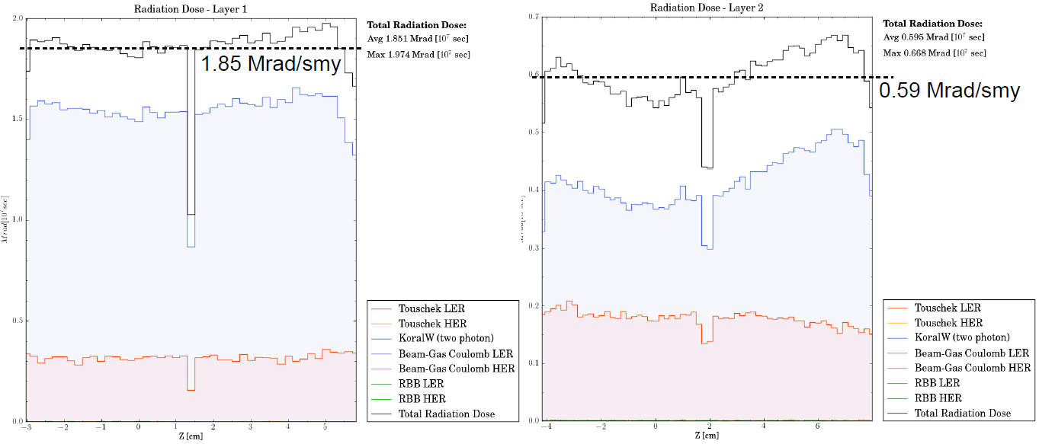
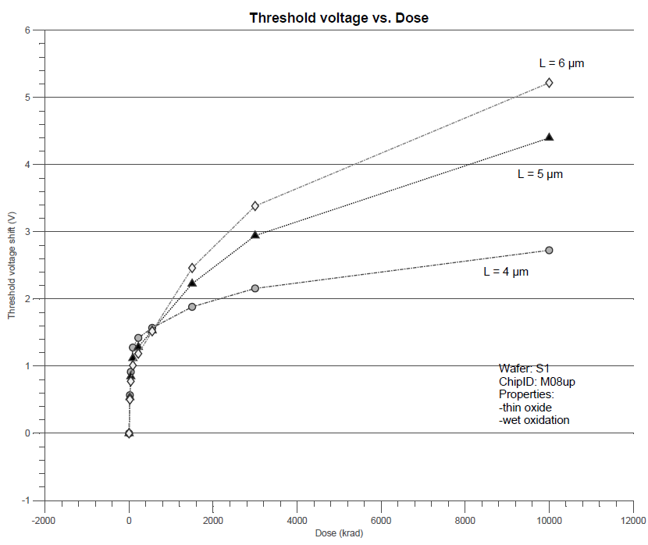
Background – rad. damage - TiD
PXD Layer 1
Total ionizing dose:
L1 ~2 Mrad/smy
L2 ~0.6 Mrad/smy
Fairly uniform over Z
Effect on DEPFET:
ΔVth after 10Mrad ~5V
uniformity of response to radiation?
ASICs to allow for additional pedestal variation

Slide 23
Background – rad. damage - NIEL
Direct neutrons from all background processes: ~1e11 neq/cm²/smy
NIEL from leptons from QED background: ~1e13 neq/cm²/smy
Effect on DEPFET: I_{leak} increase, not expected to be critical with moderate cooling

Slide 24
Injection noise
10µs packets with 2503 bunches , 200 ns gap in-between
10 µs rev. packet
20 µs frame
~ 4ms noisy /~ 400 packets
~ 16 ms “clean”
continuous injection → ~ 400 revolutions with two noisy bunches (100ns apart) every 20 ms
DEPFET integrates two trains, these noisy bunches would blank the frames → 20% loss of data
the best solution: gate the DEPFET during the passage of the noisy bunches
100ns gate, with some rise and fall times, twice per frame … is this possible?
the answers is: as far as the DEPFET is concerned, yes!
see Christian Koffmane’s talk

Slide 25
summary
Top level specs for the supporting ASICs of a DEPFET based Belle II PXD
Expected occupancy: ~1.5%
Rad. Tolerance for 5 years: 10Mrad TiD, 5e13 n_{eq}/cm²
Read-out speed: row rate 10MHz
Capacitive load: DCD input 50pF, SWB Gate and Clear 125pF(tbc)
DEPFET bias: Gate_off 3..5 V
Gate_on -3..-10V
Clear_off 2..3V
Clear_on 15..20V
Max. input signal: ~3 mips ~6µA
Signal/noise: >20 (mip MPV)
Pedestal: 100µA
Pedestal variation within matrix: technol. 10%
after irrad. tbd
General: analogue ped. correction for each pixel
support of the “gated mode”

