Slide 1
ASIC Review
Date and Location
MPP, October 27, 10:00 – October 28, 16:00, Room 313
Reviewers:
Gary Varner (Hawaii)
Wladislaw Dabrowski (AGH Krakau)
Valerio Re (Uni Bergamo, INFN Pavia)
Information distributed:
white book
DCD-B v4 pilepline
SwitcherB18 v2.0 (15.10.2014)
DHPT10 manual. 0.1 (13.10.2014)
some papers, thesis
H-.G. Moser, 18th B2GM, June 2014

Slide 2
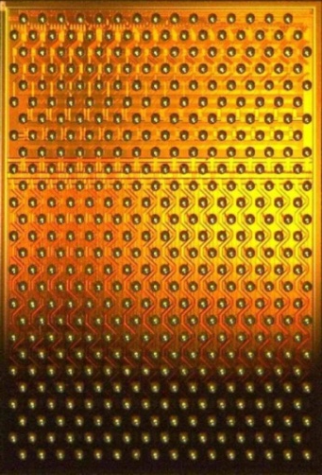
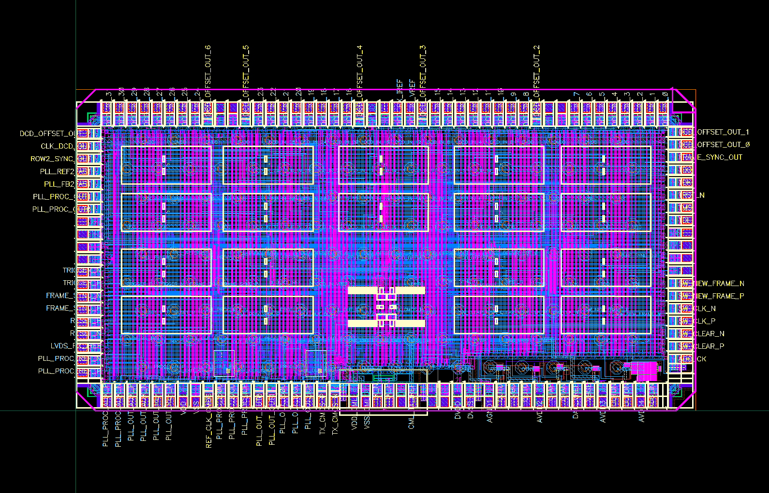
Sensor and ASICs
Switcher
Control of gate and clear
32 x 2 channels
Switches up to 30V
AMS 0.18 µm HV technology
DEPFET sensor
250 x 768 pixel
50µm x 55µm (min)
50µm x 80µm (max)
75µm thick
DCDB
Amplification and digitization of DEPFET signals
256 input channels
8-bit ADC per channel
92 ns sampling time
UMC 180 nm
DHP
Signal processor
Common mode correction
Pedestal subtraction
0-supression
Timing and trigger control
TSMC 65nm (first version IBM 90nm)

Slide 3
Charge
The review should assess the production readiness of the three ASICs used in the Belle II PXD. The schedule requires a submission of the final AISCs early 2015. In order to achieve this one has to assess:
The maturity of the chip design.
Completeness and quality of documentation.
Status of performance tests (stand alone and on system level).
Known problems and mitigation/correction plans.
Missing measurements and tests.
Work plan (responsibilities, milestones).
Schedule for next submission .
QA strategy.
It is likely that the review will conclude that there are still some issues to be resolved before a submission can be done. In this case the risks for the detector performance need to be evaluated. A clear strategy should be developed how to achieve the goal of timely submission.
Following issues need to be discussed:
General introduction in the chip design and specifications
Summary of tests and performance information
Design changes planned for the next submission
Information on QA strategy (information on yield expectations, test programs, status of test equipment, its documentation)

Slide 4
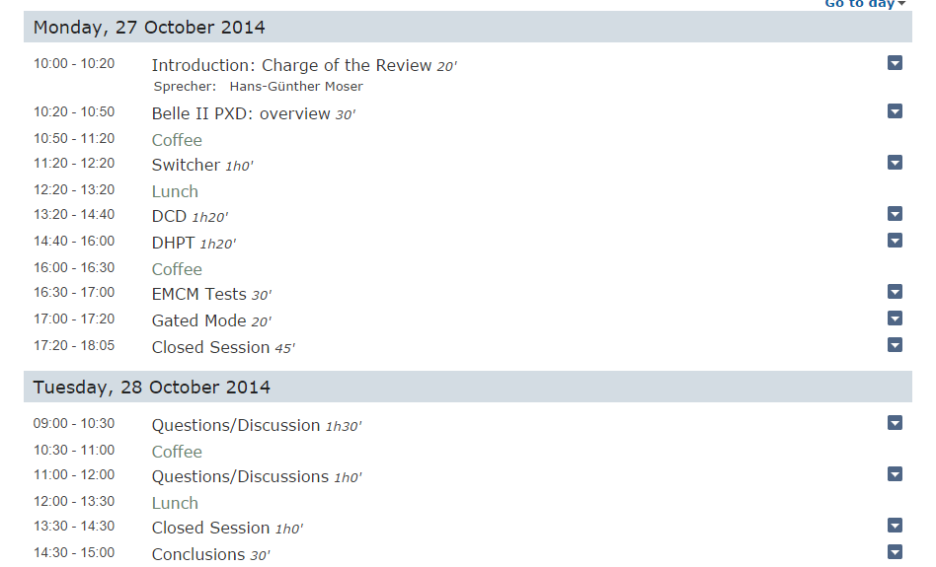
Agenda

Slide 5
Contributions
Belle II PXD: L. Andricek
Switcher: Chip Design I. Peric
Tests and plans C. Kreidl
DCDp: Chip Design I. Peric
Performance Tests C. Koffmane
Plans & QA I. Peric
DHPT: Chip Design T. Hemperek
Performance Tests I. Kishishita
Plans & QA C. Marinas
EMCM: F. Müller
Gated Mode: C. Koffmane

Slide 6
Schedule (old, before cut)
Original Schedule: shipment to KEK: October 2015
First Sensors available: January 2015
Less than one year for module assembly
No time for real prototype
ASICs need to be ready and tested before January 2015
System test with EMCM ‘Dummy’
Schedule driven by long production time of sensors
Missing prototype was seen as risk, but accepted in all reviews

Slide 7
EMCM
Dummy module with metal layers like in a real sensor module (identical process)
No sensor elements, just test structures
Purpose:
Test quality of metal processing (shorts, interruptions, missing contacts…)
Test with real ASICs
Layout
Power distribution
Cross talk, noise
Communication of ASICs
Timing, Synchronisation
Analogue performance can be tested (sort of) with a small matrix

Slide 8
Schedule (new, obsolete?)
Delay of KEKB (~ 1 year):
Use time to intensify EMCM tests (also needed to solve metal QA problems)
First Sensors available: April 2015
Shipment to KEK April 2016
ASICs need to be ready and tested before May 2015
ASIC design review in October 2015, submission shortly after
Still considerable contingency, PXD needed at KEK for integration: October 2016

Slide 9
Schedule (alternative I)
Further delay: PXD needs to be at KEK December 2016
Pilot run: equip first modules with ASICs and test (‘kind of prototype’): July 2015
Assumes ASIC submission in February 2015
Series module assembly to start in September/October 2015
Shipment to KEK in June 2016 (still contingency)
No possibility for changes of sensor, but re-submission of ASICs possible (with some delay)

Slide 10
Schedule (alternative II)
Variation: Assemble Pilot Run modules with existing ASICs: April – June 2015
ASIC submission in June 2015
Series module assembly to start in November 2015
Shipment to KEK in July 2016
Insignificant delay compared to alternative I
More time for AISC re-design (and more input from tests of present chips)
However, no ‘prototype’ with final ASICs for beam tests etc.
Are the present ASICs good enough for the tests needed?
ASIC submission date close to end of the present funding period!
Copper processing of main batches can start after test!

Slide 11
Questions
Changes/improvements of the ASICs?
Additional measurements & tests?
Wait with prototyping for next chip iteration?
What can we learn from existing ASICs?
Consider:
Impact on Schedule
Feedback on sensor production?
Limited number of sensors (and overall yield is still unknown!)

