Slide 1


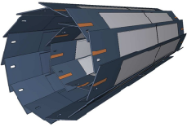
DCDpp Transfer curves
Manfred Valentan, Christian Koffmane, Eduard Prinker

Slide 2
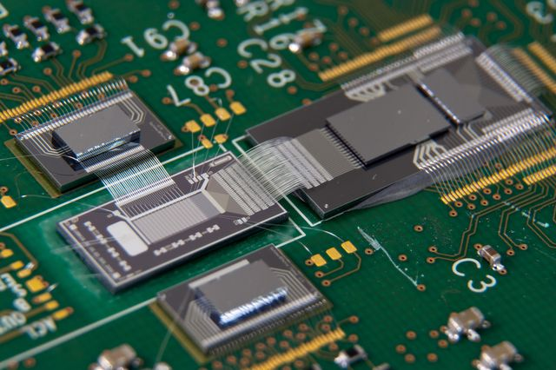
DCDpp Test System on “hybrid4”
Switcher
for Clear and Gate Control
DCD-RO
Line Driver and Buffer to FPGA
PXD6 Belle-II DEPFET
DCDpp
Read-out Chip
2nd Switcher
Not used for Belle-II type PXD6 Design

Slide 3
Overlay, pedestals
Measurement procedure:
Calibrate internal source with SMU
Select DCD channel [0,255]
Step through current values [0,384]
Record 100 samples, save noise
Analysis: use single samples, not the mean
-
σ
-
-

Slide 4
Observables – Gain and noise
k = gain

Slide 5
Gain, noise
σ
σ
Channel 121

Slide 6
Channel 121

Slide 7
Observables – Dynamic range

Slide 8
Dynamic range
σ
σ
Channel 128
σ

Slide 9
Channel 128

Slide 10
Observables – Missing codes

Slide 11
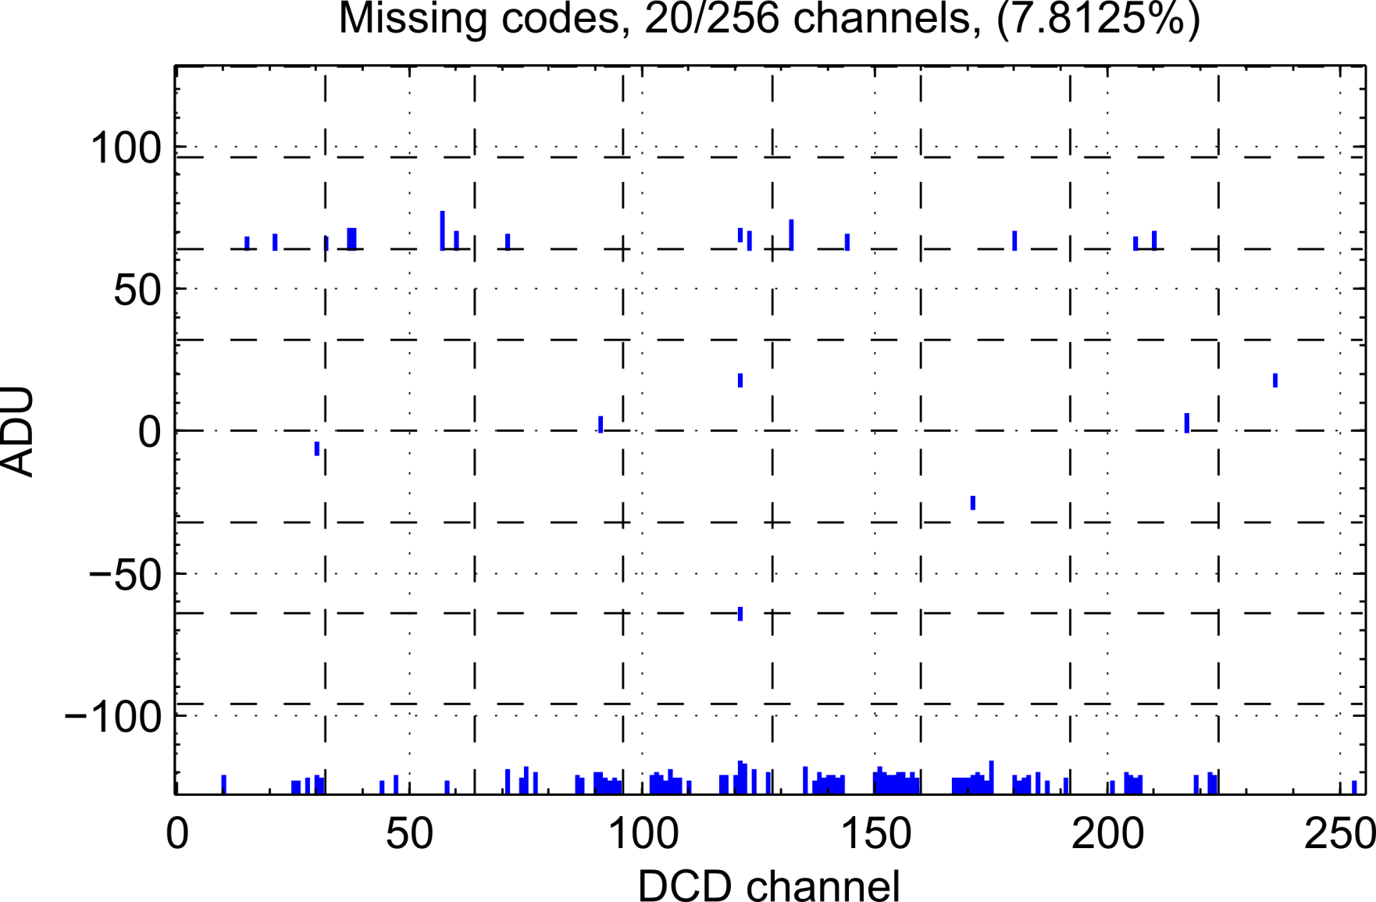
Missing codes
Note: only consider 5 or more consecutive missing codes

Slide 12
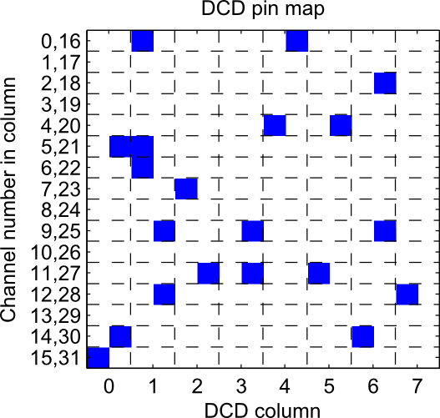
Missing codes
Channel 57

Slide 13
Channel 57

Slide 14
Influence on position measurement
Study by Peter Kodyš
3 bit missing code (8 ADUs): resolution worsens by 0.9 µm (10%)
Prerequisites:
  The affected channel is part of a cluster -> what are the odds?
  Primary signal below 20 ADU -> maybe even below threshold...
Fewer missing codes and higher signal -> smaller effect
Conclusion:
missing codes are ugly, but don‘t harm the detector performance

Slide 15
Summary
Gain:
  Channel average 73 nA/ADU
  Periodicity with half column
  Curved shape
Noise:
  Channel average 0.4 ADU
  Maximum 2.2 ADU (mean of a single channel)
  4 channels with oscillations
Dynamic Range:
  Channel average 7.8 bit
  All channels show nonlinearity at low end
  Inner four columns show nonlinearity also at high end
Missing codes
  20 channels (7.8%)
  Up to 14 adjacent missing codes
  Most zones start at 64
  No dependence on geometry

Slide 16
What‘s next
Same measurement on EMCM
  Speed up measurement
  Try for different DCDs
  Try for different supply voltages and settings
  Study effect of neighbouring chips
Refine algorithms
  Make them fit for quality assurance
  Store results in database for later reference
DCD feature request: Finer internal current source
  However, only „nice to have“ for detailed lab tests

Slide 17
Thank you
for
your attention!

Slide 18
Backup

Slide 19
How to find the linear range
Smoothen the transfer curve by
“moving average”
Linear fit between fixed lower limit and
variable upper limit -> plot Chi2/ndf
Linear fit between fixed upper limit and
variable lower limit -> second half
First derivative of Chi2/ndf curve
Apply cut, disregarding small spikes

Slide 20
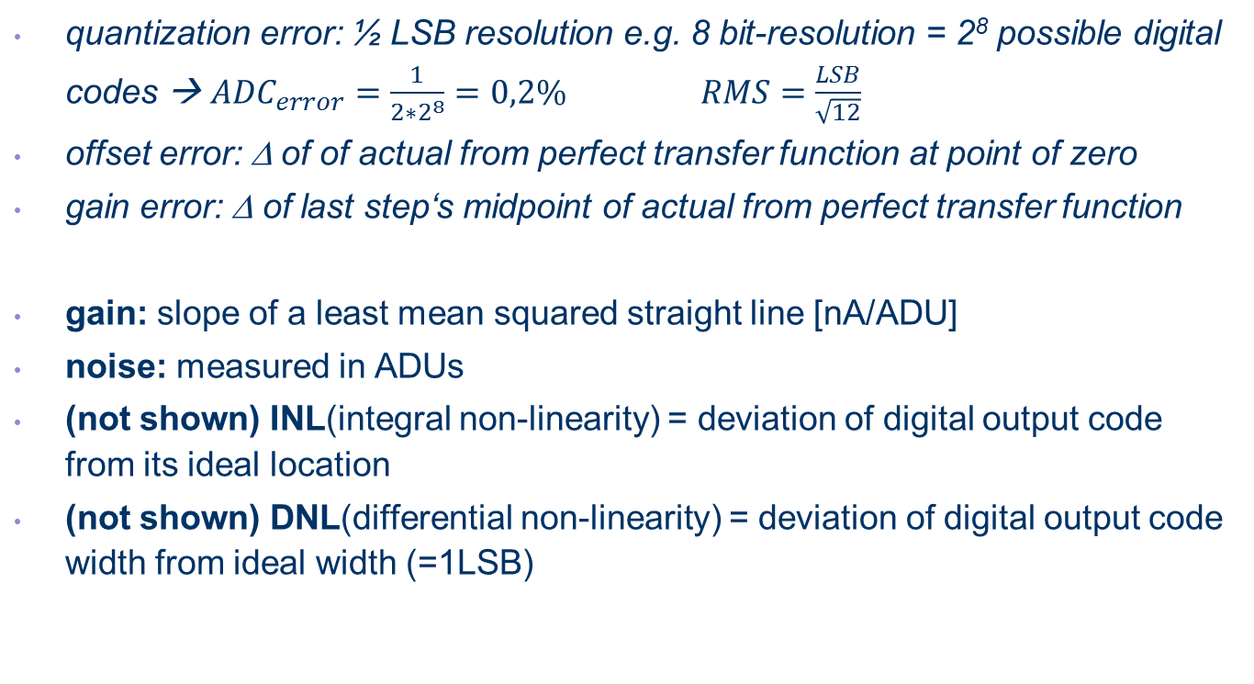
Static ADC Parameters (expressed in LSB-units or %FSR)
quantization error: ½ LSB resolution e.g. 8 bit-resolution = 2⁸ possible digital codes → ${ADC}_{error}=\frac{1}{2∗2^{8}}=0,2\%$ $RMS=\frac{LSB}{\sqrt{12}}$
offset error: Δ of of actual from perfect transfer function at point of zero
gain error: Δ of last step‘s midpoint of actual from perfect transfer function
gain: slope of a least mean squared straight line [nA/ADU]
noise: measured in ADUs
(not shown) INL(integral non-linearity) = deviation of digital output code from its ideal location
(not shown) DNL(differential non-linearity) = deviation of digital output code width from ideal width (=1LSB)

Slide 21
Ideal transfer function of 3-bit ADC
1LSB = 1 ADU = full analog range
Step width = smallest resolution
Uniform staircase with ideally infinite steps:
  tread represents a particular digital output code
  riser represents a transistion between adjacent codes
Transition not sharply defined; resembles more a probability function with slowly increasing input voltage ADC converts more and more frequently to next code
Quantization process introduces error (triangles)

Slide 22
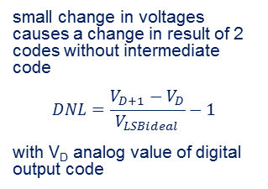
DNL – missing code
small change in voltages causes a change in result of 2 codes without intermediate code
$$DNL=\frac{V_{D+1}−V_{D}}{V_{LSBideal}}−1$$
with V_{D} analog value of digital output code

Slide 23
DNL – differential non-linearity: Precision

Slide 24
DNL - monotonicity
lower conversion result for a higher input voltage

Slide 25
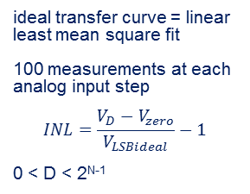
INL – integral non-linearity: Curvature
ideal transfer curve = linear least mean square fit
100 measurements at each analog input step
$$INL=\frac{V_{D}−V_{zero}}{V_{LSBideal}}−1$$
0 < D < 2^{N-1}

Slide 26
INL/DNL example

Slide 27
INL, DNL

Slide 28

DEPFET sensors at Belle II
Peter Kodyš, 23 October 2014

Slide 29
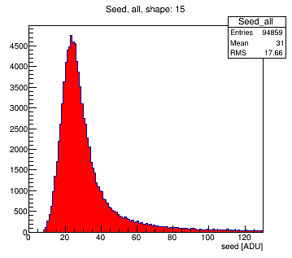
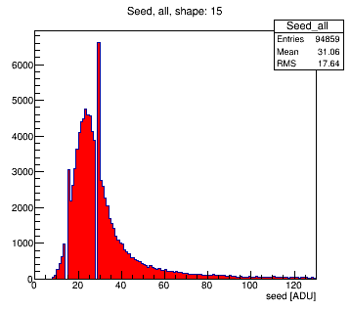

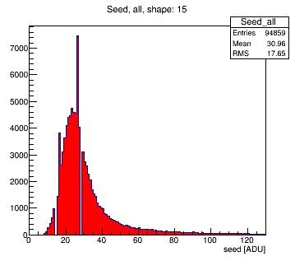
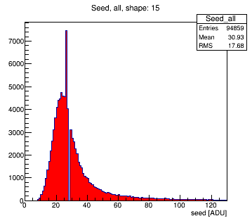
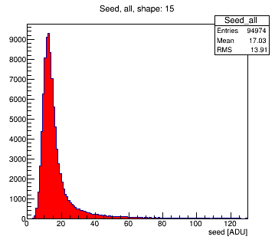
DEPFET sensors cases in study (1)
Normal response
Shift two levels in one step up
1
4
Shift one level in one step up
Shift two levels in two steps up/down
2
5
Shift one level in two steps down
Every second step shift up
Doubled one ADU
from 200 el. to 400 el.
3
6
seeds
Peter Kodyš, 23 October 2014

Slide 30
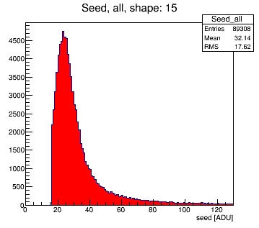

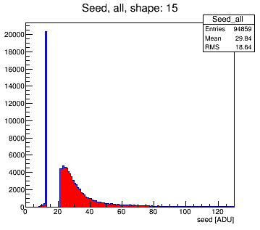
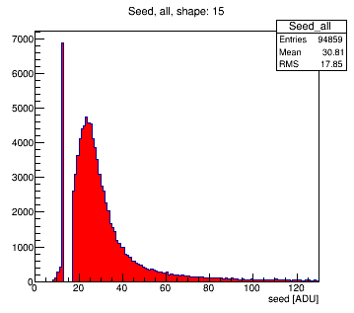
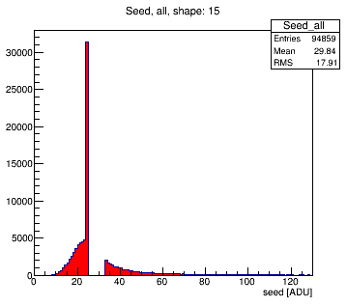
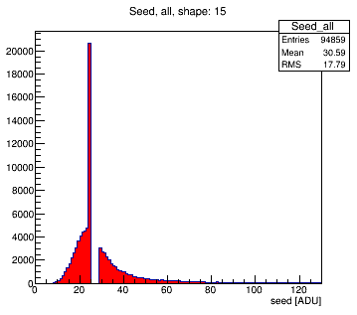
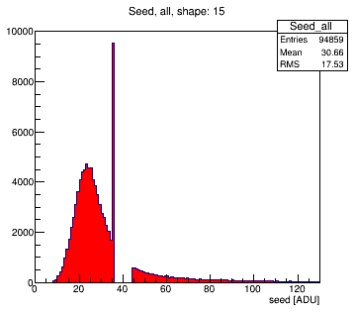
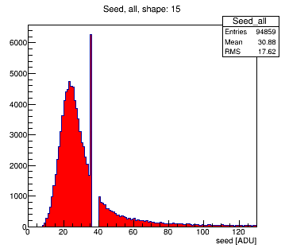
DEPFET sensors cases in study (2)
Step down from 7 and next 8
Step down from 7 and next 4
7
11
Step down from 12 and next 8
Step down from 12 and next 4
8
12
Step down from 24 and next 8
Step down from 24 and next 4
9
13
Step down from 35 and next 8
Step down from 35 and next 4
10
14
seeds
Peter Kodyš, 23 October 2014

Slide 31
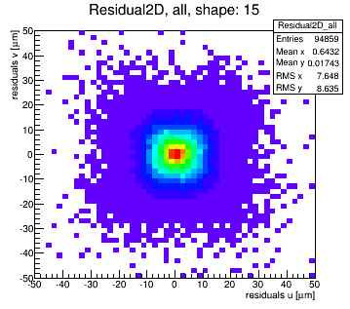
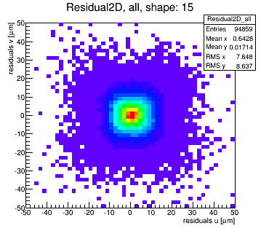
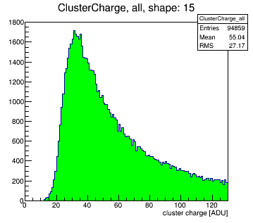
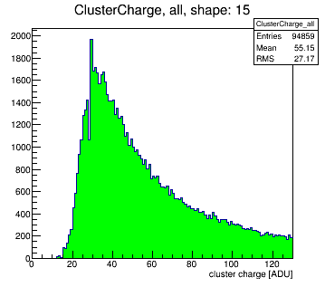
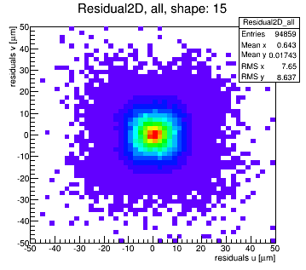
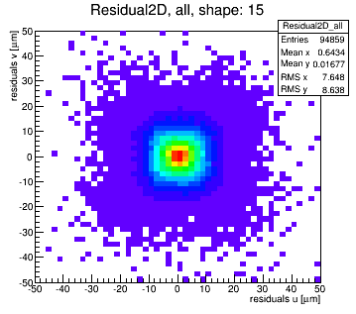
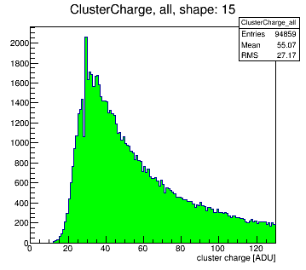
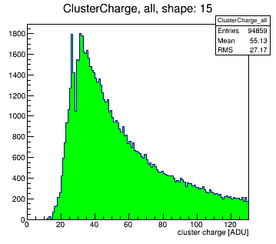

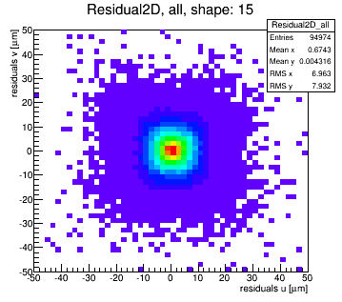
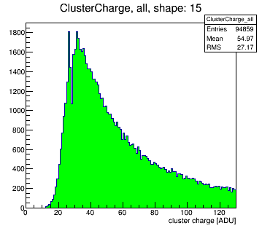
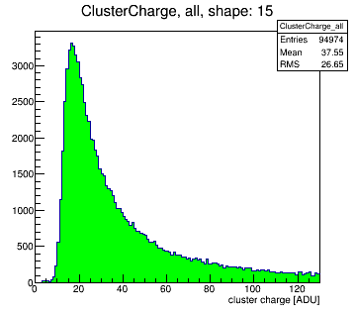
DEPFET sensors cases in study – results (1)
1
4
2
5
3
6
seeds: red, cluster charge: green, residual plots
Peter Kodyš, 23 October 2014

Slide 32
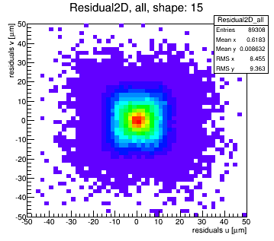
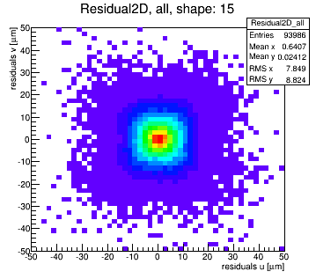
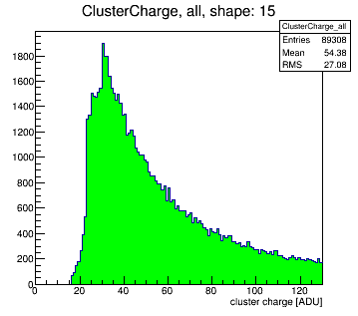
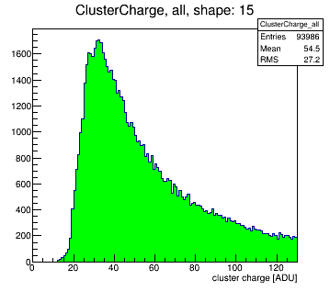
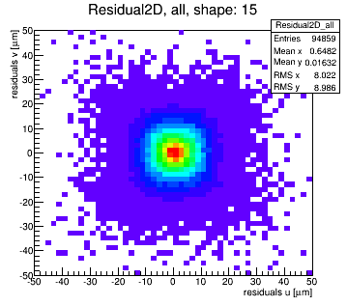
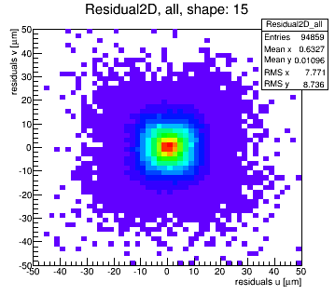
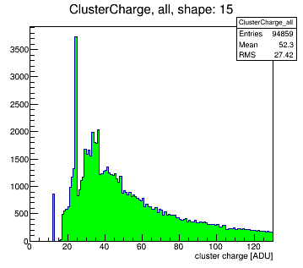
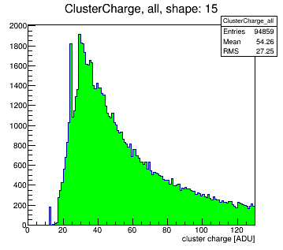
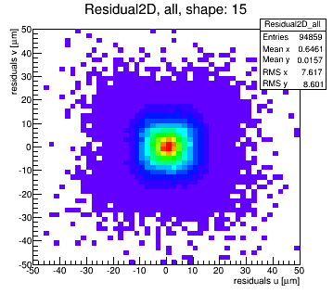
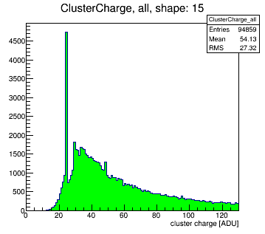
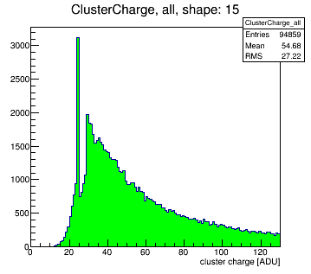
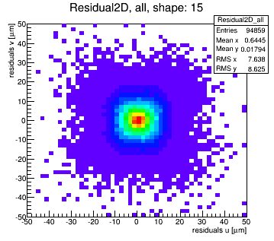
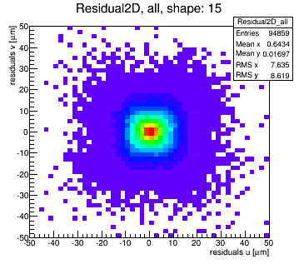
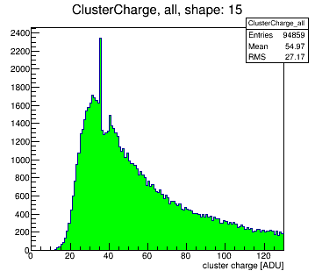

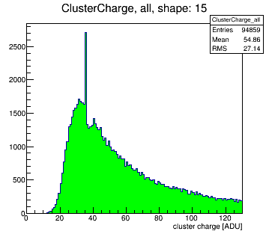
DEPFET sensors cases in study – results (2)
7
11
8
12
9
13
10
14
seeds: red, cluster charge: green, residual plots
Peter Kodyš, 23 October 2014

Slide 33
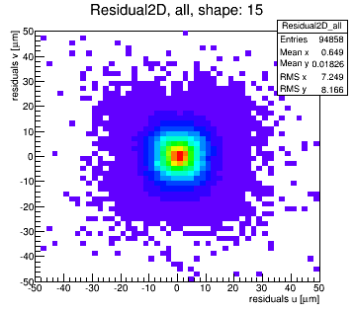
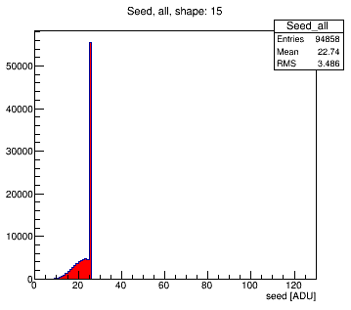
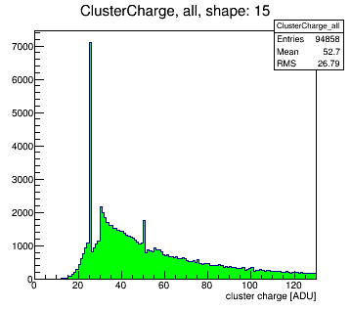
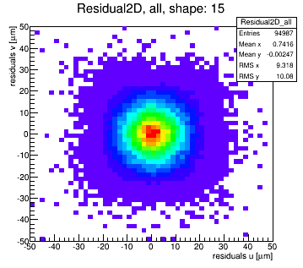
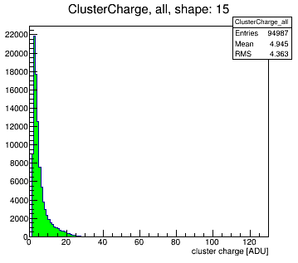
DEPFET sensors cases in study - extremes
1
Normal response
RMS 7.6 x 8.6 μm
Cut all digits over 25 to 25 ADU
RMS 7.2 x 8.2 μm
Binary readout
RMS 9.3 x 10.1 μm
seeds: red, cluster charge: green, residual plots
Peter Kodyš, 23 October 2014

Slide 34
DEPFET sensors cases in study - conclusion
Residuals was difference between true position and reconstructed position
Accumulation of ADU up to 8 up (3 bits error) affect resolution in less 0.9 μm (10 %) for signal less 20, higher signal not (case 7, 8).
Accumulation of ADU up to 4 up (2 bits error) affect resolution in less 0.2 μm (3 %) for signal less 20, higher signal not (case 11, 12).
Rest of cases and residual plot RMS varied in less 0.1 μm in u and v directions
There is no real influence to average residual plots and for resolution
Important note: resolution affection is only for clusters containing affected digit. E.g. if there is 5% of affected digits, there is 5 % contribution of adding error on average error RMS.
Extremes:
  Cut down in 25 ADU have no influence to residual plots and for resolution
  Binary readout gives in average about 2 μm worst resolution (20 %)
Presenting analysis was prepare for 50 x 55 μm DEPFET pixels we are not expecting changes for other pixel size prepared for Belle II.
Peter Kodyš, 23 October 2014

