Slide 1
SWITCHER

Slide 2
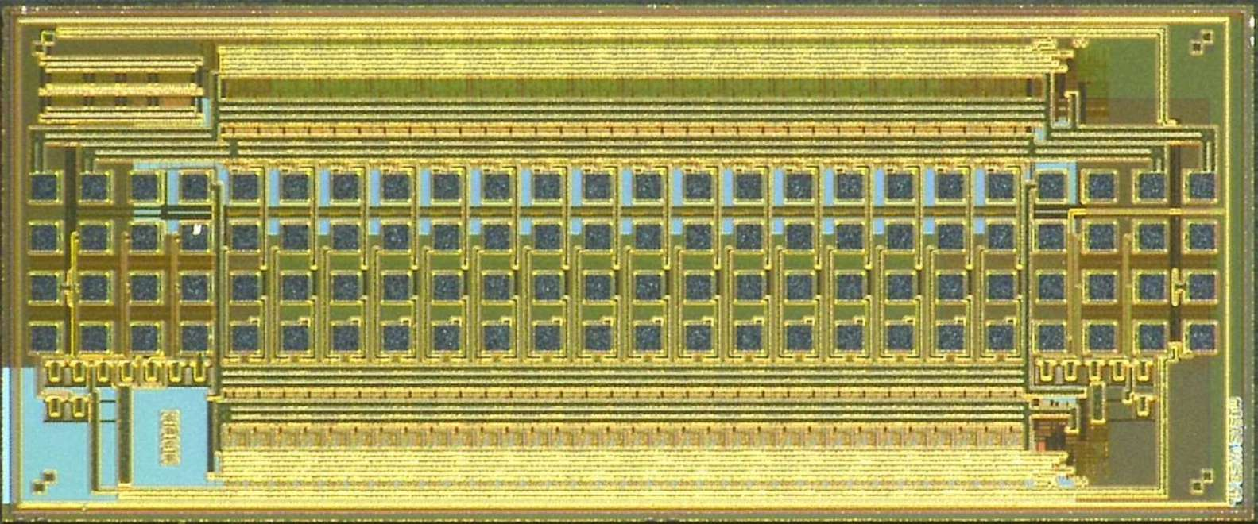
SWITCHER
SWITCEHR chips generate fast high-voltage (10 ns into 70 pF – now 100pF) pulses of up to 20 V amplitude to activate gate rows and to clear the internal DEPFET gates.
The latest SWITCHER version is implemented in HV AMS 180nm technology.
One SWITCHER will be able to address 32 different DEPFET matrix segments (row groups), for this purpose it will have 32 channels with a clear- and a gate-driver each.
Problem: make radiation tolerant high voltage drivers
SWITCHERBv1 in 350nm AMS
(radiation tolerant layout)
SWITCHER in 180nm AMS
(standard layout)

Slide 3
Block scheme
32 high-voltage channels (level shifters) that generate the high-voltage signals.
Low voltage control block (based on shift register) used to select the high-voltage channels.
Voltage regulator that generates 4 high-voltage supplies out of two main ones.
JTAG slow control
Fast control uses four signals: CLK, Sin, StrGate, StrClear !
FF
Blind mode control
SEROUT
Volt. Regulator
FF
NoisyEn3
LV Ctr.
HV Chan.
FF
FF
Slow control
FF
NoisyEn0
FF
STRG
GHi, GLo
CLK
SERIN
STRC
CHi, CLo
StrGB
CCLK or StrClr

Slide 4
Block scheme
Noisy mode (blind mode) control
FF
Blind mode control
SEROUT
Volt. Regulator
FF
NoisyEn3
LV Ctr.
HV Chan.
FF
FF
Slow control
FF
NoisyEn0
FF
STRG
GHi, GLo
CLK
SERIN
STRC
CHi, CLo
StrGB
CCLK or StrClr

Slide 5
High-voltage driver
The outputs of high-voltage channels switch between upper (CHI, GHI) and lower voltages (CLO, GLO), respectively
Voltage swing 20V
Hi/Lo versus substrate potential up to 50V
The low voltage control block and the slow control part are supplied by an additional ”floating” 1.8V supply (GNDD, VDDD).
Channels are activated one after other by means of a shift register
”1” is clocked through the channels.
Several chips can be daisy chained by connecting the serial output to the serial input of the next chip.
The chip is bump bonded to the sensor.

Slide 6
High-voltage driver
High-voltage channel - main parts:
U-I (single ended to differential) converter C
High-voltage power transistors Tp and Tn.
Floating-logic gate control blocks.
Low power consumption – sleep mode.
“Break before make” feature
C/GHI
gate control block
1.8V
Tp
off
on
C/GHI0
VDDD
1.8V
LV ctrl.
C
HVOut
LVIn
Sleep
GNDD
0V
C/GLO0
off
on
1.8V
Tn
C/GLO

Slide 7
High-voltage driver
The CMOS-to-differential convertor - C uses the ’floating’ 1.8V supply and receives two input signals, Sleep and LVIn from LV control.
High-voltage power transistors Tp and Tn can sustain high drain-gate and drain-source voltage The gate-source voltage must be within 1.8V. The on-resistance of both devices is about 20Ω for VGS=1.8V.
The gate control blocks use four high-voltage supplies
C/GHI
gate control block
1.8V
Tp
off
on
C/GHI0
VDDD
1.8V
LV ctrl.
C
HVOut
LVIn
Sleep
GNDD
0V
C/GLO0
off
on
1.8V
Tn
C/GLO

Slide 8
High-voltage driver
Working principle…
If the differential convertor receives positive input LVIn, it generates a current through OutP
Tp off, some moment later Tn on
During level transitions the conducting power transistor is switched off before the inactive one turned on. This avoids transient shorts between C/GHI and C/GLO.
C/GHI
gate control block
1.8V
Tp
off
on
C/GHI0
VDDD
1.8V
LV ctrl.
C
HVOut
LVIn
Sleep
GNDD
0V
C/GLO0
off
on
1.8V
Tn
C/GLO

Slide 9
High voltage channel – transistor schematic
C/GHI
Tonn
Tp
Tdion
Tdiop
Toffp
p1
p2
Tswn
Buff1
VDDD
C/GHI0
Tdiffn
Tdiffp
D2
LVIn
HVOut
Idiff
D1
C/GLO0
Tswp
GNDD
n1
n2
Buff2
Inv3
Tdion2
Tonp
Toffn
n3
Tn
C/GLO

Slide 20
Tp
p1
p2
Buff1
Idiff
n1
n2
Buff2
Tn

Slide 21
High-voltage driver
It is important to note. Tp and Tn are large transistors and they have large gate capacitances.
Therefore buffers Buf1 and Buf2 have to be properly dimensioned to enable fast discharge of the Tp and Tn gate-capacitances.
The switching speed depends also on Idiff value since the charging of p1 and n1 node capacitances is performed by constant currents generated by Tonp and Toffp.
A larger Idiff increases the static power consumption of the circuit.
To save the power, we decrease Idiff when circuit is in idle state - if we do not switch between states, only a small current is enough to assure that internal voltages are well-defined.

Slide 22
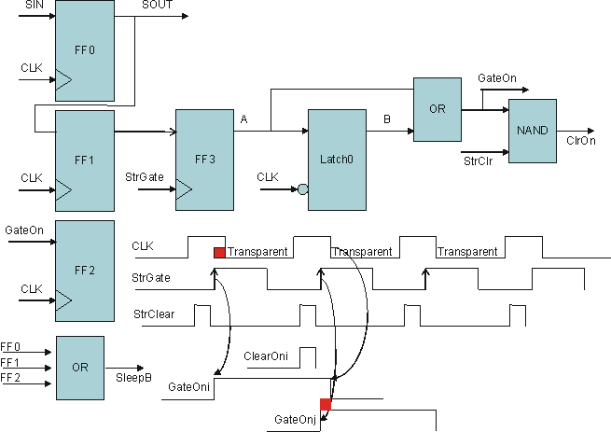
LV-control
The schematic of the digital LV-control block
StrGate signal is used to activate the channel that is currently being selected by the shift register.
If StrGate is not issued between two CLK signals, one channel will be skipped.
GateOn is activated at the leading StrGate edge and deactivated either at the next leading StrGate edge or at the falling CLK edge

Slide 23
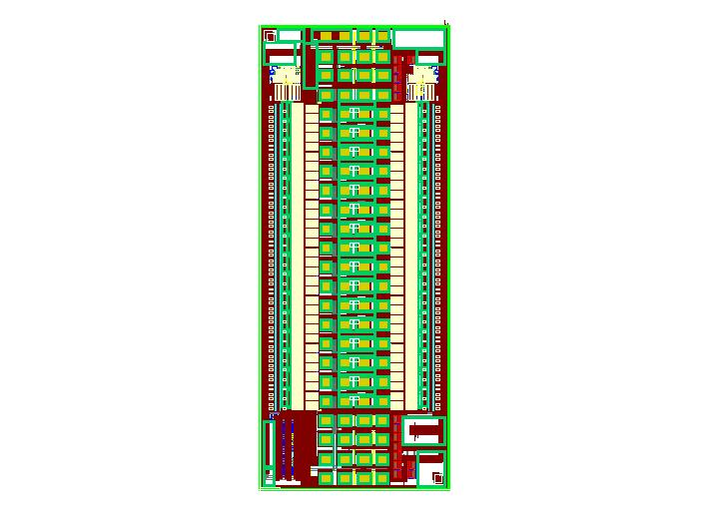
Layout of the chip
…
Volt. Regulator
LV ctrl.
Bump pads
3625μm
HV channel
LVDS receivers
JTAG
Prot. Diodes
1470μm

Slide 24
Regulator
hi
1.8
hi0
Power T
ref
lo0
Power T
1.8
sub
1.8
lo

Slide 25
Gated Mode

Slide 26
Gated mode
The channels are divided into 4 groups, 8 channels each.
These groups enter the blind (gated, noisy bunch) phase one after another to avoid high clear currents when clear signals are set high.
The controlling of the SWITCHER is performed using 4 signals StrClr, StrGate, CLK and Sin, as so far.
The activating of blind phase is initiated by the combination CLK or StrClr at the negative edge StrGate that in normal operation does not occur. This signal sequence can be produced without influencing of SWITCHER outputs in any moment (cycle)
The switching of segments one after another is realized with a shift register.
During the blind phase the LV control logic of the channel operates in a slightly different way than that during the normal phase – the control sequence should be slightly adjusted.
Gated-mode operation requires a slightly modified sequence - all control signals except StrClear can be derived from 50MHz clock.
There are two interesting gated readout modes.
Mode 1: Readout does not stop during blind phase.
Mode 2: Readout is stopped during blind phase.

Slide 27
LV-control
…
SIN
FF0
SOUT
LV control in channels
GateOn = B+ A & !NoisyEnableAll
ClearOnB = NoisyEnable#i ? !A : ClrOnNormal
CLK
GateOnNormal
OR
AND
FF1
FF
A
Latch
B
Clk
ClrOnNormal
StrClr
CLK
StrGate
CLK
Blind mode control
GateOn
FF2
NoisyEnableAll = NoisyEnable#1 + NoisyEnable#2
NoisyEn#1
NoisyEn#2
Clk Or SrtClr
FFN1
FFN2
CLK
FF0
OR
StrGB
StrgGB
FF1
FF2

Slide 28
Readout does not stop during blind phase
Noisy Seqence
Noisy Enable#1
Noisy Enable#2
StrClr
CLK
off
off
gate
gate
gate
gate
StrGate
on
on
clr
clr
Clr1
Blind mode
GateOn1
S
True reset
Clr2
Blind mode
GateOn2
S
Clr3
Bl. mode
GateOn3
S
True reset
Clr4
GateOn4
S
True reset
Clr5
Blind mode
GateOn5
S
Clr6
Blind mode
GateOn6
S
Noisy Bunches

Slide 29
Readout does stops during blind phase
Noisy Seqence
---
Noisy Enable#1
Noisy Enable#2
StrClr
CLK
off
off
StrGate
on
on
Clr1
Blind mode
GateOn1
S
True reset
Clr2
Blind mode
GateOn2
S
X
E
True reset
Clr3
A
B
C
D
GateOn3
S
S
True reset
S
S
Clr4
GateOn4
Clr5
GateOn5
Clr6
GateOn6
Noisy Bunches

Slide 30
High current protection
Despite of segmenting, switching of many clears simultaneously can lead to high instantaneous currents (>1A) that could damage metal lines and bumps.
The following circuit reduces the slope of rising and falling clear edges when many channels are simultaneously turned on/off, while the slope remains unaffected when only one channel is active.
1.5 Ohms in last metal layer
1.5 Ohms in last metal layer

Slide 31
Normal sequence

Slide 32
Normal operation of the SWITCHER
Normal mode operation
The following inputs are used:
StrGate
StrClear
CLK
Sin
The rising edge of StrGate (ON) and the falling CLK edge (OFF) control the gate signal overlap
StrClr
CLK
off
off
off
StrGate
on
on
on
Clr1
S
GateOn1
Clr2
GateOn2
S
S

Slide 33
Normal operation
Block schematics.
Power reg.
Channel control
G
C
G
C
G
C
Gated mode control
G
C
G
C
G
C
G
C
G
C
High bias current -> delay of one sample period
JTAG
Bias DAC

Slide 34
Normal operation
Block schematics.
Power reg.
Channel control
G
C
G
C
G
C
Gated mode control
G
C
G
C
G
C
G
C
G
C
JTAG
Bias DAC

Slide 35
Normal operation
Block schematics.
Power reg.
Channel control
G
C
G
C
G
C
Gated mode control
G
C
G
C
G
C
G
C
G
C
JTAG
Bias DAC

Slide 36
Normal operation
Block schematics.
Power reg.
Channel control
G
C
G
C
G
C
Gated mode control
G
C
G
C
G
C
G
C
G
C
JTAG
Bias DAC

Slide 37
Normal operation
Block schematics.
Power reg.
Channel control
G
C
G
C
G
C
Gated mode control
G
C
G
C
G
C
G
G
C
G
C
JTAG
Bias DAC

Slide 38
Normal operation
Block schematics.
Power reg.
Channel control
G
C
G
C
G
C
Gated mode control
G
C
G
C
G
C
G
G
C
G
C
JTAG
Bias DAC

Slide 39
Normal operation
Block schematics.
Power reg.
Channel control
G
C
G
C
G
C
Gated mode control
G
C
G
C
G
C
G
G
C
G
C
JTAG
Bias DAC

Slide 40
Gated mode sequence with RO

Slide 41
Gated mode operation with RO
The falling StrG edge at CLK=1 starts the gate mode, in reality there is a StrGate-T delay
Noisy Seqence
Noisy Enable#1
Noisy Enable#2
StrClr
CLK
off
off
gate
gate
gate
gate
StrGate
on
on
clr
clr
Clr1
Blind mode
GateOn1
S
True reset
Clr2
Blind mode
GateOn2
S
Clr3
Bl. mode
GateOn3
S
True reset
Clr4
GateOn4
S
True reset
Clr5
Blind mode
GateOn5
S
Clr6
Blind mode
GateOn6
S
Noisy Bunches

Slide 42
Gated mode operation with RO
Block schematics.
Power reg.
Channel control
G
C
C
G
C
G
C
Gated mode control
G
C
G
C
G
C
G
G
C
G
C
JTAG
Bias DAC

Slide 43
Gated mode operation with RO
Block schematics.
Power reg.
Channel control
G
C
C
G
C
G
C
Gated mode control
G
C
G
C
G
C
And the clear is done…
G
G
C
G
C
JTAG
Bias DAC

Slide 44
Gated mode operation with RO
Block schematics.
Power reg.
Channel control
G
C
C
G
C
G
C
Gated mode control
G
C
G
C
G
G
C
G
G
C
G
C
JTAG
Bias DAC

Slide 45
Gated mode operation with RO
Block schematics.
Power reg.
Channel control
G
C
C
G
C
G
C
Gated mode control
G
C
G
C
And the clear is done…
G
G
C
G
G
C
G
C
JTAG
Bias DAC

Slide 46
Gated mode operation with RO
Block schematics.
Power reg.
Channel control
G
C
C
G
C
G
C
Gated mode control
G
C
Clear is not on
G
G
C
G
C
G
G
C
G
C
JTAG
Bias DAC

Slide 47
Gated mode operation with RO
Block schematics.
Power reg.
Channel control
G
C
C
G
C
G
C
Gated mode control
G
C
Clear is on
G
G
C
G
C
G
G
C
G
C
JTAG
Bias DAC

Slide 48
Gated mode operation with RO
Block schematics.
Power reg.
Channel control
G
C
C
G
C
G
C
Gated mode control
G
G
C
G
C
G
C
G
G
C
G
C
JTAG
Bias DAC

Slide 49
Gated mode operation with RO
Block schematics.
Power reg.
Channel control
G
C
C
G
C
G
C
Gated mode control
Clear is on
G
G
C
G
C
G
C
G
G
C
G
C
JTAG
Bias DAC

Slide 50
Gated mode operation with RO
Block schematics.
Power reg.
Channel control
G
C
C
G
G
C
C
G
G
C
Gated mode control
G
C
G
C
G
C
G
G
C
G
C
JTAG
Bias DAC

Slide 51
Gated mode operation with RO
Block schematics.
Power reg.
Channel control
G
C
C
G
G
C
C
Clear is on
G
G
C
Gated mode control
G
C
G
C
G
C
G
G
C
G
C
JTAG
Bias DAC

Slide 52
Gated mode operation with RO
Block schematics.
Power reg.
Channel control
G
G
C
C
G
G
C
G
C
Gated mode control
G
C
G
C
G
C
G
G
C
G
C
JTAG
Bias DAC

Slide 53
Gated mode operation with RO
Block schematics.
Power reg.
Channel control
G
G
C
C
Clear is on
G
G
C
G
C
Gated mode control
G
C
G
C
G
C
G
G
C
G
C
JTAG
Bias DAC

Slide 54
Gated mode operation with RO
Block schematics.
Power reg.
Channel control
G
G
C
G
C
G
C
Gated mode control
G
C
G
C
G
C
G
G
C
G
C
JTAG
Bias DAC

Slide 55
Gated mode operation with RO
Block schematics.
Power reg.
Channel control
Clear is on
G
G
C
G
C
G
C
Gated mode control
G
C
G
C
G
C
G
G
C
G
C
JTAG
Bias DAC

Slide 56
Gated mode operation with RO
Block schematics.
Power reg.
Channel control
G
C
G
C
G
C
Gated mode control
G
C
G
C
G
C
G
G
C
G
C
JTAG
Bias DAC

Slide 57
Gated mode operation with RO
Block schematics.
Power reg.
Channel control
G
C
G
C
G
C
Gated mode control
G
C
G
C
G
C
G
G
C
G
C
JTAG
Bias DAC

Slide 58
Gated mode operation with RO
Block schematics.
Power reg.
Channel control
G
C
G
C
G
C
Gated mode control
G
C
G
C
G
C
G
G
C
G
C
JTAG
Bias DAC

Slide 59
Gated mode operation with RO
Block schematics.
Power reg.
Channel control
G
C
G
C
G
C
Gated mode control
G
C
G
C
G
C
G
G
C
G
C
JTAG
Bias DAC

Slide 60
Gated mode operation with RO
Block schematics.
Power reg.
Channel control
G
C
G
C
G
C
Gated mode control
G
C
G
C
G
C
G
G
C
G
C
JTAG
Bias DAC

Slide 61
Gated mode sequence without RO

Slide 62
Gated mode operation without RO
The falling StrG edge at StrClr=1 starts the gate mode, in reality there is a StrGate-T delay
Noisy Seqence
Noisy Enable#1
Noisy Enable#2
StrClr
CLK
off
off
StrGate
on
on
Clr1
Blind mode
GateOn1
S
True reset
Clr2
Blind mode
GateOn2
S
X
E
True reset
Clr3
A
B
C
D
GateOn3
S
S
True reset
S
S
Clr4
GateOn4
Clr5
GateOn5
Clr6
GateOn6
Noisy Bunches

Slide 63
Gated mode operation without RO
Block schematics.
Power reg.
Channel control
G
C
G
C
G
C
Gated mode control
G
C
G
C
G
C
G
G
C
G
C
JTAG
Bias DAC

Slide 64
Gated mode operation without RO
Block schematics.
Power reg.
Channel control
G
C
G
C
G
C
Gated mode control
G
C
G
C
G
C
Note, gated mode sequence also needs to turn on the high current biasing –> one sample period delay
G
G
C
G
C
JTAG
Bias DAC

Slide 65
Gated mode operation without RO
Block schematics.
Power reg.
Channel control
G
C
G
C
G
C
Gated mode control
G
C
G
C
G
C
G
G
C
G
C
JTAG
Bias DAC

Slide 66
Gated mode operation without RO
Block schematics.
Power reg.
Channel control
G
C
G
C
G
C
Gated mode control
G
C
G
C
G
C
G
G
C
G
C
JTAG
Bias DAC

Slide 67
Gated mode operation without RO
Block schematics.
Power reg.
Channel control
G
C
G
C
G
C
Gated mode control
G
C
G
C
G
C
G
G
C
G
C
JTAG
Bias DAC

Slide 68
Gated mode operation without RO
Block schematics.
Power reg.
Channel control
G
C
C
G
C
G
C
Gated mode control
G
C
G
C
G
C
G
G
C
G
C
JTAG
Bias DAC

Slide 69
Gated mode operation without RO
Block schematics.
Power reg.
Channel control
G
C
C
G
C
G
C
Gated mode control
G
C
G
C
G
C
G
G
C
G
C
JTAG
Bias DAC

Slide 70
Gated mode operation without RO
Block schematics.
Power reg.
Channel control
G
C
C
G
C
G
C
Gated mode control
G
C
G
C
G
C
G
G
C
G
C
JTAG
Bias DAC

Slide 71
Gated mode operation without RO
Block schematics.
Power reg.
Channel control
G
C
C
G
C
G
C
Gated mode control
G
C
G
C
G
C
G
G
C
G
C
JTAG
Bias DAC

Slide 72
Gated mode operation without RO
Block schematics.
Power reg.
Channel control
G
C
C
G
C
G
C
Gated mode control
G
C
G
C
G
C
G
G
C
G
C
JTAG
Bias DAC

Slide 73
Gated mode operation without RO
Block schematics.
Power reg.
Channel control
G
C
C
G
C
G
C
Gated mode control
G
C
G
C
G
C
G
Junk charge is cleared
G
C
G
C
JTAG
Bias DAC

Slide 74
Gated mode operation without RO
Block schematics.
Power reg.
Channel control
G
C
C
G
C
G
C
Gated mode control
G
C
G
C
G
C
G
G
C
G
C
JTAG
Bias DAC

Slide 75
SWITCHER: Measurements

Slide 76
SWITCHER: Measurements Gated Mode

Slide 77
Gated mode operation with RO
StrClr
CLK
off
off
gate
gate
gate
gate
StrGate
on
on
clr
clr
normal
Gate on
Gate on
Gate off
Inter

Slide 78
Run - Program
#3: unused, 2: clear, 1: gate, 0: clock
0,0,1,0 #activate row 0
0,0,1,0
0,0,1,0
0,0,1,0,addr35,keepGoing,00
0,0,1,0
0,0,1,0
0,0,1,0
0,0,1,0,addr36,keepGoing,00
0,0,0,0 #clock cycle for shifting to next row
0,0,0,0
0,0,0,0
0,0,0,0,addr37,keepGoing,00
0,0,0,0
0,0,0,0
0,0,0,0
0,0,0,0,addr38,keepGoing,00
0,0,0,1
0,0,0,1
0,0,0,1
0,0,0,1,addr39,keepGoing,00
0,0,0,1
0,0,0,1
0,0,0,1
0,0,0,1,addr3A,LDcnt,05
0,1,0,1
0,1,0,1
0,1,0,1
0,1,0,1,addr3B,JMPnoTRIGGER,35
0,1,0,1 #no clear row 0
0,1,0,1
0,0,0,1
0,0,0,1,addr3C,keepGoing,00
0,0,1,0 #activate row 1
Startup
Standard seq.
LdCnt 5
JMPnoTrig
Gated On Seq.
5x
DecCnt
JMPnoCnt0
Gated On
LdCnt 5
Gated Off
5x
DecCnt
JMPnoCnt0
Intermediate

Slide 79
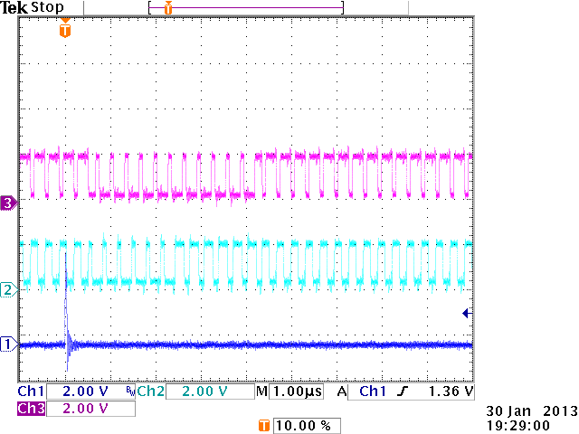
Run - Program
Startup
Standard seq.
Gated On Seq.
5x
Gated On
Gated Off
5x
Intermediate

Slide 80
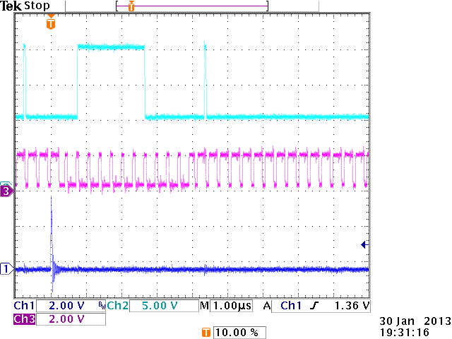
Run – Program: Clear #1
Startup
Standard seq.
Gated On Seq.
5x
Gated On
Gated Off
5x
Intermediate

Slide 81
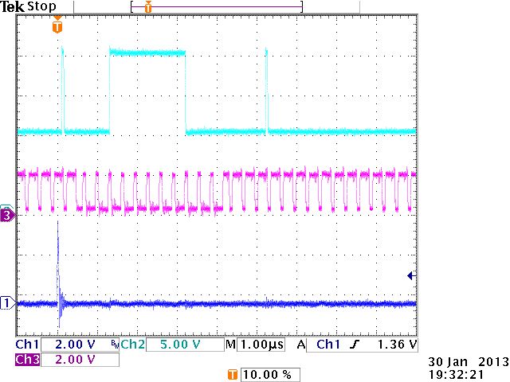
Run – Program: Clear #2
Startup
Standard seq.
Gated On Seq.
5x
Gated On
Gated Off
5x
Intermediate

Slide 82
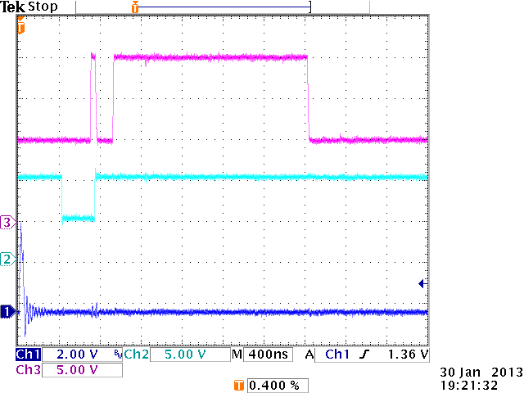
Row #1

Slide 83
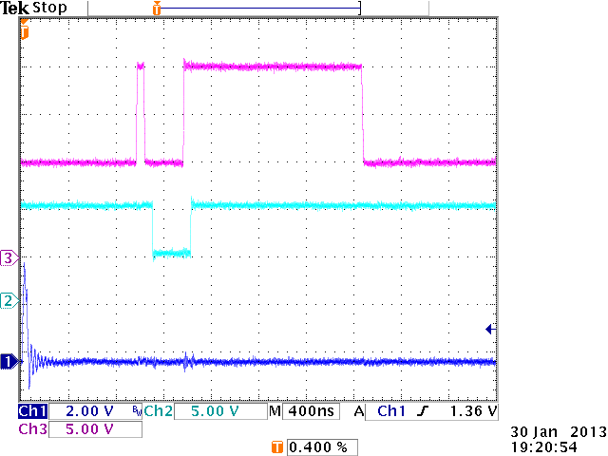
Row #2

Slide 84
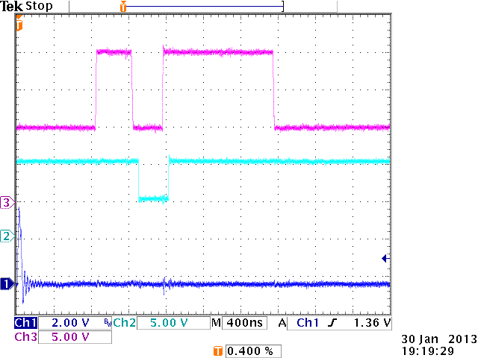
Row #3

Slide 85
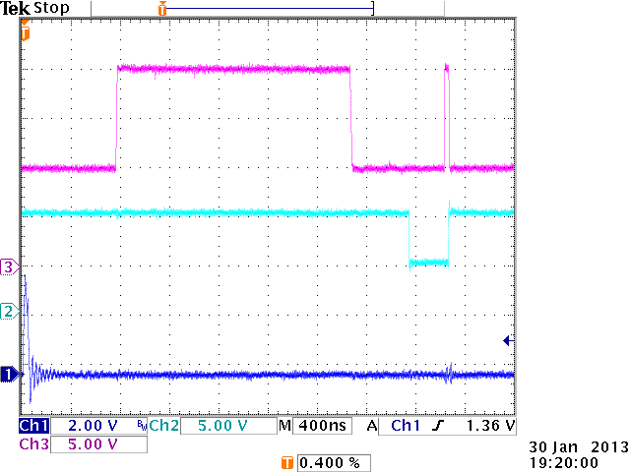
Row #4

Slide 86
SWITCHER: Measurements Rise Time

Slide 87
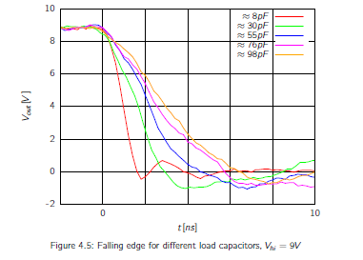
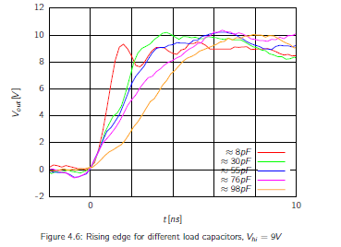
Rise Time Measurements
Rise time and fall times are ~ 6ns for 100pF load and 9V amplitude

Slide 88
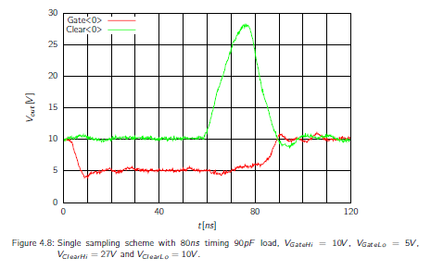
Rise Time Measurements
High voltage clear pulse is possible:
30V clear high, 10V clear low
90pF
30ns
20V

Slide 89
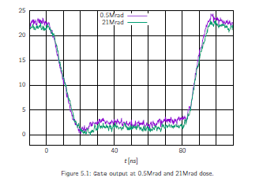
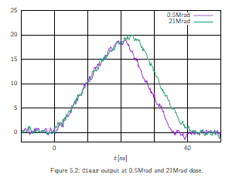
Rise Time Measurements – irradiated chip
Irradiation to 21MRad – 150pF load
We need to increase size of the power transistors
Can be done, but the chip size will increase by 100um

Slide 90
Plans
Following changes are needed
Resize the high voltage transistors to improve speed by factor of 2
Termination resistors on SIn, CK, StrobeC and StrobeG inputs should be switchable on chip level
Termination resistor on Sin should be on in the first chip
Termination resistor on CK, StrobeC and StrobeG should be on in the last chip
Bumping can be done on die level by PacTech
Ordering of wafers within MPW may be possible in 2015
In this case wafer level bumping is possible

Slide 91
Backup slides

Slide 92
Sequencer

Slide 93
Sequencer
Sequencer based on RAM.
Startup and run sequence.
The purpose of the startup sequence is to write 16 zeros in the switcher shift register. The run sequence is the normal sequence.
One RAM-line is accessed with a dedicated RAM address. It contains 4 sub-lines, each with 4 bits (Ck, StrG, StrC and NU).
Line is loaded every 10 ns to the serializer.
Serializer sends one sub-line every 2.5 ns to the switcher inputs.
CkB
SIn
Cnt
Ck, StrG, StrC
Startup
Sequence
Sub-Line
Address Cnt
Run
Sequence
Line

Slide 94
Address Flow
Upon the reset of the FPGA, the RAM-address is zero.
The address counter performs the startup sequence (0 -> start address-1).
The “start address” is the address of the first line of the run sequence.
The “stop address” marks the end of the run sequence.
These address-values are calculated in software from the sequence lengths, and stored in two FPGA registers.
When the system is started (RUN high), the addresses loop from the start to the stop address.
When the system is stopped, the address counter continues increasing to the stop address, jumps to zero and performs the startup sequence.
Important: Sin signal is not generated by the track RAM. This signal is generated automatically before every 16-th Ck-signal edge. The clock counter is incremented by CkB.
Startup Sequence
Run Sequence
0
Start
Stop

Slide 95
New Sequencer
Added “program-RAM”, two-bytes wide, clocked with the same read clock and addressed with the same address as the track-RAM.
Program-data-byte and the program-ID-byte.
The program-lines influences the address counter.
The address counter behaves as the old one if the so called “keep going” command is stored in the current line.
If one of the jump commands is stored, the value from the program-data-byte is written into the address counter. This causes a jump to a certain program line.
ID
Data
Address Cnt
Loop Counter
Track RAM
Program RAM

Slide 96
New Sequencer – Compatibility
When RUN is off, the commands do not influence the address flow.
Old Jochen’s startup sequence (without commands) can be still used.
One command-line is assigned to each RAM-line or to every fourth sub-line. We cannot jump in between the sub-lines.
The program jumps from the stop address to the start address when RUN is high, and from the stop address to zero and then continuously to start-1 when RUN=0.
ID
Data
Address Cnt
Loop Counter
Track RAM
Program RAM

Slide 97
New Sequencer – Commands
“keepGoing”,”data” – does nothing.
“JMPnoTRIGGER”,”data” – if no trigger-signal arrived, the address counter is written with “data”.
“JMPcntNoZERO”,”data” – if the “loop-counter” is not zero, the address counter is written with “data”.
“LDcnt”, ”data” - the loop-counter is loaded with the value ”data”.
“DECcnt”, ”data” - the loop-counter is decremented.
“JMP”,”data” – unconditional jump to address “data”.
ID
Data
Address Cnt
Loop Counter
Trigger Flag
Trg
Track RAM
Program RAM

Slide 98
New Sequencer – Commands (2)
The command JMPnoTRIGGER is used to make the “endless” loop that is performed during the normal operation (non-gated phase), before the trigger signal arrives.
The trigger is the OR between the TLU-/Software- and Autotrigger.
In future we will have a separated trigger for gated mode.
The trigger is stored as a trigger flag until the next JMPnoTRIGGER command is performed. The trigger flag is then deleted.
The commands JMPcntNoZERO, LDcnt and DECcnt are used to allow n-times looping through a certain program block. Can be used to make a gated mode sequence.
Unconditional jump JMP is used to return to the main program. Not necessary.
ID
Data
Address Cnt
Loop Counter
Trigger Flag
Trg
Track RAM
Program RAM

Slide 99
Run-Sequence File
Format of a line:
B,B,B,B,addrXX,[keepGoing or JMPnoTRIGGER or JMPcntNoZERO or LDcnt or DECcnt or JMP] YY
XX are two hexadecimal numbers denoting the line-address as in the RAM
YY are two hexadecimal numbers that are program-data.
Important:
All JMP commands affect the address counter with one clock delay.
If we want to jump from the address n to the address m, we must write the JMP command in the RAM-line with the address n-1.
FPGA’s RAM generates the addressed line one clock later.

