Slide 1
DHPT
Architecture & Implementation
Tomasz Hemperek

Slide 2
Outline
Overview of DHP chip iterations
DHP overview
DHPT Overview
SEU tests
Slow control/synchronization/reset
Data processing
Sequencer
Offset correction
RTL & verification
Implementation

Slide 3
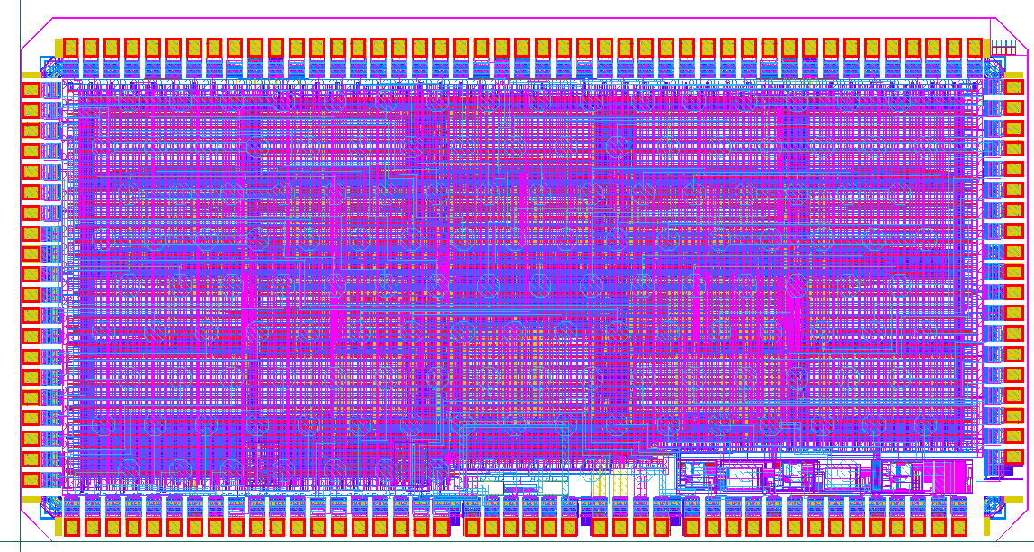
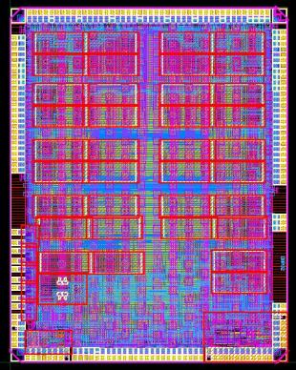
Data Handling Processor – Design History
Started with IBM 90nm technology in 2010
DHP 0.1
  Half size prototype, 2 x 4 mm², C4 bumps
  Basic digital data processing
  PLL (1.6 GHz) + High speed serial link
  ➔ Successful verification
DHP 0.2 (sub. mid of 2011)
  Full size chip, 3.2 x 4.3 mm²
  Full data processing, added switcher sequencer and bias generators
  Improvements in link performance (pre-emphasis), buffer size, and data format
  Successful tests & system operation (some issues with max. speed of CMOS clock output)

Slide 4
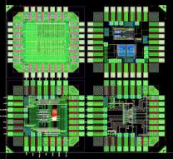
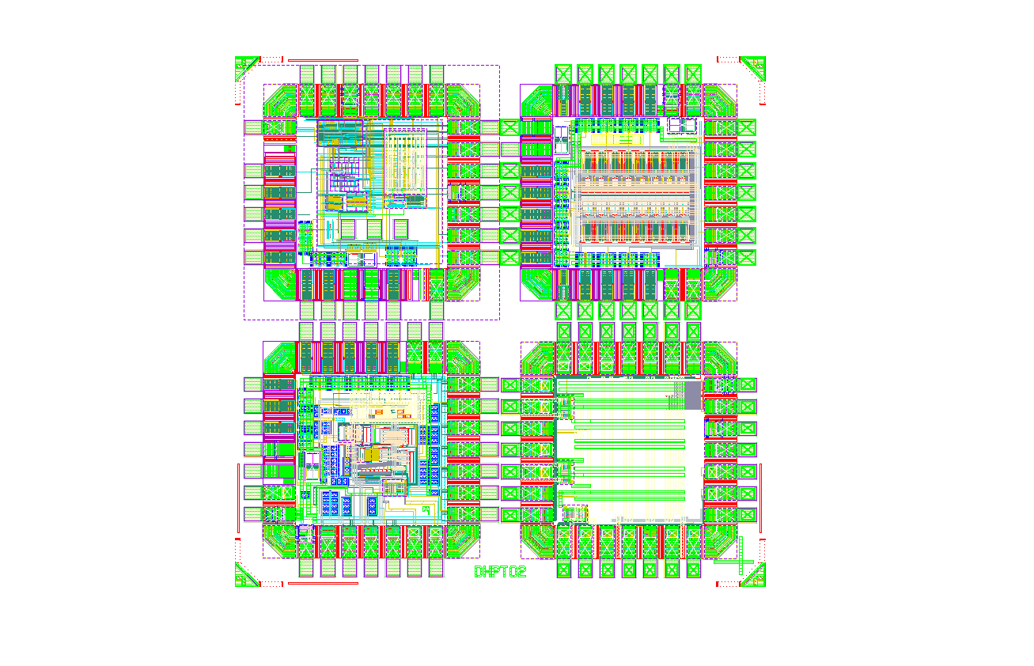
Data Handling Processor – Design History
Forced to abandon 90nm IBM process ➔ chosen 65nm TSMC, started with small prototype chips to verify full custom blocks and rad. hardness performance
DHPT 0.1 (Oct. 2011)
  PLL (1.6 GHz)
  High speed TX (CML driver)
  Bias generators (U Barcelona)
  Memory SEU test structures
DHPT 0.2 (June 2012)
  LVDS RX & TX
  Temperature sensor (U Barcelona)

Slide 5

DHPT 0.1 - SEU Test
Memory blocks
  compiled TS1N65 low power, 1024x72bits
  compiled TS1N65 low power, low leakage, 1072x72bits
  full custom register file, 64x72bits
JTAG interface
TCK
TMC
TRST
TDI
TDO
JTAG tap
M. Lemarenko, T. Hemperek
Add enable
Data enable
Data out
Data in
JTAG memory configure
Add [11:0]
Data [71:0]
Add [11:10]
Add [9:0]
A
D
Mem1
En
D
A
Mem2
Select
En
A
D
Mem3
En

Slide 6
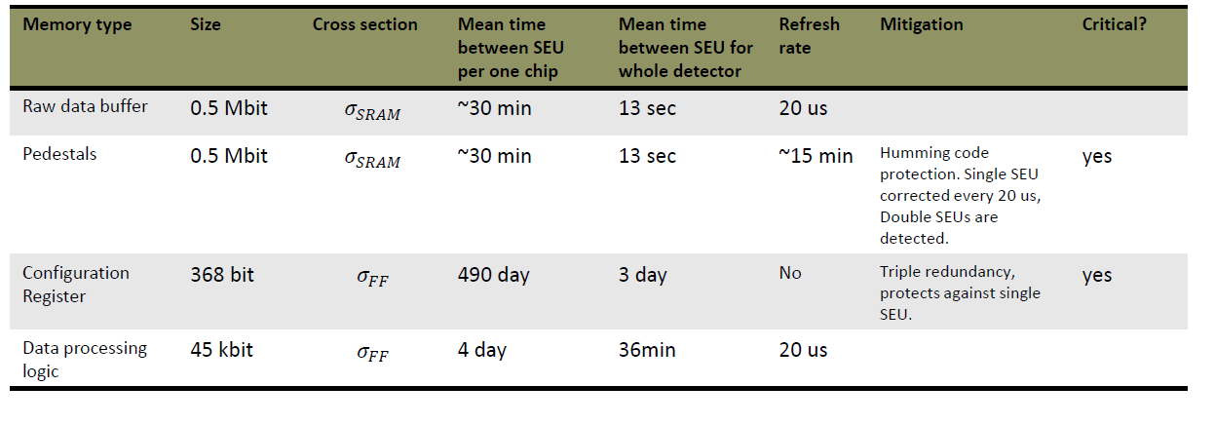
SEU Tolerance
Cross section measured at 24 GeV pion beam line
Results agrees with other data published for 65nm memory cells
SUE rate extrapolated by assuming 10⁴ neutrons s⁻¹ cm⁻²

Slide 7
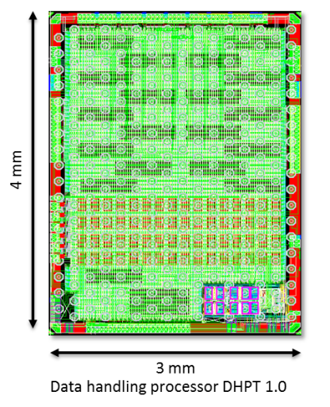
Data Handling Processor – Design History
First full size 65nm chip submission (DHPT 1.0) after internal design review
DHPT 1.0 (Aug. 2013)
  Full size chip
  Includes all pre-verified full custom blocks
  Footprint & electrical compatible to DHP 0.2
  Improved memory & processing resources
  wrt. DHP 0.2
  12 mm² area, C4 bumps, 200µm pitch
  >300k Gates, >3MB SRAM
  PLL, 1.6Gb/s serial link, CML preamhasis
  >100 LVDS and HSTL IO
  DACs, ADC
  core voltage 1.2, i/o voltage 1.8

Slide 8
DHP
To SWITCHERS
10MHz read-out frequency
81.29Gbps
(320Mbps output data x 256 lines)
Per DHP chip:
8x8 bit wide data inputs
8x2 bit wide offset correction outputs
One 1.6GB output link per chip

Slide 9
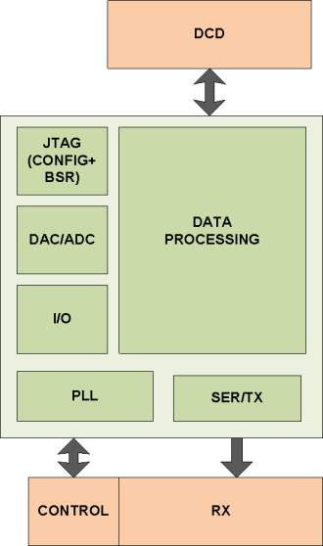
General Overview

Slide 10
Hard Macros
PLL/SER/CML Driver
LVDS RX
LVDS TX
HSTL RX
SRAM MEMORY (3 types)
IREF
DACS
ADC
PROGRAMABLE DELAY (on all inputs/outputs to and from DCD and switcher)
Will be covered in next talks

Slide 11
Block Diagram
LVDS I/O
HSTL I/O
CMOS I/O
CMD DECODER
SYNC
OFFSET CORRECTION
CORE
DATA BUFFERING
SEQUENCER
ZERO SUPPRESION
COMMON MODE CORRECTION
JTAG
SORTING
FRAMING
PLL/SER/CML
AURORA FRAMER
IREF/DACs/ADC

Slide 12
Clocking
320M
DESERIALIZERS
DIGITAL CORE
:4
32bit frame based interface (clock-domain-crossing)
80M
AURORA FRAMER
20bit@80M
80M
PLL
1.6G
SRIALIZER
20 to 1
CML
DRIVER
1.6Gbit/s
DIGITAL CORE runs mostly on 80MHz
One full DEPFET row takes 10MHz (8 clock cycles)

Slide 13
Command decoder
One control word per row period is send synchronized to the DHP clock GCK (76.35 MHz)
The control word (8 bits) transmits four independent commands: <RST|VTO|TRG|FSYNC>
  RST: Reset, level sensitive, pulse width selects different reset modes
  TRG: Physics trigger, level sensitive, pulse width selects raw data frame size
  VTO: Veto (gated mode), level sensitive, selects veto sequence while on
  FSYNC: Frame sync, edge sensitive
The state of every command is encoded in two bits (Manchester code)
  <10> = on
  <01> = off
Two additional control words are accepted (broken Manchester code)
  <00 01 11 01> synchronization sequence, should be used as IDLE
  <11 10 00 FSYNC> CALTRG (mem_dump): calibration data trigger, edge sensitive, allows simultaneous FSYNC command transmission
The command latency in the DHP core is in the order of a few GCK cycles

Slide 14
Reset
Power on Reset (CRESET)
  Reset configuration ONLY (JTAG REGISTERS)
    mainly used to set default values for DACs to bias LVDS RX
    asynchronous
Reset command/signal is level sensitive
  Short reset -> resynchronize output link
  Long reset -> reset all state machines
  Synchronous
  Recommended reset when possible
FRAME SYNC (FS)
  Every 20us resets almost all state machines and pointers

Slide 15
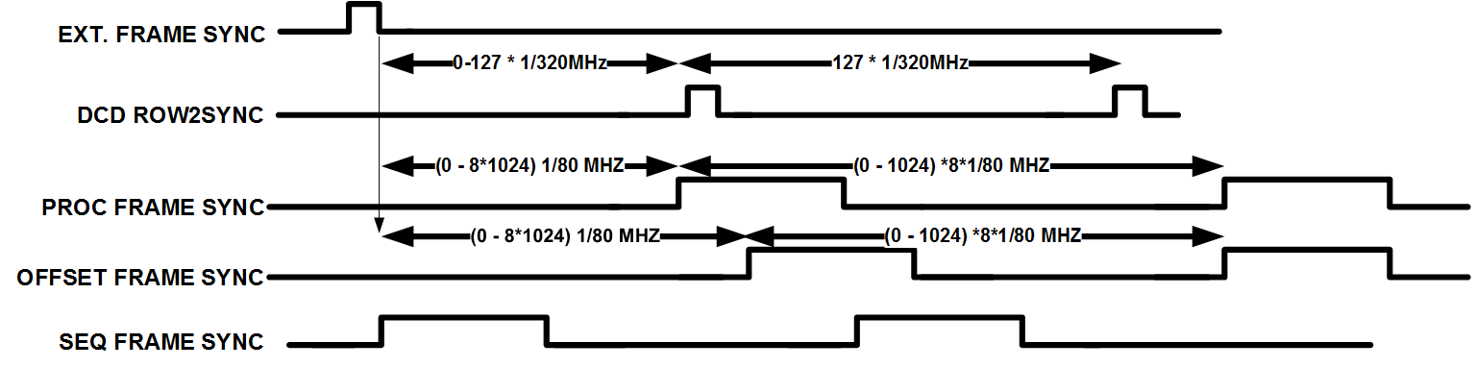
Synchronization
All signal synchronized to external frame sync
Send on trigger line

Slide 16
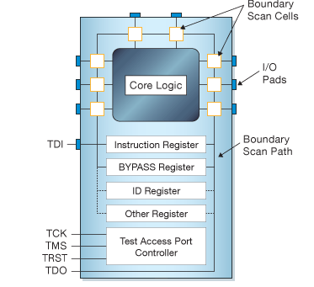
Slow Control / Configuration
TAP Controller:
Synopsys BSD Compiler
User Registers:
[SIZE-1:0] in
reset_n, clk_conf, enable,
capture, shift, update, si
jtag_conf_reg
so
[SIZE-1:0] out
read, write
Memory access (self incrementing address pointer):
en_addr
addr_reg
[15:0] addr
write_addr
reset_n, clk_conf,
capture, shift, update, si
so
[SIZE-1:0] data_in
data_reg
en_data
[SIZE-1:0] data_out
write_data

Slide 17
Data taking
Data taking with zero suppression
  Data are buffered (programmable size of matrix)
  Triggering after latency (programmable)
  Pedestal subtraction on/off (+ offset)
  Common mode correction on/off
  Hits recognition
  Formatting
  Sending out
Memory dump
  Activate by fast command
  Dump raw data from beginning of memory (programmable amount)
  Trigger need to be disabled before

Slide 18
Data Buffering
DCD data 8x8bit
memory physical organization
1024x128+parity
desterilizing and sorting (x32@320MHz)
0-255: (data)
256x8bit
256-511: (data*)
16x128bit
1024 rows
memory
1024x(128+16 parity)
X16
512-767: pedestal A
256x8bit data
256x8bit pedestal
768-1023: pedestal B
pedestal correction
pixel masking when pedestal = 255
8 clock cycles for 1 row processing (256x8 bit)
  MEM_CONF_RD
  MEM_CONF_WR
  MEM_DATA_WR
  MEM_DATA_RD
  MEM_PED_ACTIVE_RD
  MEM_PED_ACTIVE_WR
  MEM_PED_NACTIVE_RD
  MEM_PED_NACTIVE_WR
256x8bit data
Overall memory size: 4 full (1024 rows) frames (1x data + 2x pedestal)
Double buffer for pedestals:
Memory protected by Hamming code
Can be entirely used for raw data taking
concurrent JTAG access

Slide 19
Common mode correction
256x8bit data
256bit mask
average
apply threshold
input – average > threshold ? input : common mode
average
apply threshold
input – average > threshold ? input : 0
256x8bit data
There is probably something wrong with masking!

Slide 20
Hit finder
256x8bit data
64x8bit data (x4 in time)
6bit common mode
memory 256x20
frame_id[2],row_id[10],data_in[8]
X64
memory 512x16
cm, frame_id[2], row_id[8]
8x8x20bit
sort fifo
X8
8x(20+3 column) bit
sort fifo
(20+6 column) bit
sort/hit find
hit data

Slide 21
Output data buffering
hit data
memory 4096x(32+2)+ parity
data[32], sof, eof, 2/4byte
raw data
active memory dump
/ calibration data
mux
cdc_fifo
aurora framing
20bit
to serializer

Slide 22
FRAME HEADER
TYPE (3)
FLAGS (13)
FFRAMEID (16)
ZERO SUPPRESED DATA
RAW DATA
ROW (9)
CM(6)
VALUE(8)
VALUE(8)
TYPE (1)
COLUMN (7)
VALUE(8)
If CM = 63 – there was some loss in this row
CM = 62 – common mode overflow
flags: overflow ,offset_mem_active, active_ped_mem

Slide 23
Expected DHPT 1.0 Data Losses
FIFO 1: 64 FIFOs in front of the hit finder ➔ 256 words deep (DHP 0.2 → 16)
FIFO 2: between hit finder and serializer ➔ 4096 word deep (DHP 0.2 → 512)
Data loss [%]
Occupancy [%]

Slide 24
Sequencer
read sequence memory
gated mode sequence memory
veto
memory physical organization
1024x128+parity
0-255: switcher seq.
256 rows
clock
clear
gate
run
gate
data/new frame
clock
clear
256-511: unused
512-767: gated mod seq.
768-1023: unused
32 bit
3x32 bit
3x32 bit
mux
8 clock cycles for 1 row processing
SW_MEM_RD
SW_MEM_WR
SW_MEM_GATE_UP_RD
SW_MEM_GATE_UP_WR
SW_MEM_GATE_RD
SW_MEM_GATE_WR
SW_MEM_CONF_RD
SW_MEM_CONF_WR
serializer
(x32@320MHz)
Fully programmable sequencer (length and bits)
Gated mode started by veto command (at given row) stopped after programmable time
concurrent JTAG access

Slide 25
Offset correction
2 bits per pixel
memory physical organization
1024x128+parity
0-511: offset A
memory
1024x(128+16 parity)
memory
1024x(128+16 parity)
1024 word/2x256 rows
512-1023: offset B
2x128 bit
serialization (x16@320MHz)
8x2bit DCD offset data
4 clock cycles -> 4 states
  OFFSET_MEM_CONF_RD
  OFFSET_MEM_CONF_WR
  OFFSET_MEM_DATA_WR
  OFFSET_MEM_DATA_RD
concurrent JTAG access
concurrent JTAG access

Slide 26
Explanation of the Timing Diagrams
External Events
Physics event
Injection
DHP Internal Data Processing
Raw data frame
Raw data frame
Rolling shutter cycle
Data buffer write inhibit
DHP Data Transmission
Event data frame
Calibration data frame
latency
20µs
20µs – latency
~400µs
DHH➔DHP Commands
40µs - latency
Inhibit physics trigger
Physics trigger on
Physics trigger off
Calibration trigger

Slide 27
DHP timing for triggered data taking
Physics event
Raw data frame (n)
Raw data frame (n+1)
Raw data frame (n+2)
20µs
Event data frame
Latency
20µs
Depending on FIFO fill level data transmission can extend the trigger width
Frame
sync
Physics trigger on
Frame
sync
Physics trigger off
Frame
sync
Frame
sync
The transmitted Event data frame starts with hits from [row_{m}, raw data frame_{n}] and ends with [row_{m-1}, raw data frame_{n+1}]
The row index m is a function of the phase between trigger and frame sync
The trigger command is level sensitive and its width selects the size of the raw data frame to be processed
The default width is 1536 GCK cycles (8 GCK cycles/row · 192 rows/frame)

Slide 28
DHP timing for calibration data taking
Calibration data and event data frames may overlap
Raw data frame (n)
Raw data frame (n+1)
Raw data frame (n+2)
Data buffer write inhibit
Event data frame
A) Transfer finishes before cal. trigger
Calibration data frame
~400µs
Event data frame
B) Transfer overlaps
cal. trigger
Calibration data frame
Physics trigger off
Calibration trigger
The calibration trigger can be send any time within a frame period
If the previous event data transmission is not yet finished (case B), the calibration data transmission will be put on hold until the FIFOs are flushed. In some cases remaining event data still might be send after the calibration data frame (not recommended).
The transmitted Calibration Data Frame is re-sorted and always starts with
[row₀, raw data frame_{n+1}] and ends with [row_{max}, raw data frame_{n}]
Programmable row_{max} and defines the raw data buffer size to transmit (default m=255)
For better readability periodic frame sync commands are omitted in this and the following drawing s

Slide 29
DHP timing for injection sequence w/o calibration data taking
Physics event
Injection
Raw data frame (n)
Raw data frame (n+1)
Raw data frame (n+2)
Event data frame
Latency
20µs – latency
Inhibit physics trigger
Physics trigger on
Physics trigger off
The suppression of physics triggers should start 20µs – latency before the injection starts.

Slide 30
DHP timing for injection sequence with calibration data taking
Physics event
Allow a few row clock periods (~0.5µs) delay between calibration trigger and injection to allow for command processing latency compensation
Injection
Raw data frame (n)
Raw data frame (n+1)
Rolling shutter cycle (n+2)
Data buffer write inhibit
Event data frame
Calibration data frame
latency
20µs
20µs – latency
~400µs
Inhibit physics trigger
40µs - latency
Physics trigger on
Physics trigger off
Calibration trigger
The suppression of physics triggers should start 40µs – latency before the injection starts.
Calibration trigger should only be send if the previous event data transmission has finished

Slide 31
DHP timing for injection sequence with calibration data taking
Minimum timing requirements for sequence of
Physics trigger – Calibration trigger – Injection
Physics event
Allow a few row clock periods (~0.5µs) delay between calibration trigger and injection to allow for command processing latency compensation
Injection
Calibration data and event data frames overlap
Raw data frame (n)
Raw data frame (n+1)
Rolling shutter cycle (n+2)
Data buffer write inhibit
Event data frame
Calibration data frame
latency
20µs
~400µs
Inhibit physics trigger
Physics trigger on
Physics
trigger off
Calibration trigger
&
The suppression of physics triggers should start 20µs before the injection starts.

Slide 32
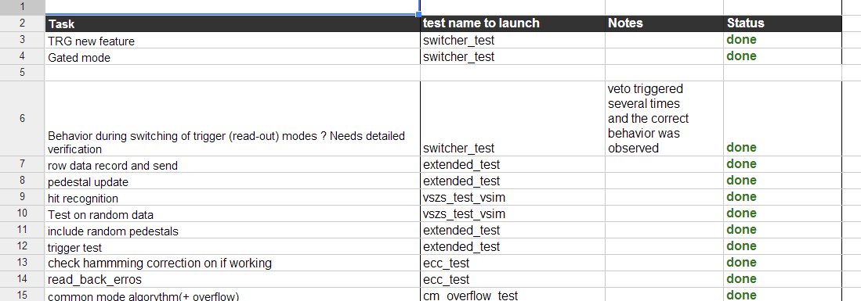
Verification Plan
You should be able to use this for chip testing too

Slide 33
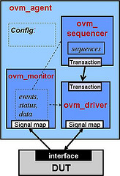
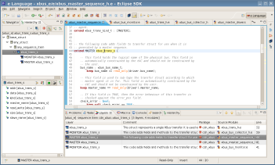
RTL & Verification
RTL and verification based on SystemVerilog (DVT & Eclipse)
UVM for verification
Use linting and simulation (Questa)
Clock Domain Crossing formal analysis (Questa)
RTL code statistics:
  Chip code lines : ~6000
  UVM code lines: ~7000

Slide 34
Testbech organization
Original DCD HDL code is used for DCD
Original Xilinx Aurora core receiver used for receiver
OVC Components:
  Command/Sync
  JTAG
  DCD/Switcher
  Aurora RX
DHP
DCD
Aurora RX
JTAG
CMD

Slide 35
PDK Preparation
Based on default 65nm OA version
Marge technology files (LEF and tf) to achieve full integration on between tools on single oa database
Standard ARM cells/io/memory
Migrate all libraries to OA to be able to automate from virtuoso and encounter same time
  Layout (from gds)
  Abstract (from lef)
  Schematics (form netlist)
Netlist for LVS is generated from Verilog netlist (need lot of magic here so that this work)

Slide 36
IP Design and Modeling
For all custom IP needed to generate
  Abstract
  Verilog model
  Liberty file
  Proper netlist for LVS

Slide 37
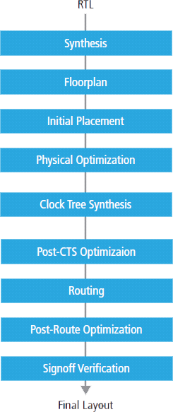
Flow (Digital on Top)
One full cycle ~20h

Slide 38
Timing Corners
 | ff | ss | tt | ff_max | ss_min
corner | ff | ss | tt | ff | ss
Voltage [V] | 1.32 | 1.08 | 1.2 | 1.32 | 1.08
Temperature [C] | -40 | 125 | 25 | -40 | 125
rc | best | worst | typical | worst | best
derate early | 1.0 | 0.9 | 0.9 | 1.0 | 0.9
derate late | 1.15 | 1.0 | 1.1 | 1.15 | 1
clock uncertainty: 0.1ns
this is quite pessimistic -> radiation

Slide 39
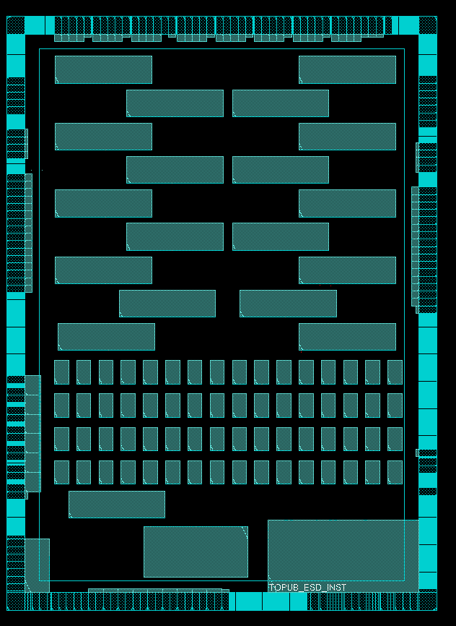
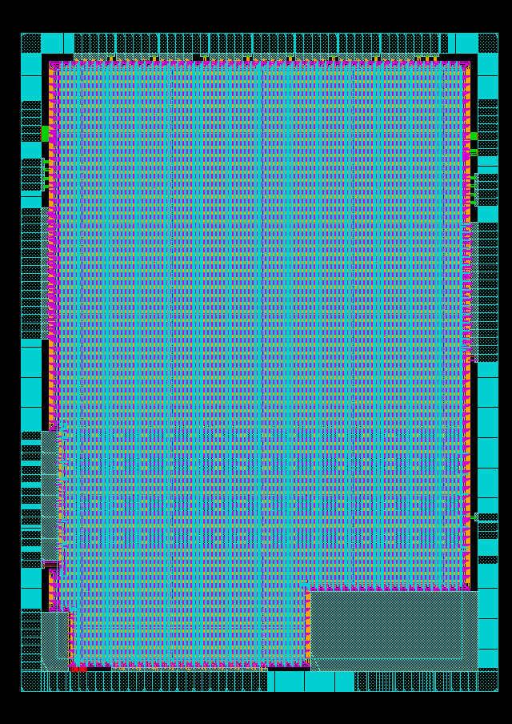
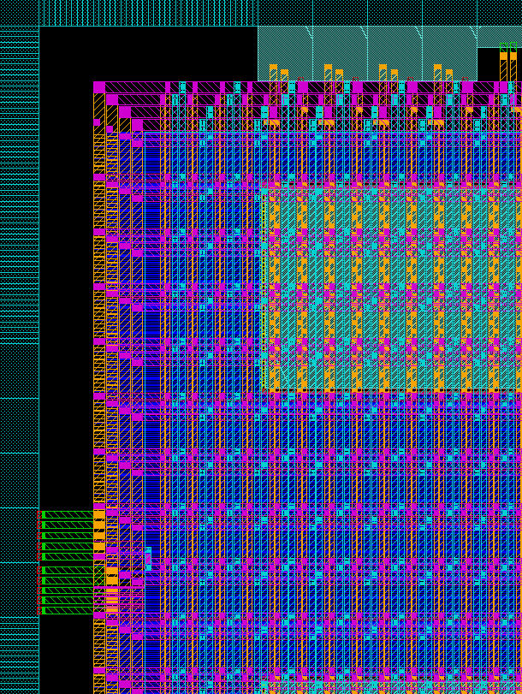
Florplan
vertical M6 and M8
horizontal M7 (and M1)

Slide 40
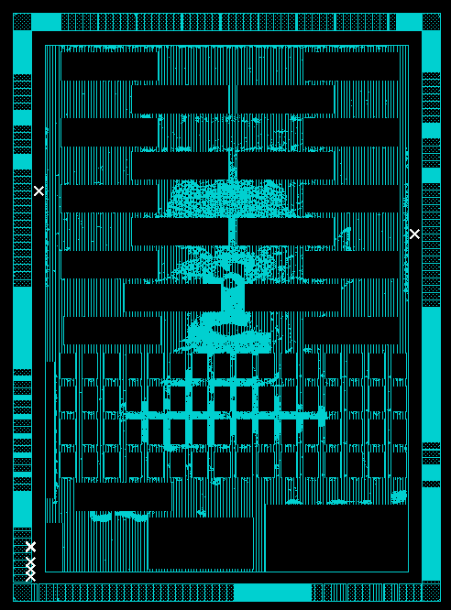
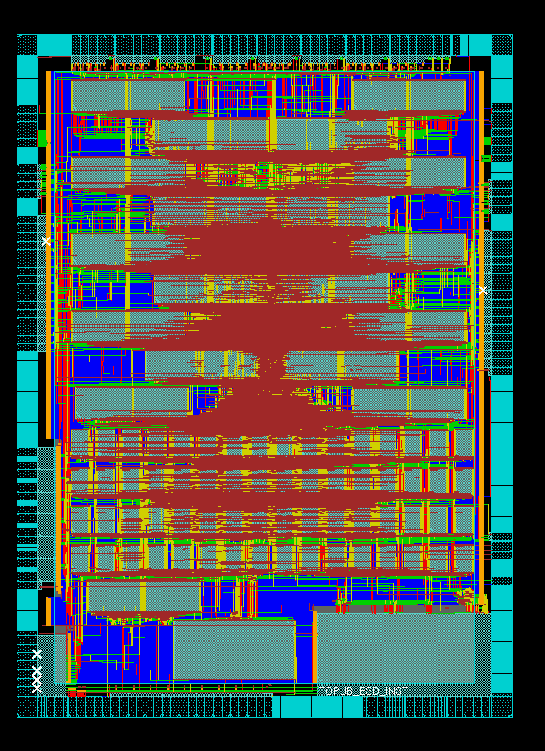
Place & Route

Slide 41
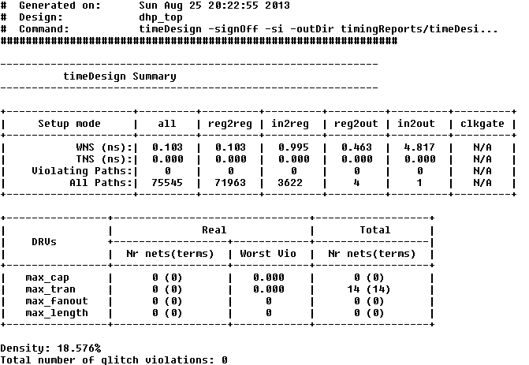
Timing Report
also with PrimeTimeSI

Slide 42
Mixed signal verification
Simulation on spice level critical blocs together with digital
Gate level
Digital (verilog)
PLL/SER
(spice)

Slide 43
LVS & DRC
Bumps and RDL added on top
Deep n-well added
No Layout view for all SRAMs
Manage to get Assura DRC “clean”
Small metal fixes

Slide 44



Thank you

