Slide 1
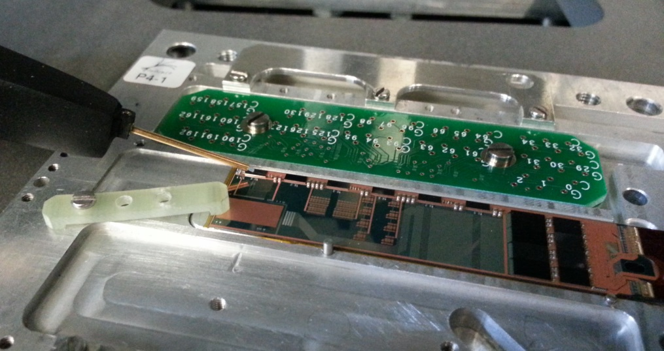
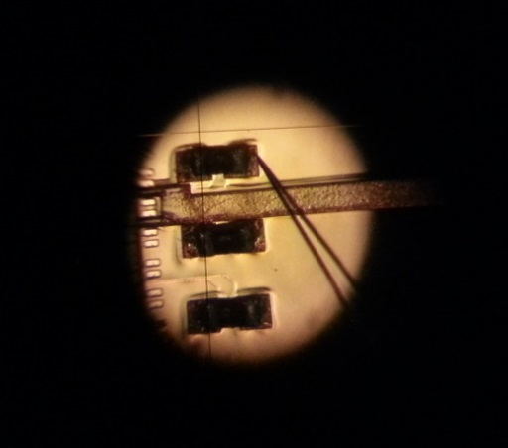
Tests of EMCM
Belle II PXD – ASIC Review
October 26 - 27, 2014
Munich
MPP, Germany
Felix Müller on behalf of the MPP / HLL TestCrew
(H.-G. Moser, C. Koffmane, M. Valentan)

Slide 2
Electrical Multi-Chip Module (EMCM)
Goal
Design and build a fully functional Belle II half-ladder (module) without DEPFET
Reasons
Technological feasibility of the 3-metal (Al1, Al2, Cu) system
Practice flip-chipping (soldering ASICs on pads) and off-module interconnection (Kapton flex cable)
Layout - check if there is enough space for full circuit design, including passive components (decoupling capacitors & termination resistors for LVDS signals)
Power Distribution & Cross-Talk - Testpads to probe the signals and voltages of the ASICs directly
(voltage drops, parasitic capacitances, resistances, check of signal integrity)
Low Noise of all 1000/1024 DCD channels at 320MHz
JTAG programming of all ASICs (including Boundary Scan of all the digital IOs)
Timing and Synchronization (Switcher sequence, DCD data transfer)
Stable operation of all 4 high speed links from DHPT to DHH
Stable Switcher outputs on fully assembled EMCM
PXD6 operation assembled on EMCM
Features
Similar metal system (3 layers) as final modules
Circuitry at periphery (end-of-stave) 4DHPs, 4DCDs, 6 Switchers (additionally 1 DEPFET matrix)
Power Supply, Slow control (JTAG) and High Speed Signals via Kapton flex cable
Sensitive region for test structures (small DEPFET matrix; 32x64 pixels)

Slide 3
EMCM – Geometrical Overview
3 metal layers on periphery
4 layer kapton cable attached
and wire bonded to Si-Module
for I/O and power
Bump bonded steering and r/o ASICs
Screw through Si
mounting to cooling structure
Space for PXD6
DEPFET Matrix
Load capacitor bank
for switcher test
Long “drain” lines connected to DCD input,
More passives to emulate load of DEPFET cell
Wire bond connections to small matrix
bias connections of matrix via Kapton
Basically it is an electrically active prototype of a half-ladder
Even beam tests are possible with small piggy-back matrix
Test vehicle for metal system and electrical performance of periphery

Slide 4
EMCM – Electrical Overview
3 metal layers on silicon substrate
2149 different electrical nets
4055 test pads (size down to 70μm x 70μm and 50μm x 100μm)
~15k vias connecting the metal system in 3D (10k aul1 to Al2, 5k Al2 to Cu)
Open and short test necessary before assembly of the ASICs
Short test contains ~110k measurements per EMCM
Kapton
Flex
DCD
DHP
Switcher

Slide 5
Matrix assembly
latest generation of ASICs:
- SwitcherB18v2.0
- DCDpp
- DHPT1.0
Optionally, a matrix can be glued on the EMCM
The DEPFET matrix is electrically connected via wire-bonds
Operate device and compare measurements to PCB-assembled test setups
(performance, noise, Signal-to-noise, stability …)
Drain lines are comparable with final modules ~45mm
Switcher
DEPFET
Passives (R,C)
DCD
DHP
Kapton
PCB

Slide 6
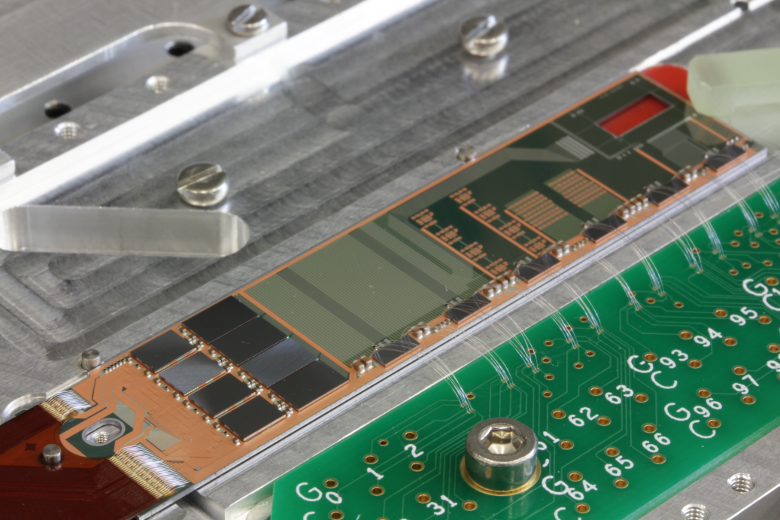
Tests – Switcher @ W17-3, 305MHz
Switcher
Switcher
Switcher
DCD
Clear and Gate
DHP
Kapton

Slide 7
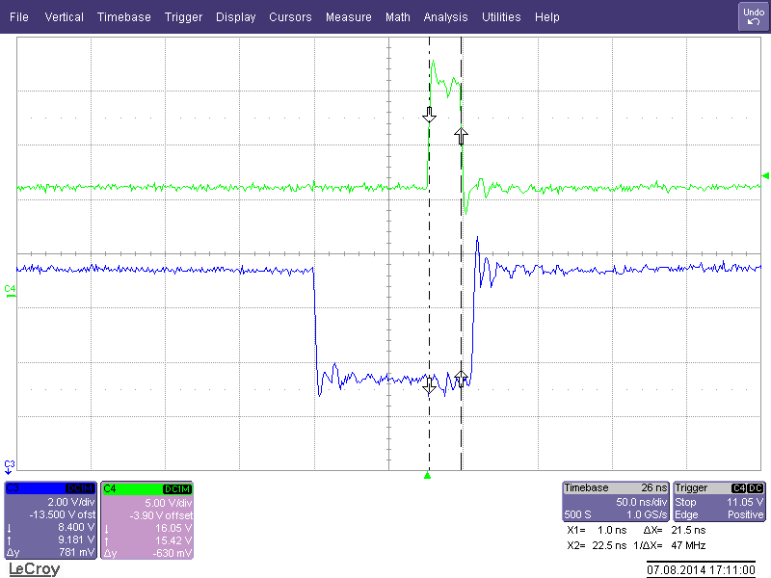
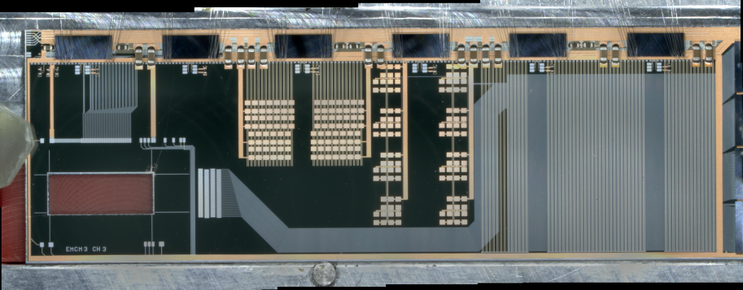
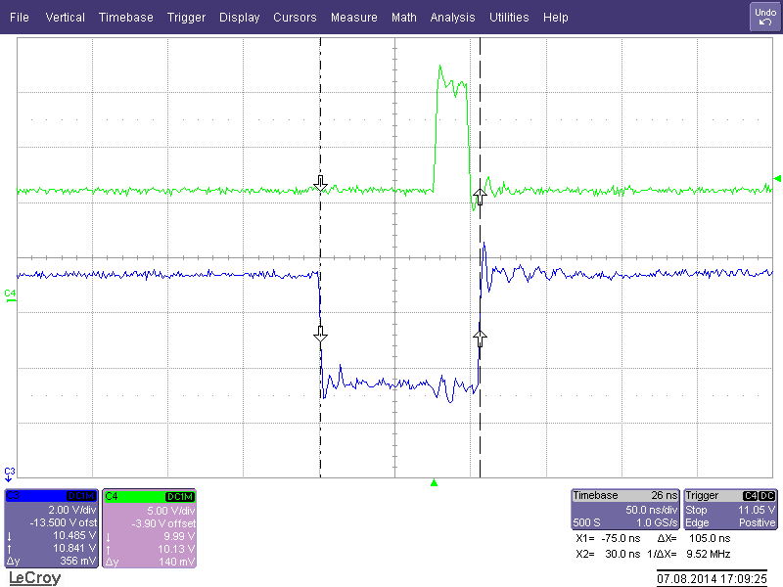
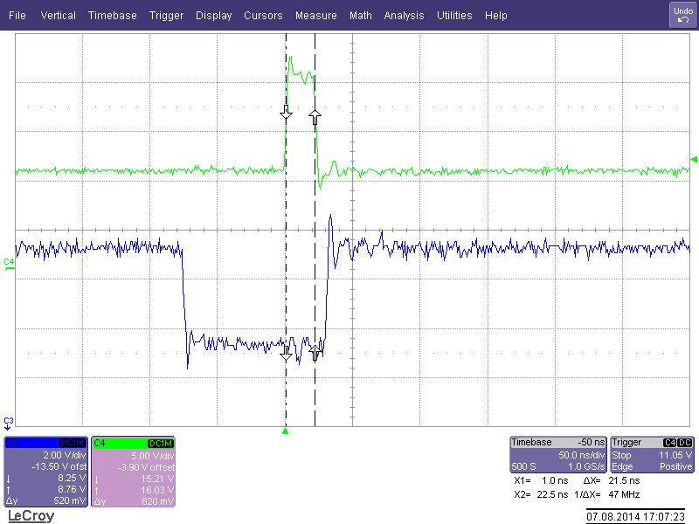
Tests – Switcher @ W17-3, 305MHz
EMCM
Switcher 0
Switcher 1
Bondwires
5
Switcher
Switcher
Bondwires
4
Switcher
control sequence
Switcher
Bondwires
3
Switcher
Switcher
Bondwires
2
Switcher 2
Switcher 3
DHP
Bondwires
1
write switcher sequence
into the DHP memory
DHH
Bondwires
0

Slide 8
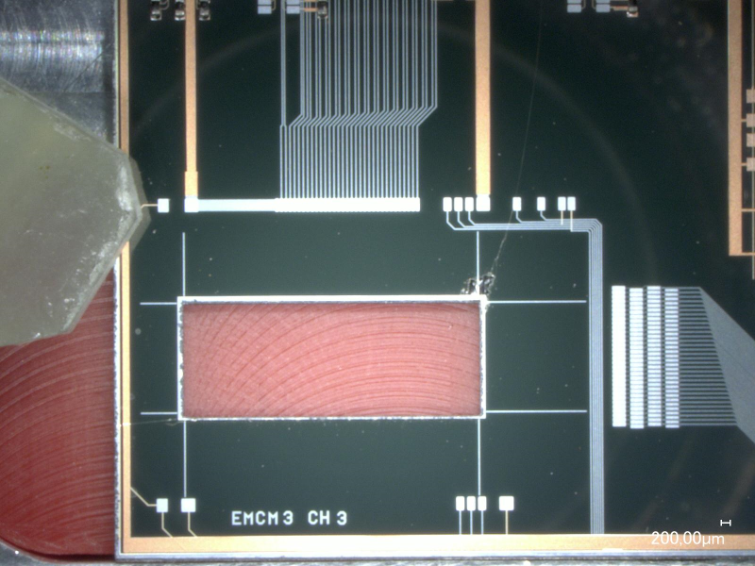
Tests – Switcher @ W17-3
TDO of Sw4 does not show any signal
TDI of Sw4 looks fine
(measured at pads, triggered on CLK)
Switchers worked in the beginning
Stop working after movements of the EMCM

Slide 9
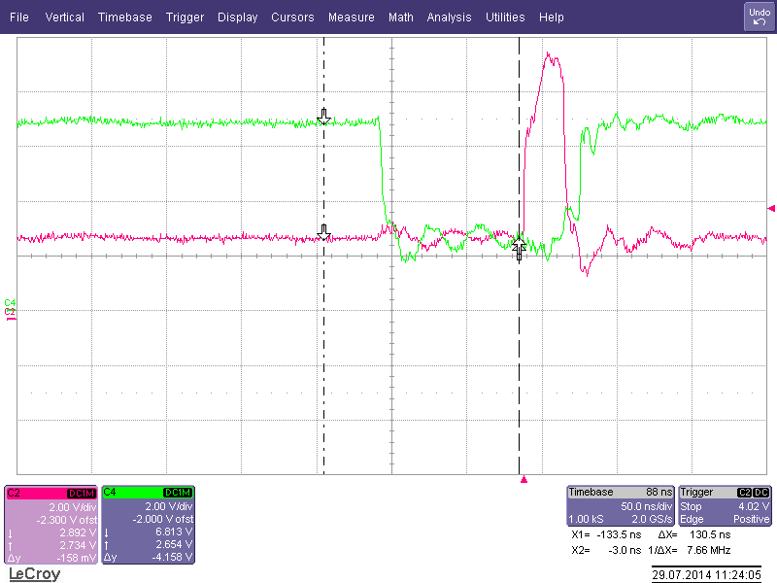
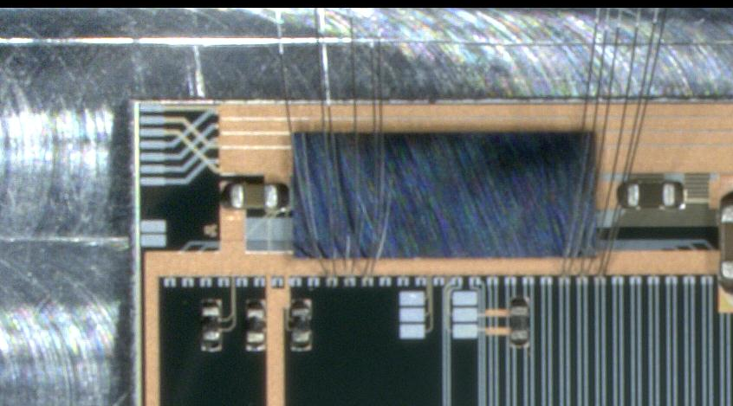
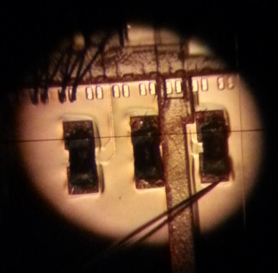
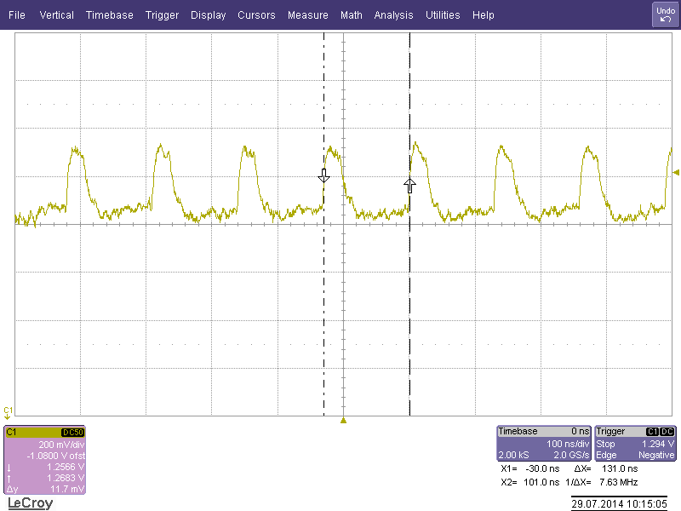
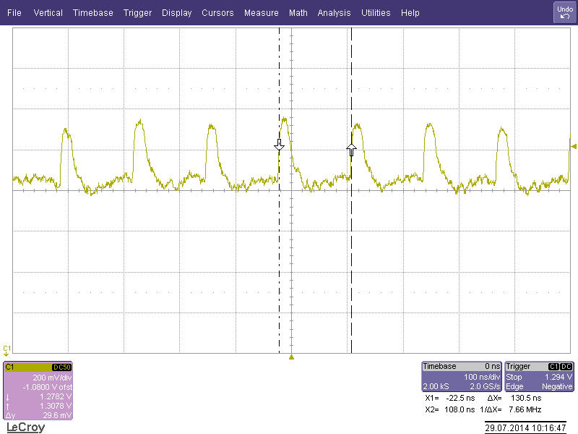
Tests – Switcher 5 @ W17-3, 250MHz
Clear
Gate
CLK
Switcher 5
Clear
Gate
CLK

Slide 10
Switcher Summary
All 6 Switchers work properly in normal operation at 305MHz
Switchers can be configured via JTAG (set termination resistors for LVDS)
should not be in a random state when switching them on
Configure termination resistors for each LVDS individually (CLK, StrG, StrC, SerIn)
(parallel: CLK, StrG, StrC; in series: SerIn)
Module W18-3: All switchers are working fine (need micromanipulator), Matrix attached
Gated-Mode Operation
Operation Mode can be changed in GUI => tested & works (no information about timing, how fast does the mode switch from normal mode to GatedMode operation)

Slide 11
DHPT 1.0 – Aurora Links – Signal integrity
Known problems:
- Design / Layout error with
- Problems during manufacturing of Kapton (impedance not controlled)
Solutions:
More capacitors at PowerPatchPanel (PCB, connected to Kapton)
Replace Kapton by PCB
DHH firmware allows „half data rate“ (800Mbit/s instead of 1.6Gbit/s) of DHPT to be transmitted

Slide 12
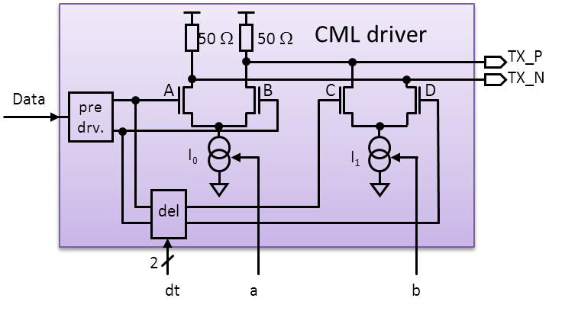
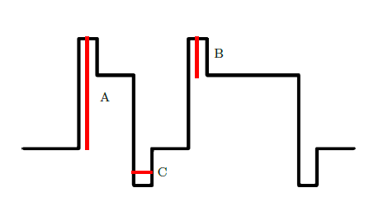
Aurora Settings – DHPT1.0
A - IDAC CML TX BIAS
B - IDAC CML TX BIASD
C - pll cml dly sel
Source: DHPT 1.0 Manual, Version 0.1, October 13, 2014, University of Bonn

Slide 13
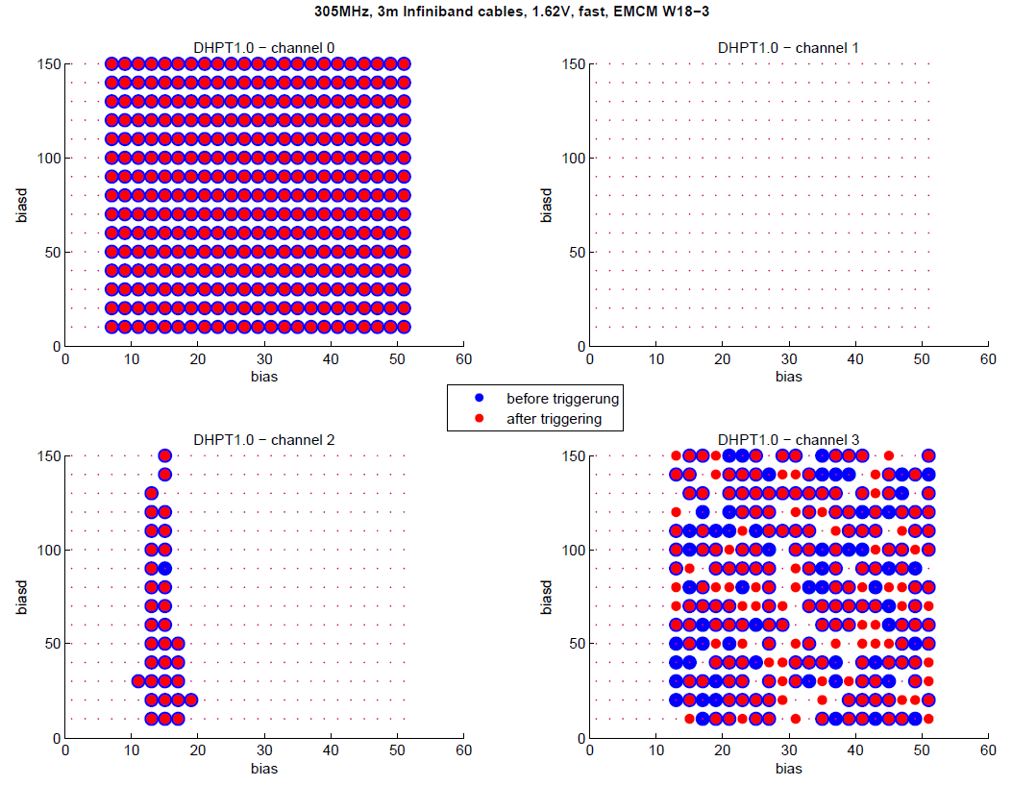
Aurora Scans – DHPT1.0
Procedure:
Long RST => get link
Check link status (blue dot)
Trigger (transmit data)
Check link status (red dot)

Slide 14
Aurora Links – Signals Integrity
Hybrid 5 - PCB
DHH / DHHemulator
15m Infiniband cable
DHPT
Wirebond Adapter
Infiniband connectors
EMCM Setup
DHH
Data Patch Panel
EMCM
Kapton

Slide 15
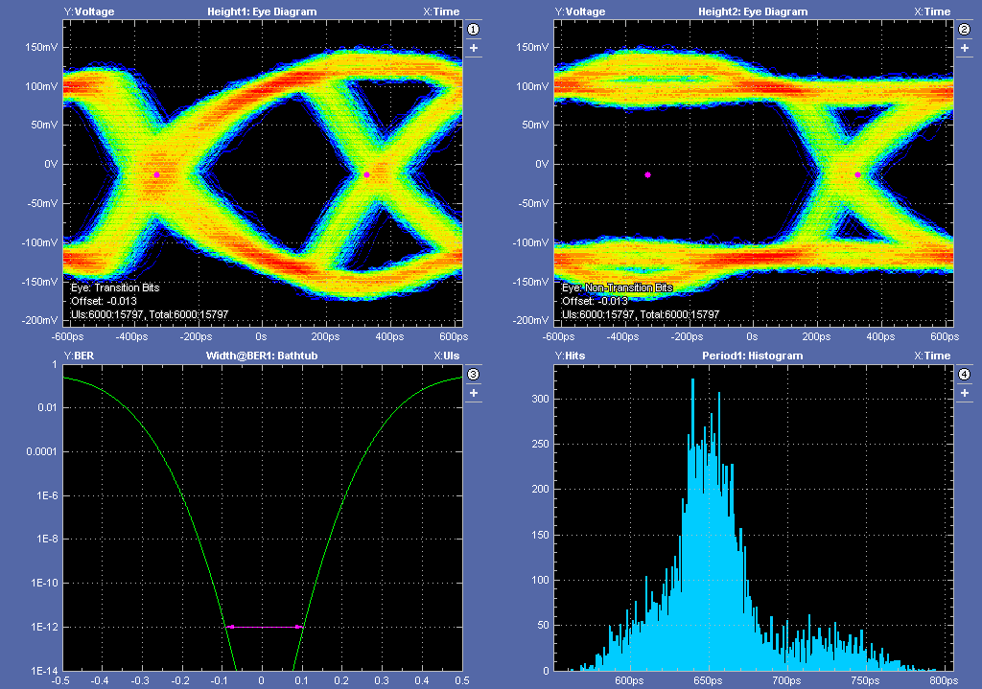
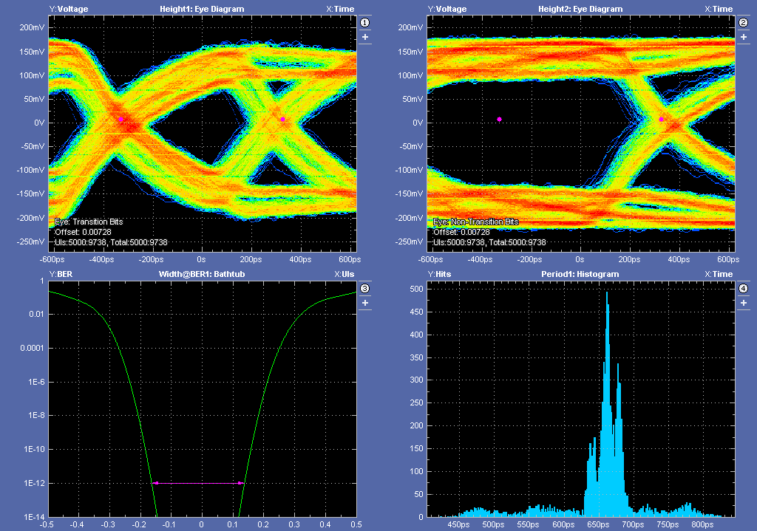
Aurora Links – Signals Integrity (1)
Module: | DHPT Testboard
Frequency: | 305MHz
Cable length: | 3m
Core Voltage: | 1.2V
Bias | 15
BiasD | 75
Module: | EMCM – DHPT0
Frequency: | 305MHz
Cable length: | 3m
Core Voltage: | 1.6V
Bias | 48
BiasD | 127

Slide 16
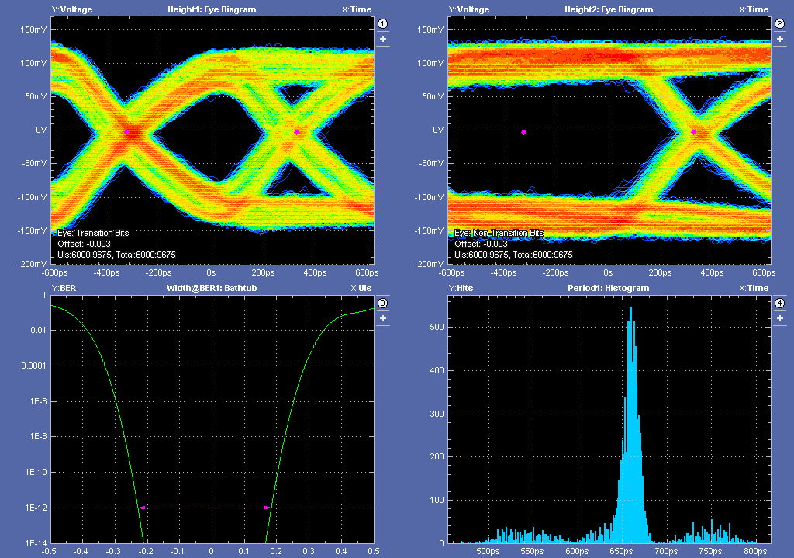
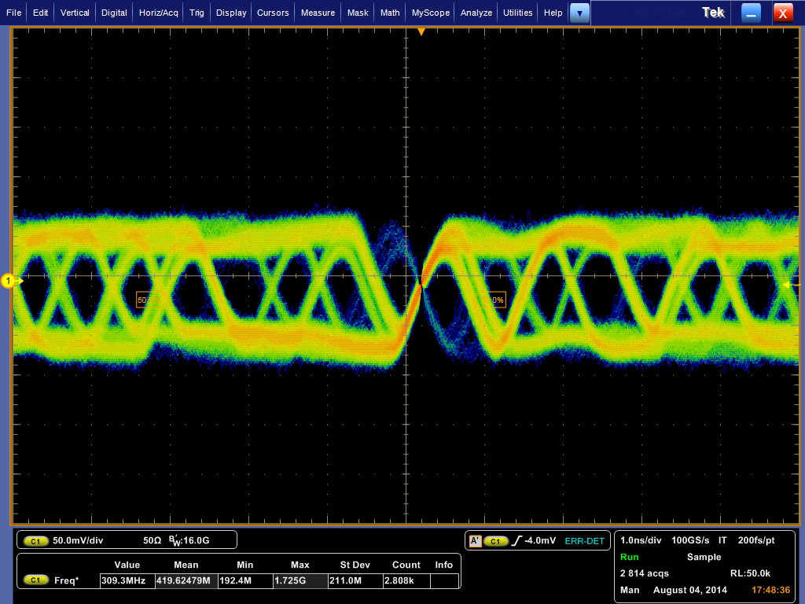
Aurora Links – Signals Integrity (2)
Module: | DHPT Testboard
Frequency: | 305MHz
Cable length: | 15m
Core Voltage: | 1.62V
Bias | 15
BiasD | 150
Module: | EMCM – DHPT0
Frequency: | 305MHz
Cable length: | 15m
Core Voltage: | 1.64V
Bias | 7
BiasD | 150

Slide 17
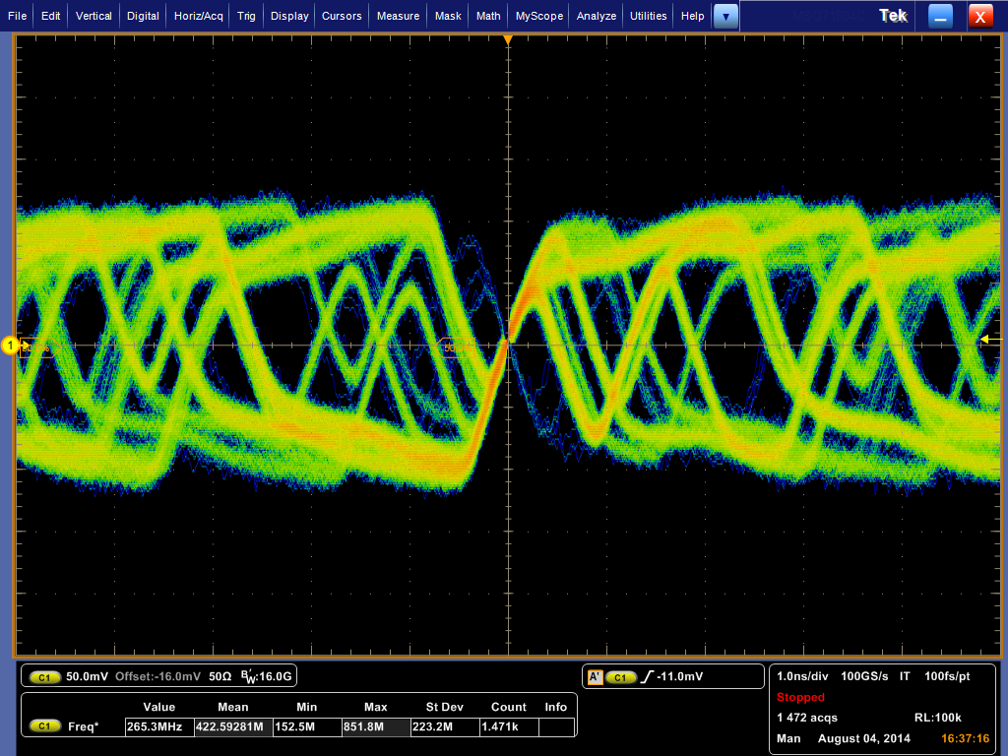
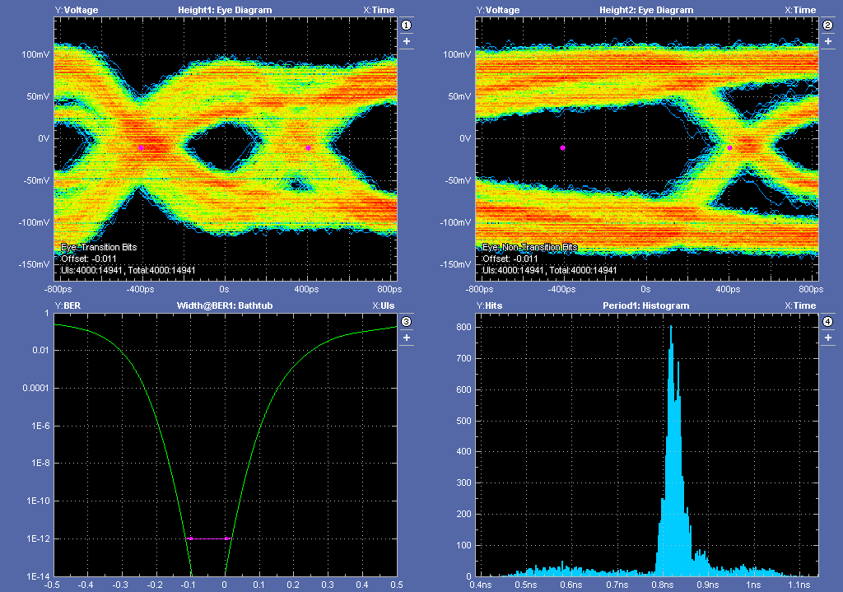
Aurora Links – Signals Integrity (3)
Module: | EMCM – DHPT0
Frequency: | 305MHz
Cable length: | 15m
Core Voltage: | 1.6V
Bias | 15
BiasD | 180
Module: | EMCM – DHPT0
Frequency: | 250MHz
Cable length: | 15m
Core Voltage: | 1.6V
Bias | 15
BiasD | 150

Slide 18
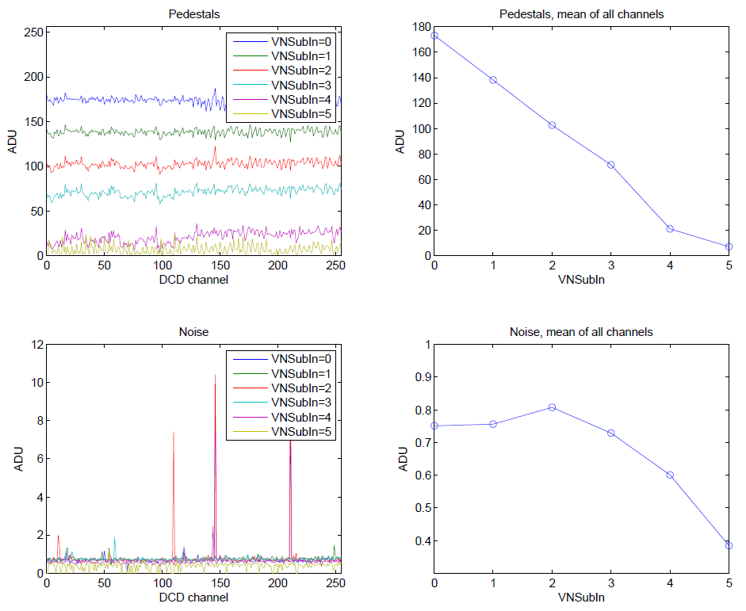
DCD Pipeline (DCDpp) – Noise Measurements
305MHz
IFBPBias=90
IPSource=90
RefIn = 0.9V
AmpLow = 1.2V

Slide 19
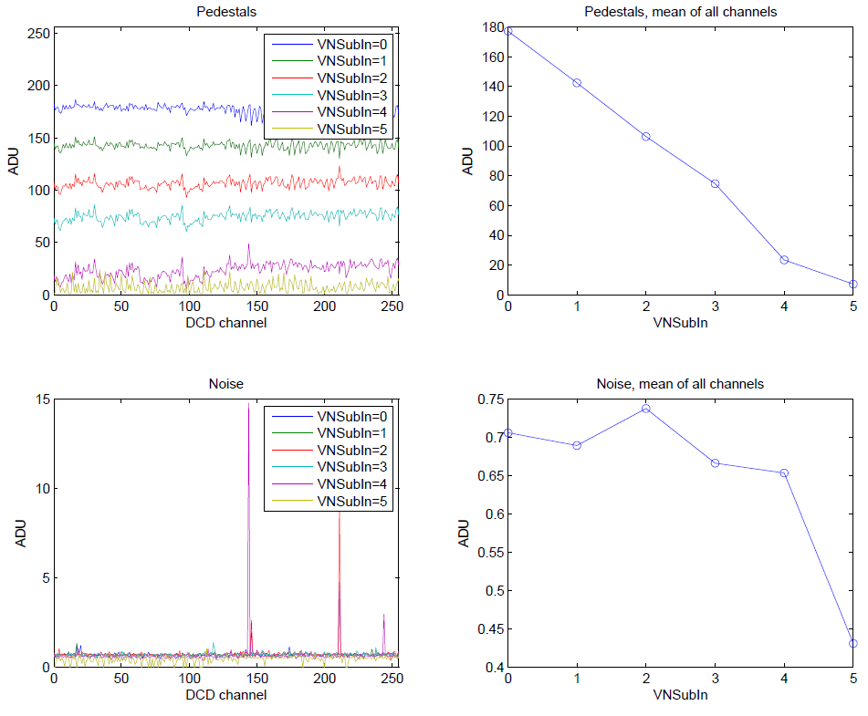
DCD Pipeline (DCDpp) – Noise Measurements
305MHz
IFBPBias=90
IPSource=90
RefIn = 0.9V
AmpLow = 1.2V
Restart of System, i.e. power cycle
other noisy
channels

Slide 20
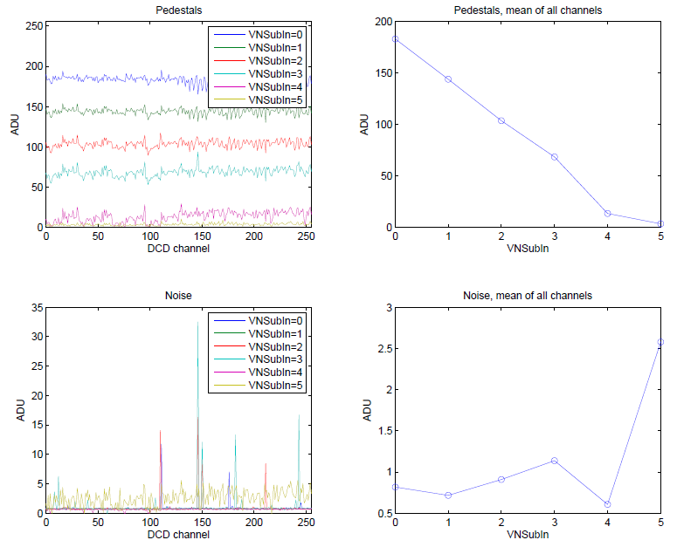
DCD Pipeline (DCDpp) – Noise Measurements
305MHz
IFBPBias=80
IPSource=80
RefIn = 0.9V
AmpLow = 1.2V

Slide 21
DCD Pipeline (DCDpp) – Internal Current Source
DCD
schematic
internal current source
Source Measurement Unit (SMU)
EMCM
Kapton
Power Patch Panel
Breakout Board
(Connectors board)
Source Measurement Unit (SMU)
reality

Slide 22
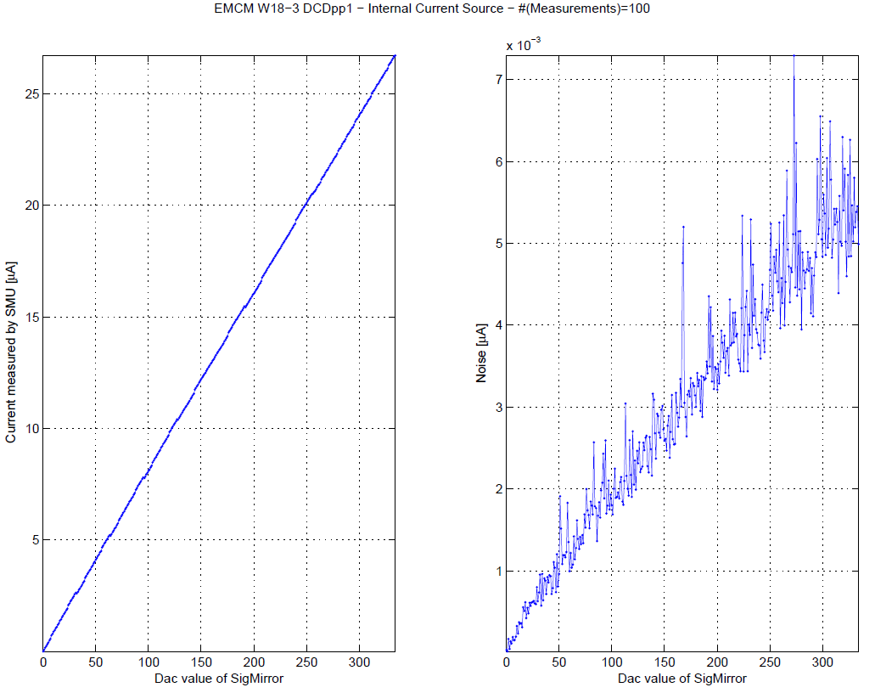
DCD Pipeline (DCDpp) – Internal Current Source

Slide 23
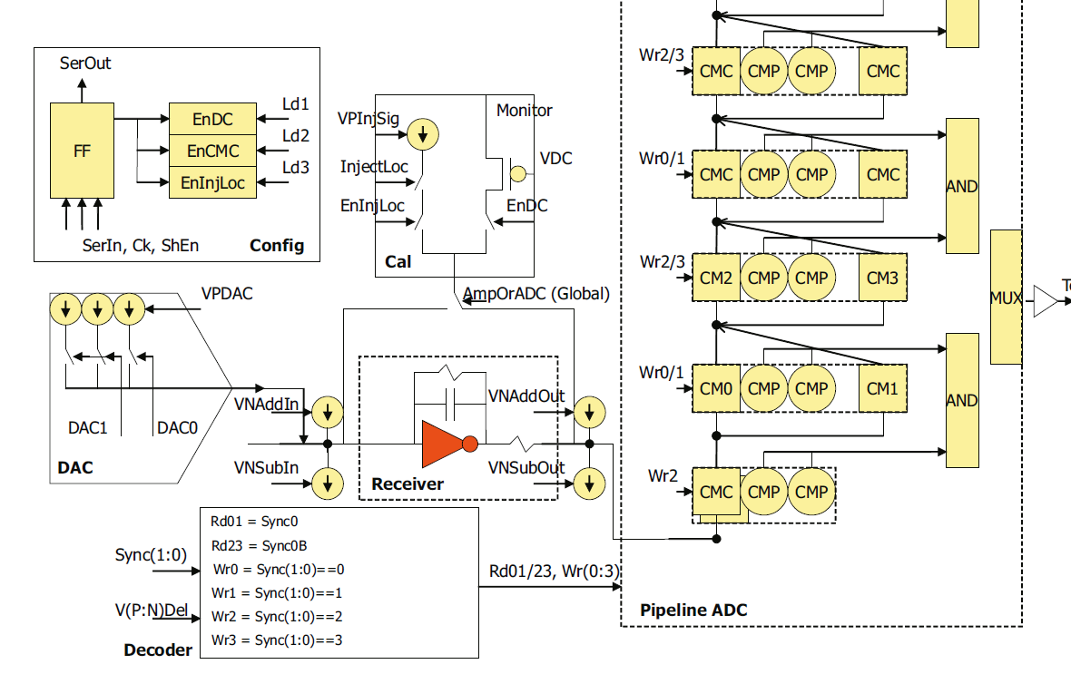
DCD Pipeline (DCDpp) – Internal Current Source
Sig_Mirror

Slide 24
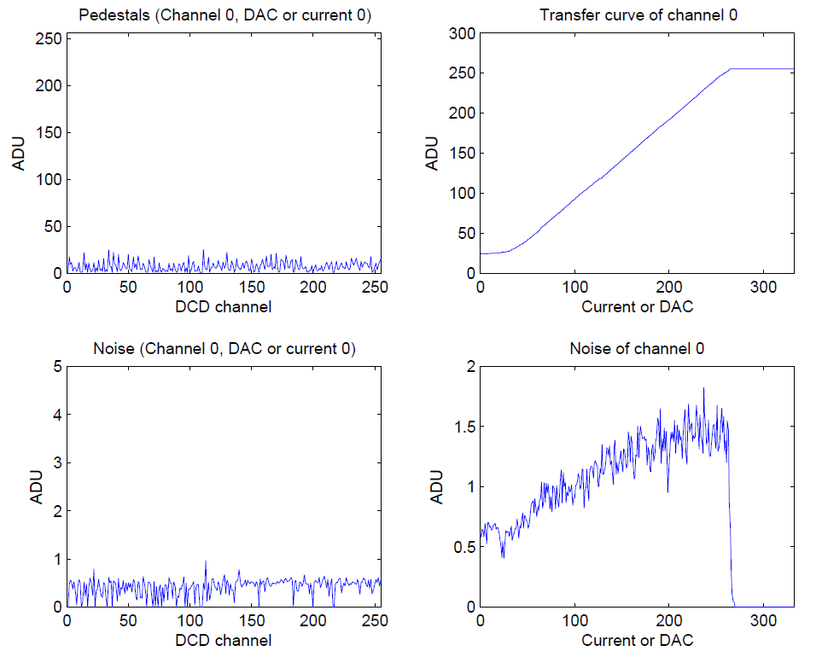
DCD Pipeline (DCDpp) – Internal Current Source
W17-3
DCDpp0

Slide 25
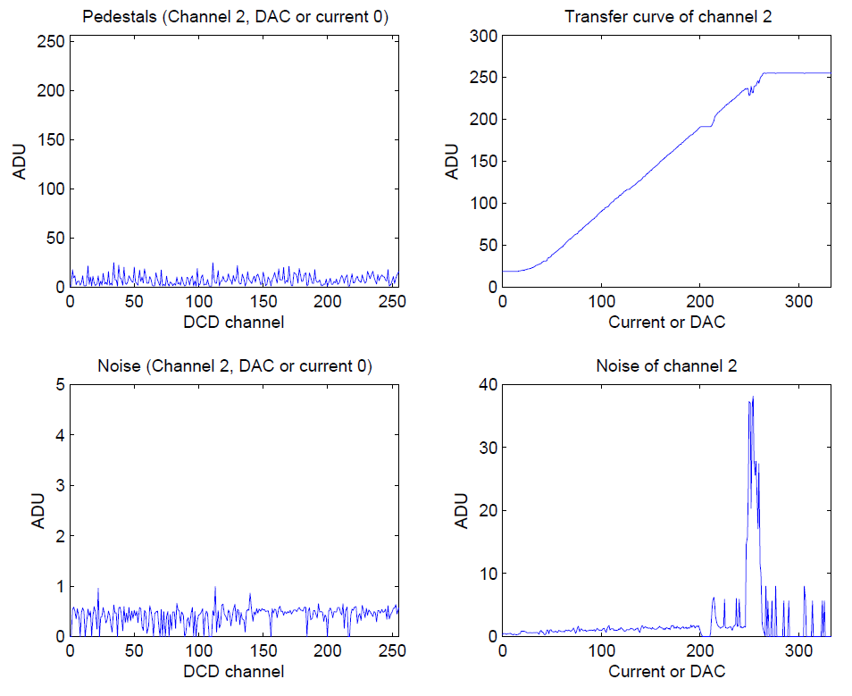
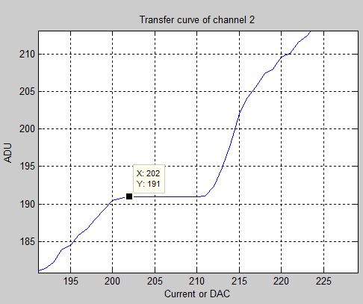
DCD Pipeline (DCDpp) – Internal Current Source
W17-3
DCDpp0

Slide 26
DCD Pipeline (DCDpp) – 2bit Offset DACs
ADU
Pedestals
DAC=3
DAC=1
DAC=3
DAC=0
ADC=2
DAC=1
DAC=3
DAC=0
1
2
3
4
5
6
7
8
pixel

Slide 27
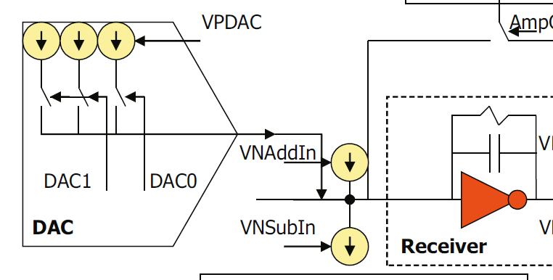
DCD Pipeline (DCDpp) – 2bit Offset DACs
individual
parameter
global parameter
IPDAC
DCD
write which pixel has which offset {0,1,2,3}
DHP
write offset memory
into the DHP memory
DHH

Slide 28
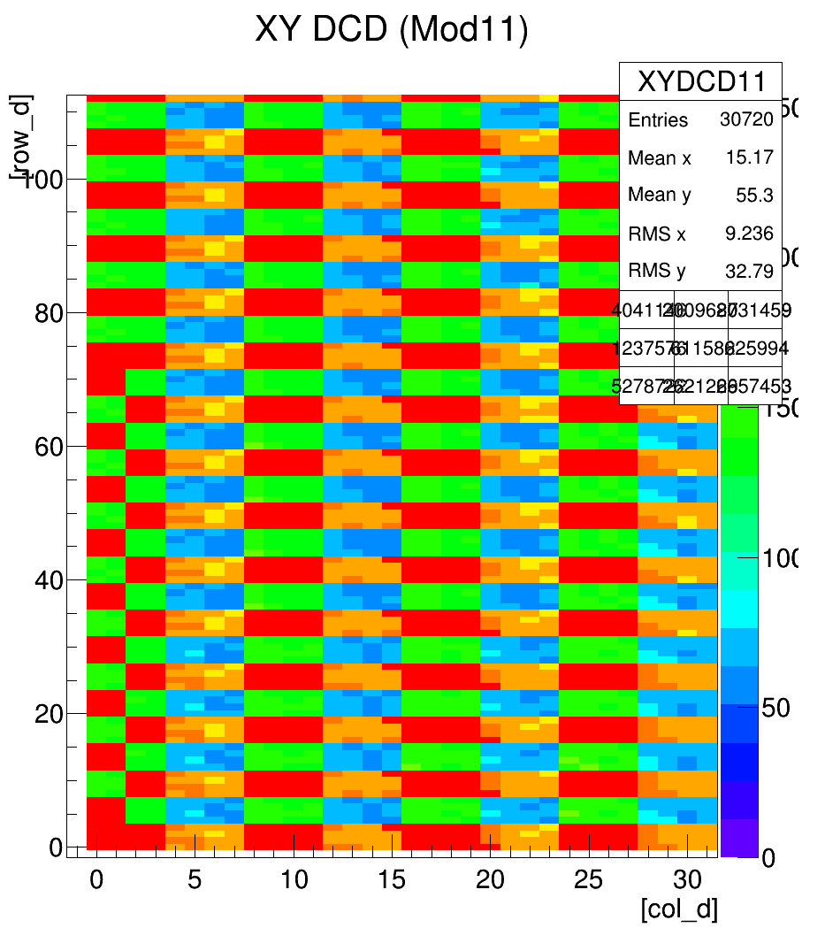
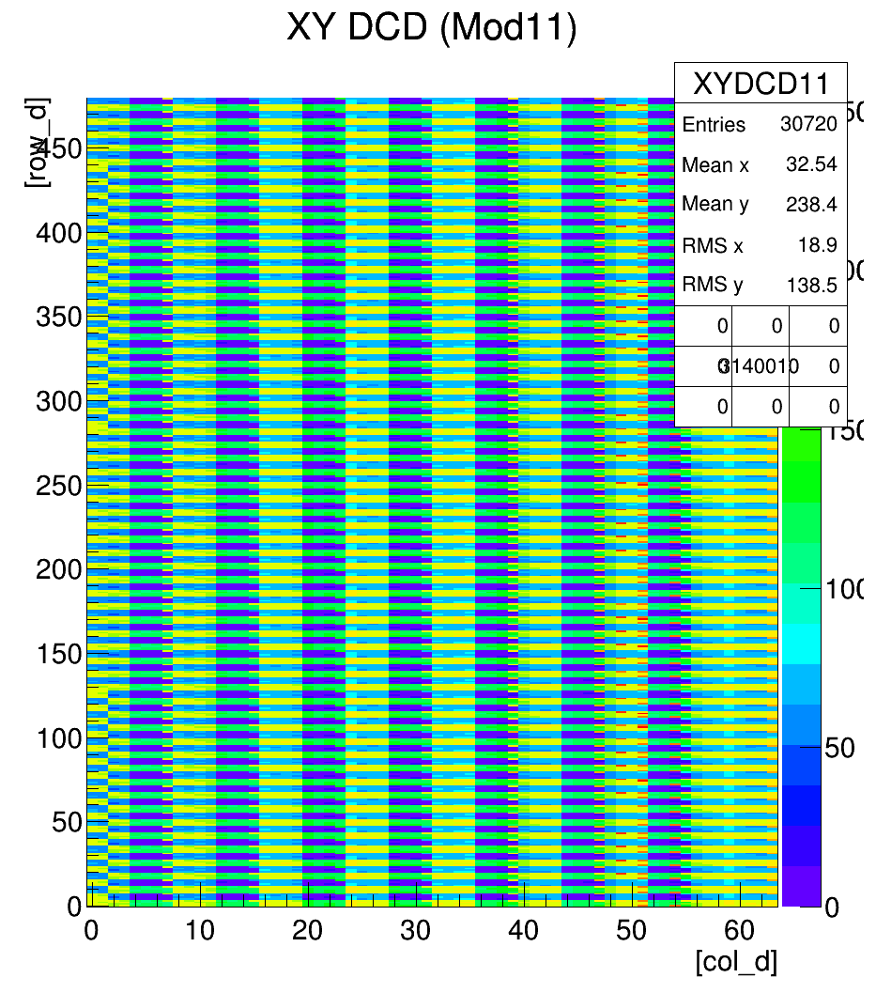
DCD Pipeline (DCDpp) – 2bit Offset DACs
Write Test Pattern into DCDpp
Still some problems with timing issues

Slide 29
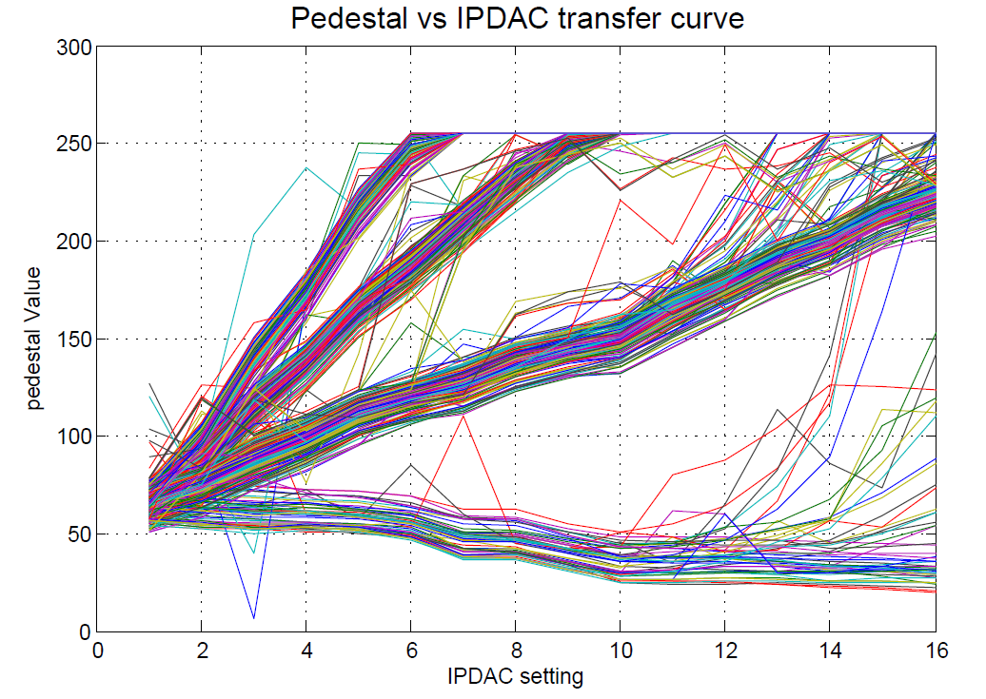
DCD Pipeline (DCDpp) – 2bit Offset DACs
Offset=3
Offset=2
IPDAC Current source can compensate 4x the dynamic range
Offset=1
Offset=0

Slide 30
DHPT1.0 – Pedestal Upload
Write Pedestals into Memory of DHPT for all pixels
ReadOut Pedestals, consisting of:
- Current values which are transferred from DCDpp to DHPT
- Memory of DHPT
DHP
write pedestal values
into the DHP memory
DHH

Slide 31
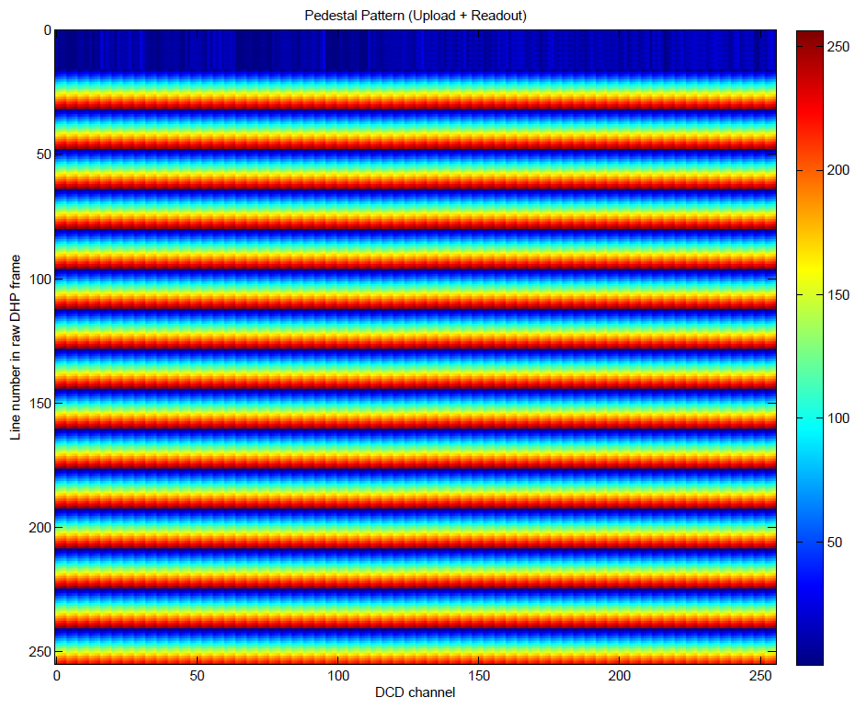
DHPT1.0 – Pedestal Upload
current
pedestals
pedestals
in memory

Slide 32
Summary & Outlook
Switcher (SwitcherB18v2.0):
Switchers: work properly in normal operation at 305MHz
Readout of settings is possible (JTAG)
DCD (DCD-Pipeline):
Internal current source is noisy
IPDAC (offset DACs) is too strong (after irradiation?)
Noisy ADC channels (need more statistics)
Works at 305MHz
Readout of settings is NOT possible (JTAG)
DHP (DHPT1.0):
problem with high-speed links
upload of pedestals, switcher sequence, offset-dacs
Readout of settings is possible (JTAG)

Slide 33
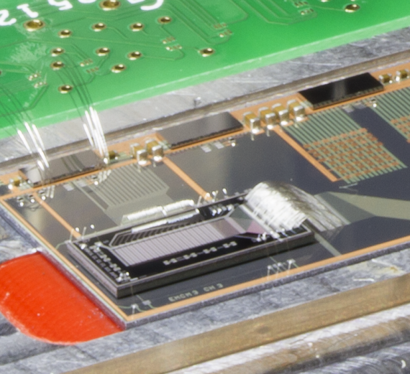
Outlook
Boundary Scan, System scanning using dedicated hardware and software is not done yet (Philipp Leitl, Master Student @ MPP, started to work on that)
PXD6 operation on EMCM at full speed with DCDpp, DHPT1.0, SwitcherB18v2.0 (Pedestal distribution (spread), noise, laser scan, source tests, GatedMode)
Studying DCDpp performance (ADC transfer curves, Pedestal Spreads, Noise Distribution, all ASICs, Common Mode Suppression)
Increase readout speed
Decrease in performance when operating multiple ASICs simultaneously (cross-talks, voltage drops …)?
Mapping in principle okay, need fine tuning of delay settings
Offset DACs okay, need fine tuning of delay settings
Replacement of Kapton (impedance controlled traces, less connectors, better connection, large loop for DCD Monitor pin)

Slide 34
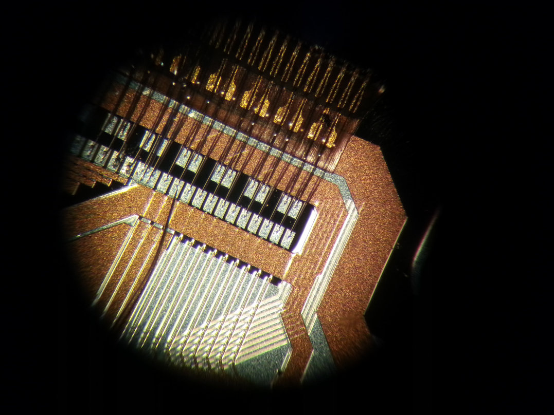
Thank
you

Slide 35
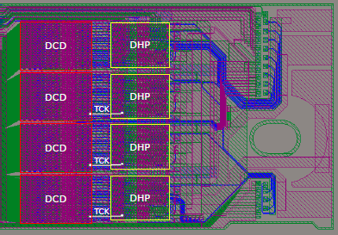
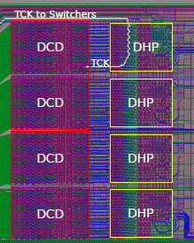
DCD Configuration Problem
last DCDB requires one bit less during configuration
same situation on the module with only one DHP-DCD pair
work around implemented in software to mitigate the problem
Source: Dmytro Levit, TUM
https://indico.mpp.mpg.de/getFile.py/access?contribId=59&sessionId=1&resId=0&materialId=slides&confId=2933

Slide 36
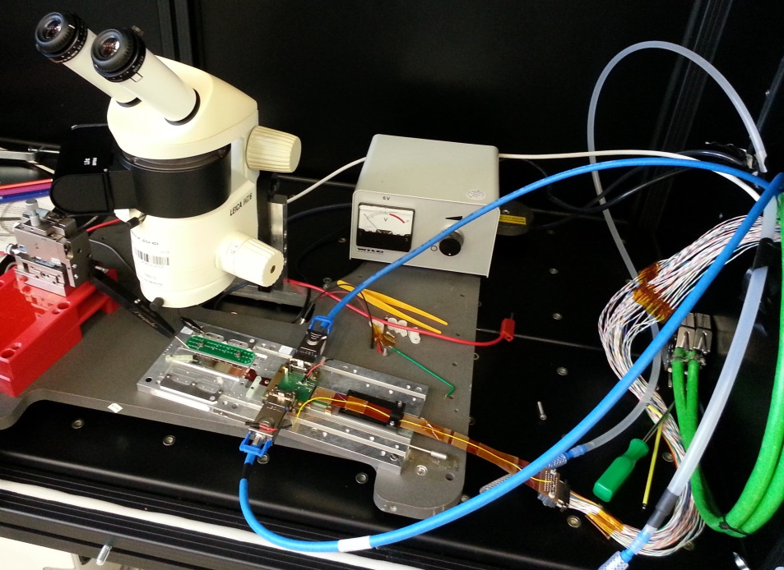
Setup
Data cables
PCB, Switcher
Output Control
Pico Probe
Micro
Manipulator
Data Patch Panel
EMCM
Power Patch
Panel
Power cable
Water
cooling
LMU Power Cable

Slide 37
Fully Assembled EMCM
DHP
DHP
DHP
DHP
4 x High Speed Link
DHH
DCD
DCD
DCD
DCD
JTAG and Control Signals
SerIn
SWB
New configuration:
JTAG chain with 14 ASICs
6 Switchers in serial
Multiple ASICs connected to the same power supply
SerOut
SWB
Switcher Control Signals: Clk, StrG, StrC
SWB
SWB
SWB
SWB

