Slide 1
ASIC Review
Date and Location
MPP, October 27, 10:00 – October 28, 16:00, Room 313
Reviewers:
Gary Varner (Hawaii)
Wladislaw Dabrowski (AGH Krakau)
Valerio Re (Uni Bergamo, INFN Pavia)
Information distributed:
white book
DCD-B v4 pilepline
SwitcherB18 v2.0 (15.10.2014)
DHPT10 manual. 0.1 (13.10.2014)
some papers, thesis
H-.G. Moser, 18th B2GM, June 2014

Slide 2
Charge
The review should assess the production readiness of the three ASICs used in the Belle II PXD. The schedule requires a submission of the final AISCs early 2015. In order to achieve this one has to assess:
The maturity of the chip design.
Completeness and quality of documentation.
Status of performance tests (stand alone and on system level).
Known problems and mitigation/correction plans.
Missing measurements and tests.
Work plan (responsibilities, milestones).
Schedule for next submission .
QA strategy.
It is likely that the review will conclude that there are still some issues to be resolved before a submission can be done. In this case the risks for the detector performance need to be evaluated. A clear strategy should be developed how to achieve the goal of timely submission.
Following issues need to be discussed:
General introduction in the chip design and specifications
Summary of tests and performance information
Design changes planned for the next submission
Information on QA strategy (information on yield expectations, test programs, status of test equipment, its documentation)

Slide 3
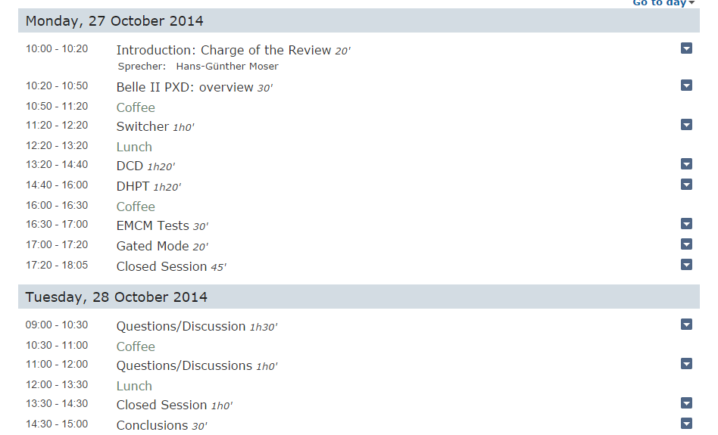
Agenda

Slide 4
Contributions
Belle II PXD: NN
Switcher: Chip Design I. Peric
Tests and plans C. Kreidl
DCDp: Chip Design I. Peric
Performance Tests E. Prinker
Plans & QA I. Peric
DHPT: Chip Design NN
Performance Tests NN
Plans & QA NN
EMCM: F. Müller
Gated Mode: C. Koffmane

