Slide 1
Standard Model Physics at ATLAS
MPP Project Review 2015
MPP ATLAS group
Munich, December 14th, 2015
G. Cortiana
Top quark mass measurements
WW cross section analysis strategy
Topological calorimeter clusters and their calibration
Prospects and conclusions

Slide 2
MPP ATLAS group
Director: S. Bethke
Senior scientists (10): T. Barillari, A. Kiryunin, S. Kluth, O. Kortner, S. Kortner, H. Kroha, S. Menke, R. Nisius, D. Salihagic, S. Stonjek
Emeriti (4): H. Oberlack, R. Richter, P. Schacht, H. von der Schmitt
Post docs (14): G. Compostella, G. Cortiana, C. Delle Fratte, M. Flowerdew, C. Giuliani, T. Ince, A. La Rosa, A. Macchiolo, F. Müller, M. Nagel, P. Schwegler, , F. Sforza, E. Takasugi, A. Wildauer
PhD (12): K. Ecker, M. Goblirsch-Kolb, N. Köhler, D. Krauss, A. Maier, S. Nowak, R. Röhrig, N. Savic, K. Schmidt-Sommerfeld,, F. Spettel, S. Terzo, G. Wichmann
Master (6): E. Fons, P. Gadow, J. Junggeburth, S. Maschekl,, V. Walbrecht, I. Weimer
Bachelor (8): S. Annies, J. Corella Puertas, D. Joseph, D. Kresse, D. Nebe, M. Rendel, L. Schlechter, C. Schmid
ATLAS wide responsibilities:
S. Kluth: ATLAS software quality coordinator
O. Kortner: Deputy muon project leader
A. Macchiolo: ATLAS pixel sensor upgrade co-coordinator S. Menke: ATLAS liquid argon electronics upgrade co-coordinator
in 2015: 24 ATLAS publications
(14 in peer-reviewed journals)

Slide 3
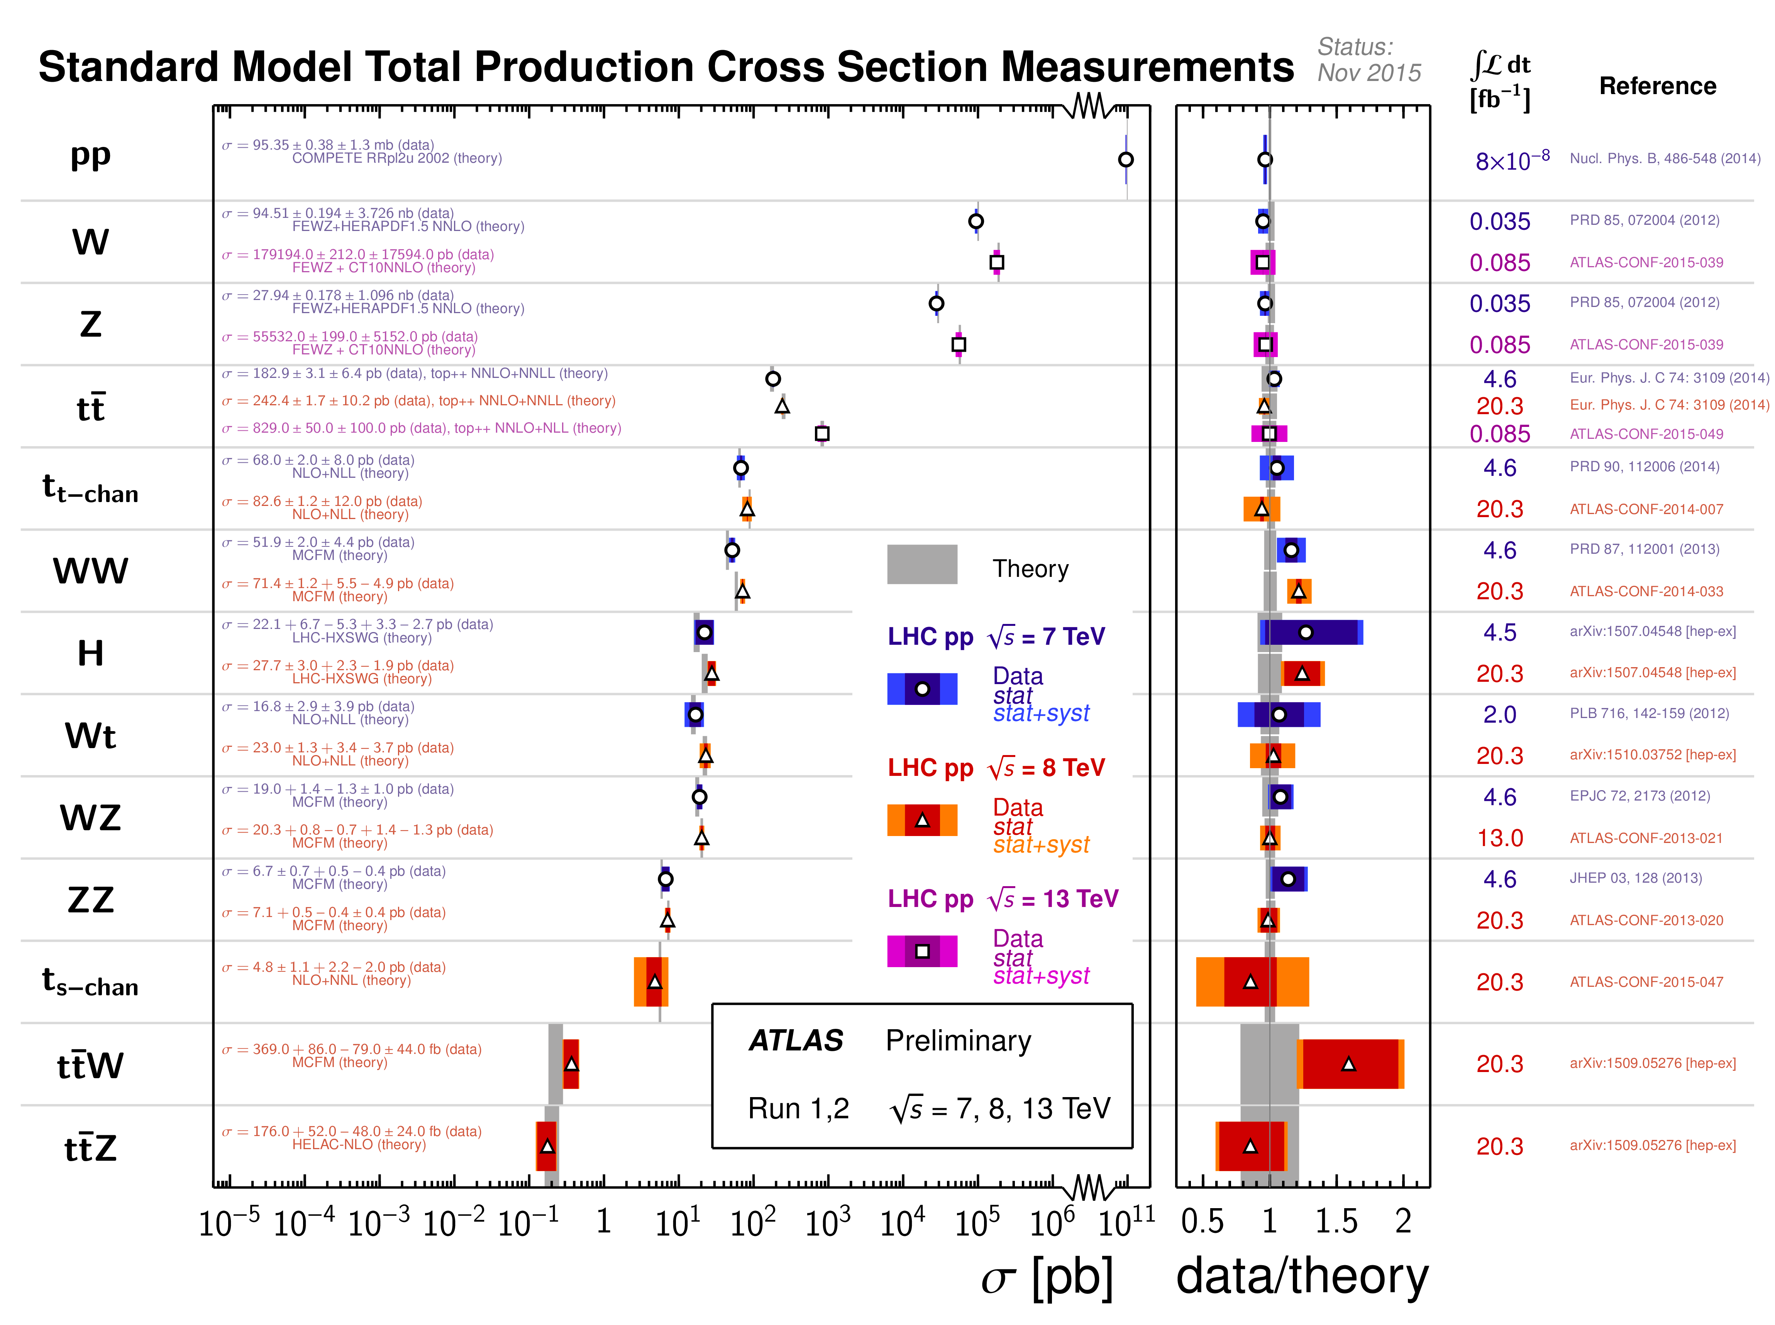
First √s = 13 TeV results
(see Oliver’s talk for LHC performance in 2015)
covered in this talk
covered in this talk
Goals:
High precision measurements complementing direct searches for new physics (NP)
Needs:
Ultimate detector calibration / data understanding
Long term projects still using 2011 /2012 datasets (√s=7 and 8 TeV)
LHC Run-2 highlights at
ATLAS and CMS EOYE (Dec 15th, 15:00)

Slide 4
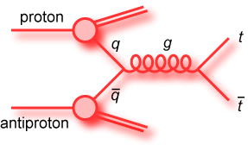
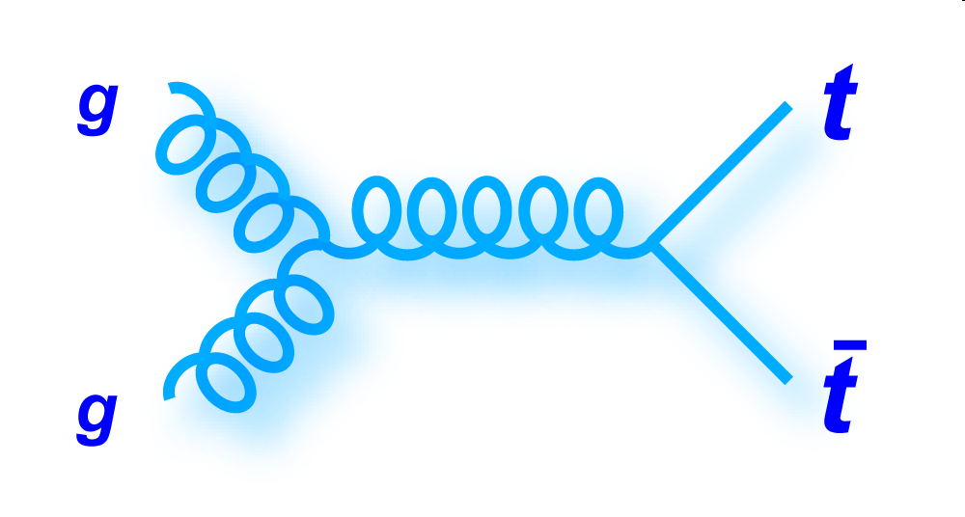
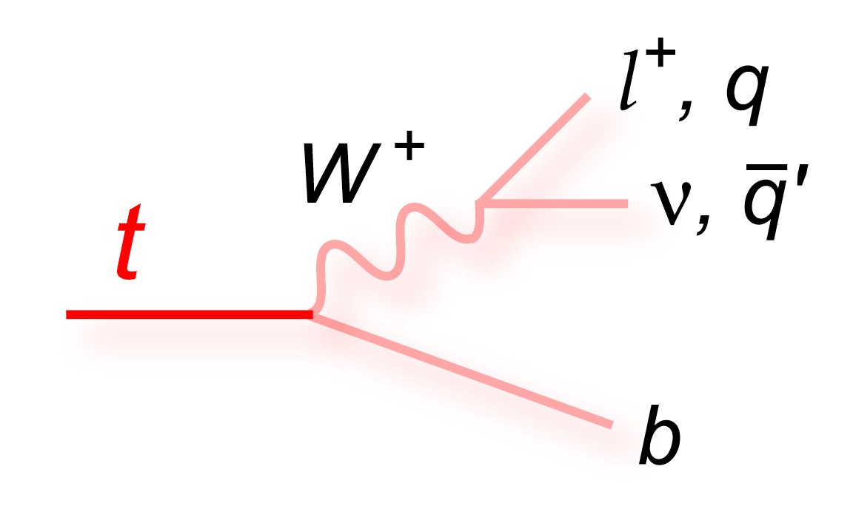
Introduction: top quark
top-quark pair production:
( )
dominant at the Tevatron
√s = 1.8 – 1.96 TeV
dominant at the LHC
√s ≥ 7 TeV
top-quark decays
Experimental signatures are classified according to the W boson decay modes
MPP analysis activities cover all final states and deliver precision measurements of the top quark mass
Stringent tests of the SM and its extensions
Important implication for the EW vacuum stability

Slide 5
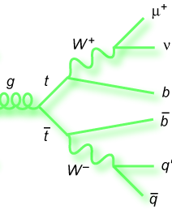
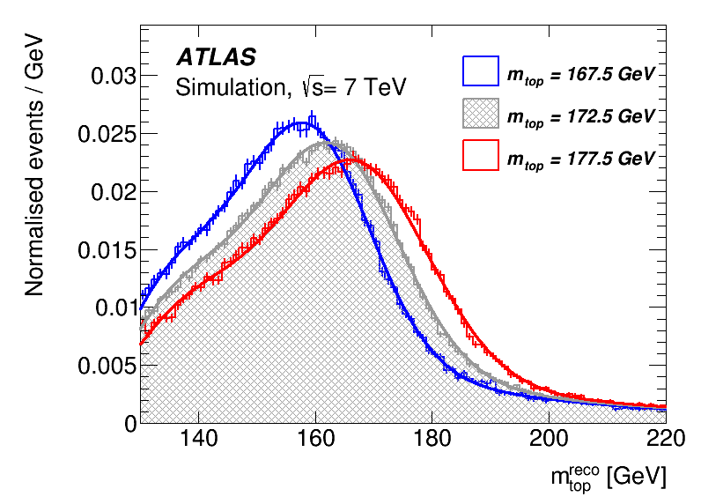
Analysis techniques: the template method
observed
objects
Estimator sensitive to m_{top}
  can be obtained from a kinematic best fit to the decay hypothesis, considering all jet permutations and taking into account physics object resolutions
Lepton
E_{T}^{miss}
Jet1
Jet2
Jet3
Jet4
example: lepton+jets final state
Eur.Phys.J. C75 (2015) 330
Template method:
  the data distribution of a given m_{top} estimator (i.e. m_{top}^{reco}) is fitted to the sum of signal and background PDFs (probability distribution functions)

Slide 6

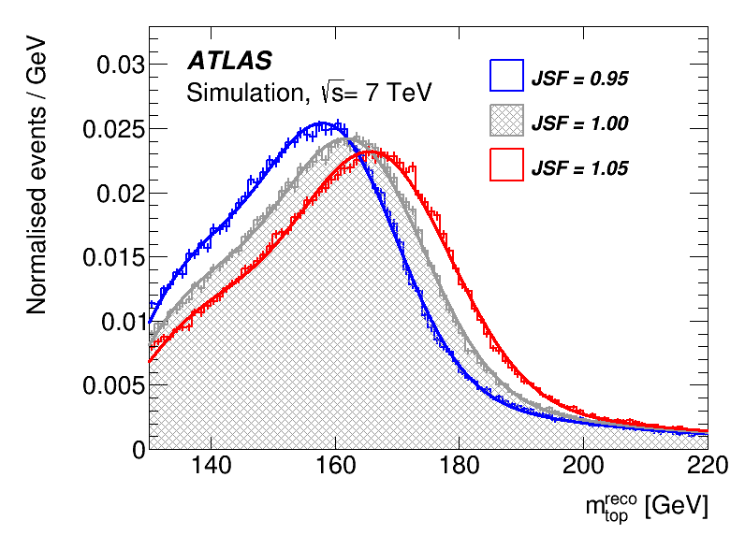
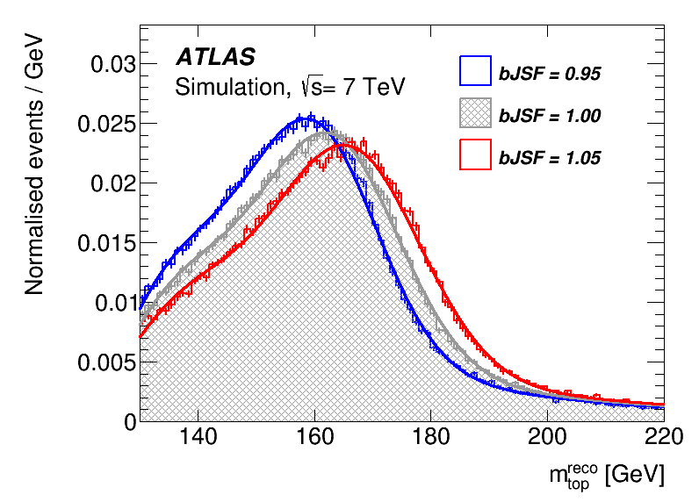
The problem… and its solution
Observables’ main dependences
m_{top}
JES
bJES
Reco m_{top}
Good sensitivity to the underlying top quark mass. The quantity to be measured
Large dependence on the jet energy scale
Large dependence on the b-jet energy scale
Large systematics
Large systematics
The uncertainties on the jet energy scale (JES) are O(few %) and vary with jet properties, flavor and event topology

Slide 7
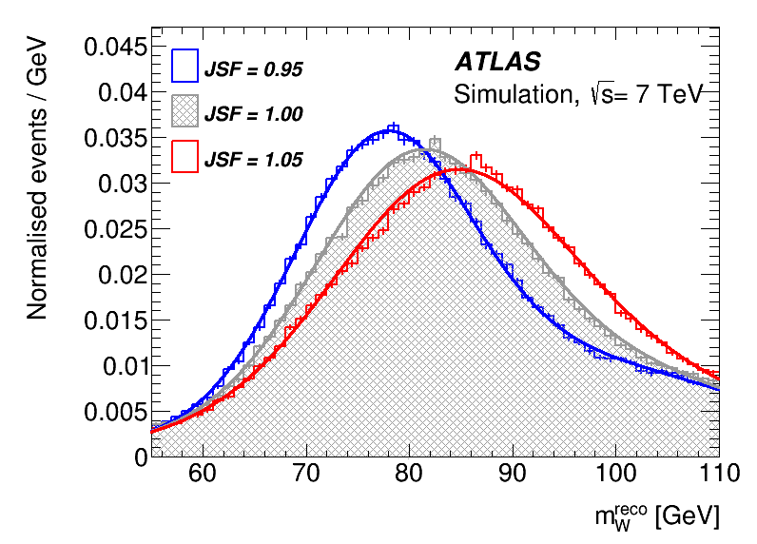
The problem… and its solution
Observables’ main dependences
m_{top}
JES
bJES
Reco m_{top}
2-dim fits for m_{top}, JSF
in the l+jets channel, the light-quark jets from W-decay can be used to determine a global jet energy scale factor (JSF) constraining the light jets JES variations
Pioneered by the CDF collaboration in
Phys.Rev.D73:032003,2006
Reco m_{W}

Slide 8
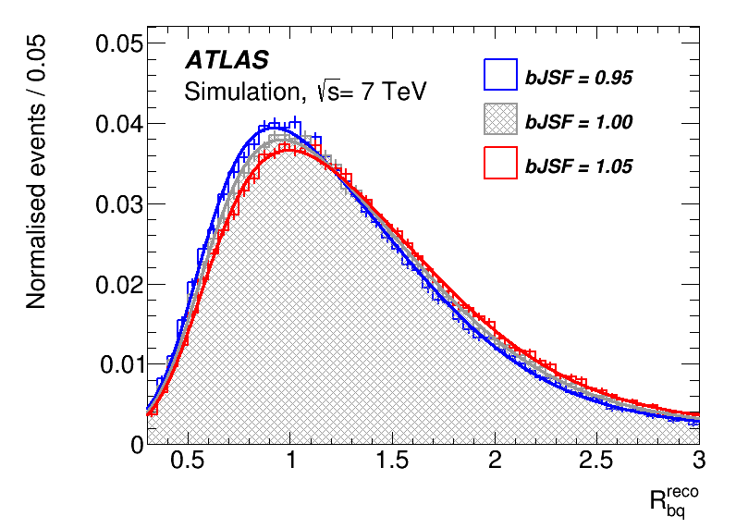
The problem… and its solution
Observables’ main dependences
m_{top}
JES
bJES
Reco m_{top}
in the l+jets channel, the light-quark jets from W-decay can be used to determine a global jet energy scale factor (JSF) constraining the light jets JES variations
3-dim fits for m_{top}, JSF, bJSF
Reco m_{W}
similarly a variable sensitive to the relative b-to-light jet energy scale (bJSF) can be used to constrain the b-jet JES variations (bJES)
Reco R_{bq}
The m_{top}^{reco}, m_{W}^{reco} and R_{bq}^{reco} templates are used in a 3d fit to the data to determine m_{top}, JSF and bJSF

Slide 9
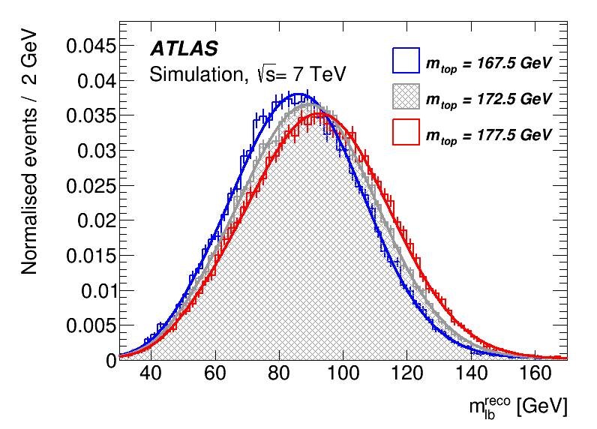
Dilepton final states
Excellent S/B ratio
Under-constrained event kinematics (two escaping ν)
Use the template method with the m_{lb}^{reco} observable as an estimator for m_{top}: exploiting a partial reconstruction of the event
m_{top}
Eur.Phys.J. C75 (2015) 330
Reco m_{lb}

Slide 10
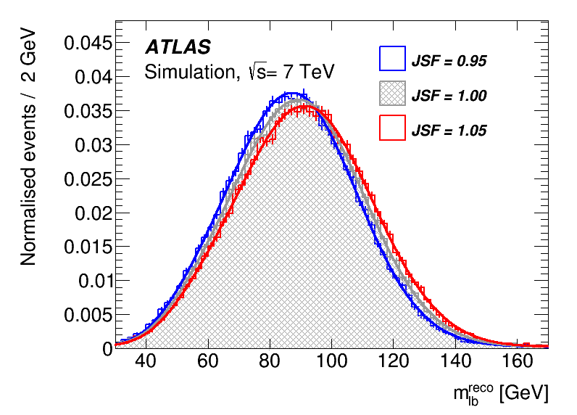
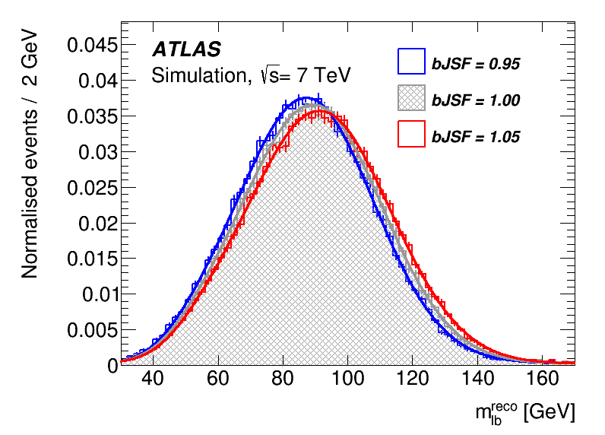
Dilepton final states
Excellent S/B ratio
Under-constrained event kinematics (two escaping ν)
Use the template method with the m_{lb}^{reco} observable as an estimator for m_{top}: exploiting a partial reconstruction of the event
same problem as for
the l+jets final state:
m_{top}
JES
bJES
Eur.Phys.J. C75 (2015) 330
Reco m_{lb}
No direct in-situ (b)JSF determination possible. No JSF/bJSF transfer from l+jets analysis, to minimize correlations and maximize gain in the combination

Slide 11
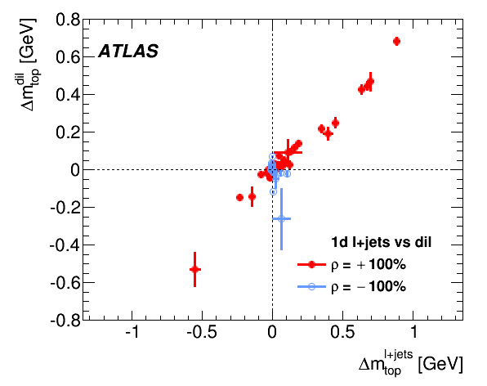
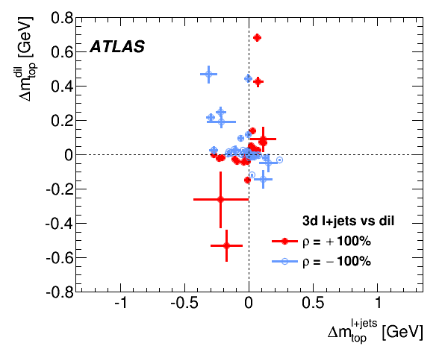
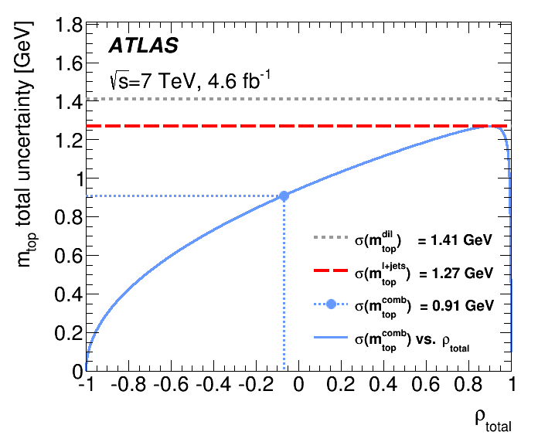
The use of different techniques (e.g. 1-dim or 3-dim templates) introduces anti-correlation effects on the observables used to measure m_{top}
Size (and sign) of the m_{top} syst. unc. in the lepton+jets and dilepton channels:
  l+jets (1-dim), fit for m_{top} only
  l+jets (3-dim), fit for m_{top}, JSF, bJSF
    overall syst. reduction (l+jets)
    de-correlation of the observables
Eur.Phys.J. C75 (2015) 330
very significant gain (28%)
in the combination

Slide 12
All-jets final states
Poorer S/B ratio
Particular attention required to model the background via data-driven techniques
The R_{3/2} observable, defined as m_{jjb}/m_{jj}, is used as for the 7 TeV analysis (carried out at LMU) which yielded:
  it achieves a partial cancellation of the systematic effects common to m_{top}^{reco} and m_{W}^{reco}
Eur.Phys.J. C75 (2015) 158
Illustrative plot
from the 7 TeV
analysis
Outlook:
MPP is leading the efforts towards m_{top} analysis updates using the 8 TeV dataset (x4 more data allows trade-offs between statistical and systematic uncertainties)
All analyses are well advanced
  All-jets: PhD thesis T. McCarthy (Sept. 2015, Carleton University + MPP)
  Dilepton: PhD thesis A. Maier (end 2015)
  Lepton+jets: phase-space optimization ongoing
Publications planned for 2016 (including their combination)

Slide 13
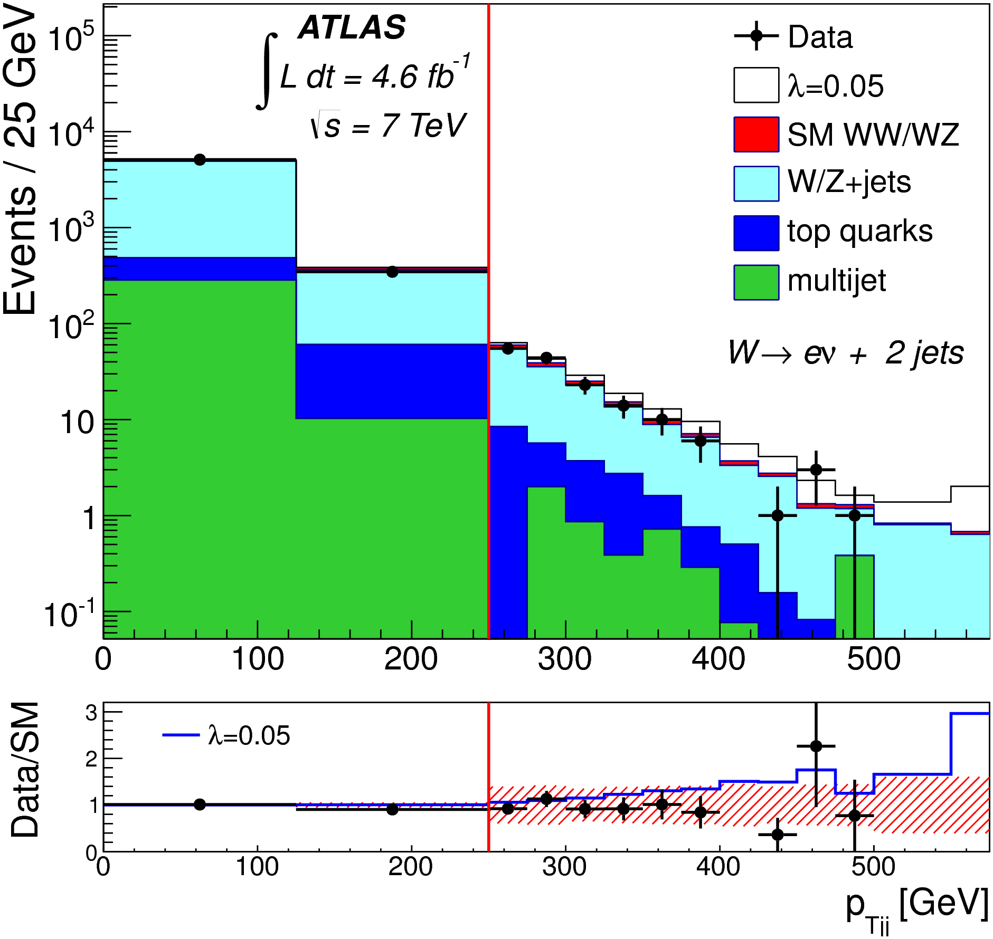
(boosted) WW x-section measurement
In addition to being the main background for H WW analyses, the WW production is sensitive to anomalous triple gauge boson couplings (aTGCs), and to possible new particles decaying into vector bosons (see Claudia’s Higgs+NP talk)
Increasingly important at higher √s and in boosted topologies
Analysis strategy:
  One leptonically decaying W
  One hadronically decaying W (boosted)
Use fat-jets techniques based on jet sub-structure identification, as well as multivariate techniques to improve signal/background ratio
PhD thesis: F. Spettel
Master thesis: E. Fons
JHEP 01 (2015) 049
Illustrative plot
from the 7 TeV
inclusive analysis

Slide 14
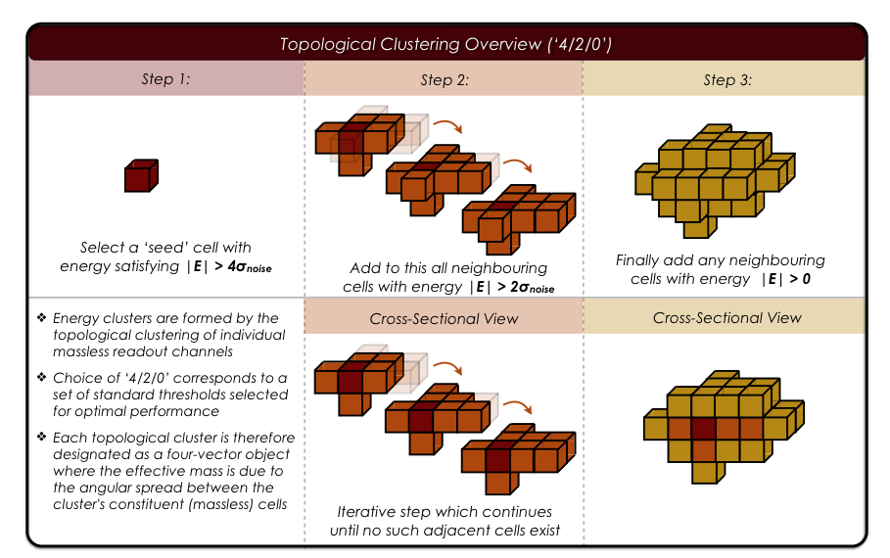
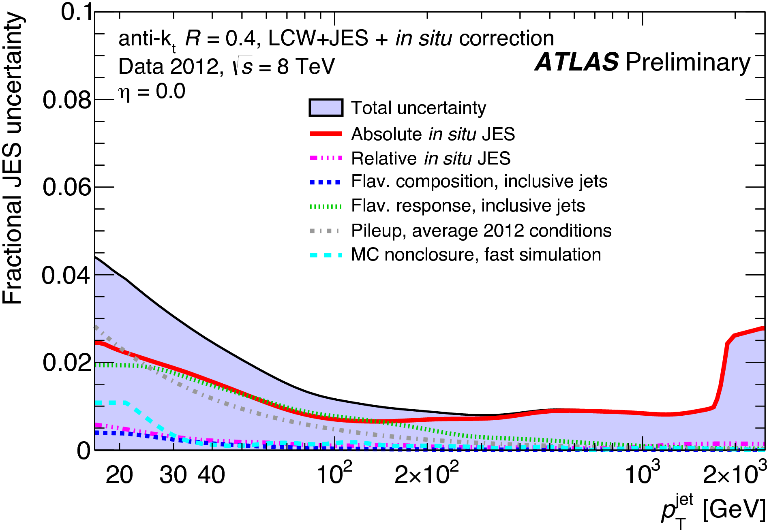
Calorimeter topo-clusters and their calibration
For all analyses described before, jet calibration (and its uncertainty) constitutes a critical input
MPP developed and fully commissioned novel ideas for the clustering and calibration of calorimeter signals into topological clusters (topo-clusters) that are used in subsequent physics object reconstruction
  follow electromagnetic / hadronic shower development
  suppress noise and pile-up energy contributions (see also arXiv:1510.03823)
  their features are used to classify and calibrate clusters
Default for √s ≥ 8 TeV analyses
  particularly important for E_{T}^{miss} and jet (sub-structures) calibration
  provides a reduced JES uncertainty (important for precision analyses)
ATLAS paper to appear soon
graphics by T. McCarthy
Topo-clusters grow around seeds according to noise dependent energy thresholds
EM+JES
calibration
scheme
ATLAS-CONF-2015-037

Slide 15
Conclusions
The MPP group is very active on high impact Standard Model measurements performed using ATLAS data
  it provides the most precise ATLAS m_{top} results and has a long history driving multi-experiment combination efforts (LHC and Tevatron+LHC). This will resume as soon as 8 TeV results are published
  it is pursuing a WW -> lνjj production cross section measurement in the boosted regime, very sensitive to anomalous triple gauge boson coupling
  it delivers standards for the calorimeter energy measurements and calibrations vital for physics object reconstruction and precision measurements (successful hand-shake between physics analyses and detector performance studies)
  Papers / theses based on 8 TeV datasets are in the pipeline
  … know-how and expertise ready to be applied to the 13 TeV dataset
Stay tuned!
Thanks for your attention!

Slide 16
– Backup –

Slide 17
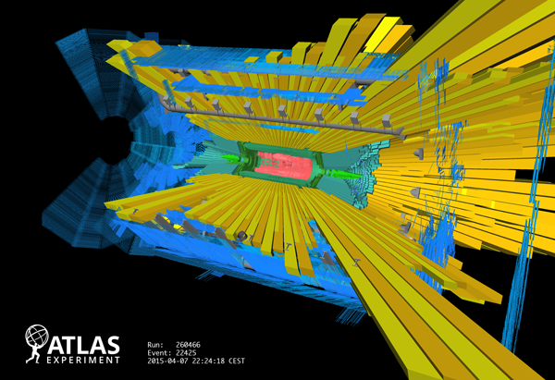
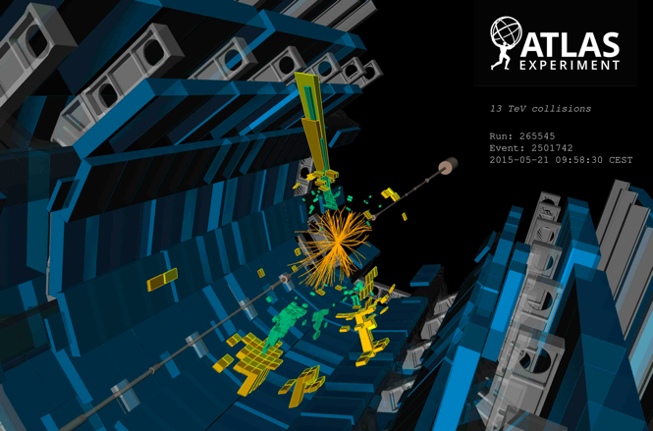
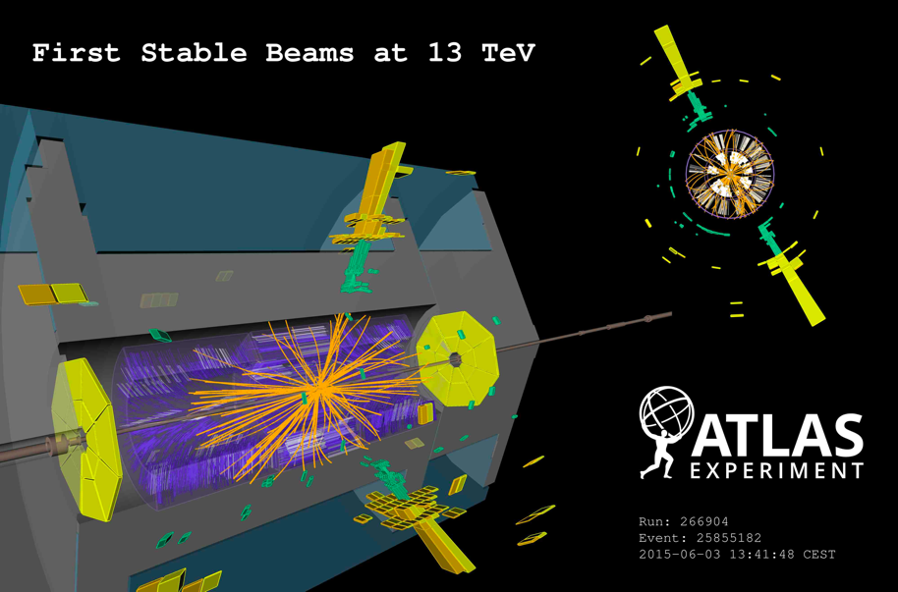
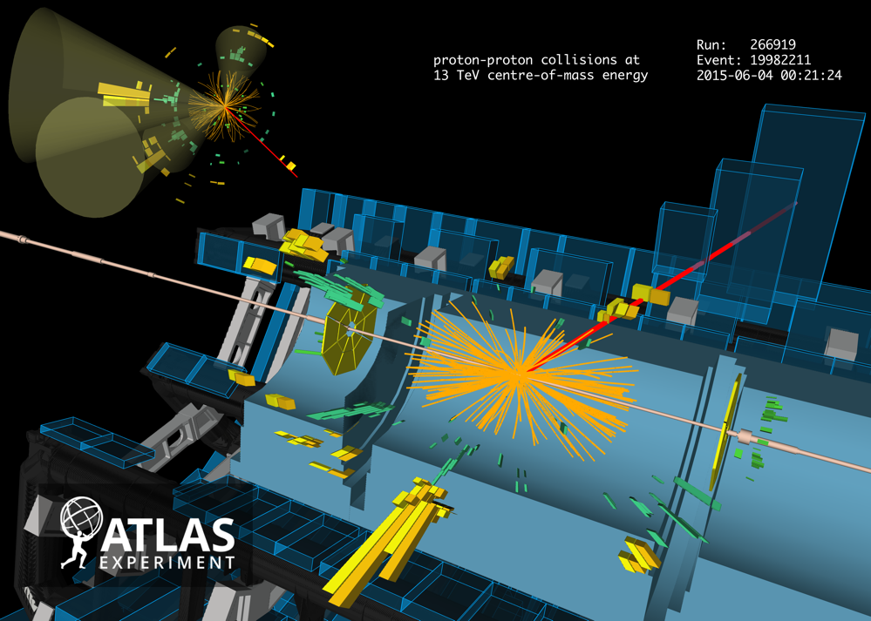
2015 : LHC @ 13 TeV
April 7th, 2015: Splash events
May 5th, 2015: first 900 GeV collisions (injection energy)
May 21st, 2015: first 13 TeV collisions
First Stable beams at 13 TeV June 3rd, 2015
First top quark pair candidate event at 13 TeV June 4th, 2015

Slide 18
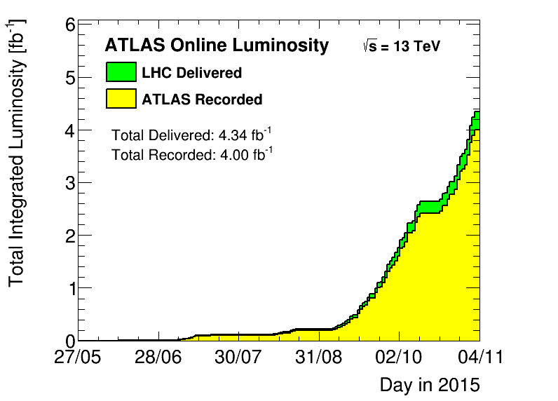
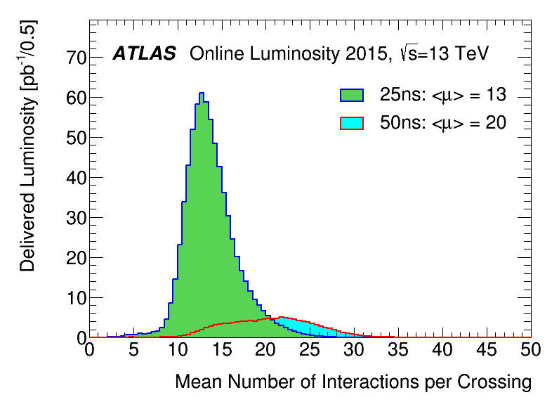
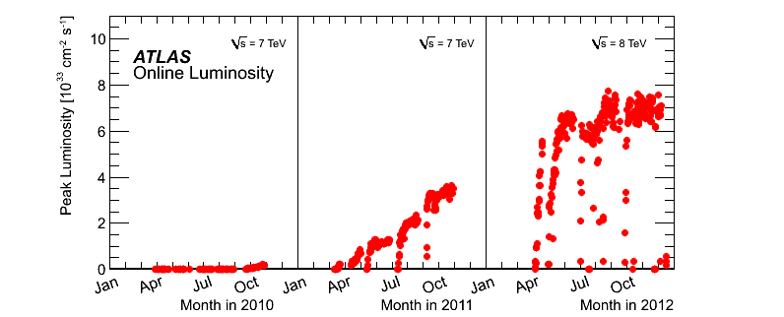
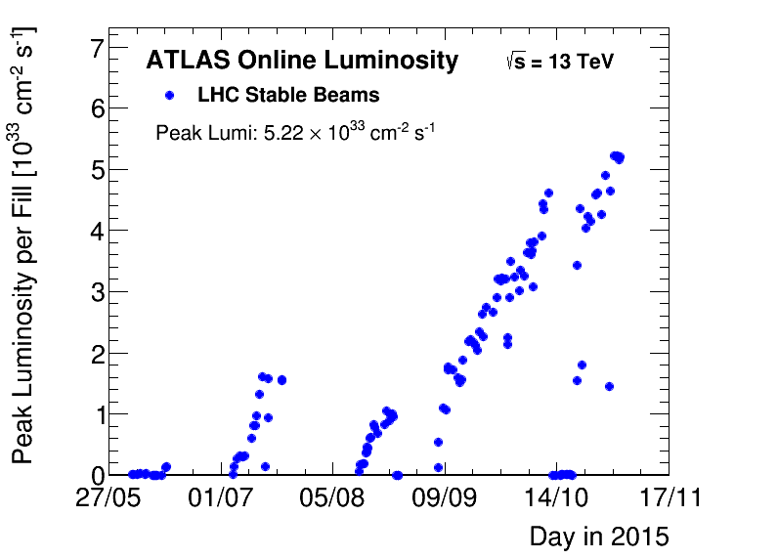
LHC performance
For comparison
√s=8 TeV <μ>= 20.7
√s=7 TeV <μ>= 9.1
For comparison
√s=8 TeV 22.8 (21.3) fb⁻¹ Del. (Rec.)
√s=7 TeV 5.46 (5.08) fb⁻¹ Del. (Rec.)
2012
2011
2010
2015
Similar performance/conditions as for 2011 data, but with almost doubled √s!

Slide 19
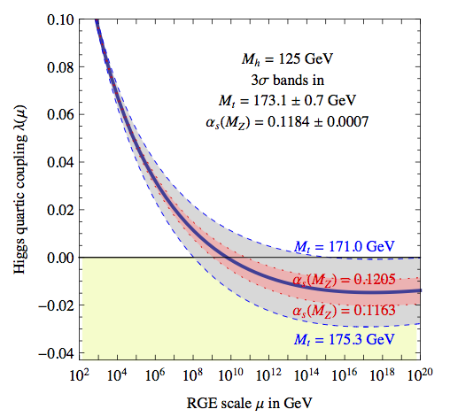
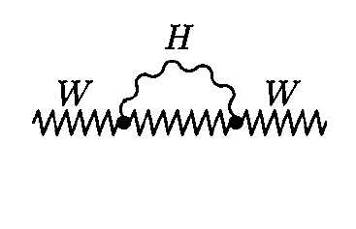
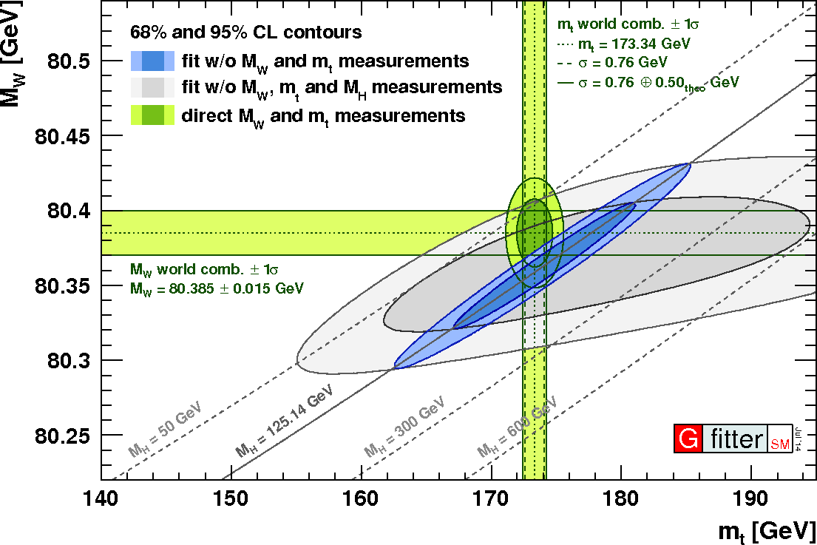
The top-quark mass
JHEP 1208 (2012) 098
Higgs, top quark, and W boson masses are related
A precise determination of m_{top} combined with EW precision measurements allows for stringent tests of the SM and its extensions
Also interesting theoretically due to its possible cosmological implications:
  depending on the values of m_{H} and m_{top}, the Higgs quartic coupling could be rather small, vanish or even turn negative at a scale smaller than the Planck scale.
  This affects the shape of the SM Higgs potential: if the Higgs field is trapped in a local minimum during the early universe, it can cause inflation (requires a non-minimal Higgs coupling to gravity)
Eur.Phys.J. C74 (2014) 3046
Notes:
Merge with the next slide SM / MSSM

Slide 20

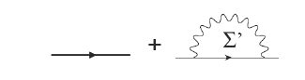
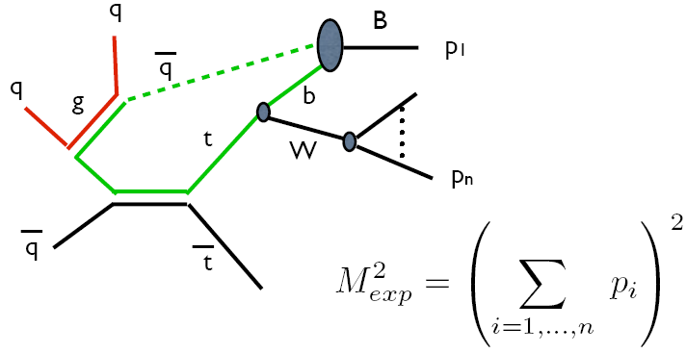
On the m_{top} definition
Pole mass = pole in the propagator
Renormalization schemes are defined by which quantum fluctuations are kept in the dynamical matrix elements and which ones are absorbed into the couplings and masses
  Different renormalization schemes yield different mass definitions
  e.g. :
but there are self-energy corrections:
m₀
and Σ’ is divergent.
The choice of the renormalization scheme corresponds to a particular definition of the mass parameter
δm can be used to absorb the divergencies

Slide 21
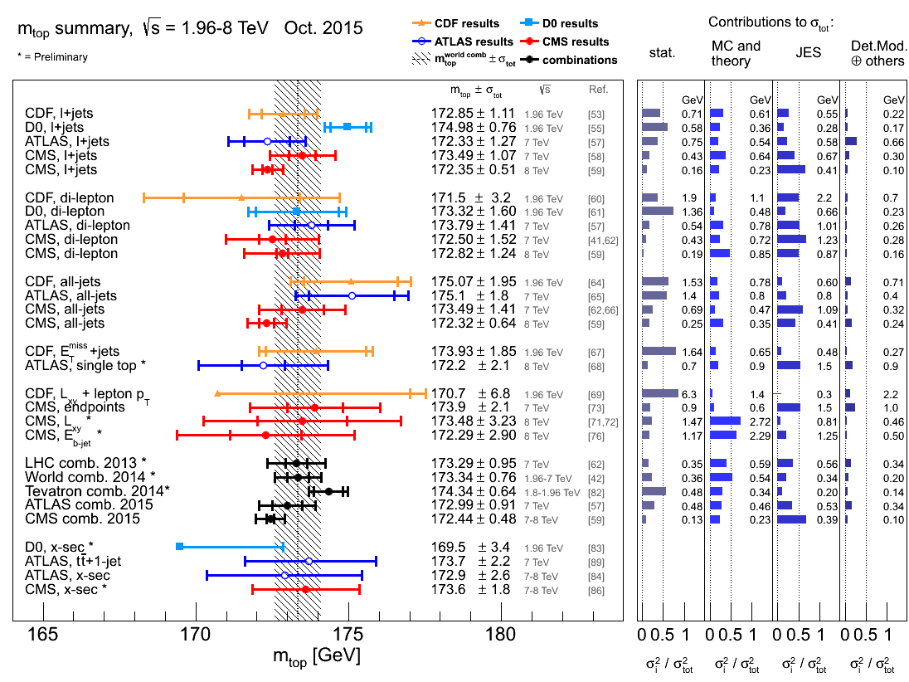
arXiv:1510.04483

Slide 22
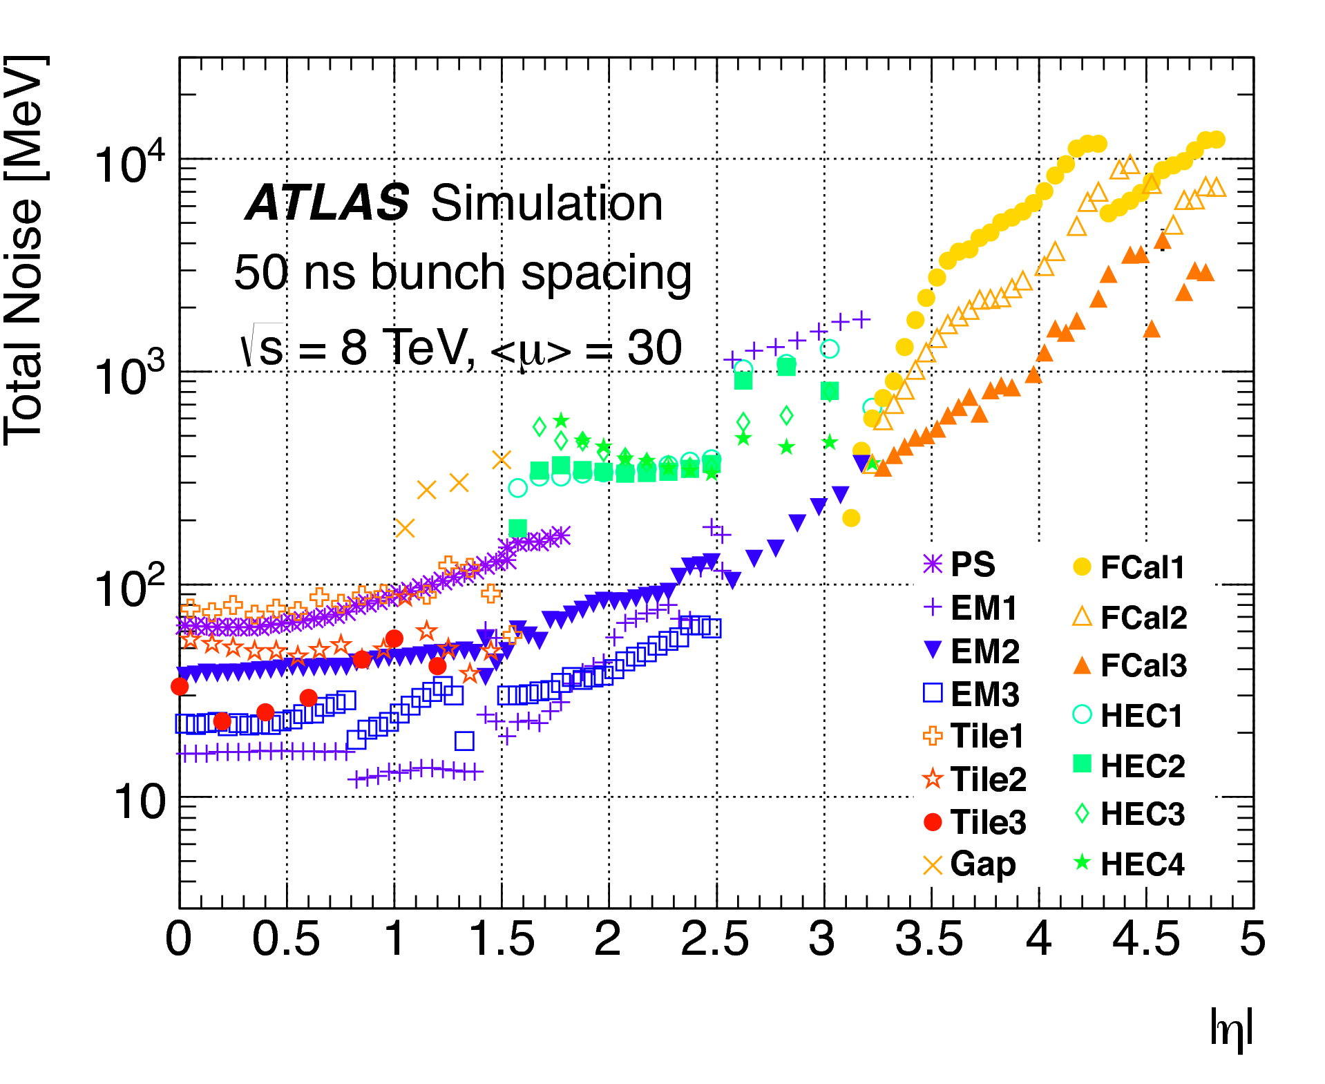
Calorimeter topo-clusters and their calibration
For all analyses described before, jet calibration (and its uncertainty) constitutes a critical input
MPP developed and fully commissioned novel ideas for the clustering and calibration of calorimeter signals into topological clusters (topo-clusters) that are used in subsequent physics object reconstruction
  follow electromagnetic (EM) / hadronic (HAD) shower development
  suppress noise and pile-up energy contributions (see also arXiv:1510.03823)
σ_{noise} (2012 pile-up conditions)
arXiv:1510.03823
graphics by T. McCarthy

Slide 23
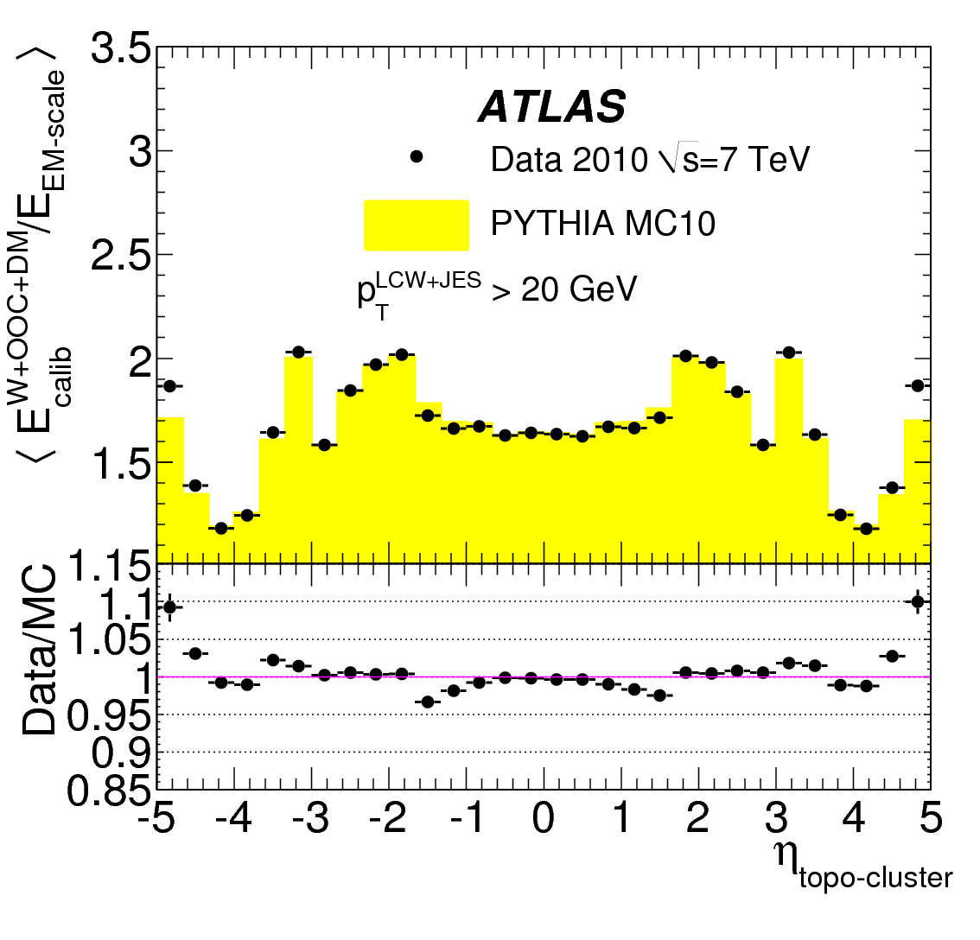
Local Hadron Calibration
Topo-custer shapes and other features are used to classify EM-like/HAD-like cluster for proper MC based local calibration
  in addition out-of-cluster and dead-material corrections are applied
Default for √s≥8 TeV analyses
  particularly important for E_{T}^{miss} and jet (sub-structures) calibration
  provides a reduced JES uncertainty (important for precision analyses)
ATLAS paper to appear soon
Eur.Phys.J. C73 (2013) 2304
EM+JES
calibration
scheme
ATLAS-CONF-2015-037

