Slide 1
Project Review:
Status of AWAKE Project
Joshua Moody
AWAKE Group
moody@mpp.mpg.de

Slide 2
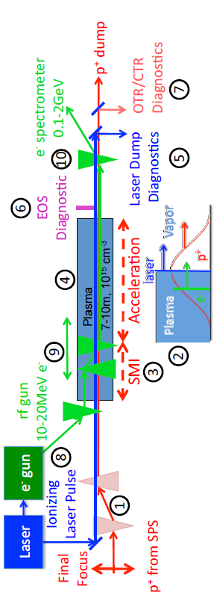
What is AWAKE?
AWAKE stands for Advanced WAKefield Experiment.
400 GeV proton beam drives wakefields in a 10 meter plasma through a self modulation instability
The wakefields accelerate electrons from 16 MeV to 2 GeV
Experiment organized into three phases:
Phase I: Demonstration of self-modulation instability
Phase II: Electron acceleration over 10 m
Phase III: Electron acceleration over long distances (yet to be approved)

Slide 3
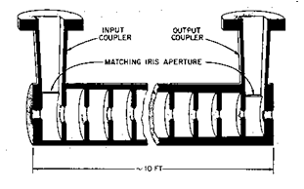
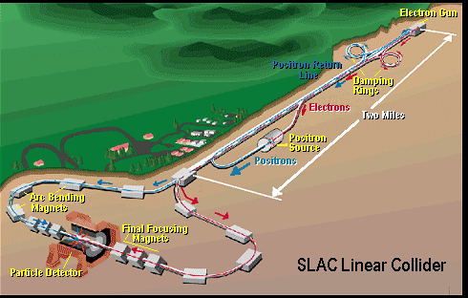
Why Advanced Accelerators?
Traditional RF (cm) scale accelerators
  Accelerating gradient limited to 50-100 MeV/m (state of the art limit) due to breakdown of the walls
  High energy accelerators must be larger and therefore costly
Advanced Accelerators:
  High Gradients
  Shorter distance for same energy
  Can have lower costs for higher energy designs
Traditional accelerator and collider designs will become prohibitively costly at higher energies
SLAC Accelerating Section (TW)
50 GeV electrons in 3.2km
16 MeV/m gradient

Slide 4
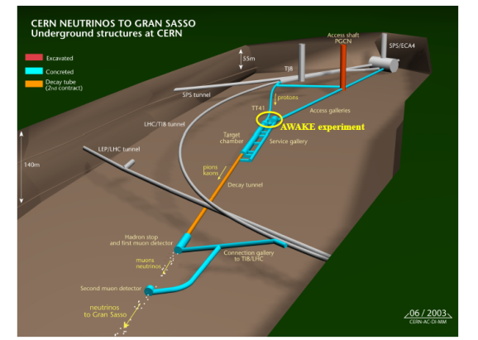
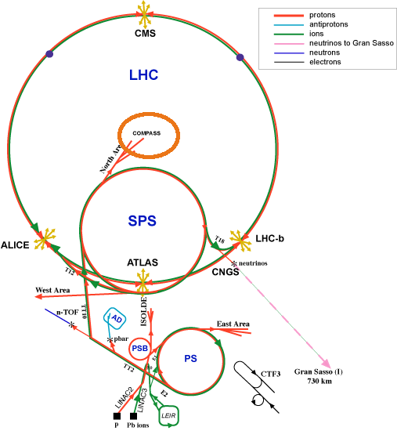
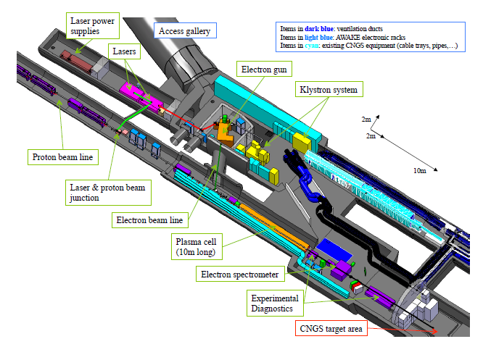
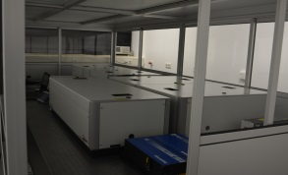

AWAKE at CERN
SPS Scale
Diagnostics:
OTR/CTR proton beam diagnostics
Electron Spectrometer
MPP Laser
AWAKE Scale
10 m Rb vapor source

Slide 5
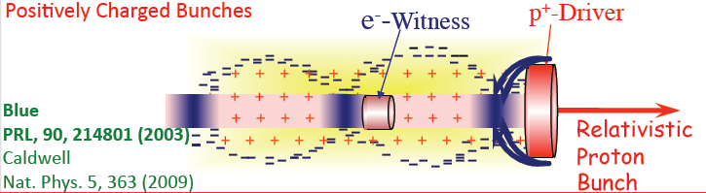
What is Plasma Wakefield Acceleration?
Fields from the relativistic charged particle beam drives wakefields in the plasma
Electrons can be trapped within the wakefield’s accelerating and focusing phase and produce a high quality electron beam in a short distance
E_{z}: accelerating field,
N: # particles/bunch
σ_{z}: gaussian bunch length,
, et al.
, et al.

Slide 6
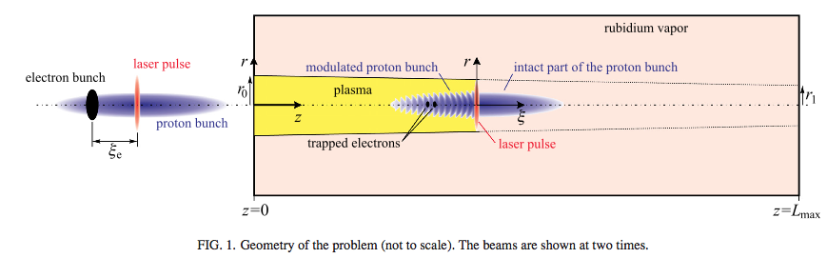
The AWAKE Experiment
K. V. Lotov et al., Phys. Plasmas 21, 123116 (2014)
Plasma requirements:
L~10m ~β*_{protons}
n_{e}=1-10x10¹⁵cm⁻³ k_{pe}σ*_{r}<1
Δn_{e}/n_{e}~0.2% Inject ~100λ_{pe}~σ_{z, protons}
r~1mm ~c/ω_{pe}
Heavy ions use ~100ω_{pe}⁻¹
Laser ionization provides seeding for the SMI

Slide 7
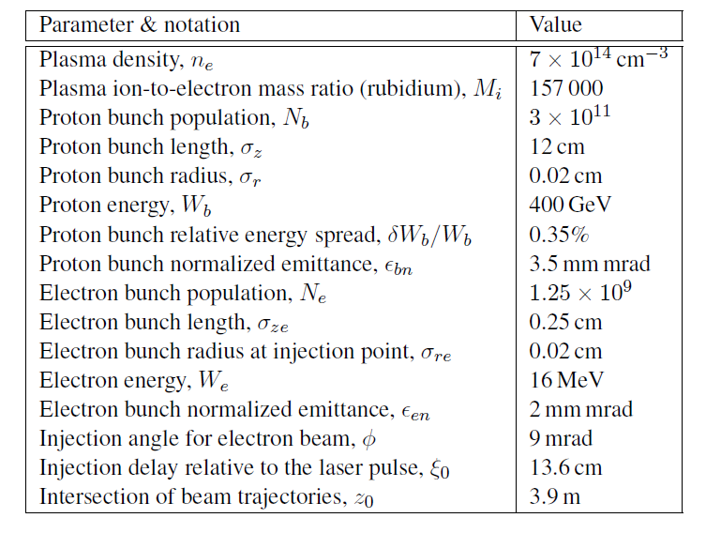
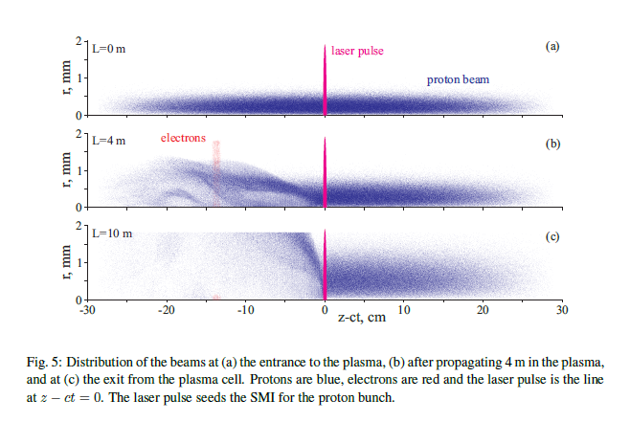
Using Protons
Protons can potentially propagate through long plasmas without reaching depletion
With a plasma wavelength of ~1mm, and a proton beam ~12cm, we rely on the self modulation instability to drive the wakefields

Slide 8
Contributions of the Institute
Vapor Source
  Vapor source: Provides uniform Rb vapor
  Rb Vapor Diagnostic
TW Power Laser:
  Ionizes Rb to make plasma and seeds self modulation,
  Seed for photocathode drive to make electron beam in phase II
  Ablation Studies for Beam Dump
Diagnostics
  OTR: Streak camera to determine proton modulation
  CTR: Coherent transition radiation to determine proton modulation
  Shadowgraphy (Transverse plasma diagnostic for ends)
Material Support
  Design and Fabrication
  Financial

Slide 9
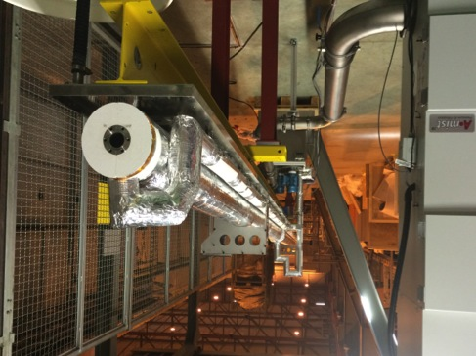
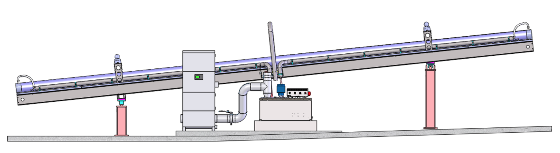

Plasma Source
(2) 10m heat exchangers @ CERN
Density adjustable from 10¹⁴ – 10¹⁵ cm⁻³
10 m long, 4 cm diameter
Plasma formed by field ionization of Rb
  Ionization potential Φ_{Rb} = 4.177eV
  above intensity threshold (I_{ioniz} = 1.7 x 10¹²W/cm²) 100% is ionized.
Plasma density = vapor density
System is oil-heated ~ 200˚ C
  keep temperature uniformity
  Keep density uniformity
E. Öz, P. Muggli, NIM 740 (2014) 197.
10m
Grant Instruments

Slide 10
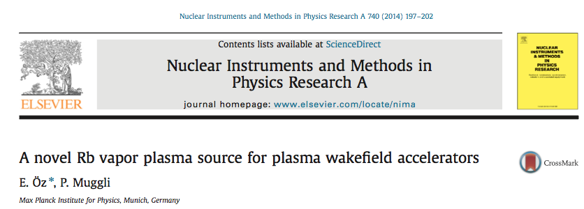
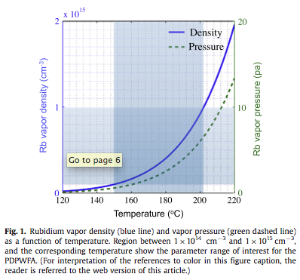
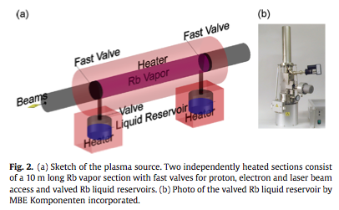
Vapor Source
People Involved:
P. Muggli
E. Oz
F. Batsch
N. Savard
Rubidium: ⁸⁵Rb(72%)+⁸⁷Rb(28%) φ_{i}=4.22eV I_{thresh}~1.7x10¹² Wcm⁻² T_{melt}=39°C
Rb vapor with imposed temperature (150-220°C) Laser pulse ionized (100fs, ~100mJ, w₀=1mm)

Slide 11
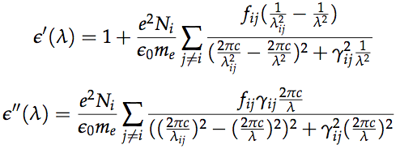
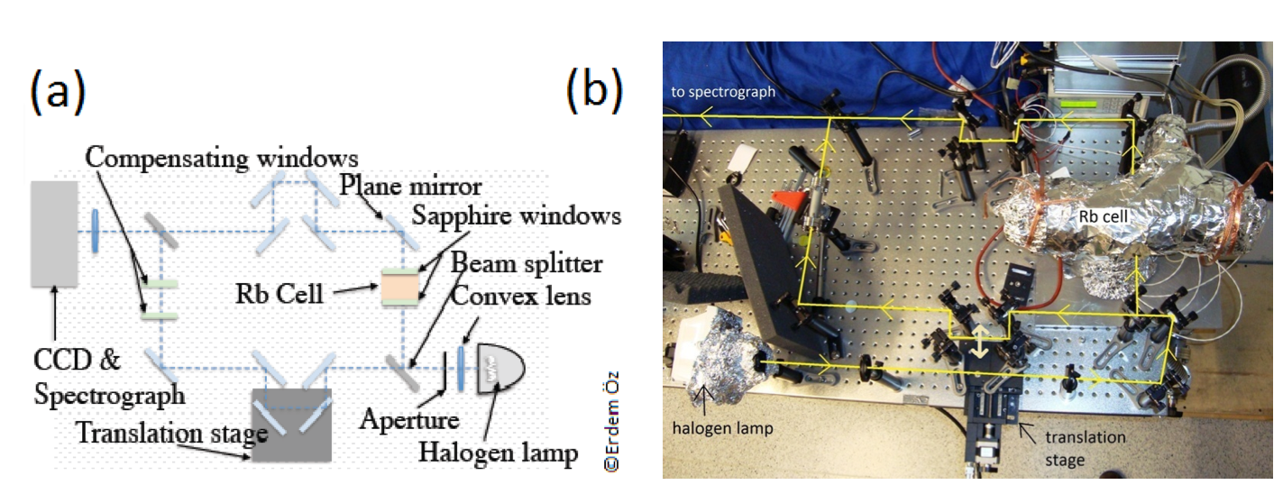
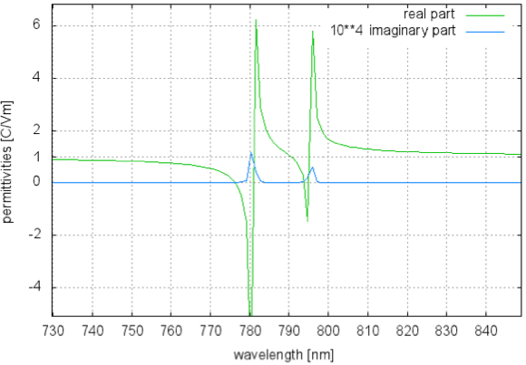
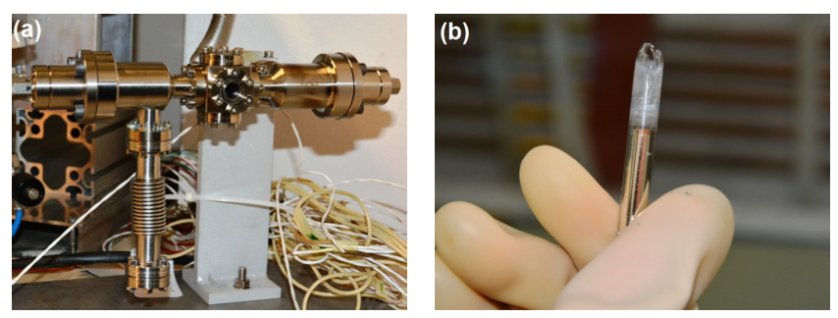
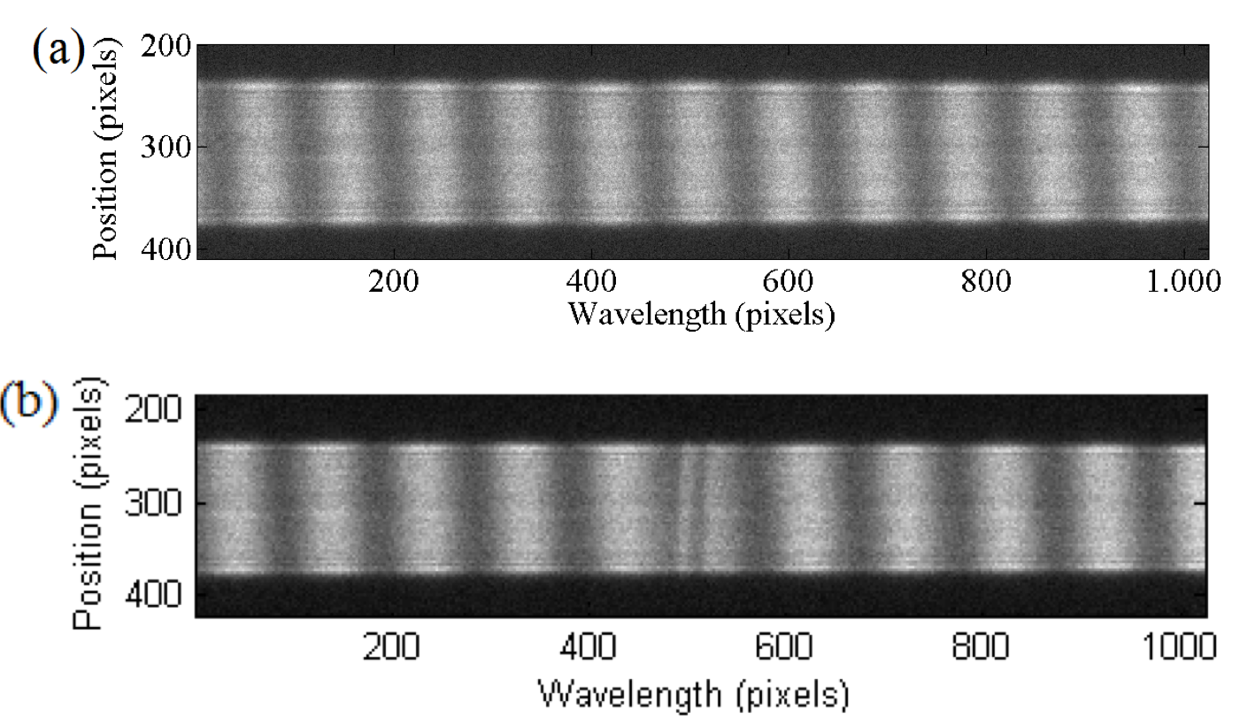
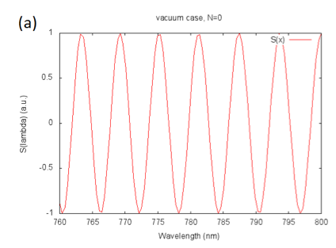
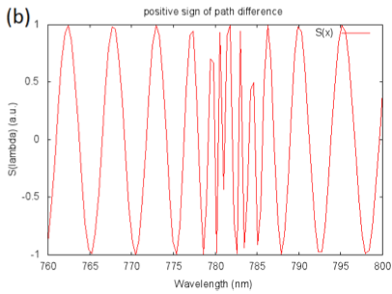
Rb Vapor Density Measurements
=>Dispersion
(anomalous)
=>Absorption
λ₁=780.2412nm
λ₂=794.9788nm
~10nm
T=20°C, no Rb
λ₁=780.2412nm
Hot, Rb
Measured AWAKE density range (10¹⁴ < n_{e0}< 10¹⁵cm⁻³) in the expected temperature range (180-200°C), Bachelor Thesis, F. Batch, TUM, 2014
Diagnostic to be implemented in AWAKE (Master Thesis …)

Slide 12
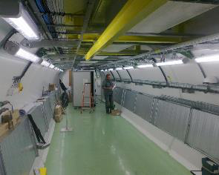

TW LASER
Laser Room in AWAKE area
Laser system in MPI, Munich
Laser Beam
Laser type | Fiber Ti:Sapphire
Pulse wavelength | λ₀ = 780 nm
Pulse length | 100-120 fs
Pulse energy (after compr.) | 450 mJ
Laser power | 4.5 TW
Focused laser size | σ_{x,y} = 1 mm
Rayleigh length Z_{R} | 3 m
Energy stability | ±1.5% r.m.s.
Repetition rate | 10 Hz
Laser installed & operating at MPP since fall 2014. Will move to CERN early 2016.
Laser Room MPP

Slide 13
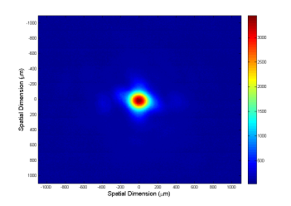
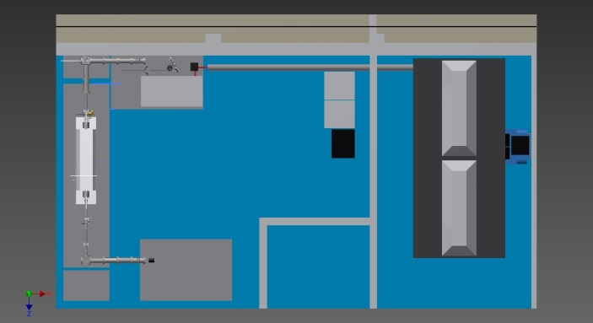

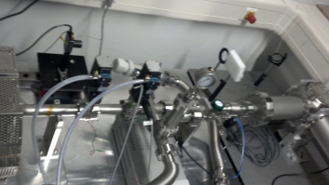
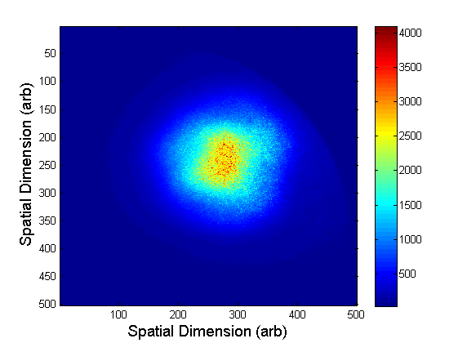
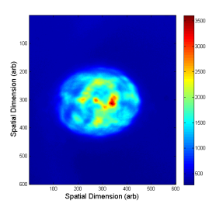
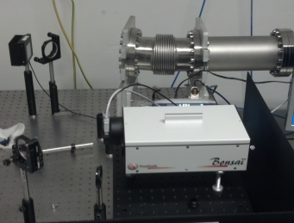
TW LASER at the Institute
Focus shifter
5 m lens
Beam
Profiler
on
Rail
Compressor
Spot at center first heater,
w0 radius is 200 um
Heat Pipe Oven
Bleed-through camera after Rb with filter wheel
Laser
Enclosure
Diagnostic table
with Autocorrelator
100uJ Pulse No Rb
10mJ Pulse Power with Rb
SHG Intensity AutoCorrelator

Slide 14
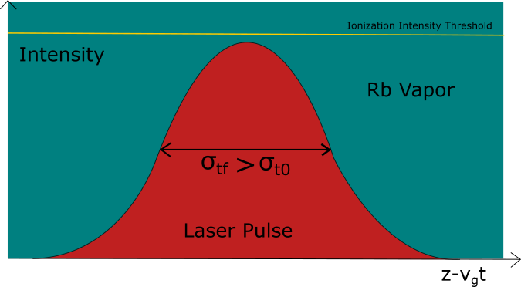
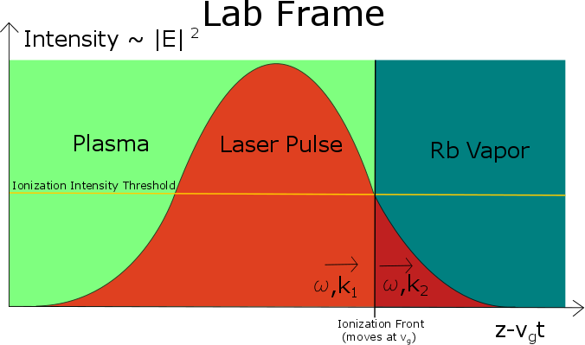
LASER at the Institute:
Laser Propagation
D1 and D2 lines dominate spectrum
At Intensities much less than ionization:
Differential index across BW of laser ~10⁻⁴
Laser pulse is stretched on cm scale
n-1
Spectrum (arb)
At Intensities above ionization:
Leading edge of the pulse ionizes or saturates the transition
Most of the pulse travels through plasma, samples plasma dispersion, which has a differential index on the scale of 10⁻⁸
Pulse stretching will lower peak intensity, causing drop below ionization threshold BUT
for intensities at AWAKE (>2 TW/cm²):
We expect little pulse stretching of most of pulse

Slide 15
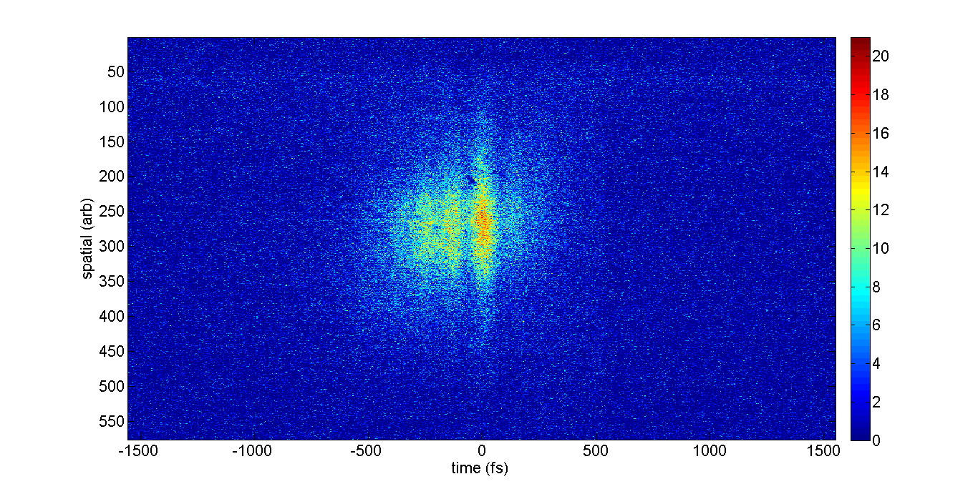
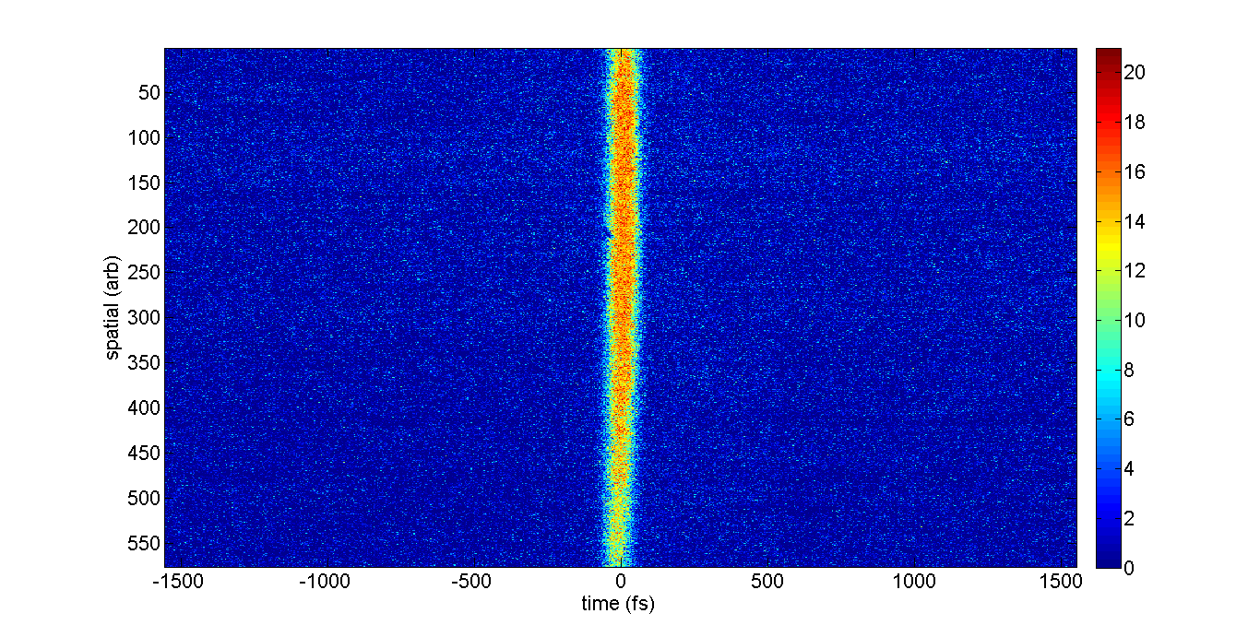
Measurement with 25 cm Rb in Heatpipe Oven
Spot size is set by aperture
Laser Intensity through plasma ~100 MW/cm²
Large scale broadening observed: from 100 fs to > 800 fs.
>800 fs
Laser Intensity through plasma ~1 TW/cm²
100 fs
NO PULSE BROADENING OBSERVED!!!
“PURPLE LIGHT” OBSERVED OUT OF BLEED PORT
Autocorrelation image with focusing

Slide 16
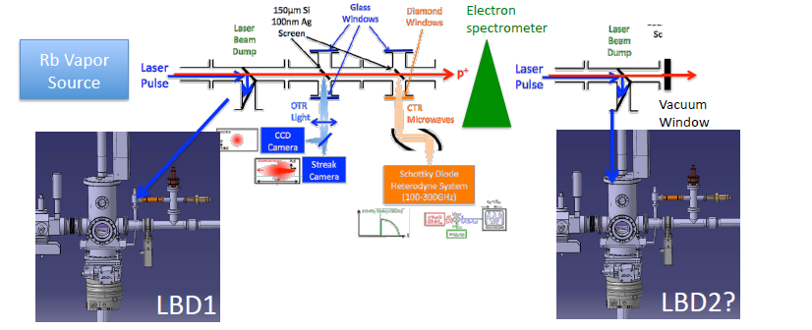
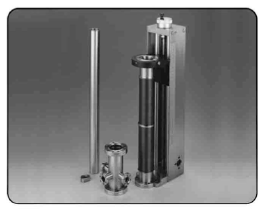
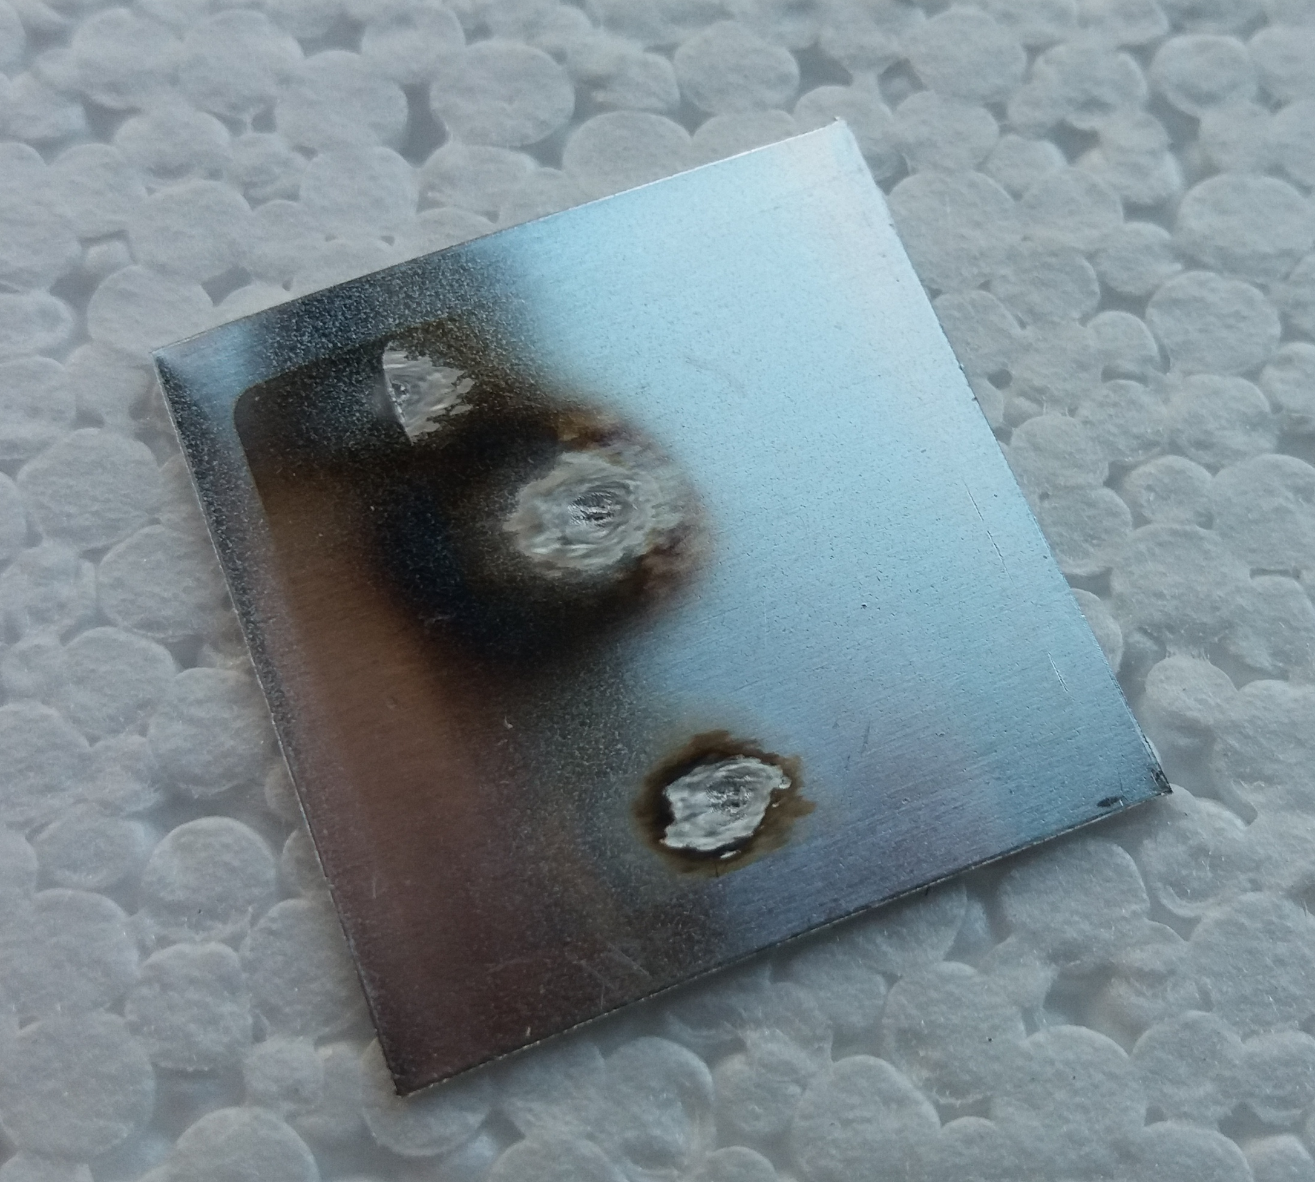
LASER at the Institute:
Ablation Study for Laser Dump
Laser Dump protects proton diagnostic screen from laser damage.
Dump is a foil on a translation stage that is moved before breakthrough
Foil should be thin to minimize radiation and thick enough such that we won’t have to change the foil in a run period (two weeks)
AWAKE fluence used to impact foils of different materials and thicknesses and the number of shots measured at MPP Laser lab.
Laser Ablation Foil at MPP

Slide 17
Proton Modulation Diagnostics for Phase I:
OTR / CTR
Measure radiation emitted by the bunch when traversing a dielectric interface
Optical Transition Radiation → streak-camera
Coherent Transition Radiation → variety of techniques under evaluation
Will work single shot !
CTR & TCTR
σ_{p} ~ 400 ps
4 ps
OTR
Simulated 100 GHz OTR signal in lab @ MPP

Slide 18
Summary
AWAKE is a plasma wakefield acceleration experiment at CERN.
MPP Contributions
Vapor Source and density diagnostics
Ionization / electron photocathode Laser
Phase I proton modulation diagnostics
Schedule
Laser will move from MPP to CERN in second week of January
Installation of Diagnostics will occur in January / Februrary
Phase I experiment will begin in Q4 of 2016
Watch for first experimental SMI results in Q4 2016!!!

Slide 19
Group Members and Acknowledgements
Group members
  Director : Allen Caldwell
  Group Leader : Patric Muggli
  Postdocs:
    Mikhail Martynaov : Diagnostics, CTR
    Joshua Moody : Laser propagation / ionization experiment
    Erdem Öz : Vapor source development
  Students:
    Anna-Maria Bachmann : Shadowgraphy
    Fabian Batsch: Vapor source density diagnostic
    Mathias Hünther: Laser dump ablation
    Atefeh Joulaei: Laser propagation/ ionization modelling
    Nicholas Savard : Vapor source development
    Karl Rieger: Diagnostics, OTR
Special Thanks:
  Machine shop
  Mister Finenko
  Mister Haubold

