Slide 1
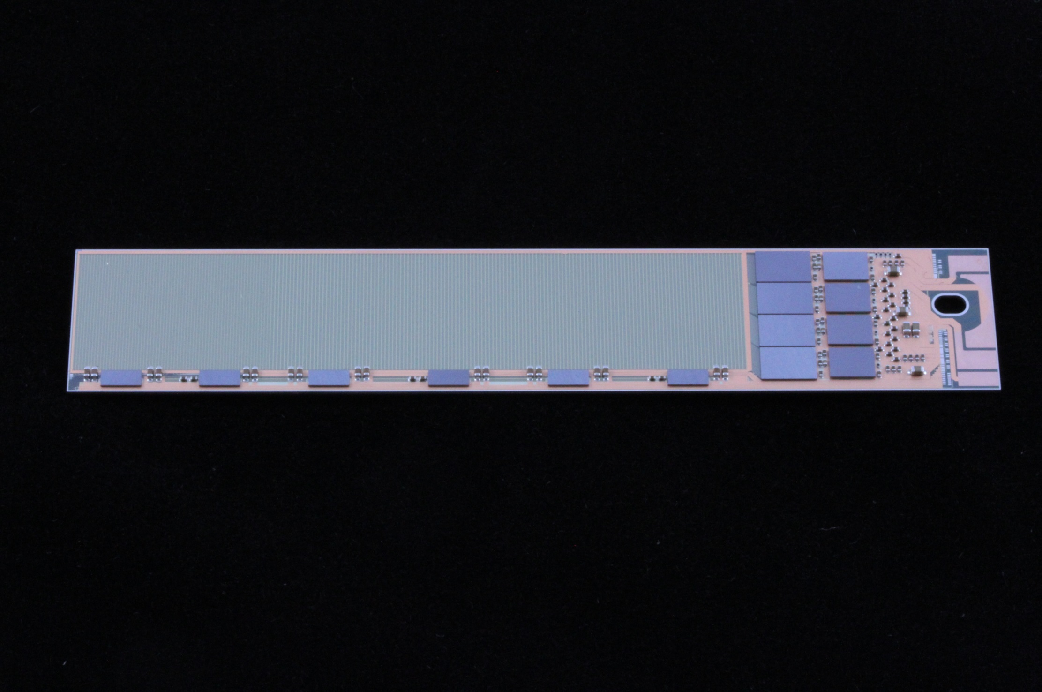
Belle & Belle II
Belle, Belle II Introduction
Belle II: accelerator upgrade status
Belle II detector upgrade
Activities at MPP
  Analysis
  Computing
  Mechanics
  - Kapton design & assembly
  Cooling
  Sensor production & Tests

Slide 2
MPP Team
Director: Allen Caldwell
Group Leader: Hans-Günther Moser
Senior: Christian Kiesling
Vladimir Chekelian
Postdoc: Luigi Li Gioi
Paola Avella
Manfred Valentan (Schrödinger Stipendium)
PhD student: Felix Müller
Fernando Abudinen
Pit Vanhöfer (finished)
Thorsten Röder (Tabuk)
Veronika Chobanova (finished)
Sebastian Sambraks (TU, NN-Trigger)
Sara Neuhaus (TU, NN-Trigger)
Master: Philipp Leitl (will continue as PhD student)
Jakob Haidl
Eduard Prinker
Technische Abteilungen: Karlheinz Ackermann, Sven Vogt, David Kittlinger, Christian Knust, Markus Fras, Miriam Modjesch, Enrico Töpper, Reinhard Sedlmeyer, Stefan Horn and more

Slide 3
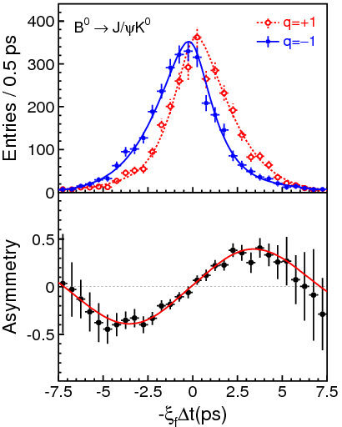
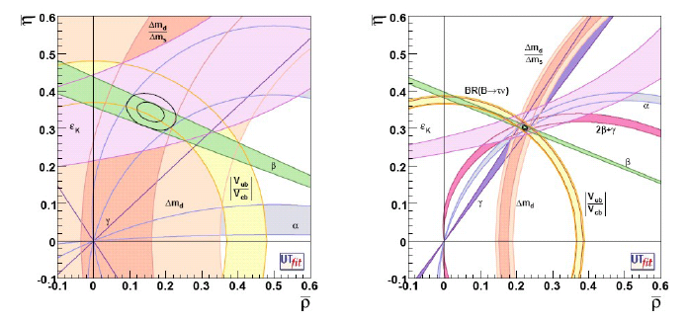
Physics at B-factories
Measurements of CKM matrix elements and angles of the unitarity triangle
Observation of direct CP violation in B decays
Measurements of rare decays (e.g., B→τν, Dτν)
b→s transitions: probe for new sources of CPV and constraints from the b→sγ branching fraction
Forward-backward asymmetry (A_{FB}) in b→sll has become a powerfull tool to search for physics beyond SM.
Observation of D mixing
Searches for rare τ decays
Observation of new hadrons
_
B⁰ tag
B⁰ tag
Motivation for upgrade:
Measure CKM elements as precisely as possible
Overconstrain unitarity triangle
Look for deviations from SM
=> Need about 50 ab⁻¹
Babar/Belle
With 50 ab⁻¹ (same central values)

Slide 4

KEKB to SuperKEKB
e- 2.6 A
Upgrade KEKB to reach
L = 8 x 10³⁵ cm⁻²s⁻¹
(40 x luminosity of KEKB)
Nano Beams: 10µm x 60nm
Increase beam current (x2)
Reduce asymmetry (boost)
KEB:
βγ = 0.42 (8 GeV, 3.5 GeV)
SuperKEKB:
βγ = 0.28 (7 GeV, 4 GeV)
Well in schedule,
first beam in February 2016
e+ 3.6 A
New beam pipes
& bellows
Belle II
Reinforce RF systems for higher beam currents
Improve beam monitors and control system
e+ Damping ring
New positron capture section
Low emittance electron gun

Slide 5
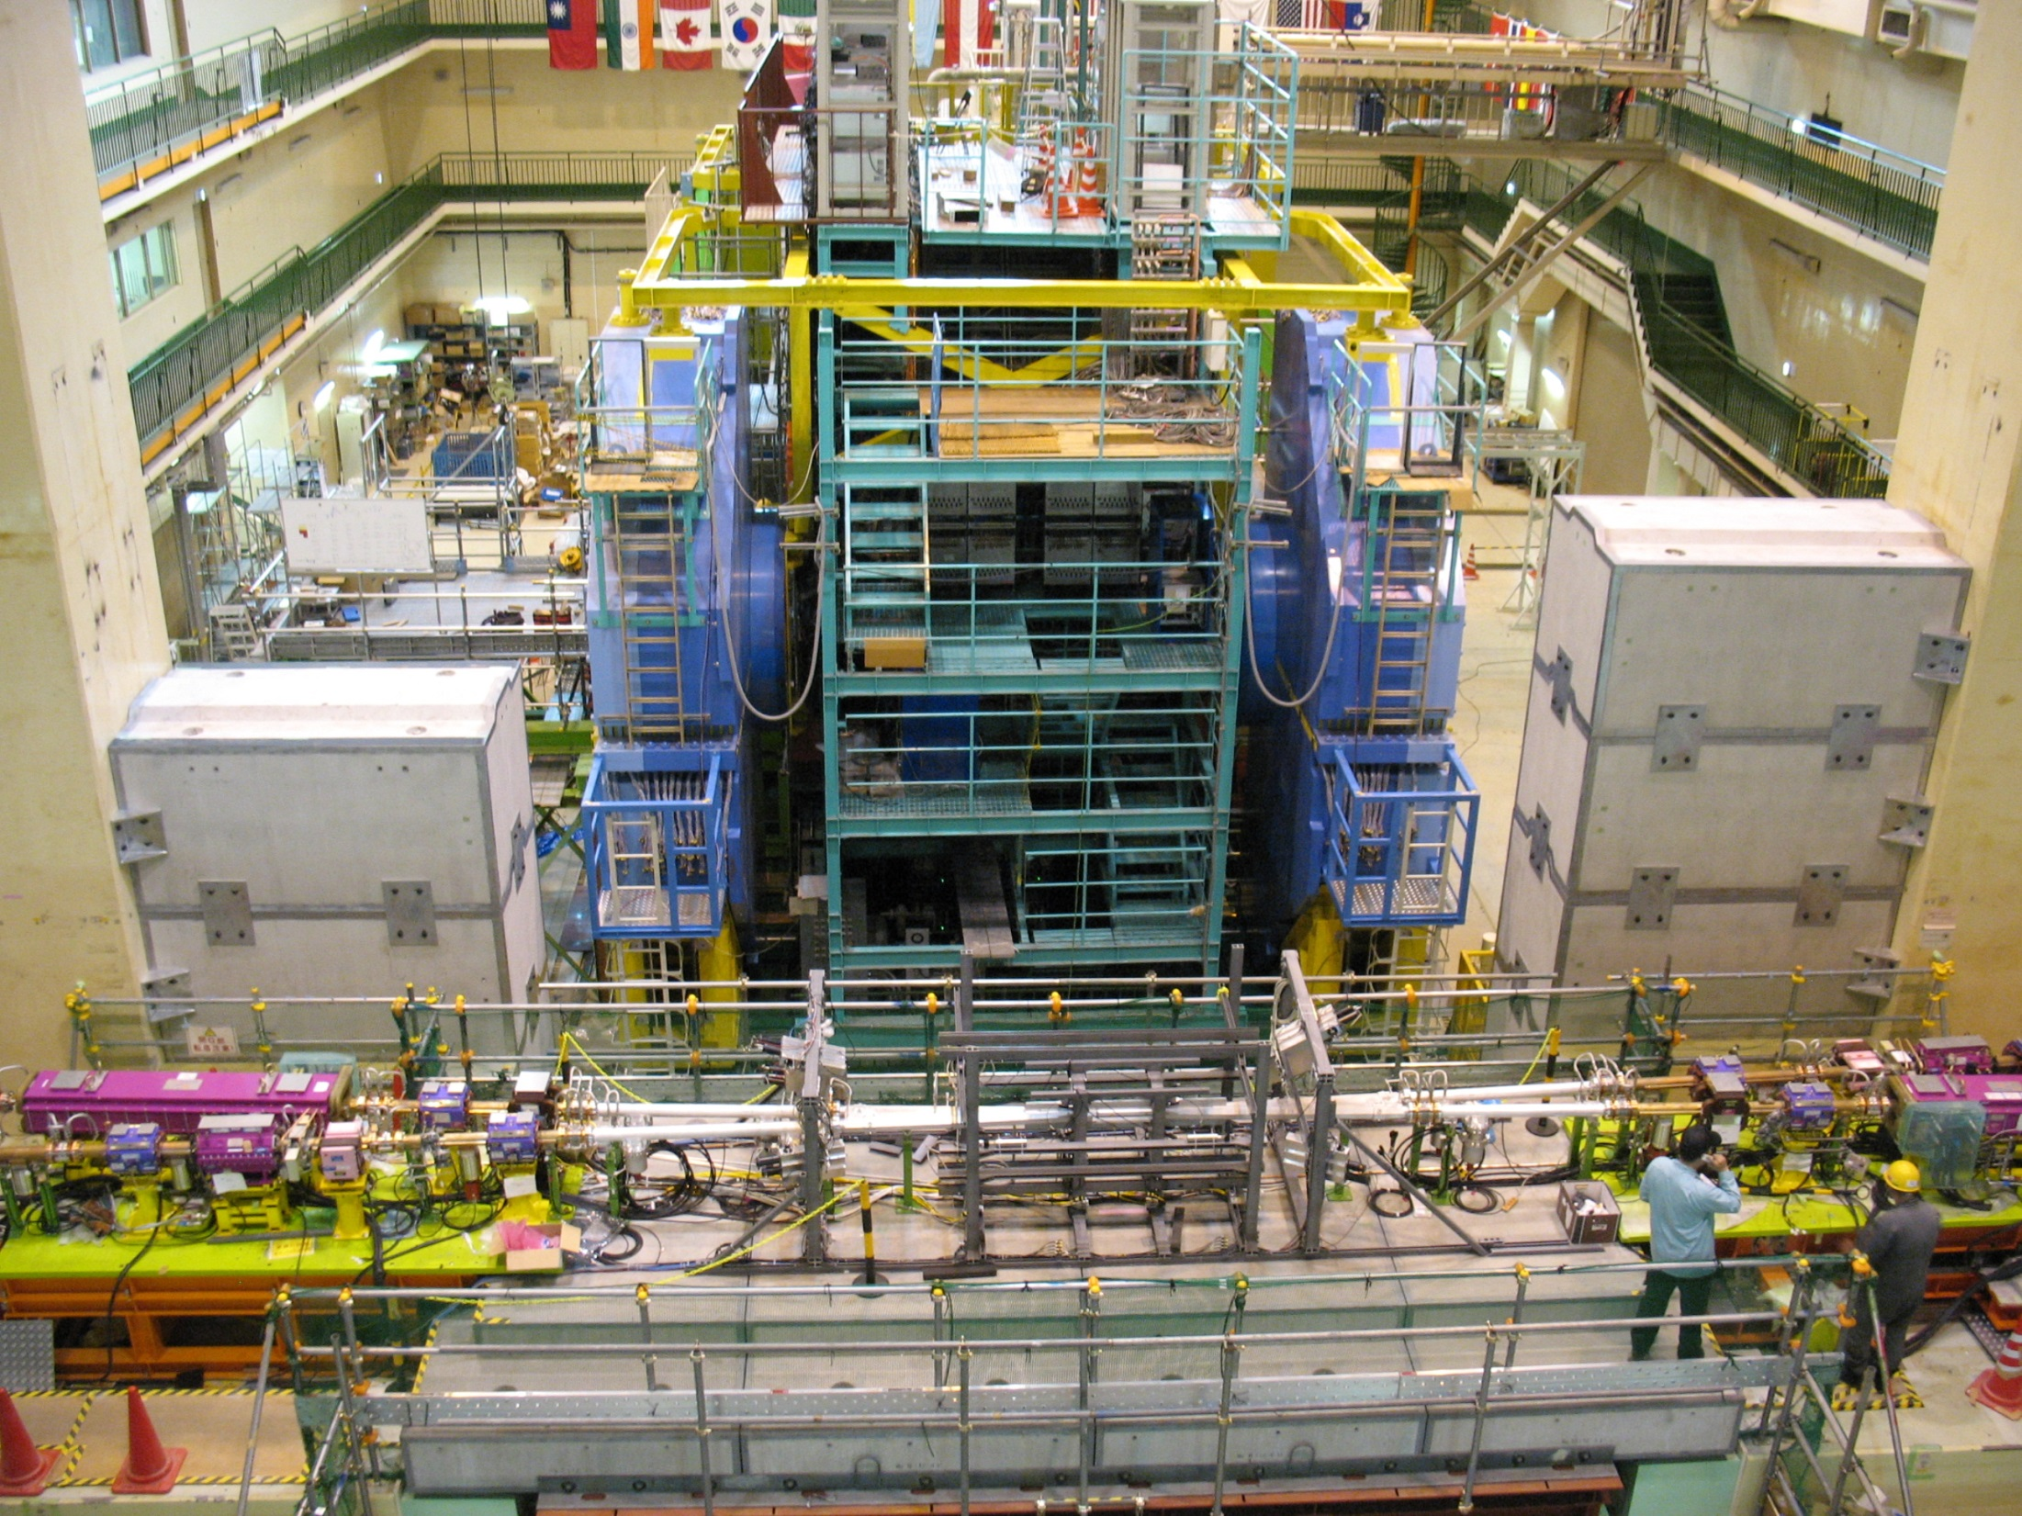
IR 6 Oct 2015
K. Kanazawa

Slide 6
Requirements for the Belle II detector
Critical issues at L= 8 x 10³⁵/cm²/sec
4 Higher background ( ×10-20)
4 Higher event rate ( ×10)
4 Special features required
radiation damage and occupancy
fake hits and pile-up noise in the EM Calorimeter
- higher rate trigger, DAQ and computing
γβ reduced by a factor of 2: compensated by improved vertexing
Result: significant upgrade of detector needed

Slide 7
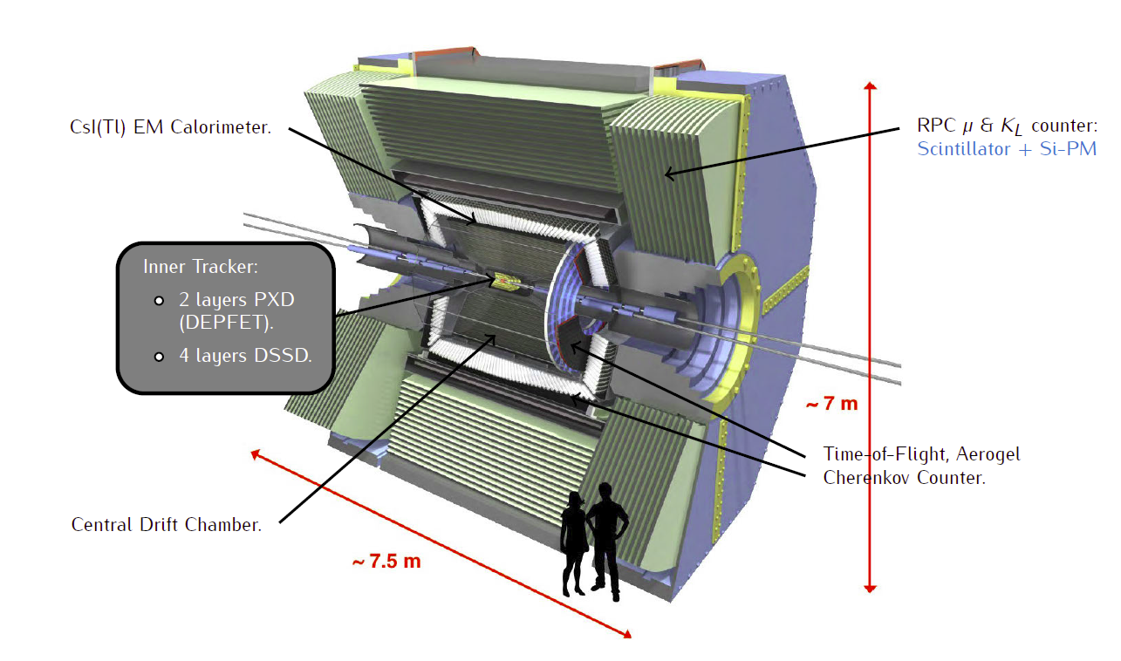
Belle II

Slide 8
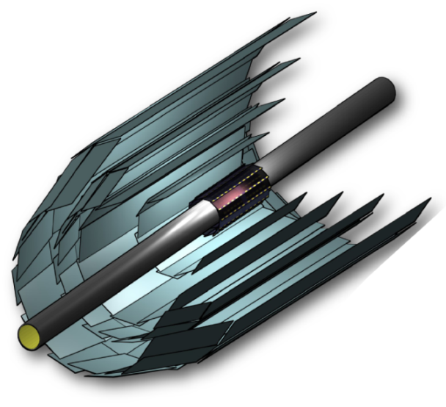
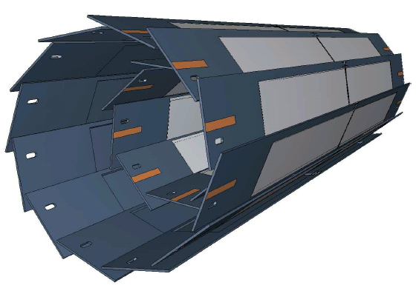
Silicon Tracking System @ Belle II
SVD: 4 layer Si strip detector (DSSD)
(R = 3.8, 8.0, 11.5, 14.0 cm)
PXD: 2 layer Si pixel detector (DEPFET technology)
(R = 1.4, 2.2 cm)
monolithic sensor
thickness 75 µm (!),
pixel size 50 x 55 µm² to 50 x 85µm² (depending on layer and z)
Significant improvement in z-vertex resolution
σ [µm]
PXD
PXD+SVD
100
Belle
50
30μm
20
Belle II
15μm
0
0.4
0.8
1.2
1.6
2.0
pβsin(θ) [GeV/c]

Slide 9
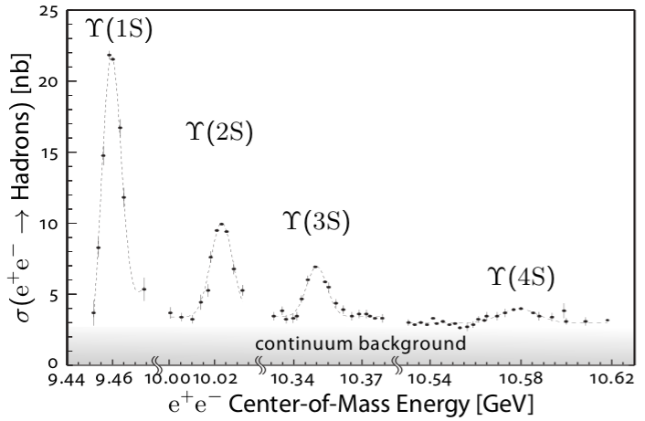
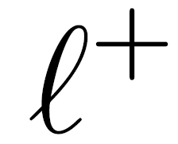
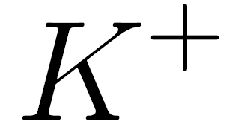
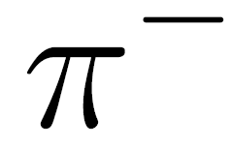

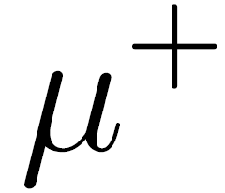
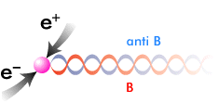


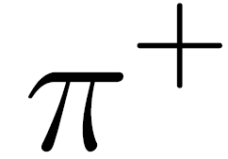
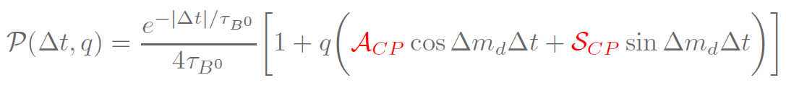
Physics & Physics Preparation
Time dependent measurements of CP violation
Y(4S) is the first resonance just above the BB production threshold
Only BB pairs are produced, and are quasi at rest in the Y(4S) frame
B_{tag}
e⁺
B_{phys}
Resolution on Δt will be dominated by the resolution of the tagging side vertex
Quantum entangled neutral
B meson pair production
Belle ~ 200 μm
Belle II ~ 130 μm
Δt probability parametrization

Slide 10
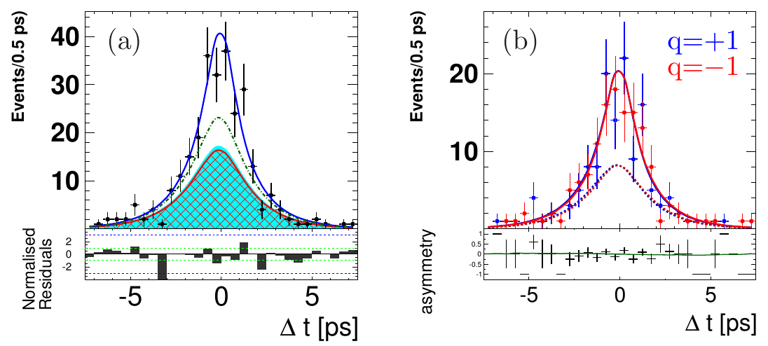
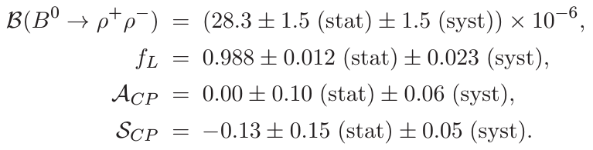
B⁰ → ρ⁺ρ⁻
Flavor integrated
Four pion final state
Precision improvement with respect to the previously published result is factor 2.
Increase of data, simultaneous extraction of observables and analysis optimization for high signal yield.
P. Vanhoefer
ArXiv:1510.01245. Submitted to PRD

Slide 11
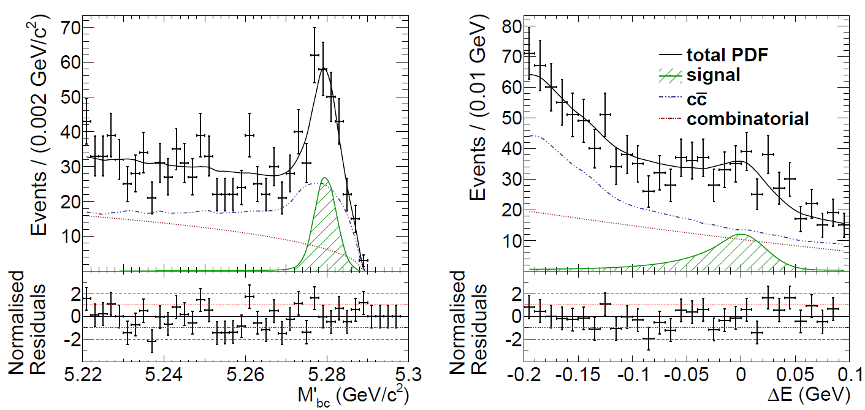
B⁰ → ψ(2S) π⁰
First observation of B⁰ → ψ(2S) π⁰
BR(B⁰ → ψ(2S) π⁰ ) = (1.17 +- 0.17(stat) +- 0.08(sys)) x 10⁻⁵
This channel may be used to constrain the penguin contamination in B⁰→ ψ(2S) K⁰ in a future measurement of its time dependent CP asymmetry
V. Chobanova

Slide 12
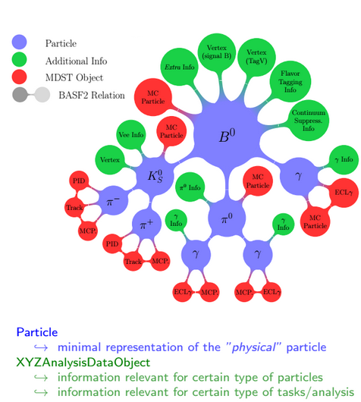
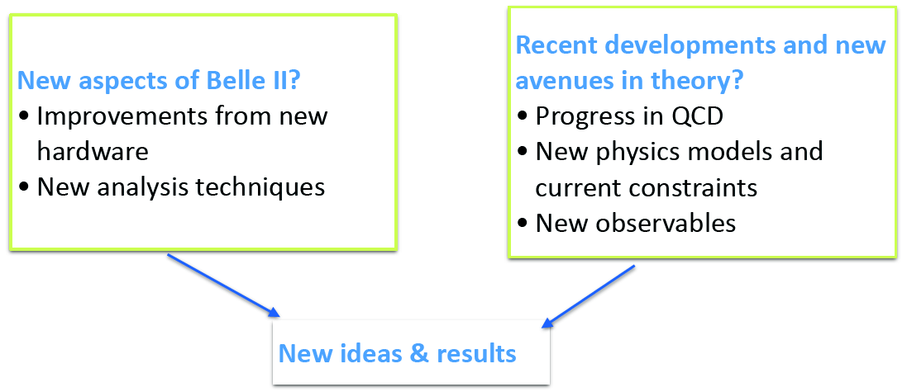
Physics preparation
The Belle II Physics preparation follows two paths
MPP Belle II team participates to both activities
The "Belle II - Theory Interface Platform" is a joint theory - experiment
program to study the potential impacts of Belle II
Physics software development
L. Li Gioi, F. Abudinen

Slide 13
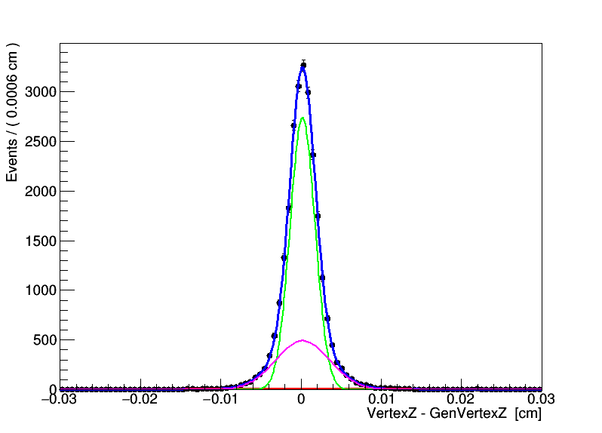
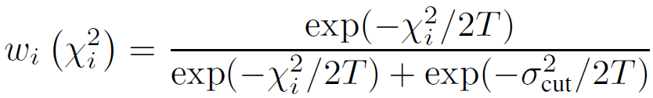
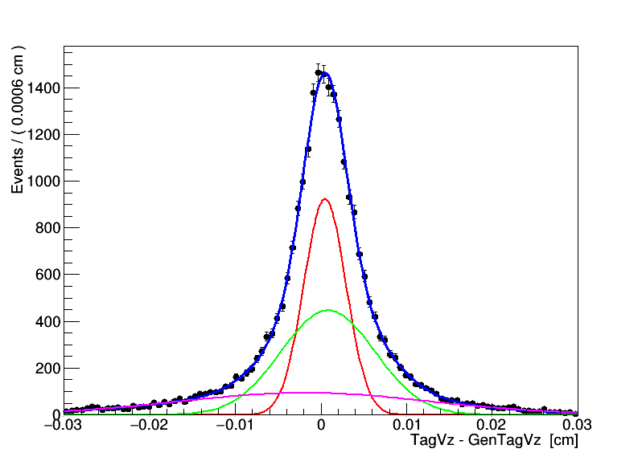
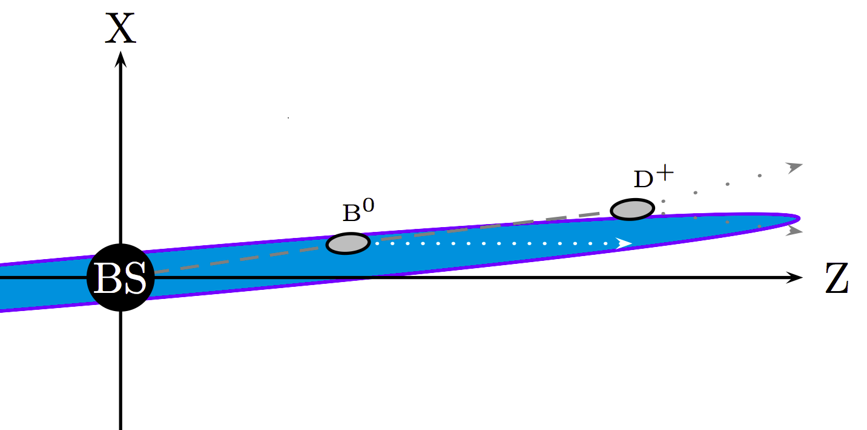
Vertexing
L. Li Gioi
Kinematic fit: J/ψ → μ μ
Two vertex fitters used in Belle II for kinematic vertex fits
Kfit : used in Belle
RAVE: porting of the CMS vertexing libraries to a standalone package, see https://rave.hepforge.org/)
Belle II
Shift = 2.0 μm
Resolution = 22 μm
Belle
Shift = 0.2 μm
Resolution = 63 μm
Tag side vertex fit: Using RAVE Adaptive Vertex Fit (AVF) algorithm:
Down-weights outliers dynamically, instead of using hard cutoffs (important for 3+ track vertices). CMS NOTE 2008/033.
Tag side vertex fit
Belle II
Shift = 1.0 μm
Resolution = 63 μm
All tracks used apart from the ones from Ks
Belle
Shift = 29 μm
Resolution = 89 μm

Slide 14
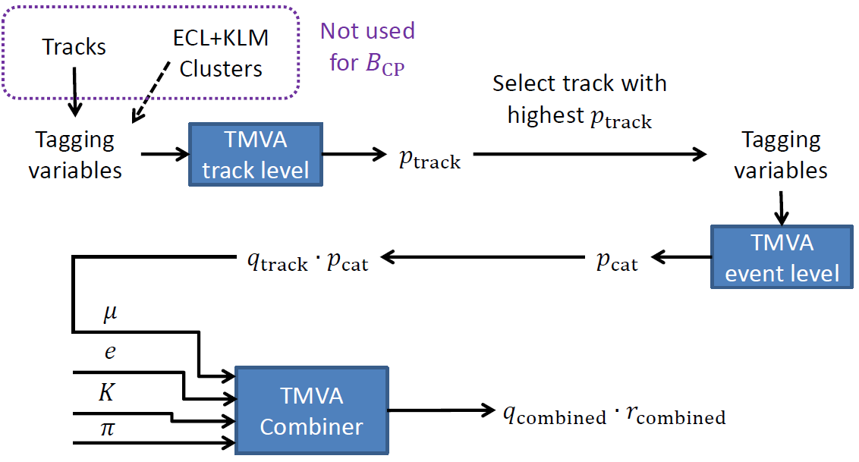
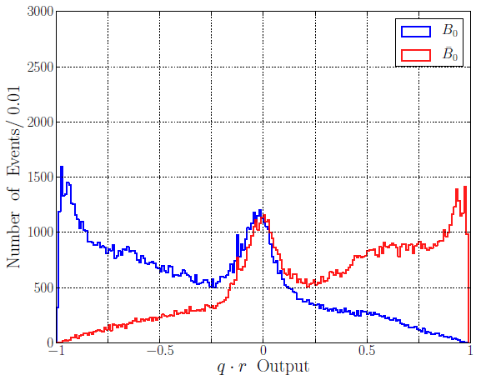
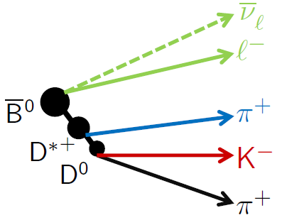
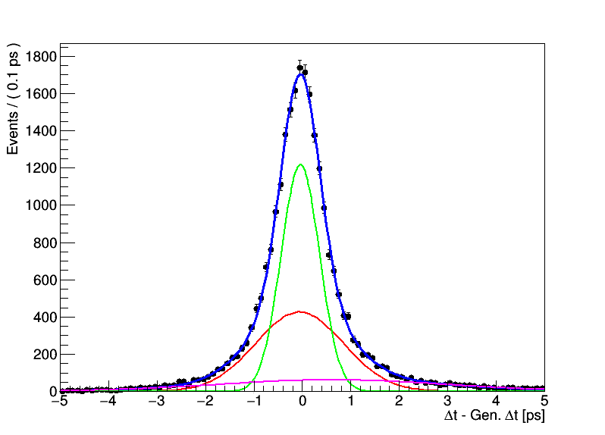
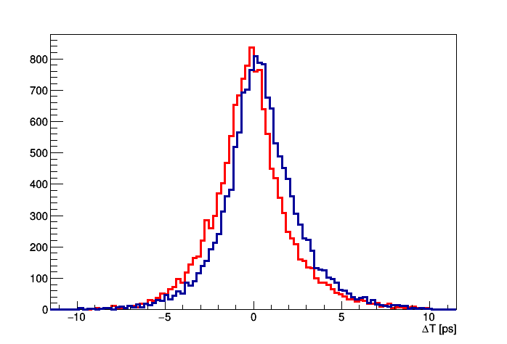
Flavor tagging
F. Abudinén
Δt resolution
Efficiency = 32 %
Belle = 29 %
B⁰tag B⁰tag
Belle II
Shift = 0.03 ps
Resolution = 0.86 ps
Belle
Shift = 0.20 ps
Resolution = 0.92 ps
Example of signatures

Slide 15
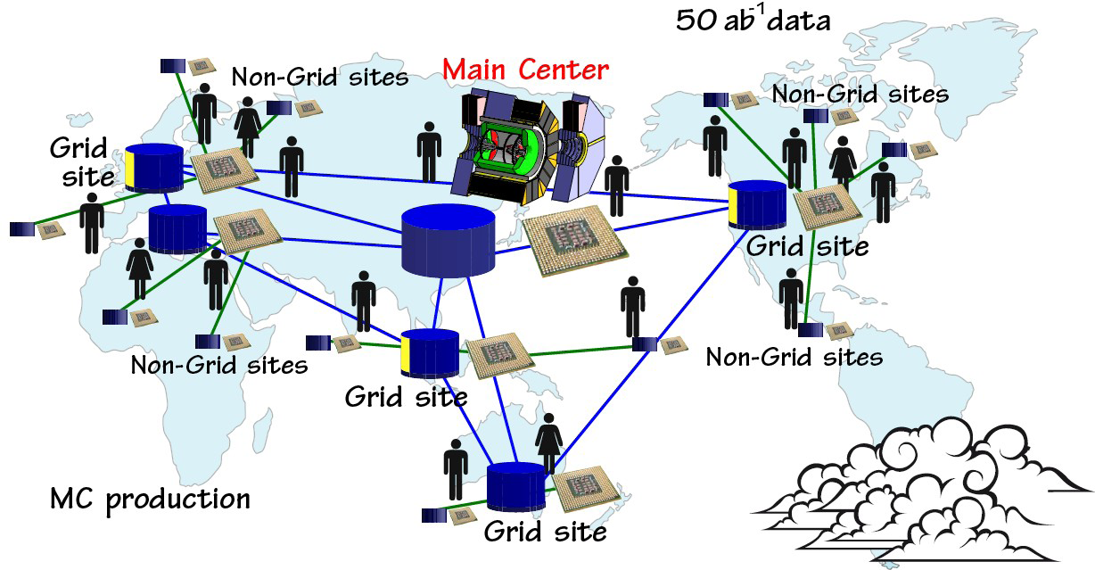
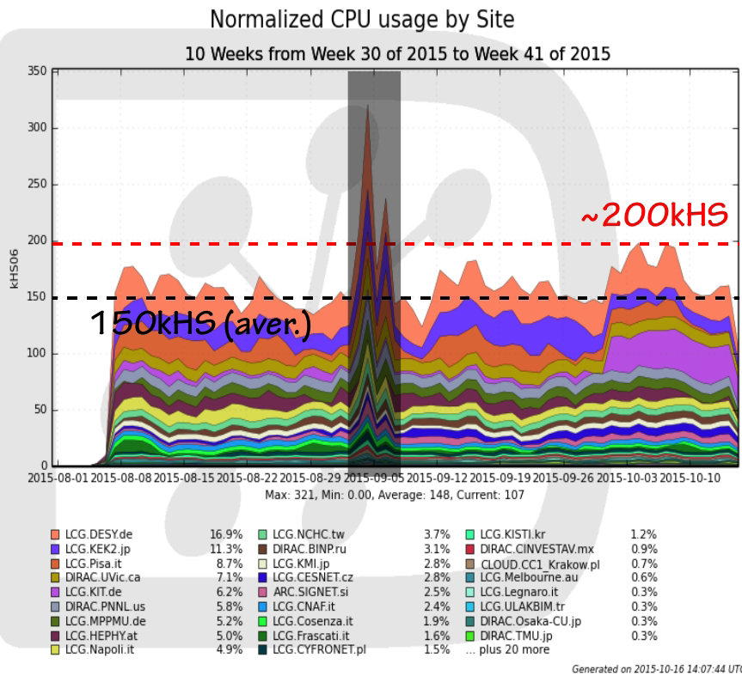
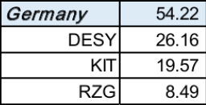
Computing
Belle II adopts GRID computing
Only Monte Carlo production so far
Large Germany contribution during last MC production
On average during last MC production kHS06
Outlook:
MPCDF as a Belle II Tier-2
Belle II data analysis farm
Belle data preservation
L. Li Gioi

Slide 16
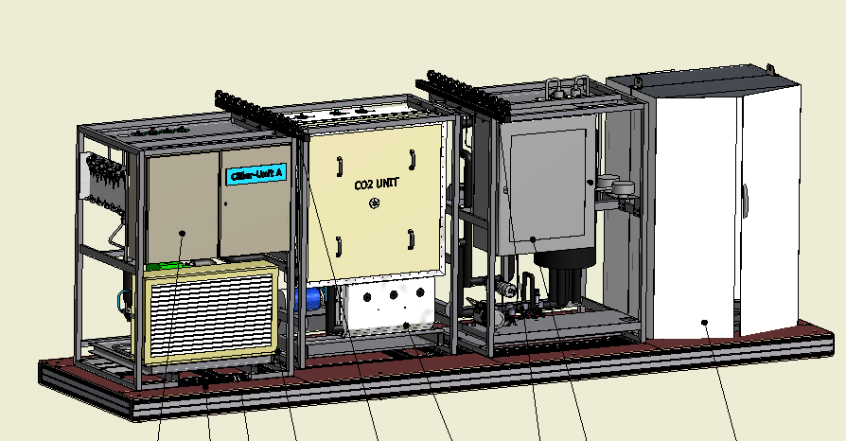
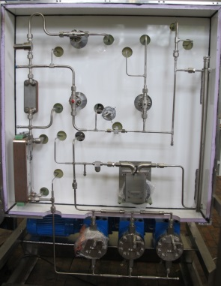
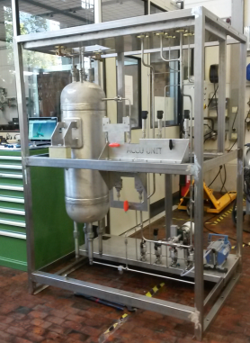
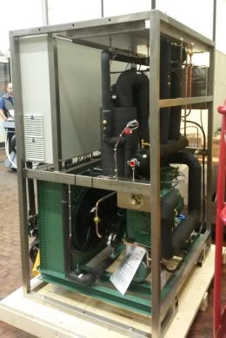
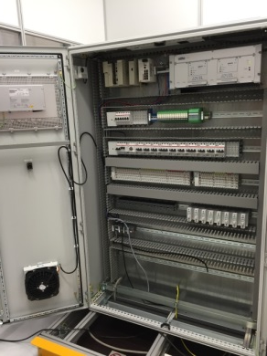
CO₂ Cooling
VXD and SVD will be cooled by a 2-phase CO2 circuit
Copy of the cooler used for ATLAS IBL: 3.3 kW cooling power at -40oC
chiller
Pump unit
Accumulator
Control Cabinet
Components were manufactured and tested in the MPP workshop
Next year: Integration, commissioning and shipment to KEK in July 2016 (S. Vogt)

Slide 17

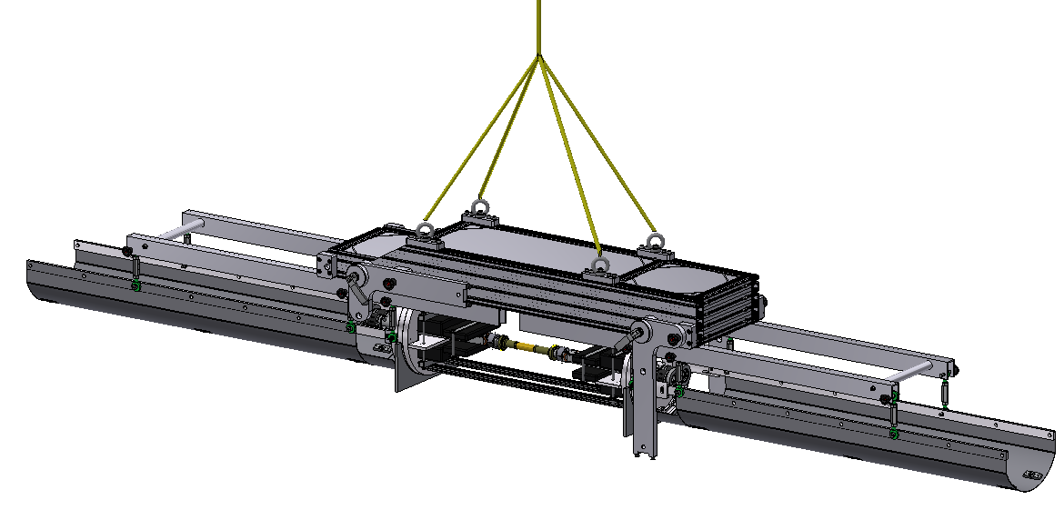
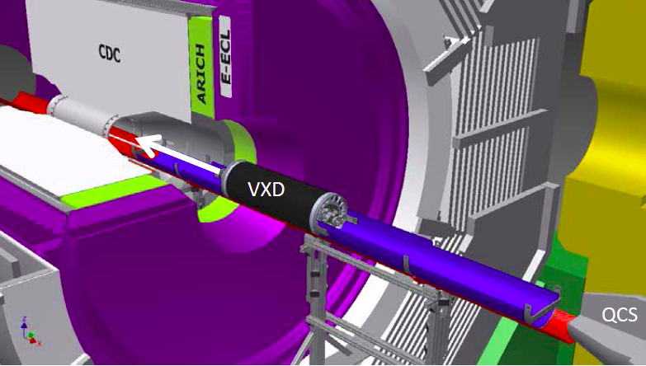
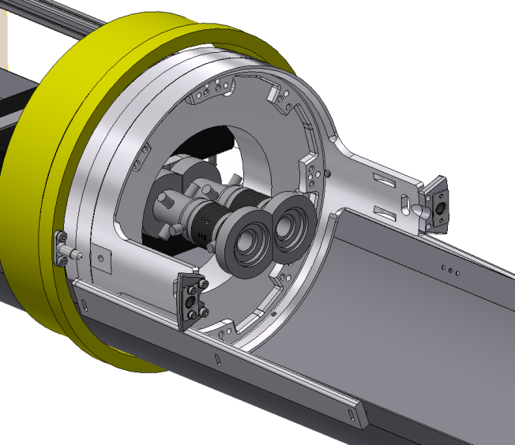
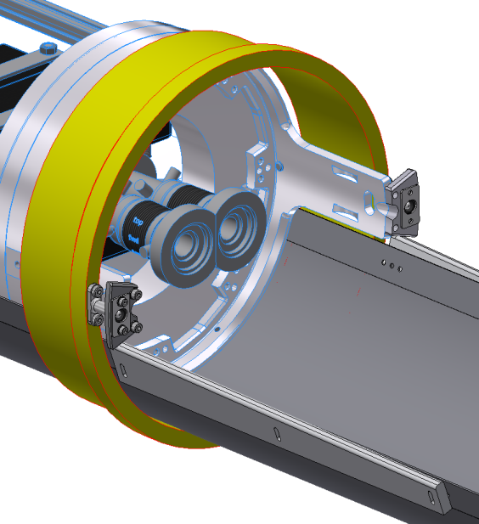
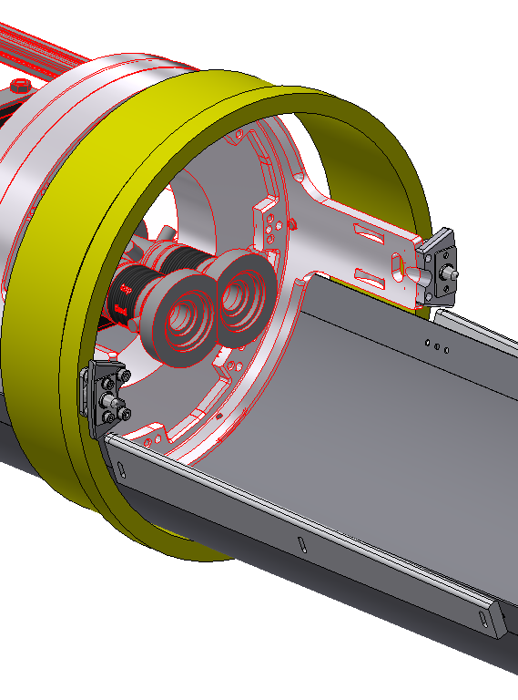
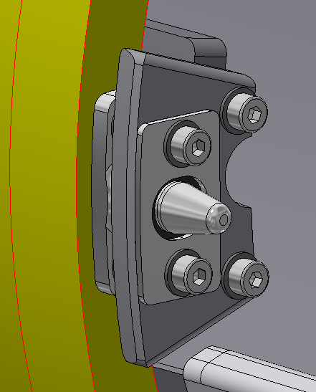
VXD Installation
The ‚AIM‘ installation procedure was approved last year
VXD slides into Belle II, vacuum pipe connection afterwards (RVC, DESY)
Now: detailed engineering (D. Kittlinger)
crane
transportation
tool
VXD - Detector
Cable trays

Slide 18
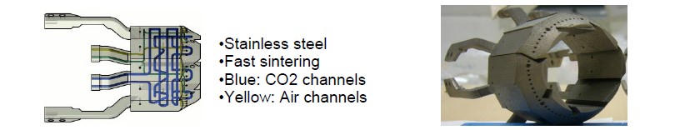
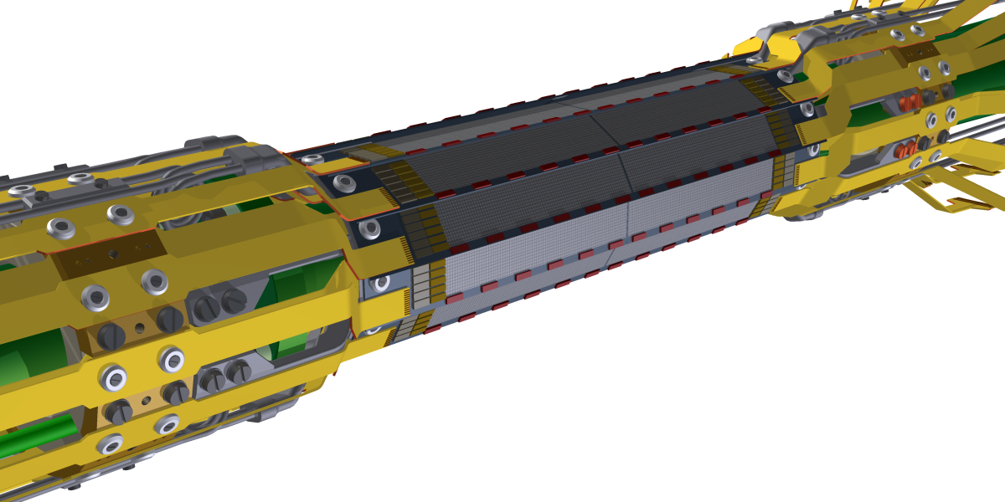
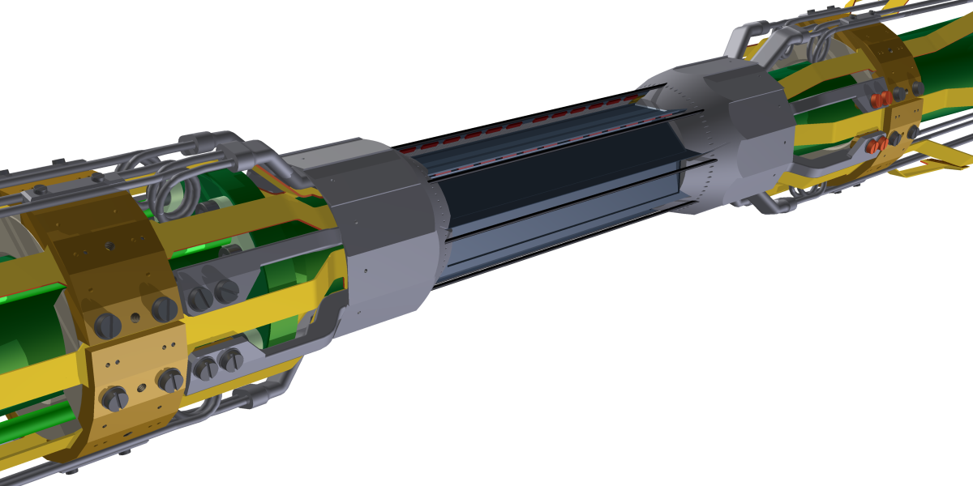
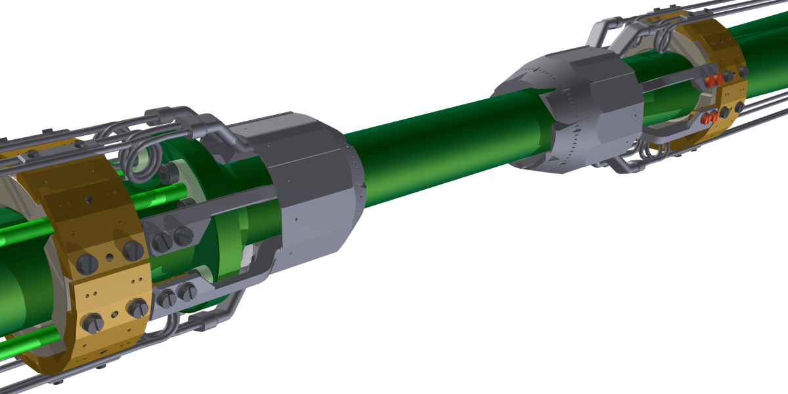
Support & Assembly
Design of support (cooling block and related parts)
Ladder assembly (K. Ackermann)

Slide 19
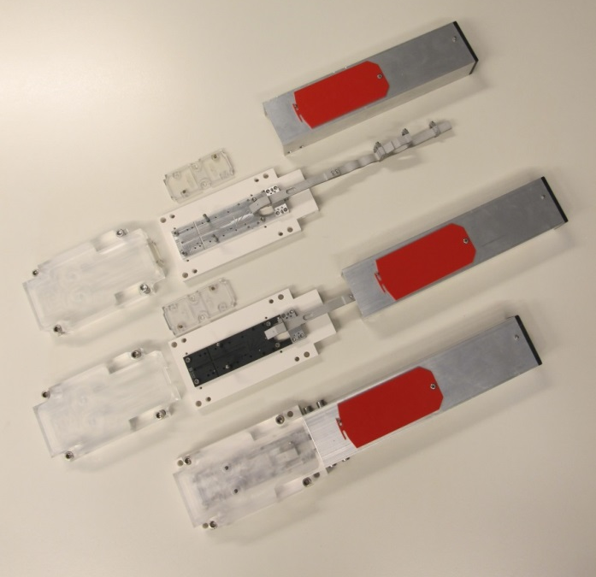
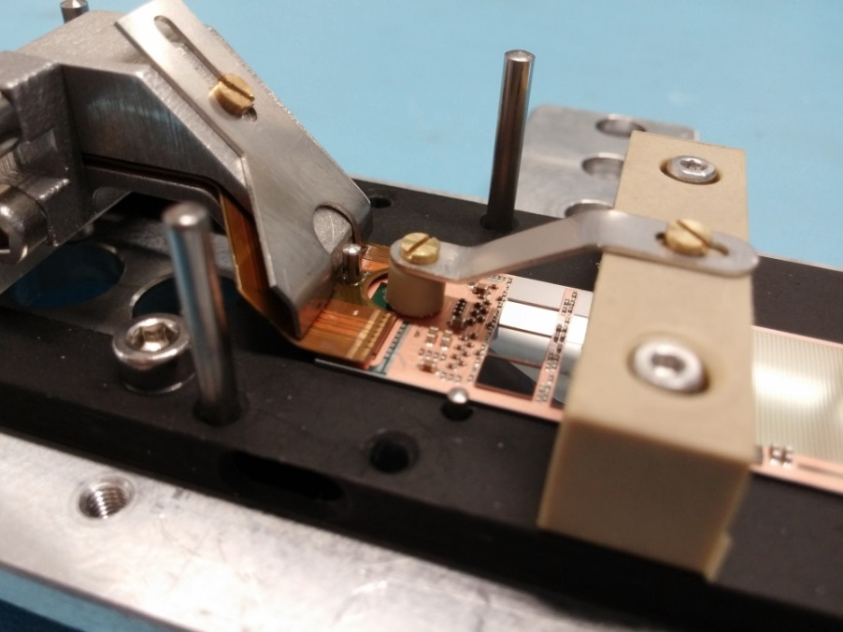
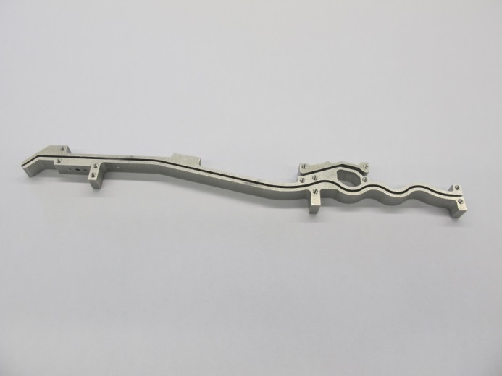

Mechanics: jigs for assembly
Various Jigs and tools were designed and produced for assembly and testing of the modules
All 40 modules (+ spares) needed will be
Assembled tested and glued to ladders at MPP
Basic handling and transport
Soldering of Kapton tape to the module
Support for Kapton tape
Alignment and gluing of two modules to a ladder

Slide 20

Kapton Design
Each module is serviced and read out be a multilayer Kapton tape
4 different types, according to position (inner, outer, forward backward)
All designed by MPP (M. Modjesch)
Prototypes produced by Taiyo, Japan

Slide 21

Sensor/Module Production
30 wafers processed at HLL
Partially completed
- no metal
3 wafers completed
- pilot run
High yield:
56% : >99% good pixels
78%:: >98% good pixels
First 3 modules assembled
- flip chip ASICs
- SMD components
- Kapton (not shown)
These modules are under test
If ok, the rest of the 27 wafers will be completed
First series modules to be assembled for a beam test at DESY in April 2016

Slide 22



1st Module Completed
Kapton fitted in hybrid workshop
(K. Wenninger, C. Knust)
Soldering
Wire bonding
Difficult operation
(Module down to 75µm thin!)
Lab tests
(F. Müller, J. Haidl, P. Leitl)
BS test of electronics
Parameter tuning
Noise, gain, linearity
Laser test
Source test
Cd source

Slide 23




Injection Noise & Gating
Continuous injection with 50 Hz
Every 20 ms two bunches are topped up
‘cooling’ time: ca 4ms
‘noisy’ bunches pass the interaction region every 10µs
DEPFET frame readout needs 20µs (and covers a time interval of 40 µs)
=> Sensor filled with hits from freshly injected bunches => ~ 20% dead time (4ms/20ms)
Gating : Sensor is made blind for a short time during high background (noisy bunch)
Signals detected in the clean period before are preserved
In normal clear operation the gate is pulsed negatively
(repels electrons)
The clear contact is pulsed positively
(attracts electrons from internal gate and bulk underneath)
In gated mode the gate is not pulsed and remains attractive for electrons.
The clear is pulsed positively,
and attract electrons from the bulk underneath

Slide 24

Tests with laser
Protection of signal
No clear
Rejection of background
clear
E. Prinker

Slide 25

Schedule
February 2016: first beam in SuperKEKB (& Beast I)
June 2016: IBBelle at KEK
May 2017 – Jan. 2018: SuperKEKB commissioning
(with Quads & Beast II)
October 2017: PXD at KEK
October 2018: First physics beam

Slide 26


Summary
Main activities at MPP for Belle/Belle II:
Belle analysis
Belle II physics preparation
  Vertexing, tracking, flavour tagging
  Contribution to computing (new: preservation of Belle data)
  Slow control software (EPICs)
  (Component) Database
  Software for module testing and characterization
Design and construction of system components:
  Kapton tapes (Design)
  CO₂ cooling plant
  Module & ladder assembly and tooling
  Ladder support structure and assembly
  General work for services layout
  Integration procedure (AIM)
Schedule
Series assembly of modules: & ladders: 2nd half of 2016 at MPP
Shipment of PXD to KEK: October 2017
First physics data: October 2018
Plans
Backup/Replacement detector:

