Slide 1
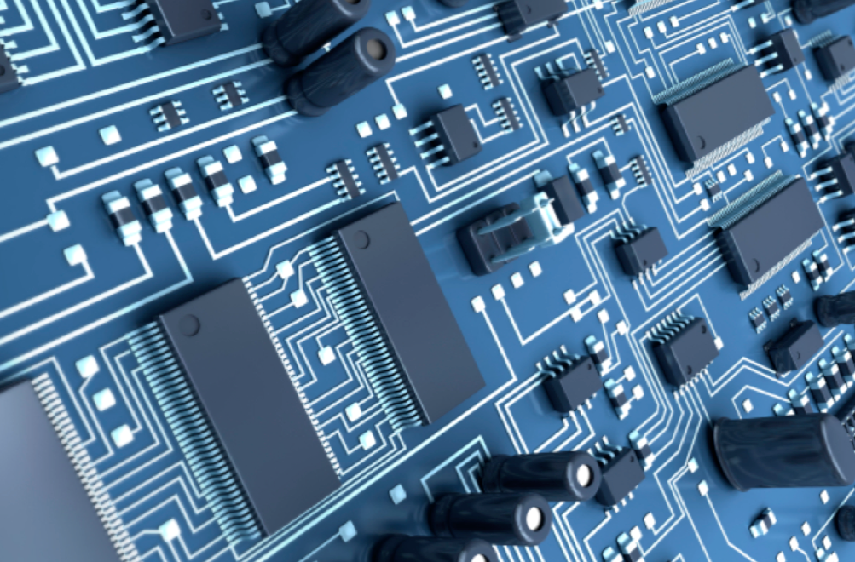
22 January 2015
Electronics Sub-Group
Markus Friedl (HEPHY Vienna)

Slide 2
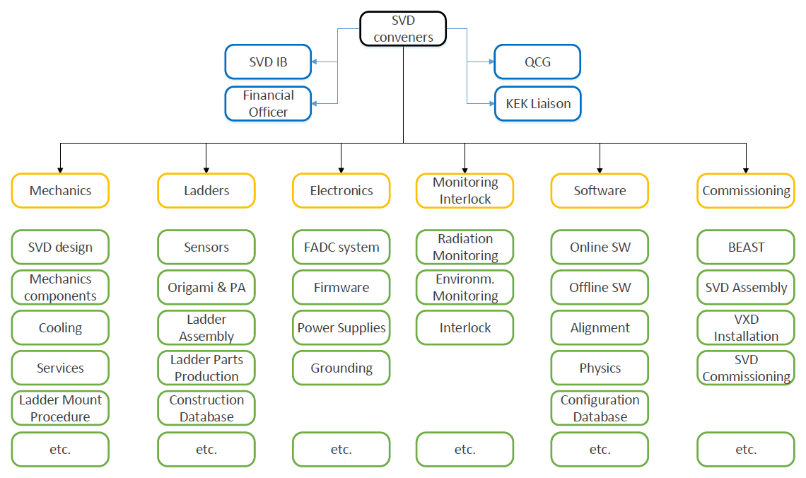
SVD Organization

Slide 3
Electronics Work Packages
FADC (hardware, firmware, software)
M. Friedl, R. Thalmeier, K. Nakamura, H. Yin, S. Bacher
FTB
W. Ostrowicz, Z. Natkaniec, K. Nakamura, M. Schnell
Power Supplies
F. Forti
Noise, grounding, test beams
T. Bergauer, M. Friedl, C. Irmler, R. Thalmeier, H. Yin
KEK infrastructure
T. Tsuboyama
(Technicians and undergrad students are not listed)

Slide 4
Collaboration
Weekly SVD meeting
Discussion of topics of general interest
Email discussion (sometimes invoking svd2ml)
For topics among experts
Topical sessions
During VXD meetings
Also for B2GM (?)
Occasionally: dedicated meetings
E.g. FADC meeting on 12 May 2014

