Slide 1
Welcome at the 7th Belle II VXD Workshop and 18th International Workshop on DEPFET Detectors and Applications
Zdenek Dolezal for the team

Slide 2
Few Organisational Remarks
Network:
eduroam
psk.troja.mff.cuni.cz (pw at the board)
suffered from instabilities past days, hopefully fixed now
Indico presentations:
try to upload to indico (B2VXD)
or contact our staff with a USB stick

Slide 3
Few Organisational Remarks
Auditoria:
T1: plenary+PXD
T9: SVD
Other rooms available on request
Coffee/Tea breaks:
1st floor next to T1

Slide 4
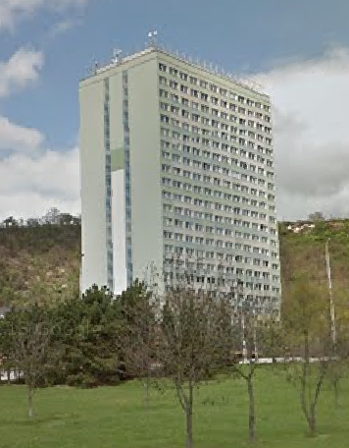
Few Organisational Remarks
Lunches:
included
served in “Mensa” (student canteen) in the high-rise 500 m from our site
10 vegetarian portions ordered

Slide 5
Lunch place
Mensa
T1

Slide 6
Few Organisational Remarks
Conference Dinner:
Thursday
Instructions provided

Slide 7
Enjoy 7th Belle II VXD Workshop and 18th International Workshop on DEPFET Detectors and Applications
Zdenek Dolezal for the team

