Slide 1
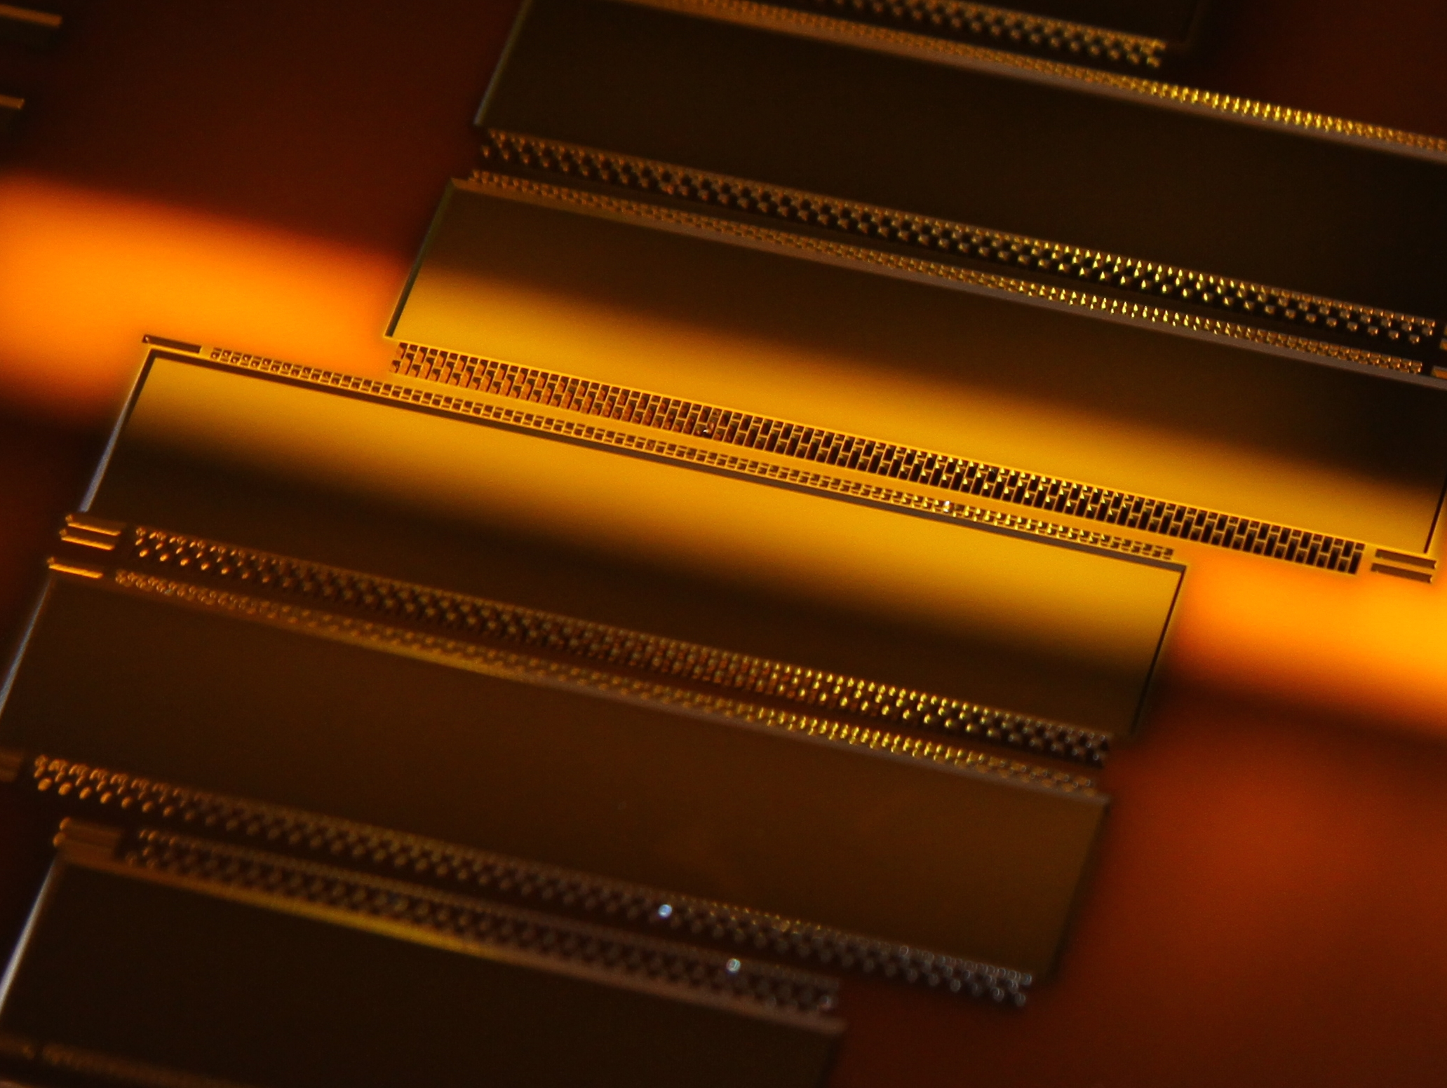
PXD Module Assembly
- Overview and SWB bumping -

Slide 2
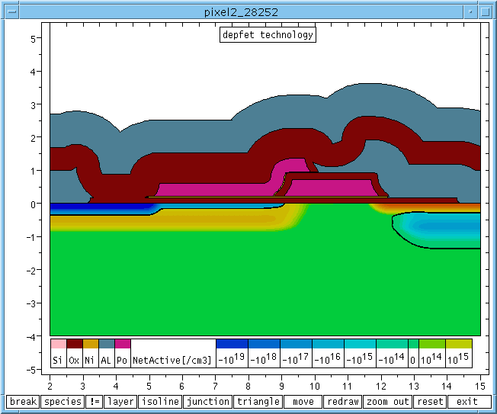
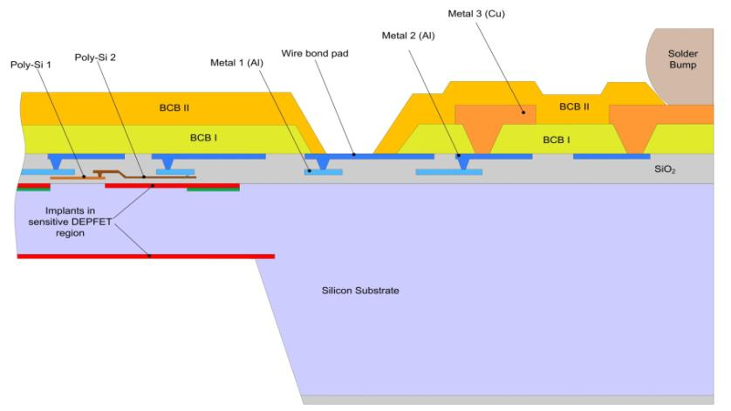
Sensor production phases and where we are
metal_2
metal_2
oxide
oxide
p+
polySi_2
polySi_1
metal_1
polySi_2
polySi_1
metal_1
deep n
n+
p+
deep n
n+
deep p
deep p
n bulk
n bulk
Phase I – before metal
Implantations
Polysilicon
Dielectric depositions
Phase II - Alu
Metal 1
isolation
Metal 2
& ILD deposition, BCB
Phase III – thinning and Cu
Handle wafer removal
Metal 3 (Copper)
Passivation/solder stop
☑
Phase II:EMCM production(s) for Alu/Cu
:- technology confirmed with EMCM4
☑
All batches finished
☑
thinning and Cu tested on PXD6
:- final verification with PXD9 metal dummies

Slide 3
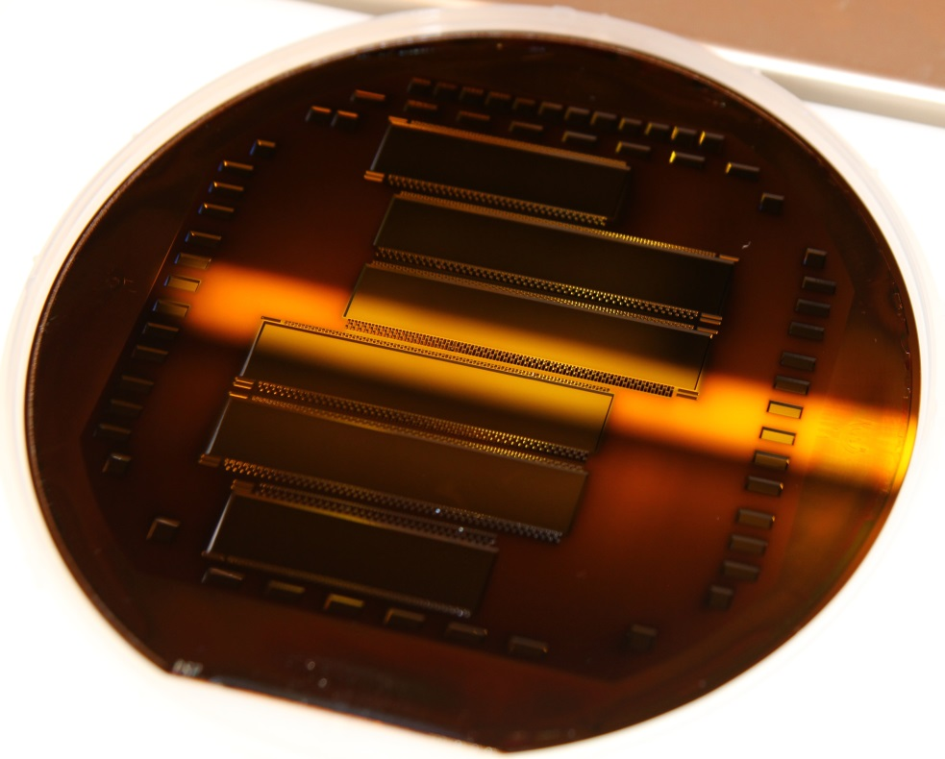
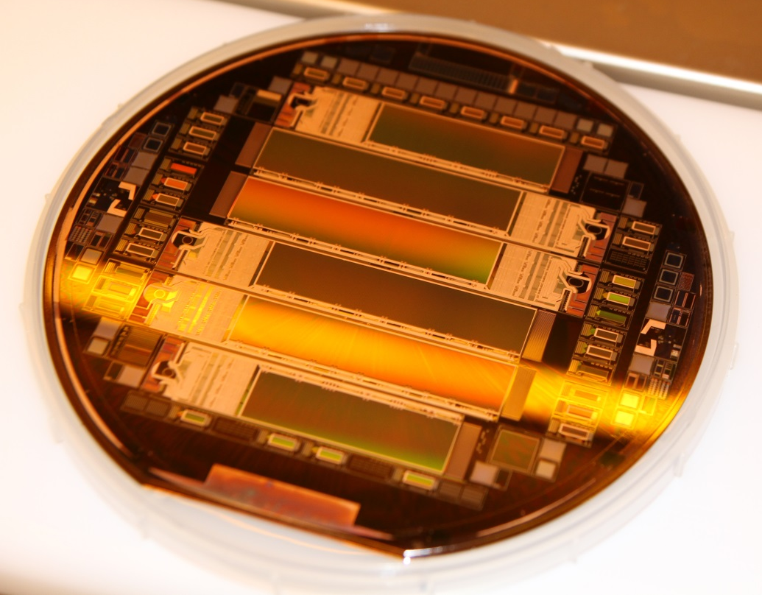
PXD9 thinned metal dummies
8 SOI Wafers, 2 with Copper
450/0.32/75 µm
Alu-2 + co3n on top
Final PXD9 back side
Practice Cu after thinning → done, no problem
and all subsequent process steps

Slide 4
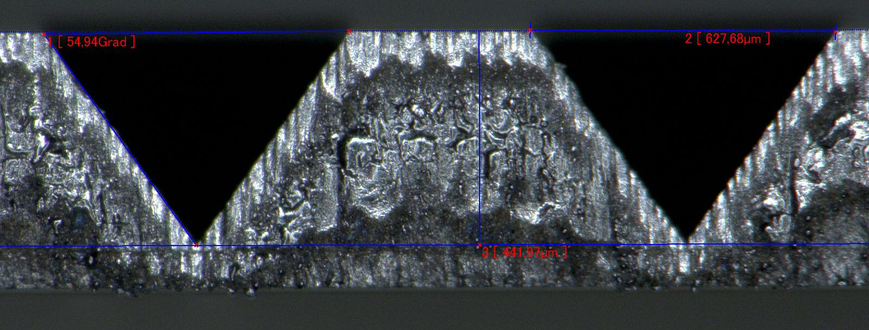
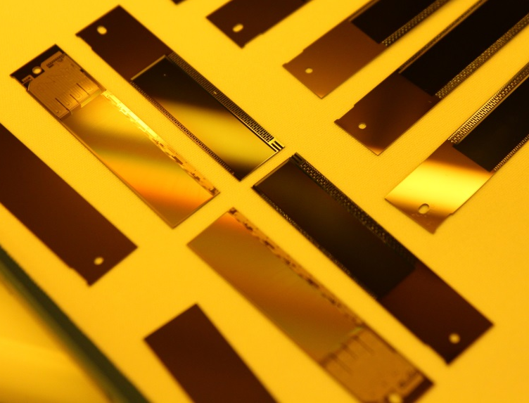
Cutting edge – V-grooves
Practice Ladder Assembly procedure
5 wafers with alu on top, laser-cut
Material for 5 inner ladders, and 10 outer
Additional std. silicon samples for gluing tests

Slide 5
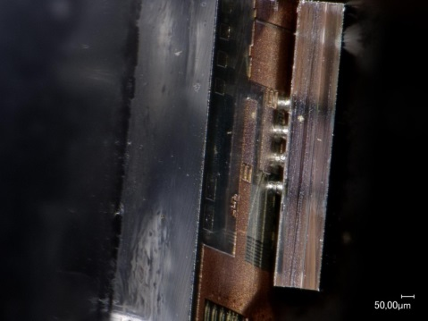
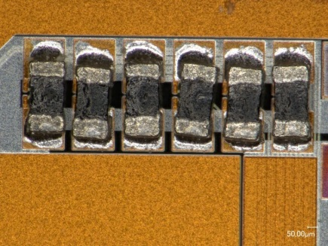
Module Assembly – procedure and status
Flip Chip of ASICs (~240°C):
Bumped ASICs have the same solder balls (SAC305)
DHP bumping at TSMC
DCD bumping ???, availability?
SWB bumping on chip level at PacTech
At IZM Berlin for EMCMs and also for final procedure
Meeting at IZM Dec. 2014: ready to go for pilot run in summer
SMD placement (~200°C):
Passive components (termination resistors, decoupling caps)
Dispense solder paste/jetting of solder balls, pick, place and reflow
PbSn 37/63 solder balls
For EMCMs at Finetech, Berlin
Solder jetting, SMD placement at IFIC/NTC Valencia
Kapton attachment (~160°C), wire bonding:
Solder paste printing on kapton,
SnBi solder
Wire-bond, wedge-wedge, 25 µm Al bond wires between kapton and substrate
EMCM and final at MPP Munich, no issues expected
01005 term. res
Ladder assembly: later in this session

Slide 6
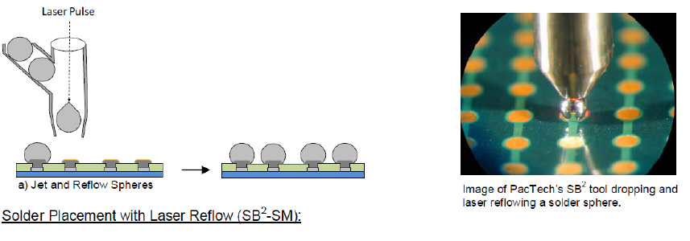
Reminder: PacTech bumping (‘balling’) on chip level
ENIG → UBM
5µm Ni + flash Au
2. SB² → balls
Sn-Ag-Cu “SAC305”

Slide 7
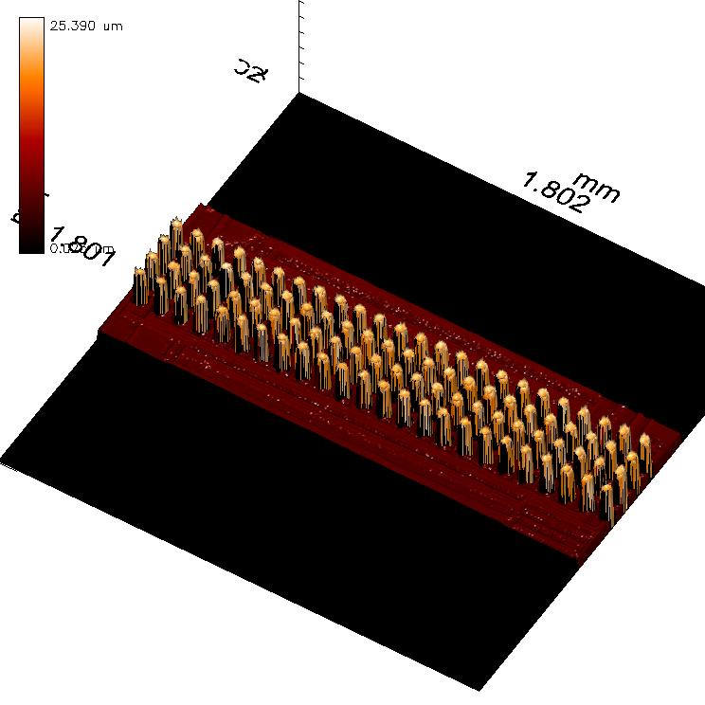
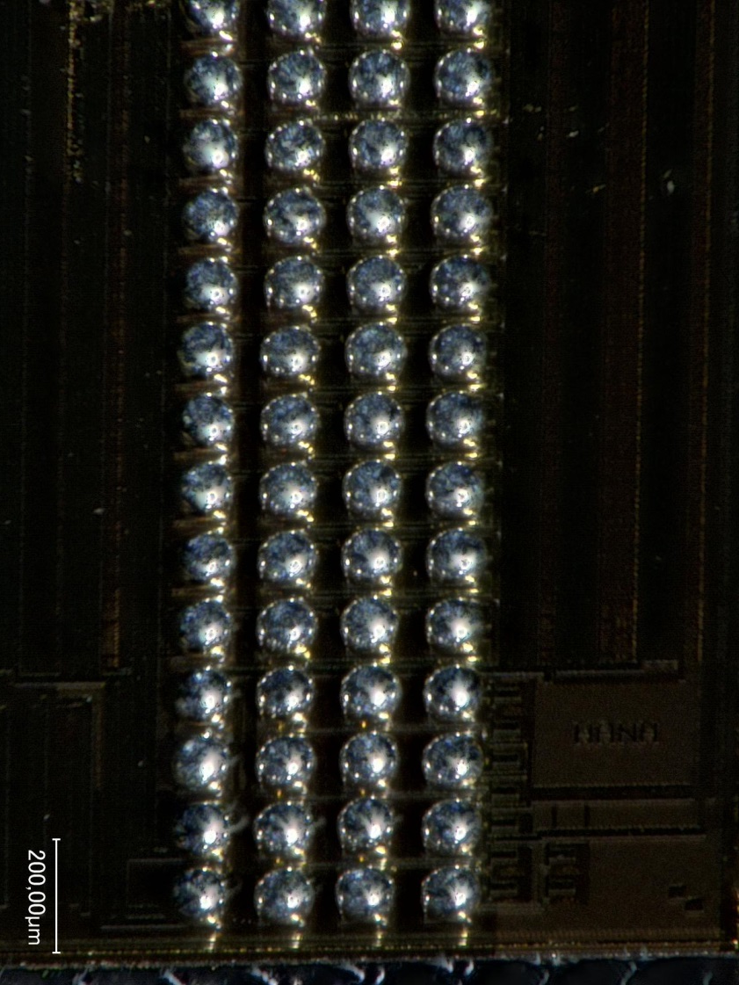
The result: 96 solder balls per chip, 100µm diameter

Slide 8
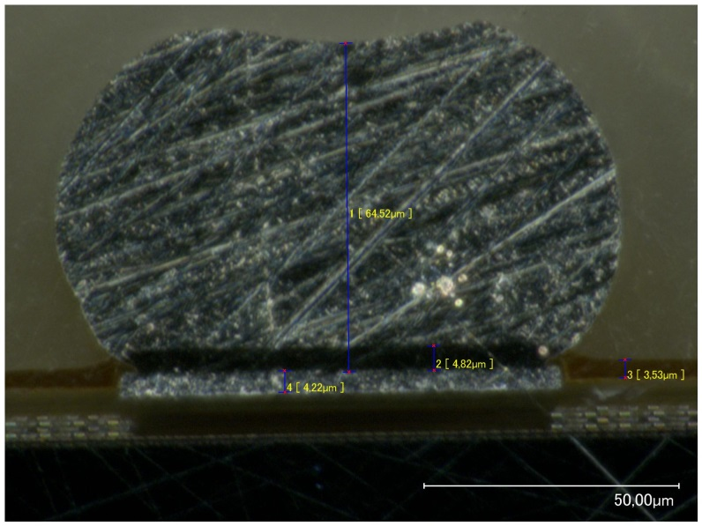
Summary of test results
20 (+10 for setup) SWB1.8 V1.0 bumped last summer
“mechanically” and optically (reported during past meetings)
height homogeneity okay
Shear tests passed: ball shear, ~50g/bump
X-ray: Voids/blisters < 15%, passed
Electrically tested at Mannheim (Probecard)
19/20 okay after bumping (Christian Kreidel)
Filp-chip to home made bump bond adapters at HLL
Basically same procedure as at IZM for EMCMs

Slide 9
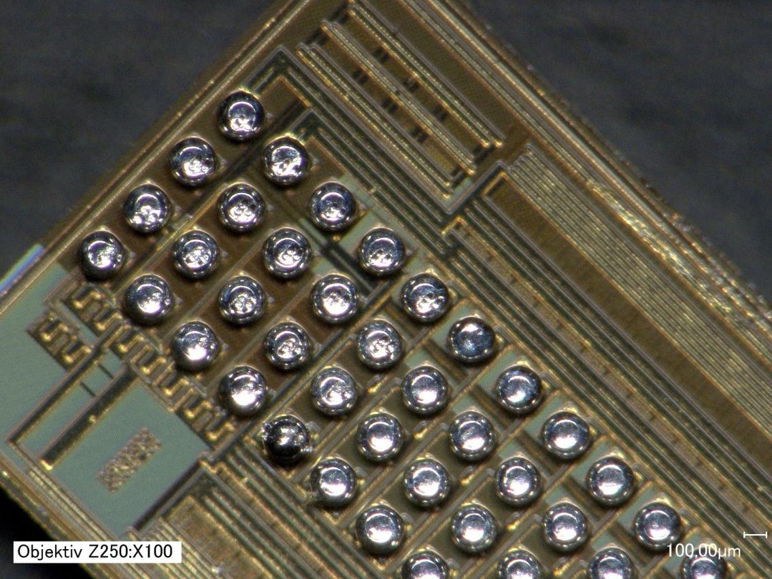
Before Flipping
Reflow of bare chips at ~250 °C
→ dip is “ironed” out
→ but the balls are changing “somehow” ..
Test flip-chip with and without this dummy reflow

Slide 10
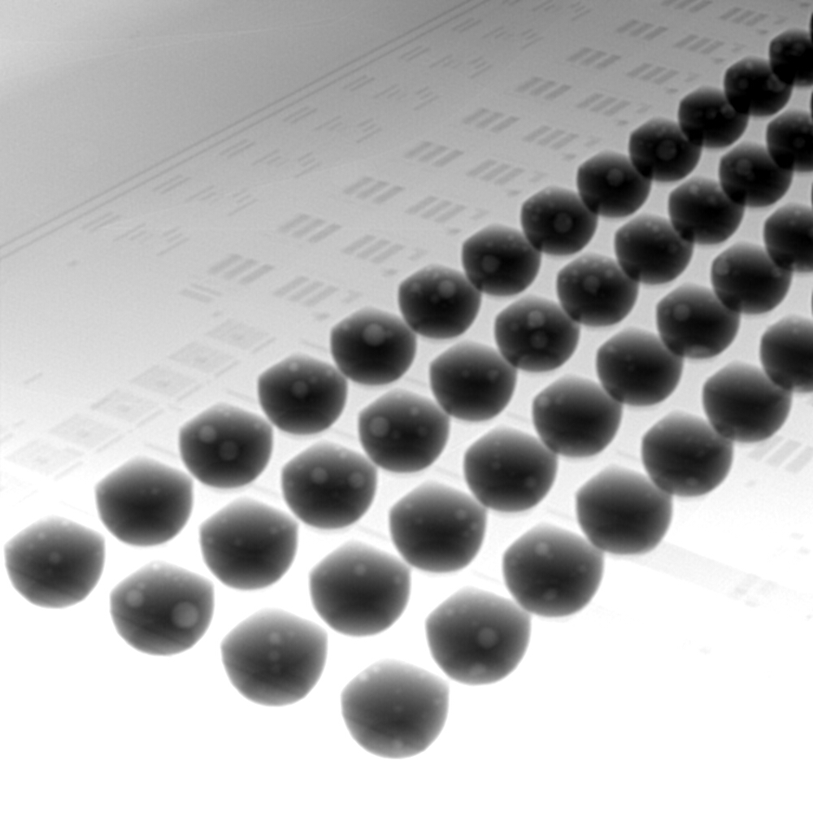
X-ray of FC Assemblies
No dummy reflow
with dummy reflow
→ The dip does not harm, don’t need to do it!

Slide 11
Taking it apart: shear tests – with dummy reflow
substrate
:- imperfect wetting
:- shear at UMB at substrate side
:- low force: ~10 g/bump
ASIC

Slide 12
Taking it apart: shear tests – without dummy reflow
substrate
:- perfect wetting
:- shear at UMB on substrate side
:- still somewhat low force but acceptable: ~25 g/bump
ASIC

Slide 13
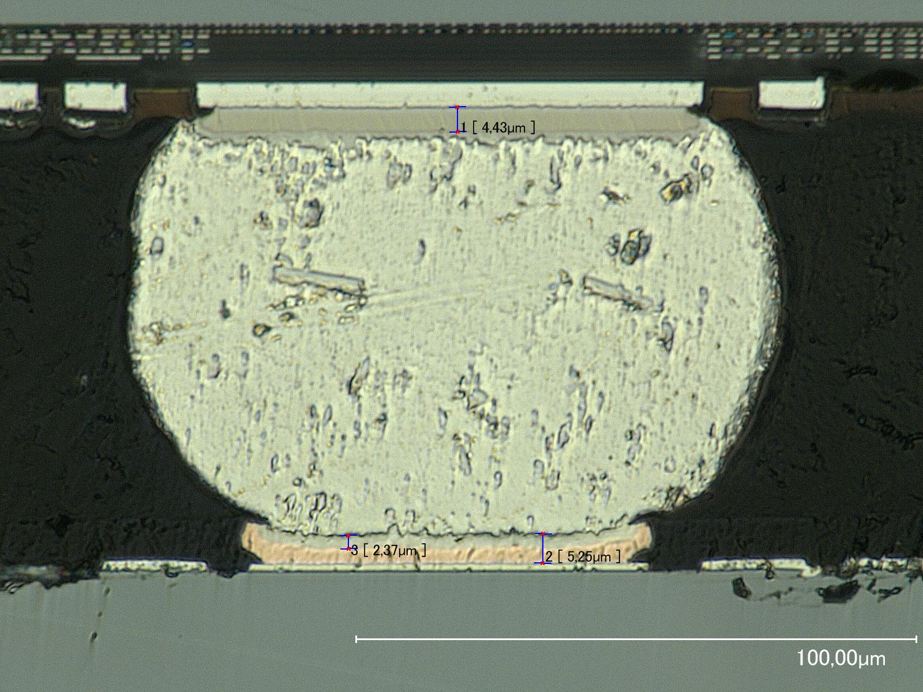
Cross section of flip chip assembly

Slide 14
In Summary
:- preparations for last production phase finished, awaiting the PXD9-pilot to come
:- thinned module samples (two wafers Copper) available
:- practice FC, SMD, Kapton attach, ladder assembly …
:- PacTech bumping of SWBs successful
:- adjust ball size (100 → 80 µm)
:- reduce Alu pad/passivation opening at ASICs to be the same as on module
:- don’t expect 100% yield …

