Slide 1




Pilot run – matrix measurements after first metal
7th Belle II VXD workshop
and 18th International Workshop on DEPFET Detectors and Applications
Rainer H. Richter and Paola Avella
for the MPP/HLL team

Slide 2


Outline
IV measurements on matrices after metal 1 (limited results)
- Top side measurements
metal1 lines within the matrix are not yet connected
(needs metal 2)
Neverthess we can already check for some defects
(diode integrity, some metal shorts)
- Backside measurements
Matrix biasing via Punch through structure
makes life much easier but should work)

Slide 3
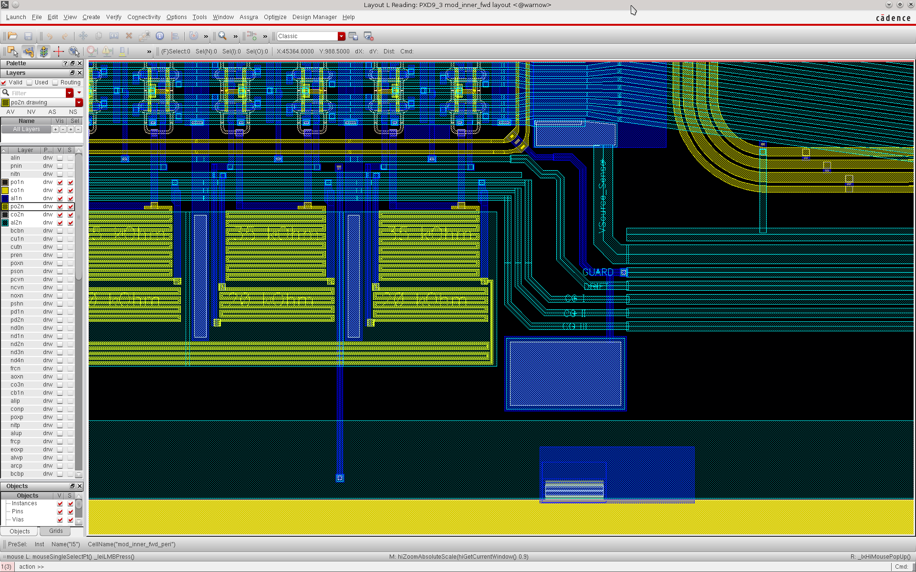
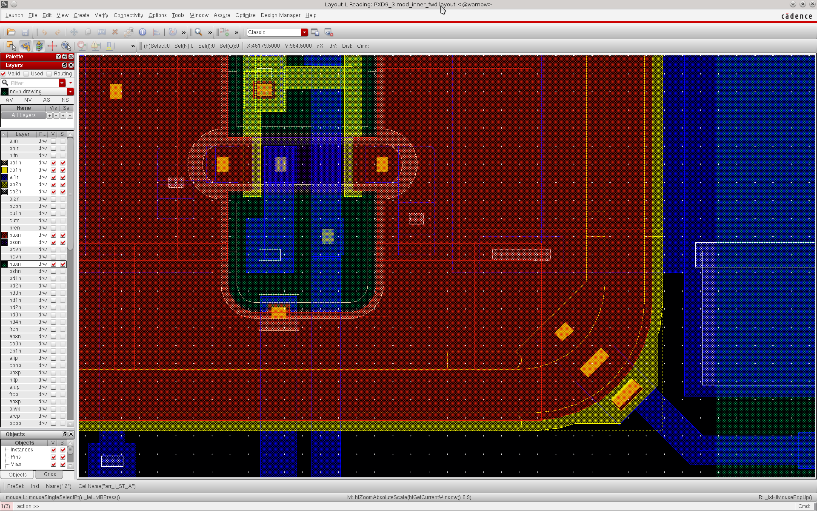
Top side measurements
Simple method: Connecting one p + contact and the n Bulk
provides information about the integrity of all diodes within the entire matrix
(experience with other project)
p+ guard vs Bulk
Contacts are foreseen in metal 1

Slide 4
How does it works?
Matrix is not depleted from the backside !
Matrix (not connected)
Vguard (V-)
Vguard (V-)
Vdrift= Vguard-Vpt
Vbulk (0V)
Vdrain
Early punch through
at small Vbulk
75µm
Backside (not directly accessible)
5cm
Measurement of a lot of small diodes in parallel
Drift, drains and sources are connected via punch through with small voltage differences

Slide 5
We are sensitive to
…all what happens in parallel to the diodes
N+/P+ shorts
Vguard (V-)
Vguard (V-)
Vdrift= Vguard-Vpt
Vbulk (0V)
Vdrain
Early punch through
at small Vbulk
75µm
Backside (not directly accessible)
5cm
Also sensitive to crystal defects generating high leakage currents !

Slide 6
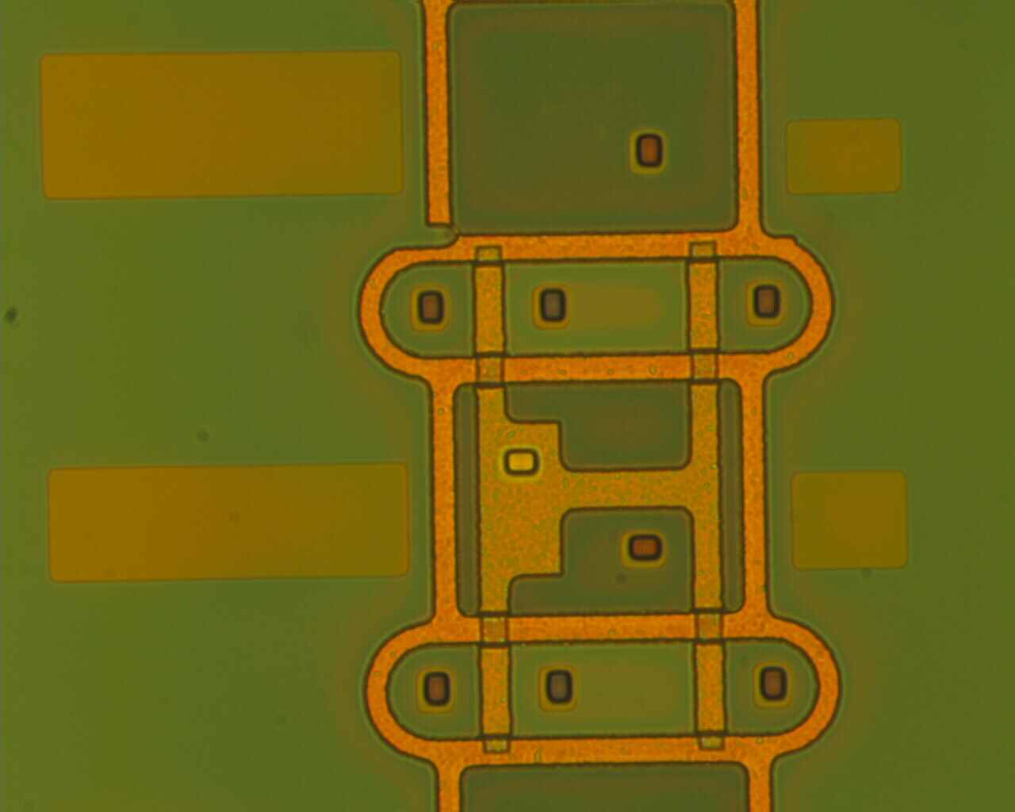
Like this: p+ drift in contact with n+ clear
Lethal defect – lost chip

Slide 7
We are sensitive to …
metal 1 shorts between p+ and n+
Vguard (V-)
Vguard (V-)
Vdrift= Vguard-Vpt
Vbulk (0V)
Vdrain
Early punch through
at small Vbulk
75µm
Backside (not directly accessible)
5cm
We dont‘ see problems between P+ regions (Drift, Drain, Source)
since this does not affect the diode characteristics

Slide 8
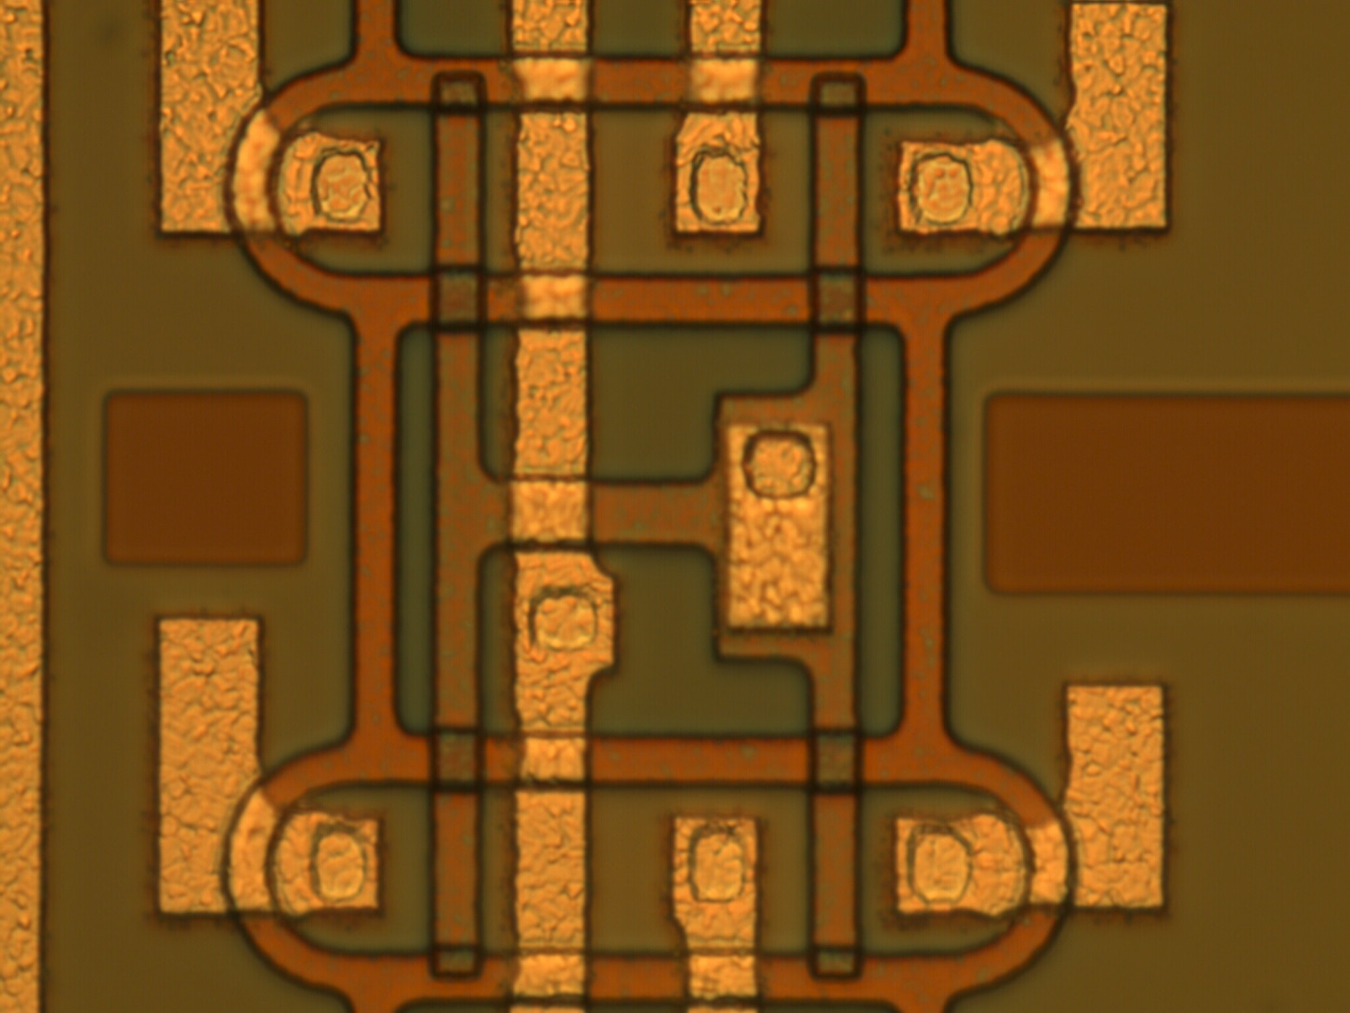
After metal 1
N+ clear line
P+ source line

Slide 9
Bulk vs Guard Characteristics
All the long matrices of all the three project wafers show small values of current (≈ nA)
Indication that the half ladders are in a healthy status
So far 100% yield
(for the testable items)

Slide 10
Backside IV measurements (Punch through biassing)
Vpunch through (V-)
Matrix (not connected)
Vbulk (0V)
75µm
Backside (not directly accessible)
5cm

Slide 11
Punch Through Characteristic
What do we expect ?

Slide 12
Punch Through Characteristic [I]
Vpunch through
Vbulk
Phase 1
Depletion expands
Depletion region expanding
from punchthrough contact into the bulk
(small volume -> small leakage current)

Slide 13
Punch Through Characteristic [II]
Vpunch through
Vbulk
Phase 2
Backside reached
Interface current
bulk current
2. Depletion region reaches backside

Slide 14
Punch Through Characteristic [III]
Vpunch through
Vbulk
Phase 3: entire bulk gets depleted
Interface current
bulk current
3. Depletion region expands from the entire backside implant into the bulk

Slide 15
Punch Through Characteristic [IV]
Interface and surface currents
Vpunch through
Vbulk
Phase 4:
Active generation centers
Interface current
bulk current
4. generation states are getting activated
generation current

Slide 16
Punch Through Characteristic [V]
Interface and surface currents
Vpunch through
Vbulk
Phase 5:
Generation current saturates
Interface current
bulk current
5. All generation states are activated
generation current saturates
Nice IV curve: low leakage level
Operation volt. (PT) : -55V …-65V

Slide 17
Punch Through Characteristics all modules of wafer 35
Faster measurement:
-> fluctuations
Not meaningful
uniform characteristics ☺
The other wafers?

Slide 18
The other wafers …
Currents on W30 and W36 are higher
Uniform ‘wafer wise‘ behavior:
All modules of wafer 35 are fine
All modules of wafer 30 and 36 are worse
Not really crucial: currents are still in a moderate range
But we want to know the reason …

Slide 19
Zoom in
Current onset starts with Phase 2: depletion regions

Slide 20
Punch Through Characteristics – Small matrices

Slide 21
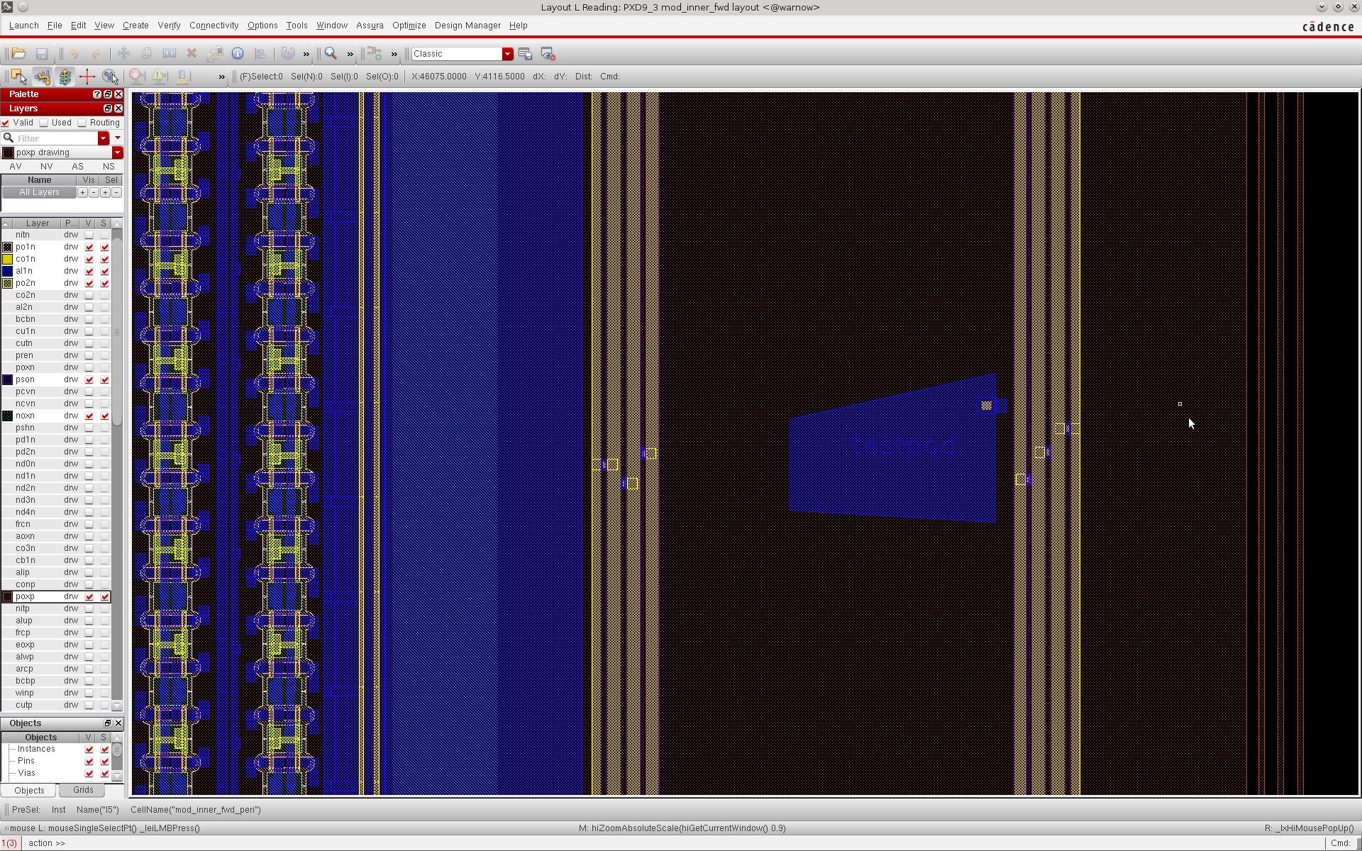
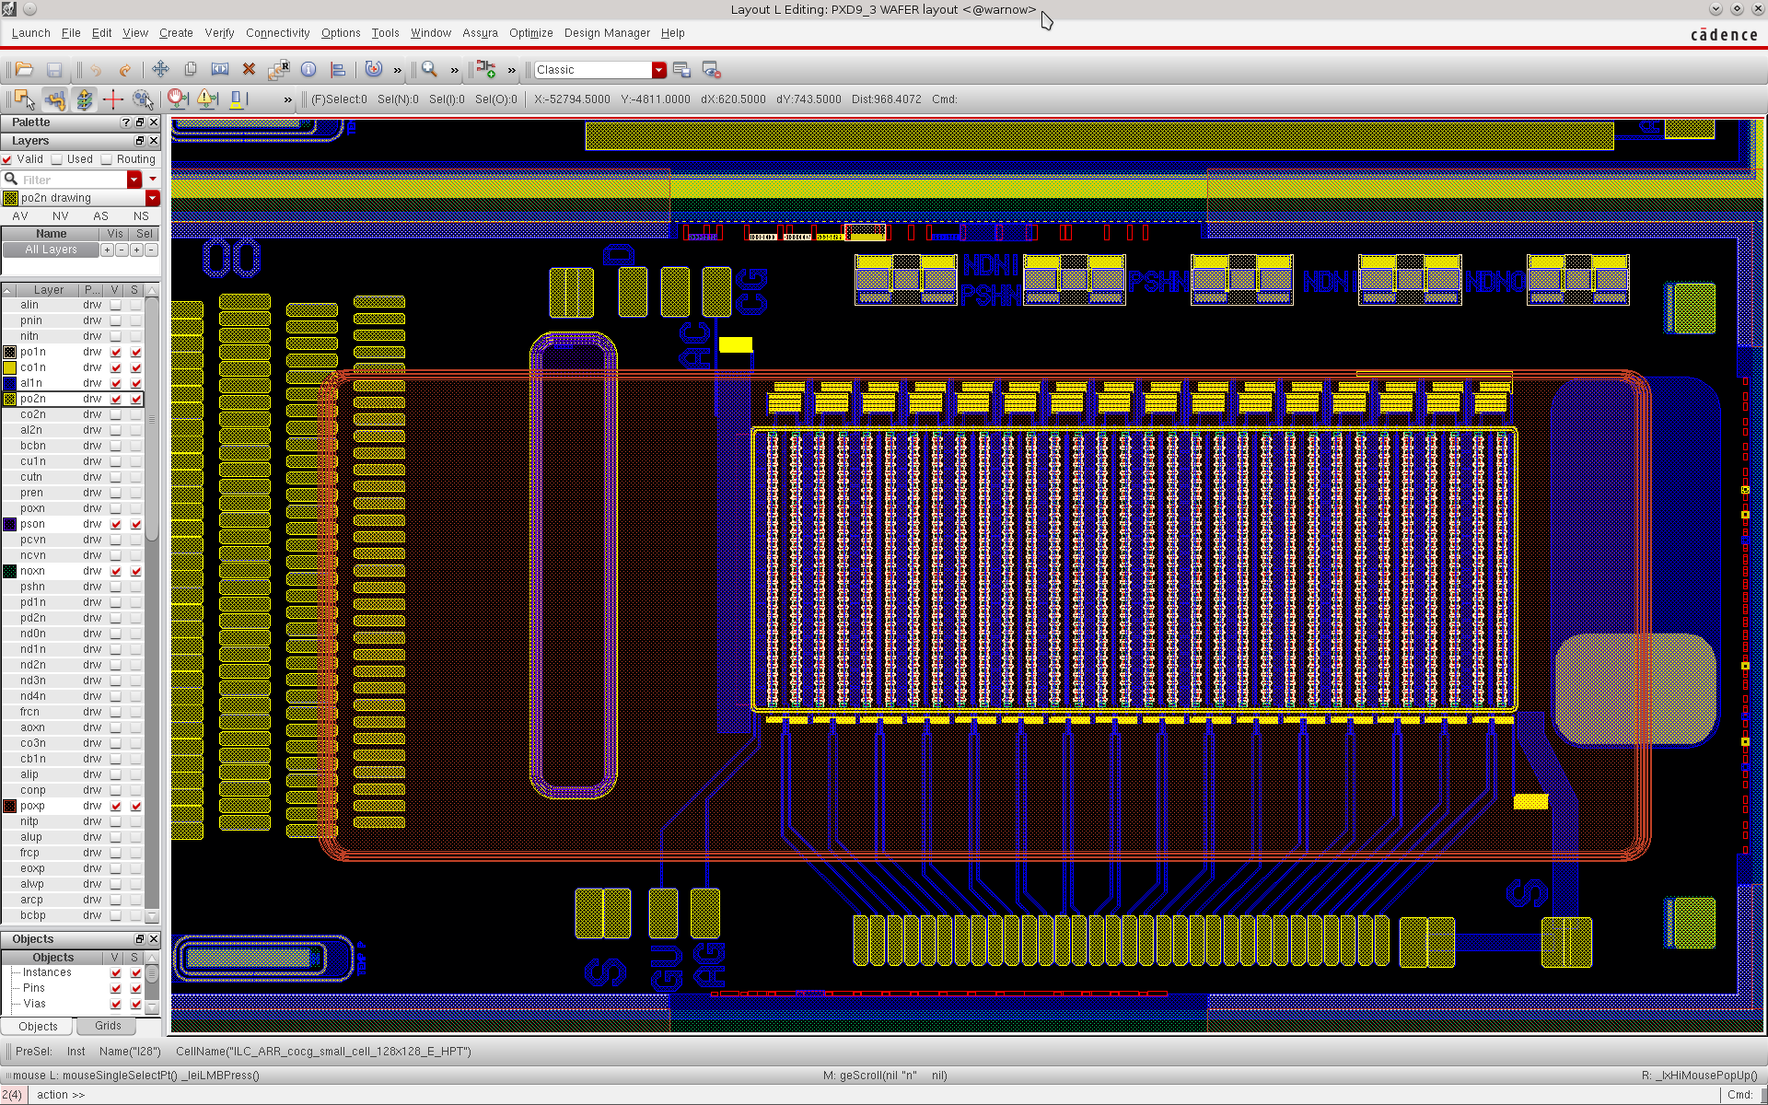
Layouts of PT same design but different sizes

Slide 22
Global effect concerning all modules to the entire wafer ?
What is ‘global‘ to all modules on a wafer ??
the handle wafer
We directly connected
the handle wafer

Slide 23
Cutting Edge (Bulk) vs Handle Wafer
The current flowing between the cutting edge contact and the handle wafer for W35 is much higher than the current measured for W30 and W36.

Slide 24
Punch Through Characteristics [IV]
VS Cutting Edge
VS Handle Wafer

Slide 25
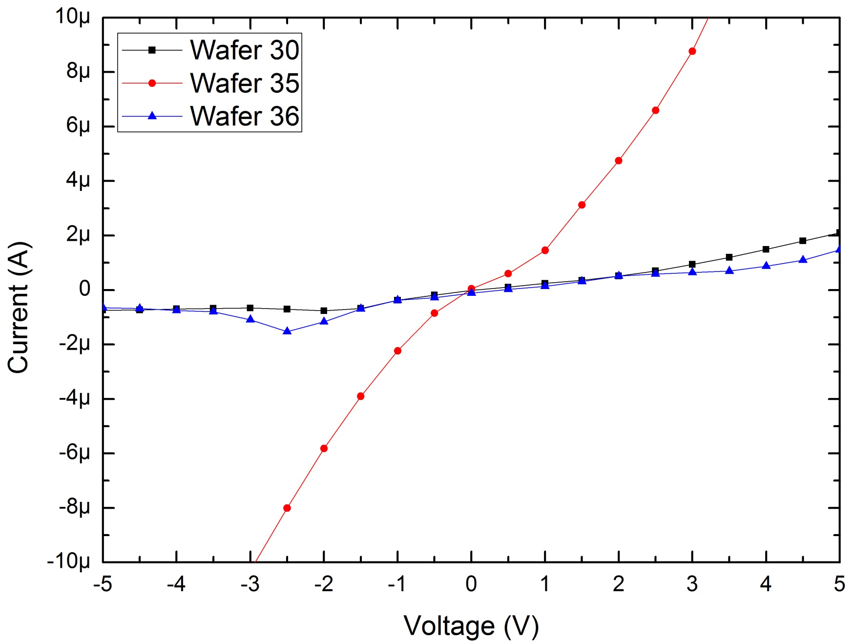
Handle wafer vs Bulk (zoom in)

Slide 26
Additional measurements
Not nice and rather noisy due to limited setup flexibilty in the cleanroom
- Changing handle wafer potential
- pos. w.r.t. bulk : no influence (up to 30V) -> no avalache
- neg. w.r.t. bulk: current increase
Long term meas.
high current is dropping with time

Slide 27
The nature of the increased current?
Handle wafer acts as backside gate
Not an avalanche current (no reaction on pos. Voltages on handle wafer) ☺
Influence of holes at the backside of the top wafer
  Inversion layer is connecting backside diode and cutting edge
  Unlikely: Handle wafer cannot become more negative than the backside p+ diode
Depletion of the SIO2/Si interface (Buried oxide)
  The interface of the whole wafer is getting generation active

Slide 28
No significant generation current (SRH) ? in normal operation
150mm
Vpunch through (V-)
Vbulk (0V)
good connection
Electron accumulation layer
- - - - - - - - - - - - - -
+ + + + + + + + + + + +
Normal operation: handle wafer at 0V
Wafer outside the module in thermal equilibrium
Interface states are occupied by electrons
- > very small leakage current

Slide 29
Large generation current (SRH) ?
If handle wafer floats …
150mm
Vpunch through (V-)
Vbulk (0V)
bad connection
Electron accumulation layer disappears
. . . . . . . .. . . . . . . . . . . ... .
+ + + + + + + + + + + +
V-
handle wafer floats to neg. potential by cap. coupling
A few 100mV are enough
Accumulation layer gets depleted
Interface states are getting genaration active
> large leakage current
Very good recombination lifetime in the bulk
large diffusion lenghts for holes
-> the whole wafer contributes
Vpunch through
Vbulk
Phase 3: entire bulk gets depleted
Small arrays are better due to their
smaller backplane (Cap.)
Backside pot. follows directly Vpt

Slide 30
Summary and Conclusions
Top side:
Test for diode integrities on all modules were successful
no shorts between Source and Clear lines found
Backside:
Badly connected handle wafer may cause parasitic gate effects
leading to an increase of current
We think that problem disappears if the wafers are diced (laser cut)
laser melting will provide a reliable contact between handle wafer and bulk
All modules of W35 (better connected) show nice IV with low leakage currents
More and better measurements (setup) will follow …

