Slide 1
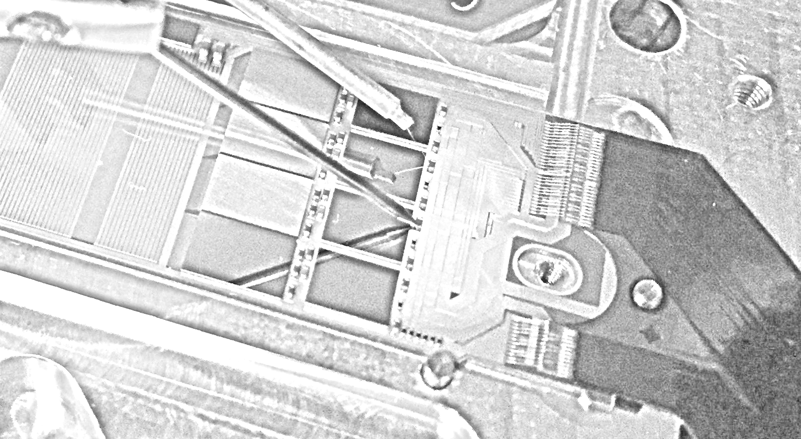
Latest results of EMCM tests / measurements
Felix Mueller
on behalf of the HLL/MPP testcrew

Slide 2
Matrix Assembly
latest generation of ASICs:
- SwitcherB18v2.0
- DCDpp
- DHPT1.0
Optionally, a matrix can be glued on the EMCM
The DEPFET matrix is electrically connected via wire-bonds
Operate device and compare measurements to PCB-assembled test setups
(performance, noise, Signal-to-noise, stability …)
Drain lines are comparable with final modules ~45mm
Switcher
DEPFET
Passives (R,C)
DCD
DHP
Kapton

Slide 3
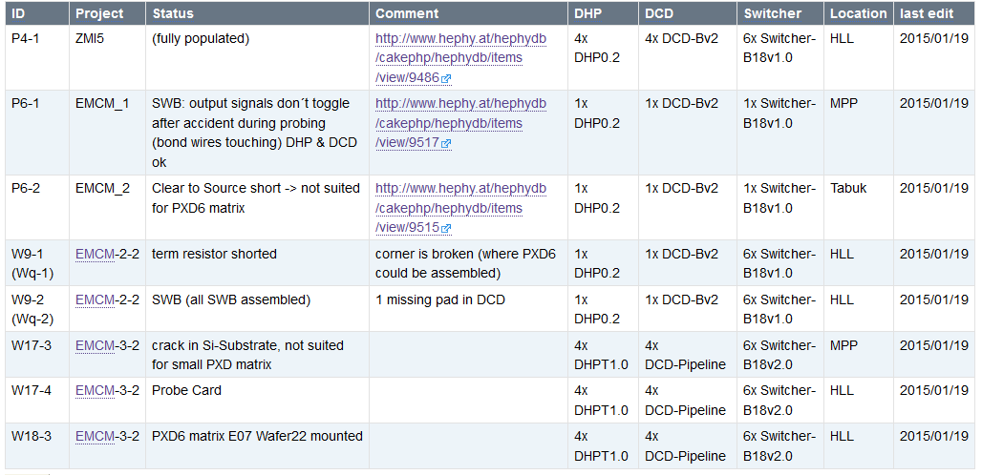
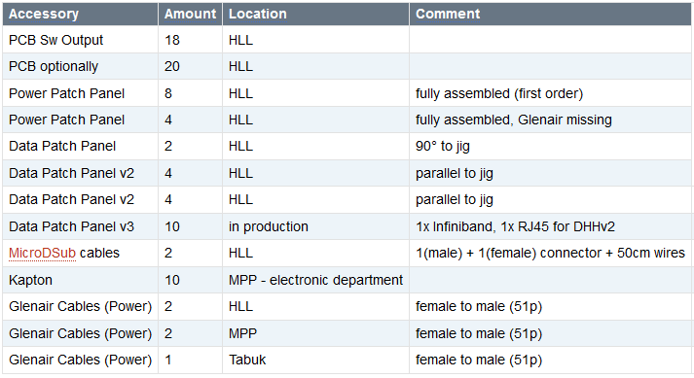
EMCM Overview
http://twiki.hll.mpg.de/bin/view/DepfetInternal/ShoppingMall#EMCM
totally: 8
old ASICs: 5
new ASICs: 3

Slide 4
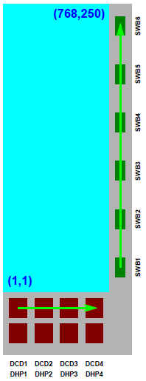
EMCM - Last Status – Using New ASICs
W17-3
Configuration of 4 DHPs & 4 DCDs & 4 Switchers
Cannot assemble matrix (due to broken Switchers SW5 & SW6)
Establish HighSpeed links, depending on frequency, voltage and cable length
W18-3
Configuration of 4 DHPs & 4 DHPs & 6 Switchers
Matrix – PXD6 E07 (W22) is assembled
Establish HighSpeed links, depending on frequency, voltage and cable length (DCD1 and DCD4, according to Belle II Note Number 0010 numbering scheme) – further measurements required
=> Matrix is connected to DCD which can be readout
W17-4
Preparation for Probecard

Slide 5
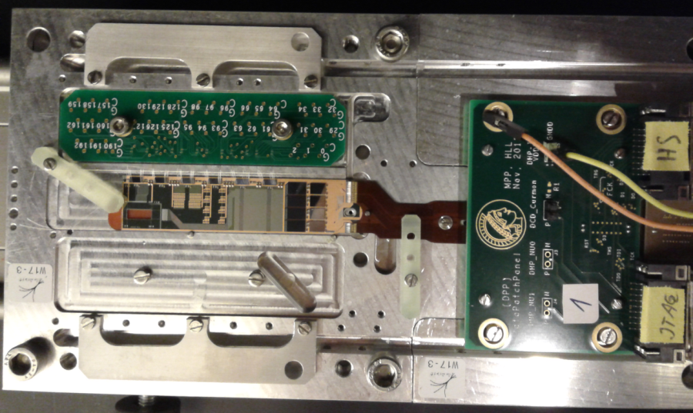
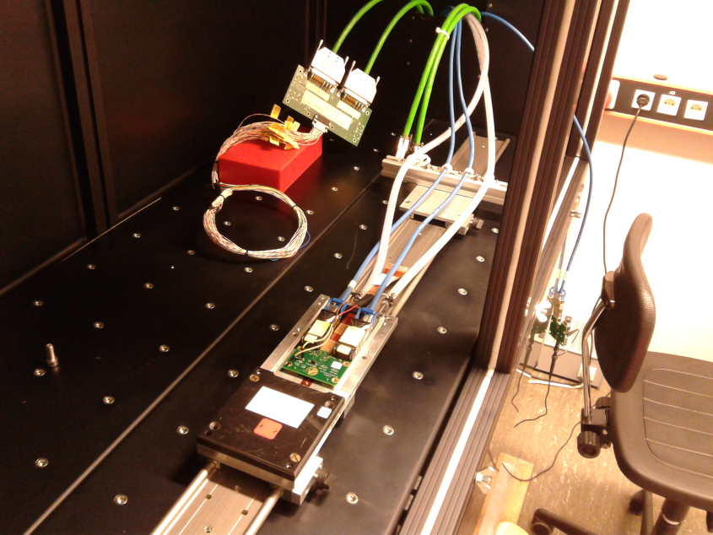
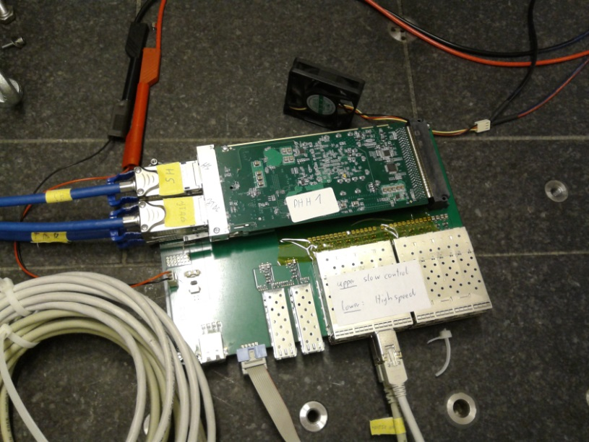
W17-3 Freimann - Setup
EMCM with PCB for Switcher outputs
Data Patch Panel
DHH and carrier board
Blackbox

Slide 6
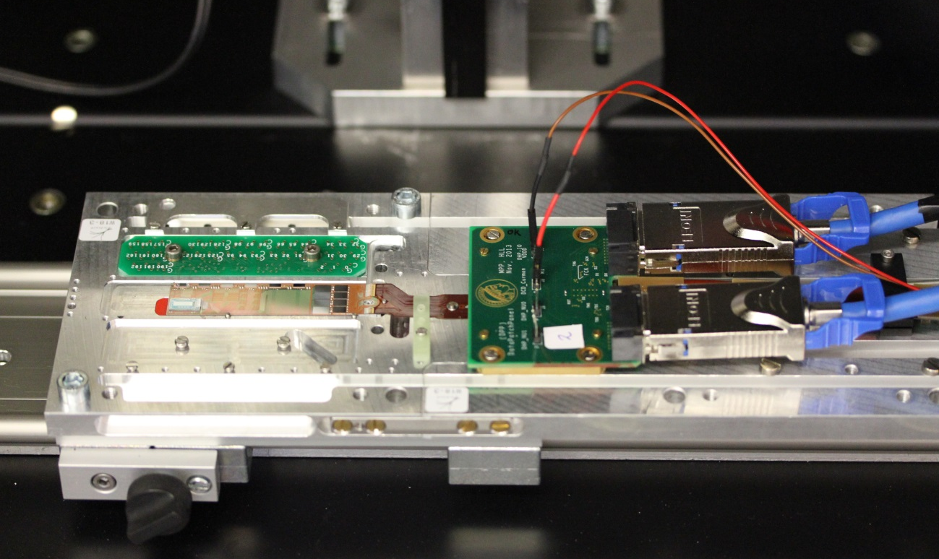
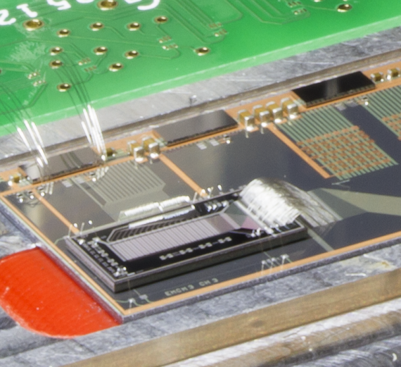
W18-3 HLL - Setup
All ASICs can be configured and read out, Switcher outputs ok!
Small PXD6 matrix (Wafer 22, E07, standard design 50 x 75 µm², short gate length 4µm) connected to (½) DCDPipeline
EMCM connected to short (10 cm) Kapton, Data Patch Panel, Infiniband cables

Slide 7
Power Consumption of ASICs
Voltage | Value | Current | Reference
DHP IO / VDDD | 1.8 V | 217 mA | GNDD
DHP Core / VDD | 1.62 V | 673 mA | GNDD
Switcher | 1.8 V | 18 mA | GNDD
Voltage | Value | Reference
DCD VDDD | 1.8 V | GNDD
DCD VDDA | 1.9 V | GNDA
DCD RefIn | 1.2 V | GNDA
DCD AmpLow | 0.4 V | GNDA
http://twiki.hll.mpg.de/bin/view/DepfetInternal/PowerSupplyScheme
(Bench PS: reference VDDA)
P4-1 – 305MHz | DCD1 | DCD2 | DCD3 | DCD4 | sum
DCD VDDD(all) | 940 mA | 940 mA | 940 mA | 940 mA | 940 mA
DCD VDDA | 406 mA | 420 mA | 444 mA | 428 mA | 1698 mA
DCD RefIn | 51 mA | 60 mA | 50 mA | 50 mA | 211 mA
DCD AmpLow | -85 mA | -95 mA | -98 mA | -92 mA | -370 mA
DCD-Bv2
x1.8
W18-3 - 305MHz | DCD1 | DCD2 | DCD3 | DCD4 | sum
DCD VDDD(all) | 617 mA | 608 mA | 620 mA | 620 mA | 620 mA
DCD VDDA | 735 mA | 767 mA | 830 mA | 755 mA | 2937 mA
DCD RefIn | 72 mA | 92 mA | 88 mA | 75 mA | 327 mA
DCD AmpLow | -280 mA | -300 mA | -330 mA | -266 mA | -1176 mA
x1.5
x3.3
± 100 mA
DCD-pp
± 20 mA
± 80 mA

Slide 8
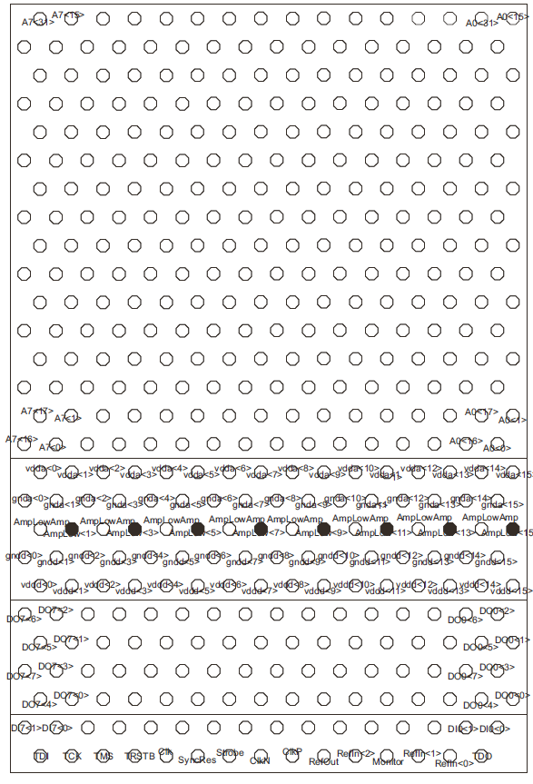
Mapping - Electrical
255
15
first tests:
4-fold readout is not taken into account
We show data of electrical routing
i.e. 256 ADC-channels (0..255)
16
1
0

Slide 9
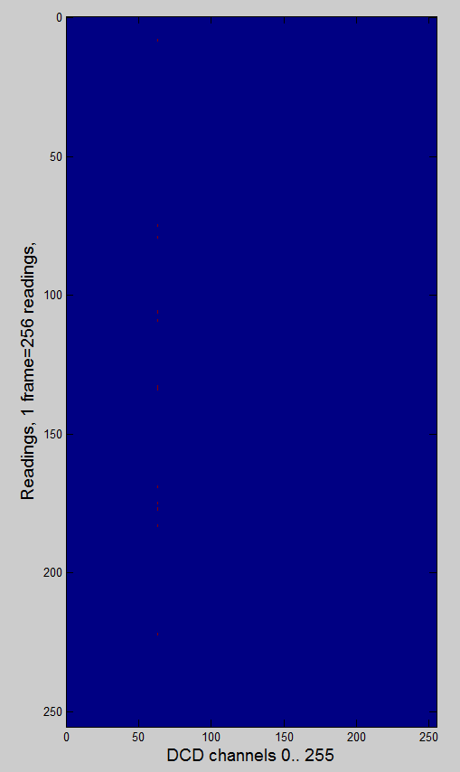
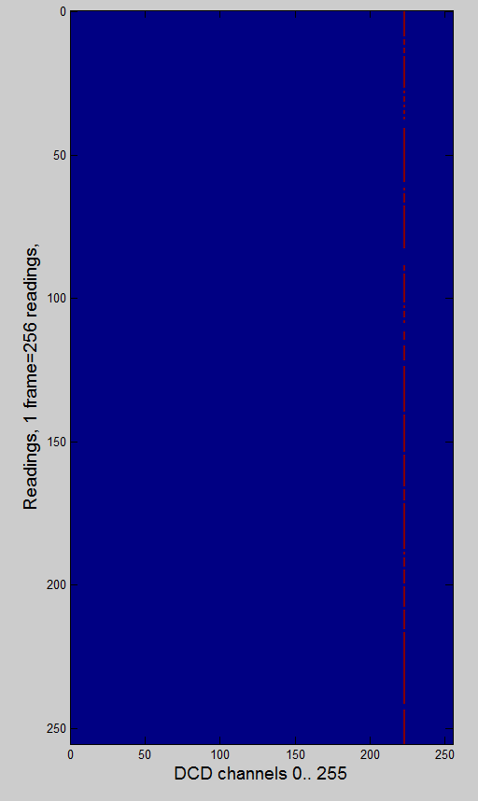
Timing Issues – Test Pattern
Difference (expected Test Pattern , Measured Pattern)
250MHz, DCD1, VDDD=1.8V
305MHz, DCD1, VDDD=1.8V
~/TIMING/15_12_22_DCDpp0_1/test_pattern_of_dhpdcd0_bit61_SLDY_0.pdf
~/TIMING/15_12_22_DCDpp0_3/test_pattern_of_dhpdcd0_bit15_SLDY_0.pdf
column 223
(128ADU 160ADU)

Slide 10
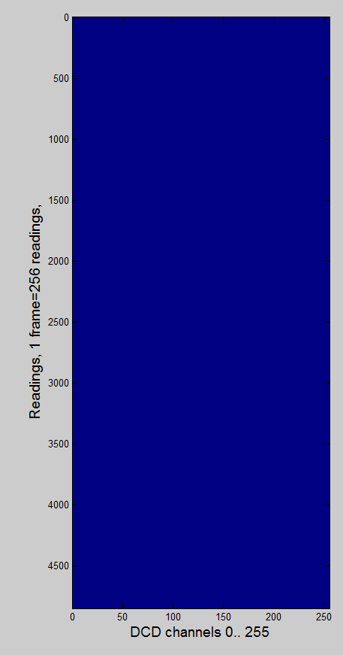
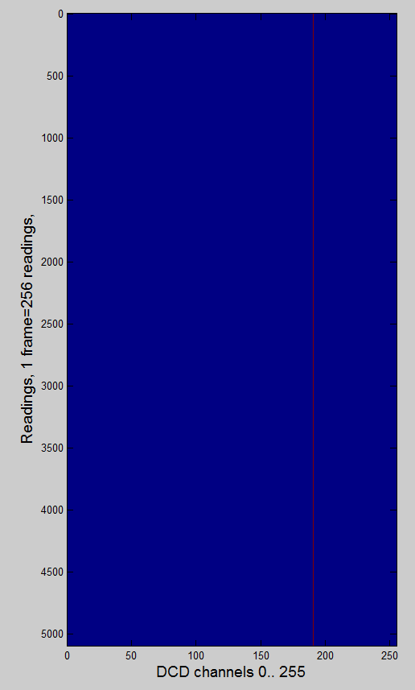
Data Transfer DCD - DHP (2)
305MHz, DCD1, VDDD=1.9V
305MHz, DCD4, VDDD=1.9V
PLL_SER_
CLK_DLY=1
~/TIMING/15_01_08_DCDpp3_2/test_pattern_of_dhpdcd3_dcd_cmos_clk_dly_0_pll_ser_clk_dly_1.pdf
~/TIMING/15_01_07_DCDpp0_1/test_pattern_of_dhpdcd0_bit0_SLDY_0.pdf
✔
column 191
(128ADU 132ADU)

Slide 11
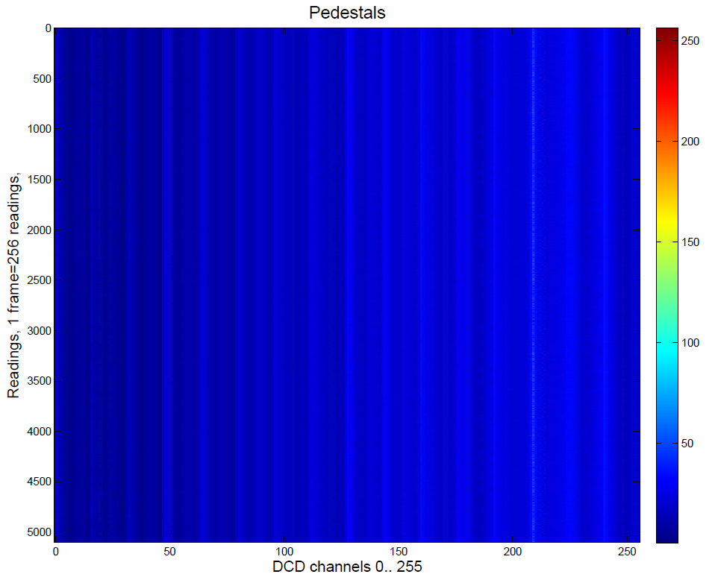
Data Transfer DCD - DHP (3)
305MHz, DCD1, VDDD=1.9V
100% correct test pattern does not guarantee 100% correct readout
Digital problem or ADC problem?
Column 209
ADU: 30, 31, 32, 33 & 63

Slide 12
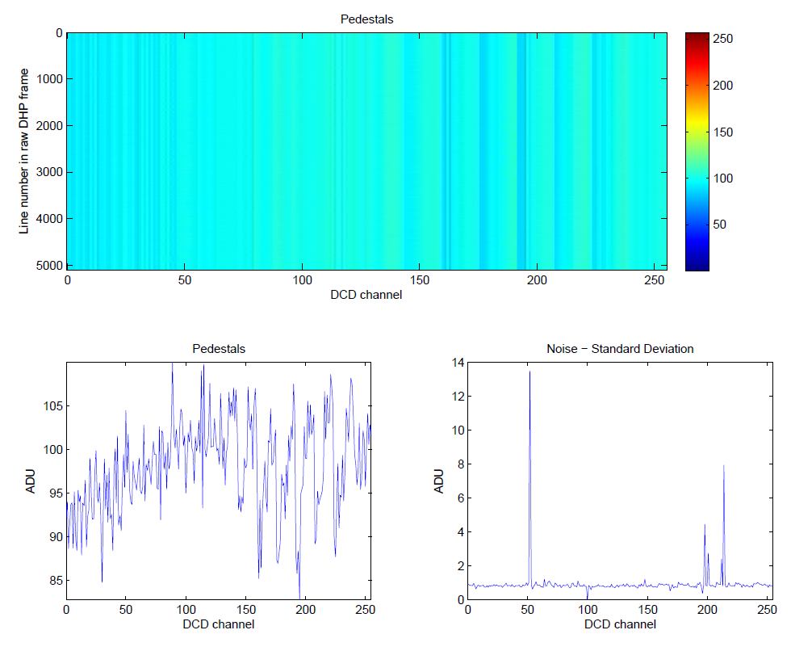
Data Transfer DCD - DHP (4)
305MHz, DCD1, VDDD=1.9V, VNSubIn=2 (instead of 5)
Column 52
ADU: 94, 95, 96, 126, 127
~/TIMING/15_01_09_DCDpp0_1/pedestals_3

Slide 13
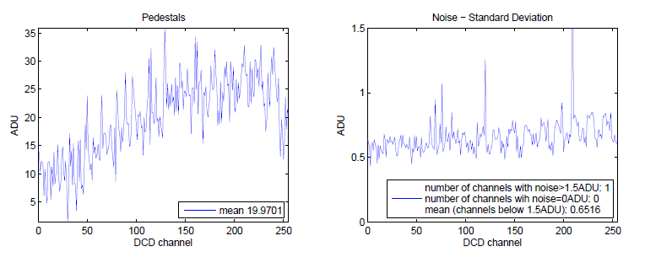
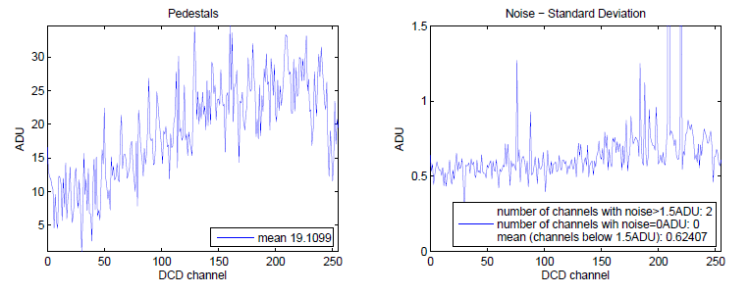
DCD noise – Comparison of BenchPS & LMU PS
LMU PS
15_01_12_parser_DCD0_63th
Bench Power
Supplies
(Hameg 4040)
15_01_12_parser_DCD0_64th

Slide 14
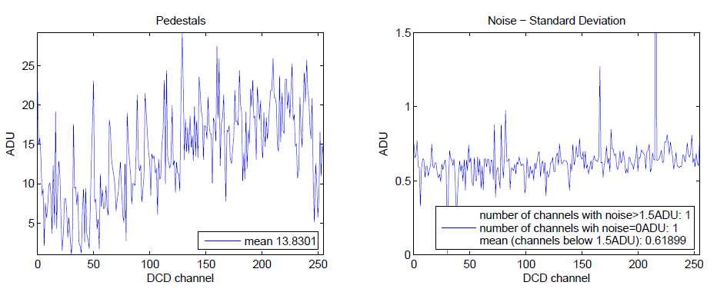
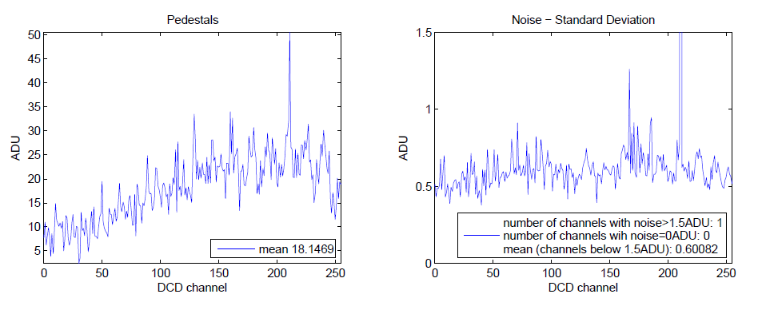
DCD Noise – Optimize Parameters (2)
LMU PS
optimized parameters for noise minimum
1 DCD on
(DCD 1)
daciampbias = 64
dacifbpbias = 85
dacipsource = 82
dacipsource2 = 63
~/ADC_curves/DCD_noise/15_01_13_DCDpp0_66th/scan5
4 DCDs on
daciampbias = 66
dacifbpbias = 80
dacipsource = 88
dacipsource2 = 77

Slide 15
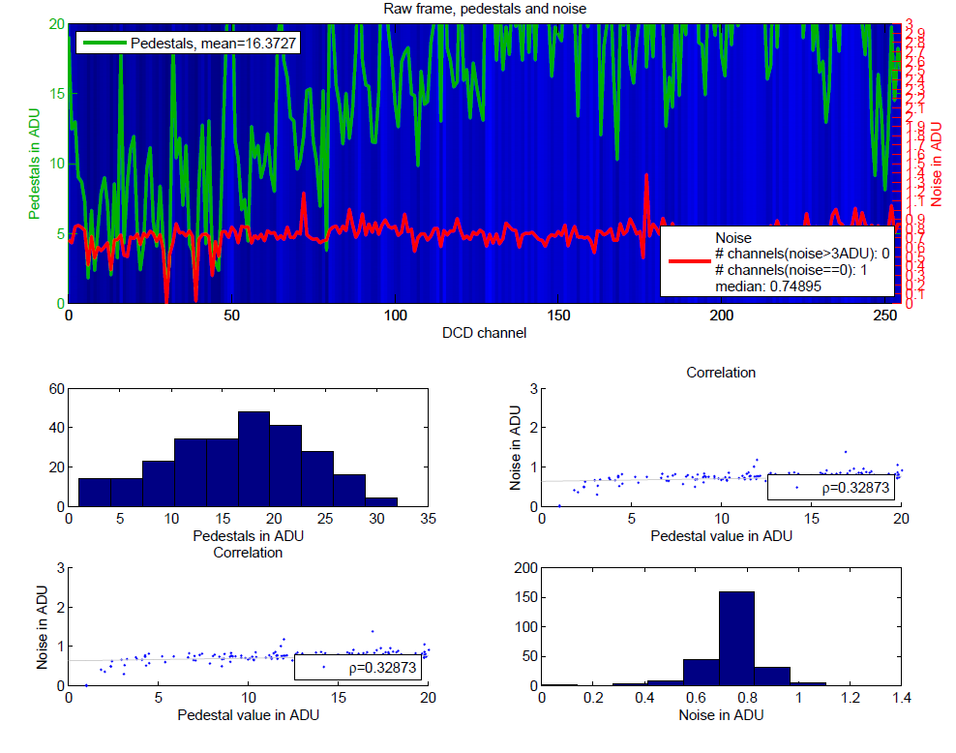
DCD1 Noise – Correlation (Pedestals , Noise)
/home/hybrid5/TIMING/15_01_09_DCDpp0_1/pedestals_1

Slide 16
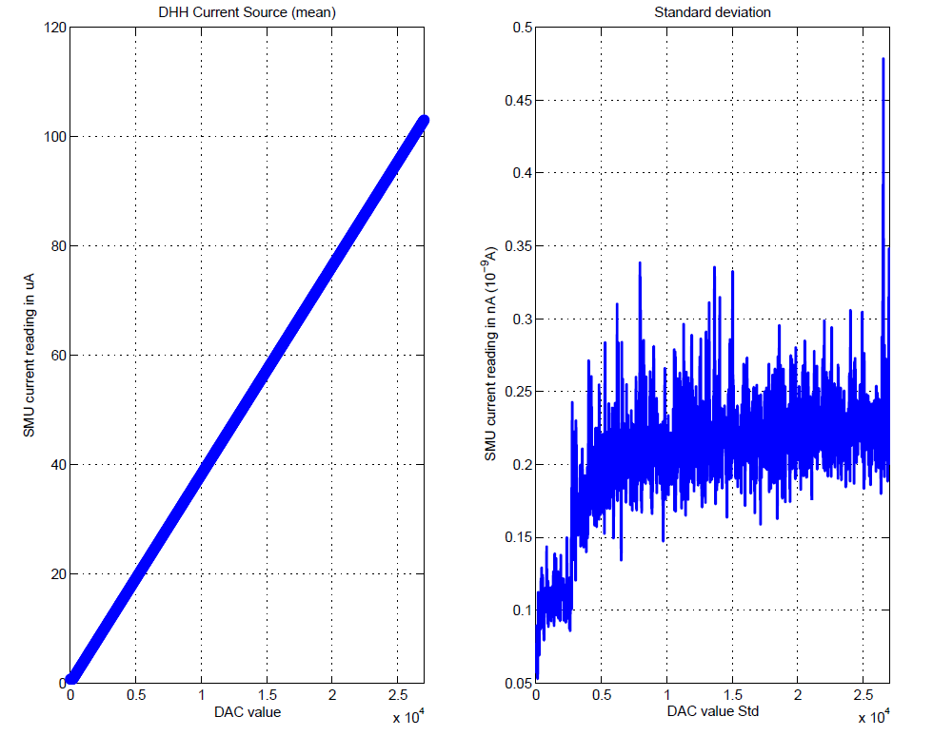
DHH/DHE Internal Current Source - SMU
DHE (former: DHH) operating at 6V connected to SMU
DHE = Data Handling Engine – see Igor‘s talk on Thursday
low-noise
/home/hybrid5/ADC_curves/DHH_to_SMU/2015_01_12__17_00_18_0_V_logfile.pdf

Slide 17
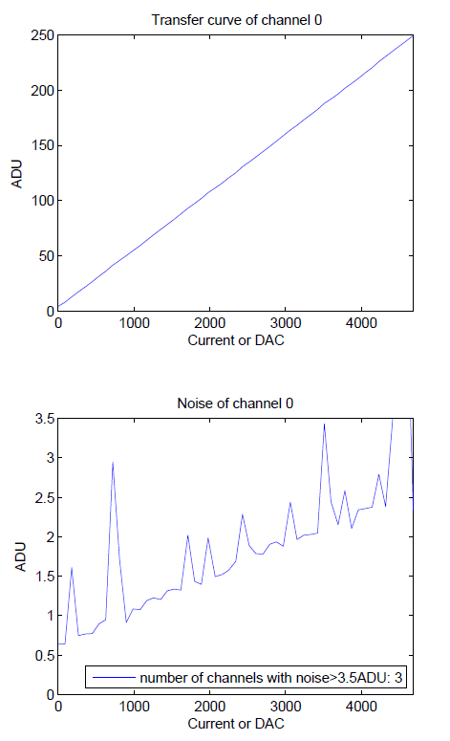
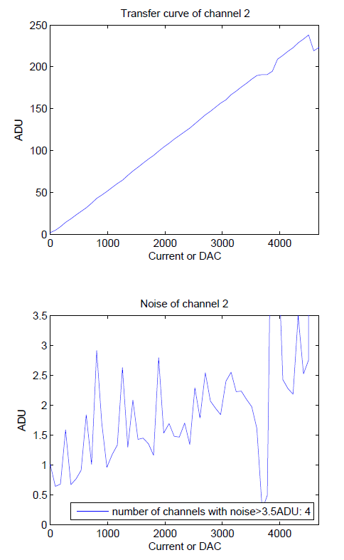
ADC Transfer Curves of DCD1
/home/hybrid5/ADC_curves/DHH_to_DCD/2015_01_13
„missing code“, known problem
/home/hybrid5/ADC_curves/DHH_to_DCD/2015_01_13

Slide 18
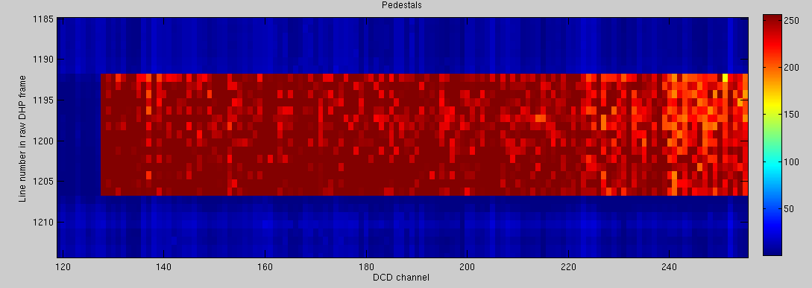
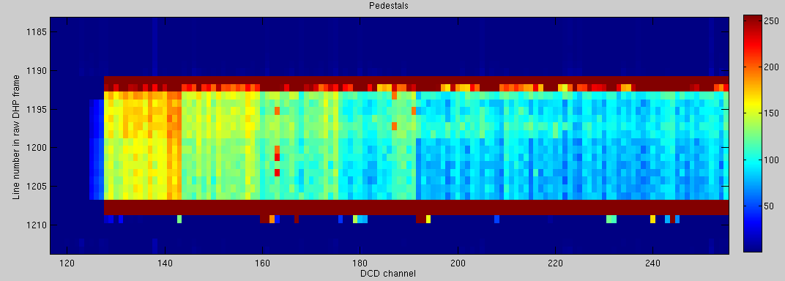
Operation of Matrix
14 rows
Connected to DCD4
Light sensitive
Row number not as expected
No syn. between DHPT-SW & DHPT-DCDpp?
Differences between DCDpp DCDB in terms of syn reset?
High noise
Optimize voltages
Optimize switcher sequence (sample point)
/home/hybrid5/ADC_curves/DCD_noise/15_01_15_parser_DCD3_70th/dcdpp_3_dacvnsubin_7
18 rows
/home/hybrid5/ADC_curves/DCD_noise/15_01_19_parser_DCD3_71th/dcdpp_3_dacvnsubin_7

Slide 19
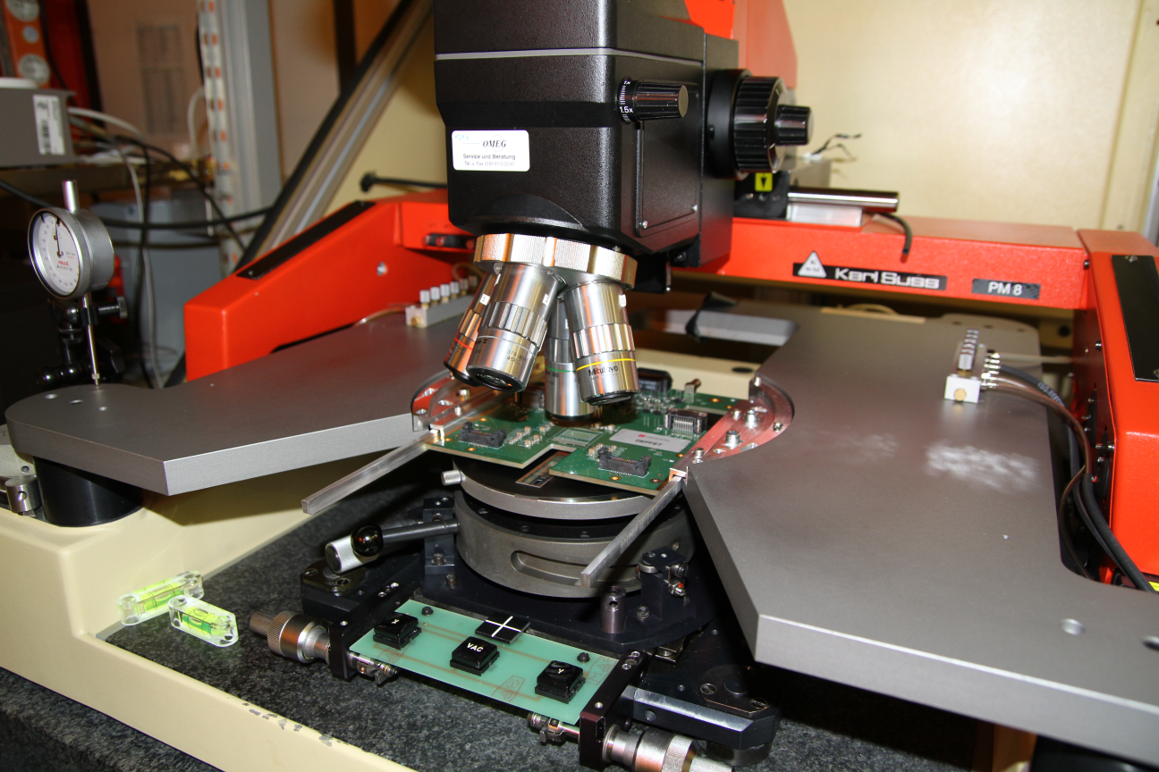
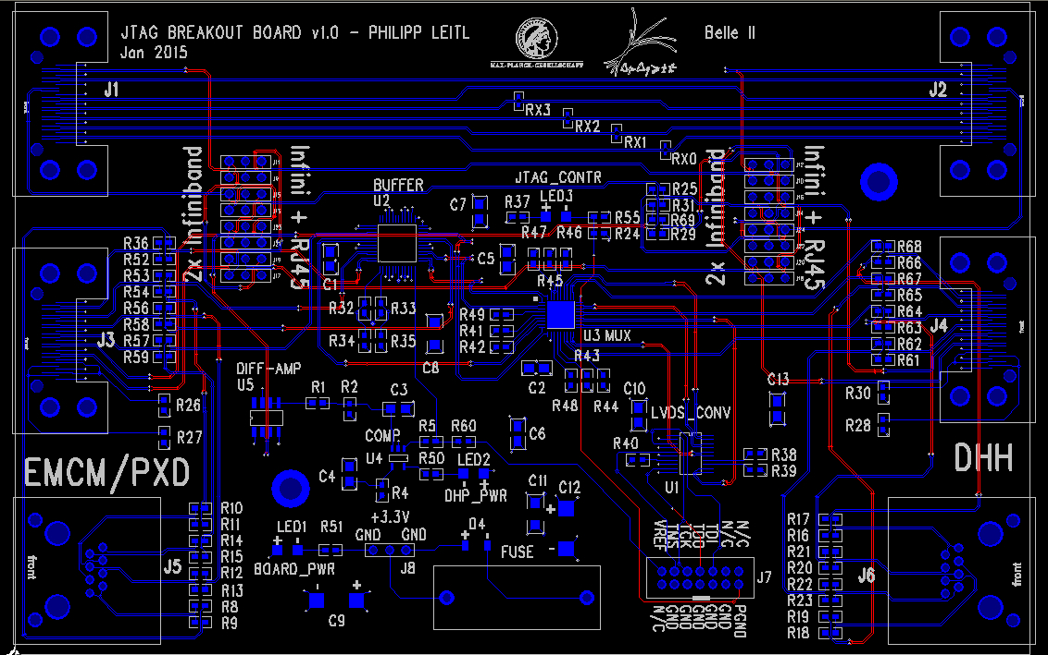
W17-4 – HLL Probecard Setup
Runs with LMU PS
Configuration of all ASICs
No HS links established
2 new probecards for PXD9 are required
=> forward & backward module
=> Adapter for commercial software & hardware by Phillip

Slide 20
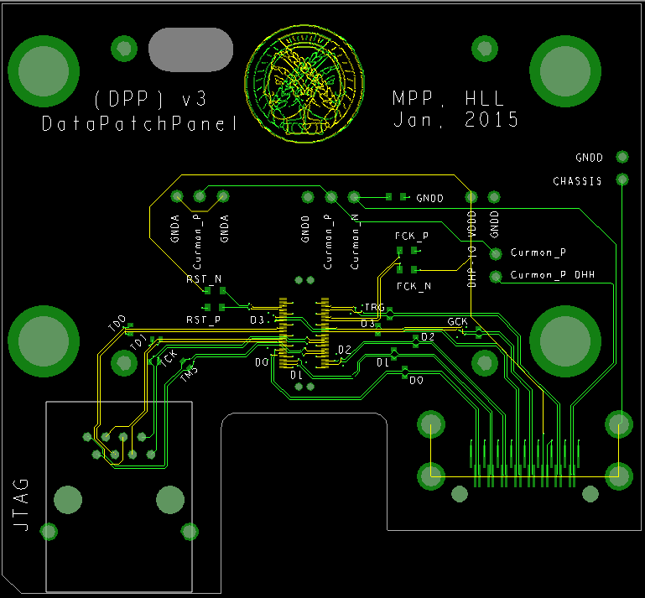
New Data Patch Panel for DHH/DHEv2
New Data Patch Panel (v3) for new DHH/DHE v2
Connect data cables to EMCM, connection to Kapton Flex
1x Infiniband (HS signals)
1x RJ45 (JTAG)
Testpads 0402 for HS signals
100 Ohm impedance controlled
FCK & RST hard wired
Headers for:
Chassis GND
Curmon (& GNDA)
to Kapton
to DHH/DHE v2

Slide 21
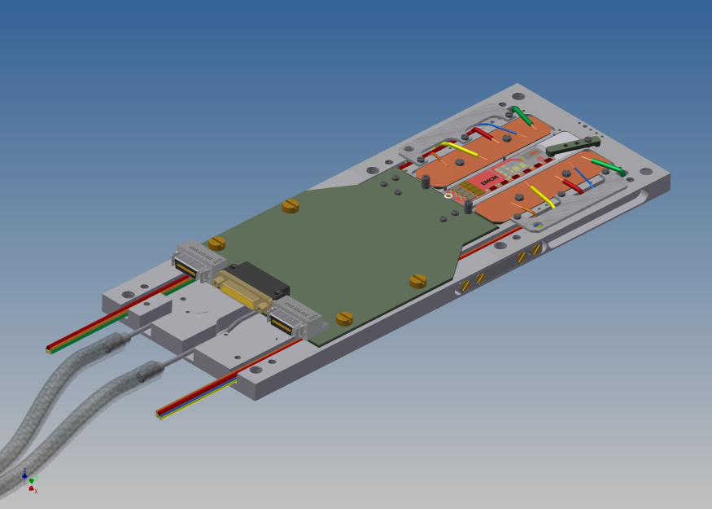
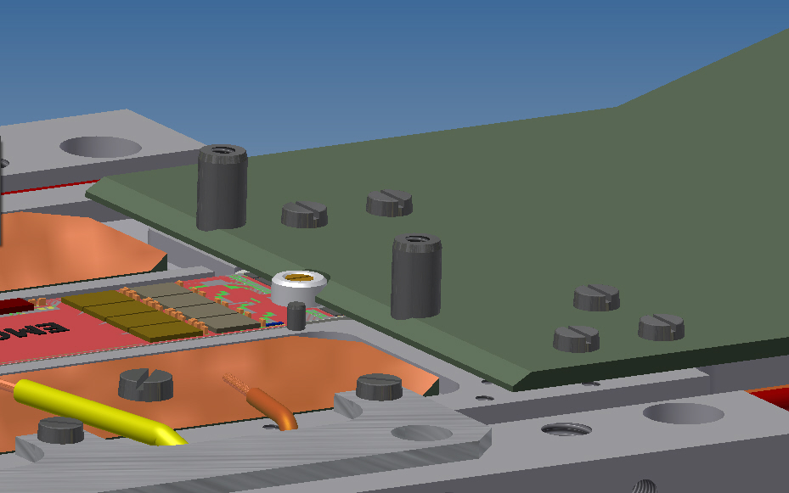
KPCB – instead of DPP, PPP, Kapton
For EMCM and PXD9
Replaces:
Kapton Flex
DataPatchPanel
PowerPatchPanel

Slide 22
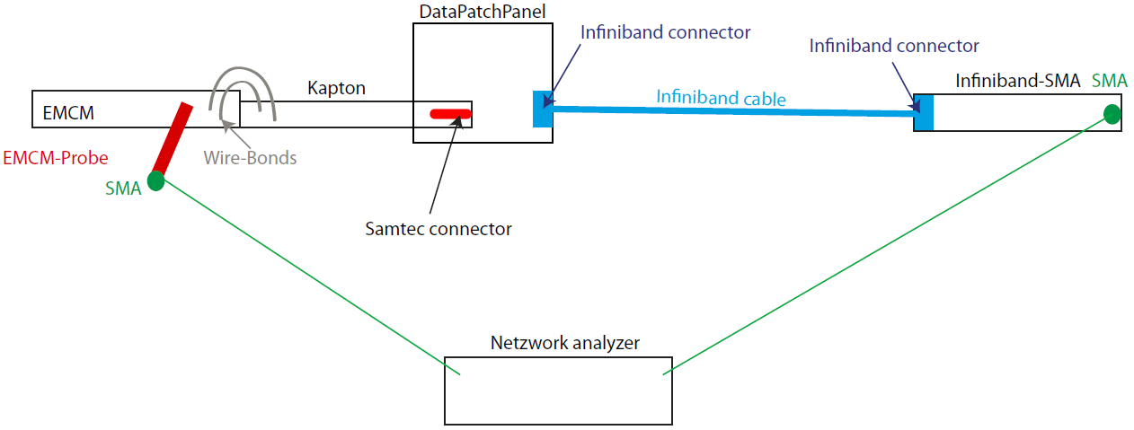
Measure Data Chain - S-parameters
GGB Probe Model 40A

Slide 23
Summary and Outlook
Timing issues between DCD and DHP are mainly solved
Test pattern looks almost correct (except of 3 columns)
100% correct test pattern does not guarantee 100% correct readout ↔ noisy ADCs ?
DCD optimized (noise ~ 0.6ADUs) with LMU PS (all ASICs in operation)
Aurora links partially established
High Speed Probe (@Probecard setup)
Data chain, extract S-parameters, measurements start 27th (Jan 2015)
Zero Suppressed Readout (Feb 2015)
JTAG Boundary Scan ↔ PCB is already ordered (Feb 2015)
KPCB ↔ EMCM, PXD9 (finished till Apr (2015))

Slide 24
Abbreviations
ADC = Analog-to-Digital-Converter
ADU = Analog-to-Digital Unit
ASIC = Application-Specific Integrated Circuit
DCD = Drain Current Digitizer
DCDpp = Drain Current Digitizer Pipeline
DHE = Data Handling Engine
DHH = Data Handling Hybrid
DHP = Data Handling Processor
DHPT = Data Handling Processor TSMC 65nm technology
EMCM = Electrical Multi-Chip Module
HS = High Speed
JTAG = Joint Test Action Group
KPCB = Kapton replacement PCB
PCB = Printed Circuit Board
PS = Power Supply
SMA = Sub-Miniature-A
SMU = Source-Measurement Unit
SW = Switcher

Slide 25
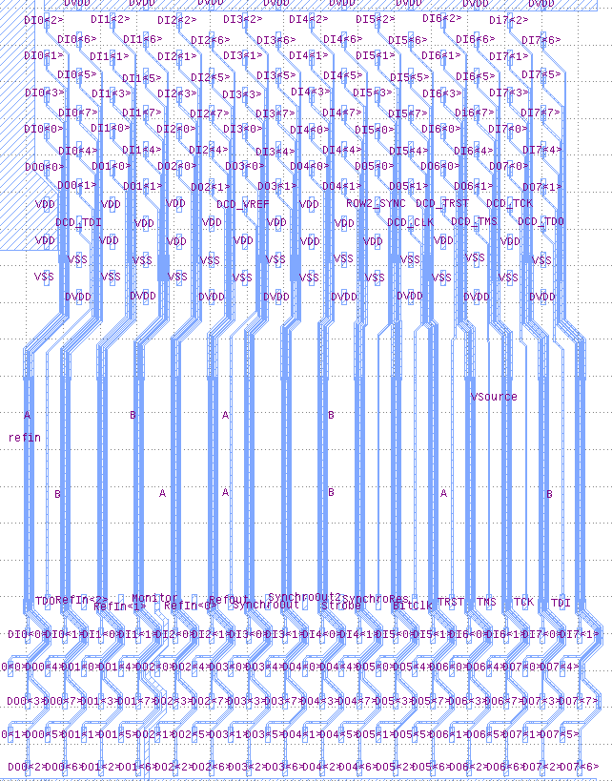
Data Transfer DCD – DHP (1)
8 buses DIX
8 lines (≙8bits) DIX<Y>
Fine Tuning parameters: SLDY 0..63
BIT | bit 0 | bit 1 | bit 2 | bit 3 | bit 4 | bit 5 | bit 6 | bit 7
LINE | DI0<0> | DI0<1> | DI0<2> | DI0<3> | DI0<4> | DI0<5> | DI0<6> | DI0<7>
ADU | 1 | 2 | 4 | 8 | 16 | 32 | 64 | 128
col 0-31
BIT | bit 48 | bit 49 | bit 50 | bit 51 | bit 52 | bit 53 | bit 54 | bit 55
LINE | DI6<0> | DI6<1> | DI6<2> | DI6<3> | DI6<4> | DI6<5> | DI6<6> | DI6<7>
ADU | 1 | 2 | 4 | 8 | 16 | 32 | 64 | 128
col 192-223
column 223 => DI6
160AUD-128ADU=32ADU => bit 53

