Slide 1
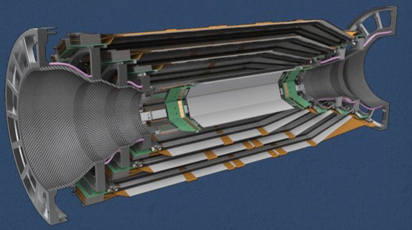


Class-X BW/FW Subassemblies
OUTLINE
Status/numbers
Tentative schedule
Needed (extra)
subassemblies
Conclusions
S. Bettarini for the Pisa Belle2-SVD group
SVD Parallel Session VXD-Workshop
Praga, 22nd January 2015

Slide 2
Classes of a subassembly (→ladder)
Let’s remind, a sub-assembly belongs to:
Class D: mock-up. Used for early tuning procedures/jigs
  The detector may be an aluminum dummy
  The hybrids may not be loaded with APV25 chips
  The Flex-PA may be an old version and not bondable
  The assembly may be glued by hand, precision o(200 um)
Class C: mechanically the same of a real one. Bonded but not electrically working.
  Used to test the final procedures/jigs before making an electrically functioning ladder. Subassemblies/Ladder are used to perform the mechanical characterization.
  The silicon detector design is the final one
  The hybrids are loaded with APV25 chips
  The Flex-PAs are bondable
  The precision of the glued parts is the same of the final ones
Class B: used the final parts and procedures, electrically functioning parts but of low quality [efficiency ~ o(90%)]
  Used for test-beam(s) and for electrical characterization (noise, grounding, …)
Class A: the very final one, to be mounted in the experiment.
An acceptance criteria (< X% of defects) must be defined.

Slide 3
Old Subassembly Numbers (already delivered)
Class D: undefined (about 2 pairs of SBW+SFW /site)
Class C: 3 SBW + 3 SFW (1 pair/site)
Class B: 3 SBW + 3 SFW (The Vienna’s ones for the test-beam)
Class A: 45 SBW + 45 SFW
pre-production: 3 SBW + 3 SFW - first spares
production: 42 SBW + 42 SFW
  38 SBW + 38 SFW
  spares production: 4 SBW + 4 SBW.
We know that the number of (ladder) spares is limited by the numbers of HPK det’s. HPK det’s counting/searching is in progress (completed for the B2GM).
Originally the number of spare ladders were: 3,2,2 for Layer 6,5,4.
At the BPAC review the new (hoped) numbers were: 5,4,3 (respectively)

Slide 4
Parts available in Pisa
Detectors:
  Micron: 1 class C + 2 class B (latest design)
  HPK: 5 class “C/B”+ 1 to be re-tested + 1 vs.1
Flex PAs:
  Remaining from the 1st pre-prod. (not-tested against shorts): to be used for class C
  Half of the 2nd pre-prod (-4 PAs used for bonding tests). Take the remaining ones at the B2GM
  Once the Flex-PA are delivered, IPMU need to measured all the pad width (how much extra time ?). Then they need to be shipped (by IPR): see det’s case.
Hybrids (sandwiches):
  2 class C FW (+2 taken from Vienna)
  0 class C BW (+2 taken from Vienna)
  64 class A to be done (1st batch)
  the hybrids (rejected by the test even after simple rework ) can be shipped back to Vienna or used as class C.

Slide 5
Detector Shipping
Defined the procedures for IPR
Vienna ←→Pisa:
  This week the 1st shipment from Vienna is expected: according to the pro-forma invoice 7 det’s: 1 Class C + 6 ClassA, but actually ?
  No further tests on them before mounting: avoid shipping the scratched (not re-tested) class A det’s!
  The mismatch between the defects spotted by the det. test in TS and in Vienna has been understood?
HPK det’s: see discussion outcome from:
  “Logistics and parts shipment”
  For the 1st shipment from KEK many issues remain to be solved…
  On the critical path: the delay in the HPK det’s shipment can seriously affect the start of the production of the subassemblies!

Slide 6
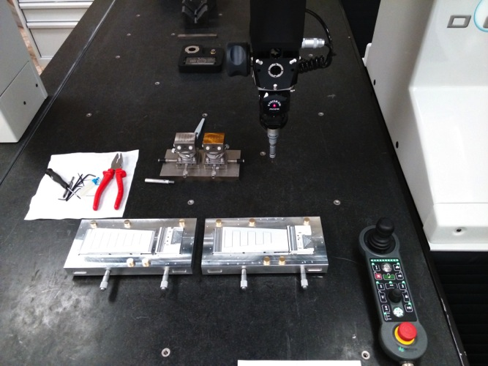
FW mech. tools
The final FW gluing jigs phi and z have been mechanically characterized under the CMM
The PA chuck are produced this week (19→23/1)
The functional characterization is to be done by gluing the 1st SFW class C next week (26→30/1)
Completed the 1st batch of
20BW+20FW Multi Purpose
Chucks (10 already used)
The 2nd batch of MPC
(more 20BW+20FW)
will be delivered in April.
Ship back to Pisa the
empty MPC as mechanical pieces.
IPMU measurements on the last
class C BW&FW subassemblies confirms that no movement of the silicon wrt the MPC occurred during the shipment (see back-up slides)

Slide 7
Let’s define the new numbers (and priorities)
At the Vienna Site-qualification:
no more class D
one more class C ladder is needed (define the priority wrt class B).
the L5 class B is the one used for the next test-beam
Collect the other requests of IPMU/TIFR.
-> class D: ? (expected 0!)
-> class C: ? (expected one more ladder/site)
-> class B: ?
In Pisa we must have an extra pair of SFW/SBW for mechanical tests of the subassemblies.
The gluing of the extra (class C) subassemblies should be done during the cooling system replacement, before the start of the pre-production and/or during the 2nd part of the Class A pre-production (and shipped accordingly to the needs).

Slide 8
“Tentative” Schedule
There is room for
time optimization

Slide 9
Class A pre-production schedule: gluing
This time can be used to glue more class C sub-assemblies
Use of only one CMM: only 2 gluing jigs are deployed. Change phi and z jigs once/week and their alignment is done with the detector just before starting the gluing procedures (0.25h).
When the glue is cured (typically the day after the gluing) the survey is done, by registering the coordinate of the crosses (0.5h) on the gluing jig.
After transferring the subassembly to the MPC (to take it away after the z gluing or for the upside-down operation to transfer it on the z gluing jig) the survey of the glue-line must be done under the microscope taking snapshots (0.5h).

Slide 10
Class A pre-production schedule: bonding/test
Test&rework means that after the 1st test, the needed operations are made by the bonding technician and eventually the test is re-done to arrive to qualify the side. Multiple tests cannot be easily quantified “a priori”.
Even if the 1st Z test has no bias voltage, shorts and unbonded channels can be spotted as well. Standard “running test time”~15 min/side
The time required to make a Vsep scan test when Vbias is ordero of 10 mins. The laser scan is done phi-up. After the final upside-down (the sub-assembly must be shipped z-up) a quick test is foreseen to ensure that no damage occurred to the bondings on both sides.
When the subassembly is tested and ready to be shipped a survey of the det's ref crosses (wrt the pins of the MPC) is performed.

Slide 11
Class A production at full speed
The class A subassembly pre-prod. has been scheduled to be not tight. Real experience on that will say if the following estimate on Class A production is right.
Key points:
  It will be crucial to have many sub-assemblies glued in the bonding/test phase to avoid waiting time.
  Max. gluing rate > Max. test rate > Max. bonding rate
  One shift/each side is foreseen both for gluing and testing
  Z side test is shorter than phi side one (when bias is on, Vsep scan and laser scan are foreseen). Laser scan don’t require rework (in principle) and it can be launched in the late afternoon or in the spare time of the phi shift.
  The shipping rate proposed is ~ 8 SFW + 8 SBW / month

Slide 12
Class A production: gluing
Assumption:
5 working day / week
One shipping (8 SFW + 8 SBW) every 4 weeks, compatible with the ladder production which will start much later
Ladder assembly sites must test subassemblies as soon as they are delivered and store them in dorms until they will use them.

Slide 13
Class A production: bonding/test
Legenda:-n (+n) means previuos (next) 8SBW+8SFW batch
Production rate: 4 FW (or 4 BW) subassemblies/week:
1→2 side/day for each operation: gluing, bonding and testing.

Slide 14
Details of test time estimation
Test rate estimate inputs:
  ~2 sides/day →
    1 test + rework (Z) + 4 quick tests or
    2 tests + rework + 1 laser scan/day (phi)
  ~2 shifts/day needed
  1 (Z) shift consists of: 2 * 15 min/test + rework + analysis and result loading into the DB + 1 hour laser ➔ 3 hour-shift
Remind:
  Test-stand needs to run also o(2x128) tests (15 min) for single side Hybrid + o(2x64) test (15 min) after gluing.
  The whole 1st batch sandwiches scheduled to be tested before starting production.

Slide 15
FW/BW subassembly: ManPower
The people who developed the tools (gluing jigs, micro-bonding set-up, electrical tests and laser-scan) are the same who will act the same role during sub-assembly production.
With the available manpower, possible to perform shifts of two teams (2 persons each)/day:
Module assembly: 1 physicist + 1 technician (3h shift)
Electrical test and laser-scan: 2 physicists (3h shift)

Slide 16
Exercise: shift allocation
To sustain the 8SFW+8SBW/month rate
the manpower resources are not saturated!

Slide 17
Conclusions
The tentative schedule has been done, by considering:
  Facilities (CMM & jigs, u-bonding machine, test-stand)
  Procedures (gluing, bonding, testing, shipping)
  Available manpower
By our estimate, we confirm that the rate of 8SFW+8SBW/month can be sustained (2 SFW+2 SBW/week). Final confirmation after Class A pre-production.
For 42 SFW-SBW Class A pairs → ~ 5.5 months
If starting the Class A production in April, we’ll finish in mid November:
7 months in total.
(Consider to add 1.5 month due to:
- Few days: Easter Holidays
-1 week: the next VXDWS in May
-2 weeks: summer vacancies in August
-2 weeks: the June/October B2GMs)

Slide 18
Back-up

Slide 19
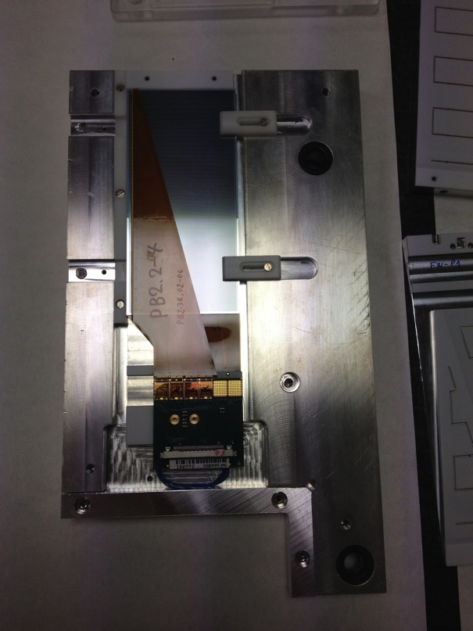
BW class C sub-assembly (SBW992)
x
Two small silicon pieces with
a reference cross on the corner
are glued on the MPC.
IPMU data
F4
F3
Cross2
F# | x[mm] | y[mm]
1 | -24.713 | 26.2842
2 | -24.872 | 85.082
3 | 99.226 | 85.419
4 | 99.386 | 26.619
Cross1
y
F1
F2
We defined the x and y axis as in figure.
We measured 4 points on the detector,
by using the “F” on its corners in this way:
Pisa data
F# | x[mm] | y[mm]
1 | -24.717 | 26.284
2 | -24.875 | 85.080
3 | 99.222 | 85.412
4 | 99.380 | 26.612
F

Slide 20
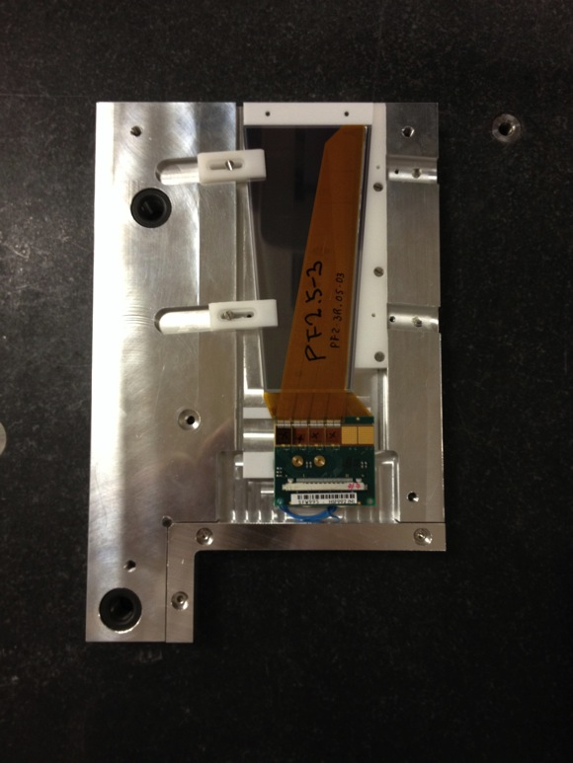
FW class C sub-assembly (SFW995)
x
Two small silicon pieces with
a reference cross on the corner
are glued on the MPC.
IPMU data
F4
F3
Cross2
F# | x[mm] | y[mm]
1 | -33.347 | 71.013
2 | -33.319 | 30.276
3 | 91.958 | 20.565
4 | 91.921 | 80.879
Cross1
y
F1
F2
We defined the x and y axis as in figure.
We measured 4 points on the detector,
by using the “F” on its corners in this way:
Pisa data
F# | x[mm] | y[mm]
1 | -33.334 | 71.006
2 | -33.317 | 30.269
3 | 91.958 | 20.565
4 | 91.918 | 80.878
F
As expected, the subassemblies didn’t move
during the shipment inside their MPC.

