Slide 1
L6 ladder assembly status and milestone.
Yoshiyuki Onuki
U-Tokyo

Slide 2
Outline
FW/BW module integration preparation
Ladder assembly procedure
Gluing procedure of slant CO₂ clip and Keratherm.
Mechanical QA
Electrical QA
Gluing and bonding
Alternative gluing method to overcome curling Origami and the bondability.
Remaining items

Slide 3
FW/BW module integration preparation
Agreement of PF2/PB2 height in the FW/BW module in the last VXD meeting.
FW/BW pick-up-jig(PF2-jig and PB2-jig) was modified to have 500um tolerance.
Backward-jig to glue BW module was also modified. Slant(Forward)-jig is milling now and delivered soon.
Trial integration of FW/BW module into ladder
We can test soon.
If it cannot work, FW/BW Pick-up jig in L5 will be ported in L6.

Slide 4
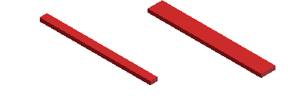
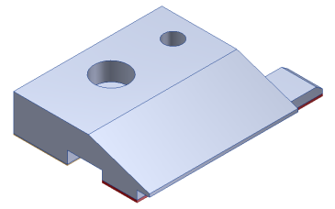
Slant CO2 clip and Keratherm
Rev2.2,
Slant CO2 clip is introduced
Size of Keratherm become wider.
Rev2.3
Optical fiber
Additional screw hole in L4-5 FW APV-cover. BW ?
Grounding wire
Slant CO2 clip should be aligned straight with the other clips.
The position may be worst determined on the Origami+z in L6 ladder.
Should be glued by Jig, not by hand.
Update of CO2 clip and Keratherm attaching procedure.
Gluing CO2 clips both Slant part and Origami part at the same time.
How to attach Keratherm

Slide 5
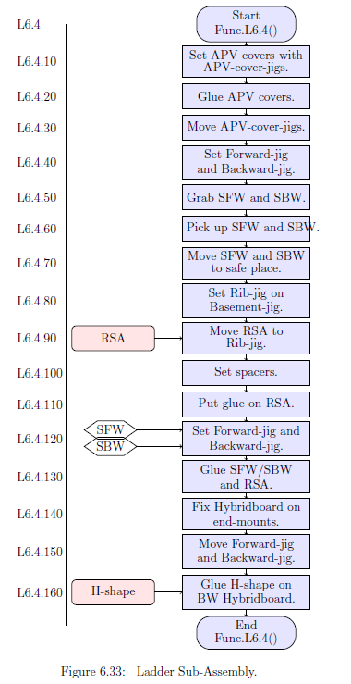
Ladder sub assembly 6.4.150

Slide 6
Ladder sub assembly 6.4.160
Insert slant AIREX gluing on here

Slide 7
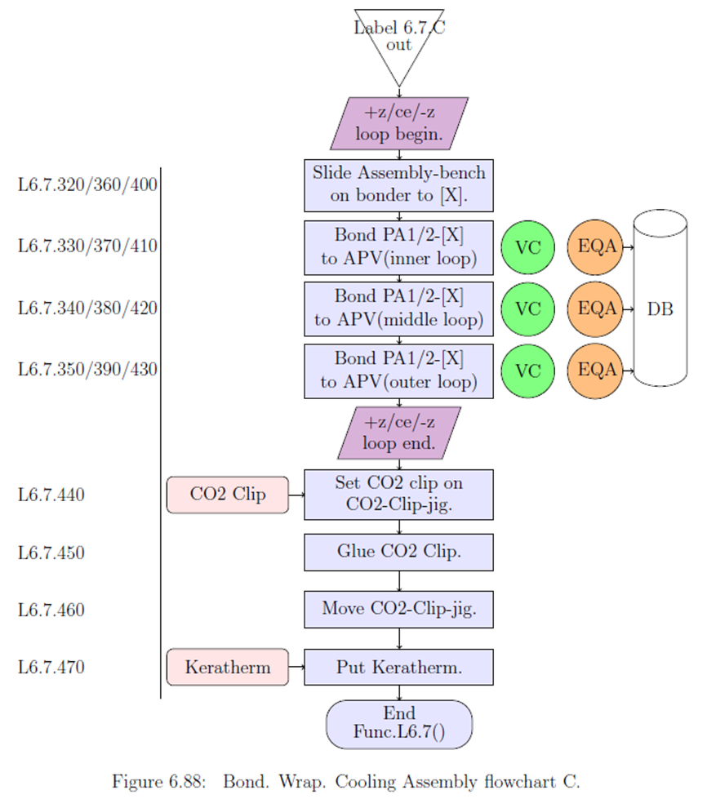
Bond.Wrap.Cooling 6.7.440
Move these procedures
to the final(ladder) assembly
procedure 6.8.

Slide 8
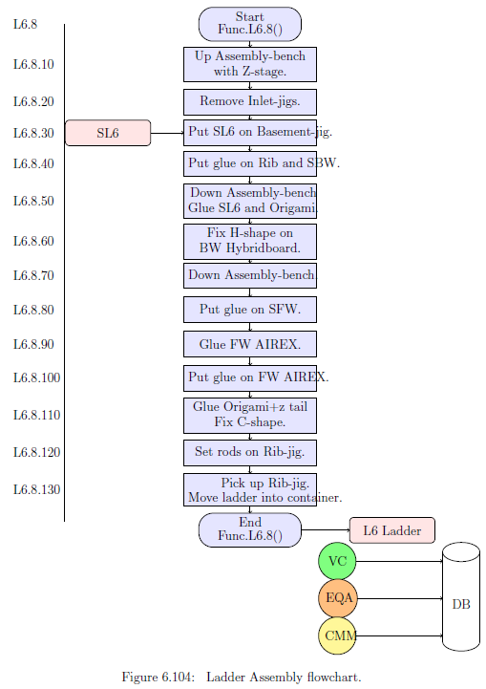
Ladder Assembly 6.8.10

Slide 9
Ladder Assembly 6.8.20

Slide 10
Ladder Assembly 6.8.30

Slide 11
Ladder Assembly 6.8.40

Slide 12
Ladder Assembly 6.8.50

Slide 13
Ladder Assembly 6.8.60

Slide 14
Ladder Assembly 6.8.70
Put glue on SFW

Slide 15
Ladder Assembly 6.8.80
Put glue on SFW
Glue Origami+z tail SFW

Slide 16
Ladder Assembly 6.8.90
Put glue on SFW
Glue Origami+z tail SFW
Set CO2 clip/Kera. on CO2-clip-jig

Slide 17
Ladder Assembly 6.8.100
Put glue on SFW
Glue Origami+z tail SFW
Set CO2 clip/Kera. on CO2-clip-jig
Glue CO2 clip

Slide 18
Ladder Assembly 6.8.110
Put glue on SFW
Glue Origami+z tail SFW
Set CO2 clip/Kera. on CO2-clip-jig
Glue CO2 clip
Move CO2-clip-jig

Slide 19
Ladder Assembly 6.8.120
Put glue on SFW
Glue Origami+z tail SFW
Set CO2 clip/Kera. on CO2-clip-jig
Glue CO2 clip
Move CO2-clip-jig
Down Assembly- bench

Slide 20
Ladder Assembly 6.8.130
Put glue on SFW
Glue Origami+z tail SFW
Set CO2 clip/Kera. on CO2-clip-jig
Glue CO2 clip
Move CO2-clip-jig
Down Assembly- bench
Set rods on Rib-jig

Slide 21
Ladder Assembly 6.8.140
Put glue on SFW
Glue Origami+z tail SFW
Set CO2 clip/Kera. on CO2-clip-jig
Glue CO2 clip
Move CO2-clip-jig
Down Assembly- bench
Set rods on Rib-jig
Pickup Rib-jig. Move ladder into container

Slide 22
MQA(Ladder precision survey)
Nobuhiro Shimizu(U-Tokyo)
Using simultaneous 6D fitting,
Misalignment parameters can be obtained as residuals from design.

Slide 23
Final result of L6 D-2 ladder survey
Nobuhiro Shimizu(U-Tokyo)
DSSD1
DSSD2
DSSD3
DSSD4
DSSD5
 | DSSD1 | DSSD2 | DSSD3 | DSSD4 | DSSD5
Δx | -0.002 | 0.057 | 0.050 | 0.041 | 0.348
Δy | -0.010 | 0.004 | -0.012 | -0.014 | 0.145
Δz | -0.190 | -0.181 | -0.196 | -0.171 | -0.437
η | -0.0010 | -0.0100 | -0.010 | -0.010 | -0.001
θ | 0.0004 | 0.0000 | 0.000 | 0.000 | 0.366
φ | 0.0105 | 0.0099 | 0.000 | 0.010 | 0.009
Translation
[mm]
Rotation
[rad]
=20.976deg(21.1deg )
This helps to pin down what should be tackled next
Origami DSSDs are shifted +0.05mm to x-axis.
Height of BW module and Origami DSSDs is -0.2mm lower than design.
May indicate something wrong in Assembly-bench.
FW module is shifted.
May indicates something wrong height spacer or Slant-jig

Slide 24
Gluing for Origami
Yoshiaki Seino(Niigata U)
Tomoko Morii (IPMU)
Baseline method
Jig
L6 group had been much utilizing straw effect for the gluing:
Upper vacuum is released ~40 minutes after gluing.
Glue spreads to the small gap spontaneously.
Pros: Well matched for thin and soft material(PA1,2).
Cons: Not matched for curling or waving material(Origami)
Origami
Airex
Al
Assembly bench
New method
Developing new method to achieve uniform glue spread at the Origami.
Upper vacuum is keeping ~4 hours after gluing.
During vacuum chucking, curling corrected to be flat.
~4 hours is the condition:
- Glue become harder and stronger than the curling.
- If glue flooded to the jig, still removal by wiping.
- Better bonding yield. Pull force is not checked yet.
Origami
Jig
Airex
Al
Assembly bench
Wiping glue test
1 hour cured
5 hours
4 hours

Slide 25
Bonding
Tomoko Morii (IPMU)
Outer loop also satisfy requirement

Slide 26
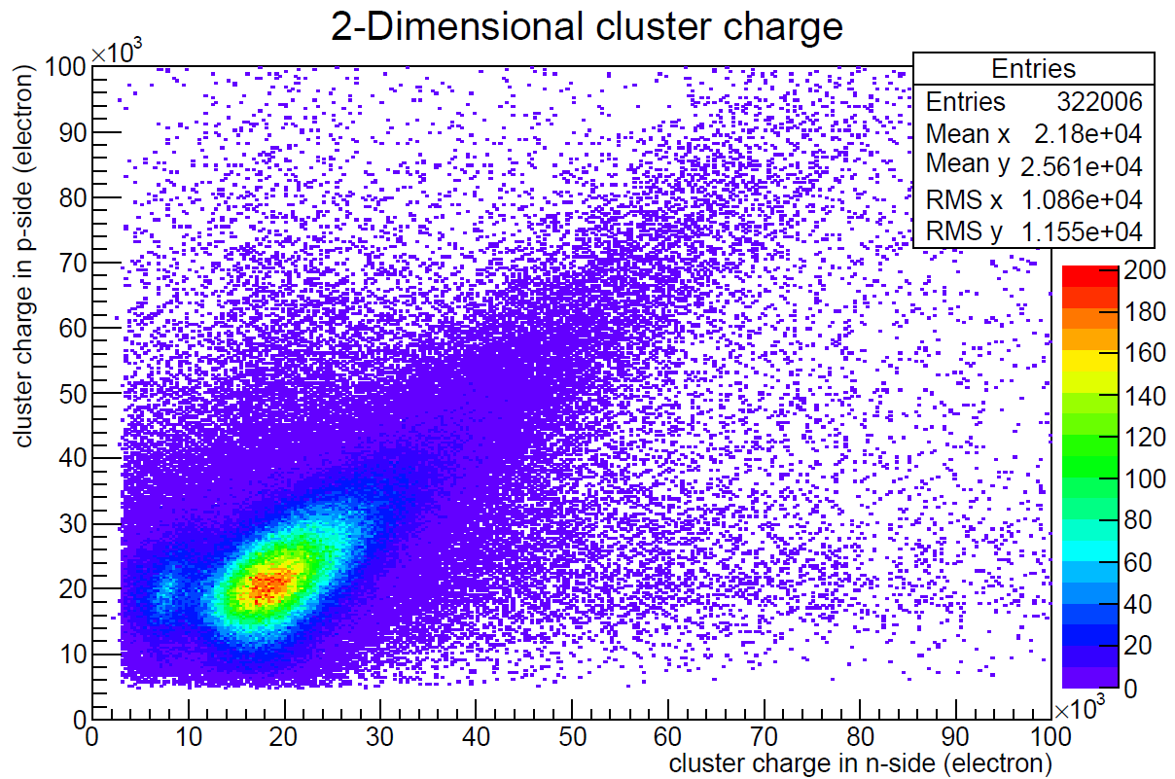
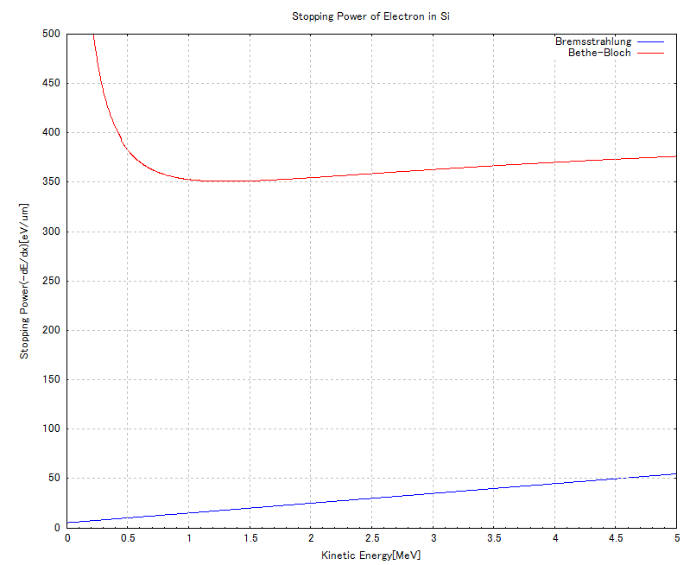
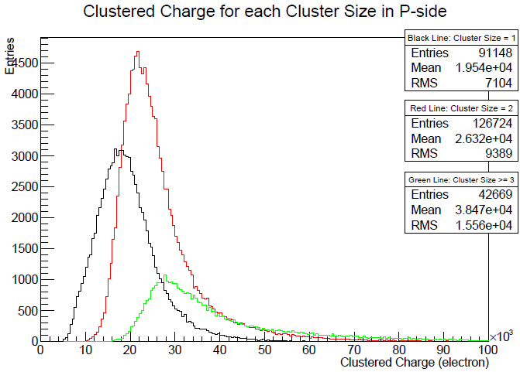
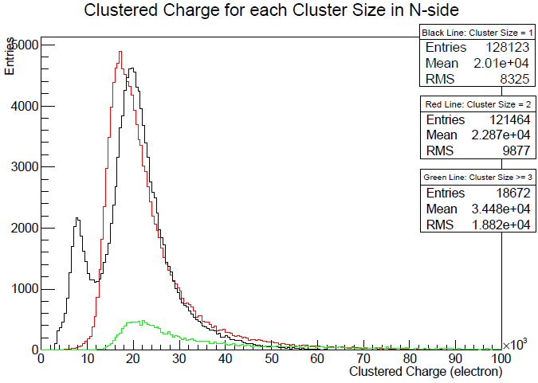
EQA
Jyunya Sasaki(U-Tokyo)
EQA document in English(M-thesis) available at
http://hep.phys.s.u-tokyo.ac.jp/~sasaki/MasterThesis_Jsasaki_20150202submit.pdf
- EQA for the parts(Parts quality evaluation )
- EQA during assembly(Bonding connectivity)
- EQA for assembled ladder(Final check & Sr90 source test)
Sr90 β-ray test w/ coincidensed Trig.
Electron dE/dx
500
400
300
dE/dx[eV/μm]
90Sr
Emax =2.2MeV
200
100
0
1
2
3
4
5
[MeV]
Geant4 simulation w/ low energy EM package is on going:
Checking mean path length in DSSD, dE/dx and multiple scattering.

Slide 27
Remaining items
Gluing procedure of slant CO₂ clip and Keratherm should be solved asap.
The method of FW CO2 clip gluing is less modification in current CO2-Clip-jig.
Where I presented how to glue Keratherm is the case of implement by ourselves.
(Another method is I presented in previous session to implement Keratherm as SMD)
Polishing PA wrapping procedure.
This may be the most time consuming problem.
Bending of Origami+z pig-tail with jig.
Pre-bending by hand → by jig. Found bending tool in the market.
Fiber insertion
EQA definition.
DSSD shape and gravity sag measurement
DSSD shape and gravity sag measurement of ladder at the arbitrary rotation angle.
Thermal cycling
Mechanical stability
Thermal stress
SLM optimization
Above each one of them is our milestone to go to Class-B(C) by definition.

Slide 28
Backup

