Slide 1
How to attach Keraterm on APV25.
Yoshiyuki Onuki
As a deputy of Ladder sub-group.

Slide 2
Keratherm
How to attach Keratherm is one of the most serious missing pieces to be solved asap.
Higher priority than the how to attach CO2 cooling pipe.
We’ll start ladder production. Where it should be in procedure and what implementation method.
Closest distance between bonding pad is 0.548mm.
Cut precision is unknown since very soft and sticky.
So far, it is believed there are 2 timings to attach Keratherm.
During ladder assembly as same as attaching CO2 clips.
After ladder mount.

Slide 3
Comparison of two possible ways
During ladder assembly
After ladder mount
Procedure
Can refer way of CO2-clip
No concrete procedure. No reference.
Make jig and verify procedure from scratch.
Can be attached on
the assembly-bench.
Care for pealing in
transportation.
Attaching Keratherm at several 0.1 mm position precision. It may be required
using dedicated-jig on the mount table.
Top approach need care for pealing and dropping on the bonding.
Difficulty
Damages
Lost one ladder.
Lost one mounted ladder.
To unmount broken ladder,
we must unmount healthy ladder(s) at first.
If we failed to attach Keratherm, the damage is serious.

Slide 4
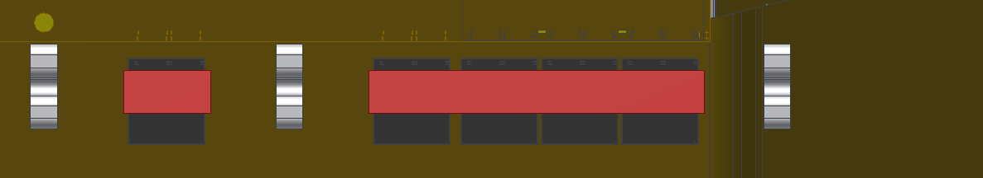
The other method
Current
Proposal
Keratherm is one of the SMD to be implemented by REPIC.
Put the dot glue on the both side of APVs
Gluing extend Keratherm 1~2mm from current design.
(No harm for jigs. Actually, the length is extended +1.0mm in rev2.1-> 2.2.)
After glue cured, it is hard to peal and drop.
REPIC may have experience and much better solution
since they has a “chip packaging” subsidiary company.

Slide 5
Comparison of three ways
During ladder assembly
After ladder mount
New method
Procedure
Can be refer way of CO2-clip
No concrete procedure.
No reference. Make from scratch.
Nothing for us.
REPIC implement as a SMD on Origami.
Can be attached on
the assembly-bench.
Care for pealing in
transportation
Attaching Keratherm at several
0.1 mm position precision.
It may be required using
dedicated-jig on the mount table.
Top approach need care for pealing
and dropping on the bonding.
No difficulty.
Just specify the position tolerance
and request never pealing.
Difficulty
Damages
Lost one ladder.
Lost one mounted ladder.
Lost one Origami
To unmount broken ladder,
we must unmount healthy ladder
at first.

Slide 6
PA and Origami status and plans, Koji Hara, Yesterday
Keratherm is one of the SMD such as H/C-shape.
We should ask quotation w/ and w/o Keratherm implementation.
We can make decision after receiving the quotation.

Slide 7
Summary
There are three methods to implement Keratherm.
During ladder assembly. Establish from now.
If we failed, we lost one ladder
After ladder mount. Establish from now.
If we failed, we lost one ladder and un- and mount ladder(s).
Implement into Origami as a SMD
If we(REPIC) failed, we lost one Origami, no DSSD(s).
Also we may be able to implement but REPIC can much better than us.
Ask quotation w/ and w/o the implementation. We can evaluate the cost and performance of the quotation and make decision.
No delay. REPIC can start study just after they get Keratherm.
We should not take avoidable serious risk
since we never allow contingency.

