Slide 1
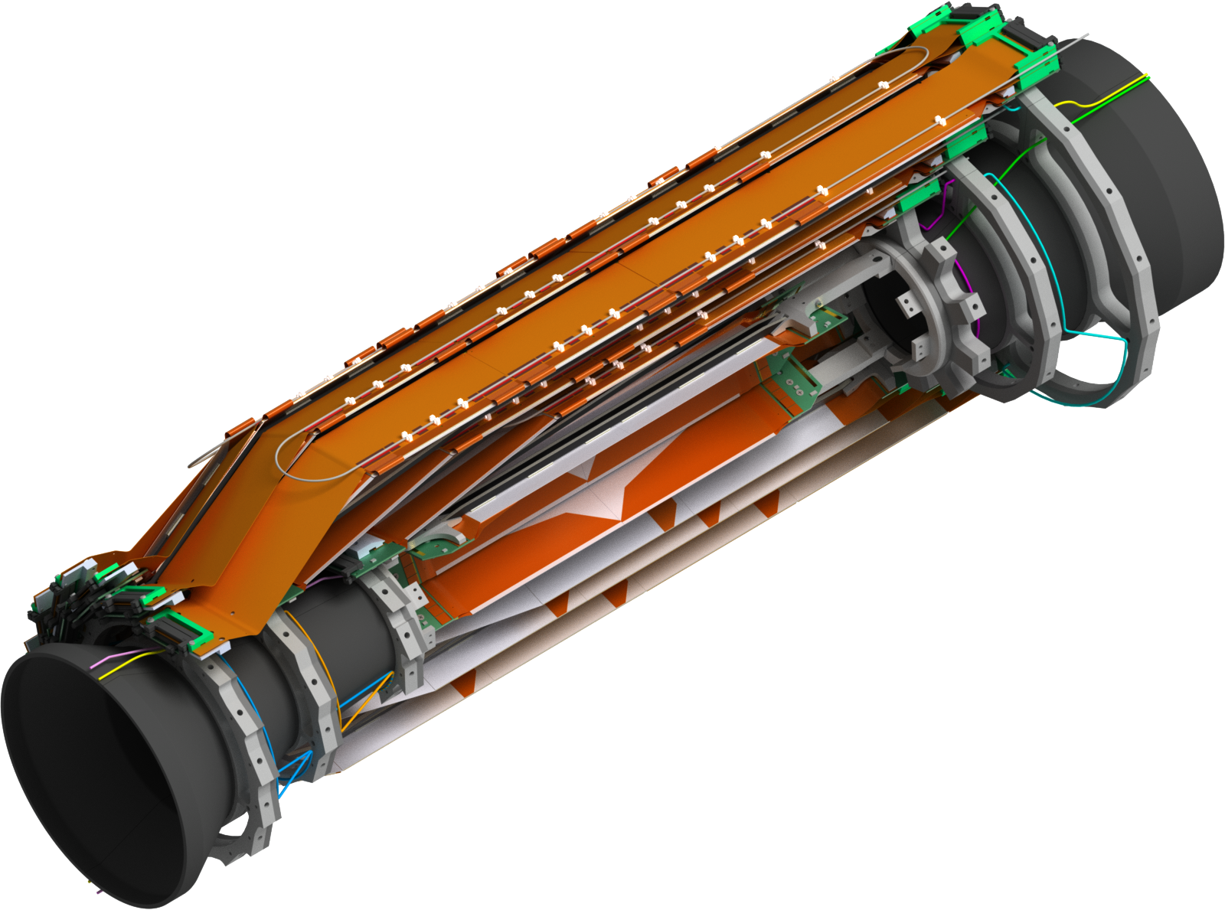
Overview SVD
7th Belle II VXD Workshop, Prague

Slide 2
Introduction
Activities and progress since last meeting
  SVD group organization
  SVD beam test at CERN
  BPAC SVD production readiness review
  Assembly site qualifications and other QC/QA issues
  Pitch adapter issues (FlexPA and PA0)
  Logistics of ladder components
  Mechanics: cooling pipes and cable routing
  etc.

Slide 3
SVD Group Organization

Slide 4
SVD Sub-Group Coordinators
Sub-group | Coordinator | Deputy | Advisor
Mechanics | Florian Buchsteiner | Markus Friedl | Filippo Bosi
Ladders | Takeo Higuchi | Yoshiyuki Onuki | Giuliana Rizzo
Electronics | Markus Friedl
Monitoring & Interlocks | Lorenzo Vitale
Software | Andrzej Bozek
Commissioning | Katsuro Nakamura
Coordinators are contact persons of their fields
Details about sub-group organization will be shown in SVD sessions

Slide 5
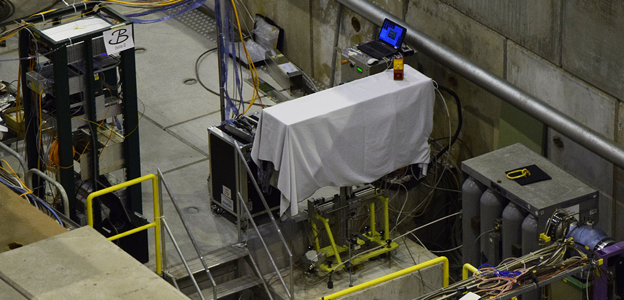
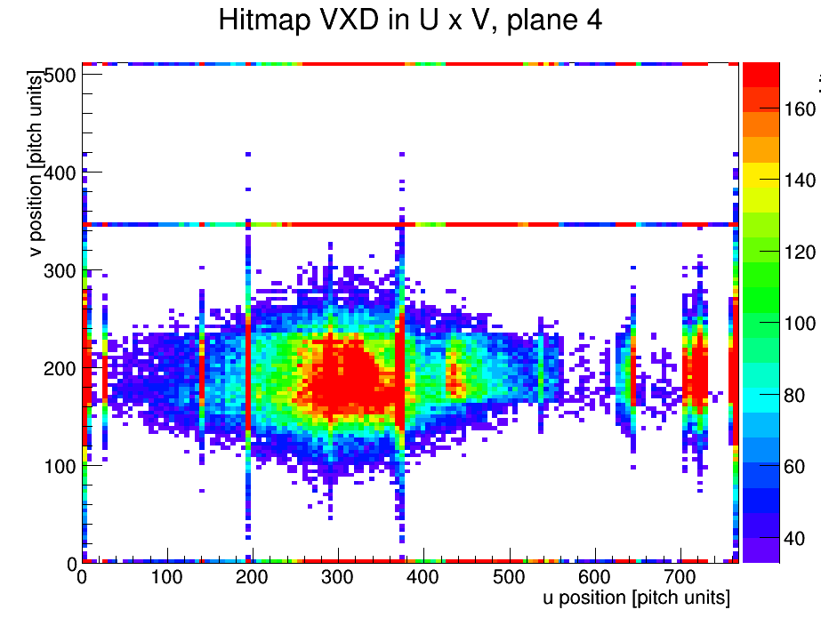
CERN Beam Test Nov. 2014
Belle II setup in H6A
  DESY module stack
  FADC→FTB→DATCON
  VME readout
  Stable CO₂ cooling
Unstable due to firmware bugs related to standalone trigger
  FADC controller
  Finally were able to take some data
FADC
DUT
CO2
battery
Hit map L4
DATCON
M. Schnell

Slide 6
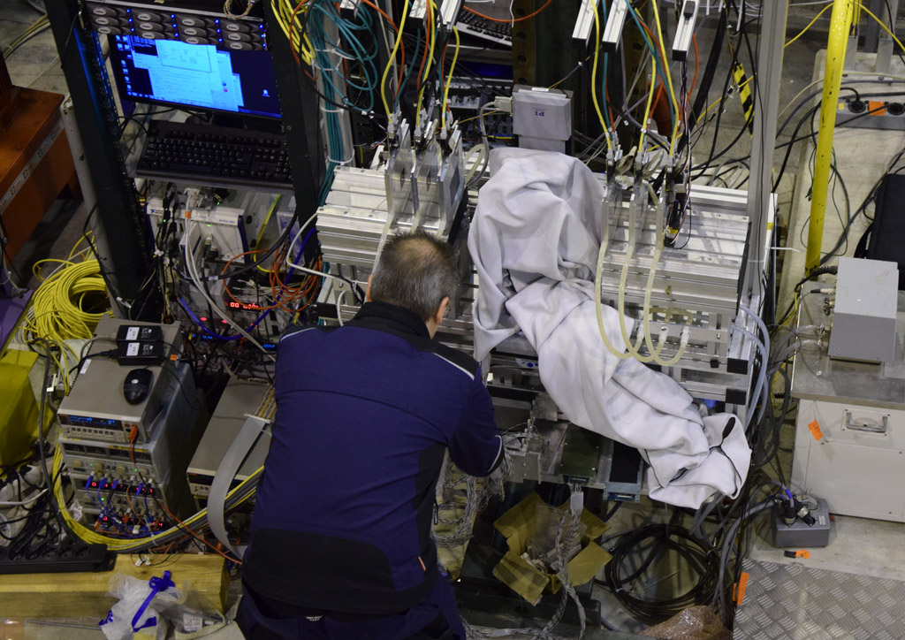
CERN Beam Test Nov. 2014
Parasitic setup in H6B
  AIDA and Infineon sensors
  “SVD3” readout system
  DUT embedded in AIDA telescope
Finally used to test SVD forward and backward modules from Pisa
  Studied behavior of
  known sensor defects
Allows resolution study on both HPK and Micron sensors → B. Würkner
AIDA telescope
DUT

Slide 7
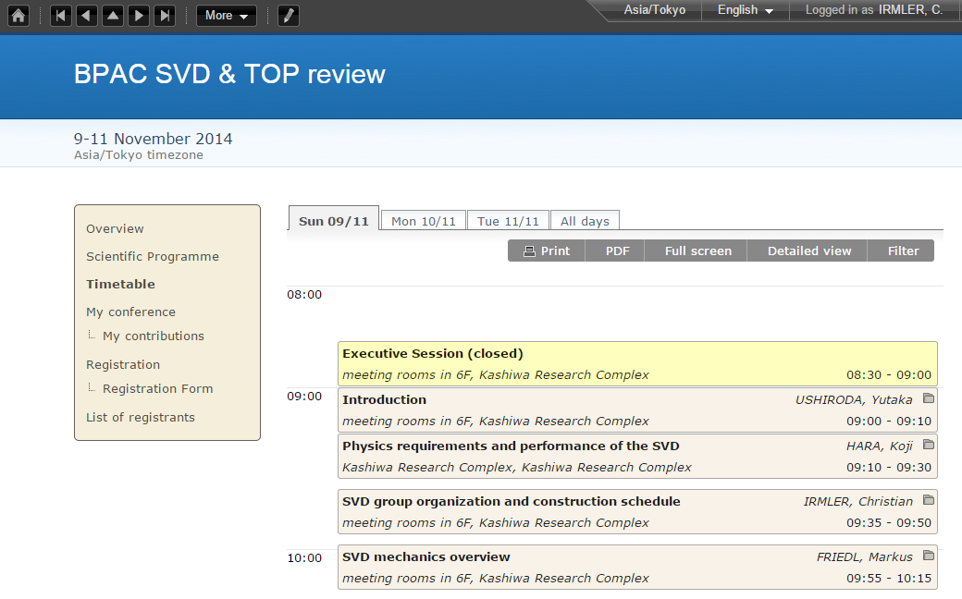
BPAC Production Readiness Review
9th – 10th Nov. @ IPMU
Focused on ladder SVD
production readiness
Also covered:
  Mechanics
  Electronics
  Thermal mockup
Report received recently
  Will be discussed in SVD session
VXD related
  Results from thermal mockup too late for ladder assembly
  Should perform additional SVD+PXD noise tests asap

Slide 8
Site Qualification
SVD ladders / modules will be built by 5 groups
Assembly groups need to be officially qualified before starting to work production level components
Class definition of components:
Partial class C qualification is possible
Requires all steps except for the electrically functional class B module
Class | Definition
A | Production quality component. Good for installation.
B | Fully functional component, but of reduced quality.
C | Mechanical, not electrically working component, but with all the features and precision of a class B (chips, sensors, wirebonds)
D | Mechanical component, possibly with missing chips, no wirebonding, aluminum sensors, reduced precision

Slide 9
Site Qualification Reviews
The reviews help the groups to
  Design stable and reliable procedures
  Document the procedures and the QC/QA
  Communicate with other sites
  Organize the manpower and schedule
It should not be a one-time event, but rather a work method
SVD QCG is responsible
for qualifying the sites.
A qualification site visit of
the committee is required.
5 February 2015

Slide 10
Other QC/QA Issues
Definition of test procedures on ladders
  Electrical tests and mechanical precision measurements before, during and after assembly
  Thermal cycling of ladders
  Verification of sliding parts of full ladder
  Common ladder coordinate system for all sites
Review of existing and new specifications
  Pitch adapters
  Origami hybrids
  etc.

Slide 11
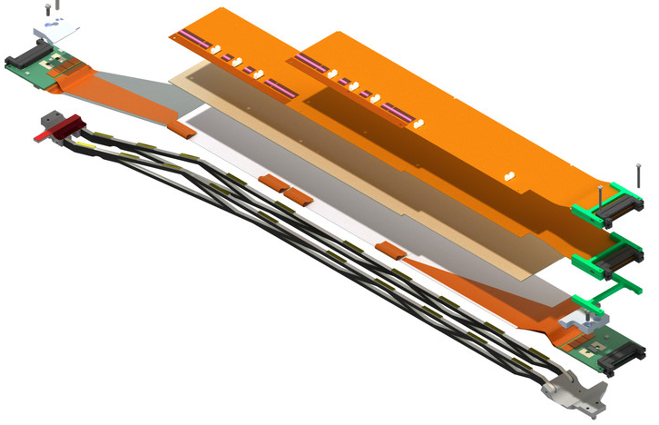
Pitch Adapters
Flex circuit to connect sensor strips to APV25 chips
Two types of pitch adapters
FlexPA
  Flexible, single-layer
  PF,PB,P3F,P3B,PA
  Produced by Tokai Denshi
PA0
  Flat, dual-layer
  Glued onto Origami hybrids
  Produced by Taiyo

Slide 12
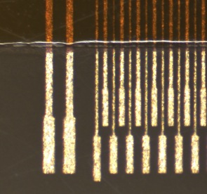
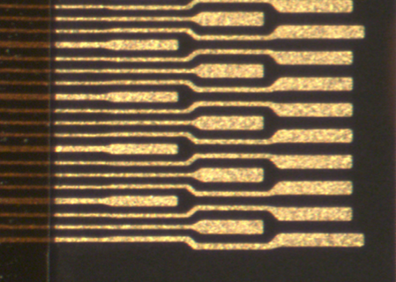
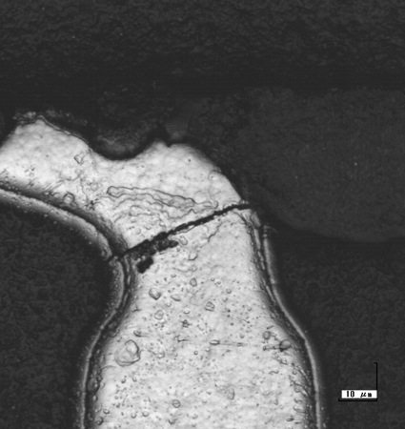
Pitch Adapters Issues
APV SIDE 2-row pads
Problem #1
  Related to FlexPA
  Arose end of 2013
  Size of pads on APV side were too
  small for wire bonding
  Could be solved by design change
Problem #2
  Related to PA0 only
  Disconnected lines due to cracks close to bond pads of PA0
PA task force formed to solve issues
APV SIDE 3-row pads

Slide 13
FlexPA Status
Pitch adapters (3-row design) of recent
pre-production currently under test
Specification almost completed → end of January
After sign-off of specs production can start in early February
Completion by mid of April

Slide 14
PA0 Status
Investigations done in last few months have led to a design and parameters which most likely allow to produce good PA0
Schedule PA0 test production
  1-2 weeks to prepare and sign-off PA0 specs document
  2 weeks for test production
  ~2 weeks for electrical testing
  First PA0 samples can be available by end of February
  If evaluation is positive PA0 mass production can start mid March
Preparation of alternative solution (single-layer) from other vendor ongoing

Slide 15
Logistics
Need to distribute valuable items like sensors from KEK to Vienna, Pisa and Melbourne
Will be sent back to KEK as assembled ladders
Want to avoid importation tax if possible
Discussion about shipment requirements and procedures ongoing between KEK, Pisa and Vienna (involving shipping companies)
Tax exemption for import of ladders to Japan possible (requires MoU between parties)

Slide 16
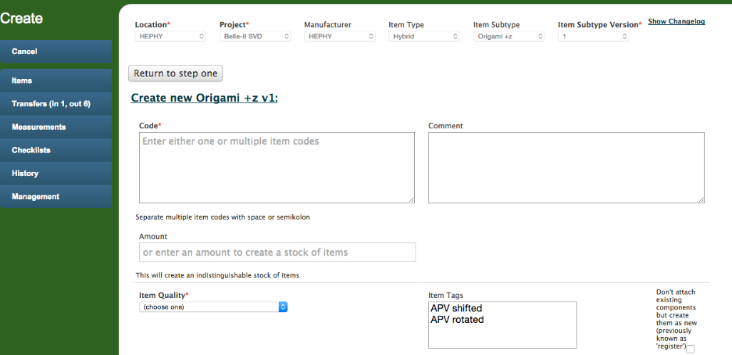
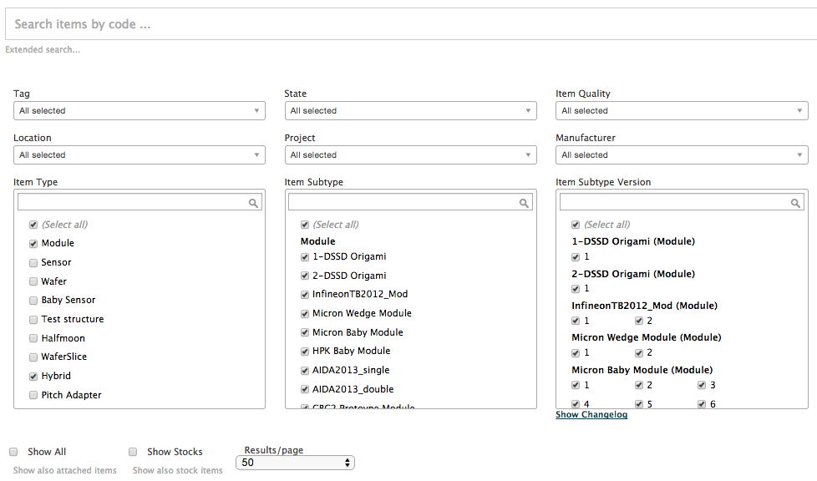
Construction Database
New features
  Checklists
  Stock items
  Unified item creation
  Transfer states
    pending
    in transfer
    completed
  Additional measurement format imports
  Improved search selector

Slide 17
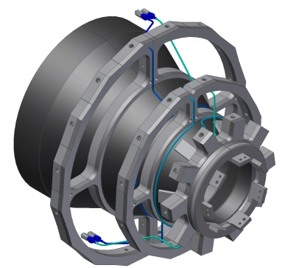
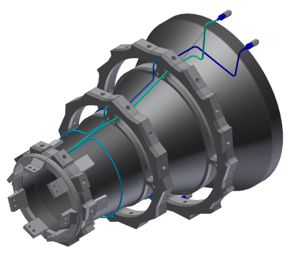
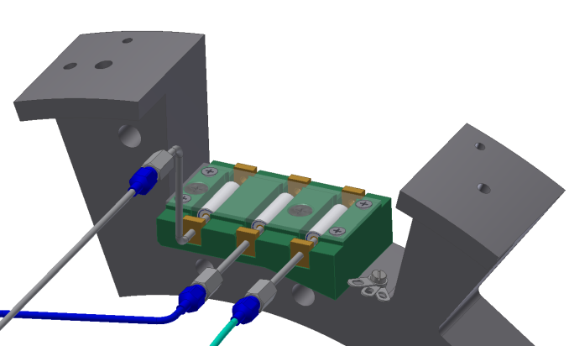
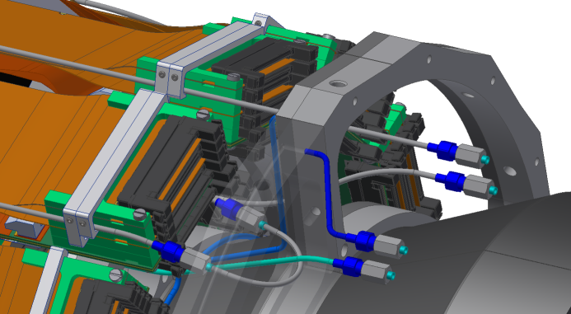
Mechanics
Design of SVD ladders fixed with Revision 2.2
Now working on cooling pipes
and cabling
Cooling pipes
  Modified routing between end rings
  New design of fixation for pipe isolation
  Origami cooling pipe clamps

Slide 18
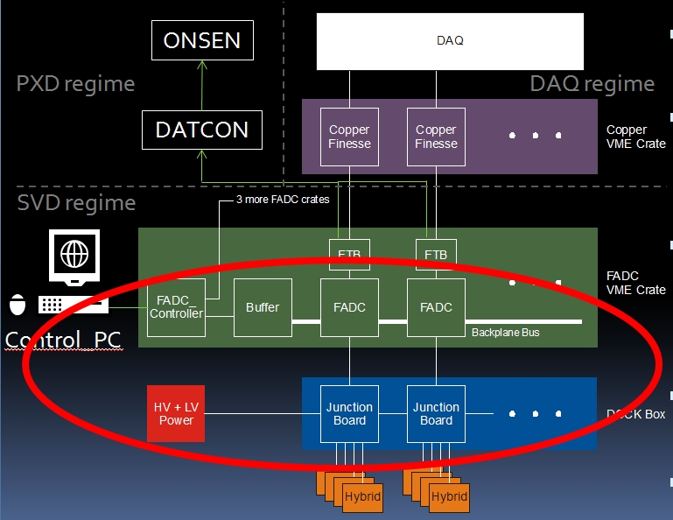
Electronics
FADC system V2
  Junction board
  FADC
  FADC Controller
  Prototype tested at CERN beam test
Noise evaluation
  Investigating noise we have seen during DESY test
  Do dedicated tests in
  our lab.

Slide 19
Slow Control
Had discussion with PXD group about common design of slow and run control in EPICs
Agreed to common use of software builds (CSS, EPICS)
Same strategy and look & feel for user interfaces
PV (process variable) conventions will be extended to cover both PXD and SVD
Main difference between SVD and PXD
  PXD has very complex power up sequence
  SVD also has to consider copper system, which runs on NSM
Agreed to arrange common meetings in future

Slide 20
Summary
New SVD group organization
  Ratified by SVD IB in December
  Definition of sub-group organization ongoing
Assembly site qualifications quite advanced
  Class C qualification done for Pisa, IPMU and Vienna
  TIFR will follow in Feb., Melbourne foreseen for March
PA0 problem not yet solved but test production of promising design will start soon
Progress made in many fields
  Will hear details in SVD sessions

Slide 21

Thank You!

