Slide 1
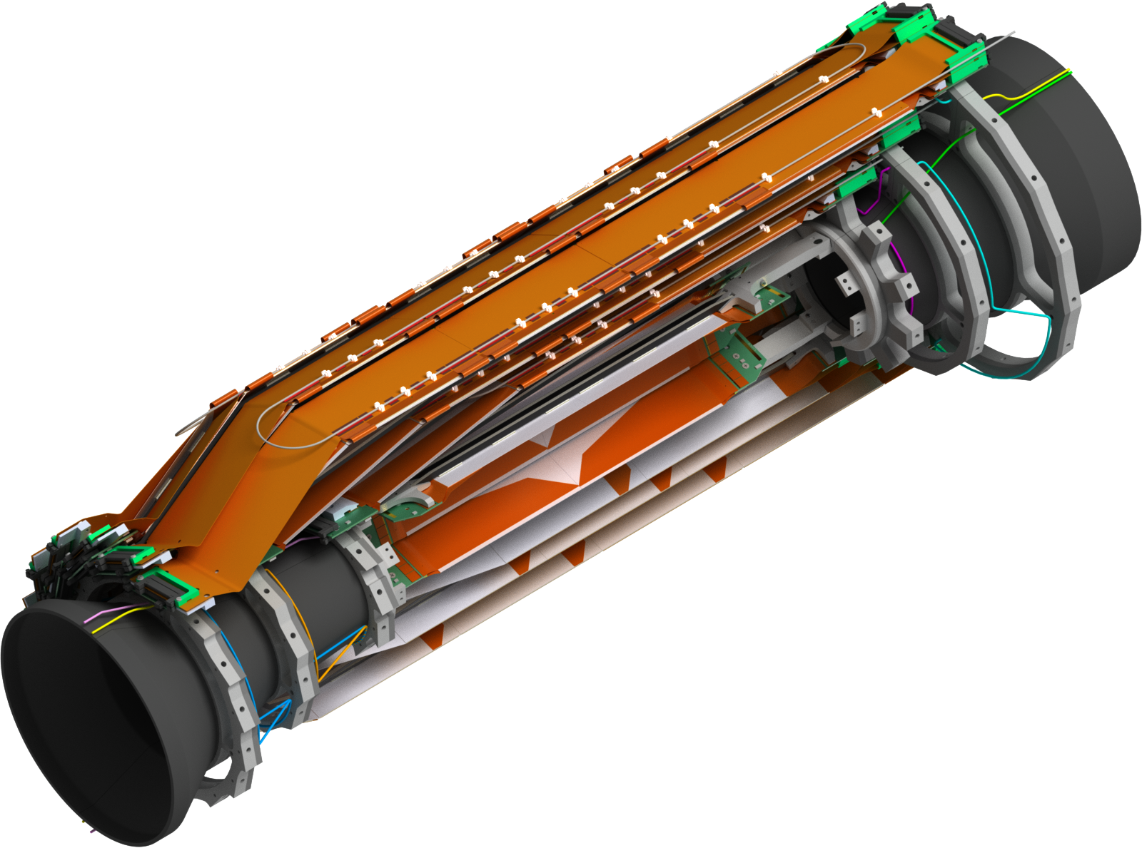
SVD Mechanics Update
7th VXD Workshop PRAGUE

Slide 2
Overview
Kokeshi Pin & new set screw
New cooling pipe routing between end rings
Origami cooling pipes & clamps
Modification BWD L5 end rings
Clamps for NTC & fiber
Cooling pipe isolation
Cable space CDC end wall
Common open issues (VXD)
Schedule
Summary and Outlook

Slide 3
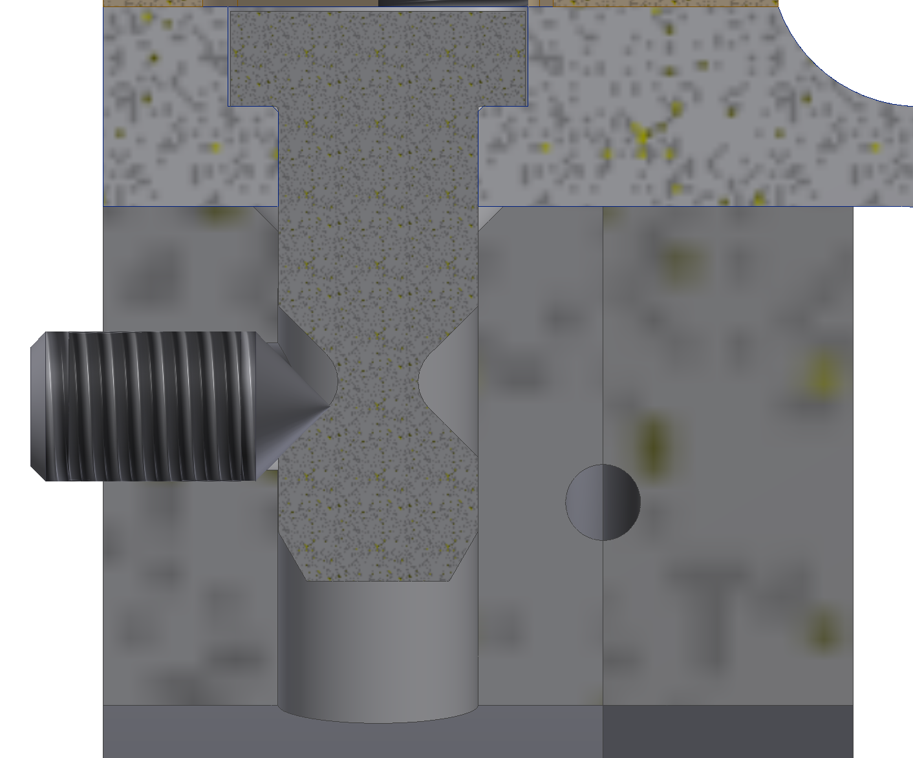
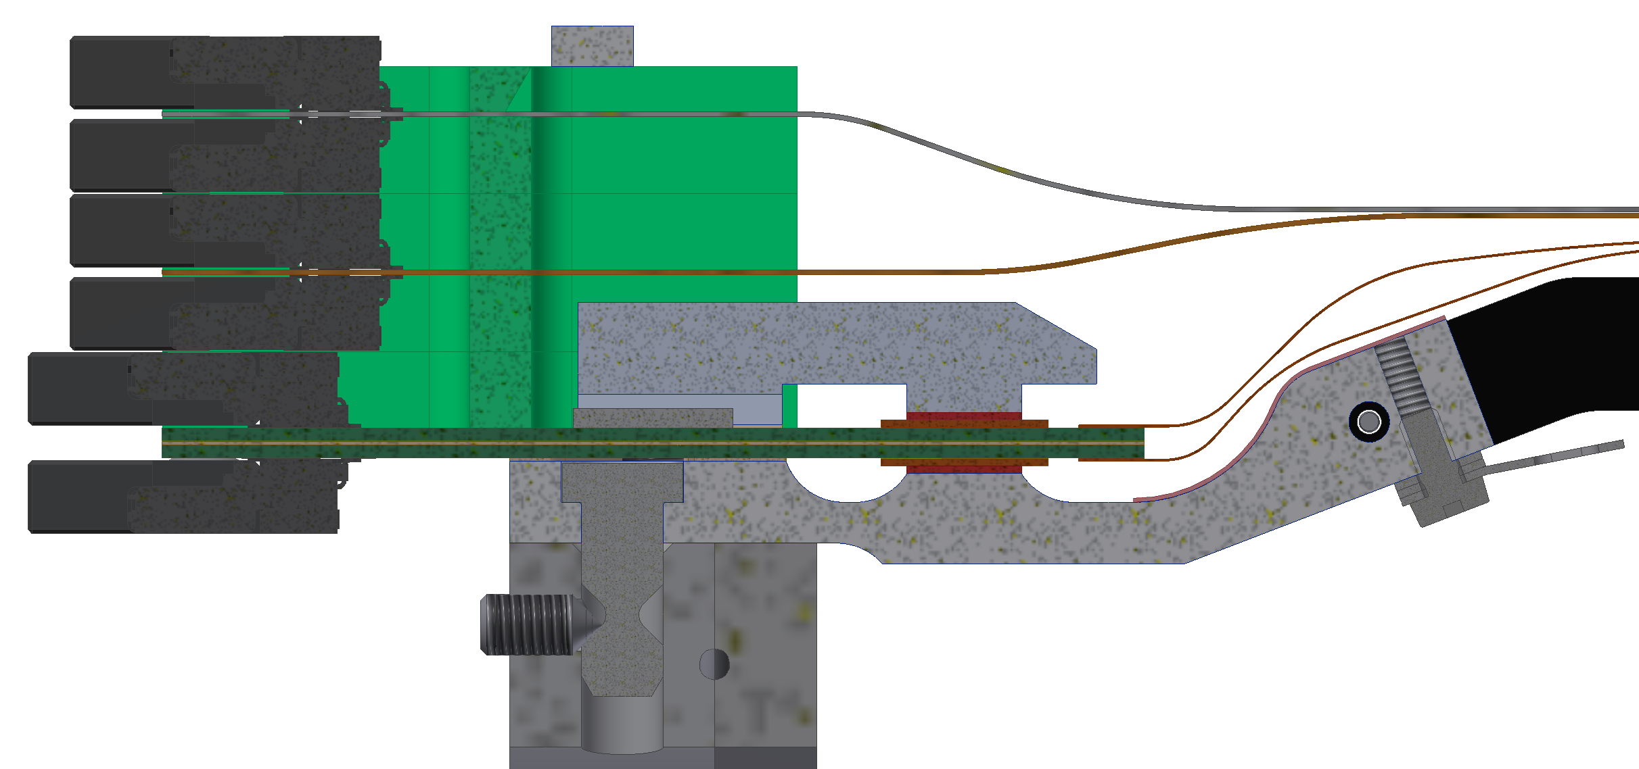
How Ladders are Mounted
BWD Kokeshi pin
Set screw
BWD end mound
BWD L6 end ring

Slide 4
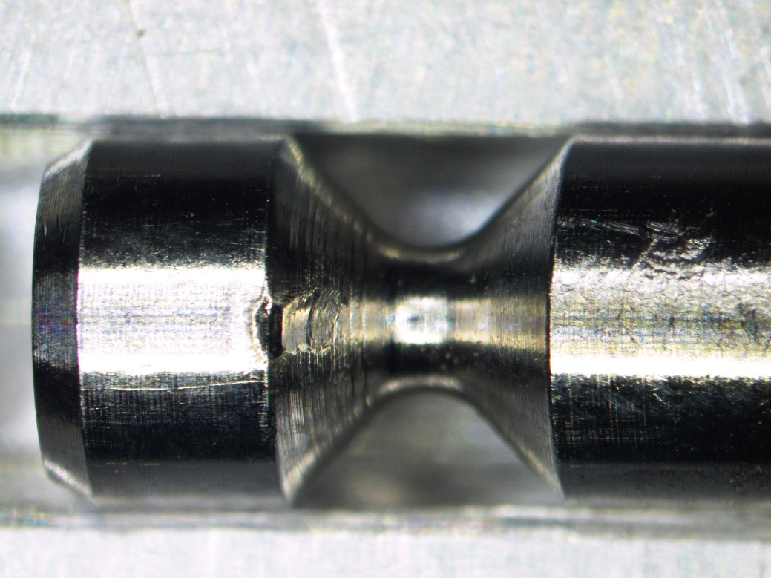
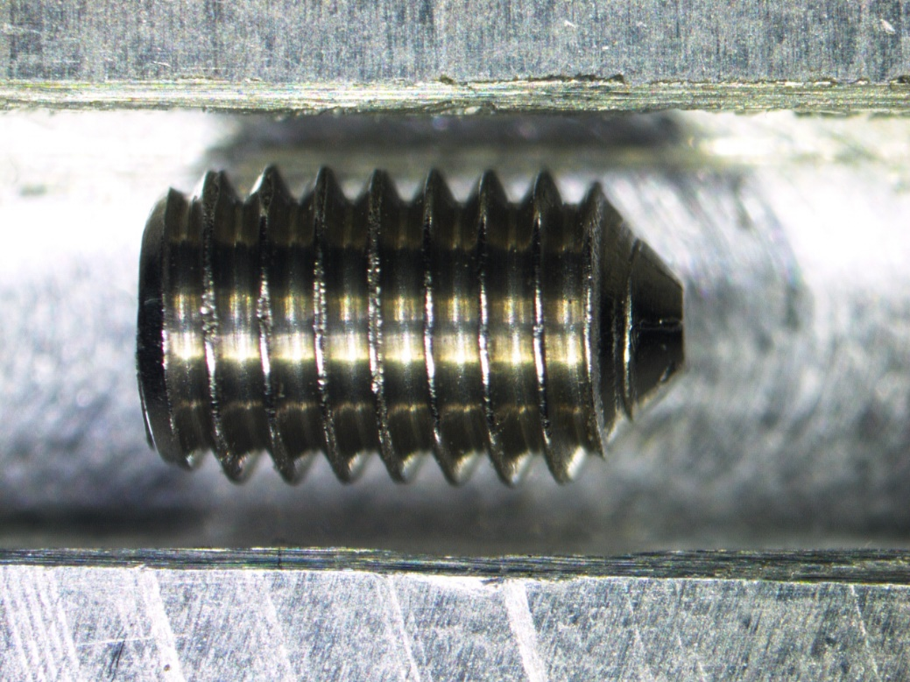
Problem With The Old Set Screw
Impression in the cylindrical part of the Kokeshi Pin (difficult to remove)

Slide 5
Modified Set Screw With A Ø 1.60mm
length = 254µm
diameter = 1.60mm
Is our current design (tolerance: -0/+0.1mm) :
Is small enough to provide sufficient distance to cylindrical part of the Kokeshi pin (even at maximum tolerance 1.7mm)
Under this diameter the screw begins to deform
This machining can be done at HEPHY for all screws

Slide 6
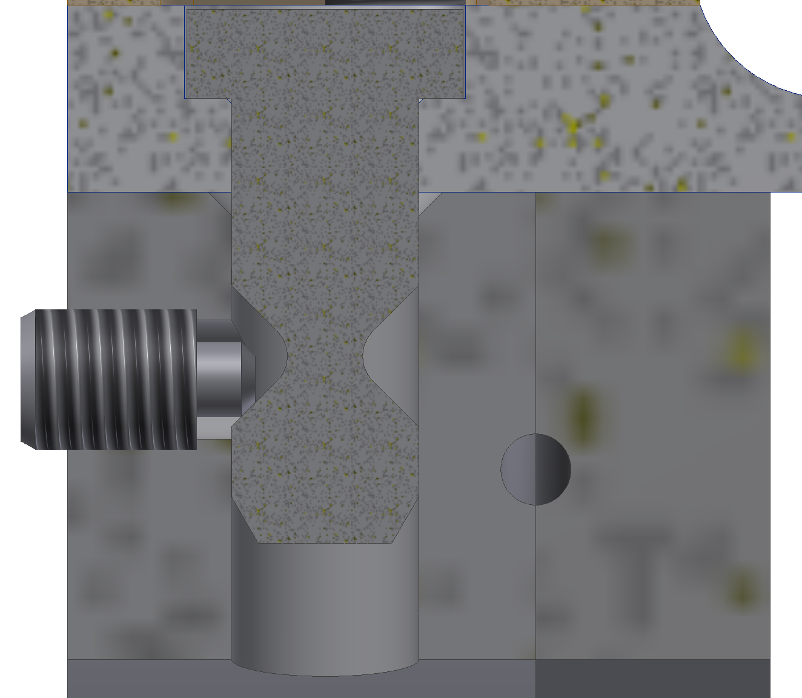
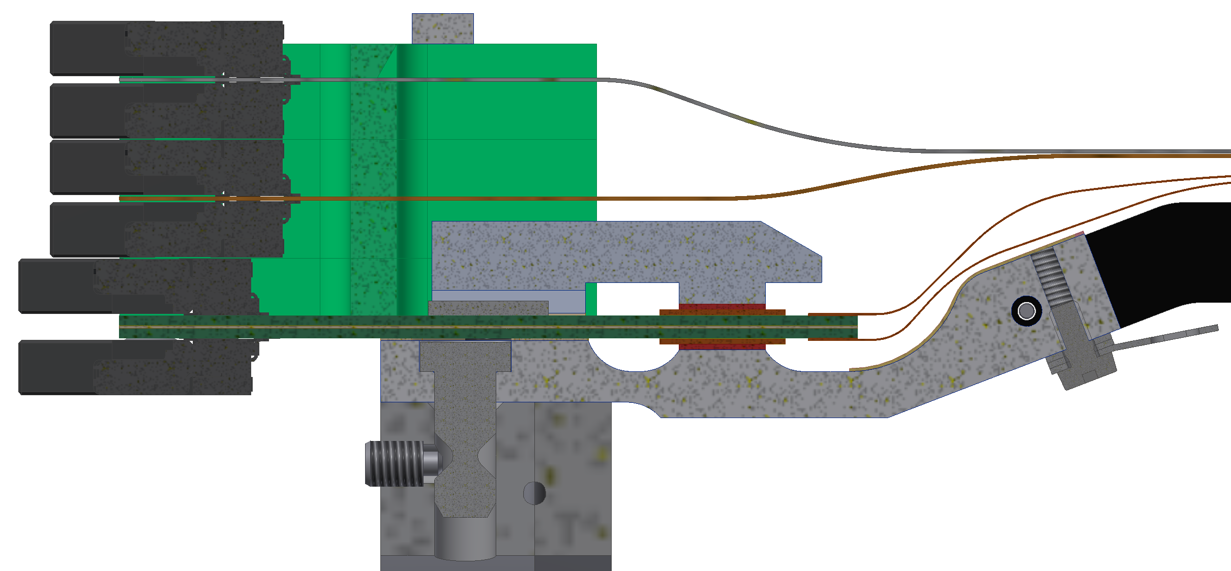
Situation With The New Set Screw

Slide 7
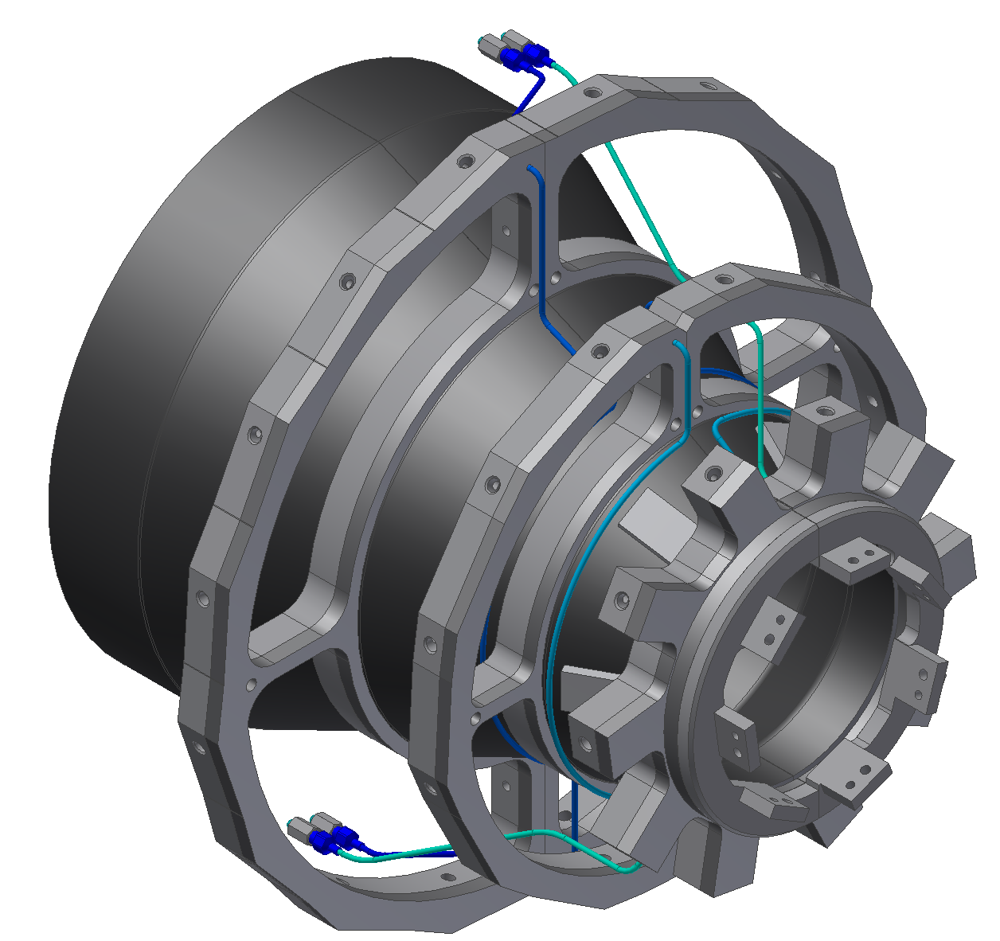
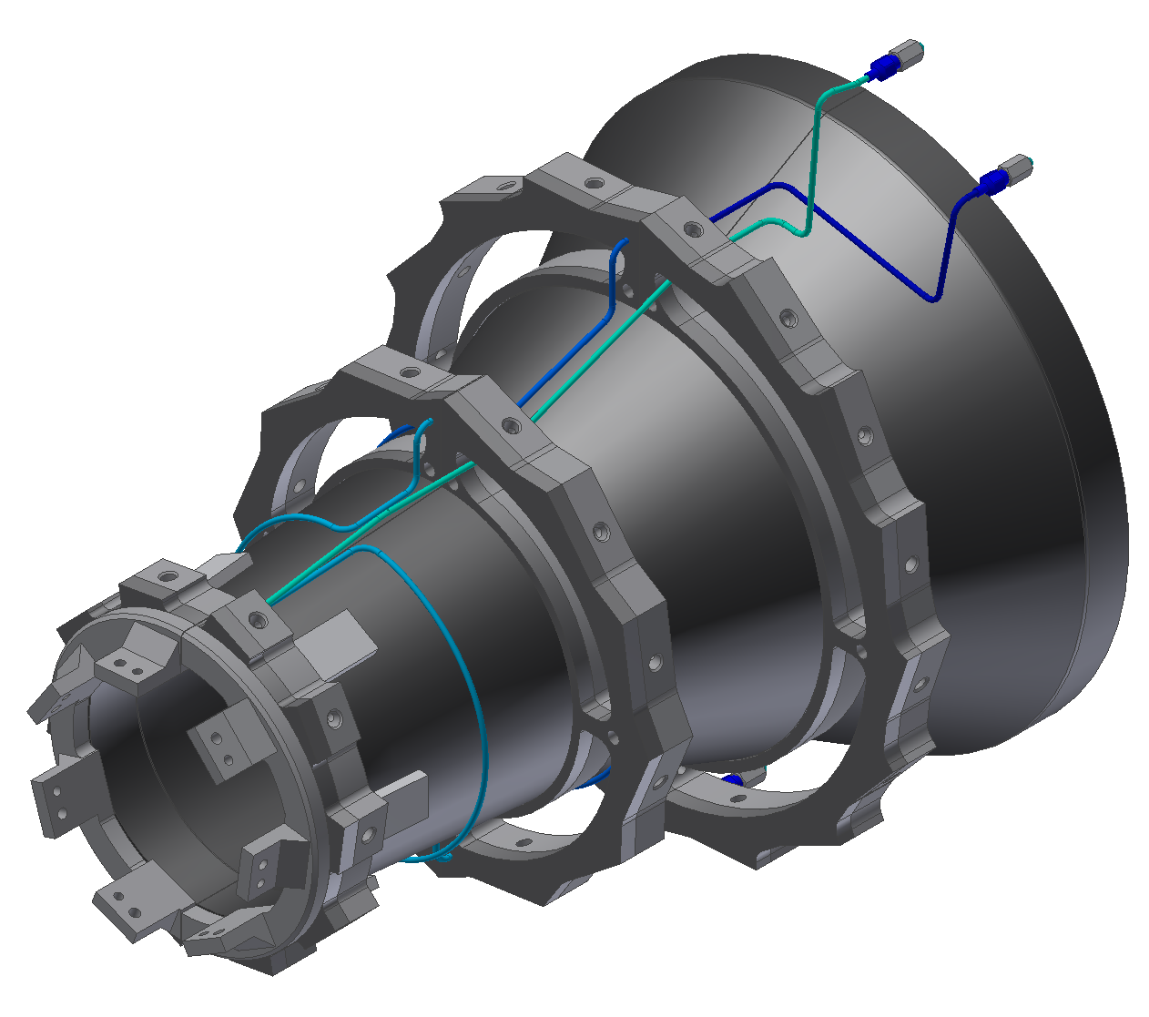
New Cooling Pipe Routing Between End Rings
Changes that are already in Rev. 2.2:
Slightly changed from Karsten G’s. pipe routing because of the diamonds
No extra grounding pipe for L5 end rings (return pipe L4 and L3 is used for grounding the L5 end rings)
The BWD in/out cooling pipe routing slightly changed from Rev. 2.2 because of the cooling pipe isolation (Rev. 2.3)

Slide 8
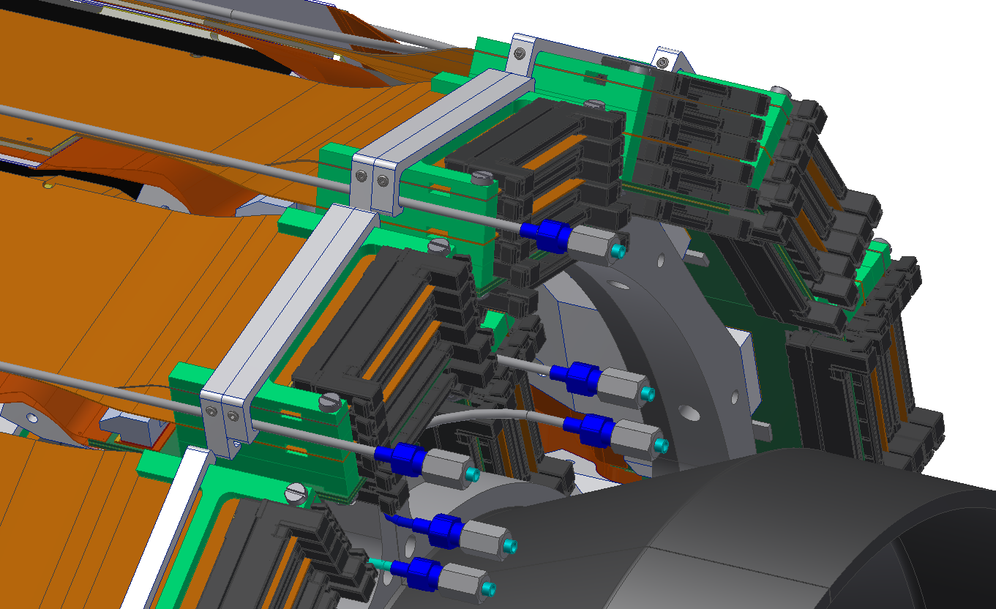
L6 Origami Cooling Pipes & Clamps
L6 Origami pipes
L6 Origami pipe clamps
(pipes are glued onto clamps after mounting)

Slide 9
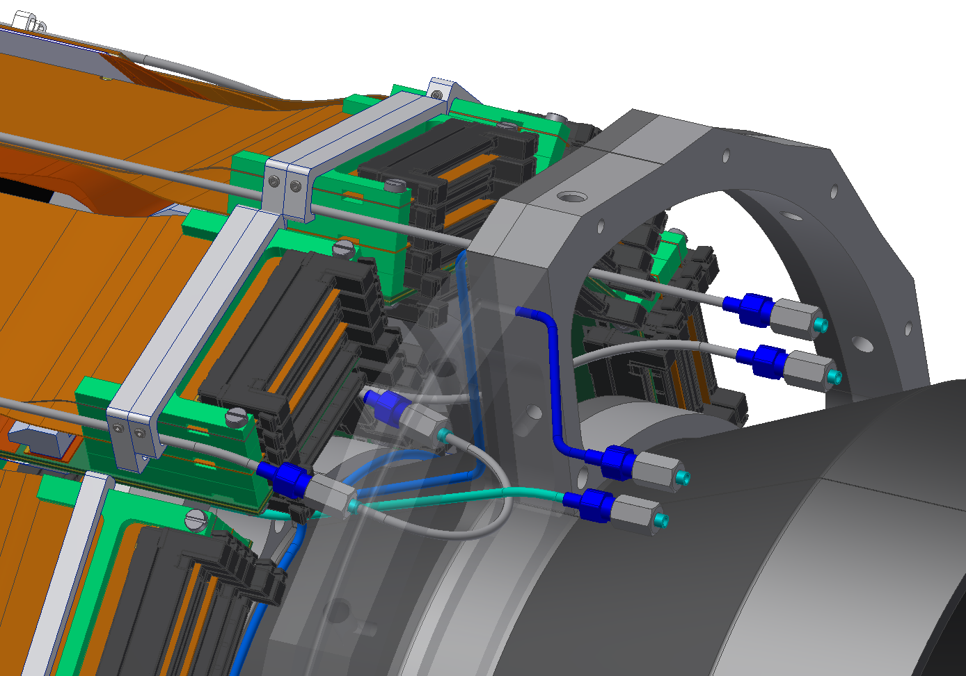
L5 Origami Cooling Pipes & Clamps
L5 Origami pipes
L5 Origami pipe clamps
(pipes are glued onto clamps after mounting)
L5 to L4 connection
(one common cooling circuit)

Slide 10
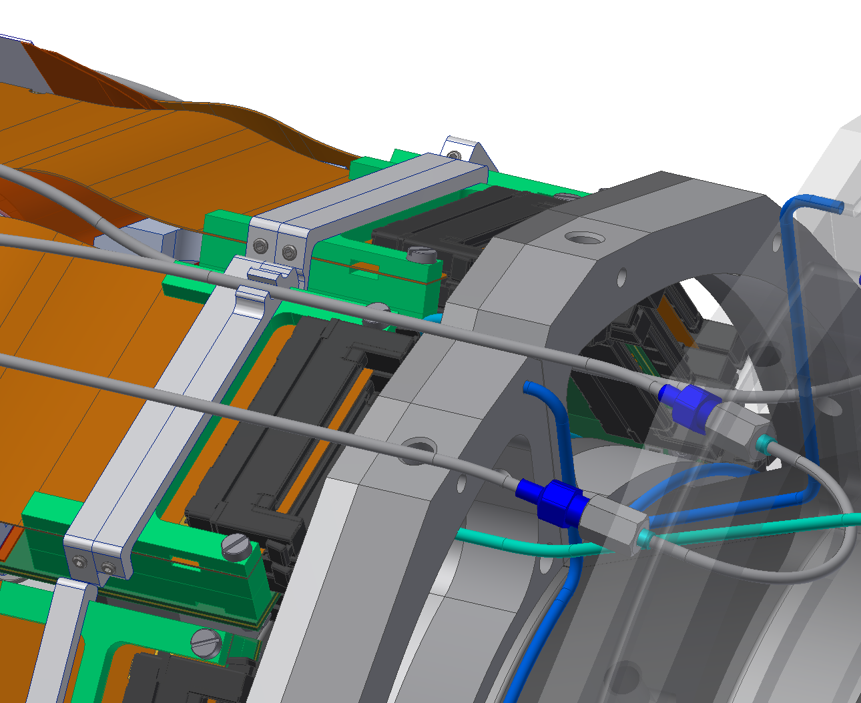
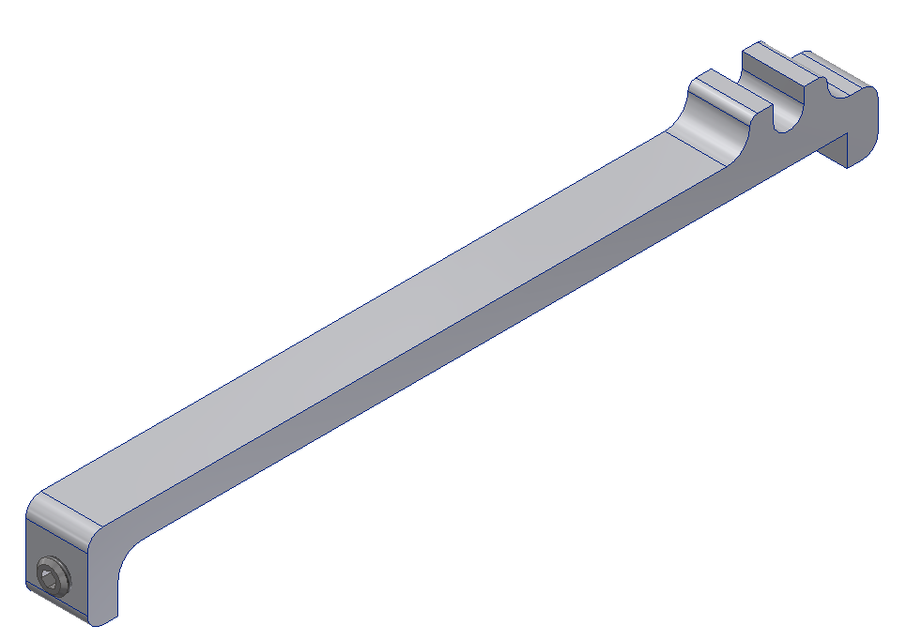
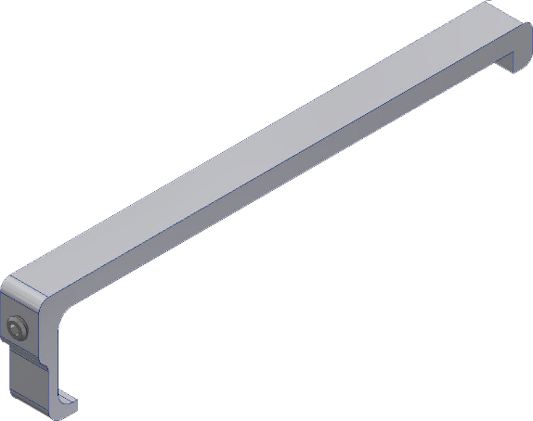
L4 Origami Cooling Pipes & Clamps
L5 Origami pipe
L4 Non-cooling return pipe
L4 Origami pipe clamp
(pipes are glued on clamps after mounting)
Layer 4 has odd number on ladders per half
Non-cooling return pipe on top of Origami
L5 to L4 connection

Slide 11
Modification BWD L5 End Rings
3mmx45° chamfer (no precision needed)

Slide 12
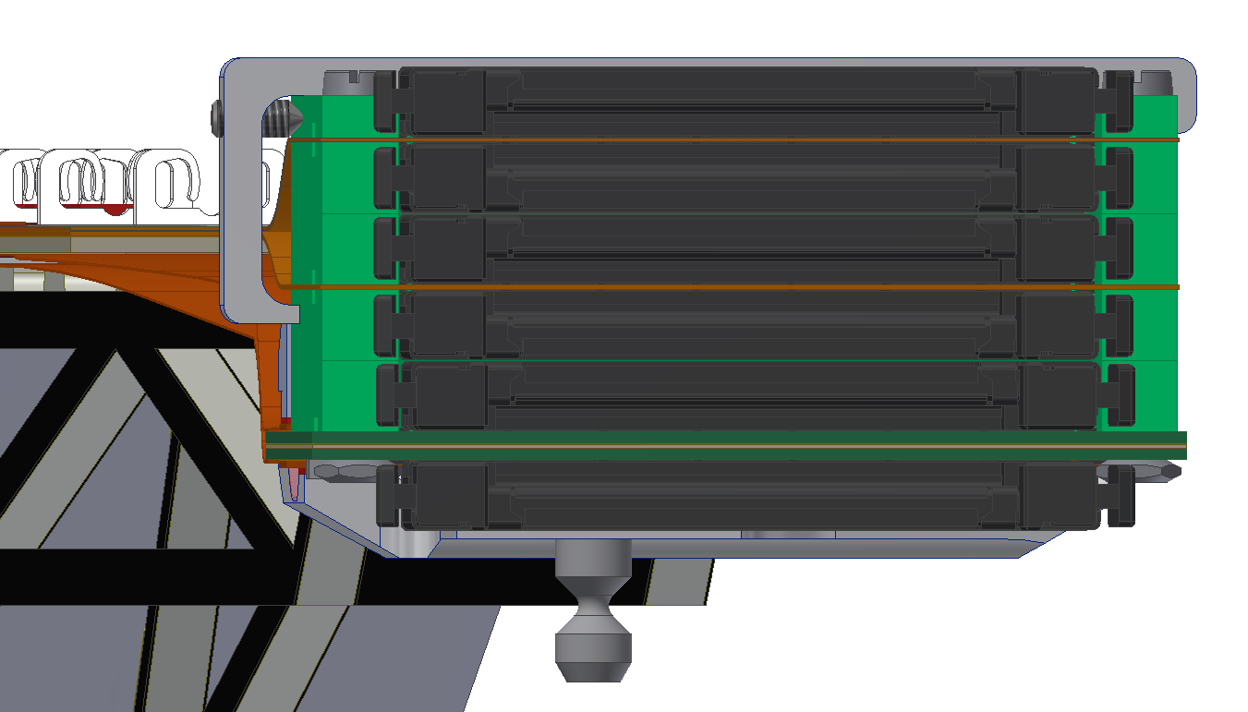
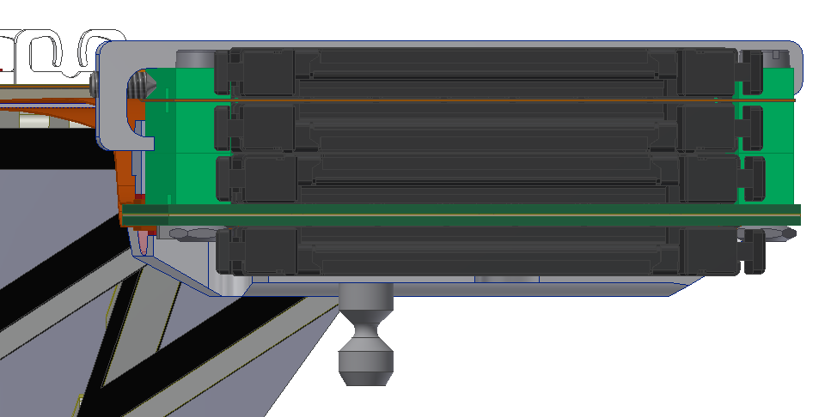
Clamps For NTC & Fiber
L6 and L5 clamps
L4 clamps
Fiber
NTC
L6 and L5 clamps
Machining can be done at HEPHY for all clamps

Slide 13
Reason For The Cooling Pipe Isolation
The reason for this is a better noise behavior
Grounding concept (VXD):
The VXD common grounding point is the end flange (aluminum)
The electrical components on the ladders are grounded on the end mounts (BWD/FWD)
The end mounts are grounded over the end rings and the are grounded with the cooling pipes to the end flange
Cooling pipes need to be isolated towards outside

Slide 14
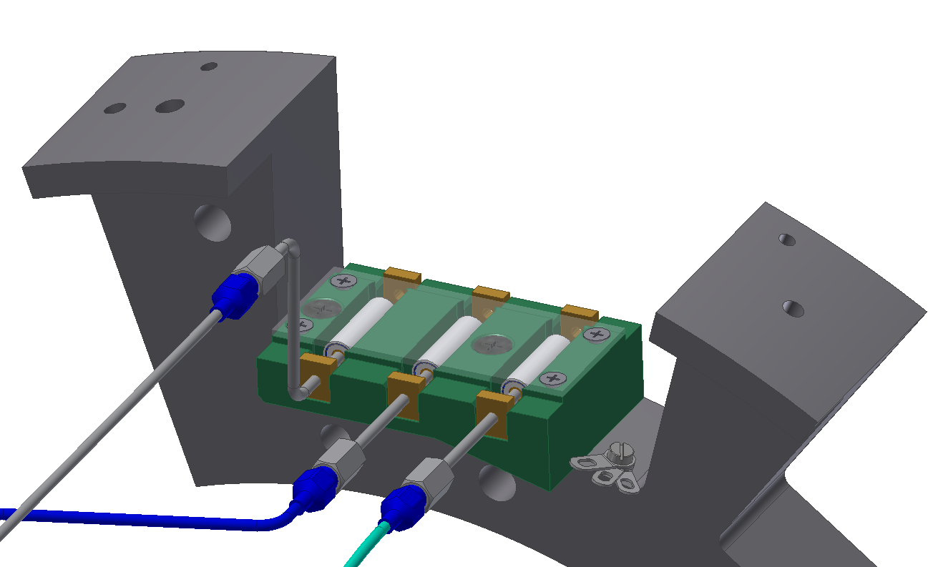
BWD Cooling Pipe Isolation
Mounting screws for end flange
Ceramic isolator (Tscharlie)
Ground plate (FR4, like H shapes)
Brass torque relief (brazed onto pipe)
End flange
Grounding point for pipes on the end flange (cable soldered to the brass torque relief and cable lugs)
Cover (aluminium)

Slide 15
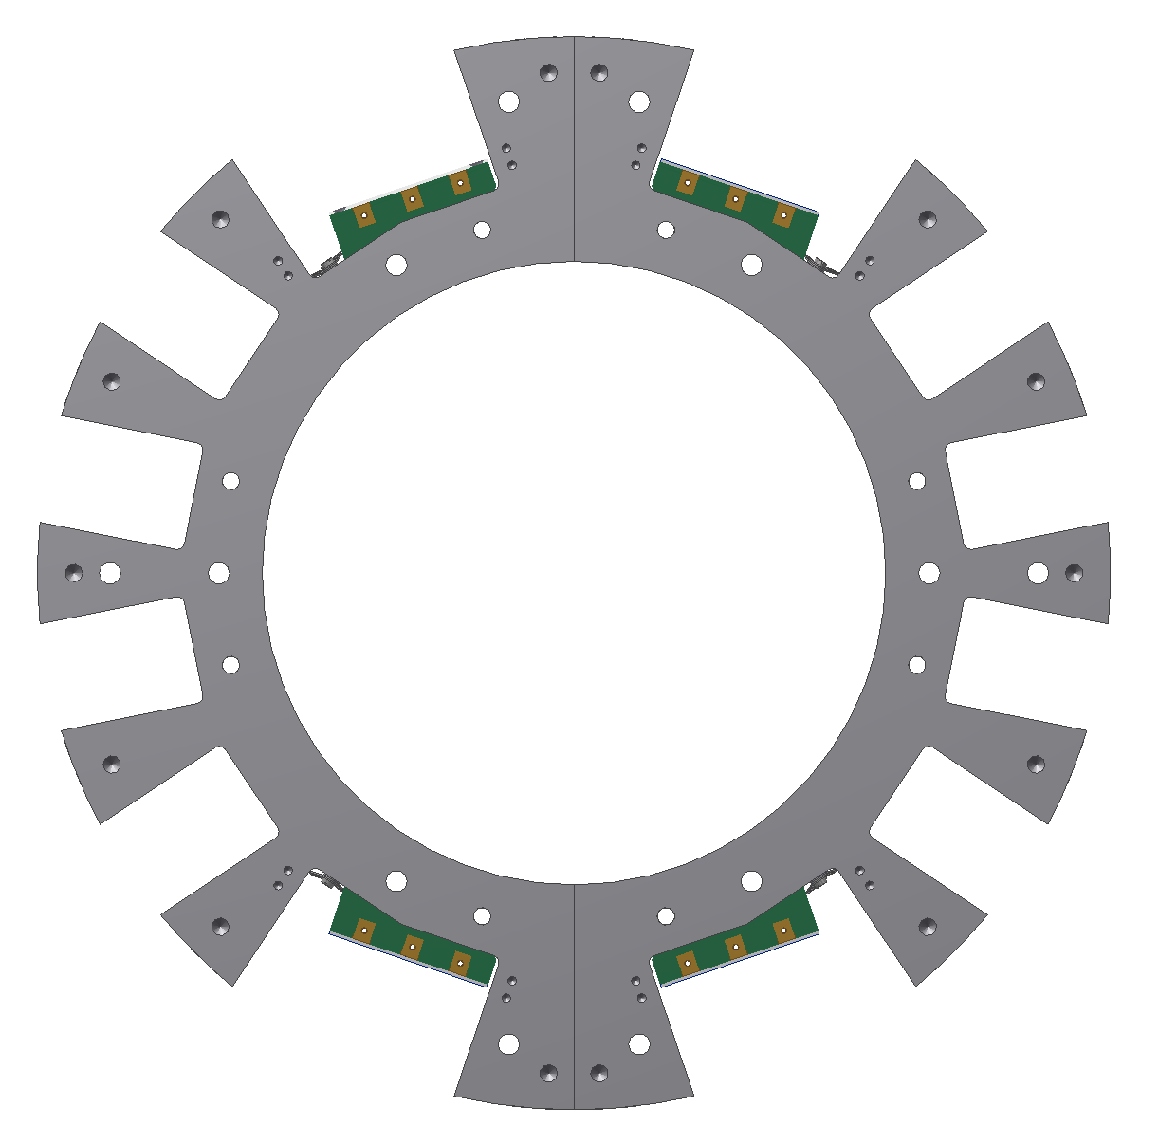
BWD Terminals Cooling lines
IN – L6 Origami
OUT – L6 Origami
IN – end ring
IN – L5 Origami
OUT – end ring
OUT – L4 Origami
right
left
End flange
OUT – L4 Origami
OUT – end ring
IN – L5 Origami
IN – end ring
OUT – L6 Origami
IN – L6 Origami

Slide 16
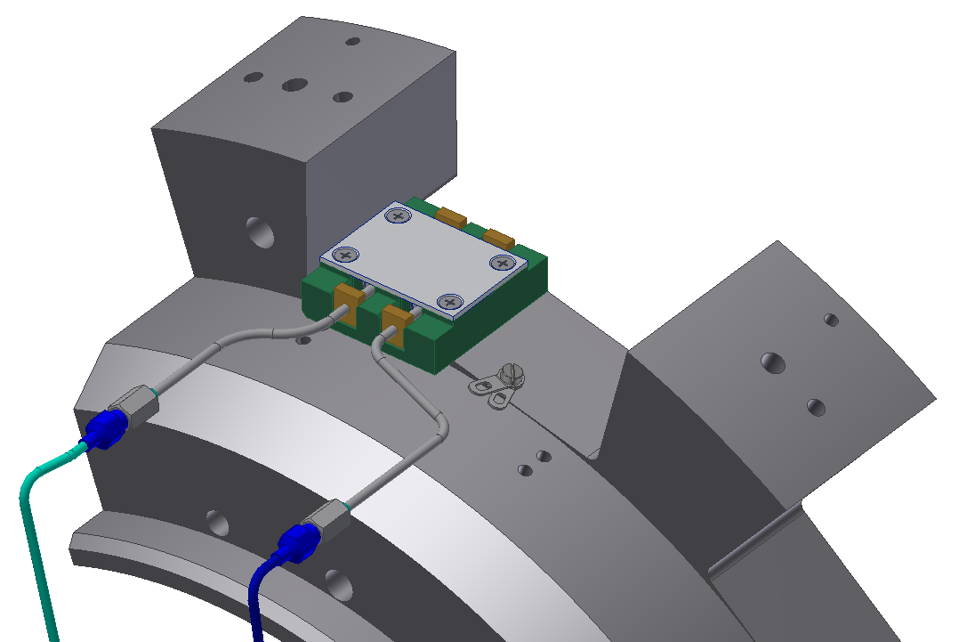
FWD Cooling Pipes Isolation
FWD:
Same system but only with two ceramic isolators because there are only an In and Out cooling pipes for end rings. (no Origami cooling pipes)

Slide 17
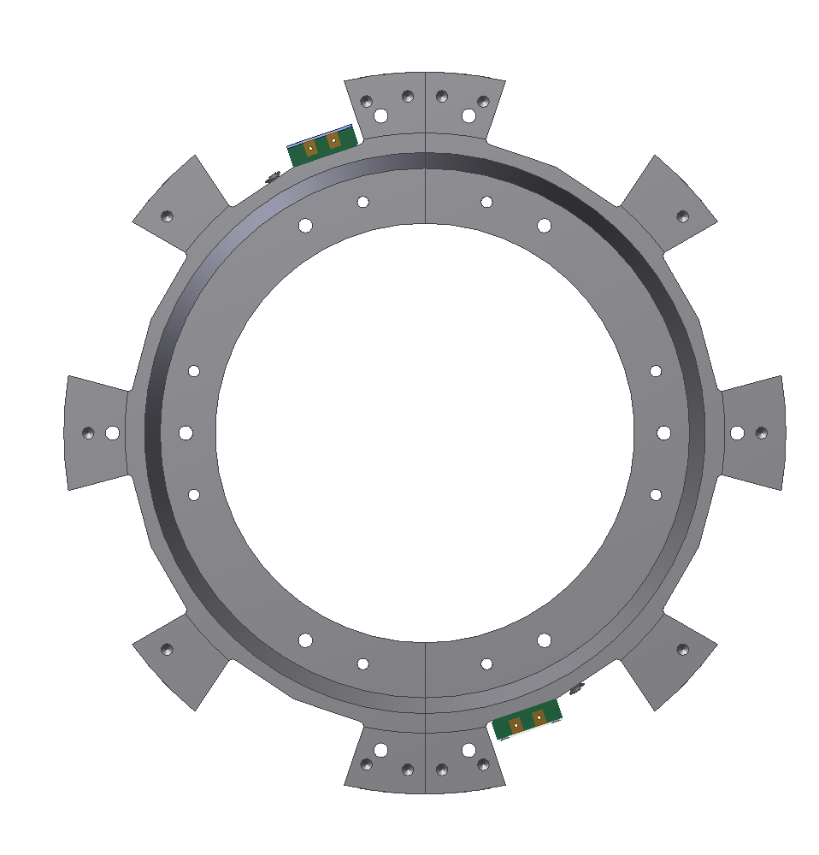
FWD Terminals Cooling lines
OUT – end ring
IN – end ring
left
right
End flange
IN – end ring
OUT – end ring

Slide 18
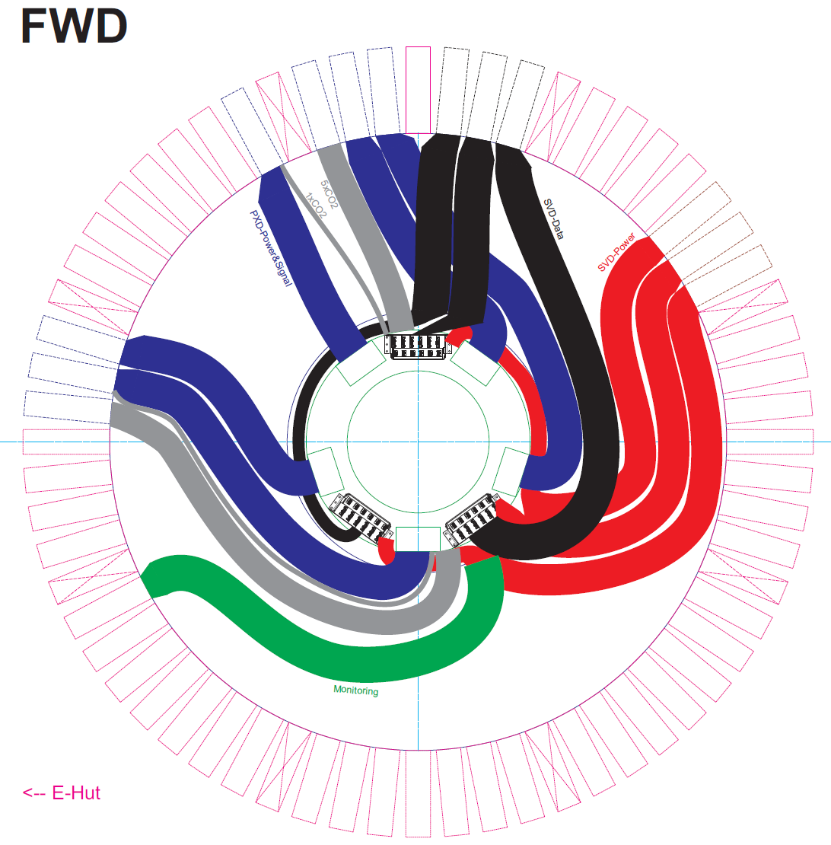
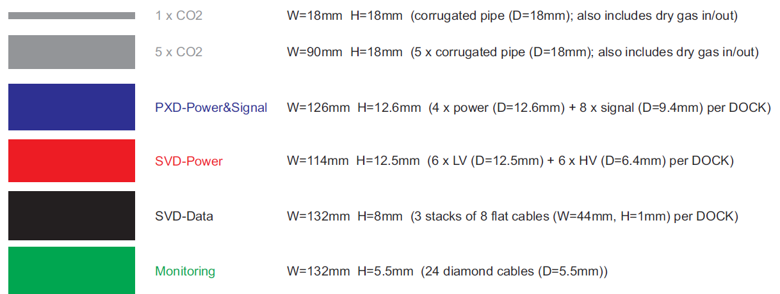
Difficulty With Cable Space CDC End Wall
The gap is only 20mm
We have assigned bays
Some cables can not be stacked
Same for cooling pipes
BWD has many more cables and pipes
That is the reason why we (MPI&HEPHY) will build a mockup for the BWD situation
(Sketch)

Slide 19
Common Open Issues (VXD)
Pipe and cable routing outside of VXD
Dock space:
Dock box installation
Cable and pipe space
Mounting and electrical isolation of dock box
VXD service installation
Tool development to bring VXD system from B1 to B4
How to make warm dry volume?

Slide 20
Near Term Schedule
Cooling pipe & thermal mockup meeting @ DESY
Pisa group (Filippo&Stefano) started with the ladder mount table concept (assembly from top)
Ladder transport box (Florian)
Start a more detailed concept for the Origami cooling pipe assembly (Florian/Filippo)
Cable space CDC-end wall @ MPI (Mockup)
Redesign of the Dock box (Florian B.)
Beam test @ CERN (3-17.June)
B2GM decision for ladder assembly from top (Pisa) or from the side (KEK) and end ring gluing procedure (DESY/KEK)
Jan.
Feb.
Mar.
Apr.
May
June

Slide 21
Summary & Outlook
Solved the problem with the set screw
Machining can be done @ HEPHY for all set screws (~200 pcs)
New pipe routing between the end rings (diamonds/pipe isolation)
HEPHY can produce all the clamps for the Origami pipes and for the NTC & fiber
The L5 BWD end rings are slightly modified (3mmx45° chamfer)
Cooling pipe isolation and torque relief are designed (BWD/FWD)
Cable routing at the CDC end wall with cable mockup @ MPI
Planned release date for the Rev. 2.3 is end of February

