Slide 1
Logistics discussion in KEK and exportation of first 10 DSSD to Pisa
20 Jan 2015
T. Tsuboyama

Slide 2
K-line logistics
KEK chose a logistics company. “K-line logistics.” Mr. Koyama.
In the first discussion in KEK, Mr. Koyama told that K-line needs to take care of exportation and importation between KEK and Narita in order for consistent treatment.
I asked Mr. Koyama make contact with Stefan and Macros company.
After our discussion, Mr. Koyama went to Narita customs’ office for discussion.
The report arrived to me last week.
Mr. Koyama explained as follows:

Slide 3
Information from Mr. Koyama
The Narita officer told Mr. Koyama as follows:
If the purpose of exportation of DSSD is “to ask foreign collaborators to produce ladders for KEK”, the process is understood as profitable for KEK. As a result, the exemption of taxes at re-importation can not be applied.
In order to avoid importation and consuming tax, only way is “donation” from foreign collaborators.
In this case, information “DSSDs are properties of KEK” is unnecessary or even harmful. Mr. Koyama (or the customs officer) asked us if we can donate DSSDs to foreign institutes first.

Slide 4
Reactions from KEK
This story is not what I and KEK expected.
Contradicting the procedure HEPHY and Pisa have prepared.
KEK can not donate DSSDs to out side institute so easily.
I asked Mr. Koyama if temporary importation procedure prepared in HEPHY and Pisa is affected or not. → No answers yet.
If we can accept this process, KEK can ship DSSD easily with the condition
Receipts
Tracing by HEPHY database.

Slide 5
Shipping cost from KEK
I asked the shipping cost of DSSD from KEK to Pisa airport.
The very rough estimation from K-Line is about 2 % of the DSSD cost including the insurance, packing and shipping.
Similar procedure will be necessary for pitch adapters.
2,000k yen for 100,000,000 yen DSSD shipment.

Slide 6
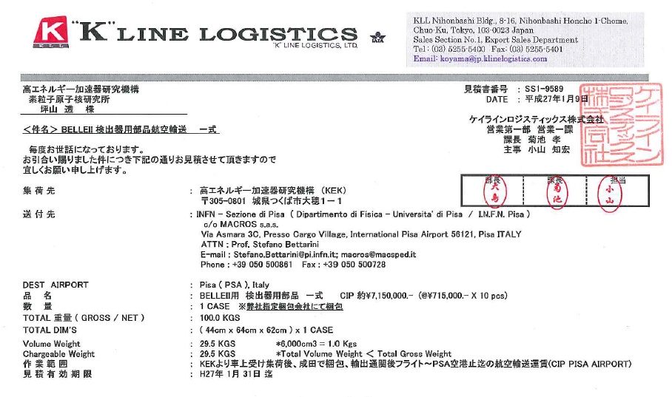
Qualification of DSSD shipment
a

Slide 7
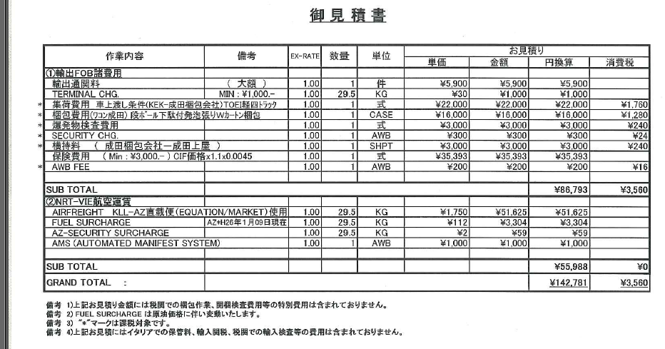
Qualification of DSSD shipment
v

