Slide 1
QCG Report
Francesco Forti
University and INFN, Pisa

Slide 2
Outline
Sites Qualification Reviews
Specifications sign-off
Open issues
QCG Evolution
https://belle2.cc.kek.jp/~twiki/bin/view/Detector/SVD/SvdQCQAGroup

Slide 3
Site Qualification
Sites need to be officially qualified before starting to work production level components
Class definition of components:
So far we have done class C qualification:
Requires all final assembly steps except for the electrically functional class B module
Necessary to move to the class B modules
Class | Definition
A | Production quality component. Good for installation
B | Fully functional component, but of reduced quality. Not installed
C | Mechanical, not electrically working component, but with all the features and precision of a class B (chips, sensors, wirebonds)
D | Mechanical component, posssibly with missing chips, no wirebonding, aluminum sensors, reduced precision

Slide 4
Site qualification reviews
The reviews help the groups to
Design stable and reliable procedures
Document the procedures and the QC/QA
Communicate with other sites
Organize the manpower and schedule
It should not be a one-time event, but rather a work method
https://belle2.cc.kek.jp/~twiki/bin/viewauth/Detector/SVD/SiteQualificationPage
The SVD QCG is responsible for qualifying the sites.
The QCG will appoint a review committee that will report to the SVD group
A qualification site visit the committee is required.

Slide 5
Outcome of the reviews (I)
Pisa on Oct 4, IPMU on Oct 31, HEPHY on Jan 19.
All sites have demonstrated the ability to build class C modules and also to test modules electrically
Reviews are positive, with some comments.
Pisa (Fwd/Bwd assemblies)
Only backward class C modules were produced with final jigs and procedures: confirmation will be needed for forward modules
Some adjustements and final checks are required
IPMU (L6)
Produced module C-1/C-2 are not fully class C (not all wirebonds are present, some parts are not class C)
Procedures are nearly, but not completely final and require some adjustement and finalization
Required to produce C-4 with completely final procedures (including documentation and DB usage)
Try to use working (class C) origamis/sensors → get a partially working module.

Slide 6
Outcome of the reviews (II)
HEPHY (L5)
Produced Class C module is not mechanically qualified yet: need to survey it to verify precision
PA1/2 gluing procedures need further optimization
Required to produce another class C to finalize procedures (also needed for mechanical interference tests).
Followup
We will need to schedule the followup class C reviews (they can be done remotely) as soon as the sites have resolved all the issues.
Time frame: february – march
They could be combined with the class B review, depending on the situation at sites.

Slide 7
Sign-off
To ensure we obtain good quality components, we need to increase the level of formality with which we define the component specification and approve them.
Sign-off is the process by which the entire collaboration ensures that a portion of the design is compatible with all the rest and authorizes the corresponding fabrication
It has technical and an administrative components:
Full specifications and production plan
Verification and sign-off
Change control

Slide 8
Full specification and production plan
Before production can start a component needs to have:
Full technical specifications including:
Mechanical and/or electrical schematics drawings.
In case the final design is produced by the company, only a conceptual/preliminary design is included
Quality assurance and quality control plan.
What design checks need to be done
What production tests needs to be done and by whom
A full production plan:
Schedule for the delivery of components
Schedule for the tests and qualification of components

Slide 9
Verification and sign-off
After the technical specifications and production plan are defined (typically by a single person or a subgroup):
They should be made available to the full collaboration on a twiki page (the verification and sign-off page)
The QCG/SVD Leaders will produce a full list of people who should be checking the design and notify them
The list will be published explictely on the twiki page
People will have to explicitely send a positive sign-off via email, or make comments/change proposals
In particular one needs to check all the points of interface to other pieces of the system
Final sign-off (authorization) will be produced after alla the relevant people have said YES.

Slide 10
Change control
After sign-off production can start
The design of that part is FROZEN. It cannot be changed without a proper change control procedure.
Change control procedures:
Specific and written proposal to change the design with a new version of the specifications published on the twiki page
Again fully checked by all relevant people
The list needs to be revised to make sure the changes are correctly reviewed
Also review administrative/financial implications if production has already started.
The new specifications are approved after all relevant people have said YES.

Slide 11
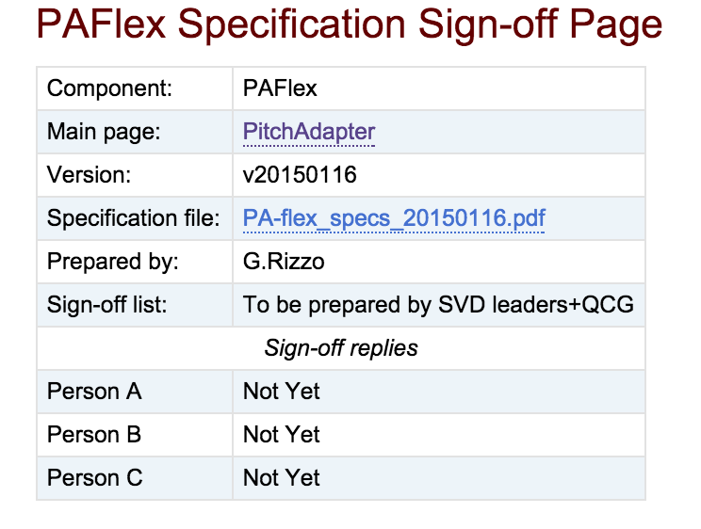
Sign-off implementation
Sign-off page created:
https://belle2.cc.kek.jp/~twiki/bin/view/Detector/SVD/SvdSpecificationsSignoff
Try to use this system for the PA production, which should be starting in a few days.
It is essential that we all agree on the system an collaborate to make it work.

Slide 12
QCG Open issues
Ladder design
Definition of ladder mechanical tolerances
Now possible after feedback from assemlbly procedure
Verification of thermal (-30 to +60 C) and mechanical properties on ladders (deformations and vibrations)
Planned in next 2 months at different sites
Verification of possible ladders mechanical interference on rings
Needs to be planned – requires precisely assembled cooling rings.
Verification of a full electrically working ladder
With simultaneous readout of all sensors

Slide 13
QCG Open issues
Ladder assembly procedures
Clear definition of all coordinate systems and survey points
Finalization of several assembly procedure details
Wrapping/gluing of PA1/PA2
Glue reinforcement of PF1 and PB1 to avoid peeling
Definition of bonding redundancy and bonding tests in production
Gluing of the cooling pipe clip on the FW slanted detector
Streamline the database usage for production checklist and measurements storage and comparison
Definition of the ladder transport container
Detailed definition of production ladder thermal tests
Ideas proposed, but need to be finalized
Detailed definition of electrical QA during production
Now possible after experience with pinhole plucking and module testing

Slide 14
QCG Evolution
Initially focused on assembly procedures and sites qualification
Need to define how to track quality during the production period
Naturally expanding into defining the QC/QA procedures for the entire system
Probably a redefinition of membership is needed
Also using the new SVD organization that is picking up speed.

