Slide 1
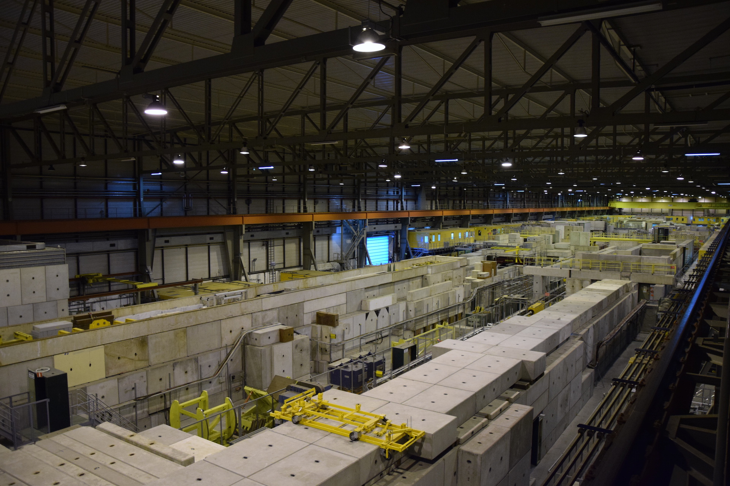
CERN preliminary beam test Results Nov 2014
Hao Yin and Benedikt Würkner on behalf of the SVD Group at HEPHY
7th Belle II VXD Workshop, Prague

Slide 2
Overview of the Setups
H6A - upstream
SVD L3-L6 Stack
CO2 Cooling
FADC and FADC Controller firmware with new functionalities
Trigger issued by coincidence NIM module.
H6B - downstream
AIDA-Telescope with HEPHY SVD3 Setup
For Belle2 tests only available on Sunday

Slide 3
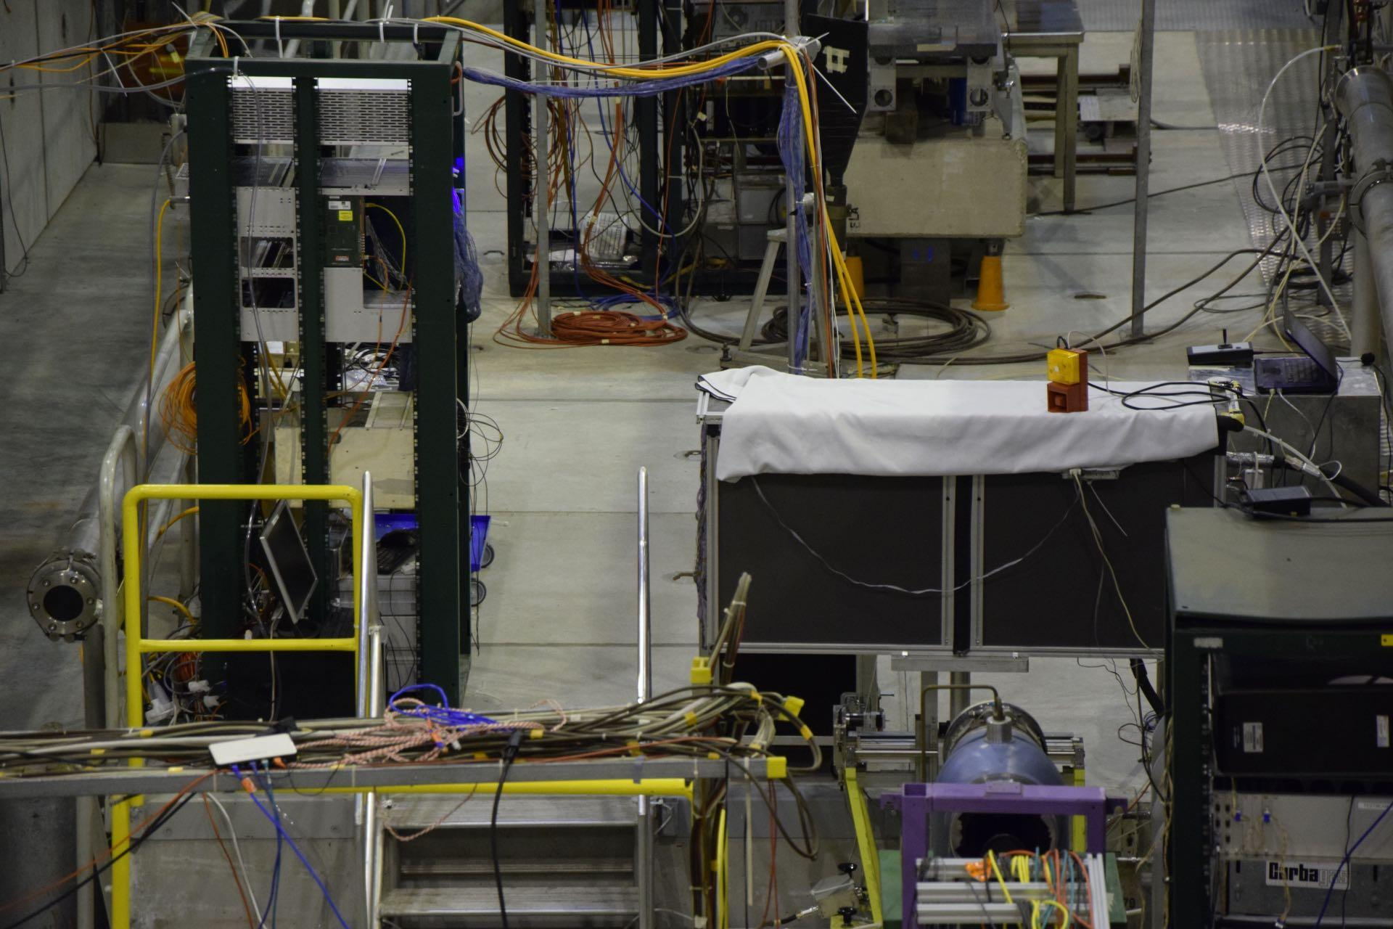
H6A Belle2 SVD Stack Setup

Slide 4
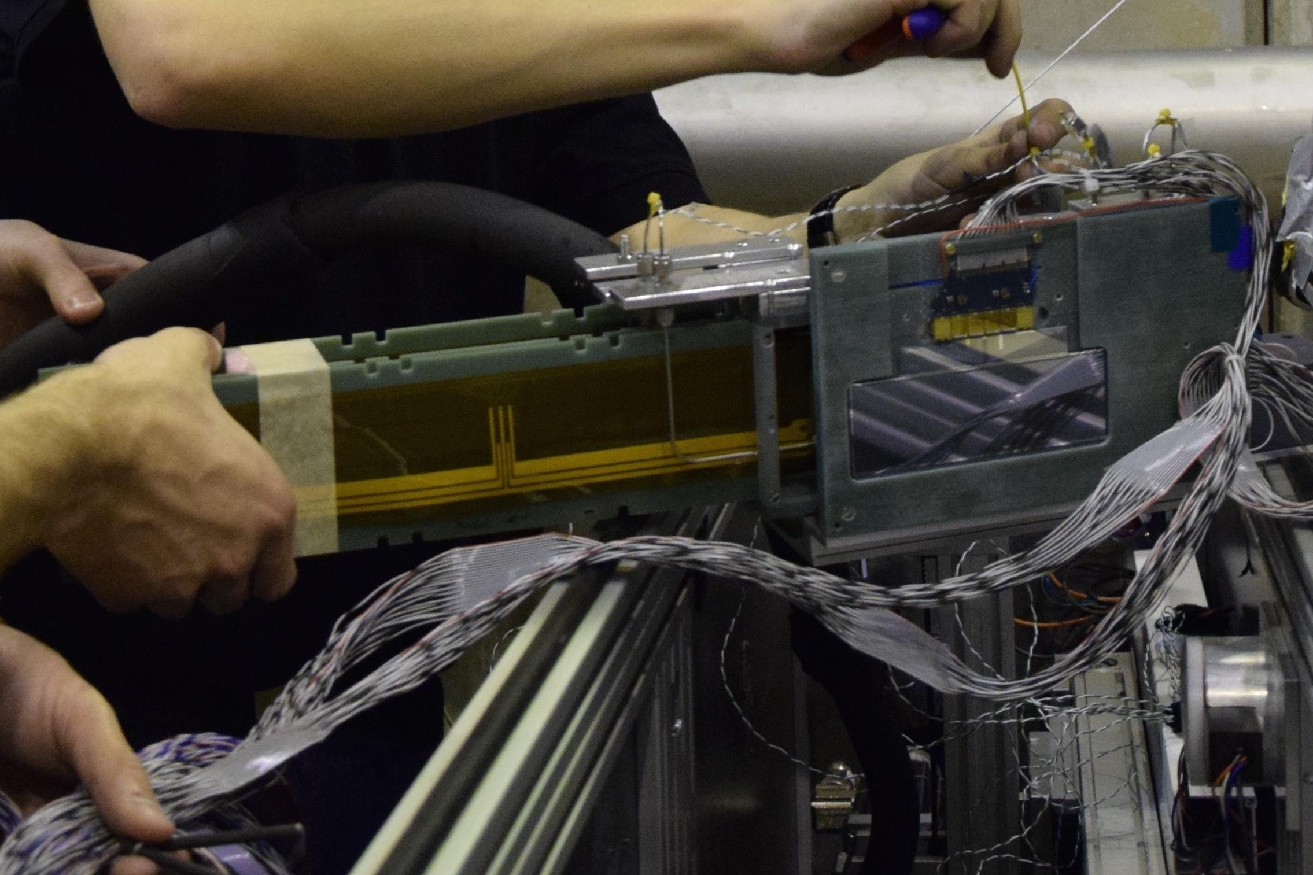
H6A Belle2 SVD Stack Closeup

Slide 5
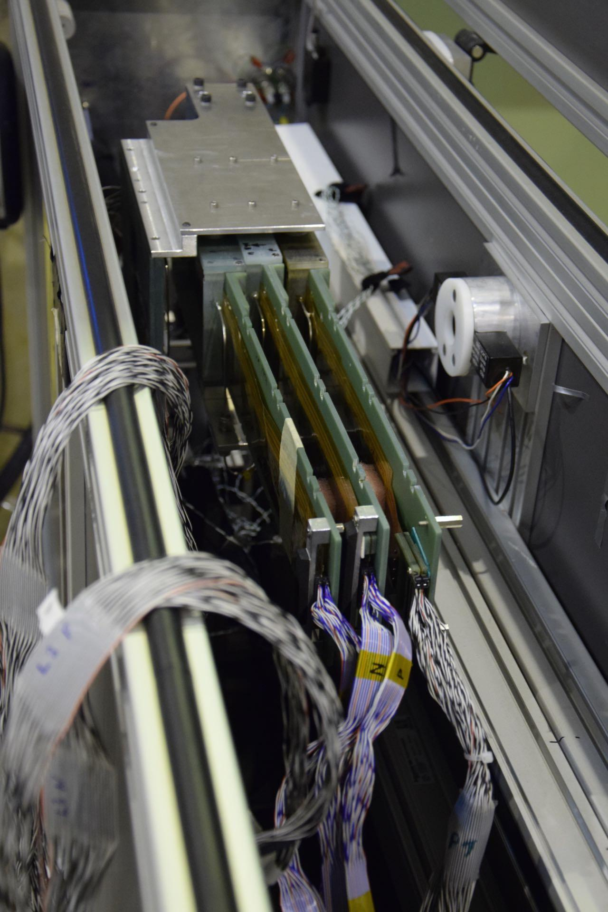
H6A Belle2 SVD Stack Closeup

Slide 6
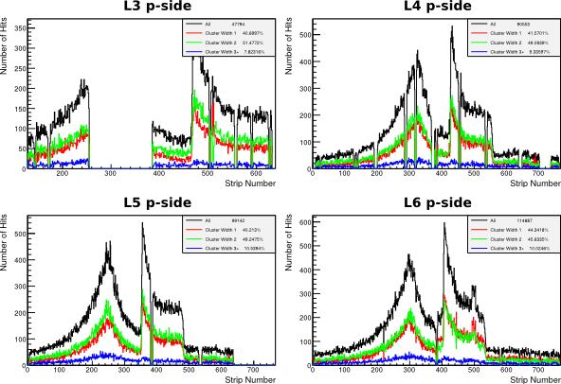
Beam Profile (I)
The hit maps shows a dip at about the same position. The cause is still unknown.

Slide 7
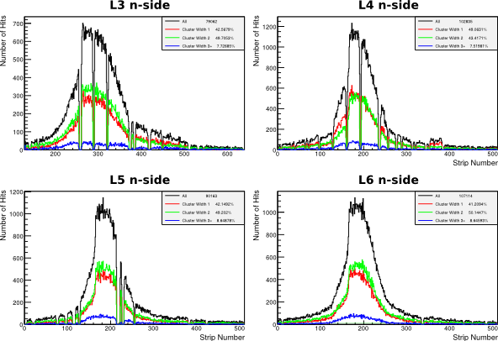
Beam Profile (II)

Slide 8
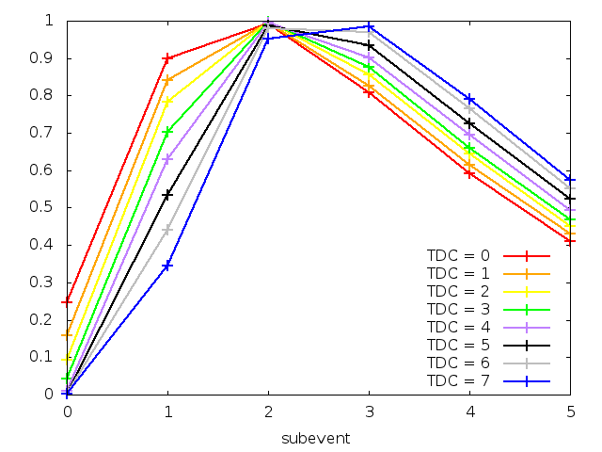
TDC values
TDC values implemented by Katsuro Nakamura.
Sample rate of the trigger is ⅛ of system clock at 32 MHz
The TDC value is saved in the main header of the FADC output.
Each line represents the normalized mean shaper pulse at a different TDC value
The shift of the maximum is clearly visible.
Notes:
figure:

Slide 9
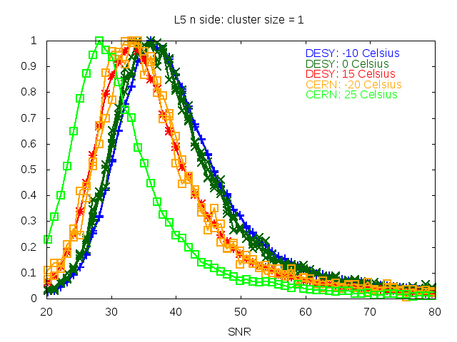
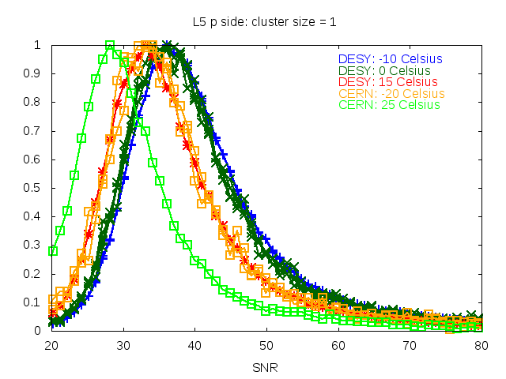
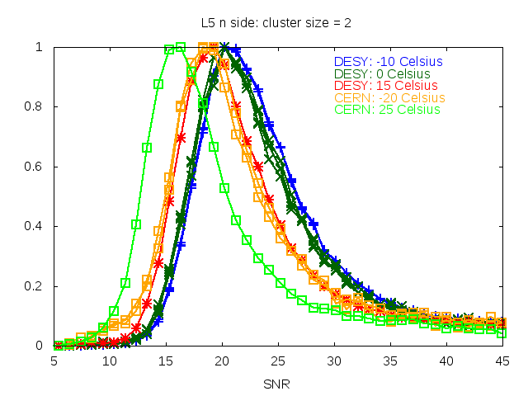
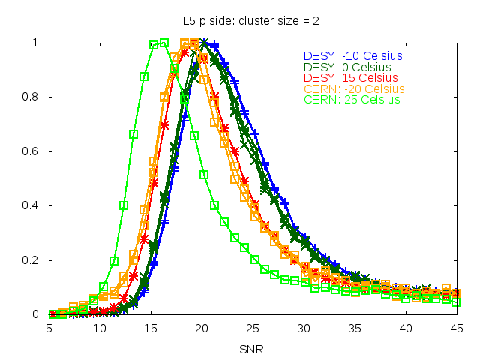
Signal to Noise
The noise of each sensor at different temperatures was about the same.
Pedestal significantly increases with the temperature.
Cooling to -20°C improved the SNR by about 5
The relative improvement seems to be consistent between CERN and DESY
k=mean(CERN-DESY)
k=[SNR/°C]
k[cw1] = -0.0467
k[cw2] = -0.0246

Slide 10
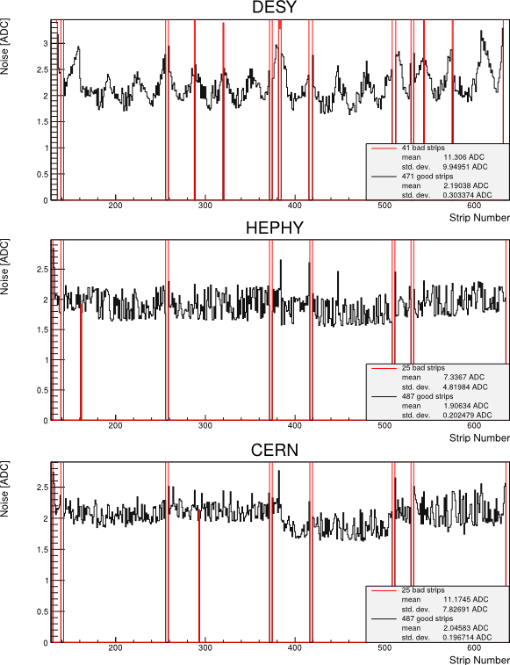
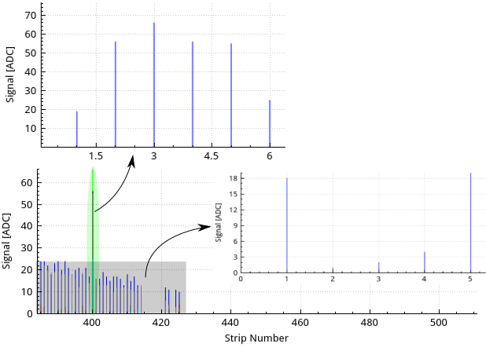
Noise L3 n-side
At DESY external noise caused a slope of strip signal of each strip within at least one frame. The resulting different CMC values distorts the shaper pulse sampled using 6 frames of data. This issue is still under investigation and the progress was presented by the previous talk(Thalmeier).
Notes:
Note: Hit time und particle signal distorted by ext. noise due to CMC at the same frame.

Slide 11
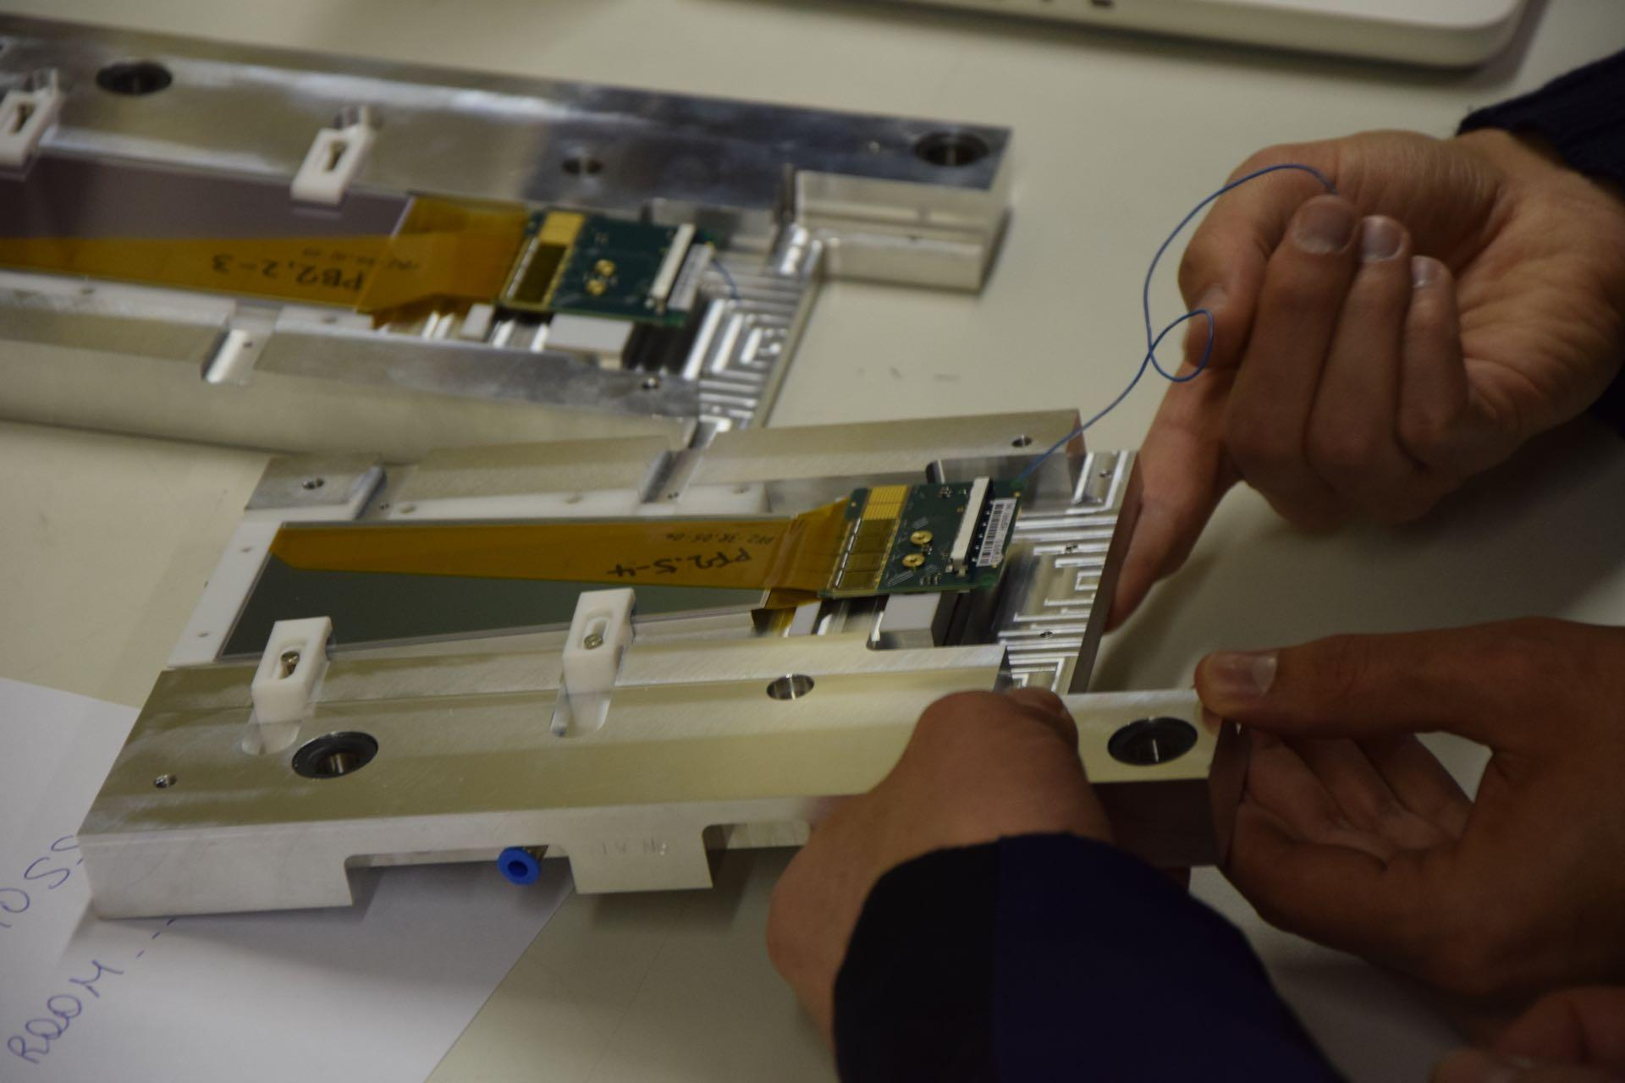
Forward and Backward Modules

Slide 12
Results of the FW&BW modules
3 runs targeting different areas
003 - hitting APVs 0/1 on p-sides, 1/2 on n-sides
004 - hitting APVs 1/2 on p-sides, 1/2 on n-sides
005 - hitting APVs 2/3 on p-sides, 1/2 on n-sides
BW Module was flipped on p-side -> run003 hit only the not connected APVs 4&5
OldWedge APV0 damaged and deactivated

Slide 13
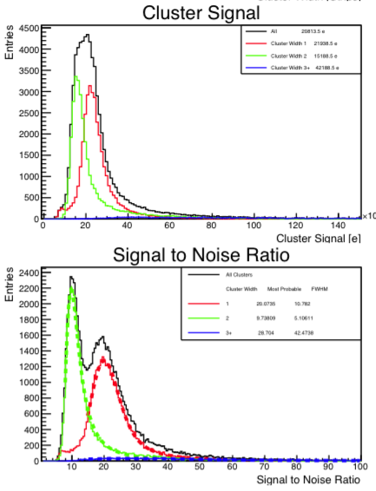
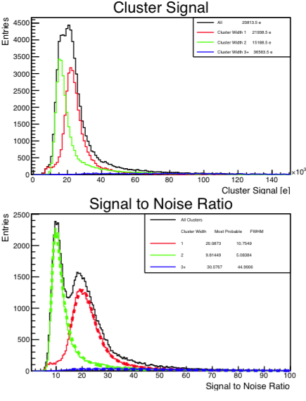
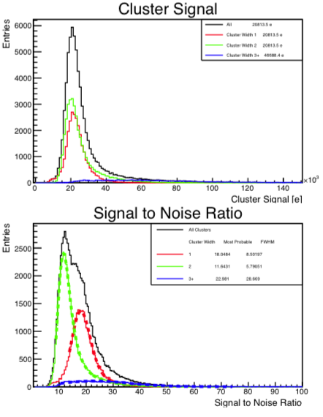
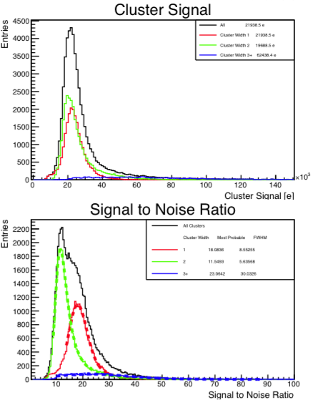
FW Module results
n-side
p-side
run005
run004
run005
run004
No significant differences between runs in spite of shifting the beam spot

Slide 14
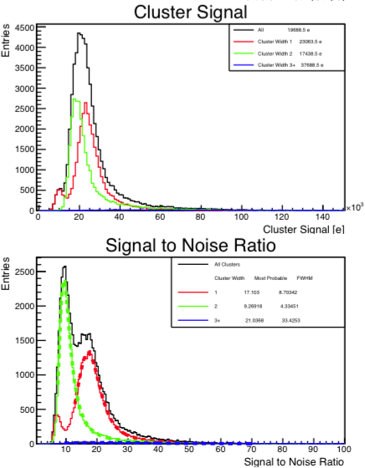
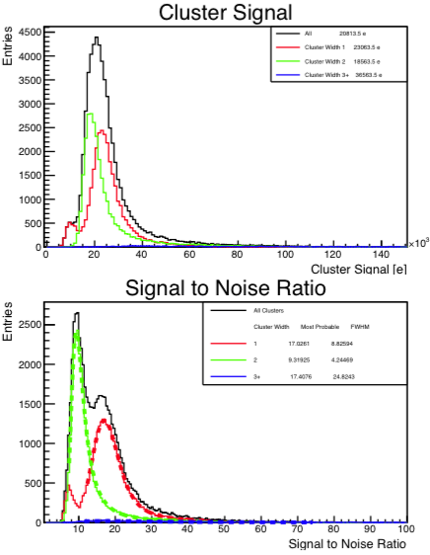
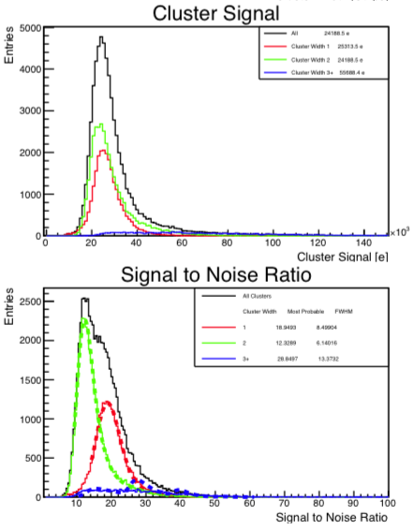
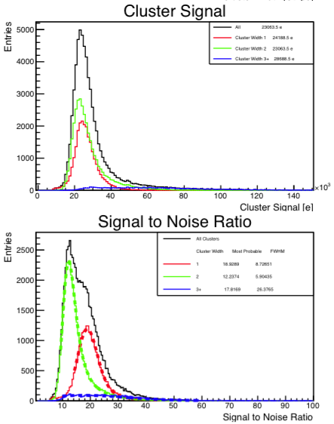
Old Wedge results
n-side
p-side
run005
run004
run005
run004
No significant differences between runs in spite of shifting the beam spot

Slide 15
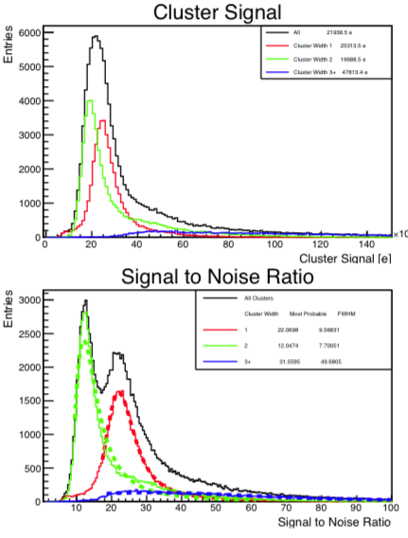
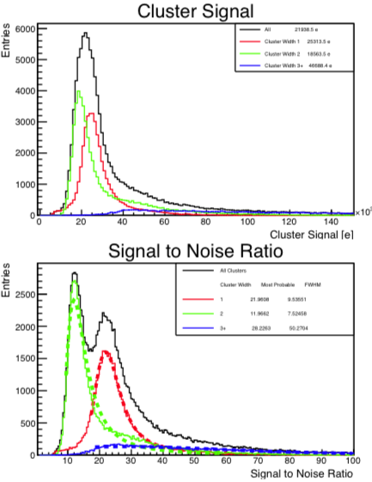
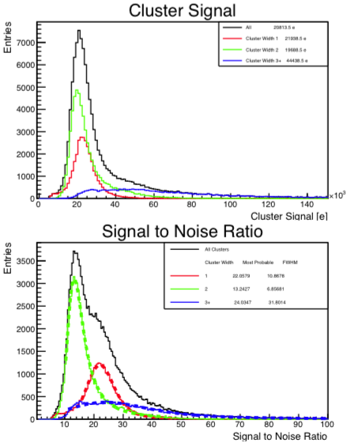
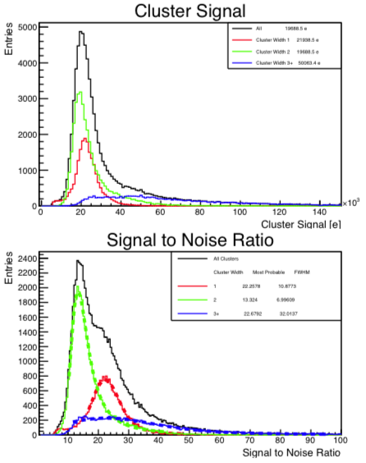
BW Module results
n-side
p-side
run005
run004
run005
run004
No significant differences between runs in spite of shifting the beam spot

Slide 16
Comparison of Old Wedge and FW
FW n-side
Old Wedge n-side
run 005
No significant differences between runs in spite of shifting the beam spot

Slide 17
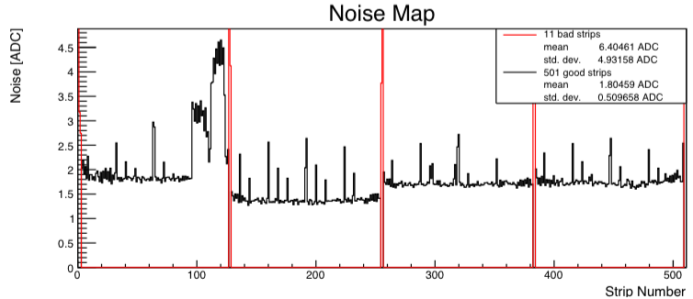
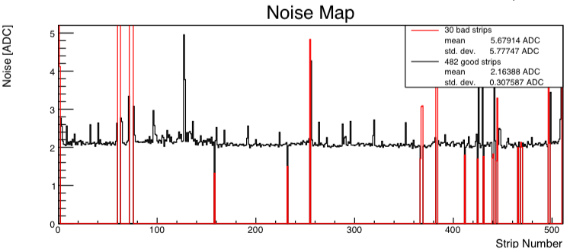
Noise map: wedge vs rectangular
Run005 BW_p
Regular peaks caused by readout system. This was countered by the FIR filter not available in the SVD3 Setup
In the APVDAQ this is available
In the final system FIR is implemented in the FADC system
Damaged area in the sensor causes failure in the CMC correction.
Run005 FW_p
Some damaged strips and but overall linear noise map

Slide 18
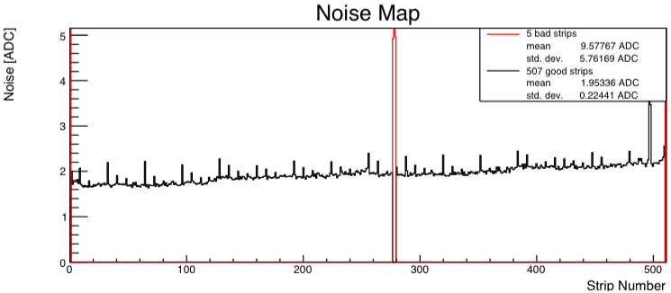
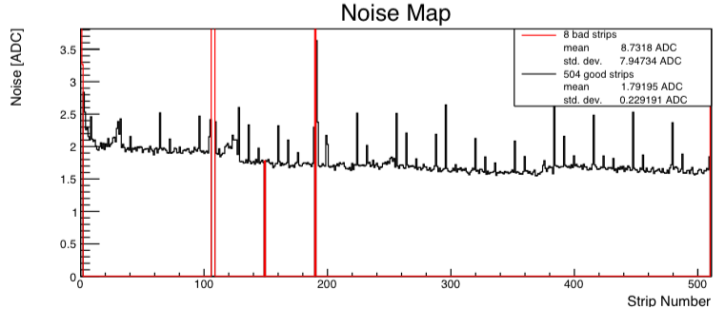
Noise map: wedge vs rectangular
Run005 BW_n
Slope in noise map caused by different PA length on the BW module
Caused by different strip length and PA length on the FW module
Nice noise map only with the FIR filter visibly missing
Run005 FW_n
Slightly descending noise map shows the fact of changing strip length

Slide 19
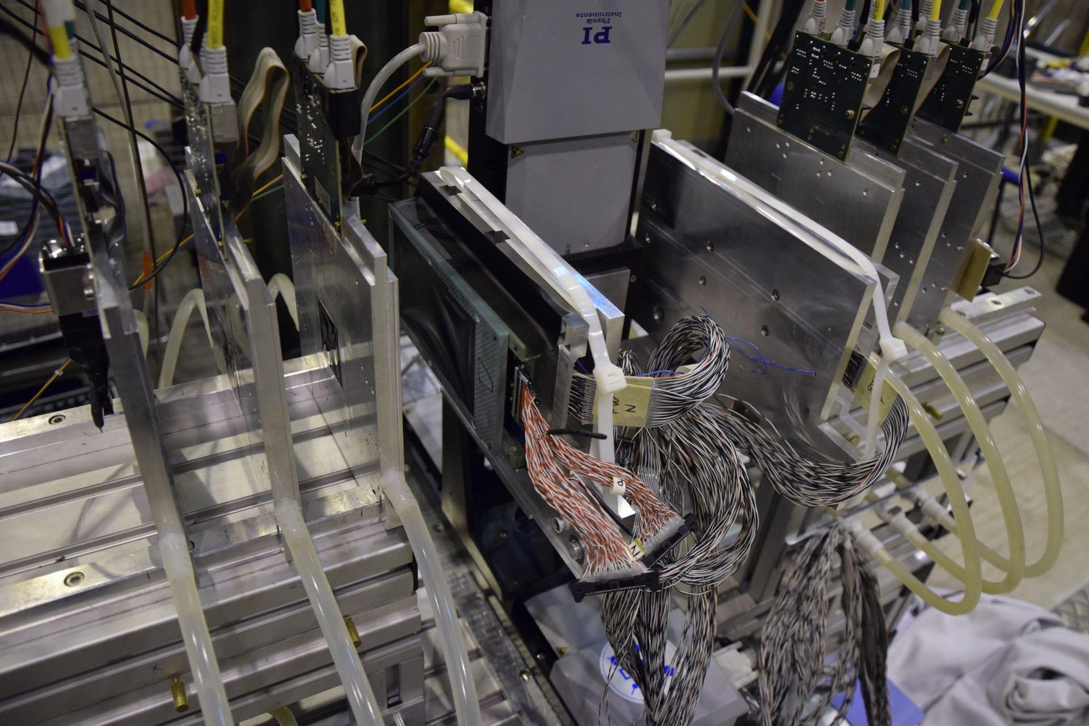
EUTelescope with FW&BW Modules

Slide 20
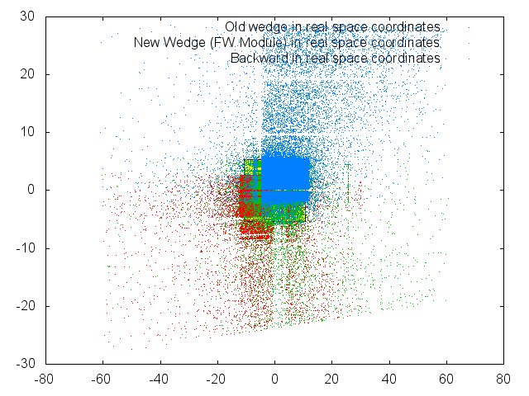
Hit map of Wedge and FW&BW modules

Slide 21
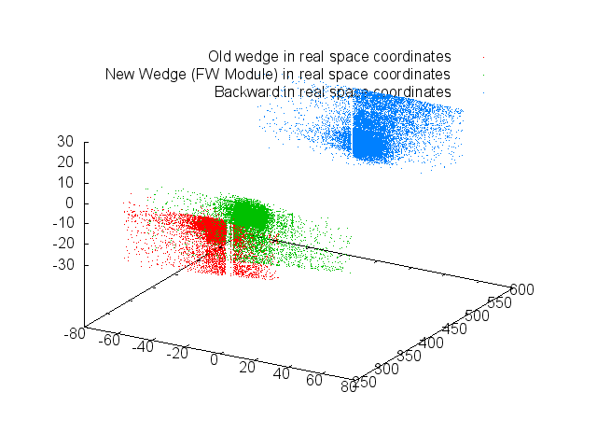
3D hit map of Wedge and FW&BW modules

Slide 22
Summary
Tested new functionalities of FADC and FADC controller
SNR shows same relative shift as at DESY
Hit map issue is still under investigation
Track reconstruction of FW&BW modules is pending
FW&BW modules were working properly

Slide 23
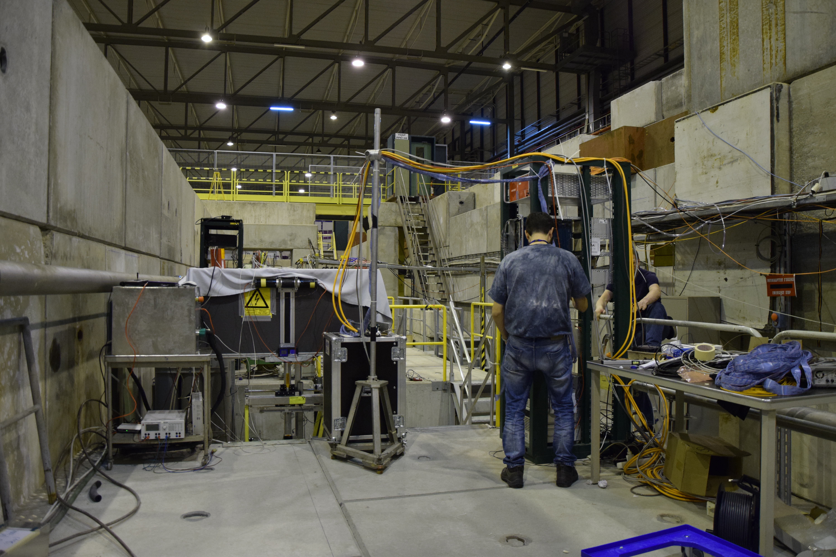

Slide 24
