Slide 1
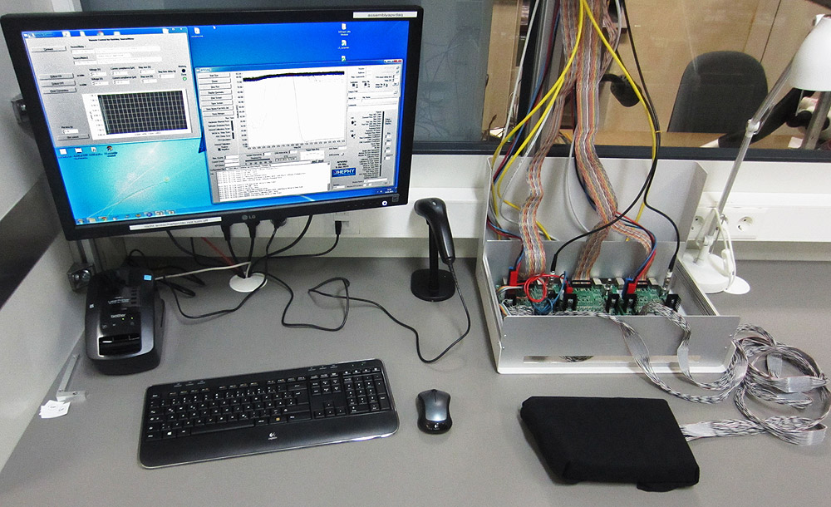
22 January 2015
APVDAQ Status
Markus Friedl

Slide 2
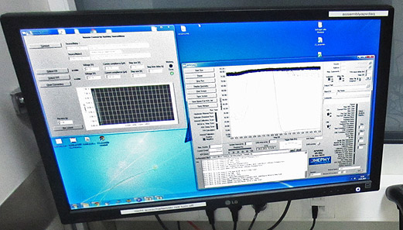
Introduction
What APVDAQ Can Do
What APVDAQ Cannot Yet Do
What APVDAQ Cannot Do
Summary

Slide 3
Introduction
What APVDAQ Can Do
What APVDAQ Cannot Yet Do
What APVDAQ Cannot Do
Summary

Slide 4
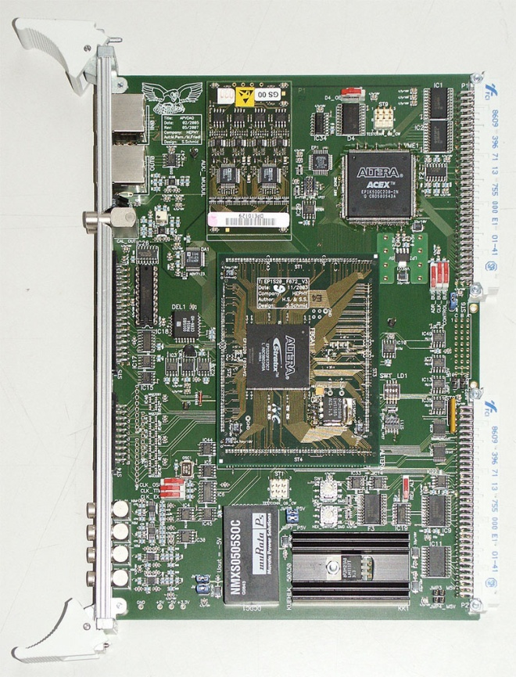
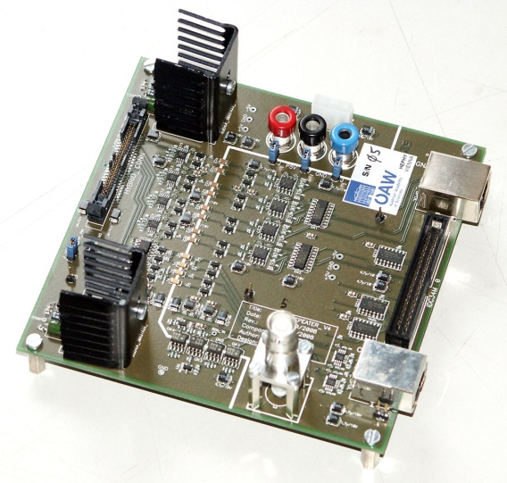
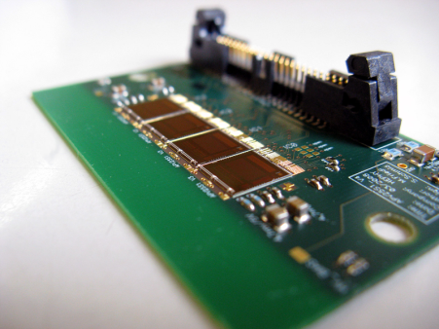
Introduction
APVDAQ is a modular readout system for the APV25
Predecessor of the Belle II SVD readout system (“FADC”)
6U VME module
Repeater board
≤30m
APV25 hybrid
≤2m

Slide 5
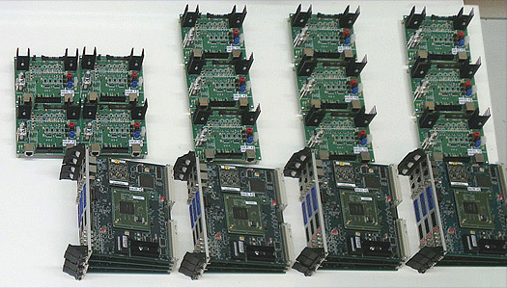
Electrical QA During Ladder Assembly
Identical setups built for all ladder assembly sites
To obtain comparable results
Results are stored in the database
Measurements:
Bare hybrids or Origamis
Ladders during construction
Final ladders (source/laser scan)
Only one sensor (2 hybrids/ Origamis) at a time can be measured
Melbourne
IPMU
Pisa
Vienna
About one year ago before shipping; KEK already had an APVDAQ system

Slide 6
Introduction
What APVDAQ Can Do
What APVDAQ Cannot Yet Do
What APVDAQ Cannot Do
Summary

Slide 7
What APVDAQ Can Do
Different run types (tests):
Pedestal/Noise (software run)
Internal Calibration Scan
IntCal vs. Vsep Scan
Source/Laser (hardware run)
Run-dependent
Online analysis
Export to CSV file for database
Bare hybrid,
Origami
With sensor during production
Final module/ ladder

Slide 8
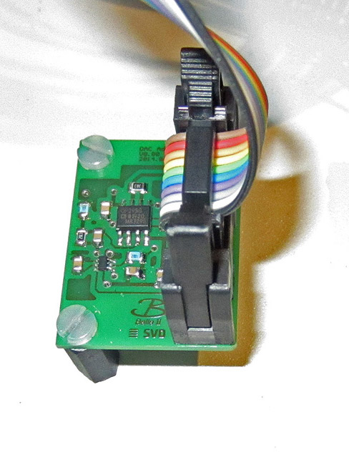
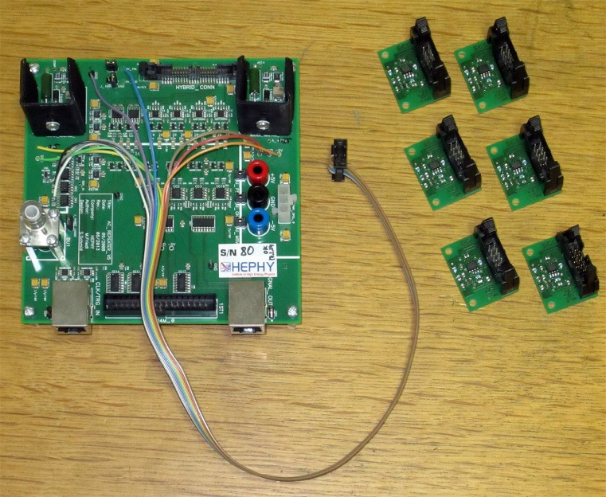
Recently Added Features (1/3)
DAC add-on board
Allows to apply separation voltage in the range -5…+5V between bias and APV ground
Supported on p-side from software version 0.96
Hardware is being distributed
Installation instructions available in Twiki:
https://belle2.cc.kek.jp/~twiki/bin/ view/Detector/SVD/ApvDaqPage

Slide 9
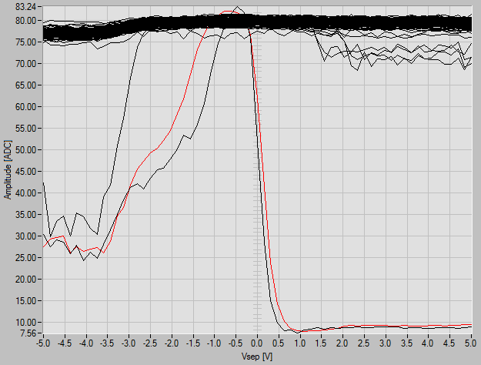
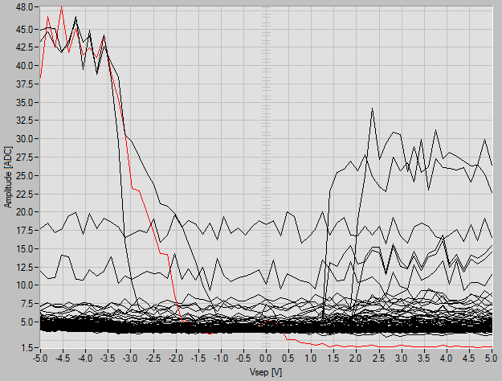
Recently Added Features (2/3)
Typical IntCal vs. Vsep plots for APV with pinholes
SFW993 p-side, APV#1, channel 30
Distinct Vsep dependence of pinhole channels for both polarities
RMS
Mean

Slide 10
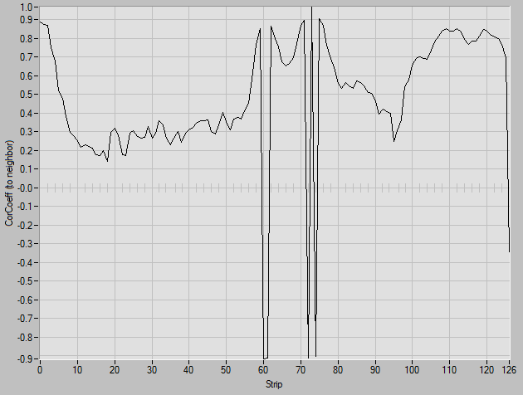
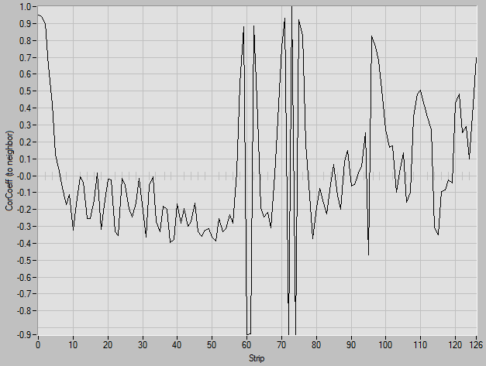
Recently Added Features (3/3)
Correlation scatter plots and coefficients between neighbors
SFW993 p-side, APV#0, pulled channels (61,73,74) are obvious
High anti-correlation to neighbors
Raw data
CMC data

Slide 11
Introduction
What APVDAQ Can Do
What APVDAQ Cannot Yet Do
What APVDAQ Cannot Do
Summary

Slide 12
What APVDAQ Cannot Yet Do
Additional features for next software release:
DAC support also for n-side
Correlation coefficient shown for scatter plot on display
What else?
Maybe more sophisticated analysis/export for source/laser run?
Please let me know any requests

Slide 13
Introduction
What APVDAQ Can Do
What APVDAQ Cannot Yet Do
What APVDAQ Cannot Do
Summary

Slide 14
What APVDAQ Cannot Do
Software does not
Interpret/judge measurement results
Grade the device under test
Human intelligence is required for those tasks
It’s not very complicated → student’s job
Instructions: https://belle2.cc.kek.jp/~twiki/bin/view/Detector/SVD/ModuleElectricalTest

Slide 15
Introduction
What APVDAQ Can Do
What APVDAQ Cannot Yet Do
What APVDAQ Cannot Do
Summary

Slide 16
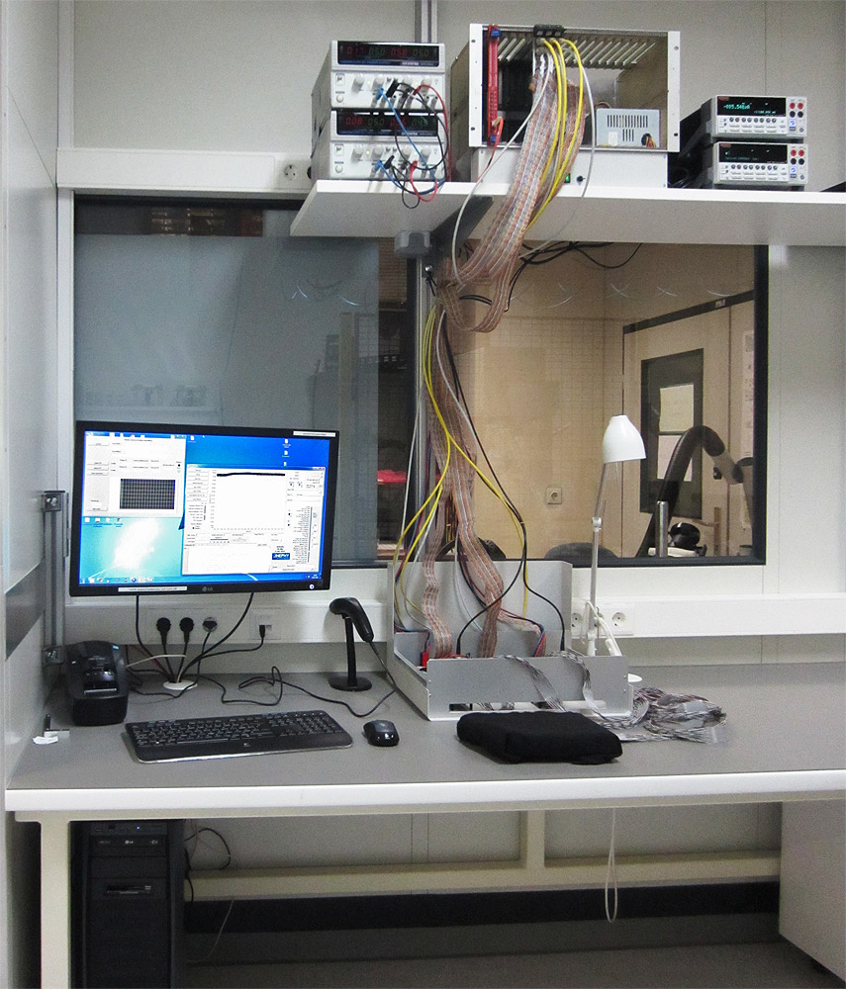
Summary
APVDAQ is a powerful tool for electrical tests
Before (hybrids, Origamis)
During
After (full ladder test)
Ladder assembly
System well matured
Few more features to be added in software

Slide 17
Backup Slides

Slide 18
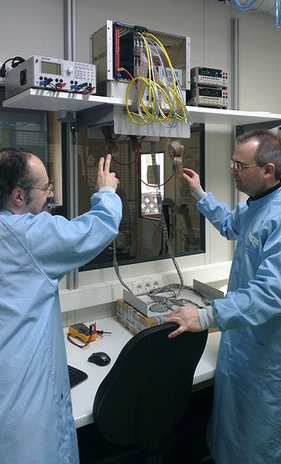
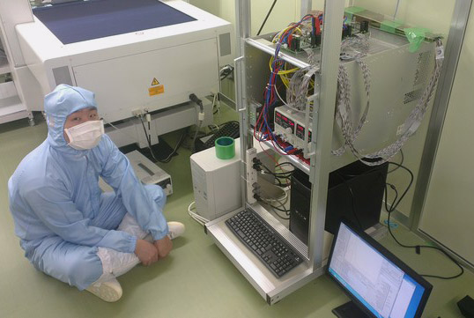
APVDAQ in Vienna, Pisa, IPMU, Melbourne
Systems installed at all assembly sites (plus KEK)
Vienna
IPMU

Slide 19
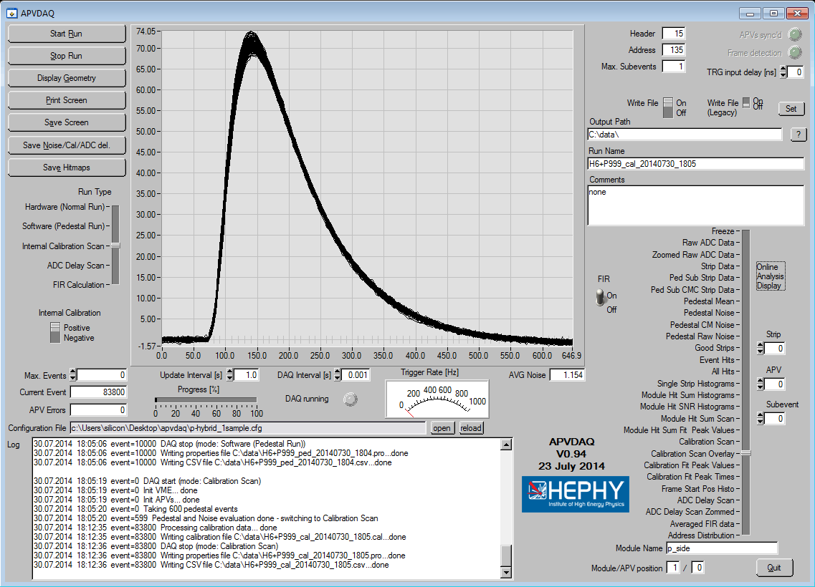
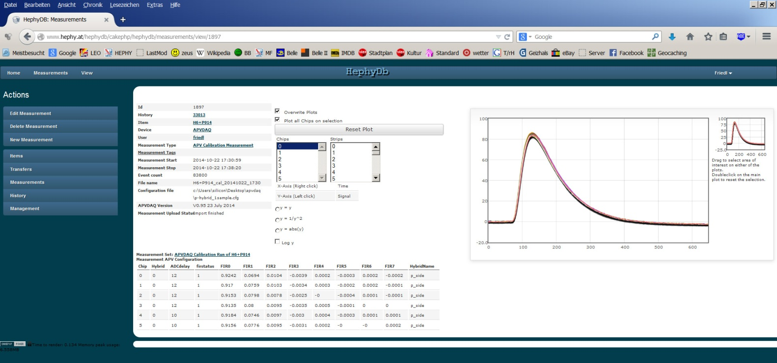
Measurements are Stored in the Database
APVDAQ software
Construction database

Slide 20
HEPHY Clean Room Installation
VME Crate
Linear LV power supplies
2 x Keithley 2410
HV power supplies
(software controlled)
Metal box with repeater boards
Barcode scanner
Device under test
(here: SFW993 wrapped in cloth)
PC

Slide 21
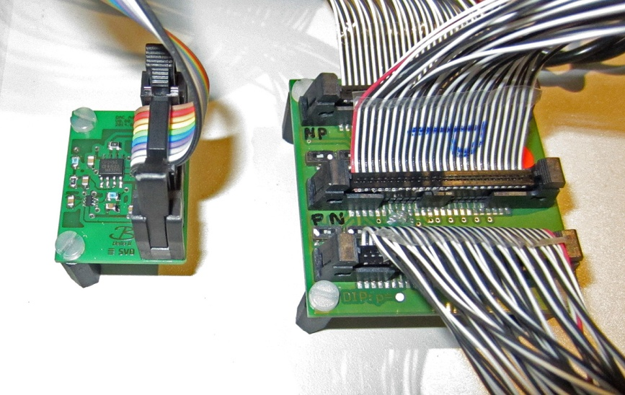
Closeup
DAC board

Slide 22
Power Supplies etc.
HV: 2 x Keithley 2410 SMU
Operated by a dedicated software
LV: 2 x GW Instek GPS-3303 (linear, 3 channels each)
Works well also with bias (floating LV)
(Had noise troubles before with switching LV PS under bias)
Barcode Scanner: 2D Imager KD-1000-OP
Reads 1D and 2D codes
Label Printer: Brother QL-720NW
Produces rad-hard, self-adhesive labels

Slide 23
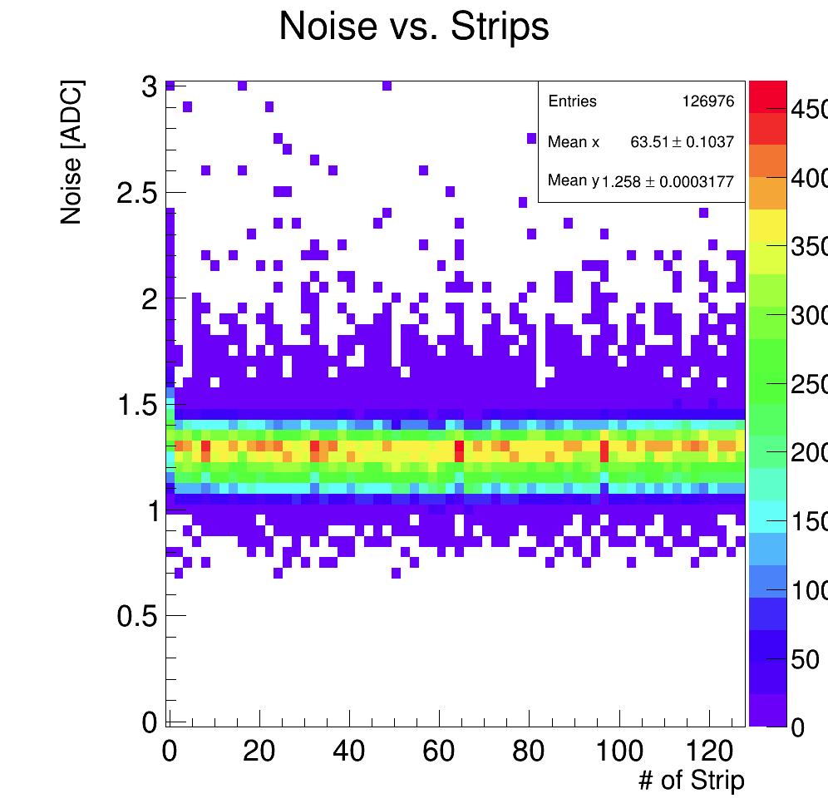
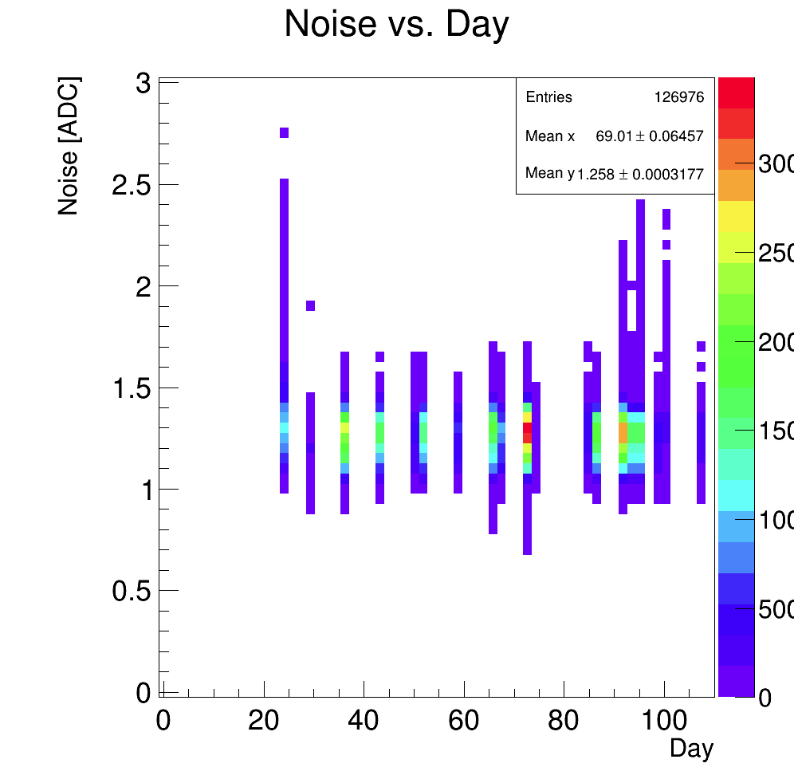
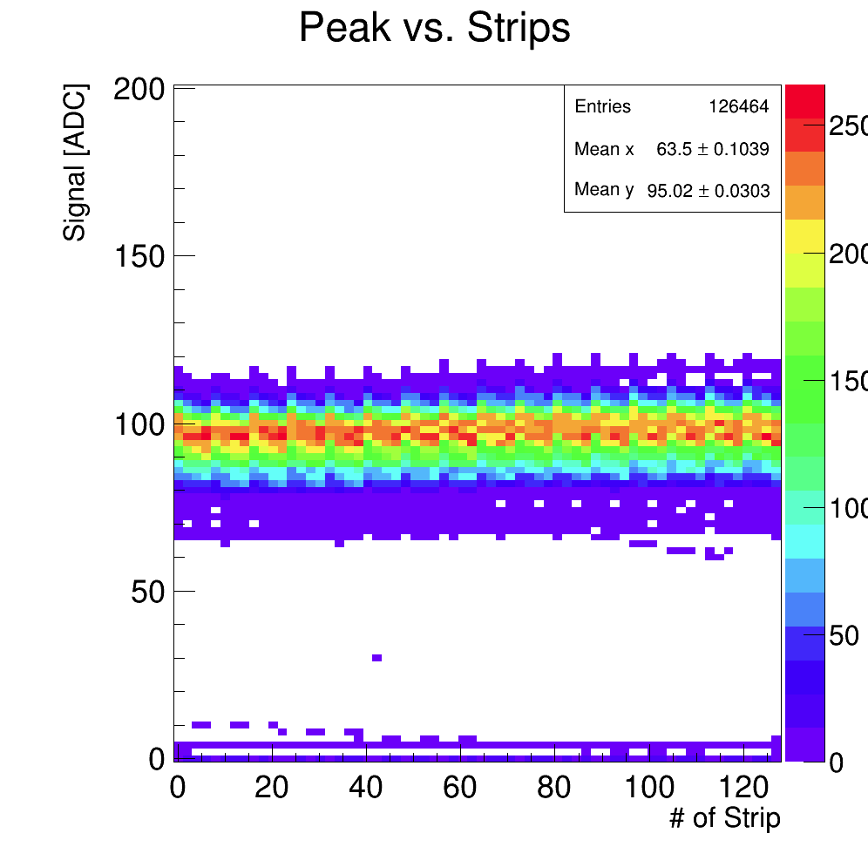
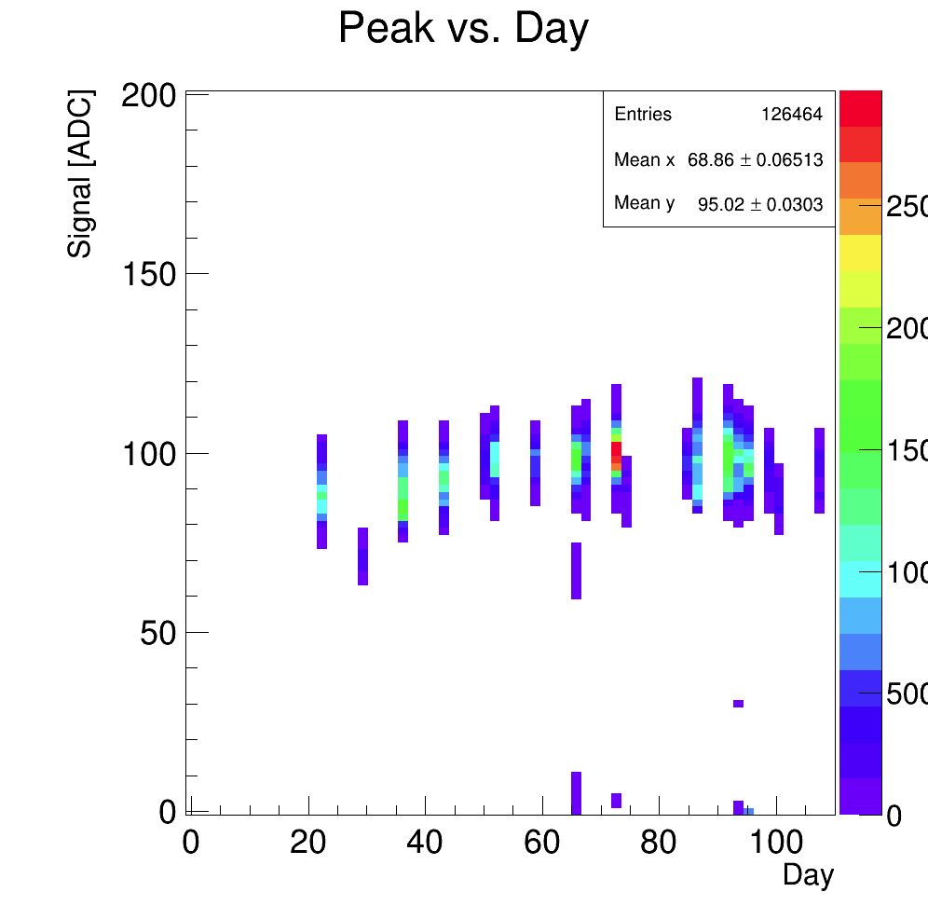
APVDAQ Stability
Data of >640 APV25 chips tested on hybrid level
Example plots shown here:
Noise
IntCal Peak
More plots:
http://www.hephy.at/project/belle/belle2svd/apvdaq/pa_dh.pdf

