Slide 1
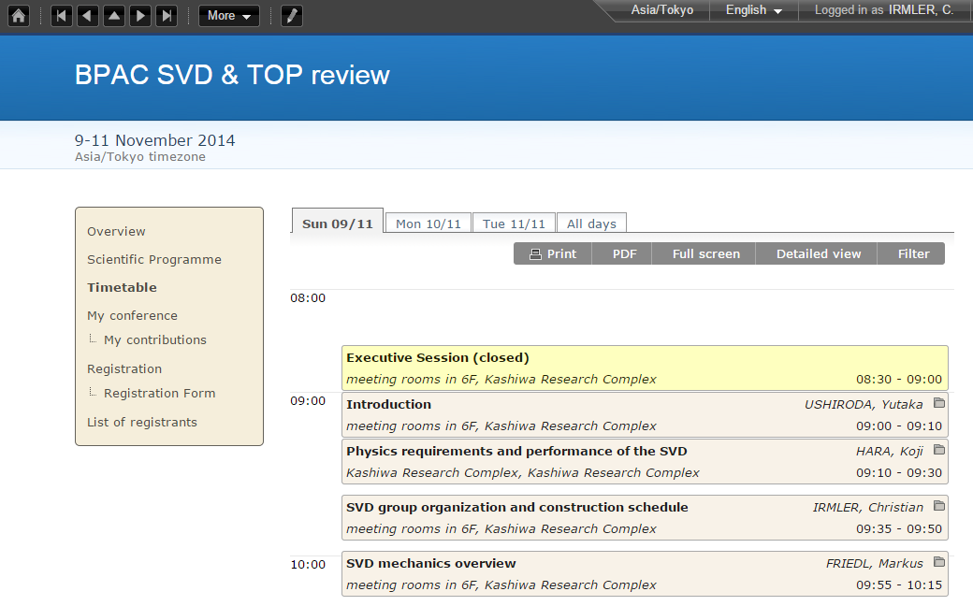
BPAC Report
7th Belle II VXD Workshop, Prague

Slide 2
Introduction
SVD production readiness review
9th -10th Nov. 2014 at Kavli IPMU
Focused on production readiness
But also cooling, electronics, etc.
Final report received few days ago
http://kds.kek.jp/materialDisplay.py?materialId=0&confId=16766
More than 5 pages of concerns and recommendations
Almost the whole report is a list of recommendations
Have to consider them seriously!

Slide 3
Concerns (1) - Delay
6 months to get new FlexPA design
Still not in production!
Origami PA0 problem
What else have we overseen?
Fully functional ladder: Need to build it as soon we have new working and tested Origami hybrids!

Slide 4
Concerns (2) – Thermal Mockup
Thermal mockup not ready before end of 2015
Ladder production has to start earlier
Should perform additional thermal tests and studies with simpler setups
Thermal cycling of single class C ladders

Slide 5
Concerns (3) – Noise & Grounding
CF ground connection might be possible solution for outer shell (and cones)
Not applicable for ribs → cut from pre-preg plates
Need to do intensive noise tests

Slide 6
Recommendations

Slide 7
General Recommendations (1)
Build fully working ladder as soon as possible
Need to complete inventory of HPK sensors first
Can build L5 ladder with pre-production Origami hybrids soon
What about other layers?
Do we have enough sensors, in particular for L3?

Slide 8
General Recommendations (2)
Additional thermal tests and verifications
Consider to give up contingency at the end of production
Should use time needed to re-produce Origami hybrids as good as possible for thermal tests on class C ladders

Slide 9
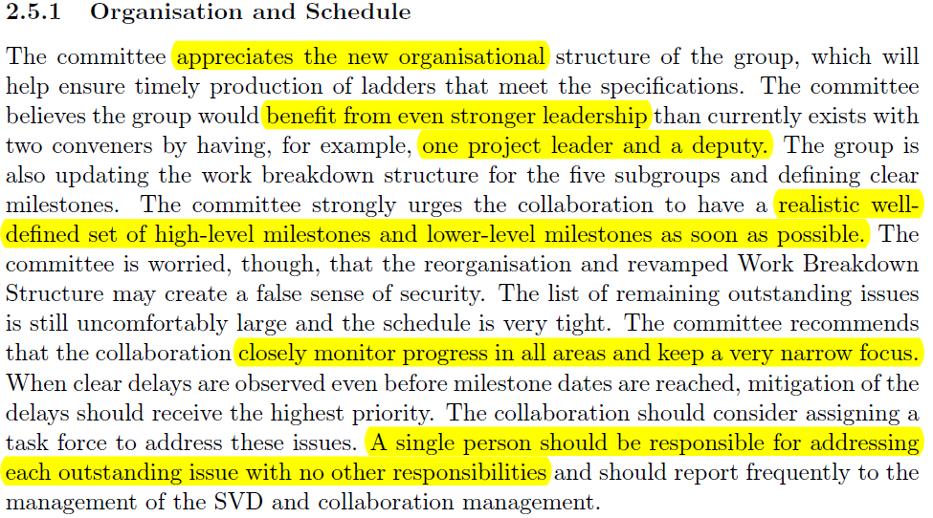
Organization & Schedule
Re-organization of group appreciated, but should go even further → topic @ SVD IB tomorrow
Define set of high-level and lower-level milestones
Closely monitor progress

Slide 10
Reasons of PA issues
Need to review specs of remaining items → on the way
Monitor companies closely
No changes or modification during production
If unavoidable: notify group, verify changes, sing-off of revised specs
Avoid to repeat these problems

Slide 11
Ladder Construction
Requirements are not well defined
Have to discuss within the QCG how we can prepare quantitative requirements
Moreover we need specifications for all components, ladders, etc.

Slide 12
Number of Spares
Only 20% spares → probably not enough
Need to complete inventory to be able to calculate the possible number of spare components we can build.
E.g. there are still HPK sensors in the database with unknown location.

Slide 13
Forward / Backward Modules
Good news: Module production in good shape
Pisa group shall take over an active role, also in preparation for ladder production
Recent commitment: Filippo will contribute to design ladder mount procedure → method to attach ladders from top

Slide 14
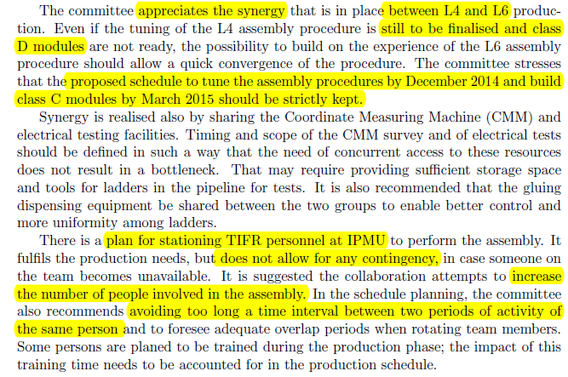
Layer 4
Main concerns: Schedule to build class C, manpower and travel plan of TIFR personal → more overlap, avoid long absence from assembly

Slide 15
Layer 5
HEPHY people are aware of this
Discussion HEPHY internal and with SVD IB ongoing
Strongly related to SVD group organization → SVD IB

Slide 16
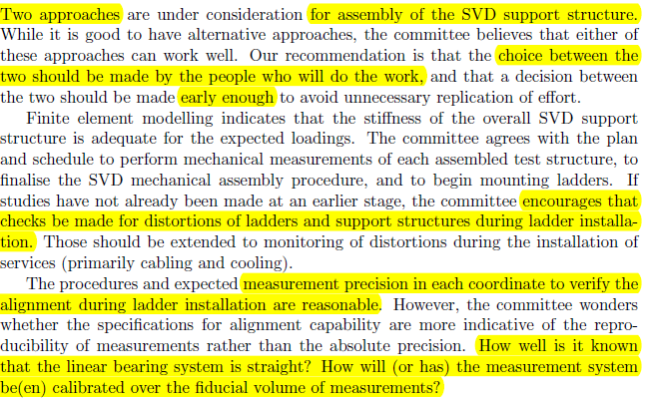
Alignment and SVD Support
Focus on one method to assemble SVD structure and mount ladders → people actually doing the work should decide
Measurement during ladder mount well considered, but how do we calibrate the tool?

Slide 17
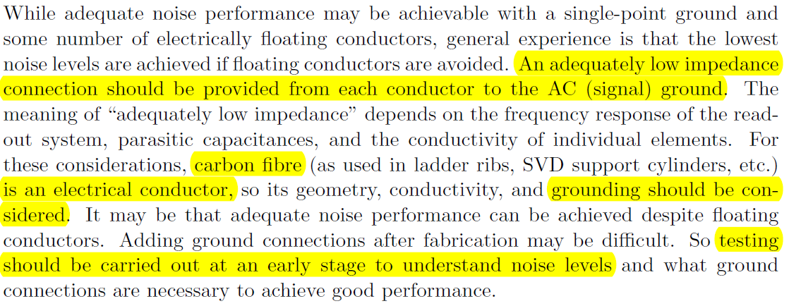
Electronics and Grounding (1)
Adequate ground connection of all electrical conductors
Carbon fiber should be considered as conductor
Testing at early stage to understand noise levels

Slide 18
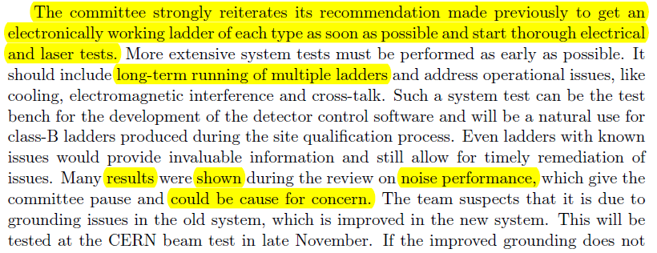
Electronics and Grounding (2)
Committee is concerned about noise
Strong recommendation to build electrically working ladder as soon as possible and perform intensive tests on it.
Even though the ladder has some known issues (e.g. dead chips)

Slide 19
Thermal Management (1)
Results from thermal mockup-up might come too late
Carry out FEA studies and test for critical issues
Perform thermal mockup tests as early as possible

Slide 20
Thermal Management (2)
How to achieve homogeneous airflow in (warm/cold) dry volume?
VXD group is encouraged to prepare inventory of interlock and powering behavior
Define complete set of failure scenarios

Slide 21
Summary
Final report of SVD review released recently
Long list of concerns and recommendations
Main recommendations:
Improve SVD group leadership
Separate construction tasks from management
Build electrically working ladder as soon as possible
Detailed investigation of noise behavior
Thermal mockup will be late → perform FEA and additional thermal tests on critical items asap

Slide 22
Thank You!

