Slide 1
PA and Origami Status and Plan
Koji Hara (KEK)
Jan. 21, 2015
7th Belle II VXD Workshop and 18th International Workshop on DEPFET Detectors and Applications

Slide 2
PA0 and Origami
PA0 problems
Cracks
Shorts between pads
Design to keep
bonding pad length
Available size of the bias hole
Shrinkage (likely by heat)
0.1-0.2%
Not uniform??
Origami status
Produced at Taiyo
Preserved as sheets before cutting and electrical test
Need to confirm Origami+z prebending method (performed by SVD group)
Any modification necessary from the previous method?
Electrical test of PA0
4 probe measurement possible for PA0 alone and PA0 glued on Origami
Test condition to suppress probe traces
Practice whole procedure
PA0 from Taiyo → Electrical test @ Daiei → PA0 + Origami gluing @ Taiyo
→ Electrical test @ Daiei → assembly@REPIC → test by APVDAQ@KEK

Slide 3
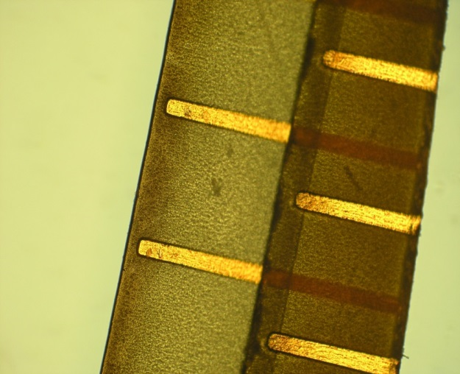
Crack
Long straight design
Acrylic glue
Laser cutting
Shorts
Carbonized glue under the top base by laser cut touches the metal line
New design
covered by coverlay on the bottom layer
Still
36KΩ!

Slide 4
PA0 latest Design by Taiyo
Released for review by SVD group on Jan. 19
Followed our request on the pad lengths and bias hole positions
dxf files on PATaskForce twiki page

Slide 5
Discussion item: Shrinkage of PA0 length
Measurement of length between alignment marks on PA0
Design : 124.3 mm
At HEPHY
Assembled by REPIC : 124.07 – 124.17 mm
At IPMU
Mockup (full process but no reflow soldering) : ~124.22-25 mm
Assembled by REPIC : ~124.12-17 mm
Must understand the shrinkage
Need to change the process?
Non-uniform shrinkage ?
“No problem” by HEPHY reflow (Vapor Phase)
No or uniform shrink?
Corresponding to the typical thermal shrink rate of polyimide
～0.1 % @ 200 ℃
Seems more or less inevitable

Slide 6
Heating in Origami+PA0 production
Procedure
1. Gluing of PA0 coverlays and 2 layers by heat pressing at Taiyo
2. Glue PA0 and Origami by heat pressing at Taiyo
3. Reflow soldering of Origami at REPIC
Q) Is it possible to do 1 → 3 → 2 ?
A) No. Heat pressing becomes impossible after mounting parts on Origami. (Taiyo)
Heat pressing at Taiyo
Gluing of coverlays, top + bottom, PA0 + Origami
160 degrees, 40 minutes, 45-50kg/cm²
Reflow soldering at REPIC (Saiden Device)
220-225 degrees (maximum temp.), 4 minutes

Slide 7
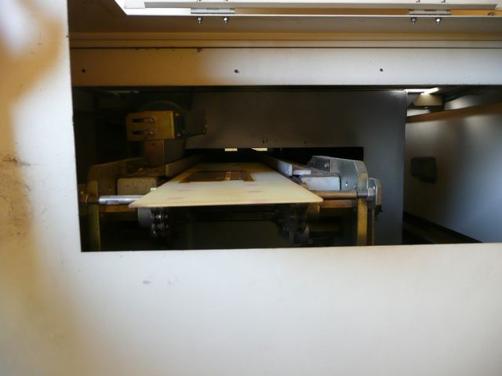
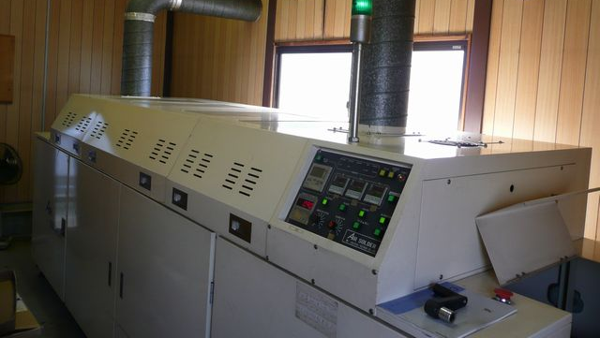
Reflow at REPIC (Saiden Device)
Origami fixed on G-10 board with Kapton tapes
Board carried by conveyor
Send to oven
3 heat cavities set to
160 degrees (for preheat)
160 degrees (for heating up)
220-225 degrees (for soldering)
Temperature monitored by sensors inside
Length : about 3m
Speed 3m/4min.
～3m

Slide 8
Electrical Test
Verified possibility to test PA0 alone and PA0 after glued on Origami
4 probe resistance measurement
With “soft landing” probe
Probe traces and scratches found → need to be solved
Visited the company again and discussed, tested PA0 pieces together on Dec. 19
Scratches not observed on Tokai Denshi PA
Tested as a sheet → seems to be better and uniform vacuum chucking
Different machine (No. 2 and No. 4)
Some areas have clear traces, some areas do not
Not depending on where the PA0 placed on the stage
→ Dependence on the machine or the probe?
Probe speed can be changed
Improvement seen by reducing the probe speed
Testing PA0 test with different speeds
Machine to be used for the final test condition
Isolation >100MΩ@10V, connectivity < 100Ω

Slide 9
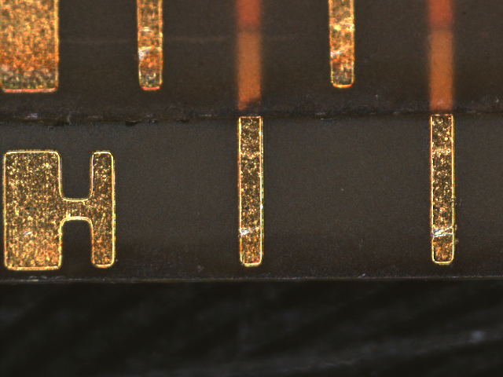
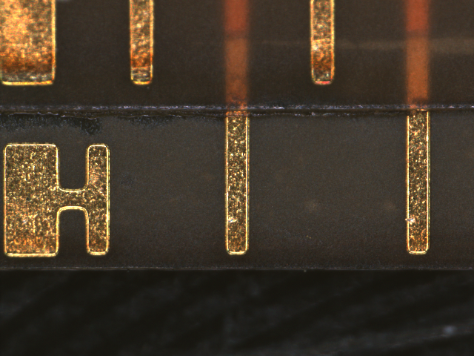
Probe speed 30%
Speed 10%
Testing more slower speed
with the same machine used for Tokai Denshi PA test
recording the S/N and use count of the probes
Down to speed setting of 3～5%
Tested PA0 will be returned next week → will be checked by microscope
Still need a few more iteration to reach to the final test condition
PA0 alone and PA0 + Origami
could be a bottle neck, if failed to converge to the good test condition
1-2 months

Slide 10
Origami+PA0 production + assembly (incomplete) schedule
H/C-shape gluing work at REPIC is not yet agreed / decided.
REPIC proposes to do by them before APV gluing/bonding for safety of connectors
Has been done at KEK by Tsuboyama-san and Sasaki-san after delivery from REPIC
Electrical test and Origami +Z bending are not included yet in the schedule
Taiyo
REPIC
 | Taiyo | Saiden | Hayashi Watchworks | Hayashi Watchworks
 | Origam FPC | Reflow soldering | APV gluing + wire bonding | H/C-shape gluing
weeks
1 | Batch0 12 pcs
2
3
4
5 |  | 12 pcs
6
7
8 |  |  | 12 pcs | 12 pcs
9
10
1 | Reproduction 141 pcs
2
3
4
5 |  | Batch1 47 pcs
6
7 |  |  | 47 pcs | 47 pcs
8
9 |  | Batch2 47 pcs
10
11 |  |  | 47 pcs | 47 pcs
12
13 |  | Batch3 47 pcs
14
15 |  |  | 47 pcs | 47pcs
16
17
18
batch0
-z 6
ce 4
+z 2
Mass reproduction
1 batch =
-z 16
ce 22
-z 9

Slide 11
Input of Discussion : Taiyo PA0 + Origami Possible Schedule
2015 Jan
PA0 new design evaluation 1-2 weeks
PA0 test production 2 weeks
Evaluation of PA0 sample 2 weeks
Crack-free
no shorts
Bonding pad lengths, bias hole effective size
Stress test
Sign-off the final specification of PA0 + Origami reproduction 1-2 weeks
accompanied by
Electrical test condition with minimum probe traces
Origami +z bending method
H/C-shape gluing specification update
Origami+PA0 batch0 production 3 months
Evaluation of batch0 Origami 1 months
Mass reproduction (3 batches) 3-5 months
2015 Feb
2015 Mar
2015 June
2015 July
2015 Oct-Dec.
Assumed electrical test 2 weeks
contingency of a few weeks

Slide 12
1-layer 3-row PA0
Production drawing prepared by Tokai Denshi for SVD group’s review
Distributed to PA taskforce Jan. 16
Uploaded to PATaskForce twiki page
Planning test production (10 pieces)
1.5 month for production
Payable by KEK budget in 2014 JFY
If delivery before end of Mar.
→ If approval of SVD made by mid of Feb. at latest.
Open issue : how and who glue it on Origami

Slide 13
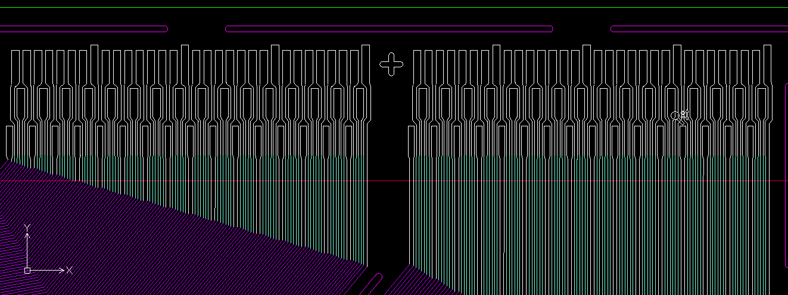

Slide 14
PA flex
Signoff the full specification document by SVD
Fix Pad width minimum limit by SVD measurement
30 µm?
By CMM at IPMU
Bonding on PA glued on Airex + Origami @ IPMU
→ result by Friday?
Must agree with Tokai Denshi on the full specification document translated in Japanese
Now translating
By end of Jan.

Slide 15
Need to be delivered in May to wait for the budget open in the beg. of 2015 fiscal year.
PA delivery schedule
ver. 20150109 by Tokai Denshi
Type | #required | 11-Mar | 17-Mar | 24-Mar | 30-Mar |  | 3-Apr | 7-Apr | 10-Apr | 14-Apr |  | #delivery
PA0 | 10 | 10 |  |  |  |  |  |  |  |  |  | 10
3PF1 | 30 | 10 | 10 |  |  |  |  |  | 10 |  |  | 30
3PF2 | 30 | 10 | 10 |  |  |  |  |  | 10 |  |  | 30
3PB1 | 30 | 10 | 10 |  |  |  |  |  | 10 |  |  | 30
3PB2 | 30 | 10 | 10 |  |  |  |  |  | 10 |  |  | 30
PA1 | 200 |  | 40 | 20 | 20 |  | 20 | 20 | 40 | 40 |  | 200
PA2 | 200 |  | 40 | 20 | 20 |  | 20 | 20 | 40 | 40 |  | 200
PF1 | 100 | 20 |  | 20 | 20 |  | 20 | 20 |  |  |  | 100
PF2 | 100 | 20 |  | 20 | 20 |  | 20 | 20 |  |  |  | 100
PB1 | 100 | 20 |  | 20 | 20 |  | 20 | 20 |  |  |  | 100
PB2 | 100 | 20 |  | 20 | 20 |  | 20 | 20 |  |  |  | 100
 |  |  |  |  |  |  |  |  |  |  |  | 930
Assumed the production start on Feb. 2
Not final in terms of payment and contract
# pieces in batch may change
To wait for budget open in the beginning of JFY
To pay more with 2014 budget
KEK and support from IPMU
Still discussing

Slide 17
PA delivery schedule assuming the start on Jan. 26
Better for budget
Consume maximum in 2014 JFY budget
Making final signoff and agreement with the full document seems not realistic
 |  |  | 2014 |  |  |  |  | 2015
 | 品名 | 要求数量 | 3月11日 | 3月17日 | 3月24日 | 3月30日 |  | 5月11日 |  |  |  |  | 納入数量
 | PA0 | 10 |  |  |  | 10 |  |  |  |  |  |  | 10
 | 3PF1 | 30 |  |  |  |  |  | 30 |  |  |  |  | 30
 | 3PF2 | 30 |  |  |  |  |  | 30 |  |  |  |  | 30
 | 3PB1 | 30 |  |  |  |  |  | 30 |  |  |  |  | 30
 | 3PB2 | 30 |  |  |  |  |  | 30 |  |  |  |  | 30
 | PA1 | 200 | 50 | 50 | 50 | 30 |  | 20 |  |  |  |  | 200
 | PA2 | 200 | 50 | 50 | 50 | 30 |  | 20 |  |  |  |  | 200
 | PF1 | 100 | 30 | 30 | 40 |  |  |  |  |  |  |  | 100
 | PF2 | 100 | 30 | 30 | 40 |  |  |  |  |  |  |  | 100
 | PB1 | 100 | 30 | 30 | 40 |  |  |  |  |  |  |  | 100
 | PB2 | 100 | 30 | 30 | 40 |  |  |  |  |  |  |  | 100
 |  |  |  |  |  |  |  |  |  |  |  |  | 930

