Slide 1
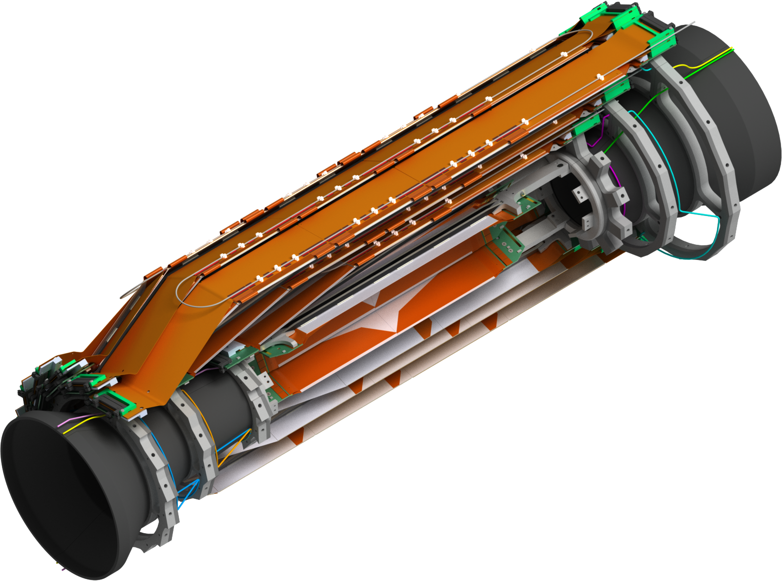
SVD group organization, schedule, milestones
7th Belle II VXD Workshop, Prague

Slide 2
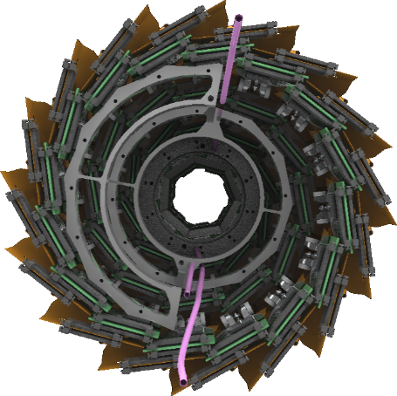
Outline
Group Organization
Schedule & Milestones
Discussion

Slide 3
SVD Group Organization

Slide 4
SVD Sub-Group Coordinators
Sub-group | Coordinator | Deputy | Advisor
Mechanics | Florian Buchsteiner | Markus Friedl | Filippo Bosi
Ladders | Takeo Higuchi | Yoshiyuki Onuki | Giuliana Rizzo
Electronics | Markus Friedl
Monitoring & Interlocks | Lorenzo Vitale
Software | Andrzej Bozek
Commissioning | Katsuro Nakamura
Coordinators are contact persons of their fields
Details about sub-group organization will be shown in SVD sessions

Slide 5
Sub-Group Tasks

Slide 6
Sub-Group Relations
Details to be defined by sub-group coordinators

Slide 7
Outline
Group Organization
Schedule & Milestones
Discussion

Slide 8
Possible new schedule (tbc)
SVD installation shifted by ~ 7 months compared to ‘desirable’ option of Nov. B2GM
Difficult to interpret what Yamauchi-san’s brief notice means, but assume phase 1 starts as “early” as Jan. 2016 (=conceivable budget scenario)
Start of TOP installation += 2mo.

Slide 9
Global SVD Milestones
Ladder mount Jan. 2016 → will slip by ~ 6 month
  How long do we really need to mount ladders
  Depends on
    Method (from top or side)
    Test to be performed after each ladder + after each layer
    Should start discussing this in detail
VXD assembly + commissioning: June 2017?
  After installation of BEAST phase II detector
VXD installation: Feb. – July 2017
SVD ladder production should be completed by May 2017 at latest.

Slide 10
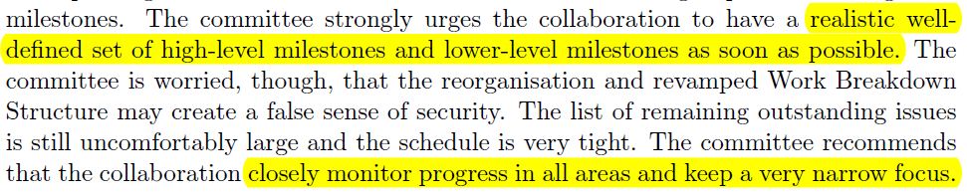
Feedback from BPAC (1)
Define set of high-level and lower-level milestones
Should agree to list of milestones before Feb. BPAC

Slide 11
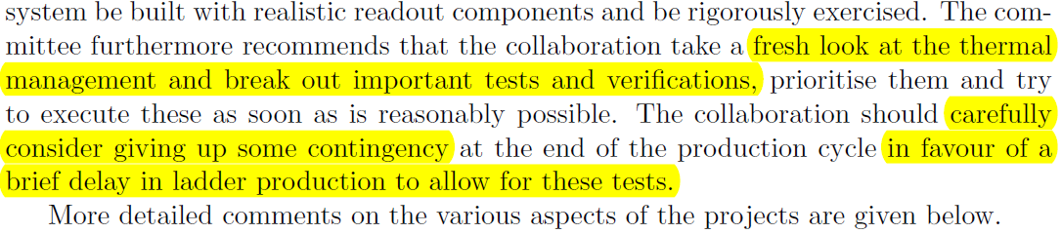
Feedback from BPAC (2)
Consider to give up contingency at the end of production to allow additional tests (thermal and electrical) on ladders!

Slide 12
Milestones Related to Ladder Production
Completion FlexPA specs: end of Jan. 2015
FlexPA production: until end of April 2015
PA0 spec: end of Jan. 2015
PA0 test production
PA0 evaluation
Start of PA0 and Origami production
First class B ladder / module (for FW/BW, L3, L4, L5, L6)
Start of class A production (for FW/BW, L3, L4, L5, L6)
Dates for final site qualifications
Evaluation of class B / A ladders
Shipment of components (from/to KEK)

Slide 13
Other Milestones (1)
Electronics
  Full prototype of FADC V2 system (incl. FPGAs)
  Start / completion of FADC mass production
  Dates for required noise tests
  Dates for Beam tests
  etc.
Mechanics
  Demonstration of ladder mount from top
  Decision on ladder mount procedure
  Completion of open design issues

Slide 14
Other Milestones (2)
Monitoring and Interlock
Software
Commissioning
  BEST 2
  Decision on SVD ladder mount procedure
  Ladder mount start

Slide 15
How to Proceed
Let’s define the Milestones for each sub-group
Extract global major milestones
Define dates for them
Who?
  SVD leaders together with sub-group coordinators.
  Need input from sub-groups.

Slide 16

Thank You!

