Slide 1
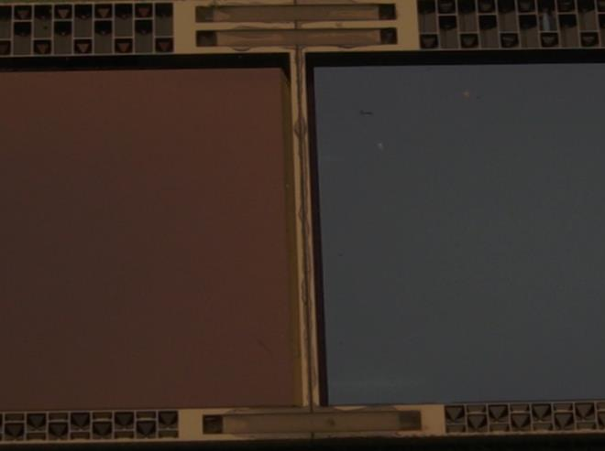
PXD Ladder Assembly
- Conceptual design of jigs -

Slide 2
The Mission
Join two modules to one ladder
Modules:
fully assembled half-ladder
electrically fully functional
Interconnect to rest of world through kapton
fully tested
Ladders:
Ready to be installed in PXD support structure

Slide 3
1st trials 2010
:- thinned silicon dummies, 50 µm “sensitive”
:- fully manual, just to test feasibility

Slide 4
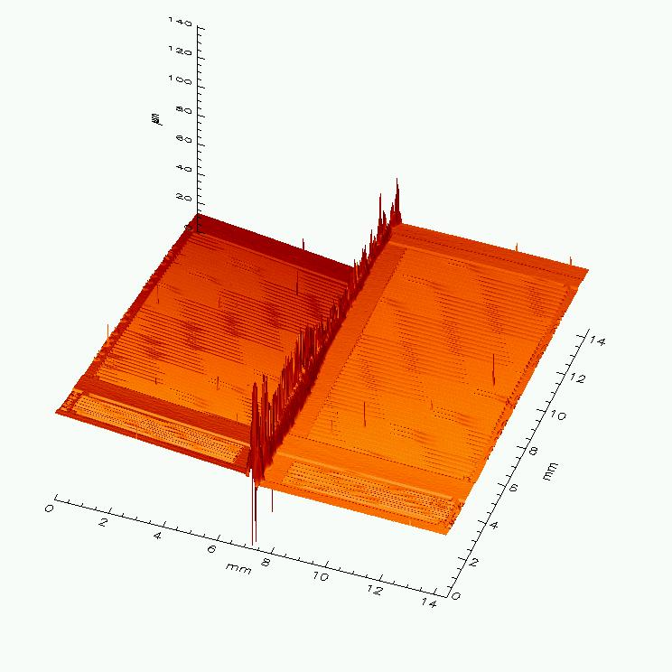
Conclusions then: in principle okay..
:- joint between two modules very stable!
:- alignment and procedure need improvement
:- still, can do it better …
:- but need dedicated jigs for this job!

Slide 5
Requirements
The jigs should allow:
:- safe storage and transport of modules and ladders
:- support for SMD mounting
:- module testing on the probe stations
:- support for kapton attachment (soldering)
:- support for wire bonding
:- support for module testing
:- glue dispensing for butt-joint and for ceramic inserts
:- alignment of two half-modules
:- support during room temperature curing of the joint
After some discussions and meetings at MPP and HLL:
→ Ladder Assembly Sequence
→ Concept of the “Ladder Universal Jig”, drawn by Tscharlie

Slide 6
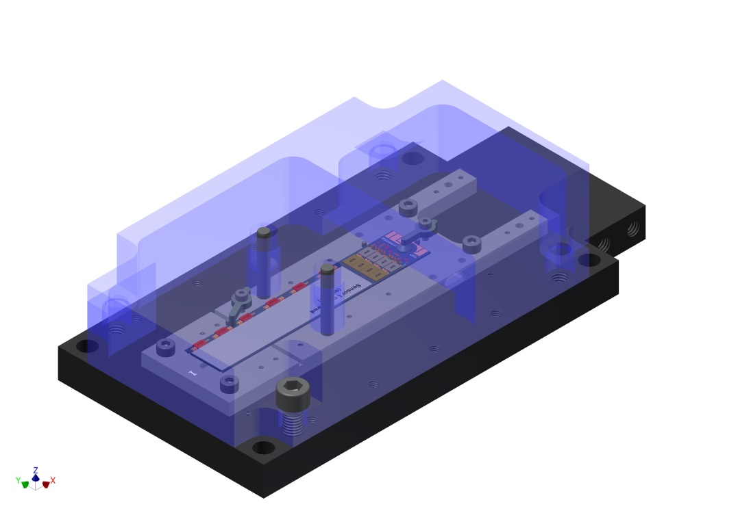
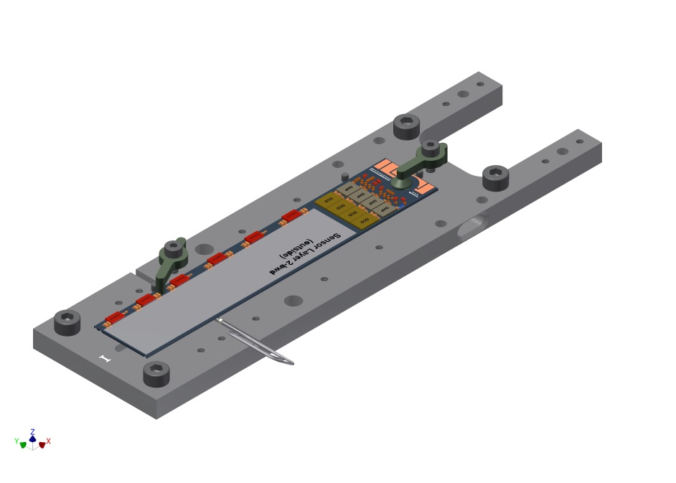
Step 0: preparation
:- Wafers are cut, modules go through final clean at HLL
:- pack modules into 4’ gel-paks, send to IZM for FC
:- FC on Si support jigs (designed and made by IZM)
:- FC and X-ray at IZM
:- in gel-paks back to HLL → inspect, X-ray on sub-sample
:- place into transport jig, label ..
→ From this point, the module stays in the jig!
base module jig
transport base
cover
Base module jig

Slide 7
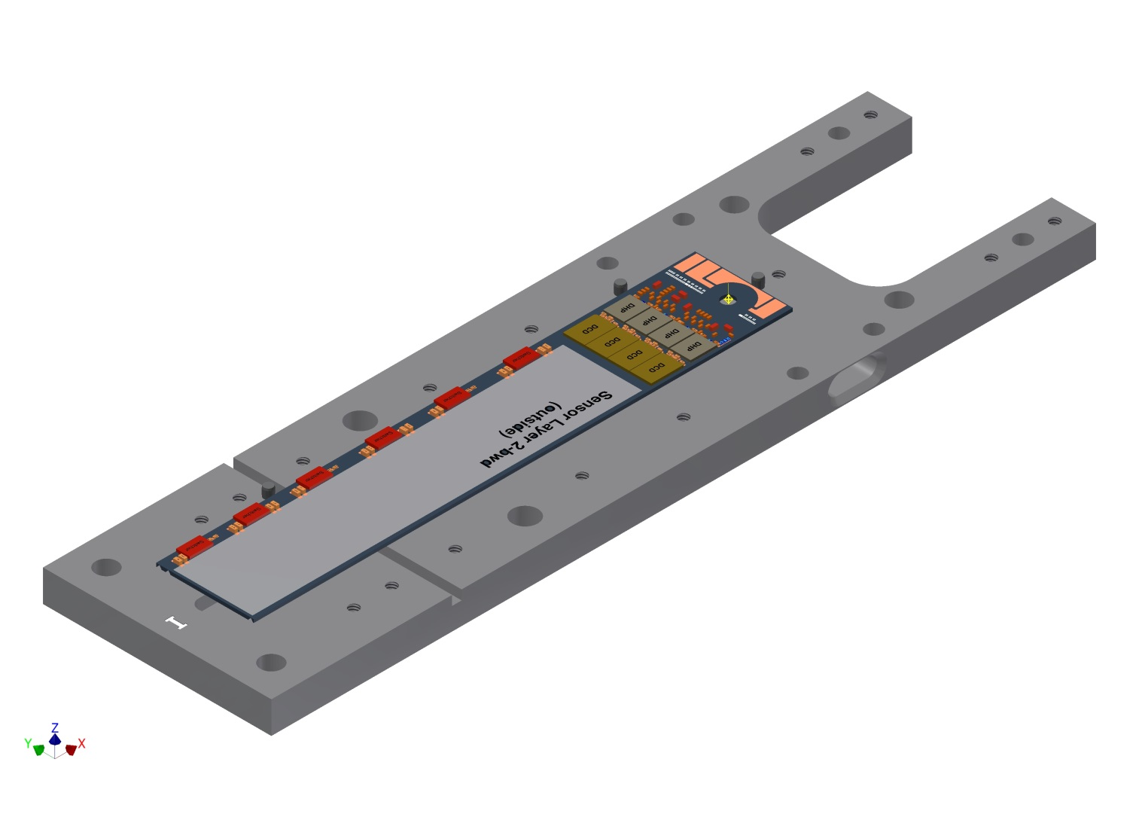
Step 1: SMD
:- modules in transport box shipped to NTC for SMD
:- disassemble, remove base module jig transport box
:- Vacuum channels in base module jig fit to vacuum channels at NTC equip.

Slide 8
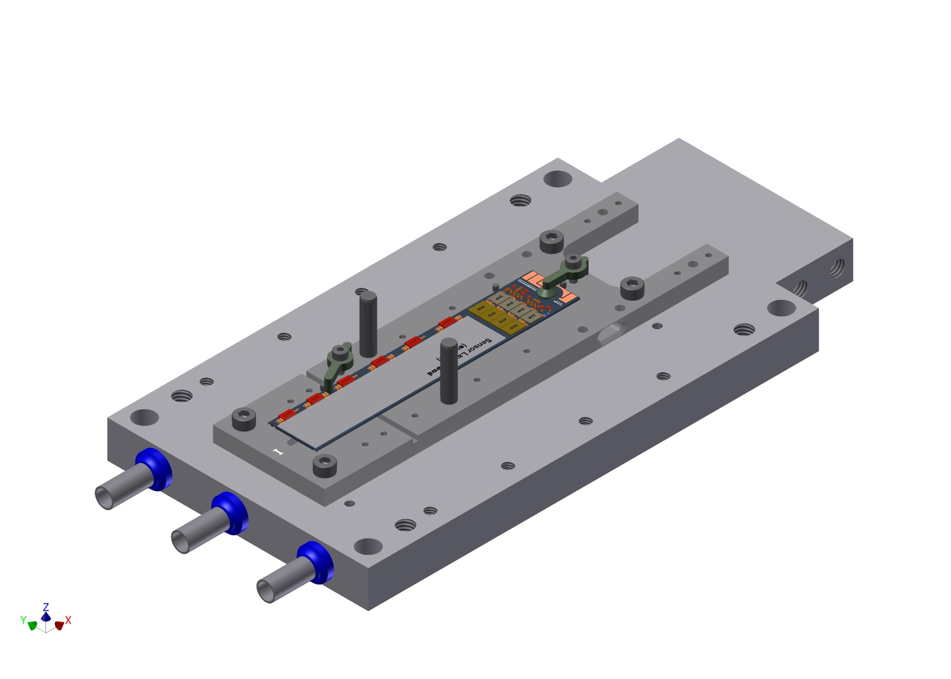
Step 2: Probe station
:- cooling plate
:- optional cooling during test, sensor held by vacuum
:- cover over sens. area

Slide 9
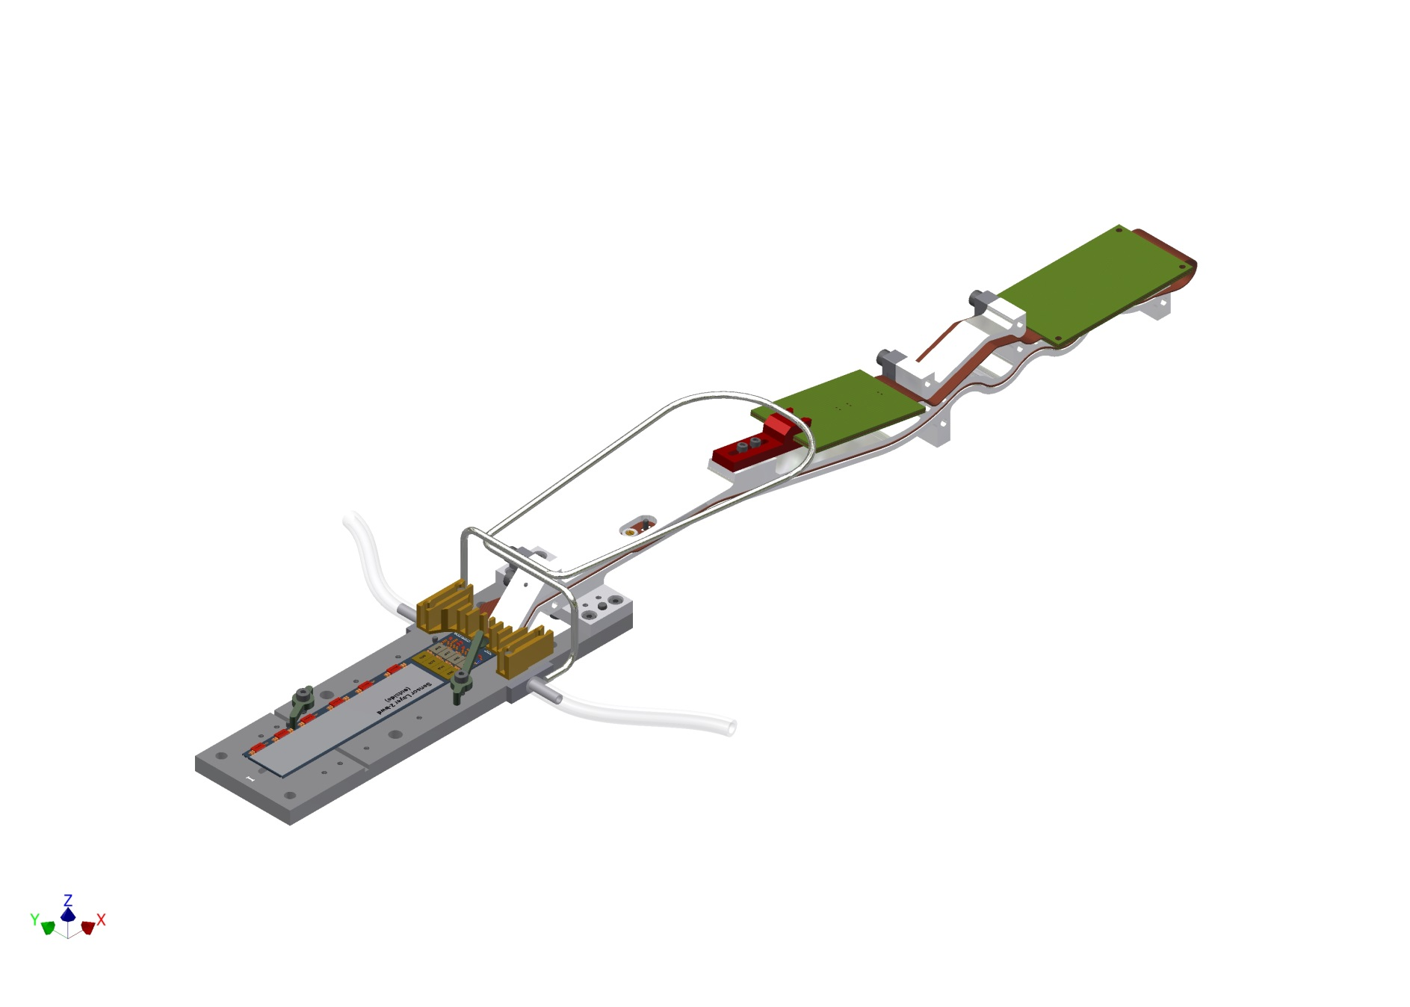
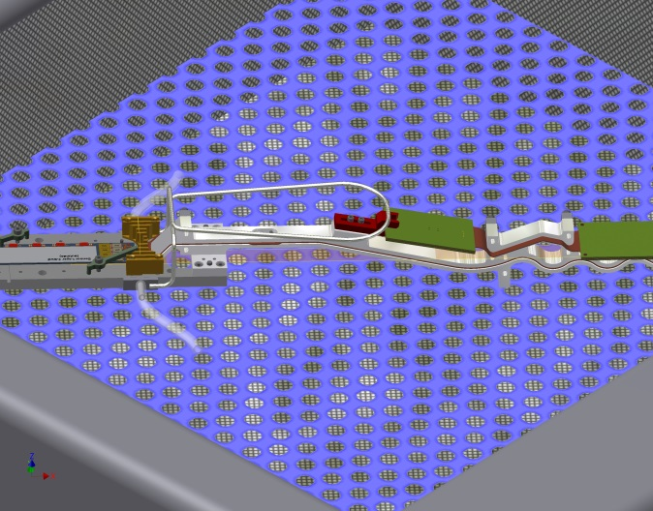
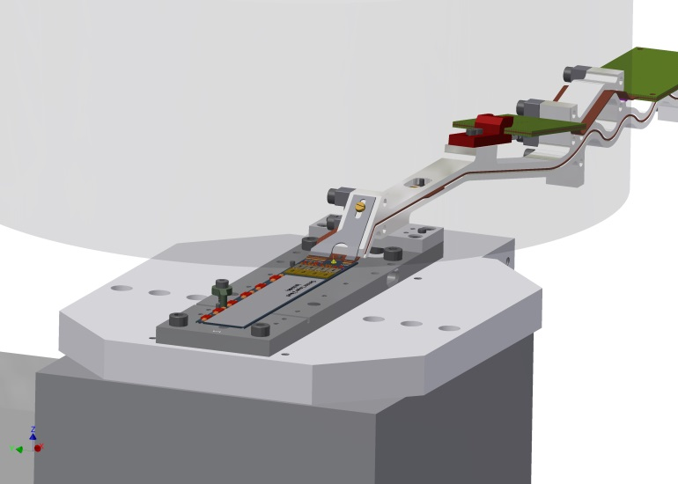
Step 3: Kapton attachment
:- attach light weight kapton jig to base module jig
:- all necessary features for kapton vapour phase soldering and wire bonding

Slide 10
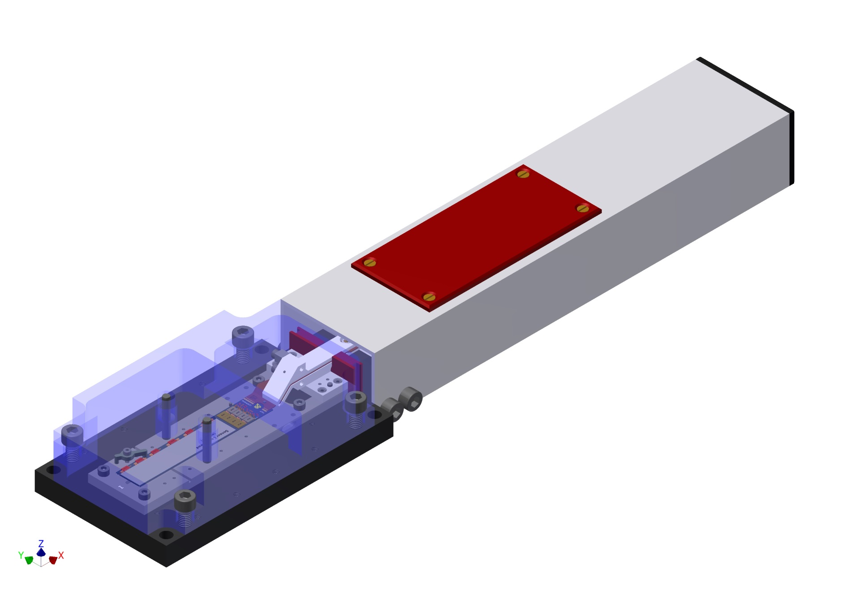
Step 4: testing and storage

Slide 11
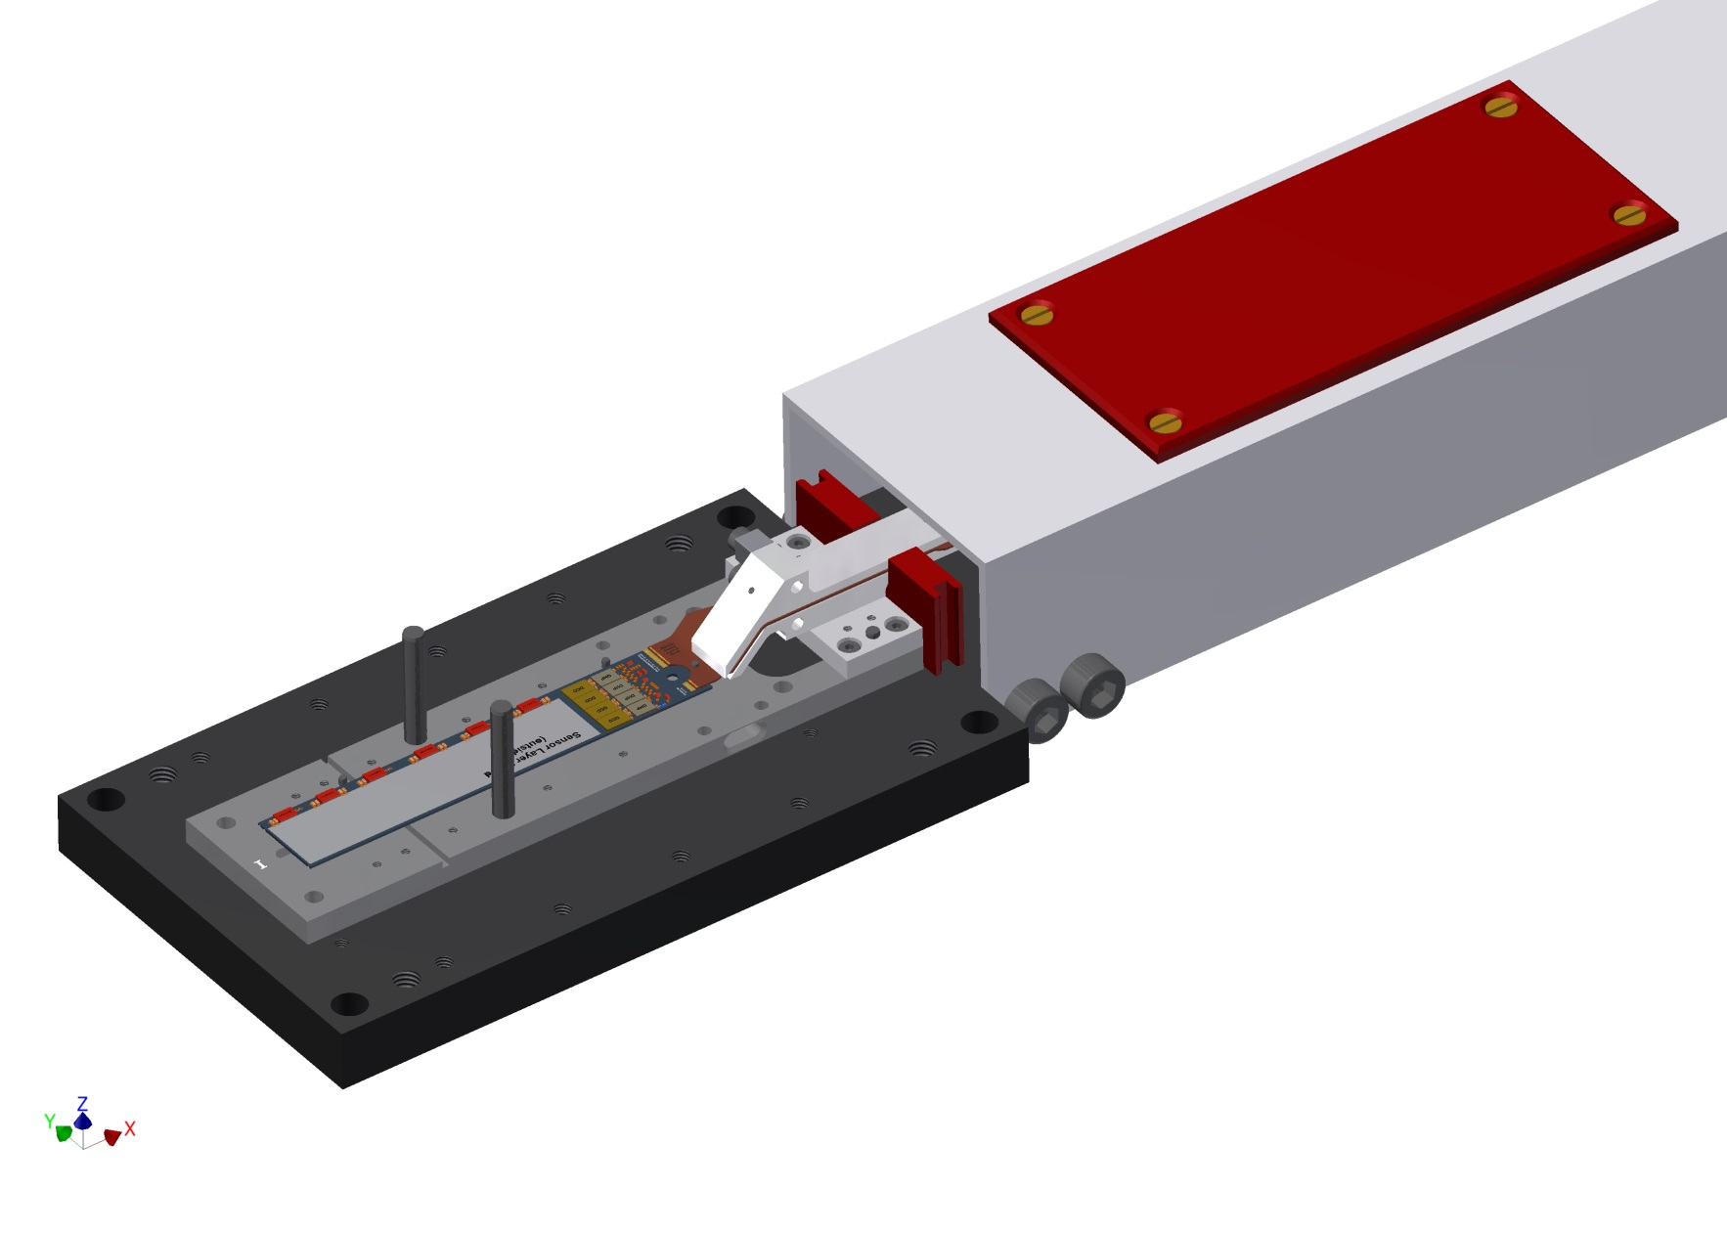
Step 5: the tricky part – turn it around..

Slide 12
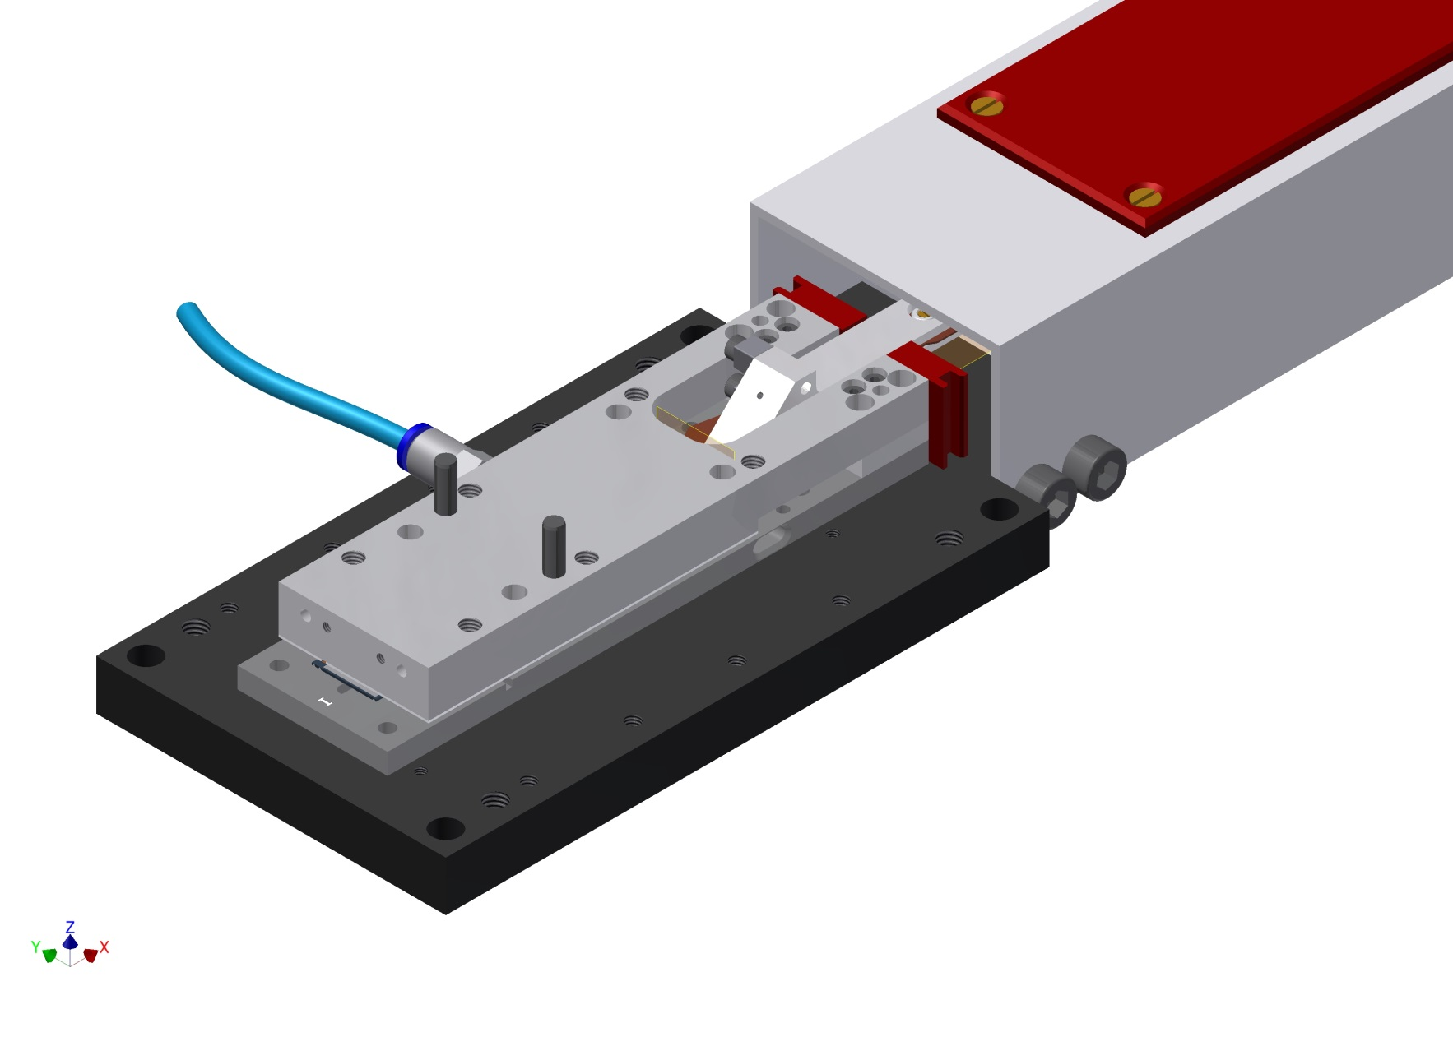
Step 5: the tricky part – turn it around..

Slide 13
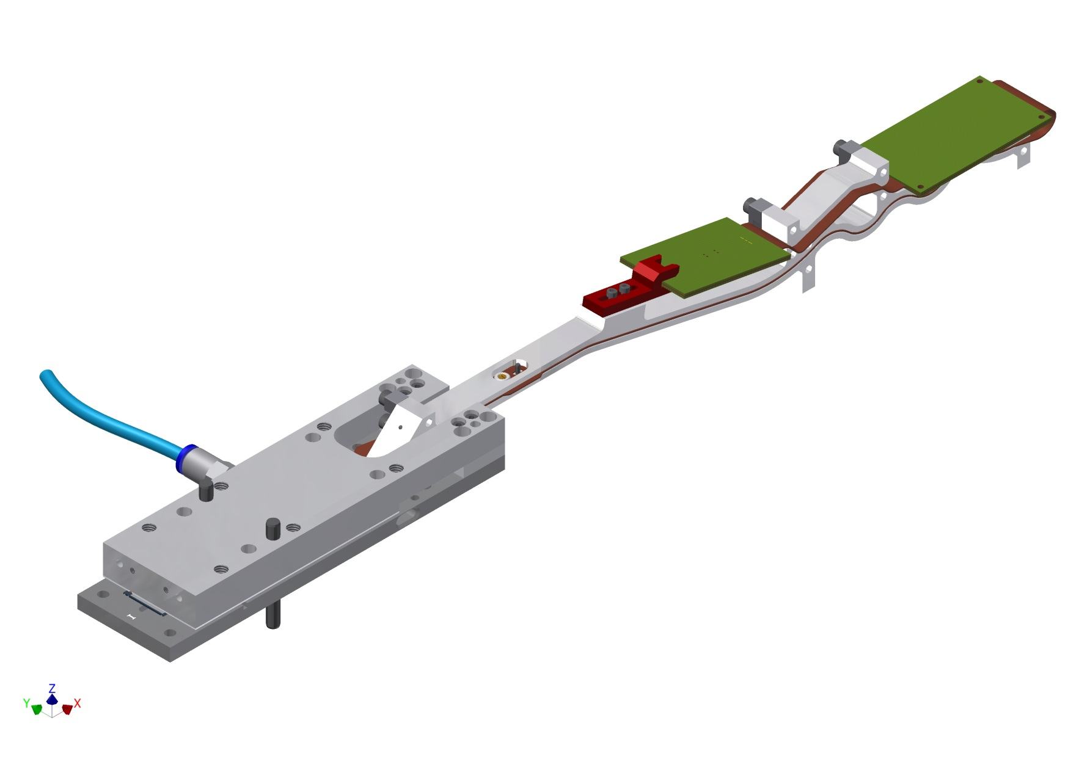
Step 5: the tricky part – turn it around..

Slide 14
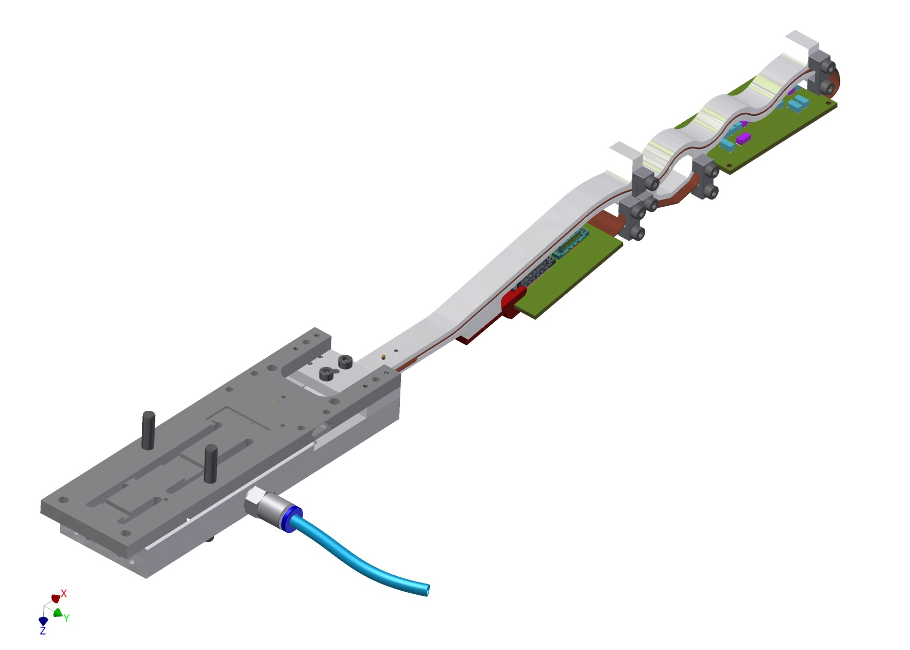
Step 5: the tricky part – turn it around..

Slide 15
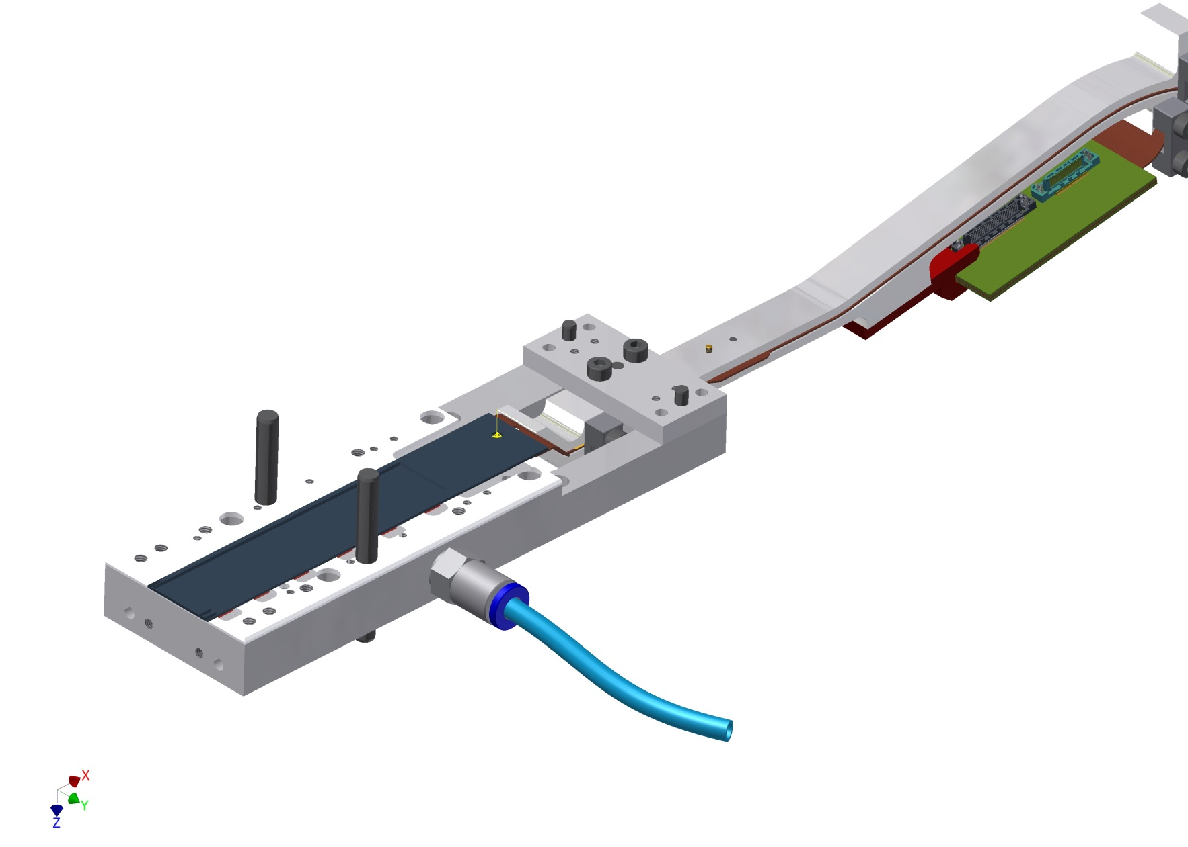
Step 5: the tricky part – turn it around..

Slide 16
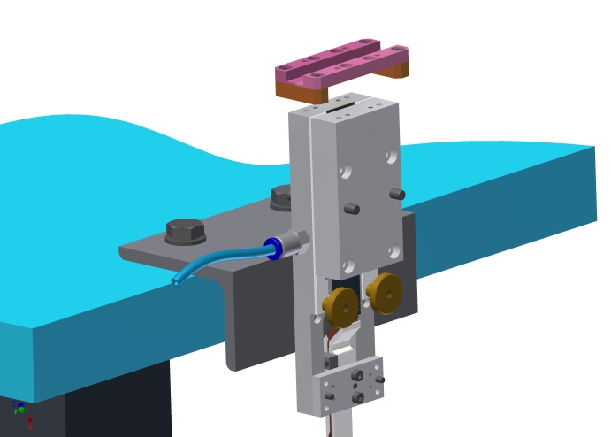
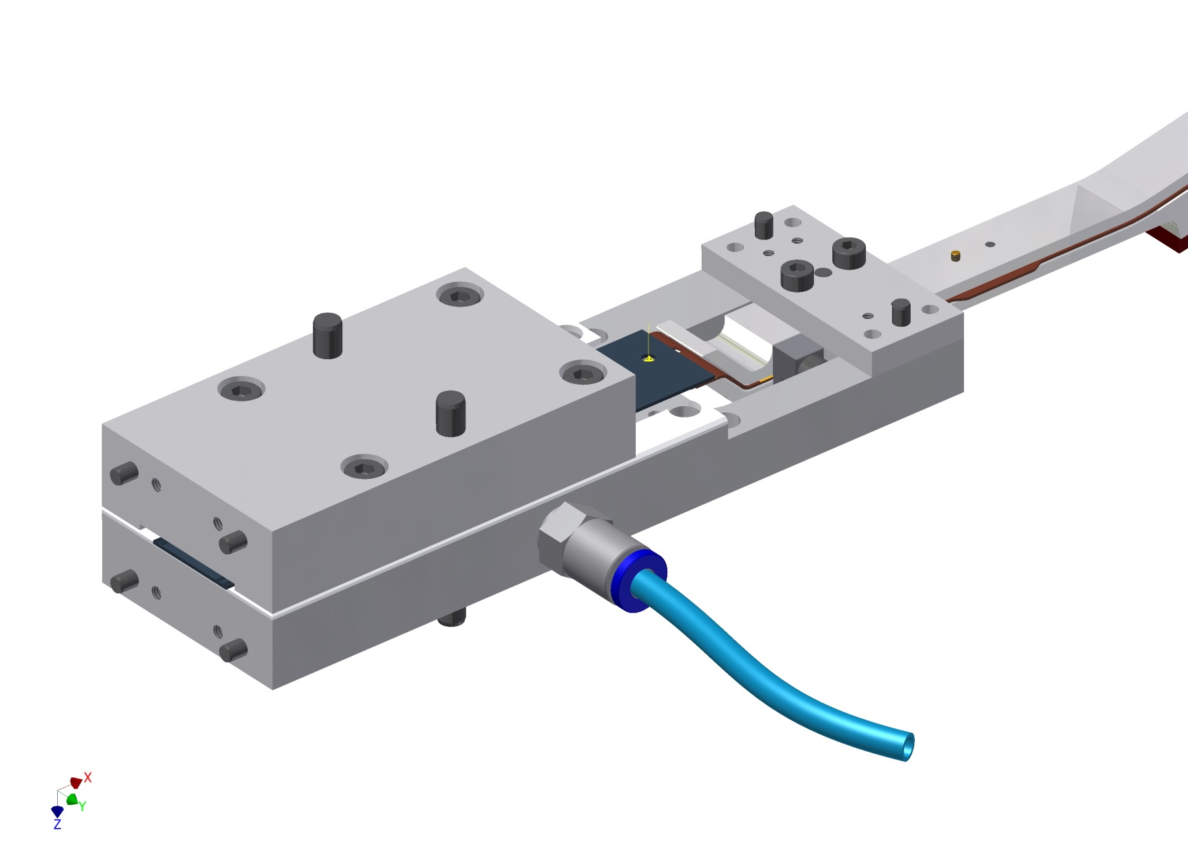
Step 6: screen printing of the adhesive – opt. 1

Slide 17
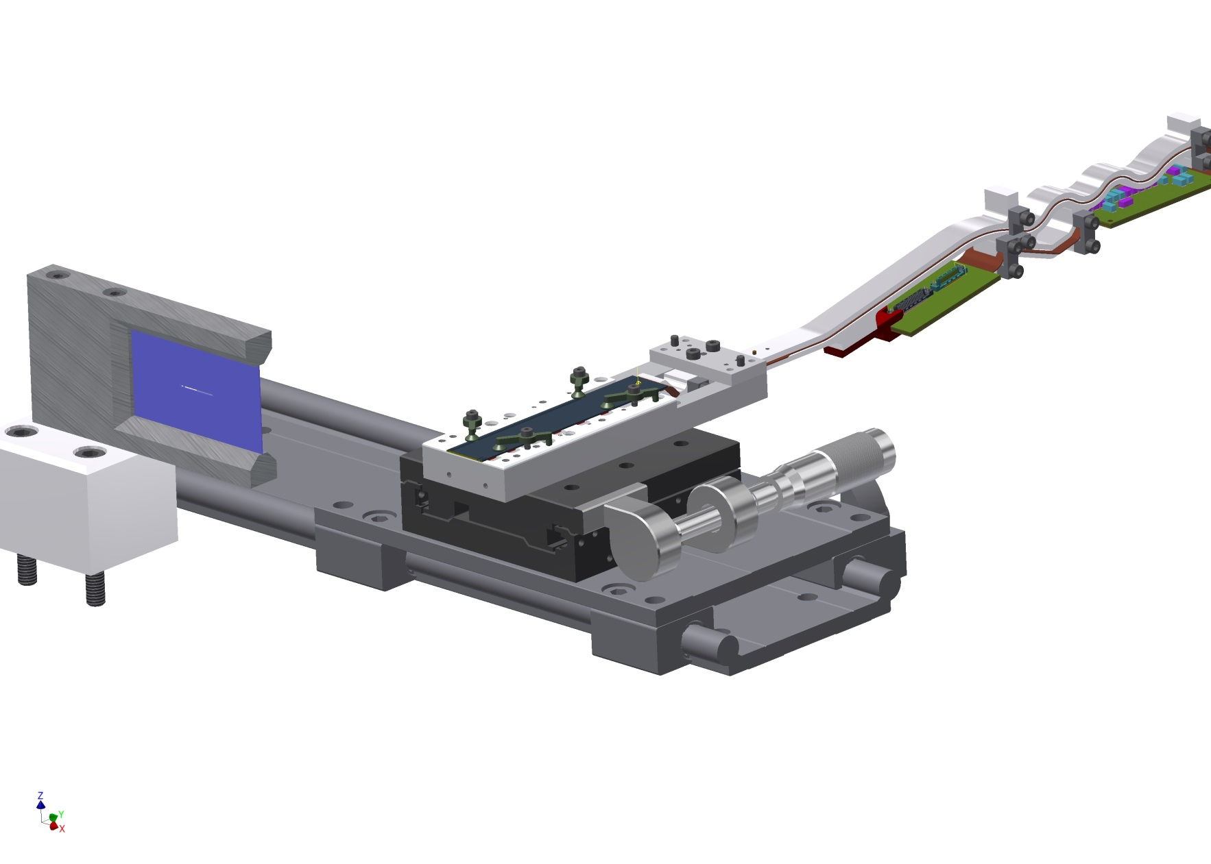
Step 6: screen printing of the adhesive – opt. 2

Slide 18
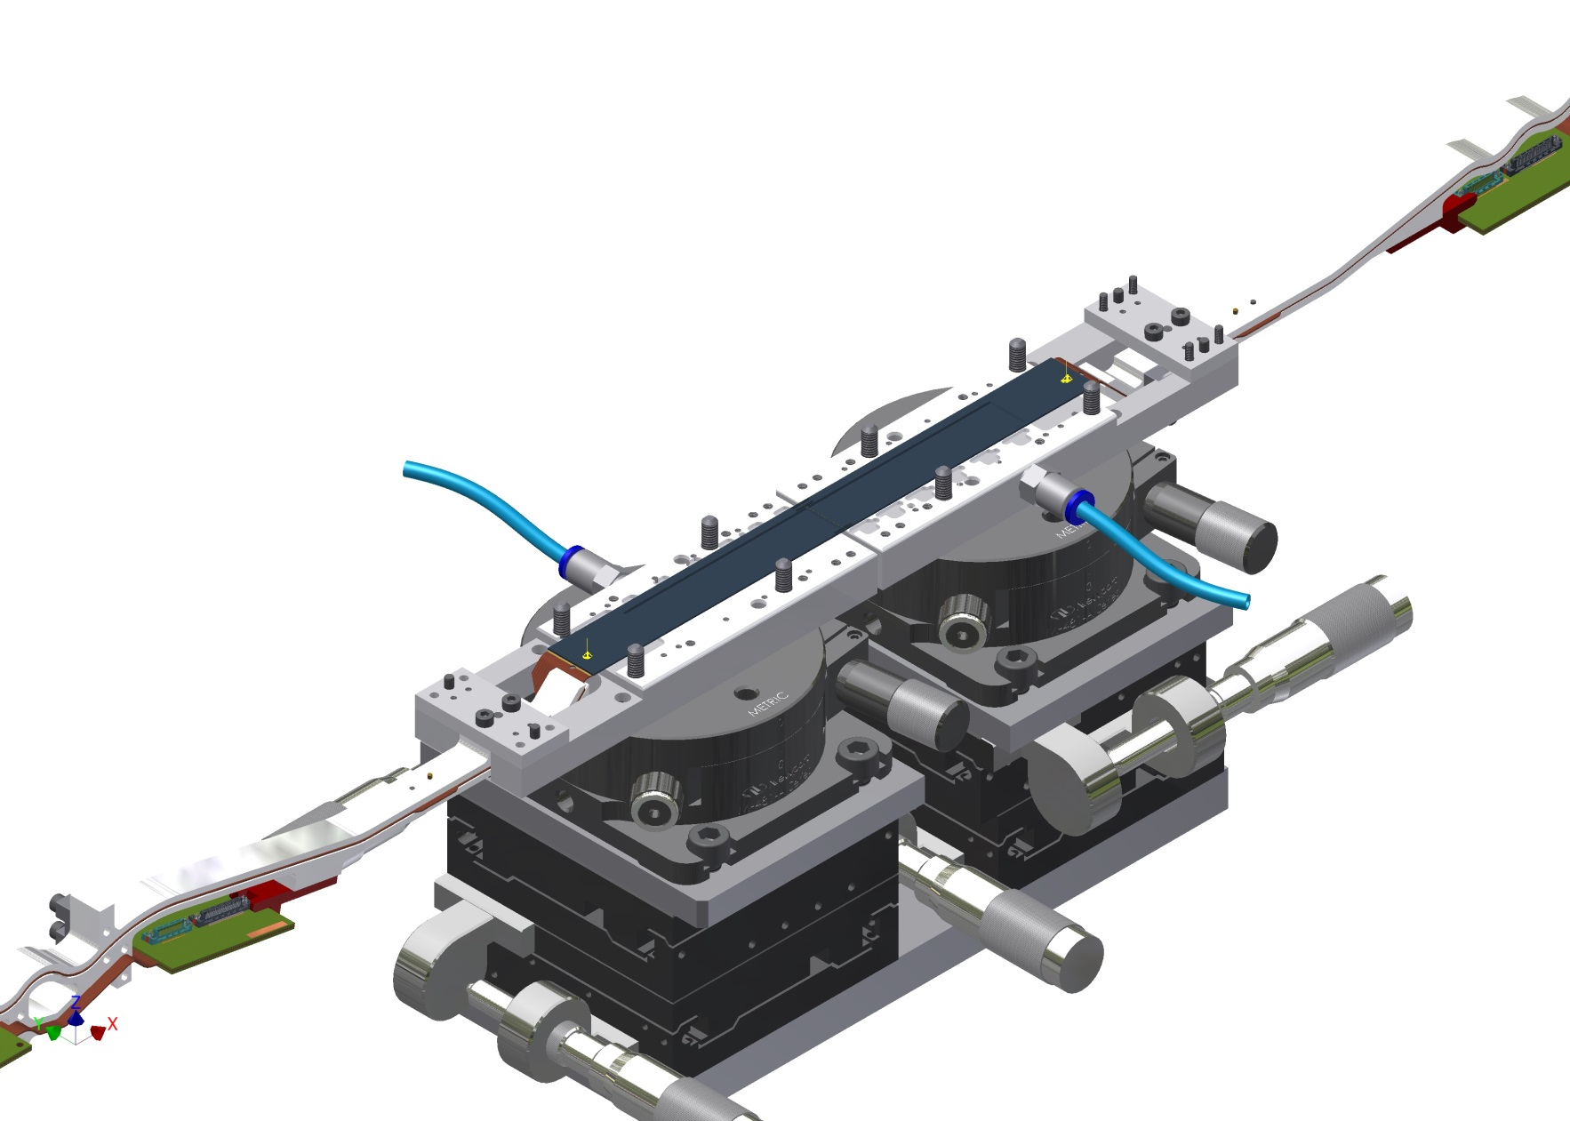
Step 7: alignment and gluing

Slide 19
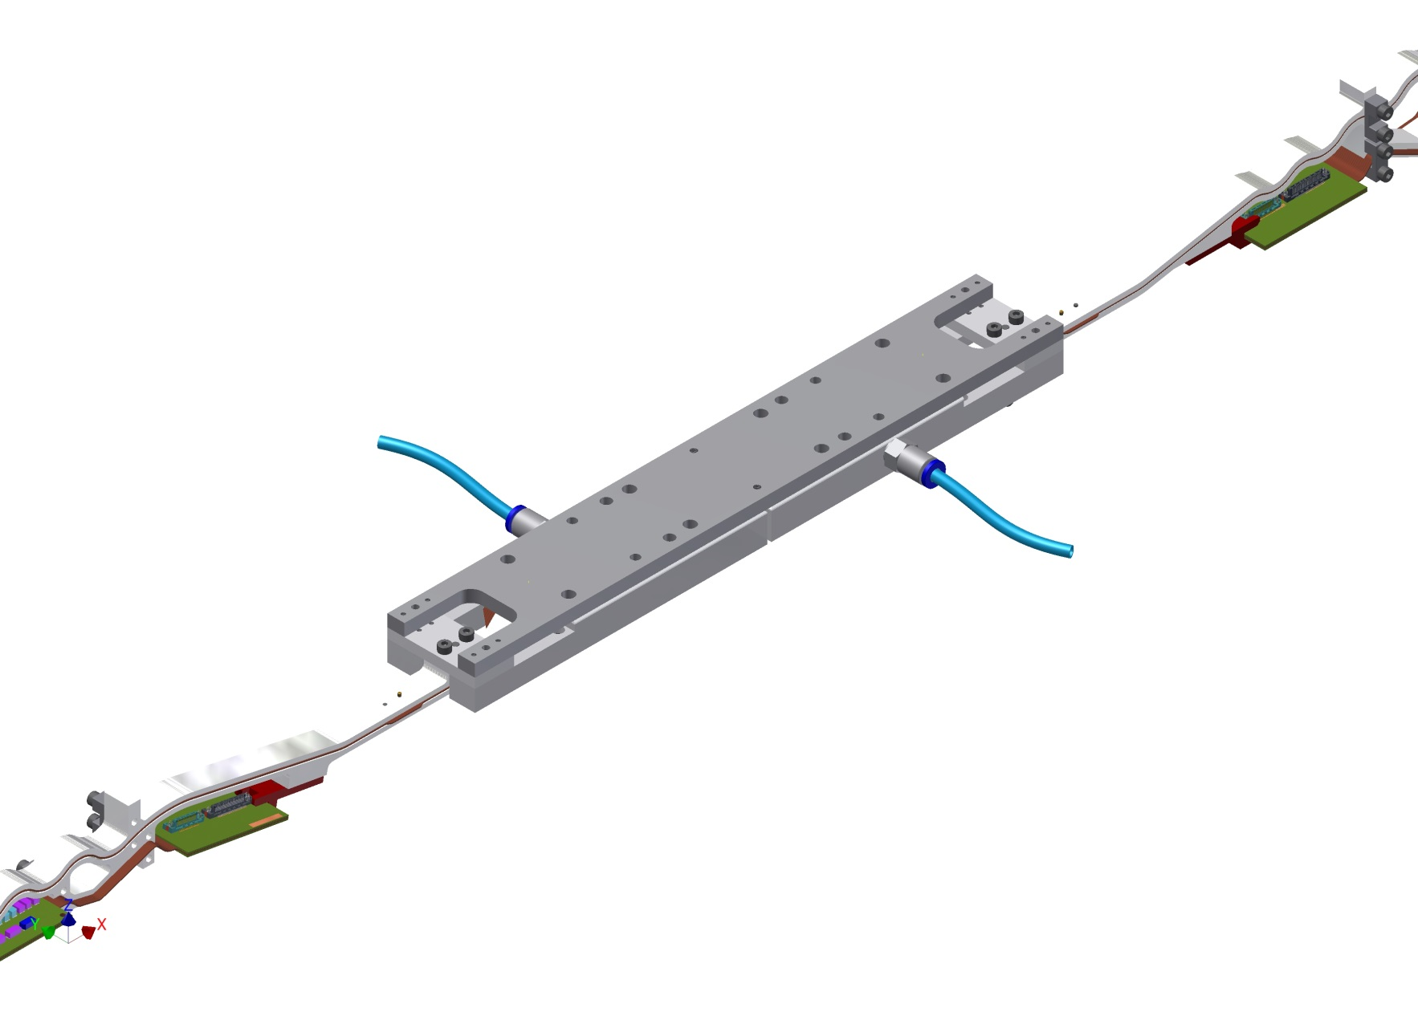
Step 8: turn back

Slide 20
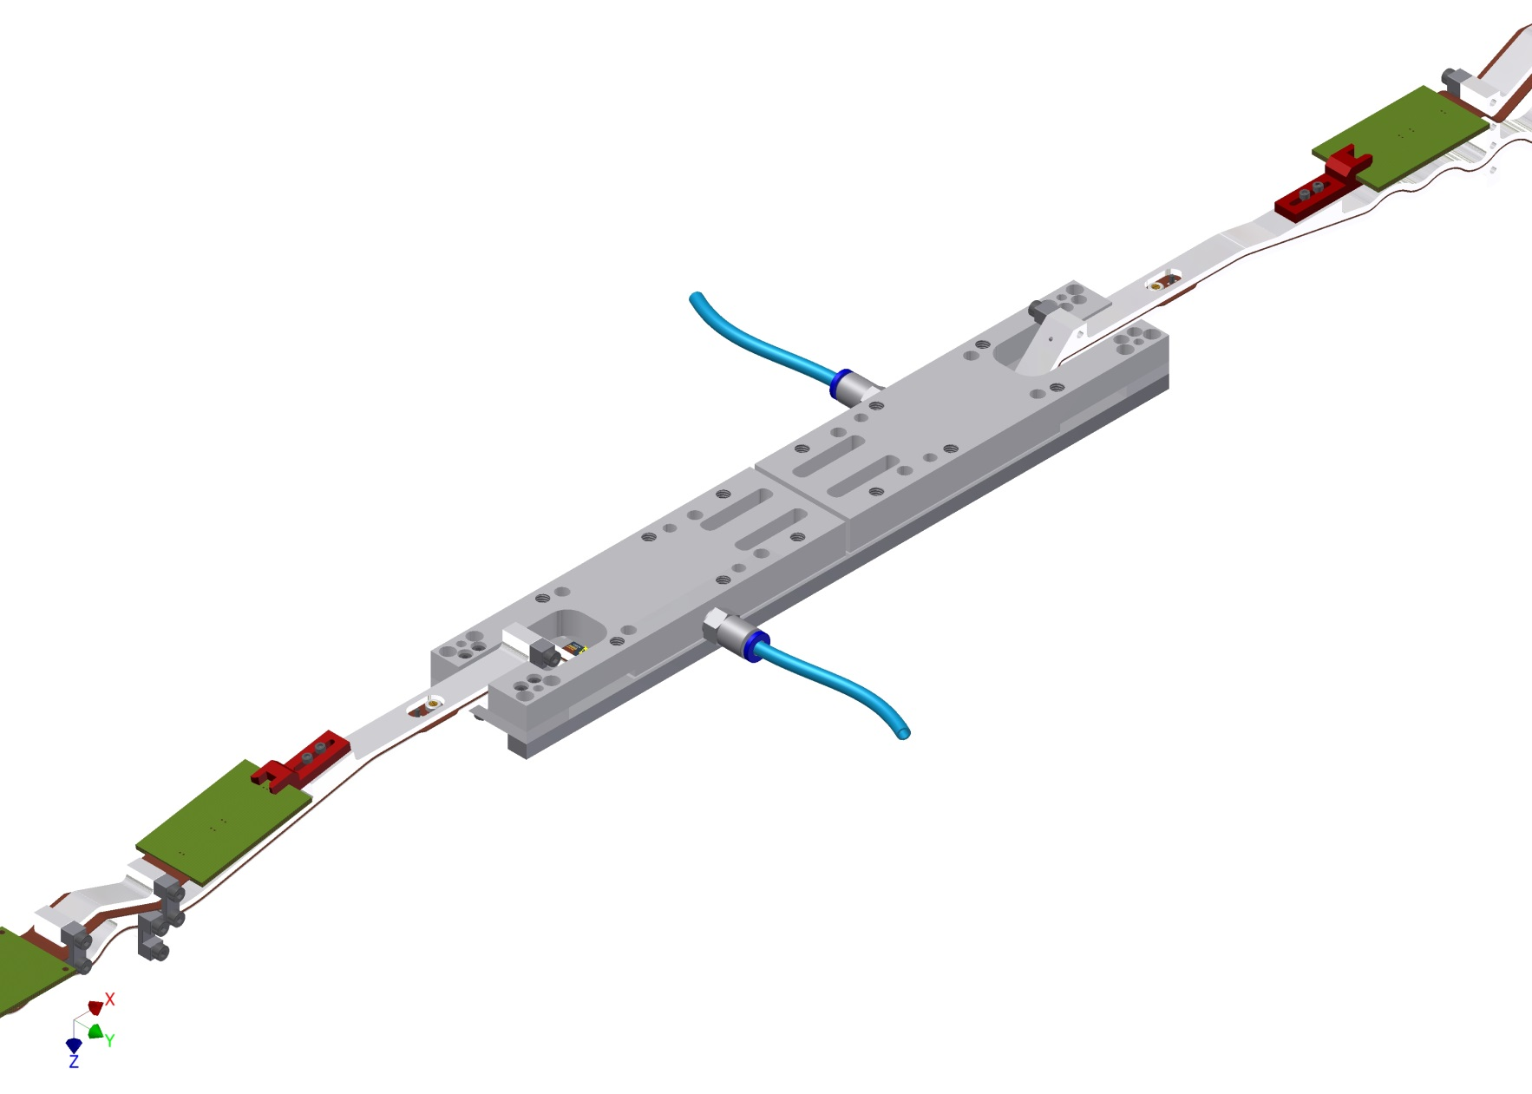
Step 8: turn back

Slide 21
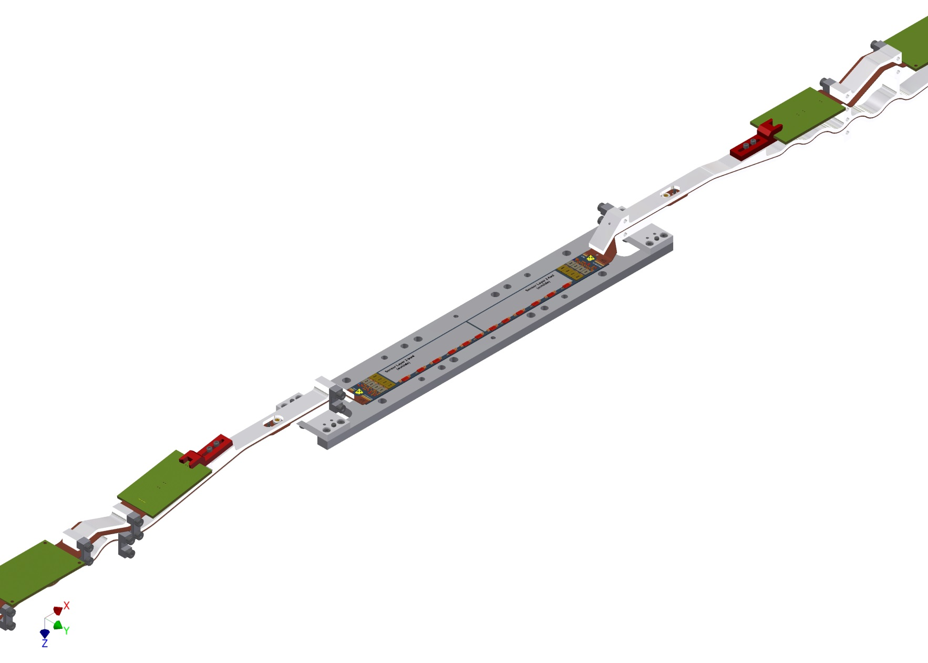
Step 8: turn back

Slide 22
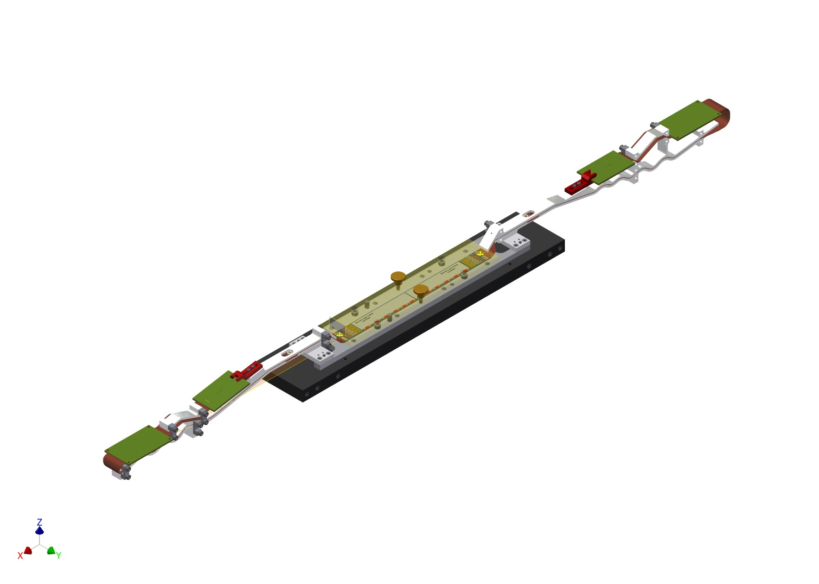
Step 9: test

Slide 23
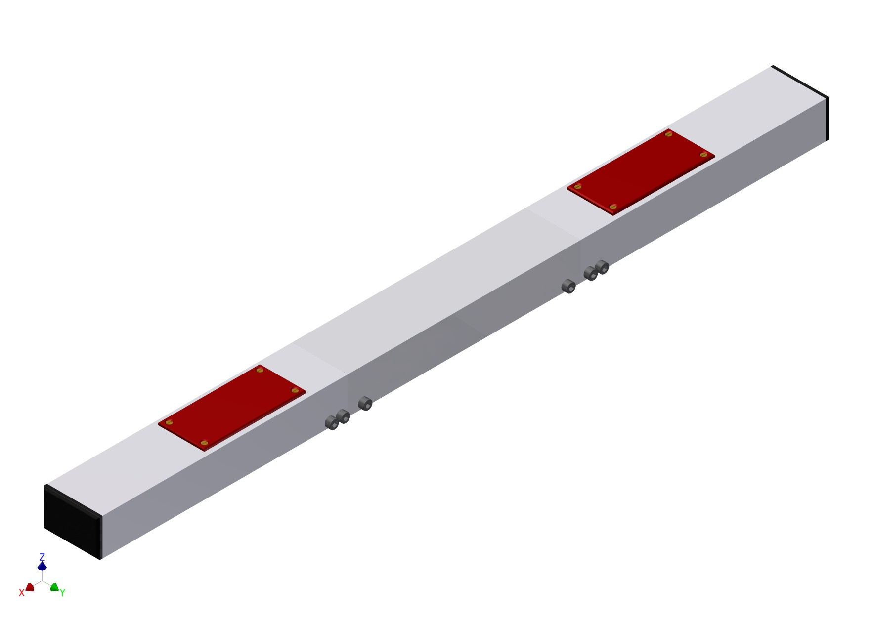
Step 10: pack and store

Slide 24
In Summary
:- please allow me not to summarize … puuuuuu
:- this is a concept, a very elaborated one, but still a concept
:- we have start with prototypes, practice (screen printing, handling ..), and optimize

