Slide 1
DEPFET
Internal amplification vs Oxide thickness
Simulation Study
Rainer Richter
for the MPG Halbleiterlabor

Slide 2
Motivated by the nice results of Florian Krasser and Stefan Rummel
If reality is behaving better than theory …

Slide 3
Classical MOS-Transistor
Scaling of all dimensions
Transistor performance benefits from thinner gate oxides
- larger gm
- and less pronounced short channel effect
Why is the internal amplification of a DEPFET behaving differently?
gq ~ tox^{1/2} (Id = const.)

Slide 4
Classical MOS FET - Saturation (Basics)
Vgate
Vsource
I = q/t
Either by many slow moving
charge carriers
or by fewer fast moving carriers
carrier velocity
v = µ E
until velocity saturation
~10⁷cm/s (in silicon)
is reached
Vdrain
Vpinchoff = V‘drain = Vgs – Vth
For Vdrain > Vpinchoff
- > saturation
Id $=k \frac{W}{L} ∗\left( Vgs −Vth\right)2$
Why is it quadratic?
- increased Vgs influences more channel carriers ΔQ = Cox ΔVgs (linear)
- V‘drain is ‘pulled‘ capacitively by Vgs ideal transistor theory: ΔV‘drain = ΔVgs
provides more field

Slide 5
By the way …
Why has a DEPFET a nice linear response
to the charge at the internal gate?
If external gate and internal gate are acting in the same way ….

Slide 6
By the way …
Why has a DEPFET a nice linear response
to the charge at the internal gate?
If external gate and internal gate are acting in the same way ….
Vgate
Vsource
Vdrain
Internal Gate V‘drain
Geometrical reason: The internal Gate is far away from the pinch off point
and has much less capacitve coupling to it than the external Gate
internal Gate is just influencing channel carriers (linear)

Slide 7
Back to the topic
Vgate
Vsource
Vdrain
Internal Gate V‘drain
smaller tox -> larger Cox -> less ΔVgs is required
to influence charge carriers in the channel
less ΔVgs -> less ΔV‘drain (lower field) -> lower carrier velocity
Signal charge (internal Gate) influence the same amount of mirror charge
in the channel but channel charge is moving slower -> less signal (Ramo, Shockley)

Slide 8
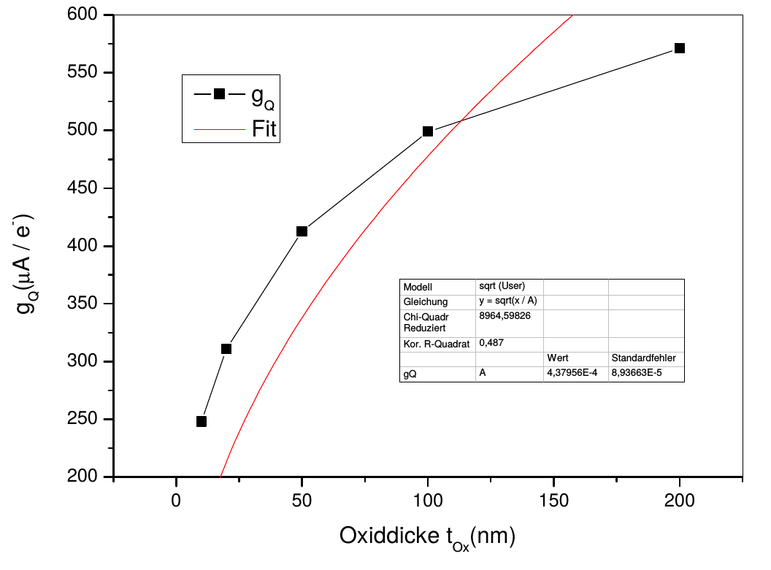
Simulations and measurements
Why is the measured gq vs tox dependancy weaker than the predicted one?
2D device simulations (DIOS, SPROCESS, TeSCA)
Change between
100nm and 200nm
14%
Measurements: tox = 195nm, gq = 870pA/e- (100µA, L=5µm) -> 10%
tox = 100nm, gq =780pA/e- (F. Krasser, Master Thesis)

Slide 9
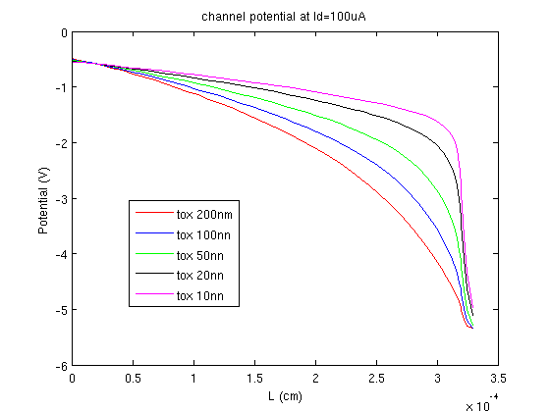
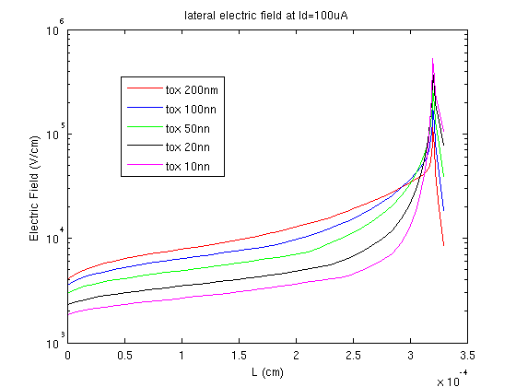
Simulation results
W =12µm, Ldesign=5µm
The thinner the oxide the higher the electric field along the channel
(in agreement with the simple theory)

Slide 10
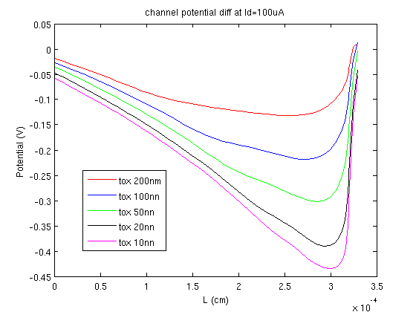
But what is the reason for the ‘better‘ behavior?
difference of the channel pot. in two states: Vdiff = Vch@100µA - Vch@100µA + 0.5V
ideal transistor theory requires for the pinch off point ΔV‘drain = ΔVgs
ΔV‘drain < ΔVgs
The coupling is much
smaller than 1
(especially for thicker oxides)
The pinch off point
is coupled also to the Drain
(not considered in
the simple theory)
The answer: for thicker oxides a higher carrier velocity is achieved but the gain is not
as high as predicted by the simple transistor model

Slide 11
Conclusions
The gq vs tox measurements performed by Florian Krasser and Stefan Rummel
can be confirmed and may be explained by device simulations.
Reason for the measured deviations to the simple theory :
Theory overestimates coupling between Vgate and V‘drain (pinch off point)
Especially for thicker oxides the channel carrier velocity is lower than expected
-> reduced Gq
Changing the point of view ;-)
before: we loose less Gq (than expected) when reducing the oxide thickness
now: we don‘t gain so much (as expected) in Gq when increasing the oxide thickness

