Slide 1
Pilot Run - Status and Plans
PXD9-6
Rainer Richter
for the MPG Halbleiterlabor

Slide 2


Pilot run wafers
Batch | W | Type | Contacts | Testing status
I | 24 | dummy | to poly, poxn, noxn | ongoing
I | 25 | dummy | to poly, poxn, noxn | ongoing
I | 26 | dummy | to poly, poxn, noxn | ongoing
I | 27 | dummy | to poly, poxn, noxn | ongoing
II | 23 | dummy | all | from 26.01.15
II | 30 | hot | all | from 26.01.15
II | 35 | hot | all | from 26.01.15
II | 36 | hot | all | from 26.01.15

Slide 3
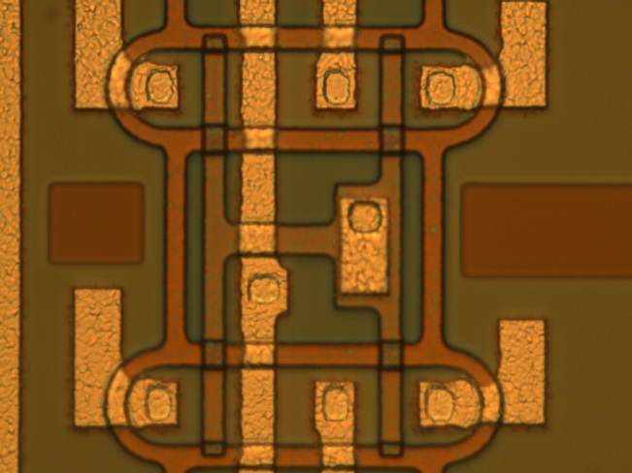
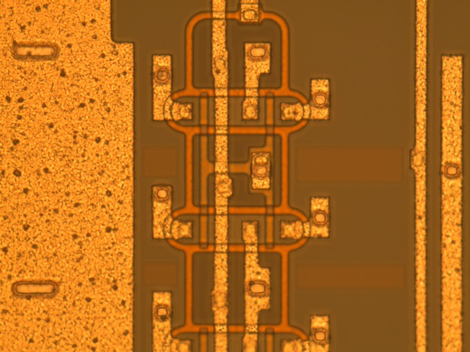
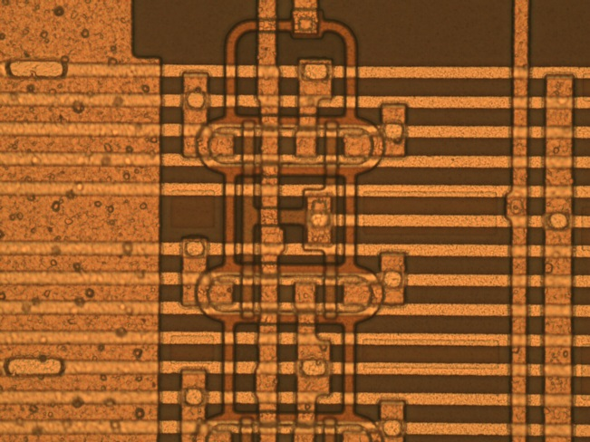
PXD9-6 production status
- first metal (al1n)
Al deposition, lithography, etching done
first electrical measurements (talks by Paola and me)
- metal1 metal2 vias (co2n)
lithography and etching done
- second metal (al2n)
Al deposition (all wafers) done
lithography and etching (dummies) done
lithography and etching (project wafers) done
(still in inspection)
Break for intense measurements
can start next week

Slide 4
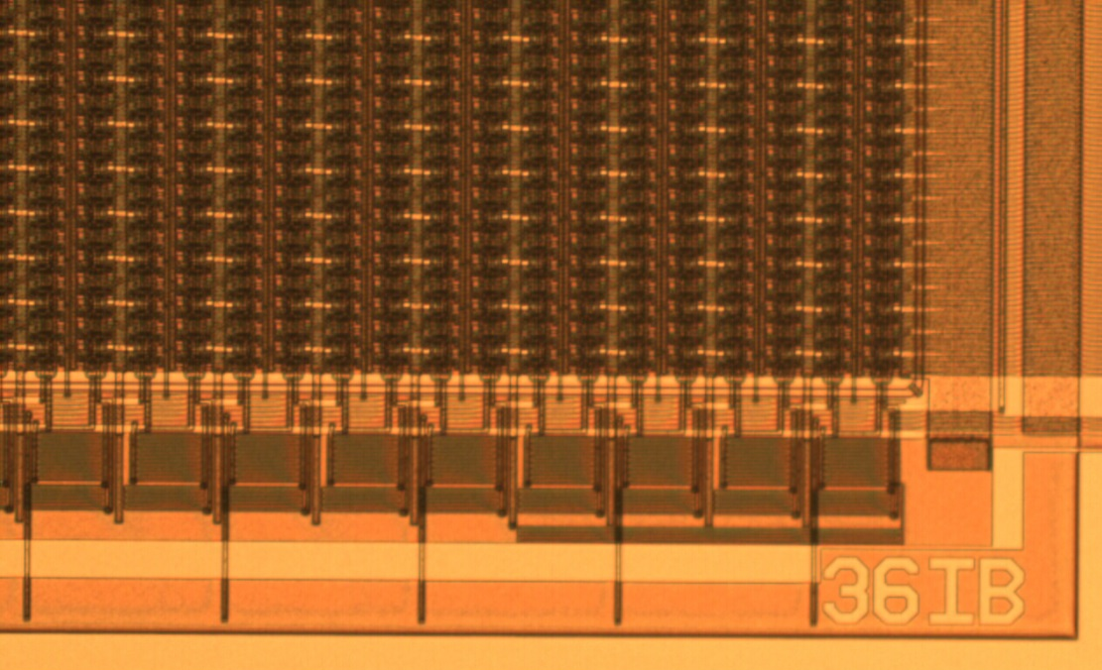
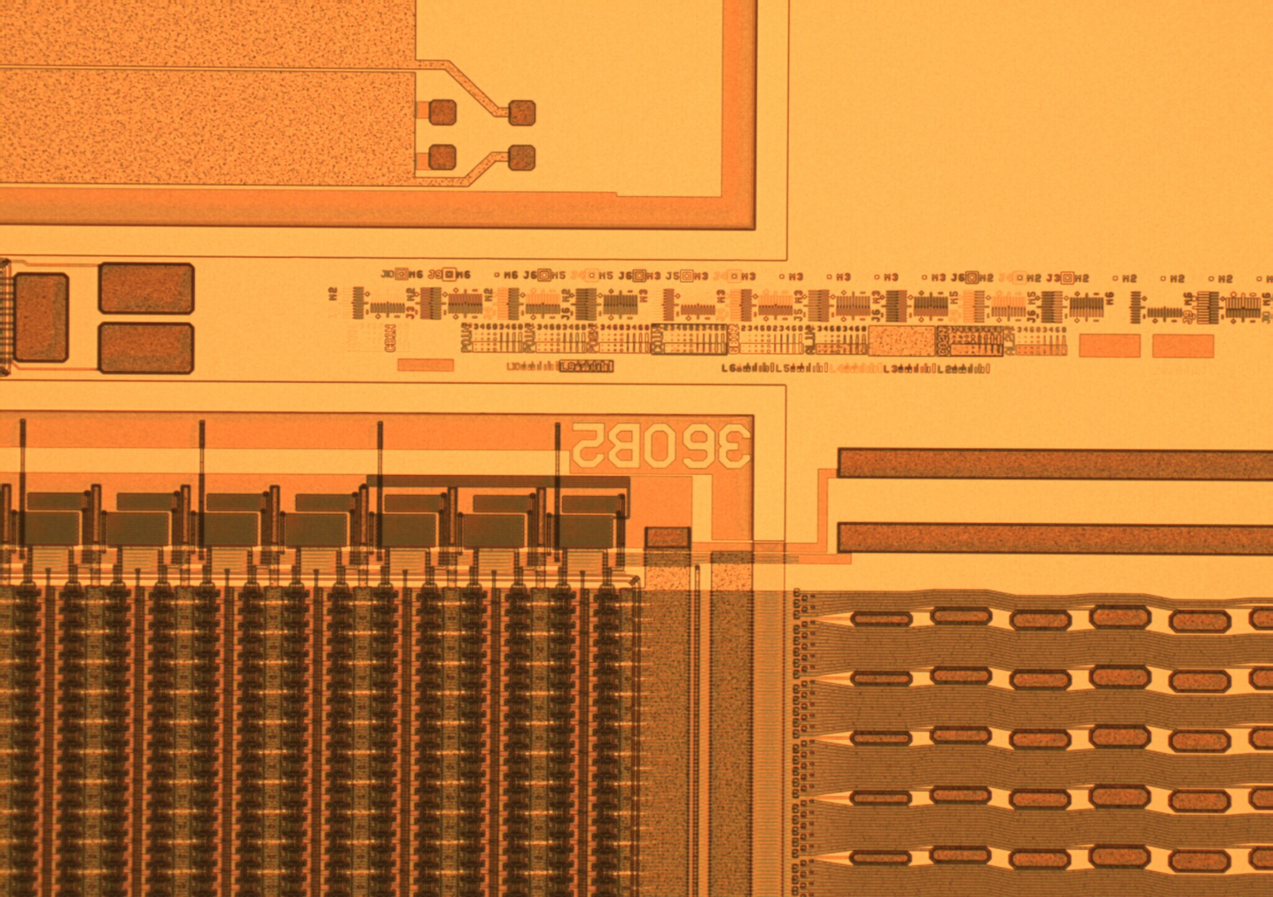
Module label
Containing:
Wafer number and module type
-> unique labels
150µm height
-> magnifying glass

Slide 5
Summary
PXD9-6 production (pilot run) is running smoothly and in time
1 week ahead of schedule
first electrical measurements (after metal 1) look promising
(see next talks)
Now: metal 2 is finished
Top side of the DEPFET matrix is ‚ready‘ (does not need copper)
Intense measurements are planned in the next 2-3 weeks

Slide 6
PXD9 Pilot production (iii)
Cons
- Risk to loose of 2 or 3 (2nd grade) PXD9 wafers
if we finally find still a severe bug on EMCM modules
- No time to wait with the remaining wafer on the results of fully equipped and tested modules
But we could wait with the first batch for the intermediate
tests of metal1/metal2
And we could stop before Copper in order to be able to react in the third metal layer on unforeseen results (e.g. Gated Mode)

