Slide 1
DCD

Slide 2
KIT
The development/production of DCD and SWITCHER chips will be done from middle of 2015 at KIT
ASIC and detector laboratory (ADL) at the Institute for Data Processing and Electronics (IPE)
Infrastructure:
1. Microchip desingn software "Cadence"
2. Clean room with a fully automatic wire bonding and gold ball machine, flip-chip machine, wafer saw, etc.
3. SMD laboratory with the automatic component placer and the reflow oven
Probe station will be available within next months

Slide 3
DCD
Submission plan:
UMC run on 18. May
Changes in design (present status):
Resize of several transistors in ADC to fix the problem of missing codes
Change sampling of TDI for global and pixel register to positive edge
Add fast parallel sampling mode for easier needle card tests
Improve test DAC resolution

Slide 4
JTAG and slow controll
Pixel Register
PixelSel
P_Shift, P_Rb, P_Ld
PixelSel
ShiftDR, CaptureDR, UpdateDR
Address
Global Register
GlobalSel
G_Shift, G_Rb, G_Ld
Digital Block
GlobalSel
State M.
ShiftDR, CaptureDR, UpdateDR
TDO
PreLoad
TMS
CaptureIn
DO0(7:0),DI0(1:0),…,DI3(1:0),SYNC_RES,CLK,RetCLK,TestInjEn,DO4(7:0),…,DI7(1:0)
LatchOut
Data Register
In
Out
CaptureIn
ExtTest OR PreLoad
Cont. Signals
LatchOut
ShiftDR, CaptureDR, UpdateDR
ExtTest
Commands
Instruction Register
FF
i
Pads
o
i
Bitck
Res
ShiftIR
The other if not ShiftIR
ShiftIR, CaptureIR, UpdateIR
Res!
TestMode
TestMode
TDI
ID Register
FF
TestPads
IDSel
ShiftDR&IDSel
Readout Reg
Readout
CaptureIn
CaptureIn
FF
FF
TCK
Full custom latches
Bypass
Ld
o
4

Slide 5
Missing Codes

Slide 6
ADC unit-cell
The ADC-unit has two current-memory cells based on two U-I converters A and B
Depending on the input current amplitude (too low or too high), a reference current (4 μA per cell) will be added or subtracted
The comparison is done in the following way:
Two copies of the current stored in A are made – this is done with the two, layout-identical, UI converters CL and CH that are connected to the same voltage as A
The threshold currents are added
14u
CL
TooLow
12u+/-4u
10u
A
CH
TooHi
12u+/-4u
B

Slide 7
Unit-cell characteristics
The purpose of the comparators is to assure that the reference currents are subtracted/added in the way so that the result current occupies two times smaller range
Only so, we can multiply the output current by two
IOut
-8u
-4u
-2u
IIn
8u

Slide 8
ADC unit-cell schematics
In this figure, the transistor scheme of TooHi comparator is shown together with the bias currents
Low
PFB
PFB
24u
24u
12u
RefFB
RefFB
Sc1(5)
Sc1(6)
Ith=10u
RefIn
RefIn
TooLow
24u
24u
24u
24u
Sc2
Sc2
Sc2
Sc2
Original
Copy

Slide 9
Offset
Let us now assume that we have by 2 μA higher current in the NMOS inside the copy U-I converter
The relative current error is ~8.3%
Low
PFB
PFB
24u
24u
12u
RefFB
RefFB
Sc1(5)
Sc1(6)
Ith=10u
RefIn
RefIn
TooLow
24u
24u
24u
26u
Sc2
Sc2
Sc2
Sc2

Slide 10
Unit-cell characteristics with offset
The TooHigh-threshold is shifted
IOut
-8u
-4u
-2u
IIn
8u

Slide 11
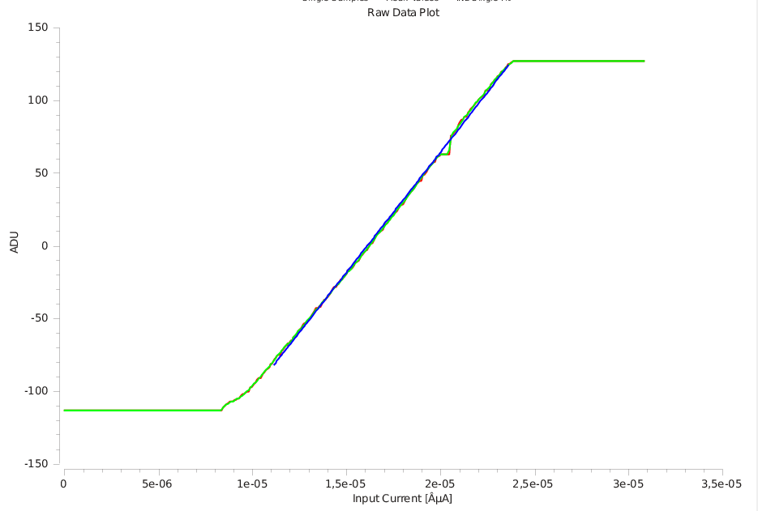
Bad characteristics causes missing codes
This causes missing codes around 64
There are three other mismatch combinations
CHI NMOS too weak (0)
CLO NMOS too strong (0)
CLO NMOS too weak (-64)
They produce missing codes around indicated values
IOut
-8u
-4u
-2u
IIn
8u

Slide 12
Origin of offset
Why does the current offset happen?
Possibility 1: transistor mismatch – fix in the next chip: make the layout in a better way e.g. the transistors bigger
Low
PFB
PFB
24u
24u
RefFB
RefFB
RefIn
RefIn
TooLow
24u
24u
24u
26u
Sc2
Sc2
Sc2
Sc2

Slide 13
Origin of offset
Possibility 2: poor current source output characteristics (low ROUT)
Notice: two output nodes are not on perfectly same potential
Original UI converter connected to amplifier input, copy UI converter to RefIn
Fix in next chip: resize the current source to have better ROUT
Low
PFB
PFB
24u
24u
RefFB
RefFB
RefIn
RefIn
TooLow
24u
24u
24u
26u
Sc2
Sc2
Sc2
Sc2

Slide 14
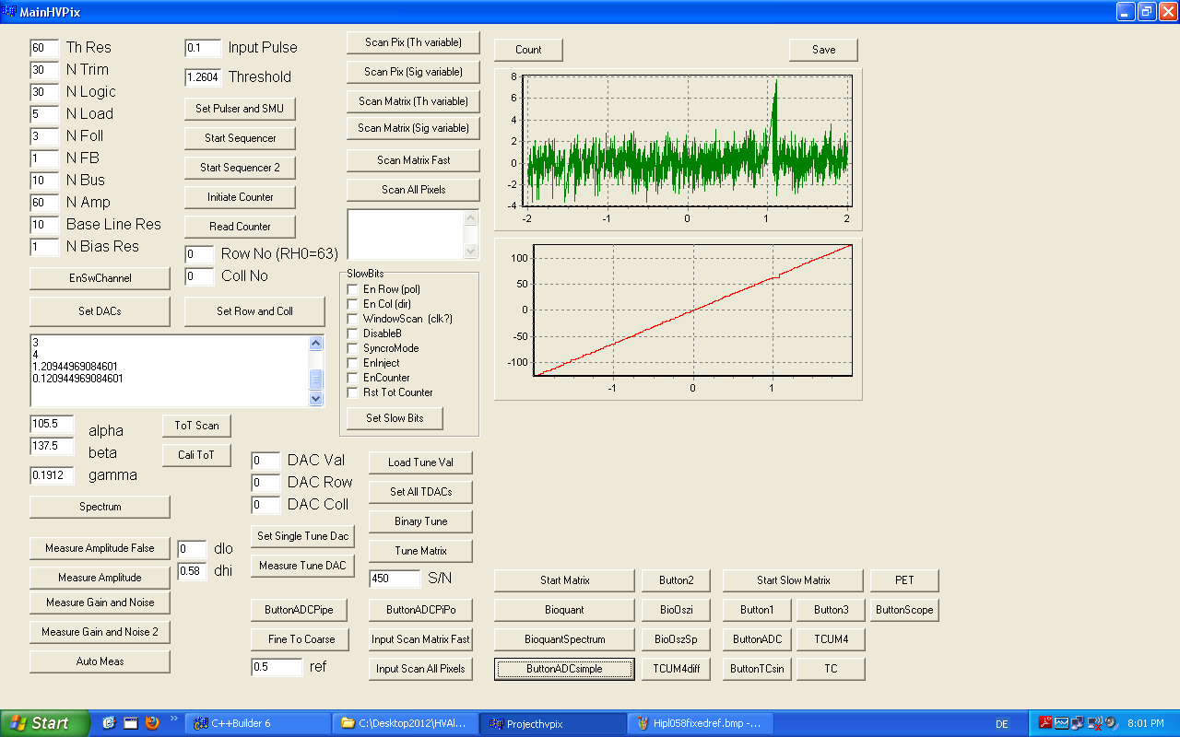
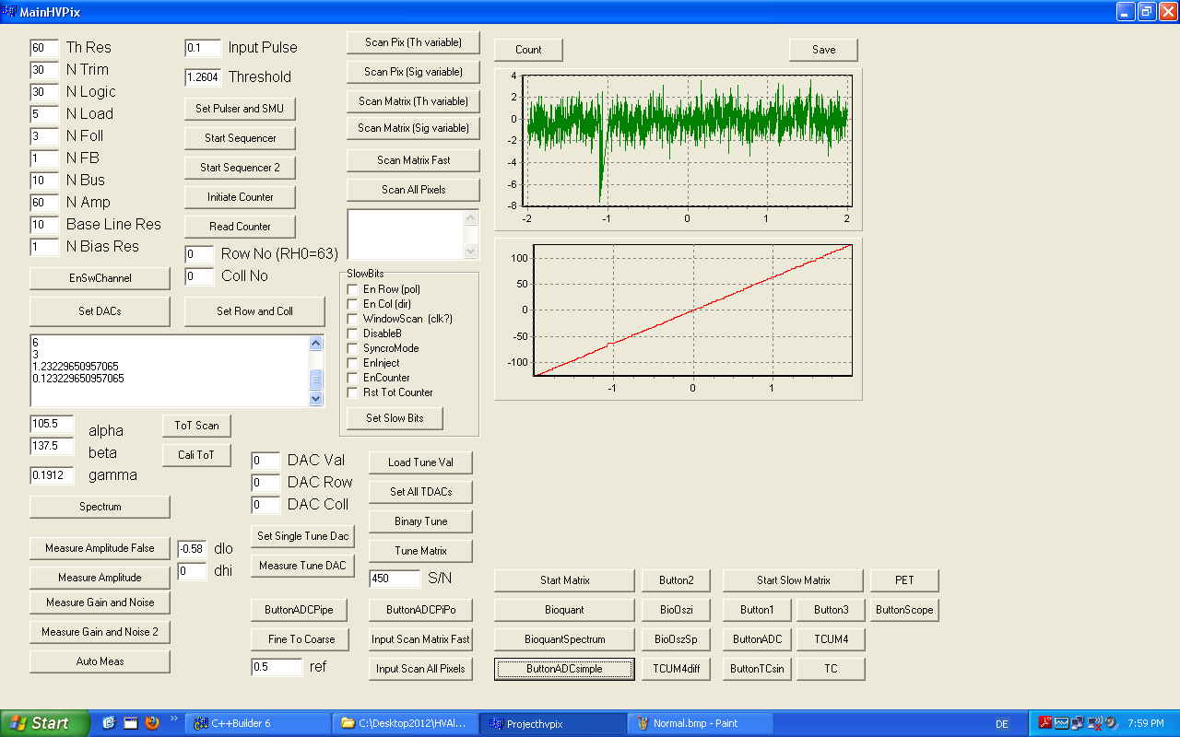
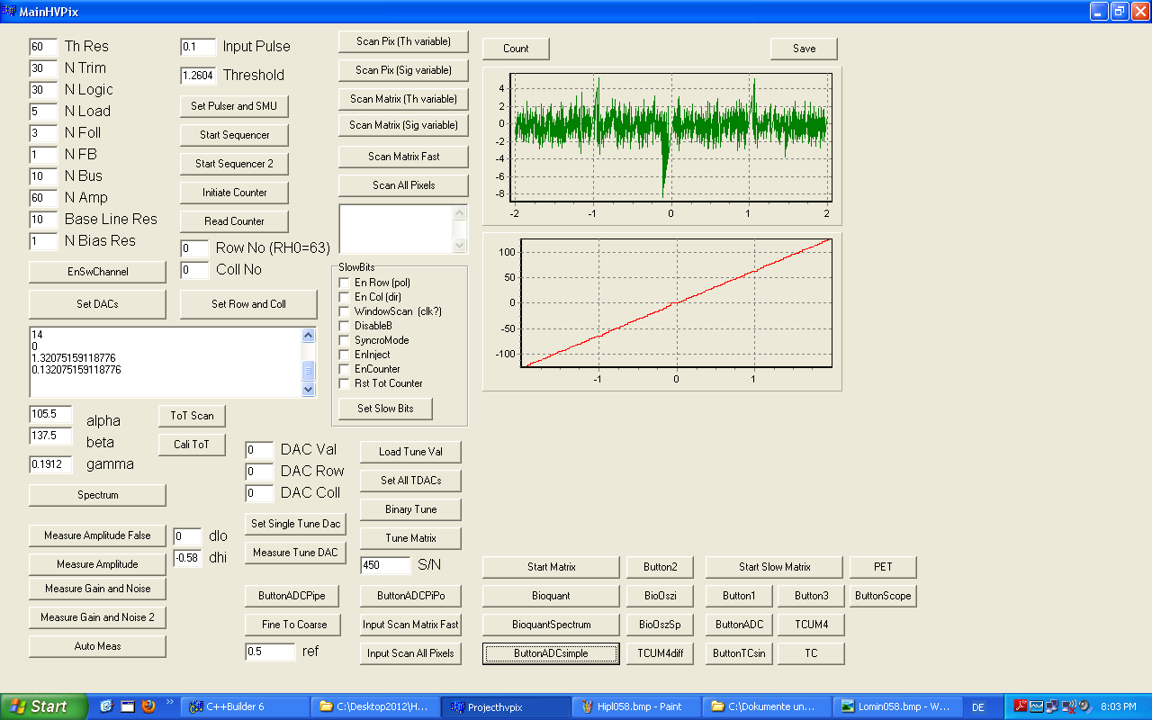
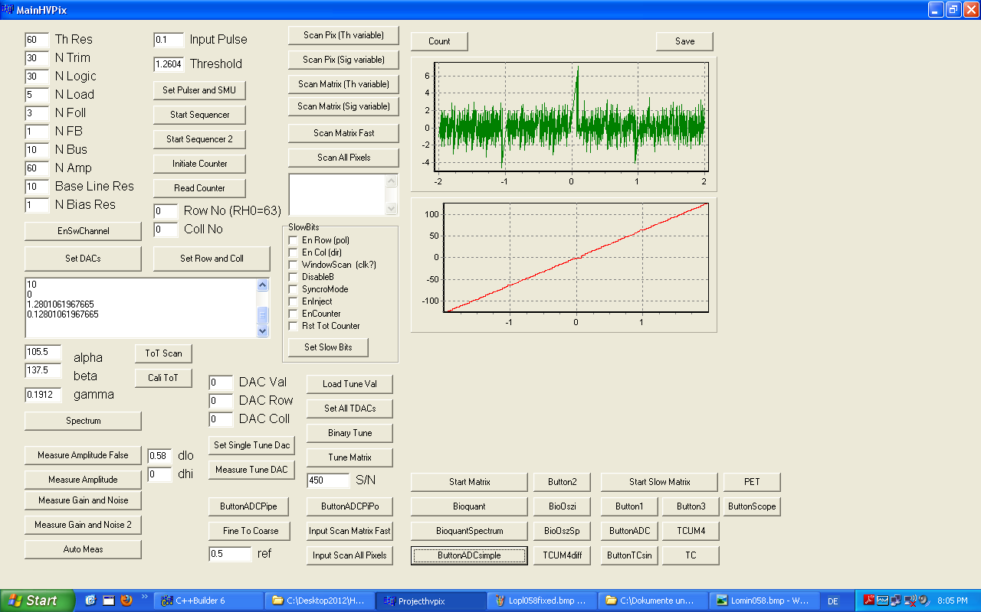
Mismatch - simulations
Left: Hi, NMOS stronger (RefIn low helps, several channels in the tested DCD)
Right: Lo, NMOS weaker (RefIn high helps, one channel in the tested DCD)
Left: Hi, NMOS weaker (not observed)
Lo, NMOS stronger (not observed)

Slide 15
Statistics
Pipelined ADC uses 8 double CM cells with 16 comparators in total
Only if all the comparators are good the ADC works correctly
Probability that ADC is fine:
If p = 99.5% -> pcomp = 0.99969
3.6 sigma < 2uA
Pipeline ADC
MSB cell
LSB cells
2
1
1
1
1
1
1
1
1
1
1
1
1
1
1

Slide 16
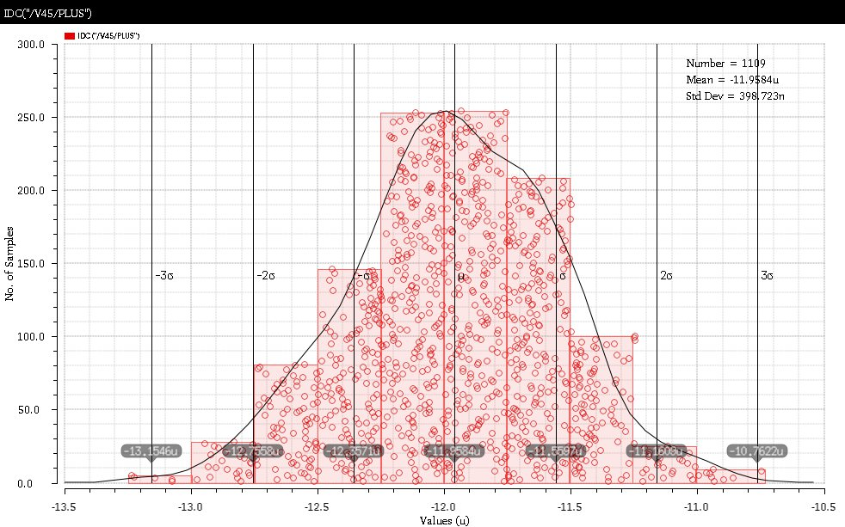
Monte-Carlo Simulation

Slide 17
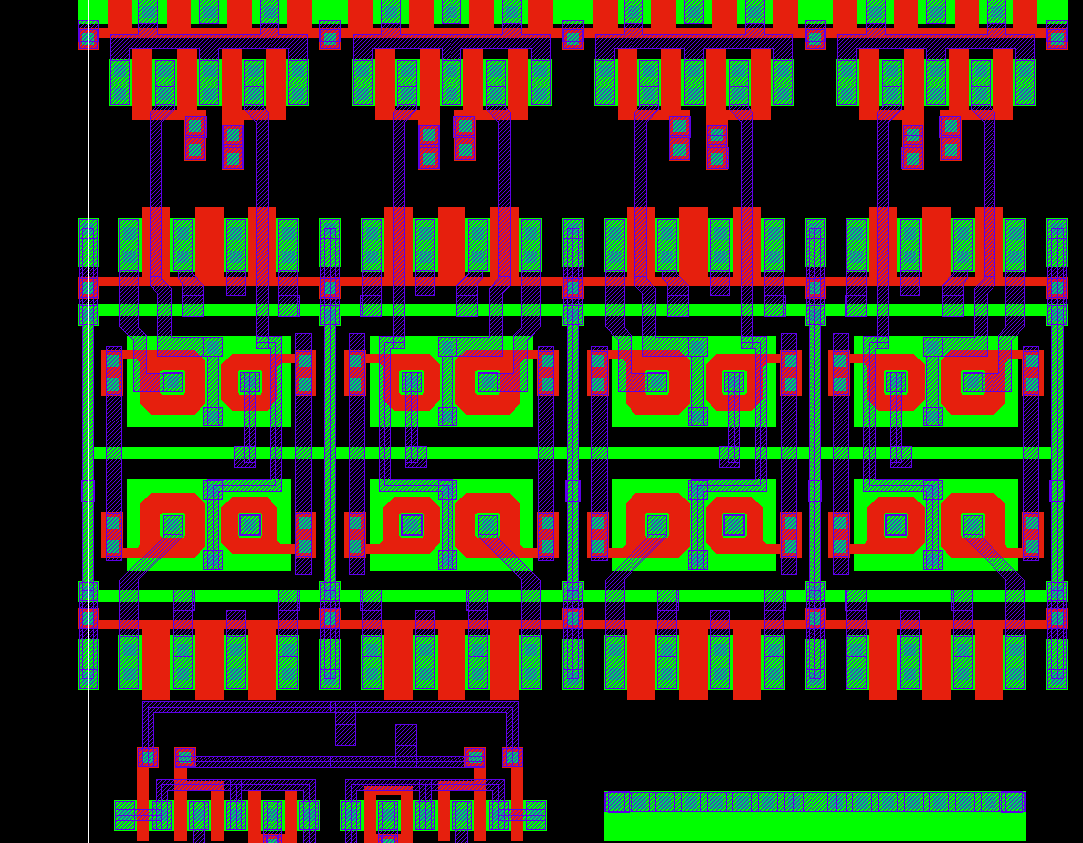
Layout
The NMOS current source has a complicated structure
It is based on enclosed NMOS and a PMOS that should compensate for voltage drops (the simple version with only NMOS behaved worse on DCD1)
The layout is dense
The current sources in the original cell and the TooLow cell are mirrored
The original cell and the TooLow cell are closer to each other – this may explain why TooHigh is more often affected in the measured chip
TooHigh
TooLow
Original cell

Slide 18
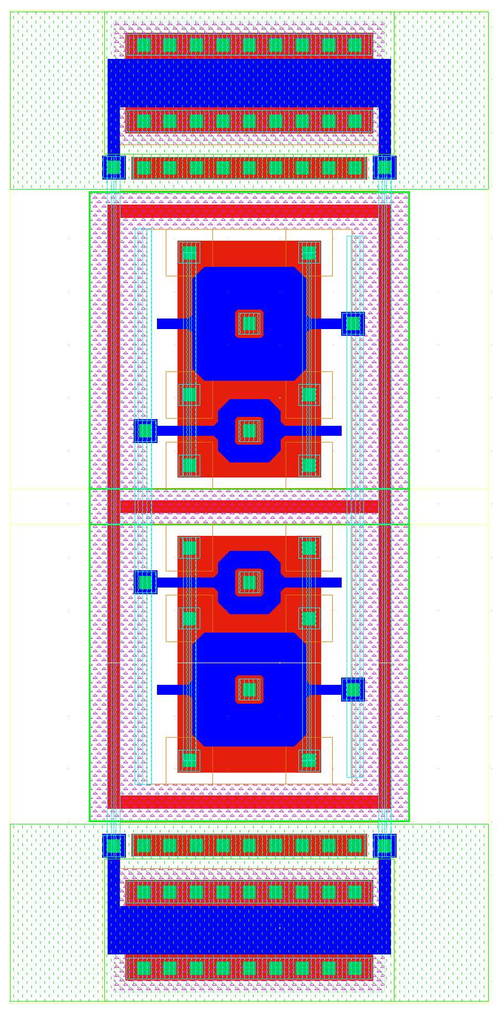
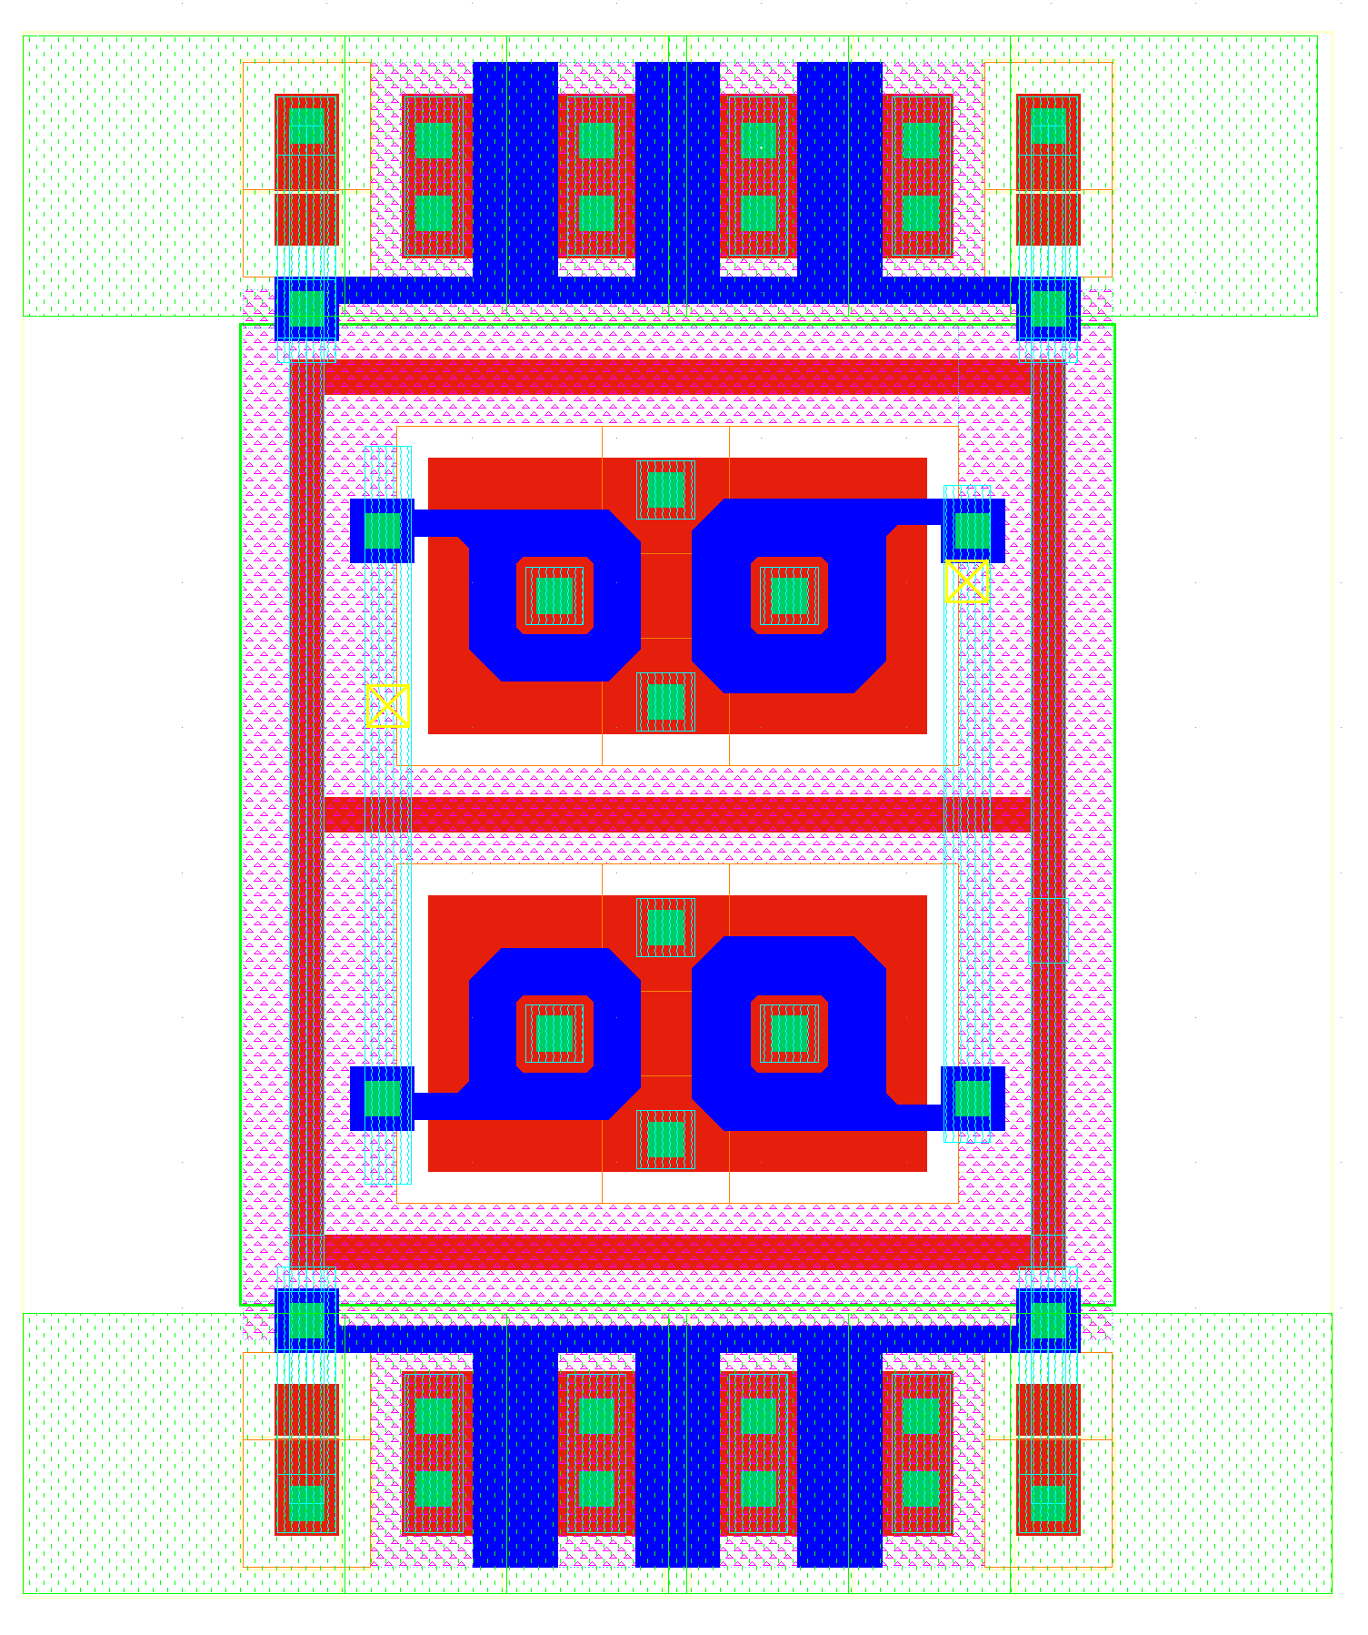
Layout
…
Old
New
11u
18u

Slide 19
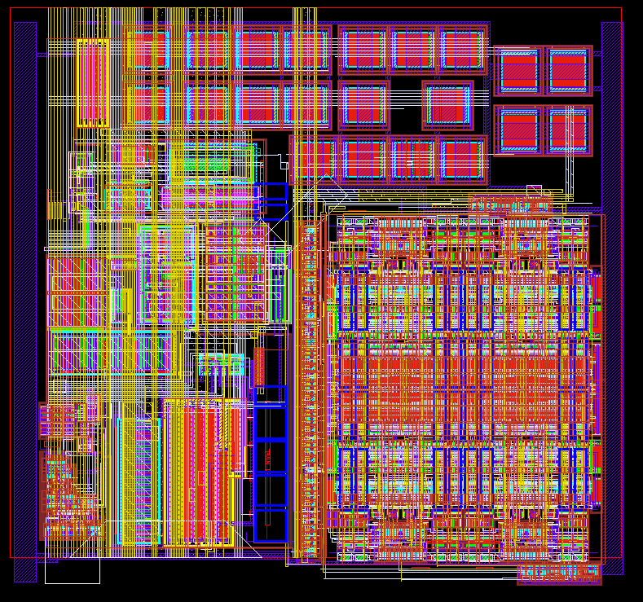
Layout
TIA
ADC
200 µm

Slide 20
SWITCHER Status
SWITCHER
Irradiation of latest SWITCHER has been done at KIT (dose 30 MRad)
The chip works after the irradiation
Bumping issue: bumping so far done in HD-lab, this works well for prototyping but is slow for production
Bumping with the required pitch (150 μm) is not offered by the vendor (AMS/IBM)
Solution: Company Pactec can place underbump metallization (ENIG) and solder bumps on single dies (price < 66 Eur/chip + 7.3 kEUR ~ 16k EUR)
SWITCHER submission planned in 2015
Improvements: faster clear driver
Separated control of the termination resistance for serial input (should be always on) and for the other fast inputs

