Slide 1
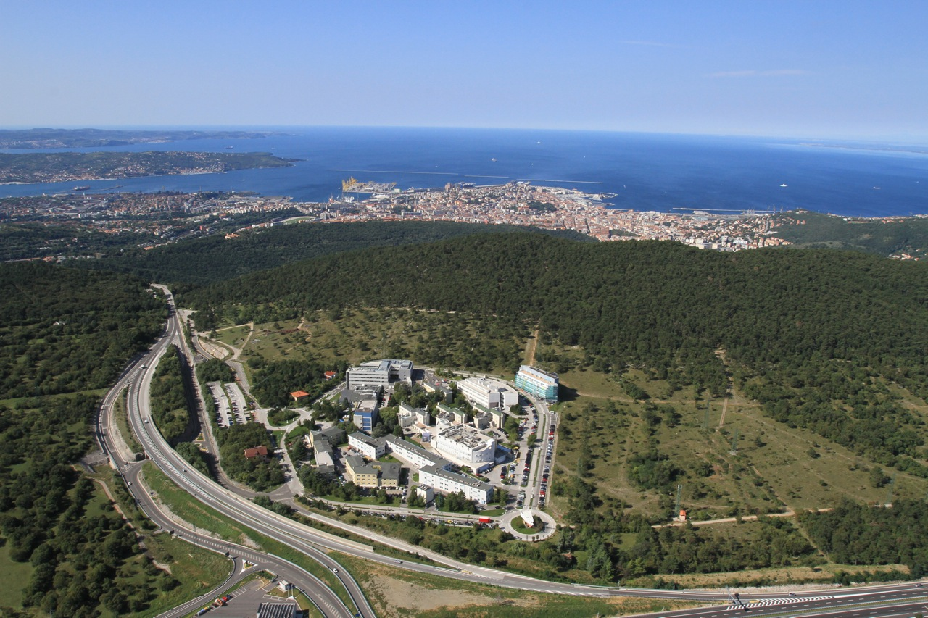
VXD Monitoring and Interlock Sub-group organization, tasks and schedule
L.Vitale
INFN and Univ. Trieste

Slide 2
Outline
SVD organization
Sub-group organization
Initials Tasks and modifications
Work packages
Financial plan
Schedule
Documentation

Slide 3
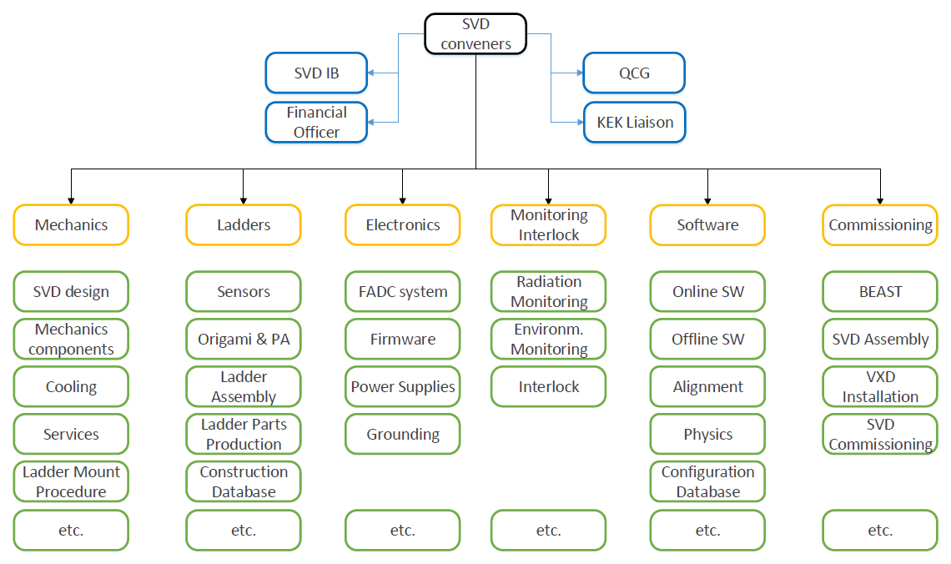
SVD organization

Slide 4
Initial tasks and modifications
SVD Radiation monitoring
Fast ~10um monitoring to protect SVD (beam abort)
Keep track of the Long Term accumulated dose
SVD Environmental monitoring
Temperature
Humidity
Evolved including
PXD radiation monitoring (VXD general task as Humidity)
BEAST2 participation both phase1&2,
FOS to monitor more points
interlocks

Slide 5
Work packages and people involved
VXD radiation monitoring and Beam Abort (L.Vitale)
Sensors (LV, LB, LL)
RO Electronics (Elettra + LL LV)
Simulations (Gianluca Inguglia?)
Software EPICS (Simon Bacher?)
SVD Temperature with NTC (L.Lanceri?)
Hardware and lab software (PC, LL)
Software EPICS (Simon Bacher?)
SVD Temperature with FOS (L.Vitale)
Hardware, lab software + calibration (LV, LL, TS techn, + help from PXD)
Software EPICS (Simon Bacher?)
VXD Humidity (L.Lanceri?)
Hardware and lab software (LL, LV)
Pipes (MPI, DESY, KEK)
Software EPICS (Simon Bacher?)
Interlock with PLC (L.Lanceri?)
BEAST2 (L.Vitale)

Slide 6
Interactions
SVD Monitoring Sub-group
SuperKEKB, Other BELLE2, SVDSub-groups
VXD radiation monitoring and Beam Abort
SVD Temperature with NTC
SVD Temperature with FOS
VXD Humidity
Interlock with PLC
BEAST2
SuperKEKB
BEAST2
Outer Detector mechanics
VXD mechanics
SVD mechanics
SVD commissioning
SVD software (slow control, simulation, ect.)
SVD electronics (Power supplies, …)

Slide 7
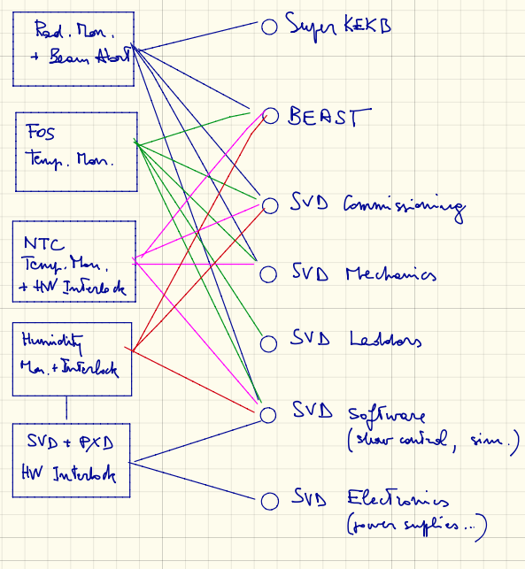
Interactions

Slide 8
Financial plan and WBS
We have already prepared a WBS (Work Breakdown Structure) in excel
to plan, foresee and keep track all activities and money flows (INFN Trieste side)
Need few updates
Other financial supports for specific activities
For BEAST2 (Carlos, Katsuro)

Slide 9
Approximate schedule (as ~Oct.2014)
Radiation | 2014 |  |  |  | 2015 |  |  |  | 2016
What | 1 | 2 | 3 | 4 | 1 | 2 | 3 | 4 | 1 | 2
Specifications, sign up
Simulations
Dosimetry, characterization
Diamond sensors choice
Mechanics & cabling design
Electronics specifications
Electronics design & proto.
Overall design, sign up
Components, procurement
"final" prototypes (4 ch.)
BEAST, 1 preliminary tests
BEAST, 2 complete test (4 ch)
electronics production & test
sensors installation & cabling
electronics installation
Temperature & humidity | 2014 |  |  |  | 2015 |  |  |  | 2016
What | 1 | 2 | 3 | 4 | 1 | 2 | 3 | 4 | 1 | 2
T&H Specifications, sign up
Fibers, mechanical layout
Fibers, assembly tests (SVD)
Fibers, multiplexing scheme
Fibers design sign up
Procurement, assembly
installation (PXD & SVD)
Thermistors, lab tests
Mechanics & cabling design
Procurement
assembly, installation

Slide 10
Approximate schedule (Jan.2015) TBU
Radiation | 2014 |  |  |  | 2015 |  |  |  | 2016
What | 1 | 2 | 3 | 4 | 1 | 2 | 3 | 4 | 1 | 2
Specifications, sign up
Simulations
Dosimetry, characterization
Diamond sensors choice
Mechanics & cabling design
Electronics specifications
Electronics design & proto.
Overall design, sign up
Components, procurement
"final" prototypes (4 ch.)
BEAST, 1 preliminary tests (mod.)
BEAST, 2 complete test (4 ch)
electronics production & test
sensors installation & cabling
electronics installation
Temperature & humidity | 2014 |  |  |  | 2015 |  |  |  | 2016
What | 1 | 2 | 3 | 4 | 1 | 2 | 3 | 4 | 1 | 2
T&H Specifications, sign up
Fibers, mechanical layout
Fibers, assembly tests (SVD)
Fibers, multiplexing scheme
Fibers design sign up
Procurement, assembly
installation (PXD & SVD)
Thermistors, lab tests
Mechanics & cabling design
Procurement
assembly, installation
= needs SVD
Sign off
= internal
milestone
= just ✓ or in progress
= shifted

Slide 11
Documentation
Wiki page: existing, TBU
Internal documentation:
General requirements: ✓
Mechanics and Cabling: TBD
Progress on diamonds sensors: TBD
Radiation Electronics: TBD (some material)
SVD NTC: ~✓
SVD FOS: TBD (only initial project)
VXD Humidity: TBD (only initial project)
VXD interlock: TBD (only initial project)
WBS: ✓TBU

Slide 12
Meetings
Specific Parallel SVD sessions at VXD workshops and B2GM
Reports at B2GM Background session
Specific meetings when needed (need at least monthly updates on progress, issues, etc.)
Periodic reports at SVD weekly meeting

Slide 13
Back-up slides

