Slide 1
Bonding study of wrapping part of PA1/2
T. Morii (Kavli IPMU) 2014/01/22

Slide 2
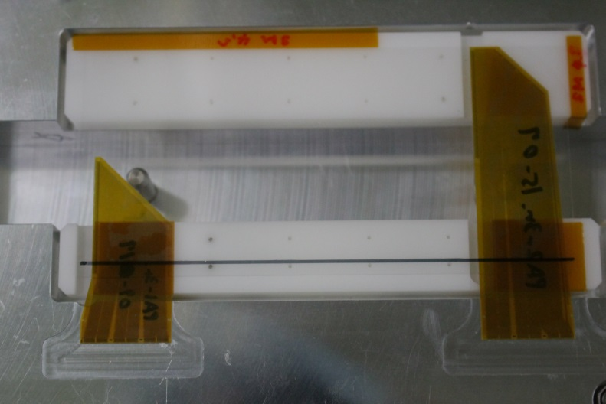
Materials
Used PA (Lot : 311008-02s)
PA1-3R. 09-17
Pad width Ave. 30.62 um, min. 28.93 um, max. 34.51um
PA2-3R. 15-07
Pad width Ave. 29.15 um, min. 26.01 um, max. 33.34 um
Sensor
Glass DSSD (thickness : 0.3 mm)
AIREX rev.2.0
Mockup origami-Z ver.5

Slide 3
Bonding condition
1st bond
1st bond : Gold metal plate at APV side
2nd bond : PA1/2 3rd row pad
Distance : 3mm
Height : 0.9mm
Power and force (Machine parameters)
: 70 and 20
These are good bonding parameters between APV25 and PA1/2. (Studied by Kang-san and Jeon-san using pull test module)
Bonding pad : 96 pads / 1 PA
2nd bond
Realistic values at IPMU

Slide 4
Pad width
30 um
30 um
Pad width (um)
Pad width (um)
23 pads width are less than 30 um.
84 pads width are less than 30 um.

Slide 5
Wrapping condition
PA1 side
PA2 side

Slide 6
Wrapping condition
PA1 side
PA2 side
Glue line
No glue part
No glue part
Glue is not spread to 3rd row pads
Glue looks spread to under the 3rd row pads

Slide 7
Pull force result
PA1 w/ correction factor
PA2 w/ correction factor
Efficiency 99%
Efficiency 100%
5.0±2.1
7.5±0.8
Pull force (g)
Pull force (g)
Pull force is too low (less than 4g) at some pads, because of bad glue condition.
PA2 side, pull force value is enough for requirement.

Slide 8
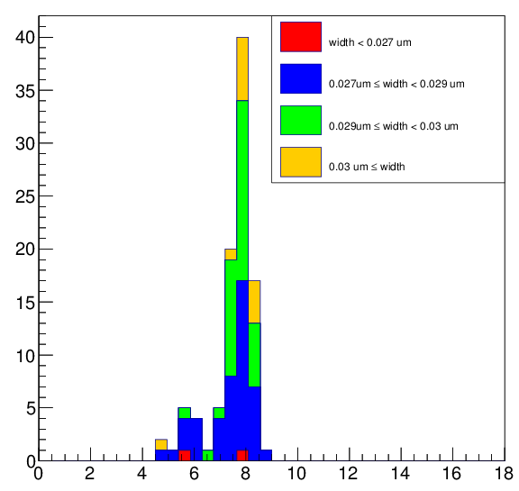
Pad width V.S. pull force of PA2
Width < 27 um
27 um ≦Width < 29 um
29 um ≦Width < 30 um
30 um ≦Width
Pad width = 27 to 29 um, pull force looks not so bad.
Pull force (g)

Slide 9
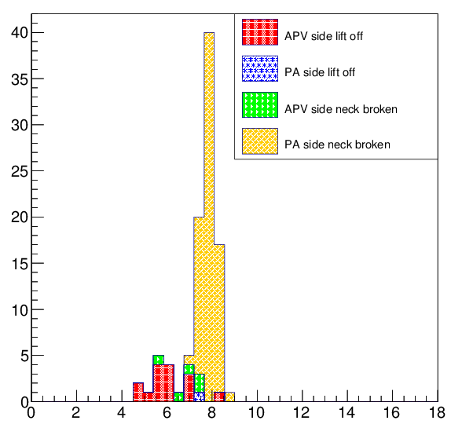
Bonding foot condition V.S. pull force of PA2
PA side lift off
APV side lift off
PA side neck broken
APV side neck broken
Pull force (g)

Slide 10
PA1 pull force VS pad width and bonding foot condition
Pad width
Bonding foot condition
PA side lift off
APV side lift off
PA side neck broken
APV side neck broken
Miss bonding
Pull force (g)
Pull force (g)

Slide 11
Conclusion
We measured wrapping part pull force.
Wrapping method is not defined, but glue is good condition at PA2 side. PA1 side, glue is not spread to 3rd row.
84 pads width are less than 30 um at PA2 but still enough pull force.
7.5±0.8 (w/ correction factor) at PA2 part, it is among the requirement.
Very low pull force at PA1, because of bad wrapping condition.

Slide 12
Raw pull force
Pull force (g)
Pull force (g)
Pull force w/o correction factor.

