Slide 1
Readiness of the FOS monitor for the thermal mock-up and recent activities. PRAGUE, January 7th VXD Workshop
E. Currás, D. Moya, I. Vila, A. L. Virto., J.González
Instituto de Física de Cantabria (CSIC-UC)
G. Carrión, M. Frövel.
Instituto Nacional de Técnica Aeronautica (INTA)

Slide 2
Outline
Status and open issues concerning the FOS for the mock-up.
Fiber connectors and matting sleeves for docs connection.
Relative displacement monitoring for the final application at Belle II vertex.

Slide 3
Fiber cables and sensors for the mock-up
Four cables with four sensors
Additional FOS with not specific support (see next table)

Slide 4
FOS for PXD mock-up
Fibres for PXD thermal set-up
Fibre Nº | Nº of sensors | position | tube | parameter
51 | 4 | On top of PXD on air | Teflon | Temperature
52 | 4 | On top of PXD on air | Teflon | Temperature
53 | 4 | On top of PXD on air | Teflon | Temperature
37 | 4 | On top of PXD on air | - | Temperature + humidity
38 | 4 | On top of PXD on air | - | Spare
OS-4210 | 1 | To be defined | metal | Temperature
sensor 1 | 1 | To be define | Teflon | Temperature
sensor 2 | 1 | To be define | Teflon | Temperature
Fibre 1 polyimida | 2 | To be define | - | Temperature + humidity
Fibre 2 polyimida | 2 | To be define | - | Temperature + humidity
SN89356/0003 | 1 | To be defined | metal | Temperature
 | New sensors
 | January Test Beam sensors
DAQ integration using January test beam EPICS driver

Slide 5
Open issues :Offset calibration
Test beam fibers: same calibration parameters
All the new fibers calibrated with temperature. Temperature sensitivity obtained.
The offset will be measured at IFCA before mounting in the mock-up and checked in the mock-up if possible
To obtain the offset at IFCA the fiber will be positioned as in DESY’s mock-up and the humidity will be reduced up to a value of about 8%. A temperature reference sensor will be positioned near de sensors in order to measure offset reference temperature.
Offset for the fibers without teflon tubing obtained from thermal calibrations.

Slide 6
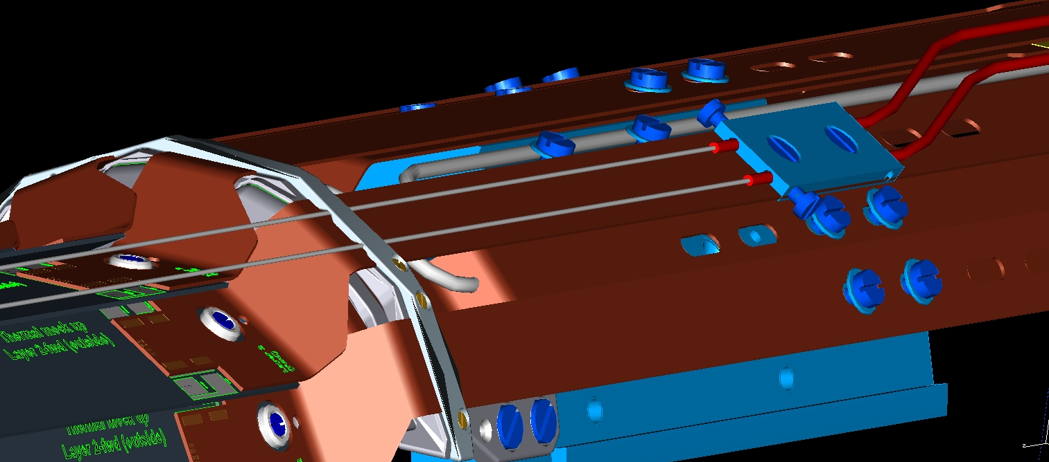
Mock up Mechanics for Teflon tubing sensors
The support mechanics for fibers positioned in the air above PXD ladders already defined :
Due to some difference with real application some changes in the fibers could be necessary.

Slide 7
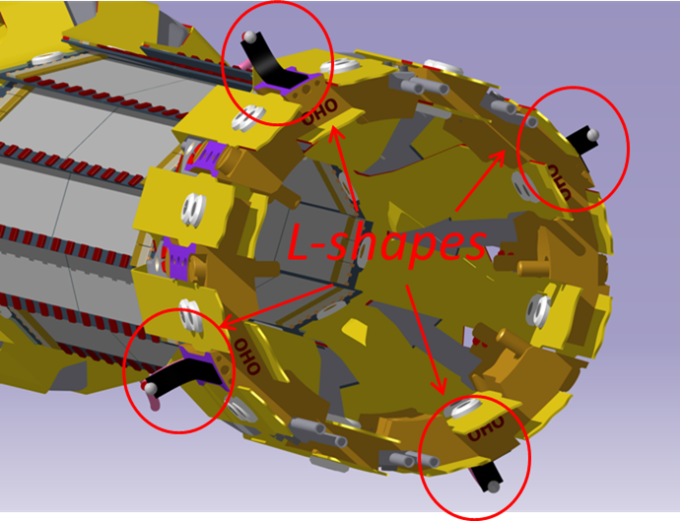
Mock-up displacement monitoring
Use four L-shapes in order to measure relative PXD SVD radial displacement in the mock-up

Slide 8
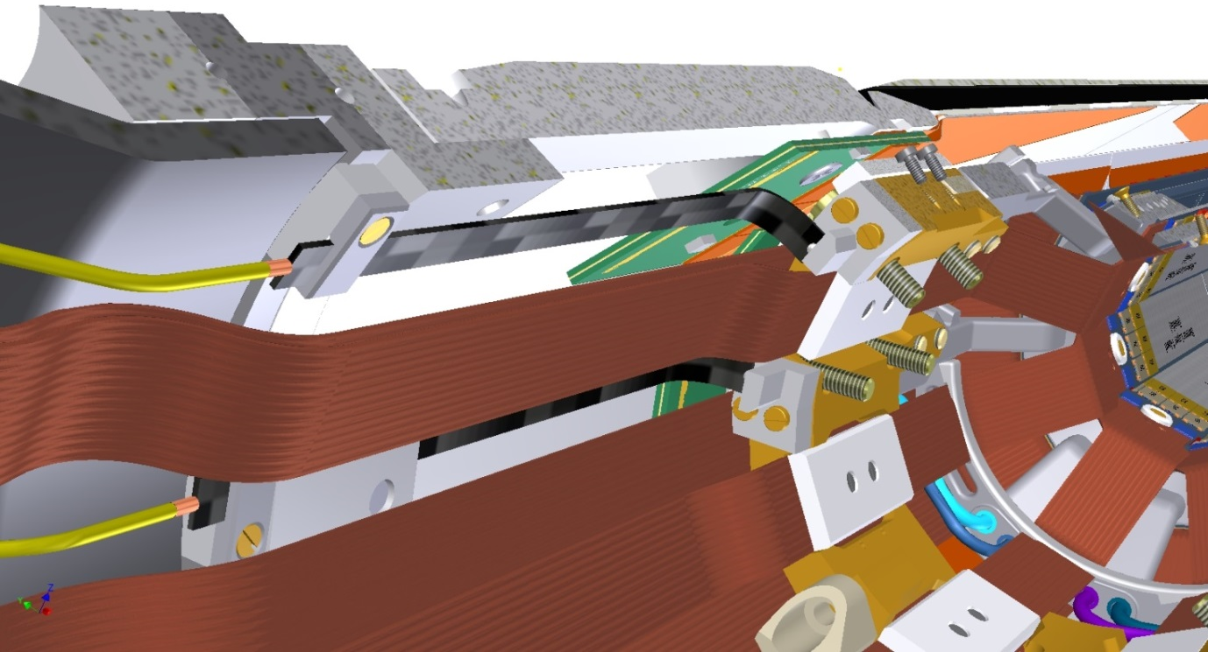
Open issues
Fixation of l-shapes in the mock-up.
A first position and locking proposal: Ok from both PXD and SVD part
L-shape locking mechanics needed for L-shapes calibration
Manufactured at IFCA (design needed to check if possible) or manufactured
outside and sent to IFCA for L-shapes calibration ?

Slide 9
R/O of the FBG sensors for the mock-up
For PXD mock-up DAQ ready: Readout integrated in epics similar to the test beam ( integration expected to be smooth)
For PXD-SVD mock-up:
The sm041-408 switcher is intended to be integrated in the system ( in order to increment the interrogation channels and to be able to measure L-shapes)
The possibility to measure vibrations is being studied by Michael Ritzer (Heidelberg) and Javier Gonzalez (IFCA)

Slide 10
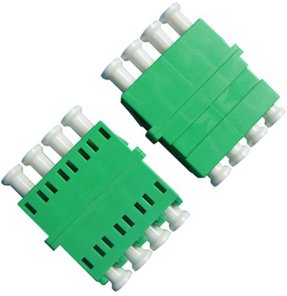
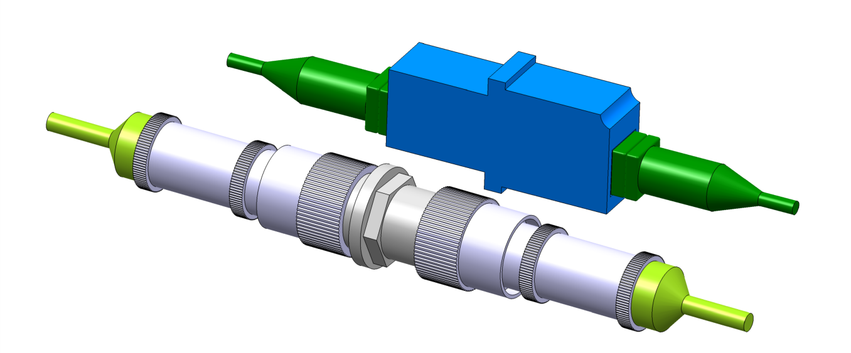
Connection of the fibers in the docs
Studding two possibilities : FC-APC vs LC-APC
Size : LC-APC seems better
For LC-APC connectors you can buy multiple LC-APC matting sleeve ( not in the case of FC-APC)
LC-APC interconnection more simple ( without thread or connector key)
LC-APC connectors
Matting
sleeves
FC-APC connectors

Slide 11
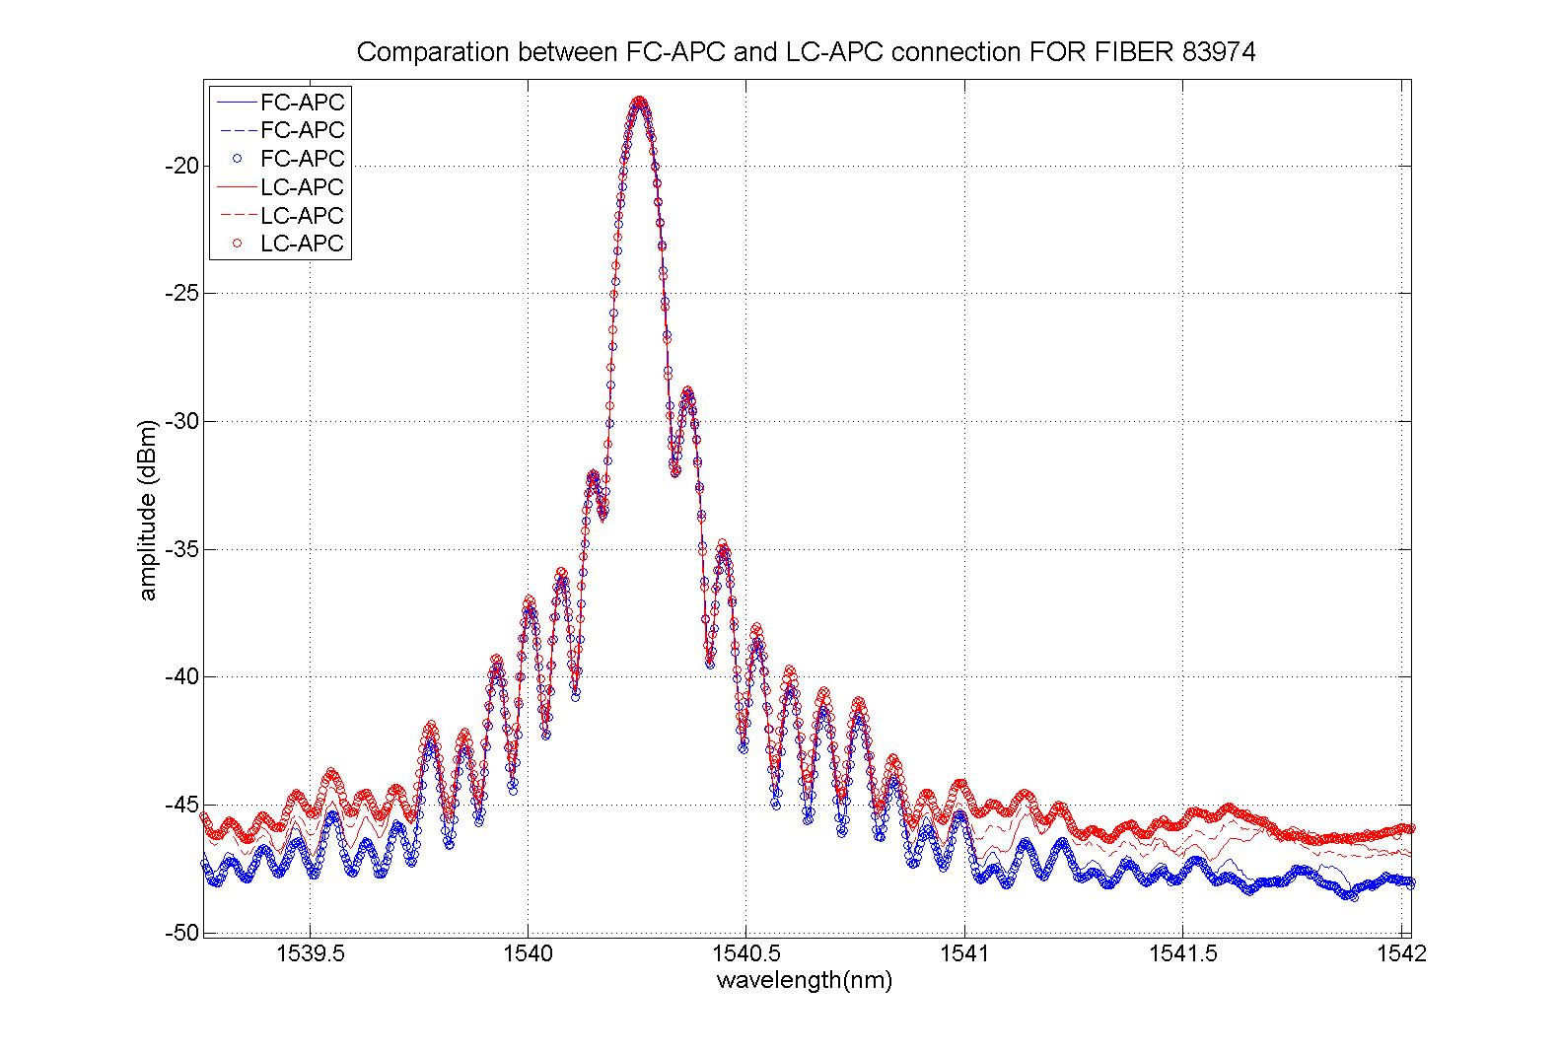
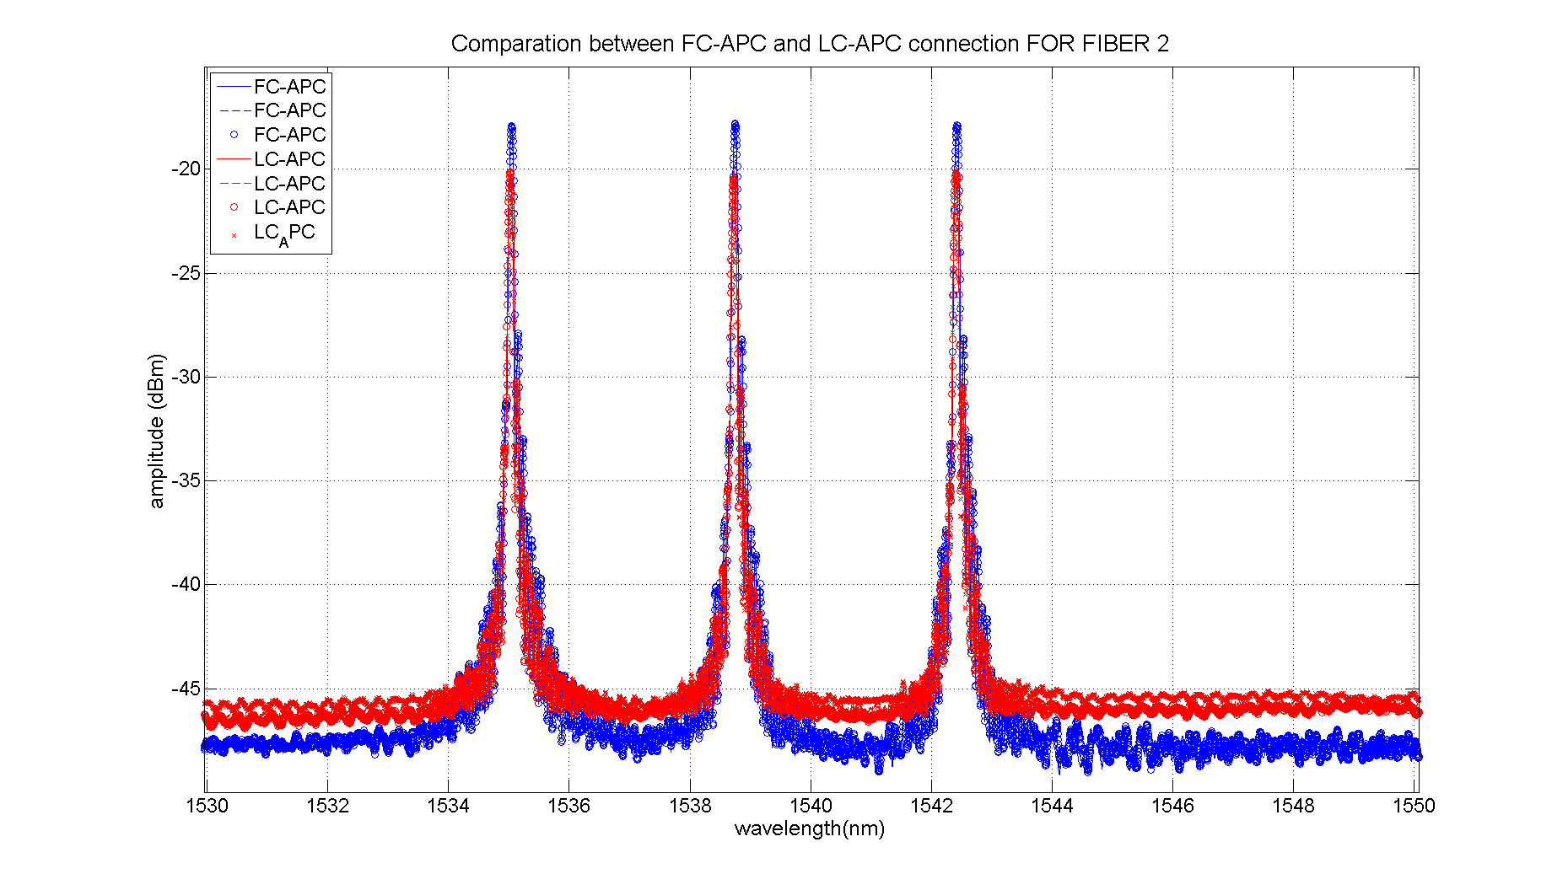
Connection of the fibers in the docs
LC-FC comparison in signal attenuation: a little bit higher for LC-APC connectors but not problematic.

Slide 12
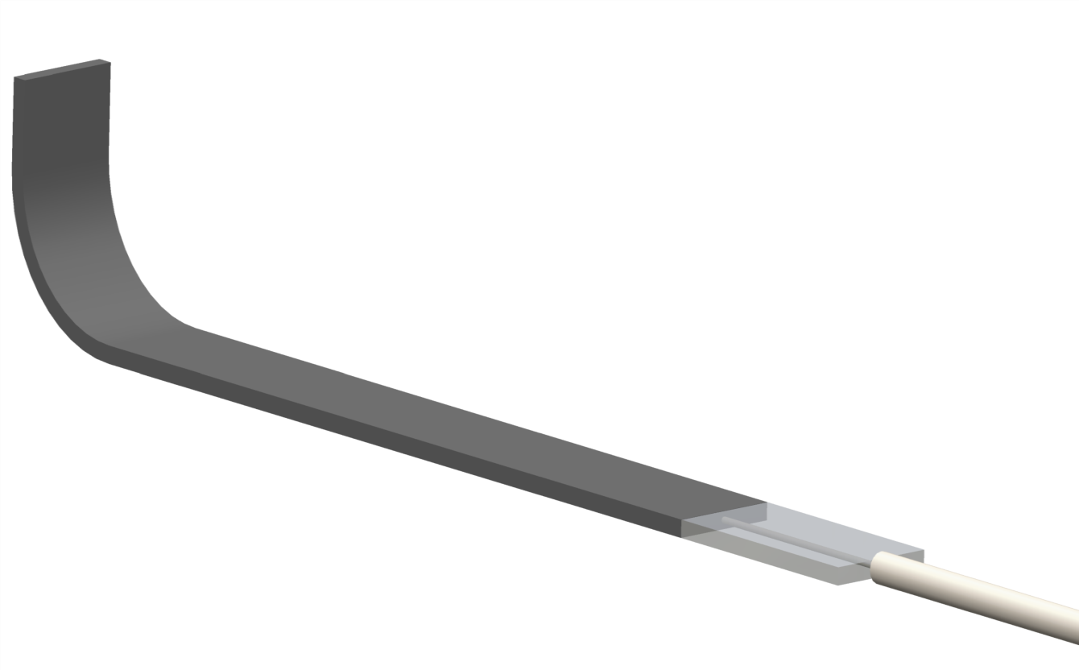
For the final application
Define displacement to be measured.
Relative radial displacement
Relative displacement in Z direction ( the problem must be define ( resolution, range, positioning tolerance..)
CFRP L-shape
Fiber egress protection
NEW DESIGN
OR
30 mm
7 mm
3.5 mm

Slide 13
Questions & Comments ?
Supporting documentation and manual stilll under preparation.
Assuming installation of fibers in the mock-up by middle- end of February and of L-shapes in May
Comparison between LC-APC and FC-APC connectors. LC connectors less bulky but higher attenuation ( not a problem for the system)
For the real application
Relative displacement to be measured must be define (Radial or in Z direction). In this last case the problem must be defined (range, resolution and positioning dimensional tolerance)

