Slide 1
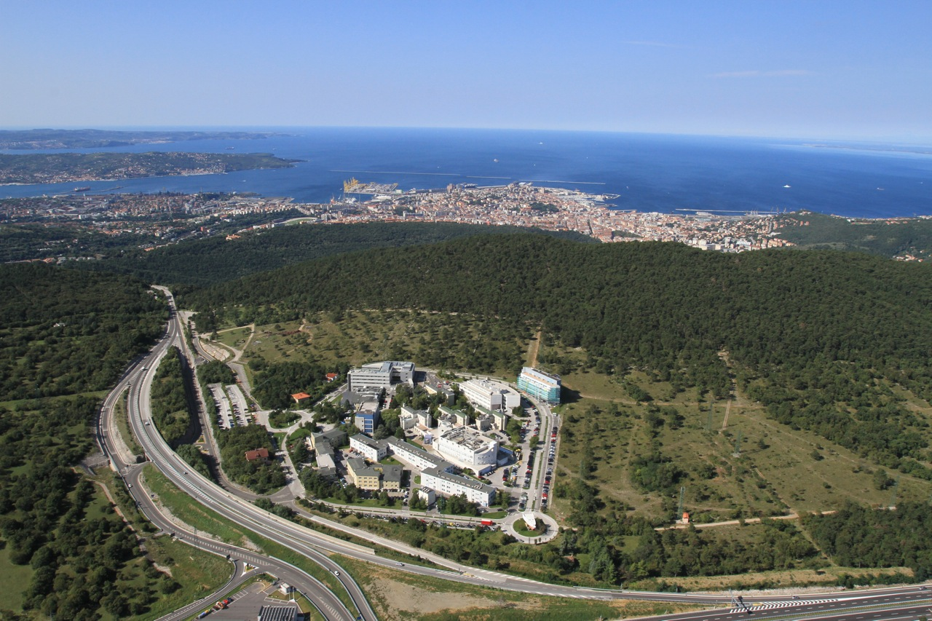



VXD Radiation and Environmental Monitoring
L. Bosisio, P.Cristaudo, L.Lanceri, L.Vitale
INFN and Univ. Trieste
+ Electronics&Detectors group at Elettra, Trieste

Slide 2
Outline
Radiation monitor & beam abort
  scCVD diamond sensors, electronics
  Background simulations
  Beast Plans
Temperature monitoring
  Optical Fibers Sensors (FOS)
  NTC thermistors
Humidity monitoring/interlock
SVD+PXD interlocks: PLC
Parallel session on Friday 10.30: discussion
Still ongoing in Trieste: sensor testing - not covered in this talk

Slide 3
Radiation monitoring
& Beam abort

Slide 4
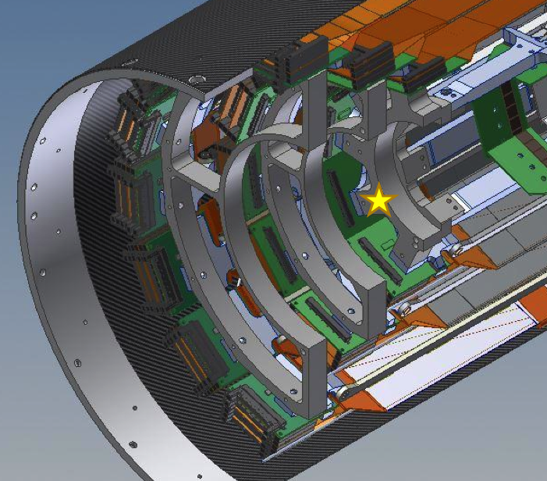
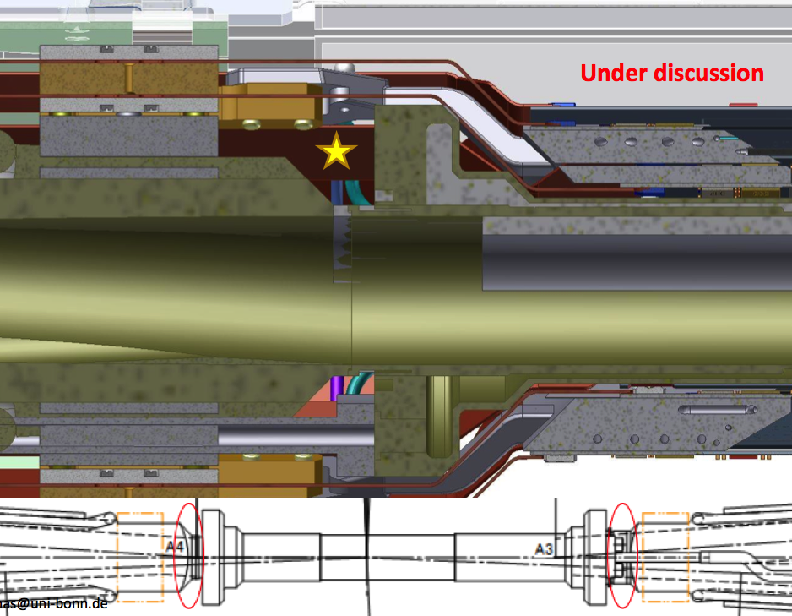
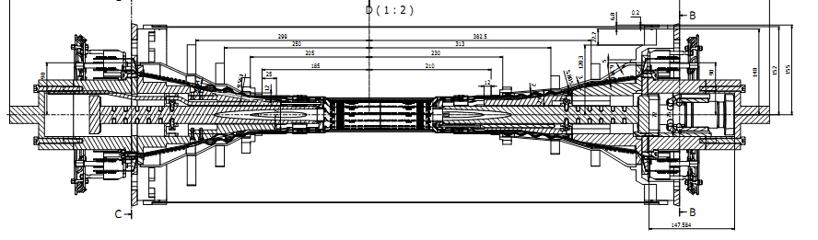
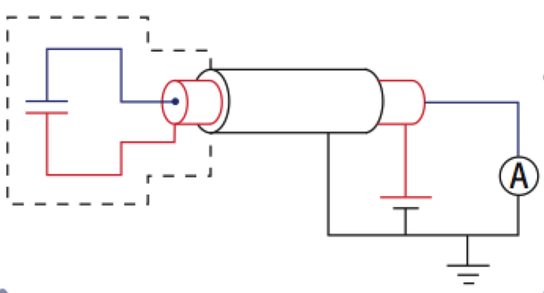
scCVD radiation sensors
4 + 4 sensors
PXD-beam pipe
6 + 6 sensors
on SVD support cone
close to L3 rings
Shielded
diamond
sensors
3+15 m (3+40 m) cables
Voltage sources (150÷500 V)
picoAmmeters

Slide 5
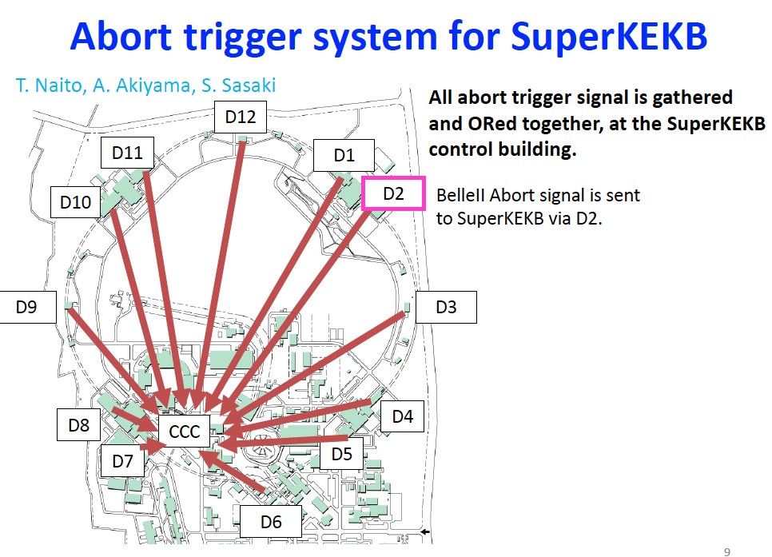

Slide 6
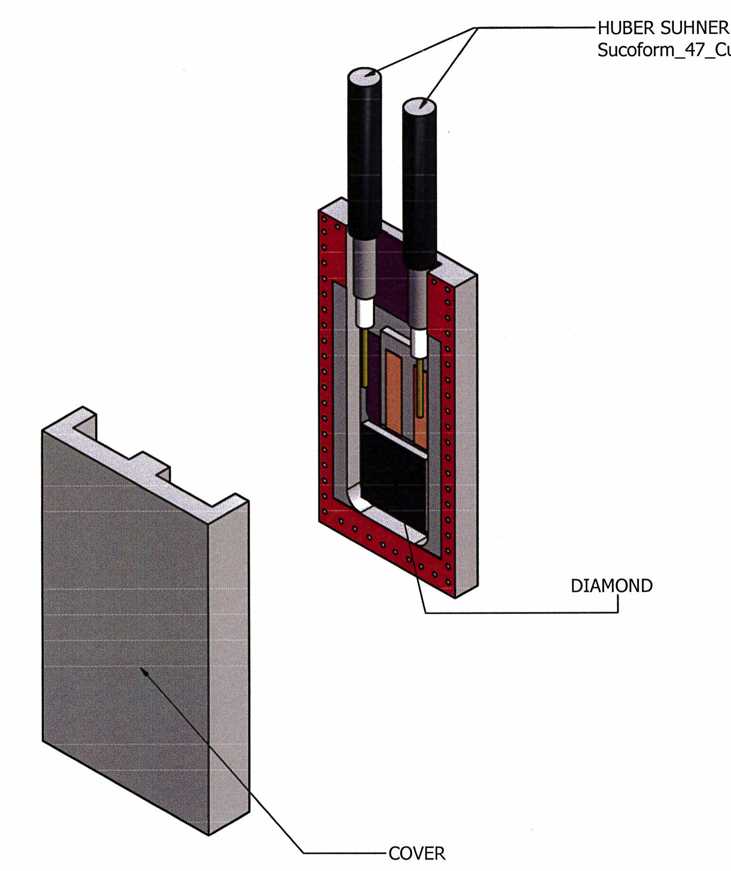
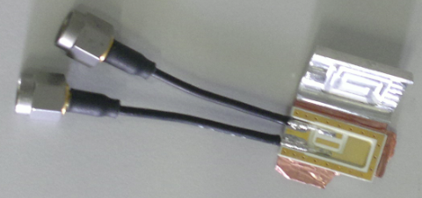
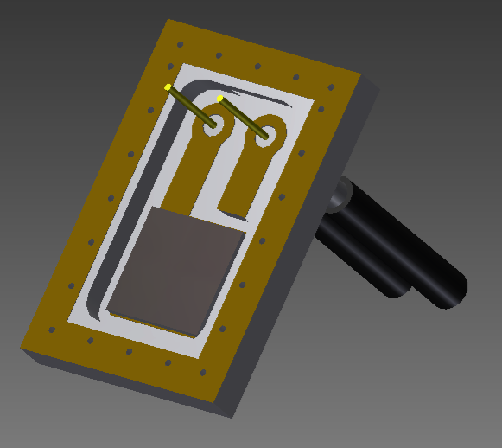
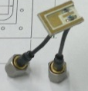
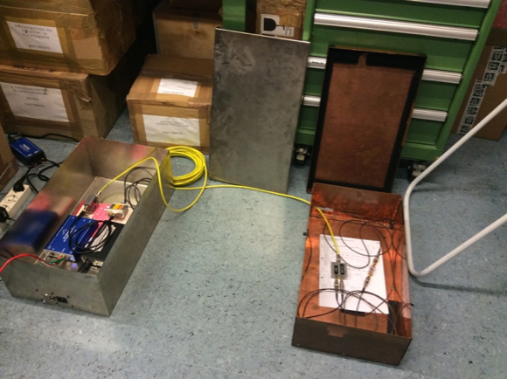
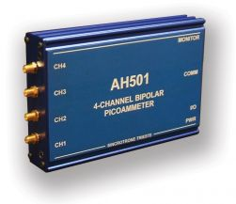
Mechanics, cabling
Compact packages:
  1) SVD 12 x 20 x 3.1 mm³
  multi-layer package, Rogers laminate ok for SVD (we already have 28 pc)
  2) PXD 12 x 10 x 3.3 mm³
  Same material, with perpendicular or parallel mounting (simulation)
Cabling (~20 m)
  3 m coaxial thin (HS SM47LSFH) from sensors to DOCKs
  + 15 m (or more) HS S_04162-B60, double shield

Slide 7
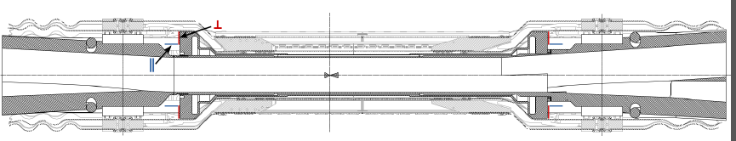
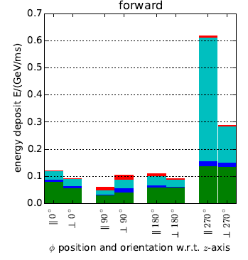
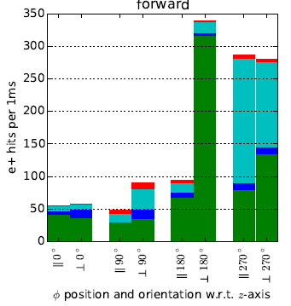
Expected radiation from simulations
VXD radiation/abort sensors included in simulation geometry, thanks to Martin Ritter MPI (Nov. 2014). Now Gianluca Inguglia DESY is taking over.
Energy deposit
Particle fluence (e-)
Preliminary
Preliminary

Slide 8
Location for “beam pipe” sensors: “perpendicular” option

Slide 9
Modified package for “perpendicular”

Slide 10
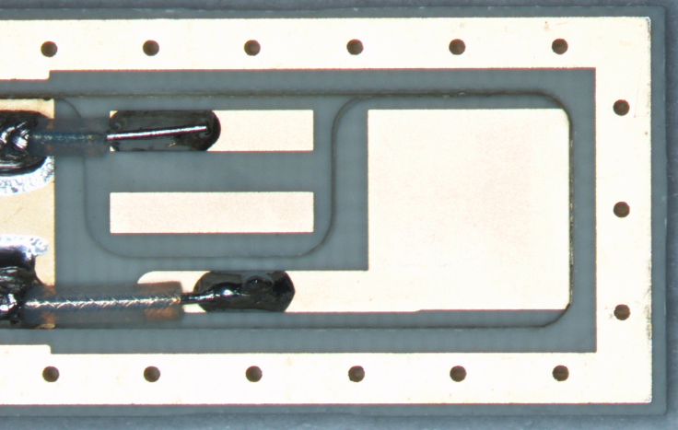
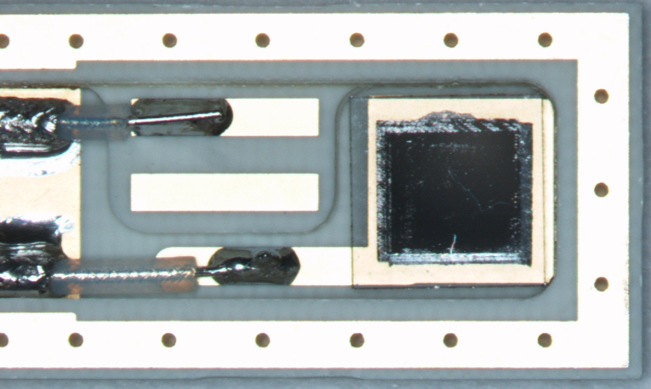
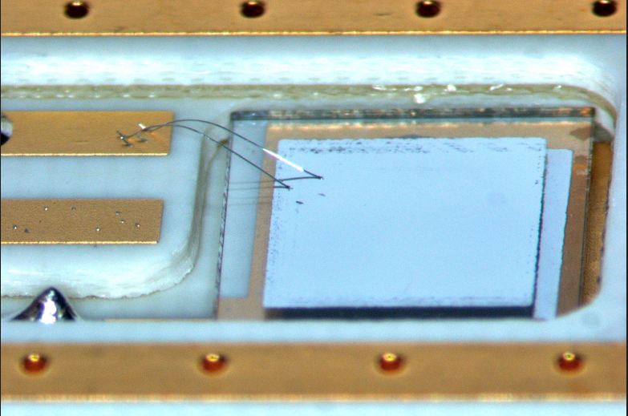
First tests of “final” package

Slide 11
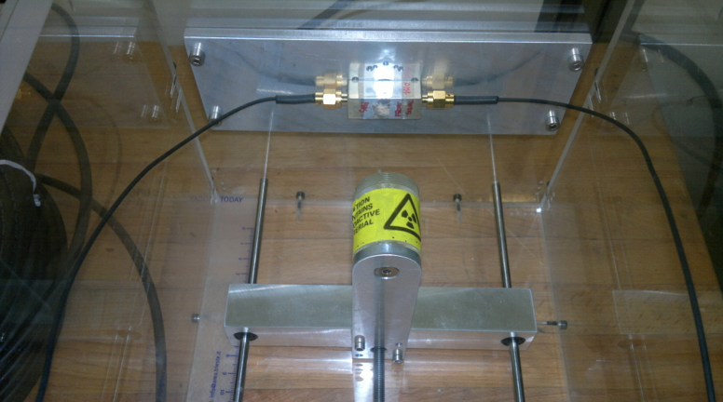
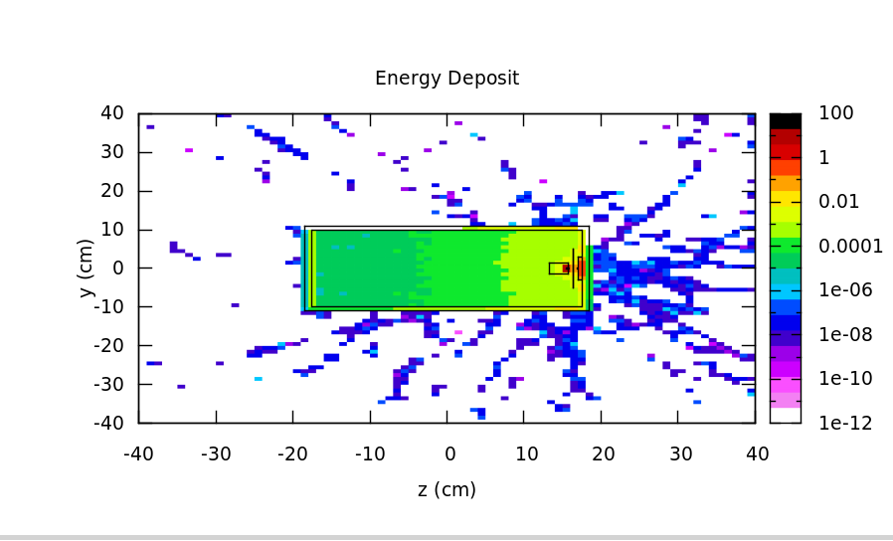
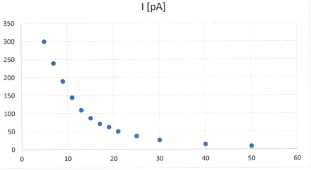
After MIPs tests: dosimetry
Sr90 point-like source, 3 MBq, at different distances, compared to FLUKA simulations
d [mm]

Slide 12
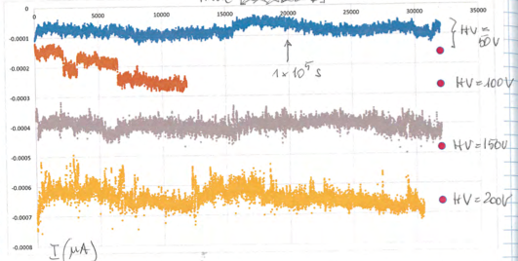
Long term stability studies
1 day
HV = 50-200 V

Slide 13
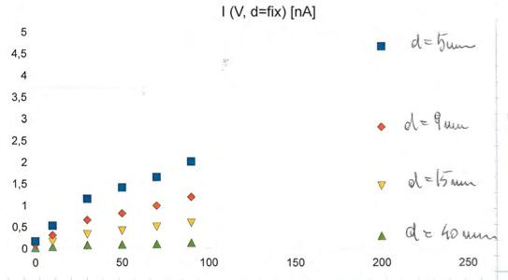
Current (dose rate) vs HV
I(nA) vs HV(V)
unexpected voltage dependence (no saturation?)
on both tested sensors (Micron)
at all distances
cross checked with different picoammeters

Slide 14
Diamond sensors are not that simple
Simplest model: just “ionization chambers”, but…
pCVD, known solid-state effects:
  “pumping” or “priming” (filling of long-lived “deep” traps)
  on/off transients (“shallow” traps, space charge and polarization)
  electrodes: complicated metal-diamond interfaces
    blocking vs. ohmic contacts, depending on materials & preparation
    charge injection and “photoconductive gain >1” are possible
scCVD: less defects, more stable behavior
  However similar (smaller) effects are possible
  Seen in our lab, to some extent (transients, gain?)

Slide 15
Sensors: plans
One “final” Cividec prototype ordered recently
Final acceptance tests will include:
  I-V without irradiation, both polarities
  Charge collection efficiency, MIPs (⁹⁰Sr β-source)
  Currents/dose rates measurements (⁹⁰Sr β-source)
  Measure electric field uniformity inside with TCT (Transient Current Technique) + ²⁴¹Am α-source
At the moment Cividec
  seems to be the most expert commercial provider of complete, metallized (and preliminarily tested) sensors
Other solutions are still open (discussion Friday)

Slide 16
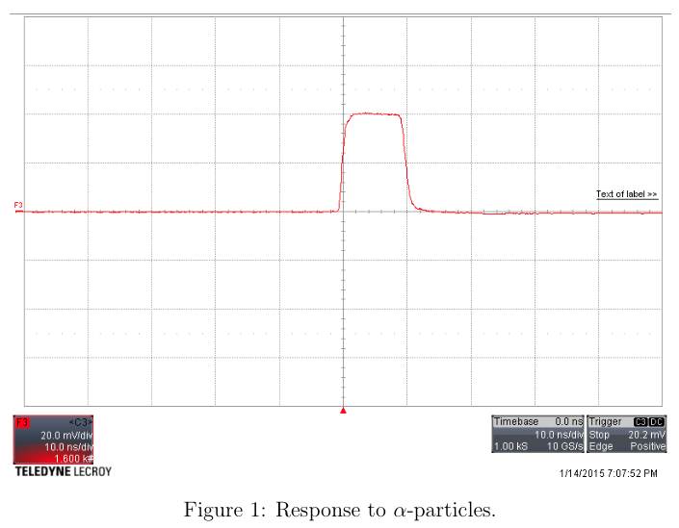
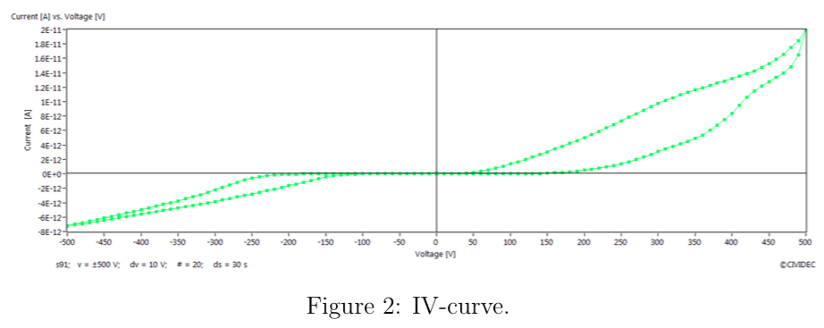
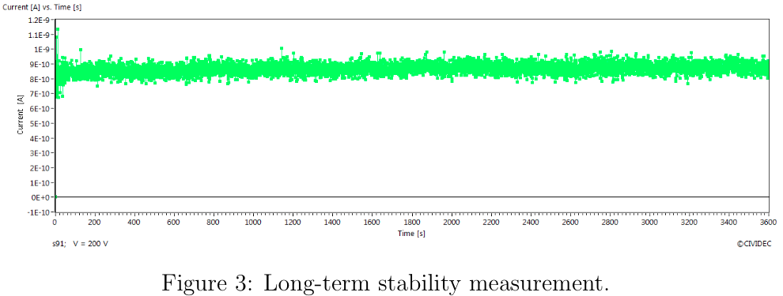
Cividec acceptance tests
10ns
→ ←
←10pA
Drift time
α-source
500V
←1nA
β-source 54MBq
Distance ~1cm
@ 200V
3600 s

Slide 17
Progress in electronics design
Collaboration with electronics&detectors group at Elettra, Trieste
  G. Cautero, D.Giuressi, R.H.Menk + F.Vulpone (student)
Modular design, FPGA + Memory + ADCs + HV + Ethernet
  project’s kernel: ALTERA DE3 evaluation board, with a STRATIX III FPGA
  External memory: Transcend 1GB DDR2 RAM
  3 peripheral boards will be connected with DE3
    board with 4 ADCs, HSMC connector
    board with 2 Ether-W-ease (Ethernet), 2 GPIO connectors
    board with 4 DACs and 4 HV diamond bias outputs
Schedule plans:
  “Final” prototype available for test with 4 sensors at BEAST phase 1
  “Production” modules ready for BEAST phase 2

Slide 18
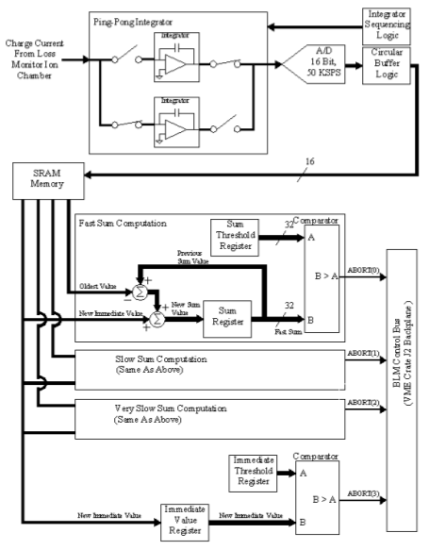
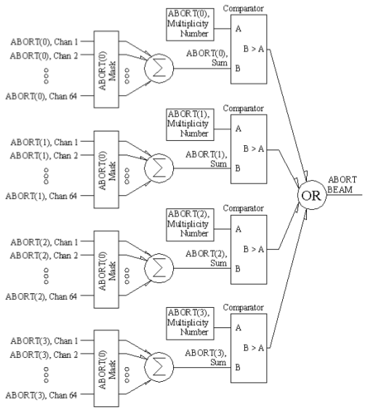
Desired functionality:
similar to Fermilab BLM
BLM Digitizer Card (“logger”):
ADCs, circular buffers, running sums
Analog front end + ADC
derived from
Elettra AH510 Pico ammeter
BLM Abort Card:
masks, majority logic,
thresholds (4 levels)

Slide 19
Rad.Mon+Abort, 4-channel Box
3 Sums
4 Abort Levels
Circular
Buffers
(for each
input channel)
ADC
Ethernet I/O
From 4 diamond sensors
FPGA
Timing
Control
Abort
HV
Ext. Clock (100 kHz)
Abort from SuperKEKB
Timing buffer
SuperKEKB status
Thresholds
etc.
to SuperKEKB
to 4 sensors

Slide 20
Design and implementation plans
Input currents
SuperKEKB timing
Ethernet I/O
ADCs
DE3/FPGA
Ether-W-ease
DACs
Ether-W-ease
HV outputs
Abort signals
Read and write the external RAM memory using the FPGA
Design and prototypes of the ADC’s and DAC’s boards
Design and prototype board with two Ether-W-ease
VerilogHDL program for the FPGA
  Synchronization, buffers, running sums, thresholds, abort logics

Slide 21
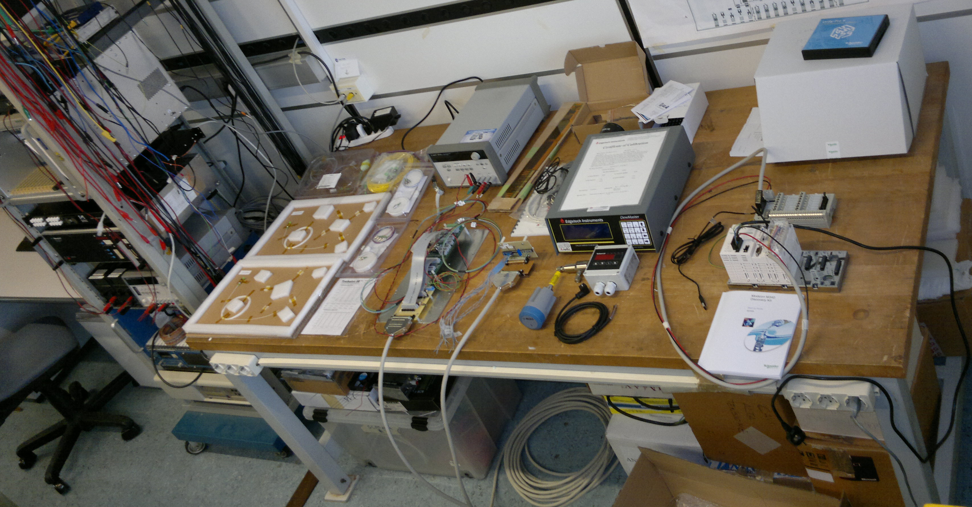
Environmental monitoring

Slide 22
SVD FOS fibers system (baseline)
(4x1)couplers
DOCKs
Layer 6: 16 ladders
16 fibers x 4 (+1) FBGs
Layer 6
4 couplers
…
…
Interrogator
…
Layer 5
3 couplers
Layer 5: 12 ladders
12 fibers x 3 (+1) FBGs
(16 inputs)
…
…
Layer 4: 10 ladders
10 fibers x 2 (+1) FBGs
Layer 4
3 couplers
…
…

Slide 23
SVD FOS fibers system -2 FBGs/origami
(4x1)couplers
DOCKs
Layer 6: 16 ladders
16 fibers x 7 (+1) FBGs
Layer 6
4 couplers
…
…
Interrogator
…
Layer 5
3 couplers
Layer 5: 12 ladders
12 fibers x 5 (+1) FBGs
(16 inputs)
…
…
Layer 4: 10 ladders
10 fibers x 3 (+1) FBGs
Layer 4
3 couplers
…
…

Slide 24
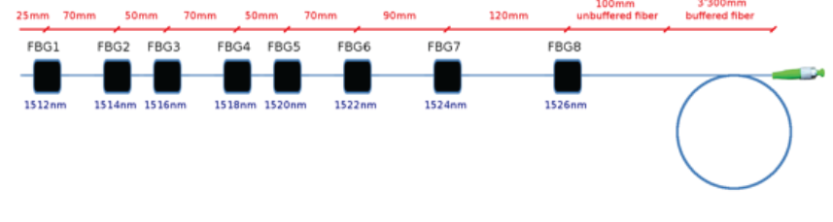
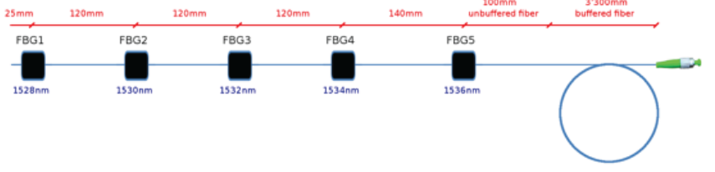
FOS temperature sensors: status
Recent purchases (delivered last week and yesterday):
  16-channel interrogator, Micron Optics (Pisa)
  Prototypes with different numbers of sensors per fiber, from 2 providers:
    Micron Optics
    Smart Fibres
  Final purchases
    38 fibers
    Early 2015
Environmental chamber for calibrations
  [−30°C ÷ +70°C], available in Trieste; help from Santander welcome!

Slide 25
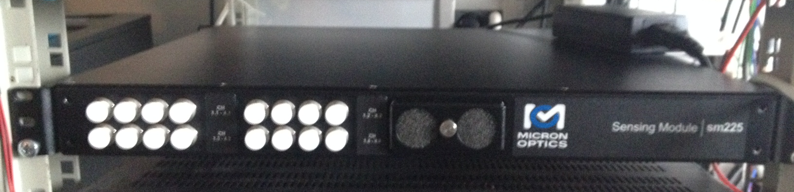
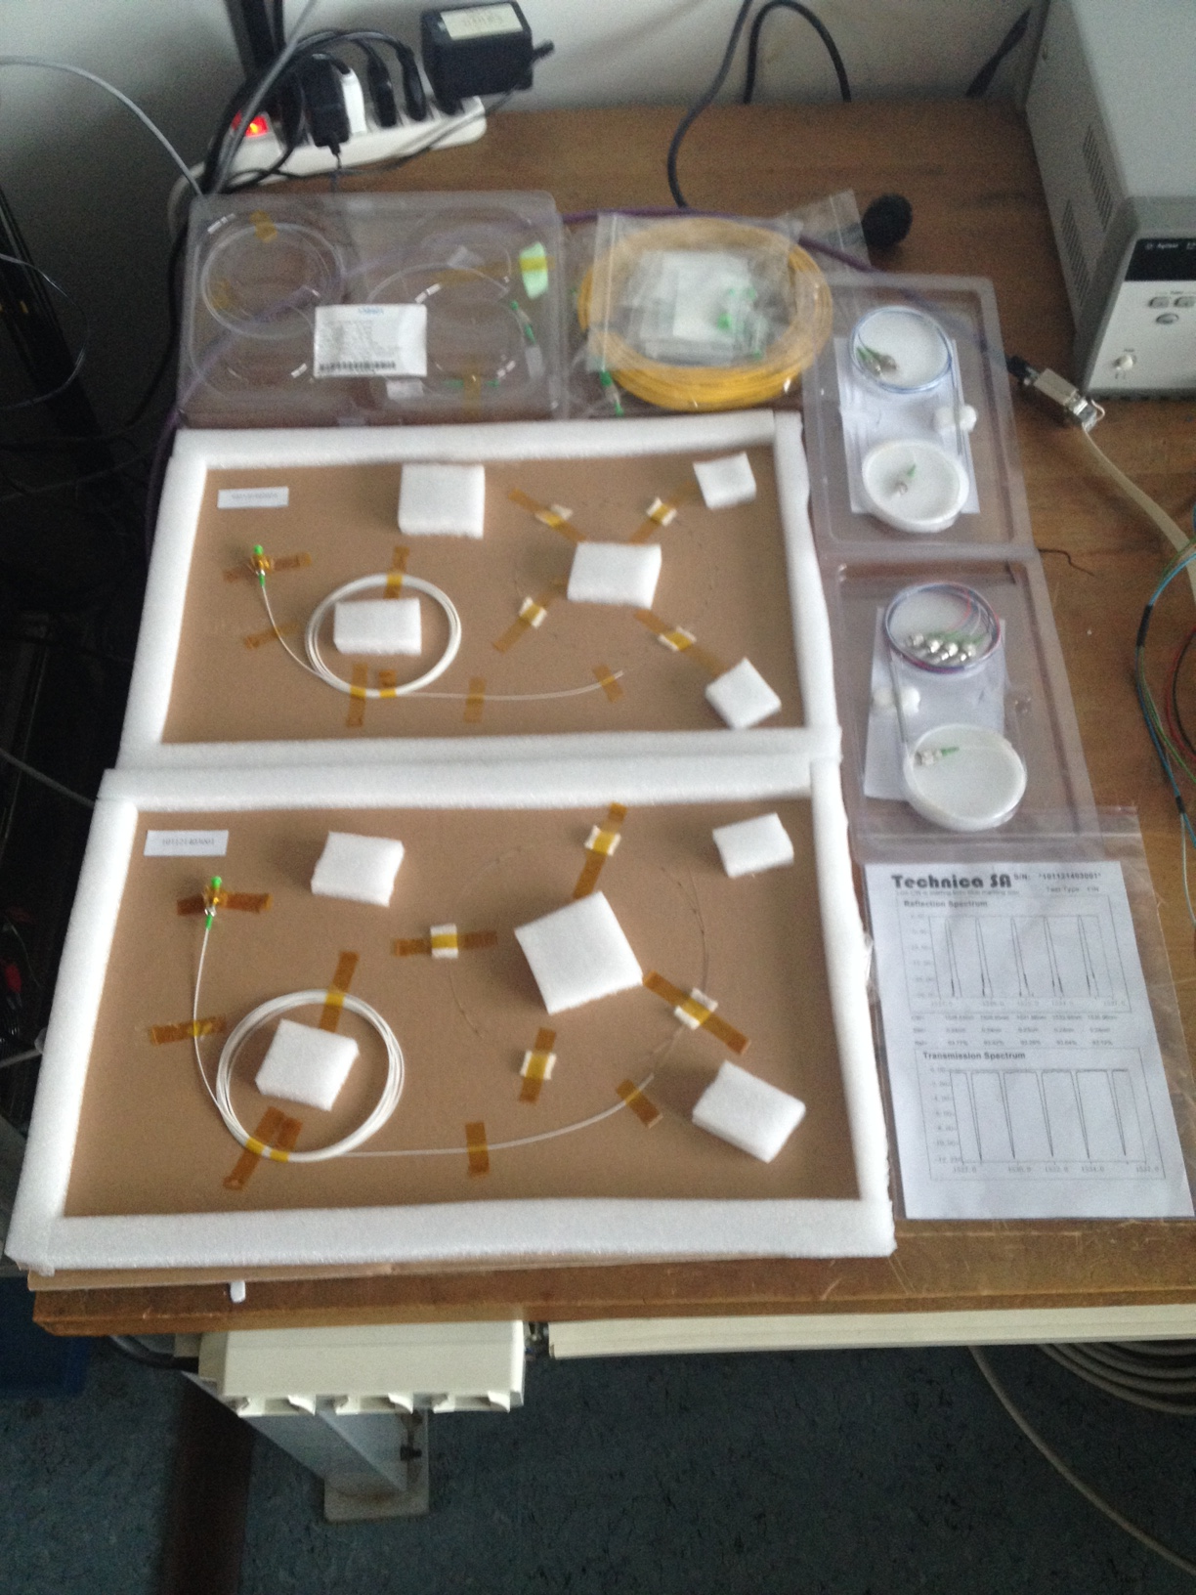
SM 225-800 16-channel interrogator, Micron Optics
Test fiber received from Santander
(2x1)coupler
Fiber with 8 sensors
(4x1)coupler
Fiber with 5 sensors

Slide 26
NTC ELMB readout, preliminary design
sensors
docks
Box in Electronics Hut
≈ 3÷4 m
Current
sources
+ interlocks
6 x 2 signals
to VXD
Interlock
logics
Shielded
twisted
pairs (16)
8 twisted pairs
(no shield)
2 interlock signals
8 twisted pairs
(no shield)
(shield
grounded
at docks)
ELMB
Small
connect.
board
ELMB
CANbus
connectors
+ jumpers
Temperature:
up to
6 x 16 = 96
NTC thermistors
ELMB
PC
Power supply
EPICS
Slow Control

Slide 27
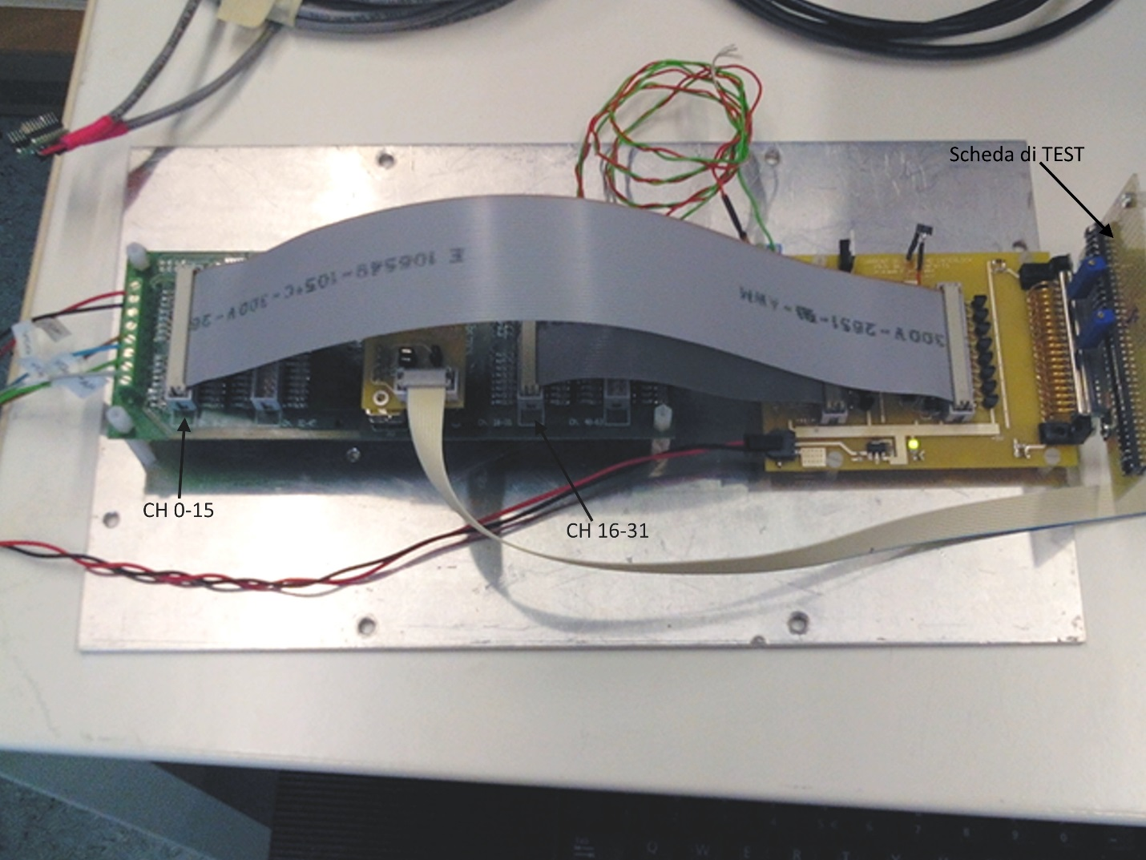
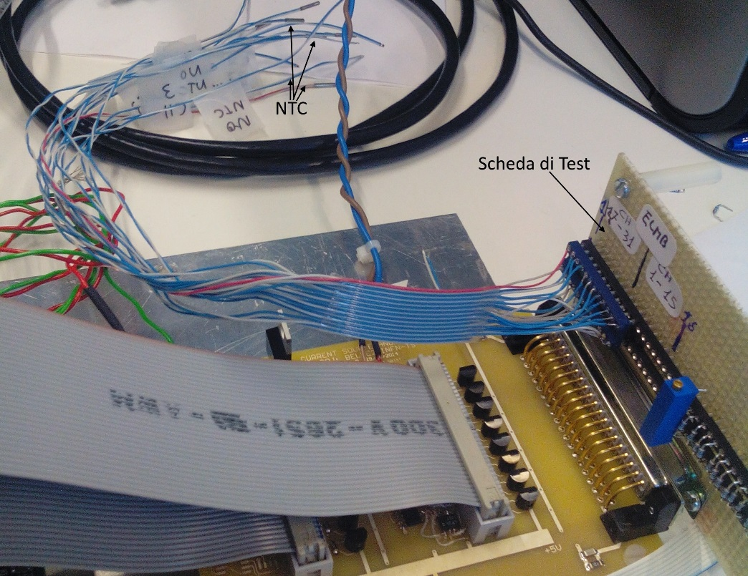
NTC: full prototype chain tested
Motherboard
100k NTC thermistors
- Betatherm (TS)
- Murata (Vienna)
ELMB
board
CANbus
adapter
Current sources
Interlock comparators

Slide 28
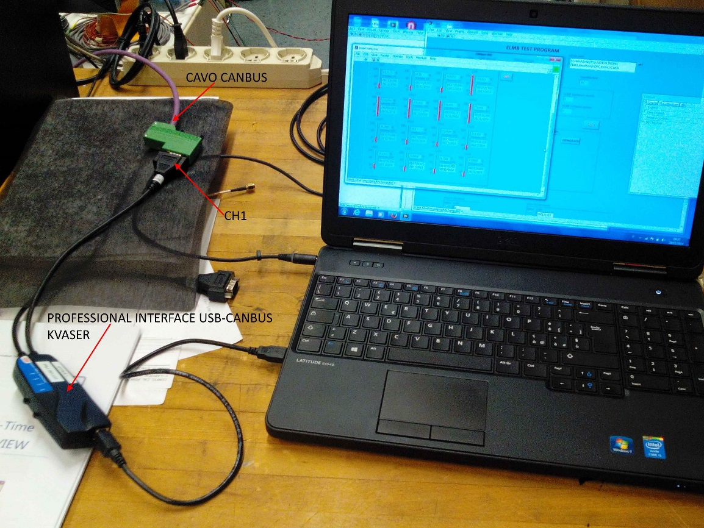
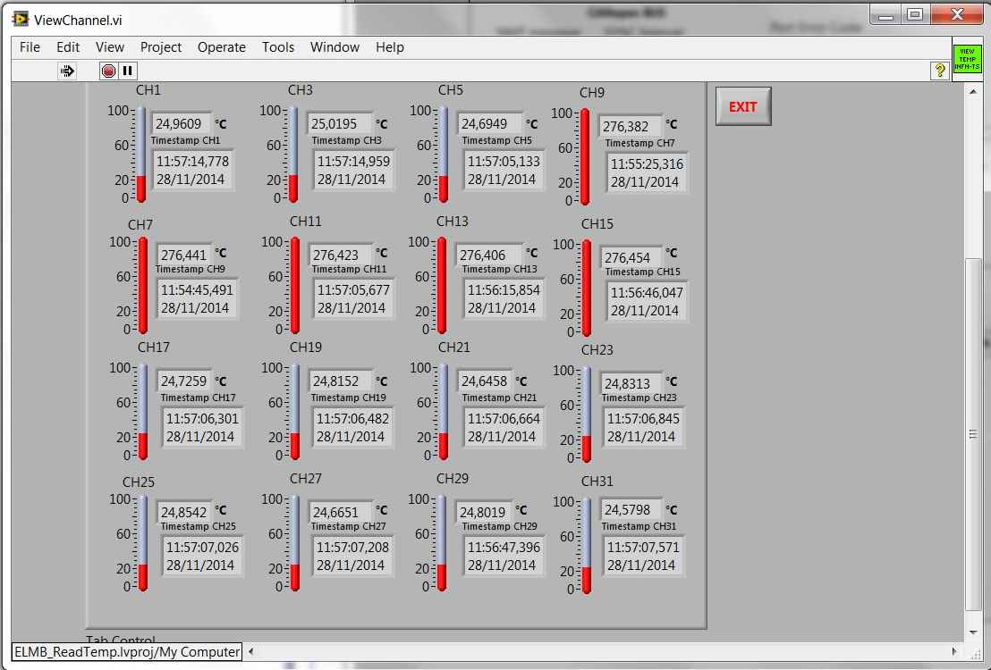
Interface, software and stability
New Kvaser CANbus-USB interface installed
Software
  Stand-alone debugging program
  LabView + CANopenOPCServer 2.9.7.4
  EPICS: expert visit welcome
Uniformity and stability tests on 11 thermistors
  OK !

Slide 29
Final motherboards design, completed
sensors
docks
Box in Electronics Hut
twisted
pairs (32)
≈ 3÷4 m
4 interlock signals
3 x 4 signals
to VXD
Interlock PLC
Current
sources
+ interlocks
ELMB
4 x 8 twisted pairs
(no shield)
3 Small
connect.
boards
Current
sources
+ interlocks
CANbus
ELMB
Current
sources
+ interlocks
Temperature:
up to
3 x 32 = 96
NTC thermistors
ELMB
PC
connectors
+ jumpers
Power supply
EPICS
Slow Control

Slide 30
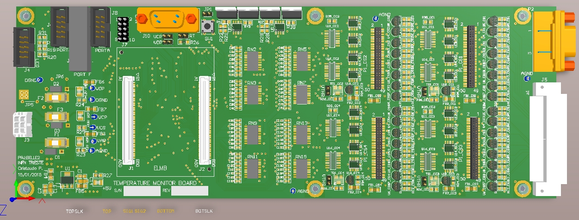
“Final” NTC ELMB design readout and interlock board
CANbus connector
interlock
to PLC
Input
32 NTC
ELMB
Reference resistors
Current sources and interlock comparators

Slide 31
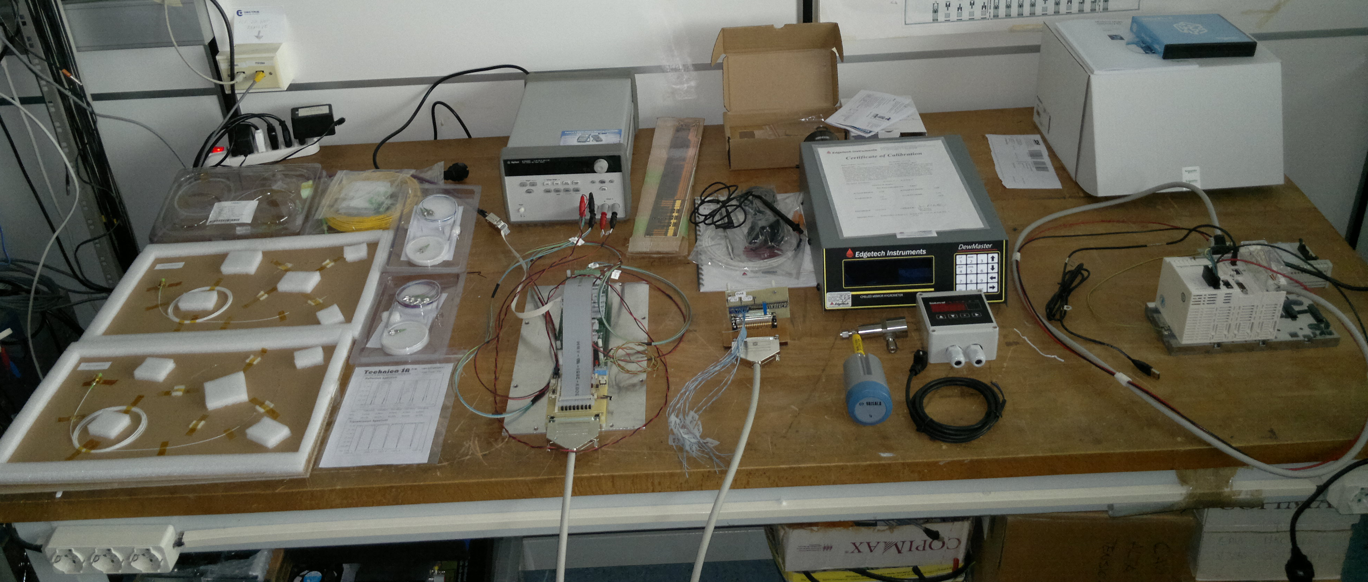
Humidity monitoring & interlock

Slide 32
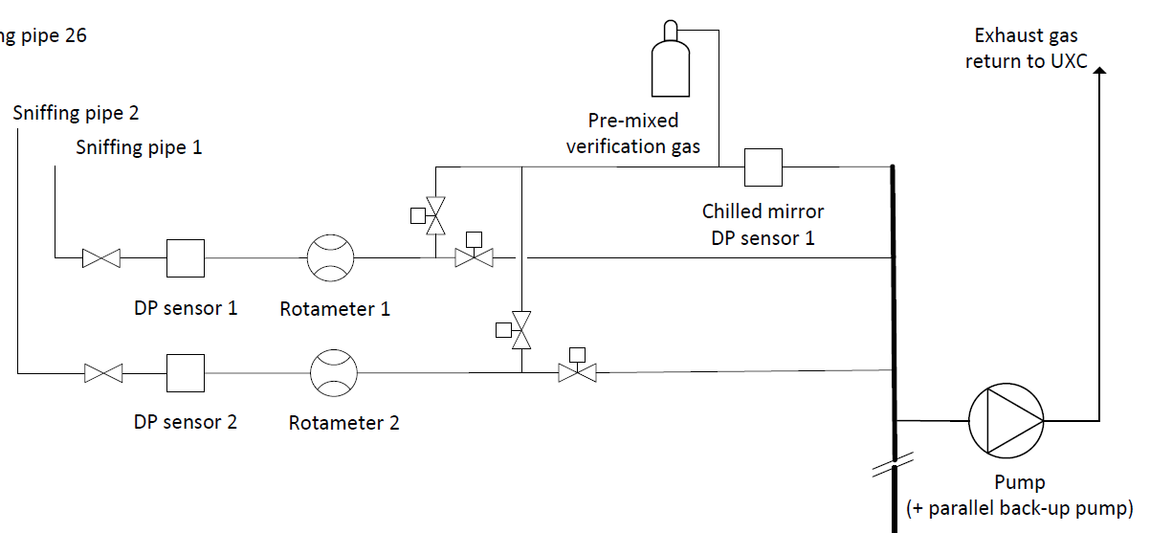
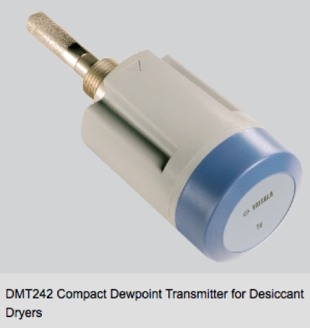
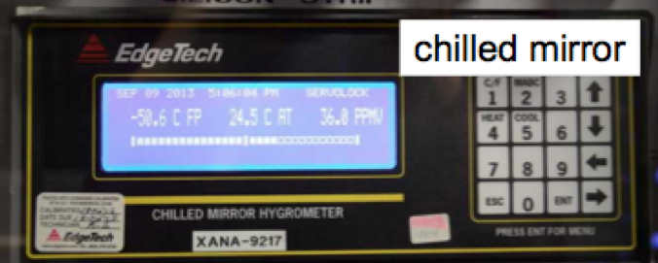
Dew Point Sensors (interlock @ -30°C)
Sniffing pipes
Vaisala DMT242B
Dew Point Transmitters
[-60, +60]ºC dew point range
Main components
received
Prototype planned
(1st quarter 2015)
Edgetech Dewmaster
Chilled Mirror Hygrometer
(for calibrations)
Rotameter
flux meters
Pump

Slide 33
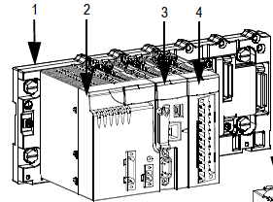
SVD + PXD Interlocks
INPUTS
INTERLOCK
LOGICS
OUTPUTS
Temperature (NTCs)
Dew point (Vaisala)
Sniffer Pump(s)
Cooling plant failure
Beam Abort
Fire alarm?
…etc
?
?
?
PXD power supplies
VXD power supplies
(not segmented)
…etc
Programmable Logic Controller (PLC)
Schneider M340 – cpu BMX P34 2030
Modbus/EPICS drivers exist! expandable
kit (p.s. + cpu + I/O + software) purchased
Local expertise: INFN technician

Slide 34
Summary
Good progress on:
  Radiation monitor & beam abort
  Temperature monitoring
  Humidity monitoring/interlock
  SVD+PXD interlocks: PLC
Documentation to be prepared!!!
Parallel session on Friday 10.30: discussion
A very busy period also for us …

Slide 35
Approximate schedule
Radiation | 2014 |  |  |  | 2015 |  |  |  | 2016
What | 1 | 2 | 3 | 4 | 1 | 2 | 3 | 4 | 1 | 2
Specifications, sign up
Simulations
Dosimetry, characterization
Diamond sensors choice
Mechanics & cabling design
Electronics specifications
Electronics design & proto.
Overall design, sign up
Components, procurement
"final" prototypes (4 ch.)
BEAST, 1 preliminary tests
BEAST, 2 complete test (4 ch)
electronics production & test
sensors installation & cabling
electronics installation
Temperature & humidity | 2014 |  |  |  | 2015 |  |  |  | 2016
What | 1 | 2 | 3 | 4 | 1 | 2 | 3 | 4 | 1 | 2
T&H Specifications, sign up
Fibers, mechanical layout
Fibers, assembly tests (SVD)
Fibers, multiplexing scheme
Fibers design sign up
Procurement, assembly
installation (PXD & SVD)
Thermistors, lab tests
Mechanics & cabling design
Procurement
assembly, installation

Slide 36
Back-up slides

Slide 37
Diamond sensor characterization
Label | Provider | sc/p CVD | Geometry mm^3 | pads | Validation ⁹⁰Sr beta
PD | DDL | sc | 4.7x4.7x0.15 | 2x2 | OK
DC1 | Cividec | sc | 4.7x4.7x0.50 | 3x3 | OK
DC2 | Cividec | p | 5.0x5.0x0.50 | 3x3 | TBD
DM1* | Micron | p | 5.0x5.0x0.50 | 1 | OK
DM2* | Micron | sc | 4.7x4.7x0.50 | 1 round | OK
DM3 | Micron | p | 5.0x5.0x0.50 | 1 | Rejected
DM4 | Micron | sc | 4.7x4.7x0.50 | 1 | OK
DM5 | Micron | sc | 4.7x4.7x0.50 | 1 | OK
DM6 | Micron | p | 5.0x5.0x0.50 | 1 | TBD

Slide 38
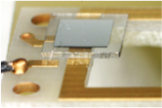
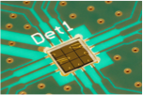
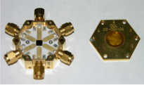
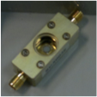
Diamond sensors
DM1
DC1
PD
DM4

Slide 39
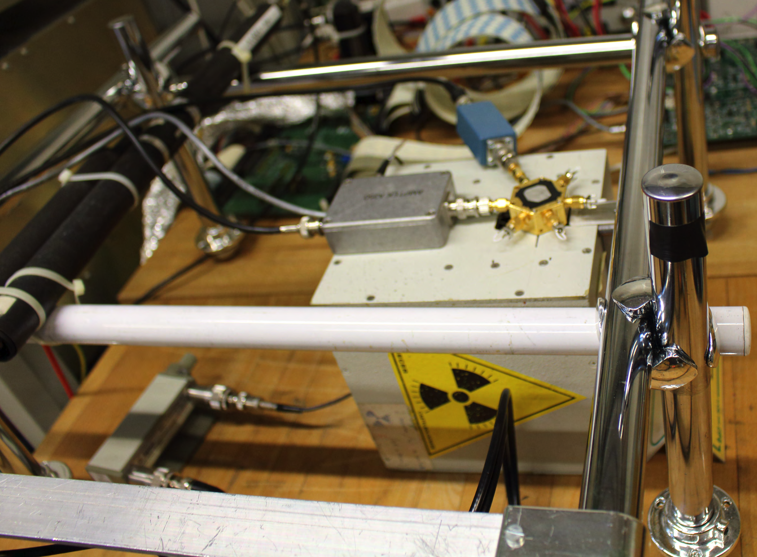
Test tools
Static characterization of the samples (I-V and C-V)
Single channel Amptek chain: A250 preamp. (2.5 ns risetime) + PX5 digital shaper (semi-gaussian equivalent time 40 ns – 40 µs).
A pointlike ⁹⁰Sr source (~2 MBq), beta spectrum hardened by magnetic field and collimators
Tests repeated at DESY 2-6 GeV electron beam

Slide 40
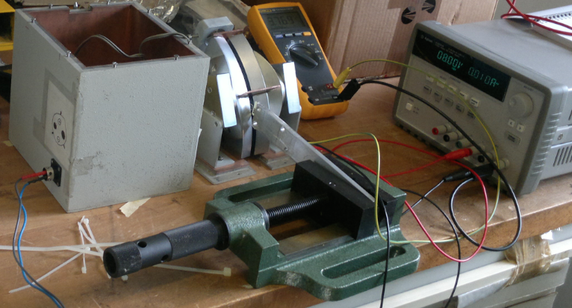
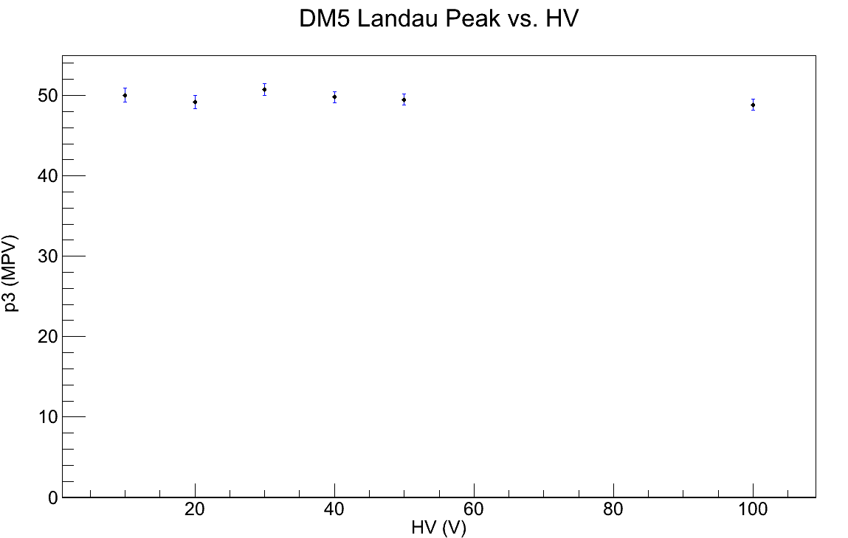

MIP Characterization of scCVD sensors
Single electrons, 1-2 MeV (MIP): Landau peak vs HV
MPV vs HV

Slide 41
Belle II-VXD Radiation Monitoring and Beam Abort
Main requirements
  Measurement of instantaneous dose rates & integrated doses
    Sensitivity ≈ 1 mrad/s = 10 μGy/s, sampling rate ≈ 100 KHz
  Beam Abort for excessive beam losses affecting PXD, SVD
    Programmable thresholds, depending on accelerator conditions (filling injection, stable beams, machine development, …)
    “Fast” (10 μs = 1 accelerator revolution) Beam Abort trigger
    “slower” Beam Abort triggers, based on digitally filtered signals (averages over programmable numbers of samplings)
Conceptual design
  Based on experience from Belle, BaBar, CDF, LHC
  scCVD diamond sensors, measurement of currents:
    Reference: typical pCVD sensor (10 × 10 × 0.5) mm³ @ 500V: 1 nA = 7 mrad/s = 70 μGy/s
    Noise should be limited to a few pA, in current measurements
  4 + 4 sensors located near PXD (very limited space)
  6 + 6 sensors located near SVD
  Background dominated by electrons

Slide 42
VXD Monitoring & Beam Abort electronics
5 modular Boxes, dealing with 4 scCVD sensors each:
  4 individual HV bias supplies
  Currents digitization with 4 (16-bit) ADCs at 160 MHz, with oversampling
  Data averaging and buffering for
    Continuous Monitoring (averaged data, 1-10 Hz read-out)
    Post-mortem (abort) analysis (full data, frozen circular buffers)
  Running Sums, Programmable Thresholds, Majority logics for Abort signals
  Ethernet interfaces (2) for programming and data read-out
Compatibility with the SuperKEKB Abort System requires:
  Sampling synchronized to SuperKEKB revolution period (10 μs)
  “SuperKEKB status” register, set via EPICS (for the selection of thresholds)
  2 final output “fast abort” signals, correlated with LER and HER
  600 ms deep data buffers, read out upon an abort, internal or external
  Synchronization with SuperKEKB aborts: digitization of 2 beam currents, and “abort confirmation” digital signal from SuperKEKB

Slide 43




Similar approach: BLM at LHC
FPGAs
Running Sums
Thresholds

Slide 44

NTC current sources and interlock signals
6 small boards, each:
  Current sources for 16 NTCs
  16 comparators with hardwired thresholds
  2 interlock signal outputs (each: OR of 8 channels)
Built-in redundancy
  2 NTCs per measurement point
  Each contributes to a separate interlock OR
Design completed, prototype channel tested

Slide 45

ELMB-based NTC readout
In one box, with 3 x 32 NTC channels modularity:
  1 power supply board, 3 motherboards with ELMB and CANbus adapter, 3 x 2 current source (16-channel) boards, 3 x 2 x 16-channel connectors

