Slide 1


Status of IBBelle
VXD Cooling Requirements
IBBelle Overview
Commissioning at CERN (ATLAS version)
Software Control
Ordering of Parts
Location of IBBelle at KEK
Schedule and Responsibilities

Slide 2
VXD Cooling Requirements & Specs
Minimize material in acceptance region
SVD requirements:
coolant temperature for APV25 @ -20°C for SNR improvement
total dissipated power ~ 700 W
PXD requirements:
sensor temp. < 25°C, ASICs < 50°C : cooling block @ <-20°C
dissipated power ~ 360 W
Cooling power ~ 1.6 kW at VXD (incl. ~ 540 W parasitic heat influx)
have to add heat loss through 15 m of transfer lines → ~ 2-3 kW
Dry Volume (nitrogen):
dew point inside VXD volume: ~ -30 °C
Outside of VXD: room temperature ( ~ 23°C) at the CDC
may need a thermal enclosure towards CDC, well isolated

Slide 3
SuperKEKB/Belle II Schedule
shown during B2GM in Nov. 2014
Calendar
2014
2015
2016
2017
2018
Japan FY
JFY2014
JFY2015
JFY2016
JFY2017
JFY2018
now
Power restriction
in summer
Power restriction
in summer
Power restriction
in summer
Power restriction
in summer
SuperKEKB Construction
phase 1
phase 2
phase 3
Start-up
w/o QCS
w/o Belle II
QCS, Belle II
VXD install
w/ full Belle II
Original plan
w/ QCS
w/ Belle II (no VXD)
JFY2014 Operation budget cut by 12 Oku-Yen
SuperKEKB Construction
phase 1
phase 2
phase 3
Current plan ongoing
“C4”
Start-up
w/o QCS
w/o Belle II
QCS, Belle II install
w/ QCS
w/ Belle II (no VXD)
VXD install
w/ full Belle II
JFY2015 Operation
(small) budget cut
“conceivable” schedule
SuperKEKB Construction
phase 1
phase 2
phase 3
(A) JFY2015 budget 60 Oku-Yen
Start-up
w/o QCS
w/o Belle II
QCS, Belle II install
w/ QCS
w/ Belle II (no VXD)
VXD install
w/ full Belle II
CO2 Cooling is needed in Tsukuba hall already for BEAST 2

Slide 4


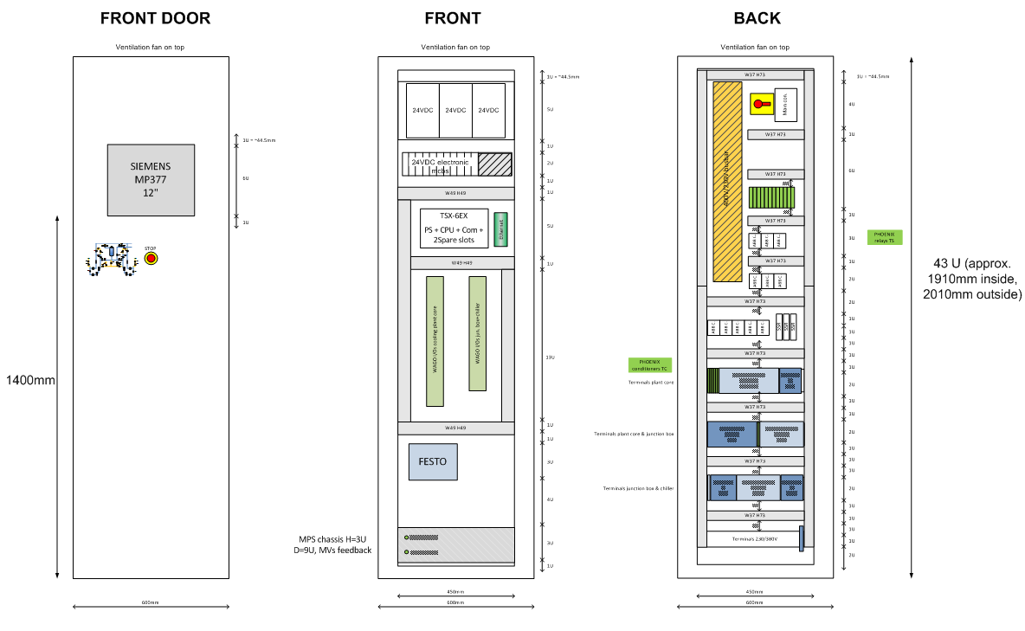
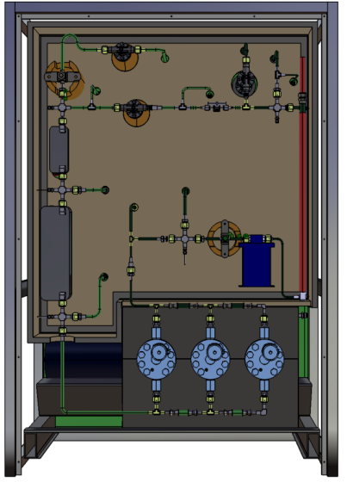

CO2 System Overview
Junction box
BD016
PT116 / PT316
TT116 / TT316
⅜”
16
Dummy load (testing only)
HX036
MV018
MV017
½”
MV036
Transfer lines
(~ 100 m)
36
FL018
FL017
EH117
TT117
TS117
BD036
PT136 / PT336
TT136 / TT336
TTz36 (DCS)
BD020
PT120 / PT320
TT120 / TT320
TTz20 (DCS)
¼”
20
⅜”
AV017
10
VP510
12
VP512
MV035
nc
PT510
TT510
PT512
Vacuum isolated
¼”
Manifold box
EV508
⅜”
½”
DN40
08
Vacuum system
DN40 vacuum
nc
EV608
EH122
TS122
06
10
VP610
12
VP612
DCS:
TTa24 - TTn24
(FTa24 - FTn24)
MVa24 - MVn24
PT610
TT610
PT612
04
Flex
lines
~15 m
HX012
vacuum isol.
Cables and inter connection pipes
Two-stage dry volume
PXD / SVD
CO2 Plant „IBBelle“
(IBL + Belle)
14 staves (a-g),(7 flow pairs)
(10x BW flow / 4x FW flow)

Slide 5
IBBelle
12
CO₂ to experiment
MV042
PT142
PT342
MV040
BD112
10
SV042
SV043
LT142
LT342
MV043
SV040
SV041
10
Cold CO2 line
Cold R404a line
Warm service line
(Cold lines require 32mm insulation)
NV110
AC042
½”
NV310
40
CO₂ from experiment
¼”
CV142
CV342
¼”
PV110
no
nc
nc
no
PV310
System A
nc
MV110
MV310
nc
42
System B
MV041
⅜”
AV108
nc
bs
AV308
BD108
PT108
TT108
PV108
EH142/143
TT142/143
TS142/143
EH342/143
TT342/143
TS342/143
PV308
⅜”
8
8
BD308
PT308
TT308
Fill port
FL144
PV144
PV344
FL344
nc
Fill port
nc
EH106
TT106
TS106
44
nc
44
FL106
vent
VP056
evacuate
EH306
TT306
TS306
FL306
nc
MV054
½”
MV052
nc
BD050
PT050
MV056
MV306
MV106
nc
MV050
nc
MV058
½”
nc
6
nc
¼”
nc
6
TT146
46
46
TT346
FT106
HX148
EV148
EV348
FT306
nc
nc
HX348
FL104
TT148
48
PT149
TT149
PT349
TT349
48
TT148
BD304
PT304
TT304
FL304
PT104
TT104
50
50
4
HX150
CV149
Freon chiller A 200
Freon chiller B 400
CV349
HX350
4
LP101
LP301
EH101 / EH102 / EH103
TT101 / TT102 / TT103
TS101 / TS102 / TS103
PT101 / PT102 / PT103
nc
nc
LP101
EH301 / EH302 / EH303
TT301 / TT302 / TT303
TS301 / TS302 / TS303
PT301 / PT302 / PT303
50
½”
½”
50
BD150/ PT150/ TT150
BD350/ PT350/ TT350

Slide 6
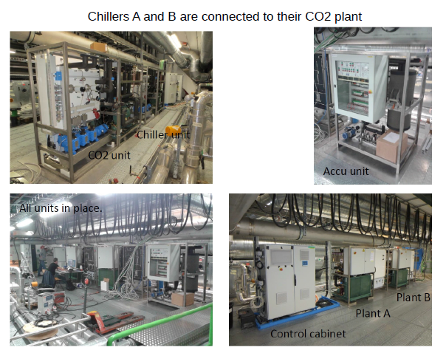
IBBelle at CERN
Installation at CERN (ATLAS Experiment): the “twin” of IBBelle
Accum.
rack
Construction of IBBelle (ATLAS) is finished, commissioning with dummy heat load is done
Some problems getting down to -40°C
(not important for the Belle version
IBL now cooled down

Slide 7
Ordering of Parts for the CO2 Plant
Mechanics: Production drawings mostly up-to-date
Parts list largely established, still visit at CERN necessary
MPI working on this: Sven Vogt
Swagelok part list done, ordering ongoing, first parts have arrived
Control (PCLs etc): mostly documented.
MPI working on this: Reinhard Sedlmeyer
Further visit to CERN necessary
Parts being ordered through CERN, parts are coming in

Slide 8
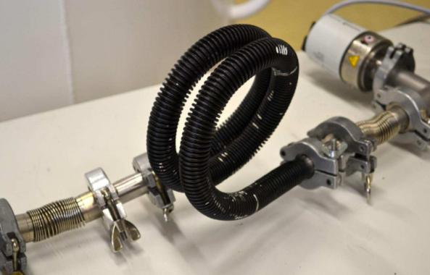
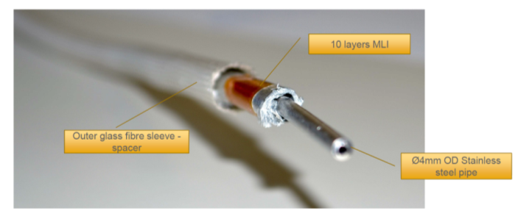
CO2 Vacuum Flex Lines
Flex line design (by CERN/NIKHEF)
MLI (super) insulation
~ 12m long
4 mm OD /
3 mm ID
outlet tube
1.6 mm OD /
1.0 mm ID concentric
inlet tube
18 mm OD corrugated vacuum tube
MLI
admissible bending radius:
~ 50 mm
CERN crew offers help building the tubes

Slide 9
Construction and Commissioning
IBBelle for VXD will be an almost EXACT copy of IBBelle (ATLAS)
Variants possible in the transfer system from IBBelle to VXD
(include results from Thermal Mockup)
Up-to-date 3D CAD model and production drawings exist
Ordering of parts according to lists established at MPI (based on material from CERN/Nikhef for ATLAS IBL) by MPI
Construction at MPI starts in 2015 (workshop is prepared), including pressure tests, control electronics, etc.
Commissioning will be done with the help of CERN/Nikhef crew (exact dates to be organized) by the end of 2015 at MPI, including engineers from DESY, KEK and SVD (tbd)
Certification by TÜV (process being prepared at present)

Slide 10
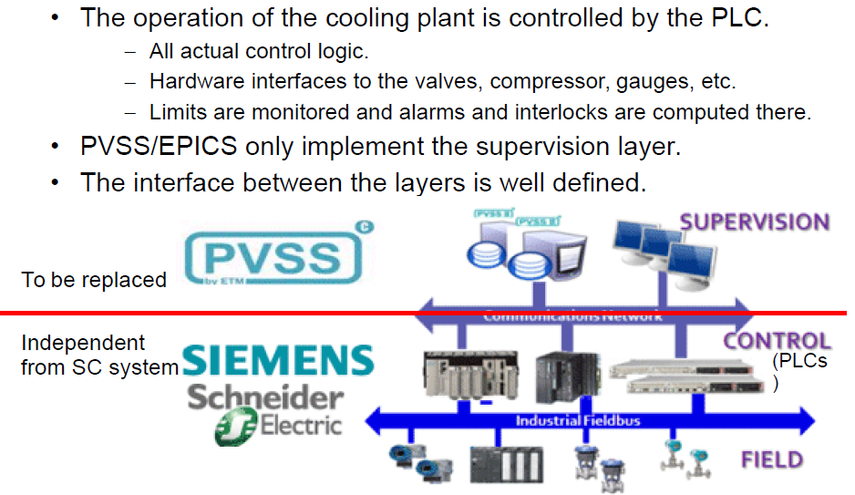
PVSS -> EPICS
Remark: This is a desired option, not a necessity

Slide 11
PVSS GUI for IBBelle
Plant A
PVSS sets operation points (T, CO2 flux) and monitors the operation
Supervising layer (+GUI) will be
re-written in
EPICS / CSS
(Michael, Bogdan, Thorsten)
All critical control / operation functions are formulated in PLC and will not be touched

Slide 12
IBBelle Form Factor: ATLAS Model
40’ Container, to be placed outside of Tsukuba hall
Advantage: unit can be assembled and commissioned at MPI, no need to take it apart for transport, no reassembly
Requirements at KEK: Need earth-quake-safe hut around IBBelle, need water/electricity outside hall

Slide 13
Services for IBBelle
European standard P/S at KEK, needs to be reactivated
Requirement: 400 [V] ± 10 % (filtering of V spikes)
Water for the chiller cooling: 20 l/min, room temp OK,
only filter needed, connections to be specified
N2: 50 l/min (Gas), room temp OK
Air conditioning: room temp ± 3°C, rel. humidity < 70 %
Transfer lines & connection standards still need to be specified (depending on location of IBBelle)

Slide 14
Phase 2 / PXD Integration
VXD Assembly clean room in B1

Slide 15
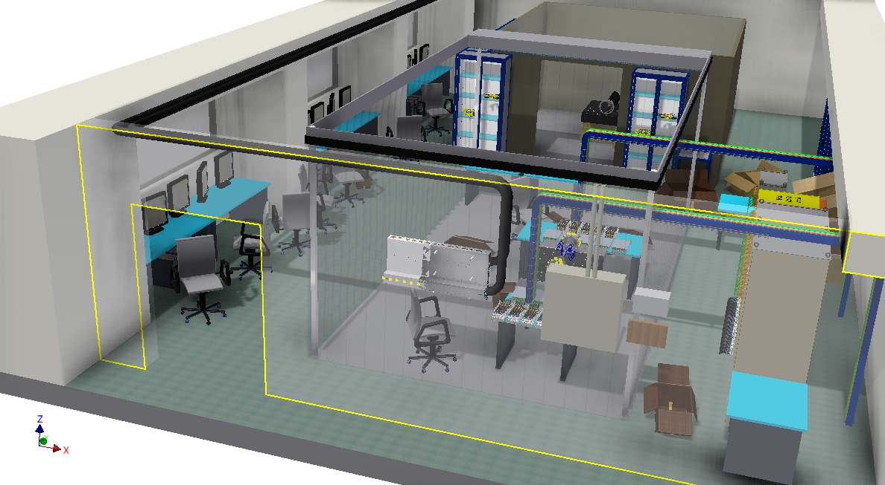
VXD Clean Room in B1
Should already be available for BEAST Phase 2 assembly
Tscharlie Ackermann

Slide 16
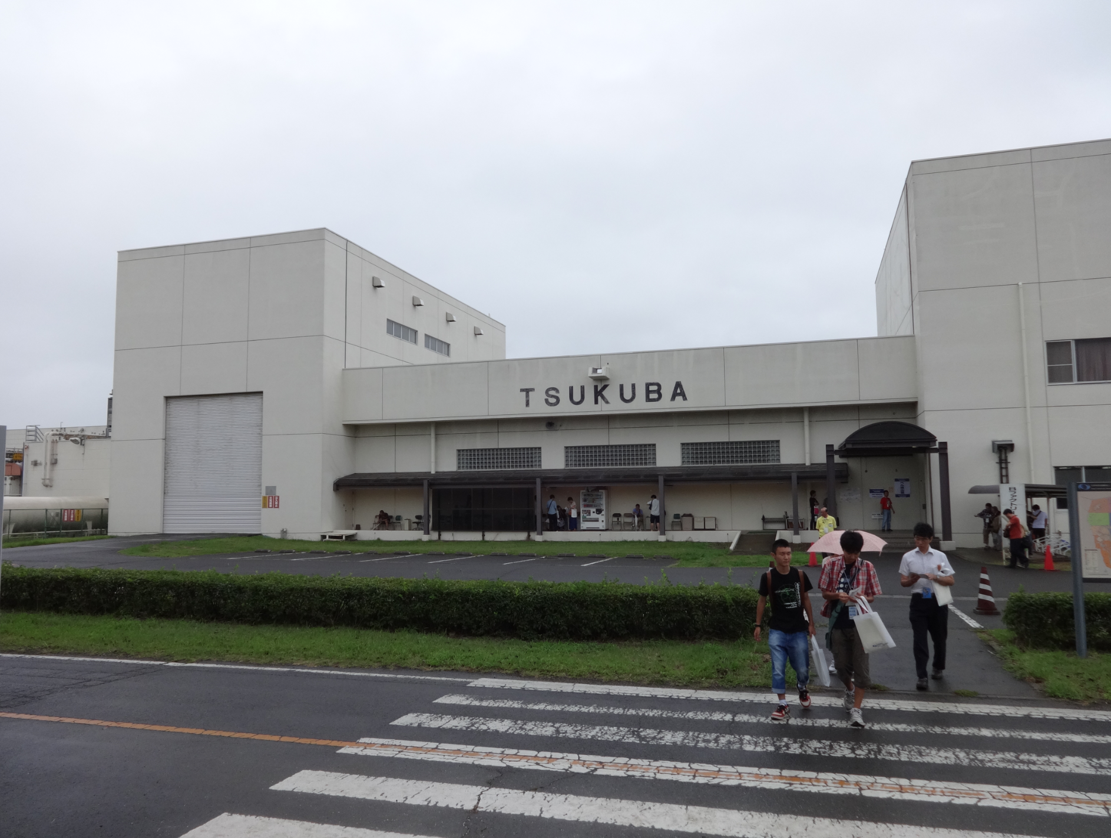
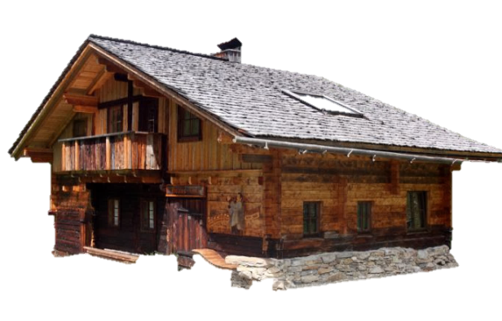
Proposal for a “Small” Hut

Slide 17
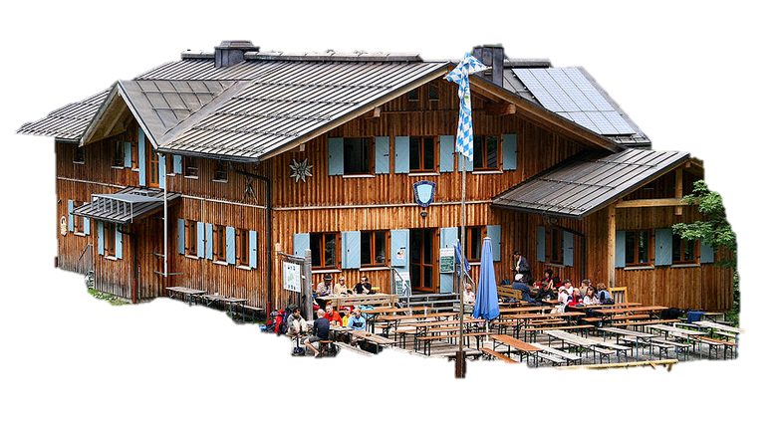
Proposal for a somewhat larger Hut

Slide 18
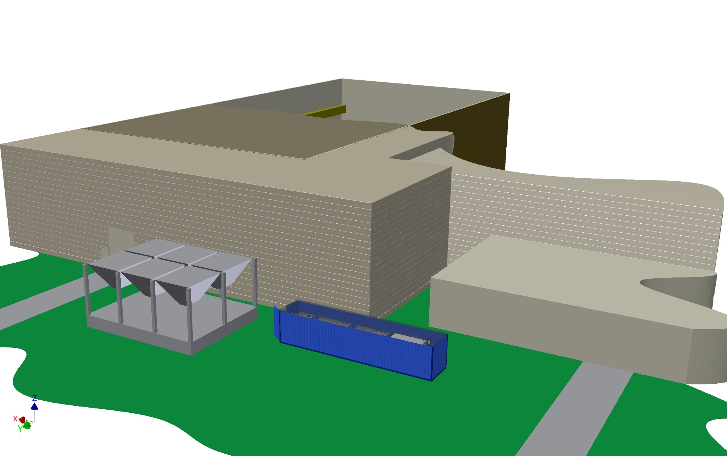
Proposal for a somewhat larger Hut
Possible location of IBBelle: behind Tsukuba Hall
Transferline: L_max = 112 m (to B1), 80 m (to Belle)

Slide 19
Schedule for the CO2 Plant
IBBelle at KEK in summer of 2016

Slide 20
Responsibilities, Operation at KEK
Lead institute (main responsibility): MPI Munich
Collaborating institutes: DESY + SVD (tbd)
Installation at KEK: MPI, DESY, SVD (= “VXD”)
Commissioning: VXD + KEK
Agreement with KEK (Nov. 13 B2GM meeting):
KEK will operate and monitor IBBelle
standard service tasks executed by KEK
(e.g. filter cleaning, replacement of spare parts)
major failures will require action by VXD crew

Slide 21
Conclusions
Parts list almost complete, ordering/delivery has started
Construction to begin next month
Commissioning in fall 2015 (help by CERN colleagues)
Certification by German TÜV
Transport to KEK as a unit by summer 2016
Location of IBBelle on the backside of Tsukuba Hall
(climatized hut needed, will be provided by KEK)
Documentation in Twiki (started)

