Slide 1



Test Beam with Hybrid 6
Florian Lütticke for the Testbeam Crew
Bonn University
7th Belle II VXD Workshop and 18th International Workshop on DEPFET Detectors and Applications

Slide 2
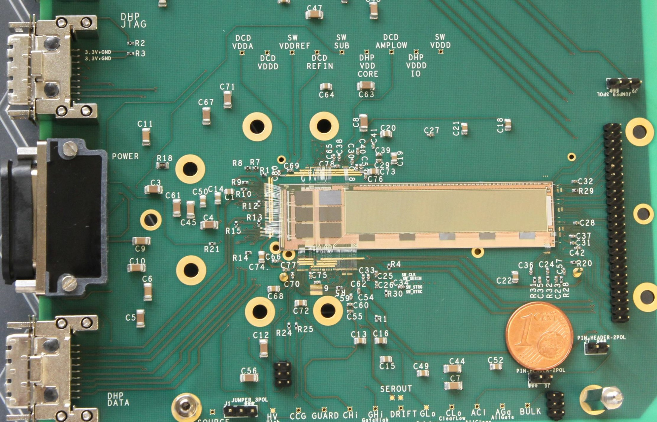
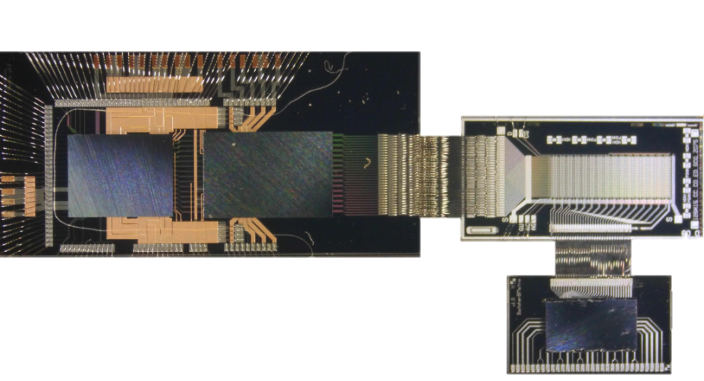
Hybrid 6: J00
J00
CCG Design, DHP 0.2, DCDB 2
480x192 Pixel
50x75x50 µm³

Slide 3
Hybrid 6: J00
3 DCDB2 + 3 DHP0.2
4 Switcher 1.8 v2(G)
Switcher controlled by DHH
Switcher configured over own JTAG
Level converter for JTAG works at 3.3 V → would kill Switcher, which need 1.8 V!
No Switcher JTAG data return visible
Configuring of DCD and DHP works.

Slide 4
Hybrid 6: I06
1 DCDB2 + 1 DHP0.2
4 Switcher 1.8 v2(G)
Switcher controlled by DHH
Switcher configured over own JTAG
3.3V Level converter with 100Ω resistors on data lines.
Configuring of Switcher looks promising.
Configuring of DCD and DHP works.
Short between DHP Core, DCD Digital and DCD Analog: 1.8 Ω
Can‘t be used in test beam.

Slide 5
Requirements for Test Beam of Your Dreams
Stable operation for long time
Reliable power up of the System
Working trigger
Low noise
Well understood parameters
Mechanics available and tested
Working telescope and motor stage
Stable beam conditions
Wake Up!

Slide 6
CERN TB 2014
Issues:
Too many crashes.
Things done:
Slow control software update
Migration to new EPICS version
New IPBus version
Updated scripts
Problems remaining:
Some crashes on IPBus controlhub
Some crashes on EPICS, can be recovered, do not limit data taking but system configuration
Data drops: Strange network problems.
Not perfect, but good enough.
Stable operation for long time
Reliable power up of the System
Working trigger
Low noise
Well understood parameters
Mechanics available and tested
Working telescope and motor stage
Stable beam conditions

Slide 7
CERN TB 2014
Issues:
Sense voltages on bench power supplies
  Only one ASIC pair at a time
  Jumping power consumptions and jumping voltage drops.
Switcher JTAG level converter is running way out of specs
Things done:
Manual sensing (in the lab)
Problems remaining:
Switcher can’t be configured. Switching on can lead to bad control voltage current consumptions (Clear Low)
Bad. Sometimes can be switched on, sometimes not.
Stable operation for long time
Reliable power up of the System
Working trigger
Low noise
Well understood parameters
Mechanics available and tested
Working telescope and motor stage
Stable beam conditions
All power supply operations done by hand.
Automatic system initialization

Slide 8
CERN TB 2014
Issues:
Need special cable for TLU communication
Wrong trigger number
High trigger delay
Things done:
Produced custom cable
Fixed trigger number problems (?)
Stable operation for long time
Reliable power up of the System
Working trigger
Low noise
Well understood parameters
Mechanics available and tested
Working telescope and motor stage
Stable beam conditions

Slide 9
Trigger Delay
PXD + DCD
Fixed Delay for Digitization
Setting in DHP and DHH
DHP can adjust read latency. Can read data which is up to one frame old.
DHH can delay trigger
Measurement Idea: Use laser pulse and vary delay
On best delay you always see laser pulse
Can put additional laser pulse delay over pulse generator.
DHP
Latency Setting – can look into the past
DHH
Trigger Delay – delay data taking
Trigger Width – take multiple frames
TLU
Fixed Delay
Particle in Scintillator
or
Laser pulse

Slide 10
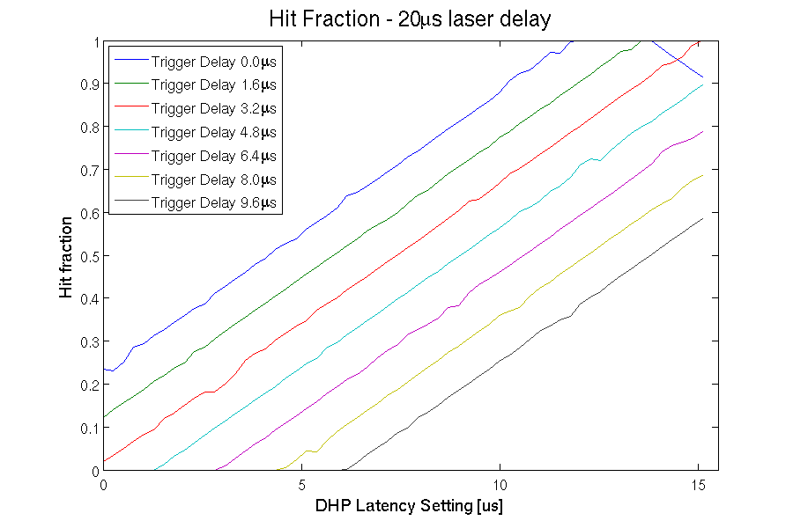
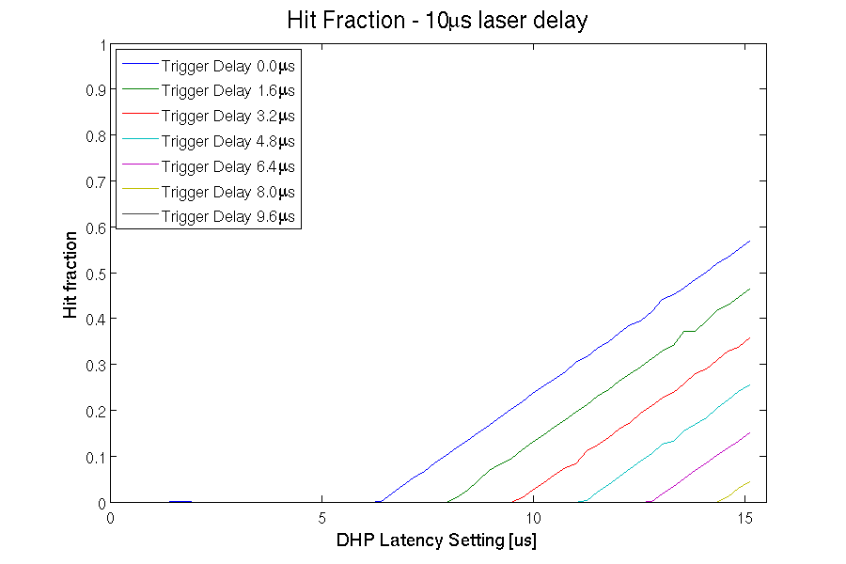
Trigger Delay
DHH
Trigger Delay – delay data taking
Trigger Width – take multiple frames
TLU
Fixed Delay
Particle in Scintillator
or
Laser pulse

Slide 11
CERN TB 2014
Issues:
Need special cable
Wrong trigger number (?)
High trigger delay
Things done:
Produced custom cable
Fixed trigger number problems (?)
Problems remaining:
High trigger delay – Bug in DHH found, will be fixed. Unsure, if it is the only source.
Bad. Sometime no correlation found, sometimes 30 % missing data.
Stable operation for long time
Reliable power up of the System
Working trigger
Low noise
Well understood parameters
Mechanics available and tested
Working telescope and motor stage
Stable beam conditions
Explanation for correlation problem: We were unrecoverable late.
Why do we sometimes see correlation? Different TLU readout speed?

Slide 12
CERN TB 2014
Issues:
System changes between high noise and very high noise during runs.
High common mode, especially when offset bits used
Reasons:
Bad voltages?
System needs to run at low speed in order to understand DCD data (250MHz). Not low enough?
DHP 0.2 PLL runs way out of specs @ 62.5 MHz -> Jitter?
→ Not good, less an issue for Test Beam
Stable operation for long time
Reliable power up of the System
Working trigger
Low noise
Well understood parameters
Mechanics available and tested
Working telescope and motor stage
Stable beam conditions

Slide 13
CERN TB 2014
System does not reliably start. No previous measurements.
Mechanics needed to be finished during test beam
Motor stage worked after some debugging.
Telescope had some problems, bad trigger numbers, dead scintilators, new software version etc.
Two days without beam due to machine development
Stable operation for long time
Reliable power up of the System
Working trigger
Low noise
Well understood parameters
Mechanics available and tested
Working telescope and motor stage
Stable beam conditions

Slide 14
Conclusion
Very complicated system
Considerable amount of work went into debugging and writing automatic scripts
Some bugs remaining, including unrecoverable ones.
Unclear why we got data
But: We learned a lot on software, slow control and firmware.
Direct positive feedback to future PXD9 Operation

Slide 15
Outlook
Check for short on I06.
Retry to switch on J00
Understand high noise, especially high CM noise
Laser scans if possible, but:
Is it sensible (or feasible) to continue on Hybrid 6?
What can we additionally learn from this device?

