Slide 1

Vertical Ladder Mounting concept
&
Mechanical/thermal test in Pisa
F. Bosi
on behalf of the Pisa Belle2-SVD Group
7th Belle II VXD Workshop and 18th International Workshop on DEPFET Detectors and Applications
22nd January 2015

Slide 2
Ladder Mount: existing solution by KEK
At the latest B2GM (GEMBA meeting) a demonstration took place, proving that the existing Ladder Mount approach by KEK is working:
The set-up has been tuned by several mounting tests and it already reached a high level of development
The side approach guarantees that operations are performed outside the volume of the SVD and it is safe against any accidental mishandling or drop of tools
The ladders are taken from the shipping box by the grabbing jig, which is mounted on a cart endowed by several degrees of freedom: the high-precision stages allow approaching sideways to the end rings
It is the baseline project and the side-mounting approach demonstrated to be effective also in the mounting of the Belle-SVD
The system provides also the possibility to make the survey after completing the mounting of each layer.

Slide 3
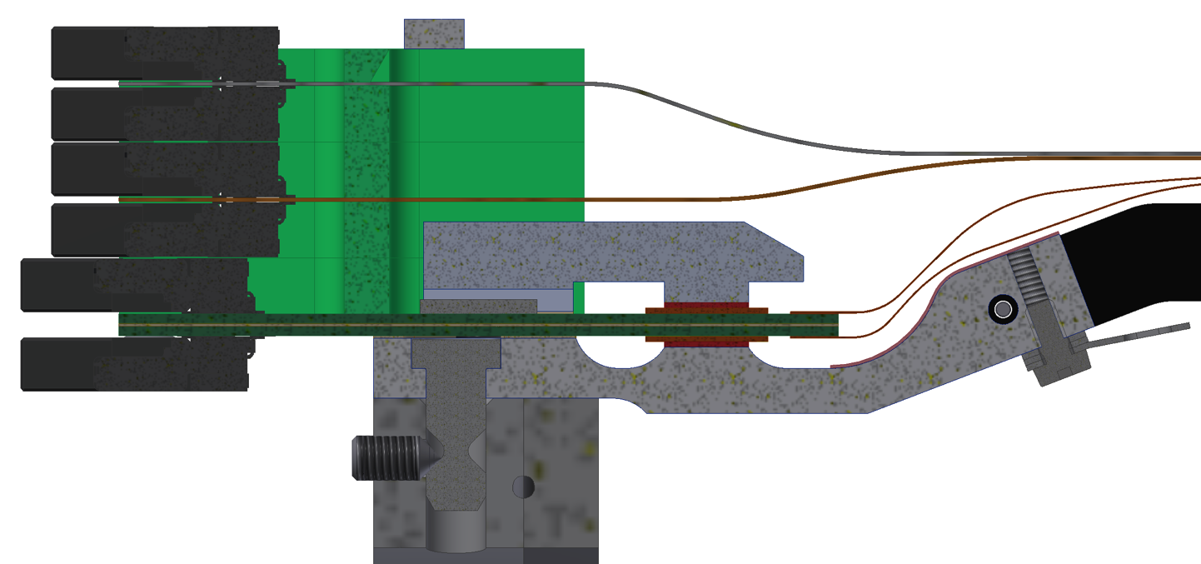
How Ladders are Mounted
BWD Kokeshi pin
Set screw
BWD end mount
BWD end ring
Courtesy by Florian

Slide 4
Some considerations …
This method needs high mechanical precision in the alignment between the K-pin and the holes of the end-ring in order to avoid possible mechanical tensions transferred to the ladder, without any feedback sensed by the operator.
The mechanical system doesn’t provide any dumping of these forces.
The effect of gravity doesn’t help the alignment and co-axiality of the K-pins with the end-ring holes.
Our experience (BaBar-SVT module mounting) suggests that a guided vertical ladder mounting technique, driven by gravity and by the sensitivity of the skilled operator, seems to be safe and free of the side mount drawbacks.
The negative aspect of the vertical method is due to the fact that during the operations some mechanical components are placed over the volume of the SVD.

Slide 5
Conceptual Top mounting procedure
The whole operation can be split into 3 main phases:
Ladder loading from the shipping box to the “Two Arm Support”
Horizontal movement of the ladder on top of the end-rings
Guided lowering and locking of the ladder in its final position

Slide 6
Phase 1.
The grabbing jig is engaged to the ladder in the shipping box and is used to load the ladder on a Two Arm Rigid Support.
The two arm rigid support is fixed to a sliding cart and it is equipped at each end of the arm with a thin flat pincer, hosting the K-pin.
The pincers support the ladder holding it by the end-mount; the holes of the pincers can engage or release the K-pin.
The backward K-pin is locked by the corresponding pincer, the forward K-pin remains in a 5 mm loose hole (K-pin diameter is 4 mm).

Slide 7
Phase 2.
The cart has been pre-set to bring the ladder on the top of the end ring holes, in such a way that the bottom surface of the K-pin is ~2mm higher wrt the end ring top plane.
The cart is locked in the final position, where the K-pins are centered respect to the ring holes with a horizontal tolerance +0.5 mm.
At this point the backward pincer is opened up to a diameter of 5mm (as the forward one) and the ladder in this condition is supported but free to move + 0,5 mm.

Slide 8
Phase 3.
By acting on a vertical micro-positioner on a the TAS, the ladder is lowered until the bottom of the K-pins reach the end mount top plane.
The pincers are further lowered by 2 mm.
The operator can drive very gently the ladder by handling that from the H-shape and engage coaxially the end-ring with the K-pins by using:
  his sensitivity
  gravity
  conical coupling between the K-pins and the end-ring chamfer holes
When the partial (2 mm) insertion is done, the two arms rigid support is still safely lowered (3 mm), the pincers are completely opened and removed, the cart is retracted.
Manually the ladder is guided down to its final position and finally the K-pins are fixed by screws to the end ring.

Slide 9
Tight Collaboration
To develop the design of this possible mounting solution it’s crucial a close collaboration/interaction with the experts of the other sites (HEPHY, KEK).
Our plan foresees the design of the whole system to be presented at the next June B2GM, with the realization of some prototypes of the most critical components (two arm rigid support, pincers, …).

Slide 10
Mechanical/thermal test
Possible test to perform in Pisa:
Forw/Backw sub-assembly (SA): thermal and vibrational test in order to prove shipping condition from Pisa to other sites.
Class C ladder : vibrational test and Thermal Intensive Cycling for Ladder design verification

Slide 11
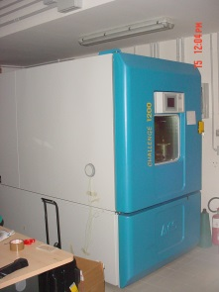
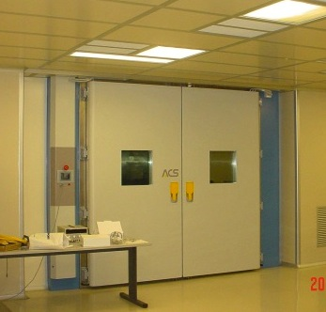
Thermal Environment test facilities
Humidity & temperature test chambers for
thermal cycles available in Pisa labs
Environmental chamber - Pisa lab
Angelantoni ACS 1200°
Test volume 1000x1100x1000 mm³
Temperature range:
-70°C - +180 °C
No active RH control
Test volume 3300x3500x2500 mm³
Temperature range:
-30°C - +80 C
RH active control
Environmental chamber - S.Piero lab Angelantoni WZH30-A1
11

Slide 12
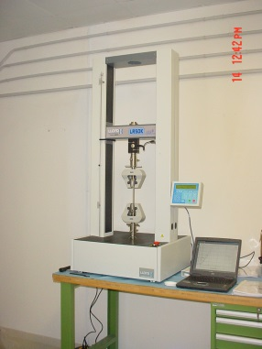
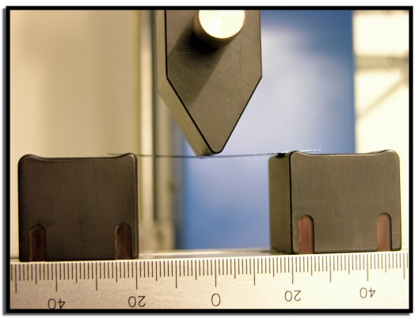
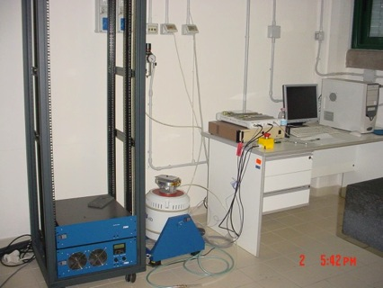
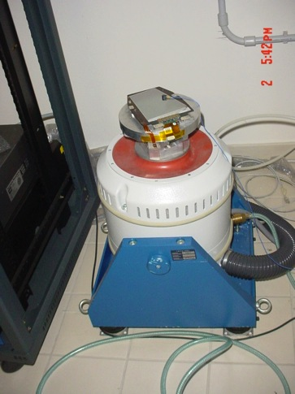
Structural test Lab
Mechanical characterization
Materials Testing Machine Lloyd Instruments LR50KPlus for deformation Test (test up to 50.000 N)
Si sample
50 um thick
Test Shaker : TYRA-TV5220
Shaker Controller: DATA PHYSICS- Signal Star Vector
Accelerometer : KS777 MMF
(up to 120 g, 0.5 gramms)
Vibrational Analisys
(Dynamic Shaker max load 8Kg at 8 g up to 2000 Hz )
12

Slide 13
Fw / Bw sub-assembly Test
Stress Test to verify sub-modules integrity during shipping:
Random and shock vibrational stresses
Thermal cycling between -30 C to 60 C
Also To verify the stability of sensor positioning and clamping system on the MPC/shipping box

Slide 14
Ladder Tests
Design Verification Tests:
Natural frequency analysis
Random and shock vibrational stresses
Deformation test
Intensive Thermal cycling between -30 C to 60 C

Slide 15


Ladder Vibrational Test
What we have to prepare :
Support Interface to be designed and fabricated for ladder
FEA needed to verify the natural frequencies of the support
Vibrational Test:
- Sine test cycle up to 2000 Hz on three axes
- For each axis sine sweep 20/2000 Hz at 2oct/min to measure the modals / resonance frequency of the ladder;
- Random test according to a random vibration environment of shipping to be defined ( car and flight transportation)
-Shock test : also to be defined
15

Slide 16
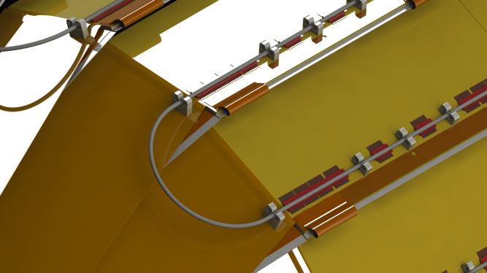
Deformation test
In order to simulate the insertion of the cooling pipes on the clamps :
- Apply a known force on the ladder and measure relative deformation using the materials testing machine
- To know which is the maximum force we can apply without damage on the ladder
- Mechanichal test machine sensitivity order of fraction of gramms.

Slide 17
Intensive thermal cycling
Measure ladder with CMM before thermal cycling and repeat the measurement after, in order to detect permanent deformations.
Perform 100 cycles between -30 to 60 °C
Heating and cooling speed about 2 deg/min ( total time for one cicle about 90 min )
About one week for the complete test !
Performing an intermediate CMM measurement every couple of days

Slide 18
Conclusion and test plans
Some maintenance (computer updates and HW controls on the machines are needed (scheduled begin February)
Design and fabrication of supporting interface for vibrational analysis (on february)
Tests can proceed afterwords and will take order of 1 month.

