Slide 1
SVD Mechanics Group Organization & Work packages
7th VXD Workshop PRAGUE

Slide 2
SVD Organization
Deputy: Markus Friedl
Advisor: Filippo Bosi

Slide 3
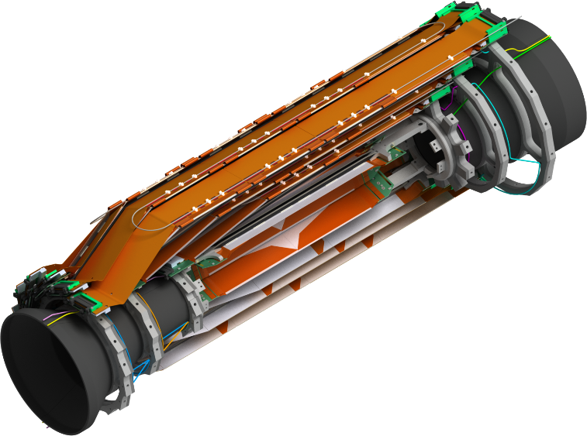
Work packages
SVD design (Florian)
Mechanics components
Cones, end flange, outer shell (Shuji)
End rings + cooling pipes (Karsten, Toru)
Components for the ladders (Koji, Florian)
Cooling:
Inside end flange (Florian)
Outside end flange (Tscharlie&Florian)
KEK infrastructure (Shuji, Toru, Katsuro)
Ladder mount table
Assembly from top (Filippo&Stefano)
Assembly from side (Toru&Sato)
End ring assembly on the support cones (Karsten/DESY, Toru/KEK)
SVD half structure management (Shuji, Toru)

