Slide 1
Belle II Schedule
Yutaka USHIRODA
Jan. 2015

Slide 2
Nov. 9, 2014
SuperKEKB/Belle II Schedule
Calendar
2014
2015
2016
2017
2018
Japan FY
JFY2014
JFY2015
JFY2016
JFY2017
JFY2018
now
Power restriction
in summer
Power restriction
in summer
Power restriction
in summer
Power restriction
in summer
SuperKEKB Construction
phase 1
phase 2
phase 3
Start-up
w/o QCS
w/o Belle II
QCS, Belle II
VXD install
w/ full Belle II
Original plan
w/ QCS
w/ Belle II (no VXD)
JFY2014 Operation budget cut by 12 Oku-Yen
SuperKEKB Construction
phase 1
phase 2
phase 3
Current plan ongoing
Start-up
w/o QCS
w/o Belle II
QCS, Belle II install
w/ QCS
w/ Belle II (no VXD)
VXD install
w/ full Belle II
Detailed estimation of inter-phase schedule: 11 months for phase 1->2, 6 for phase 2->3.
SuperKEKB Construction
phase 1
phase 2
phase 3
(B) JFY2015 budget ◯◯ Oku-Yen
Start-up
w/o QCS
w/o Belle II
QCS, Belle II install
VXD install
w/ full Belle II
Desirable budget
w/ QCS
w/ Belle II (no VXD)
SuperKEKB Construction
phase 1
phase 2
phase 3
(A) JFY2015 budget △△ Oku-Yen
Start-up
w/o QCS
w/o Belle II
QCS, Belle II install
VXD install
w/ full Belle II
Conceivable budget
w/ QCS
w/ Belle II (no VXD)
Tragic
Prospect will be clearer in the very end of Dec.

Slide 3
Timeline
Jan. 9, 2015
Cabinet Decision of JFY2014 supplemental budget
Apr. 10, 2015
Congressional Approval
Jan. 14, 2015*
Cabinet Decision of JFY2015 budget
* delayed due to Lower House election
MOF
MEXT
KEK
IPNS, Acc. Lab
Belle II, SuperKEKB
３兆１１８０億円
９６兆３４２０億円
[private, preliminary announcement from Yamauchi-san]
Dear Tom,
The JFY2015 budget was informed by MEXT today. KEK's international projects
were given maximum considerations by MEXT, which will allow us to start the
phase-1 commissioning early next year. We thank you once more for your great
help.
Please share this information with the Belle II colleagues.
Best regards,
Masa Yamauchi
19a
20p

Slide 4
Possible new schedule (tbc)
Difficult to interpret what Yamauchi-san’s brief notice means, but assume phase 1 starts as “early” as Jan. 2016 (=conceivable budget scenario)
Start of TOP installation += 2mo.

Slide 5
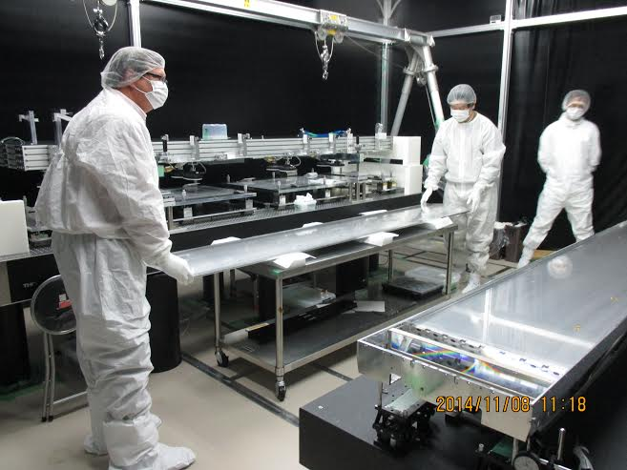
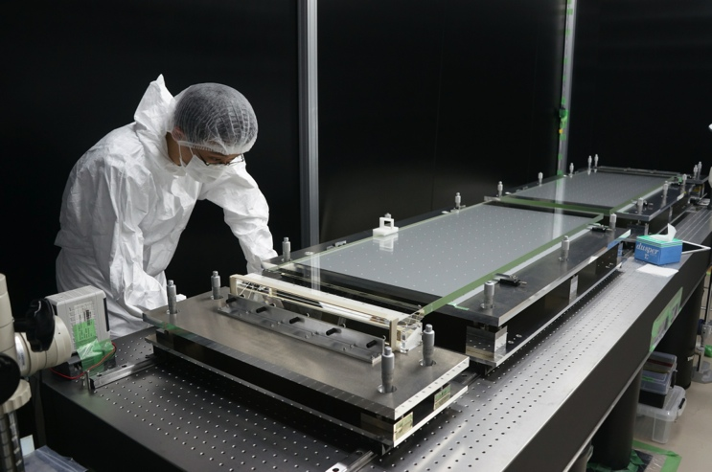
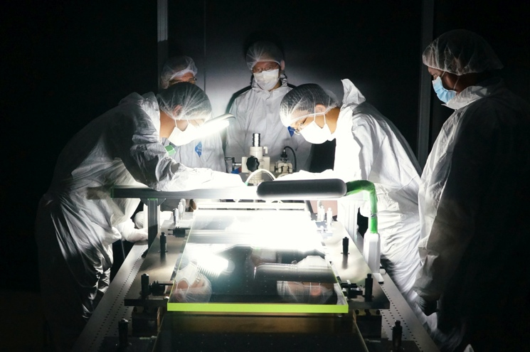
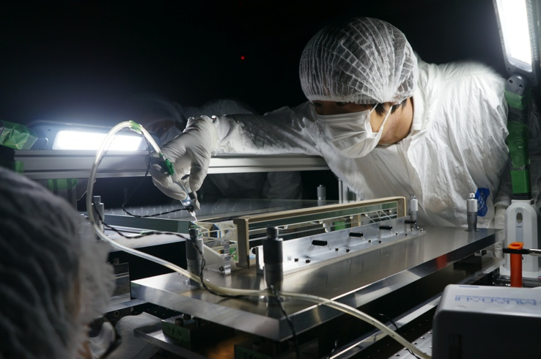
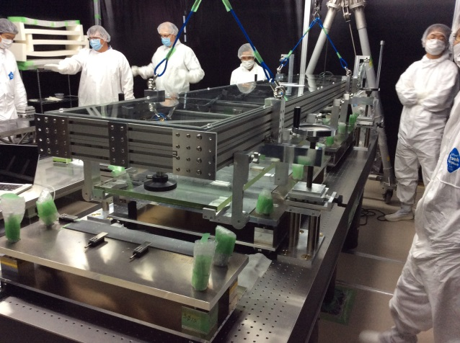
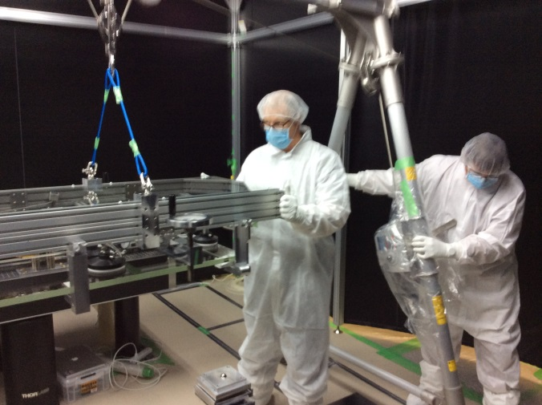
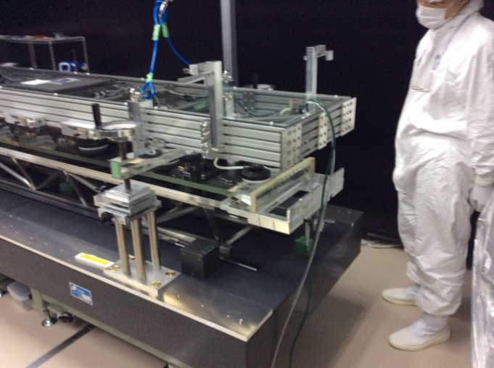
TOP Assembly “dry runs” + 1st module
The first real TOP module completed
All 16+2 modules to be made in 1 year
Dry runs towards 1st Belle II TOP counter assembly
  Practice using actual assembly systems and jigs on mechanical dummy (glass)

Slide 6
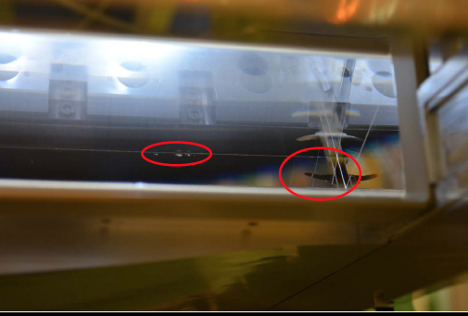
Module 01 after a month
Found quartz glue joint has failed
module production suspended
~8 weeks of delay for additional studies

Slide 7
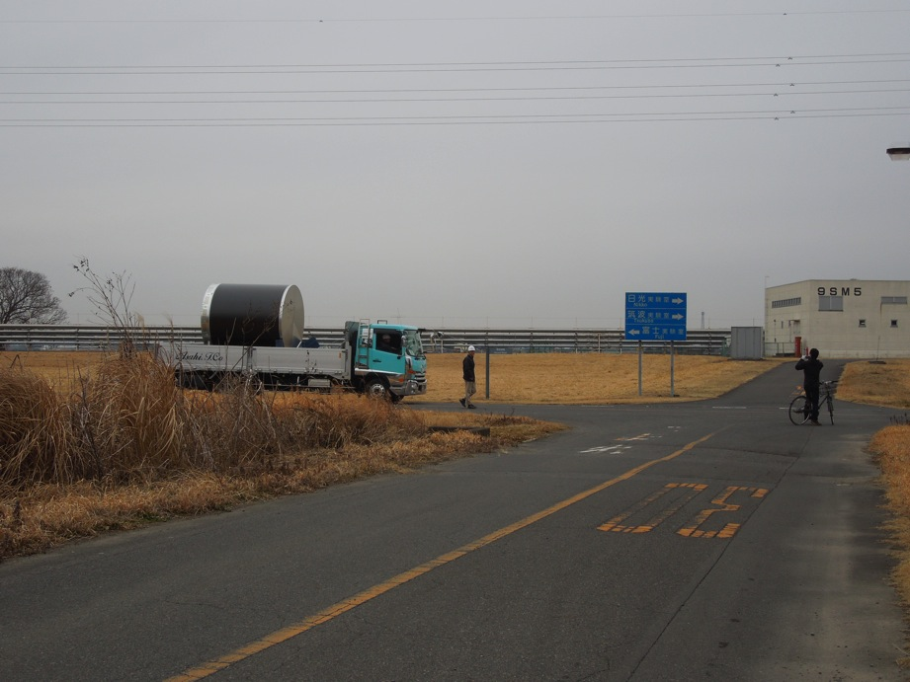
Hot news!
CDC moved from Fuji to Tsukuba
Jan. 21st, 2015

Slide 9
Jan. 13, 2015
SuperKEKB/Belle II Schedule
Calendar
2014
2015
2016
2017
2018
Japan FY
JFY2014
JFY2015
JFY2016
JFY2017
JFY2018
now
Power restriction
in summer
Power restriction
in summer
Power restriction
in summer
Power restriction
in summer
SuperKEKB Construction
phase 1
phase 2
phase 3
Start-up
w/o QCS
w/o Belle II
QCS, Belle II
VXD install
w/ full Belle II
Original plan
w/ QCS
w/ Belle II (no VXD)
JFY2014 Operation budget cut by 12 Oku-Yen
SuperKEKB Construction
phase 1
phase 2
phase 3
Current plan ongoing
Start-up
w/o QCS
w/o Belle II
QCS, Belle II install
w/ QCS
w/ Belle II (no VXD)
VXD install
w/ full Belle II
Detailed estimation of inter-phase schedule: 11 months for phase 1->2, 6 for phase 2->3.
SuperKEKB Construction
phase 1
phase 2
phase 3
(B) JFY2015 budget ◯◯ Oku-Yen
Start-up
w/o QCS
w/o Belle II
QCS, Belle II install
VXD install
w/ full Belle II
Desirable budget
w/ QCS
w/ Belle II (no VXD)
SuperKEKB Construction
phase 1
phase 2
phase 3
(A) JFY2015 budget △△ Oku-Yen
Start-up
w/o QCS
w/o Belle II
QCS, Belle II install
VXD install
w/ full Belle II
Conceivable budget
w/ QCS
w/ Belle II (no VXD)
Tragic
Prospect will be clearer in the very end of Dec.
* delayed due to Lower House election

Slide 10
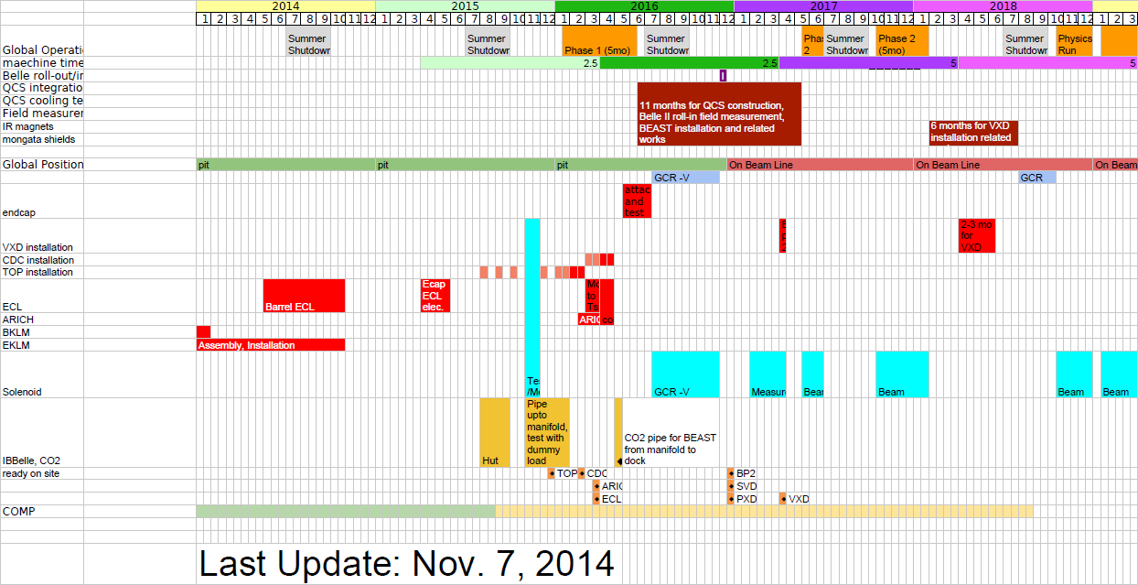
Detector Construction Schedule
A) Conceivable

Slide 11
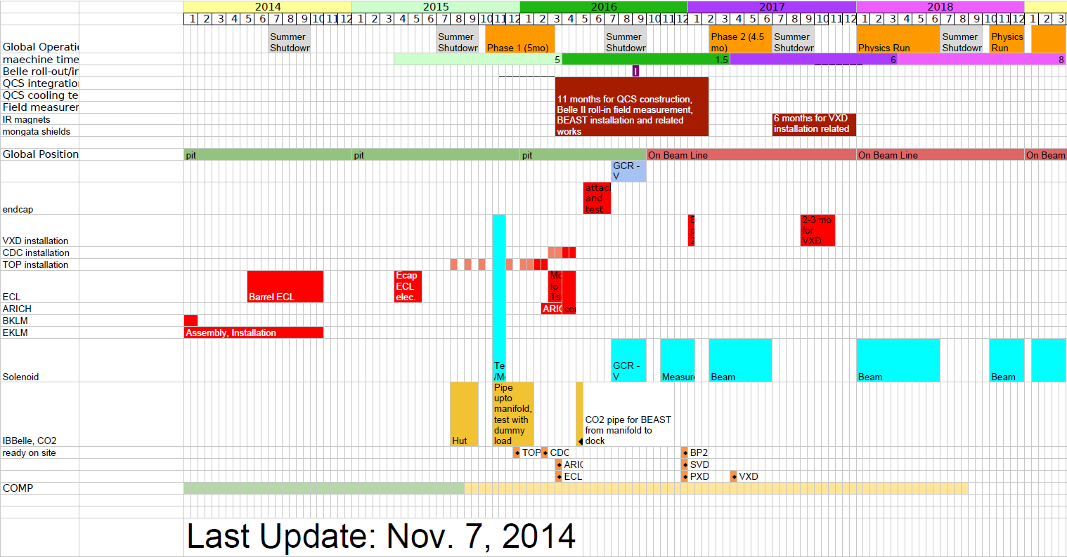
Detector Construction Schedule
B) Desirable

Slide 12
3 months difference in start of phase 1
6 months difference in start of VXD installation
9 months difference in start of phase 3
Phase 2 planning is more important in conceivable scenario as split into two

