Slide 1
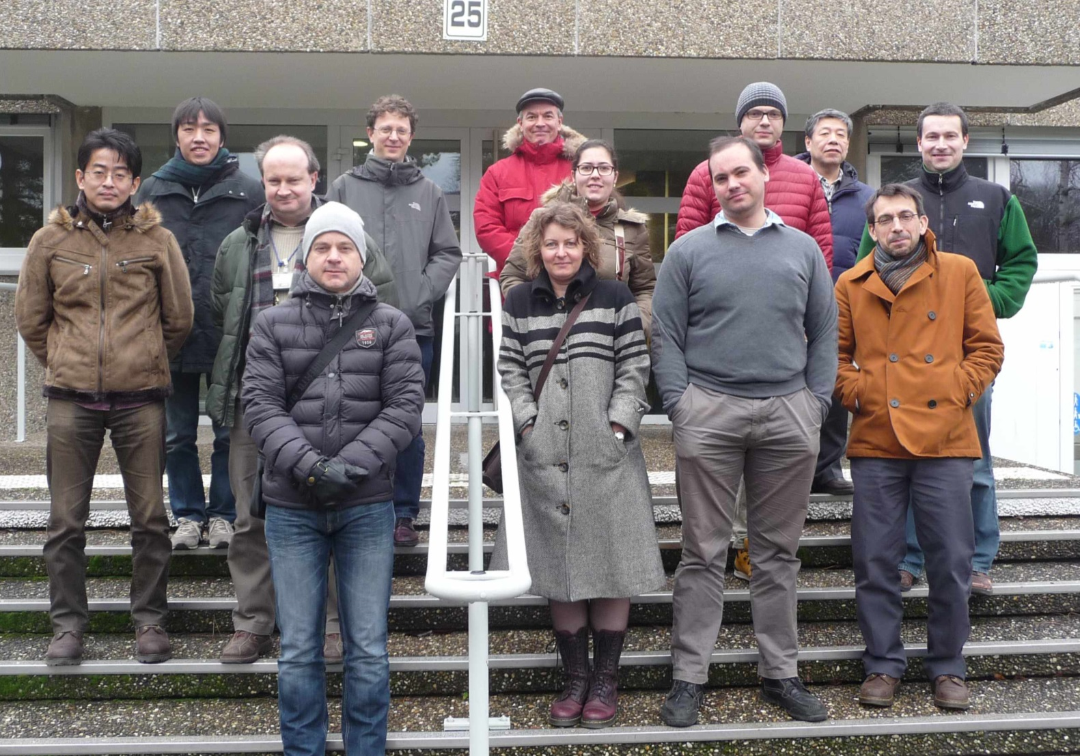
Summary of Strasbourg Meeting
H. Nakayama (KEK)

Slide 2
Strasbourg Meeting info
IN2P3-KEK collaboration on Belle II and BEAST meeting
19-20 January 2015, Strasbourg, France
Meeting INDICO page: https://indico.in2p3.fr/event/10971/
~20 participants (on site + remote)
IPHC Strasbourg, LAL Orsay, KEK, Hawaii, Bonn, DESY, Torieste, …
To discuss fine-tuning the proposed French contribution to BEAST BG studies(with PLUME) and first luminosity feedback
Based on discussion at Pre-Meeting (Jan. 12-13)with VXD people
https://indico.mpp.mpg.de/conferenceDisplay.py?confId=3240

Slide 3
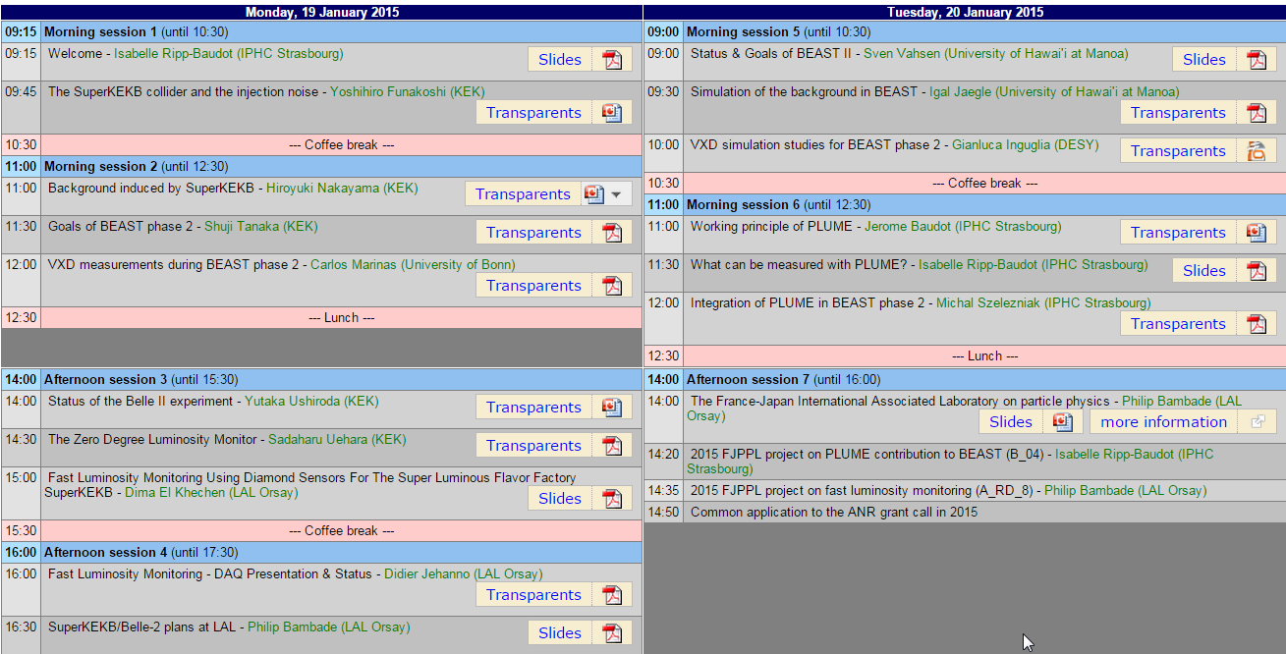
18 presentations
BEAST/BG session
PLUME session
Lumi. feedback session
https://indico.in2p3.fr/event/10971/

Slide 4
Highlights
Objectives & goals of BEAST phase-2 by S. Tanaka(KEK)
BEAST phase-2 sensors(VXD and others) by C.Marinas(Bonn), S.Vahsen (Hawaii)
Injection noise details by Y.Funakoshi (SuperKEKB)
PLUME details by Jerom Baudot (IPHC)
Possible measurement by PLUME by Isabelle Ripp-Baudot (IPHC)
Mechanical integration to Phase2 by M. Szelezniak(IPHC)
Luminosity feedback by S.Uehara(KEK), Dima Khechen(Orsay)
DAQ for lumi feedback by Didier Jeahanno(Orsay)
LAL Orsay activities by Phillip Bambade (Orsay)

Slide 5
PLUME details
Jerome Baudot (IPHC-PICSEL group)
This talk also covers :
- counting rate/ pixel multiplicity
- radiation tolerance
- potential phase2-dedicated optimization for PLUME-3
- Integration time (few µs possible by skipping some pixel-lines)
- Occupancy (<1 %)
- But, 20 ns time-stamping or gating mode unreachable (for next year)
- Readiness: mid-2016 (baseline PLUME-2 ,100 us integration)
early 2017(PLUME-3, 20 or 2 us integration).

Slide 6
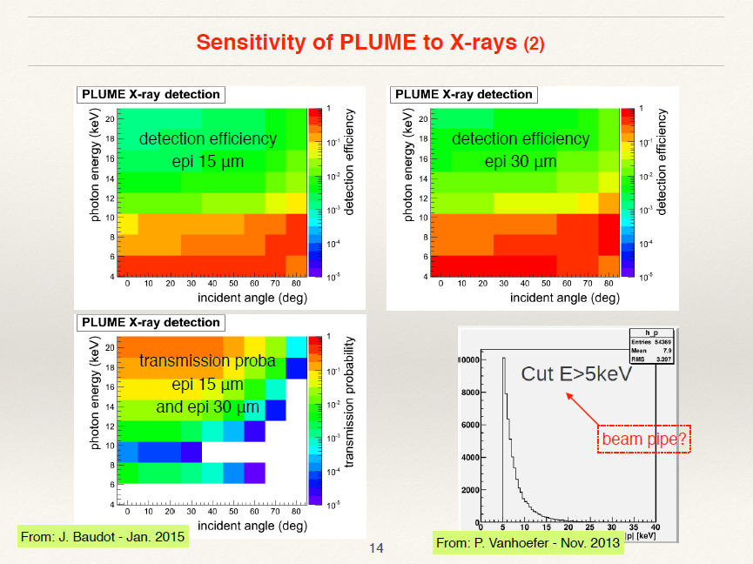
Possible PLUME measurements
Isabelle Ripp-Baudot (IPHC)
Possible measurements on the summary slide:
- Hit rates (occupancy seems acceptable, still very preliminary calculation)
- Track incident angles (advantage of double-sided sensor)
- Synchrotron Radiation (PLUME not transparent to X-rays, not energy sensitive)
Other topics discussed
- Injection damping measurement: 2us resolution possible with PLUME-3
- Correlate PLUME measurement with Scintillator+SiPM data?
- IP vertexing with VXD? (back-to-back tracks, important feedback to machine)

Slide 7
FJPPL: France-Japan Particle Physics Laboratory
http://fjppl.in2p3.fr/cgi-bin/twiki.source/bin/view/FJPPL/WebHome
Management:
- Japan: Junji HABA (KEK), director
- France: Philip BAMBADE (IN2P3), director and Marc BESANÇON (IRFU), co-director

Slide 8
Thank you!!
Related talk in this workshop
- Monday 15:10- “BEAST Phase 2” by C. Marinas
- Tuesday 14:00- “PXD Parallel Session IV: Beam Tests and BEAST 2”

