Slide 1
Prologue: Strasbourg Interest in BEAST
(how I understand it after discussion with Philip Bambade at KEK)
Two activities of French groups at KEK:
“Machine Detector Interface group” (Philip Bambade, LAL):
ATF-2 (ILC) & Fast Lumi Monitor (SuperKEKB-Belle II,
in collaboration with the machine & Uehara-san)
Philip is the French leader of the
“France-Japan Associated International Laboratory”
“BEAST group” at KEK: special new group outside of Belle II, collaboration agreement between KEK and IN2P3
(no participation in Belle II at present: lack of “critical mass”)

Slide 2
Prologue: Strasbourg Interest in BEAST
Two presentations by Strasbourg group so far at B2GMs by
Isabelle Ripp-Baudot (2012), Jerome Baudot (2014):
-> MAPS (“Plume”) for background studies in Phase 2
(detector principle realized in sensors of the EUDET telescope)
Special BEAST background meeting planned in Strasbourg
on Jan. 19/20, 2015
Unfortunately too close to the VXD Meeting in Prague
Therefore: Pre-meeting between Strasbourg and VXD members
- requirements for background analysis during Phase 2
- plans for sensors and their arrangement by the VXD groups
- discuss potential and possibilities for Plume sensor in Phase 2
Report on pre-meeting at Strasbourg via Seevogh (C. Marinas)

Slide 3


Concept for BEAST Phase 2
by the VXD Group
Present Schedule for SuperKEKB
Specification for the Phase 2 VXD
Setup for Sensors, Responsibilities
Assembly of Phase 2 VXD
Where could Plume fit in?
Installation: RVC and AIM
Schedule for Phase 2 VXD
Summary & Outlook

Slide 4
To be shown at BPAC review
Nov. 7, 2014
SuperKEKB/Belle II Schedule
Calendar
2014
2015
2016
2017
2018
Japan FY
JFY2014
JFY2015
JFY2016
JFY2017
JFY2018
now
Power restriction
in summer
Power restriction
in summer
Power restriction
in summer
Power restriction
in summer
SuperKEKB Construction
phase 1
phase 2
phase 3
Start-up
w/o QCS
w/o Belle II
QCS, Belle II
VXD install
w/ full Belle II
Original plan
w/ QCS
w/ Belle II (no VXD)
JFY2014 Operation budget cut by 12 Oku-Yen
SuperKEKB Construction
phase 1
phase 2
phase 3
Current plan ongoing
Start-up
w/o QCS
w/o Belle II
QCS, Belle II install
w/ QCS
w/ Belle II (no VXD)
VXD install
w/ full Belle II
Detailed estimation of inter-phase schedule: 11 months for phase 1->2, 6 for phase 2->3.
SuperKEKB Construction
phase 1
phase 2
phase 3
(B) JFY2015 budget ◯◯ Oku-Yen
Start-up
w/o QCS
w/o Belle II
QCS, Belle II install
VXD install
w/ full Belle II
Desirable
w/ QCS
w/ Belle II (no VXD)
SuperKEKB Construction
phase 1
phase 2
phase 3
(A) JFY2015 budget △△ Oku-Yen
Start-up
w/o QCS
w/o Belle II
QCS, Belle II install
VXD install
w/ full Belle II
Conceivable
w/ QCS
w/ Belle II (no VXD)
Tragic
Budget will be clearer in the very end of JFY (?)

Slide 5
Requirements for VXDP2
Phase 2:
Belle II on beamline, fully installed except VXD
Final Focus System (QCS) installed for the first time.
Final beampipe and HM masks around IP
First attempt to collide beams and achieve 1x10³⁴ /cm s
Determine particle/photon fluxes for the individual background contributions (syn.rad., Touschek, rad. Bhabha, 2γ)
Study injection bg and exercise gated mode operation of VXD
Determine bg status safe for PXD/SVD, exercise H/W interlock,
radiation & environmental monitoring (!)
“Background”: particle fluxes and energy spectra, correlation with rest of Belle II (full DAQ and Slow Control)

Slide 6
VXDP2 Specification
Need to understand the background,
measure the physics spectra,
train the Monte Carlo
- Install some real PXD / SVD ladders
- need to cover rest of solid angle
Specs: need fast sensors with adequate energy resolution
e.g. ΔE/E ~ 20% @ 5 keV
Δt ~ 1-20 ns
NTU group wants to measure
Bhabhas: install BGO crystals
Strasbourg group wants to contribute (discussion)

Slide 7
VXDP2 Equipment during Phase 2
BGO
SVD:
Install full sector in the accelerator plane
(maximal flux of 2γ-QED)
Four layers of SVD ladders

Slide 8
SVD part of VXDP2
Install one sector of SVD ladders
(four layers)
full coverage in polar angle
Final arrangement for Belle II
“cartridge” design of
SVD sector,
supported on the end flanges

Slide 9
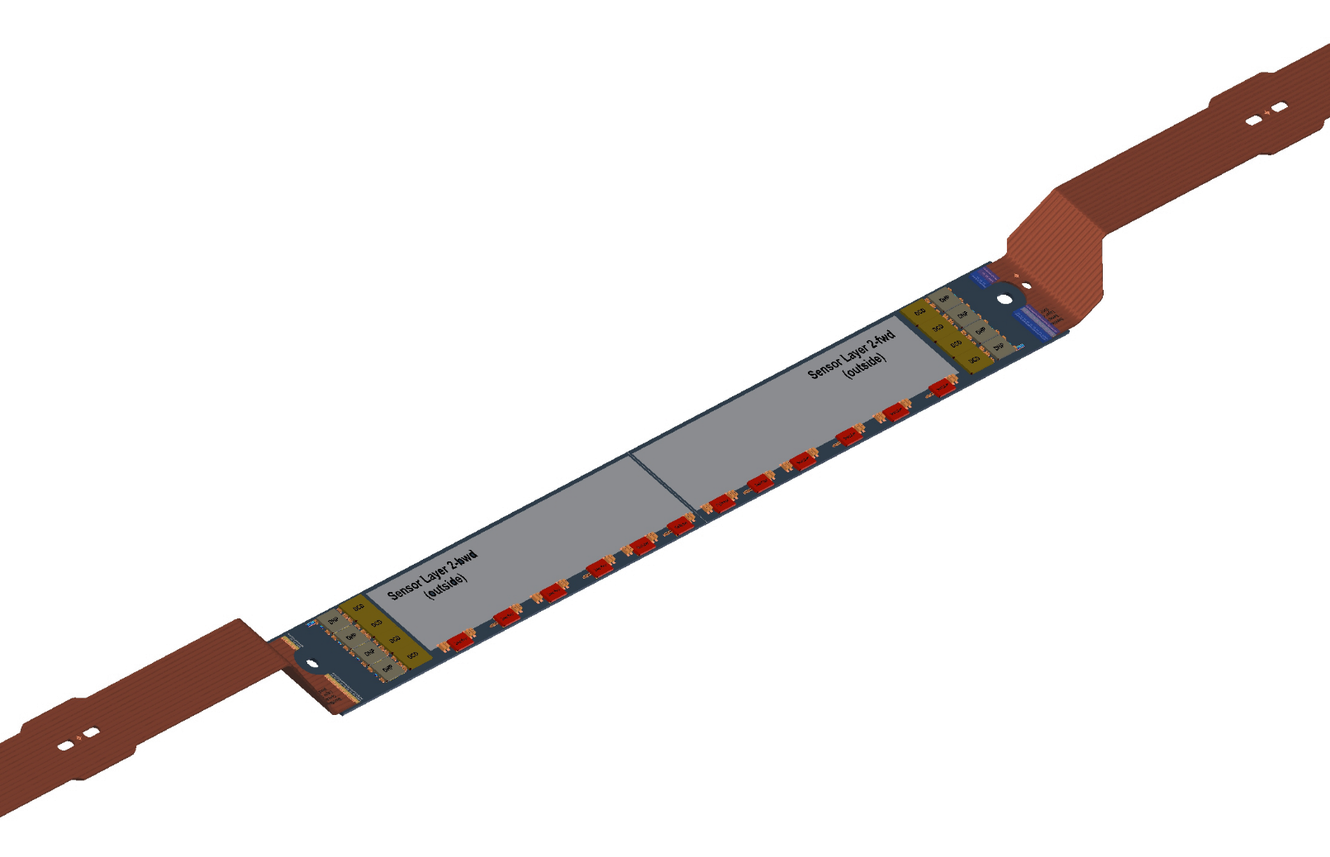
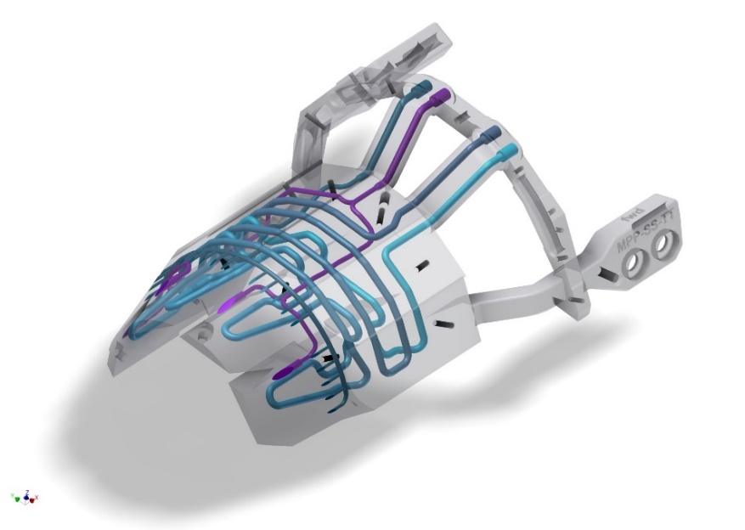
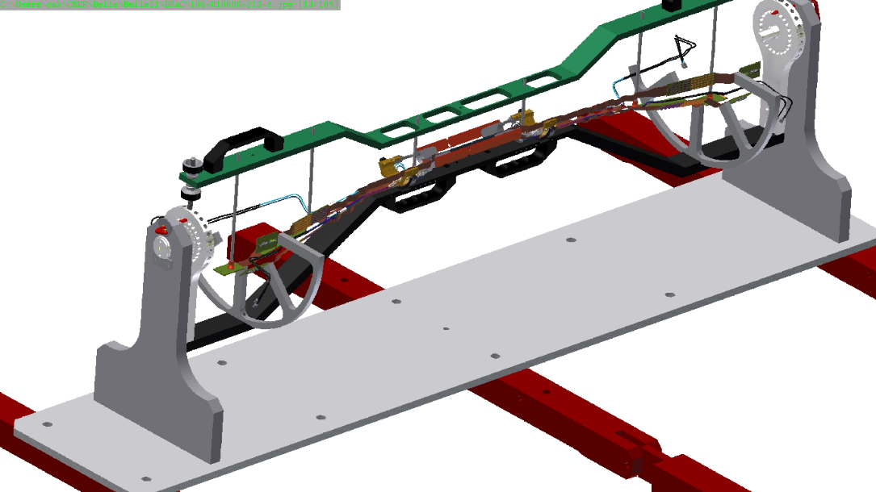
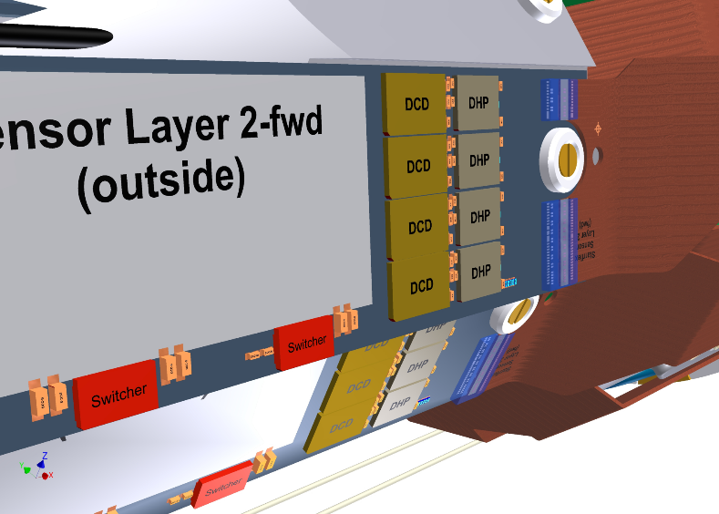
PXD part of VXDP2
Support- and cooling block
two layers of 2 modules glued together
→ “Ladder”
Assembly same as for
the full PXD
15 mNm

Slide 10
Additional Sensors during Phase 2
Principle: Close the solid angle not instrumented by PXD
and SVD ladders
y
z
Sensors to be placed in the accelerator plane and perpendicular to it.
In the area of the PXD:
Fast, rad-hard,
good energy resolution
Supports within the acceptance mandatory,
will try to minimize
material
x

Slide 11
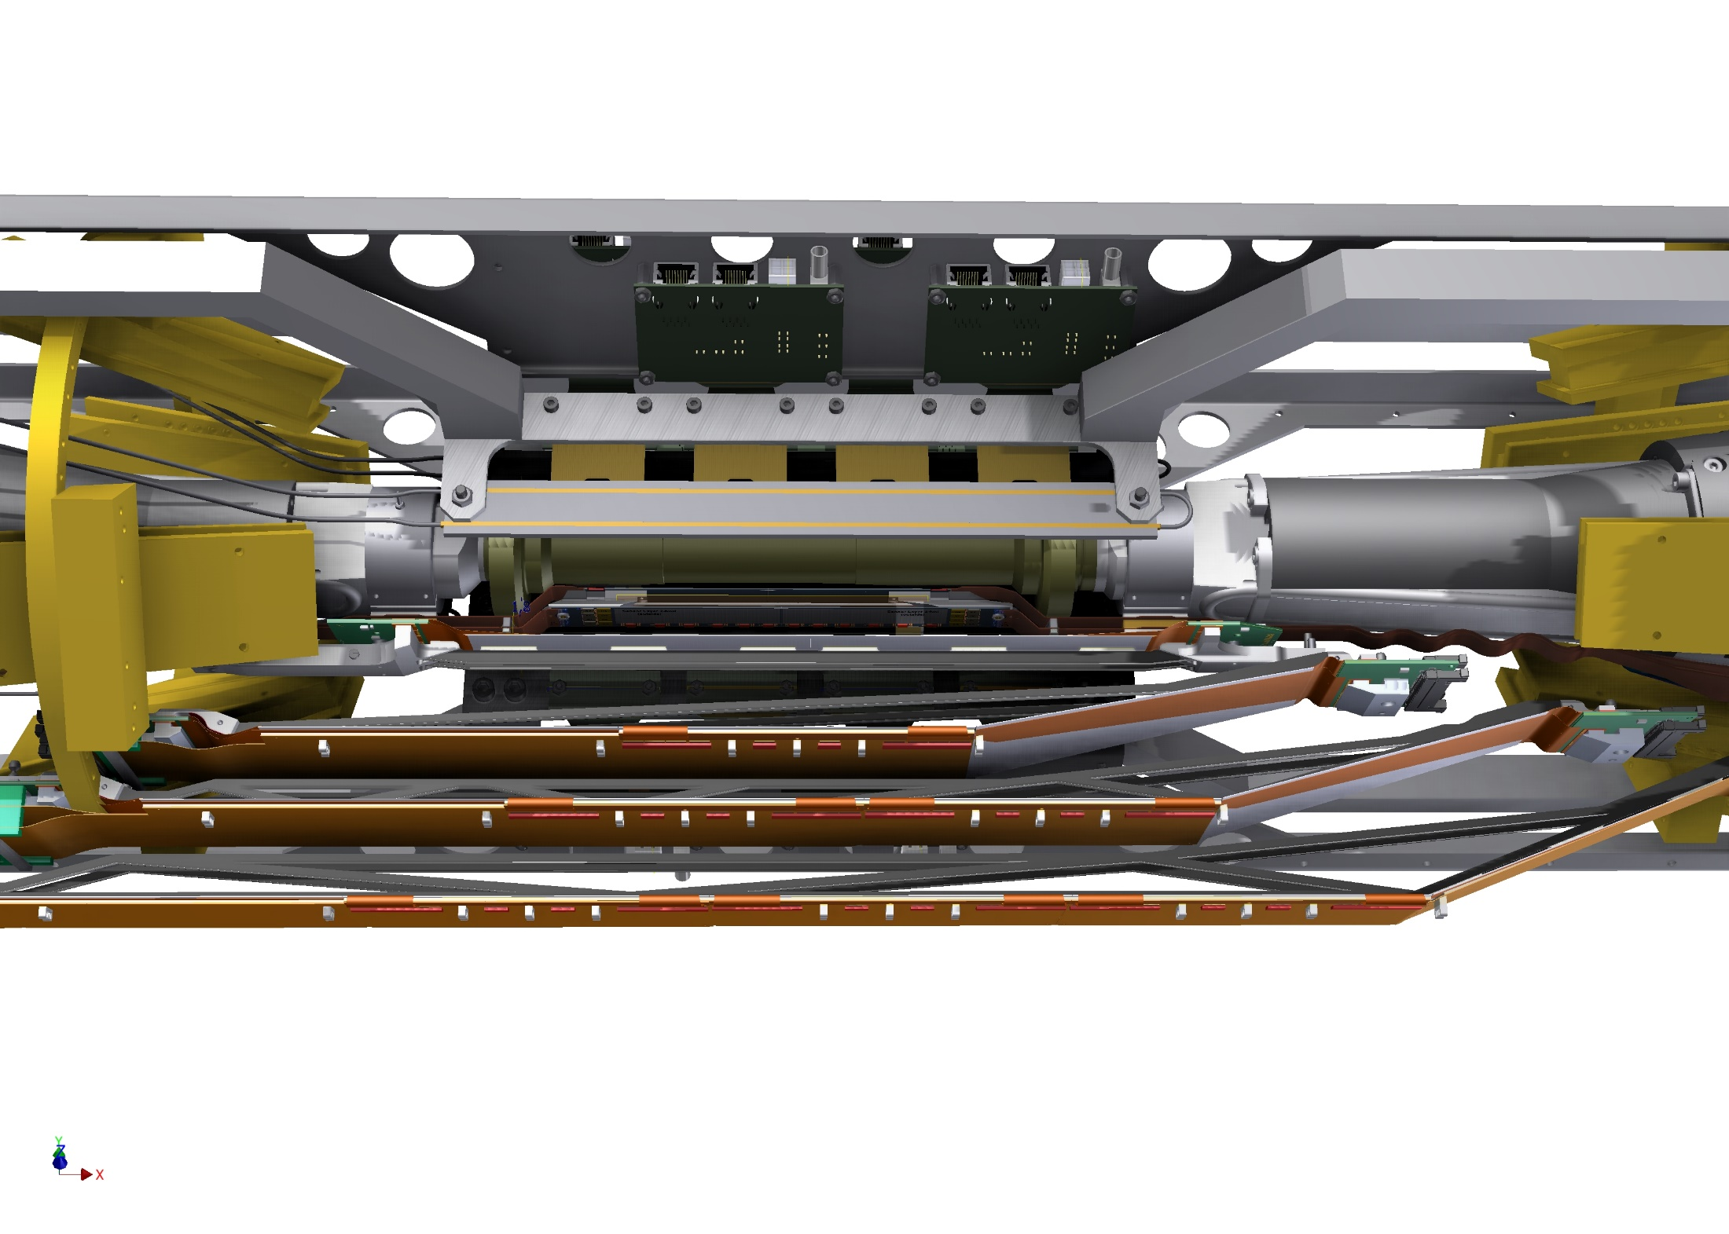
VXD Equipment during Phase 2
X-ray detectors: ATLAS IBL test sensors (+FE-I4) :
cover 90°, 180°, 270° in φ, full acceptance in θ (Bonn project)
135°, 225°: cover with fast scintillator and SiPM: offer by KEK
MPI ILC group agreed to carry this project

Slide 12
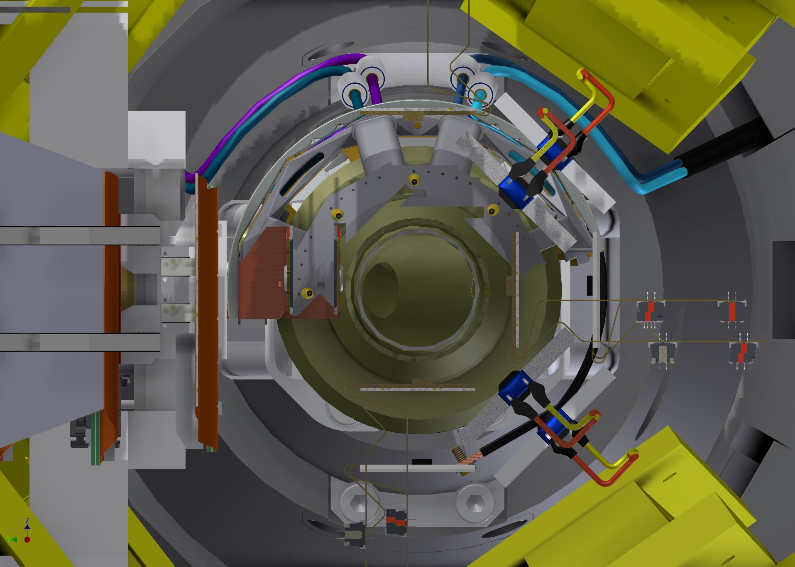
VXD Equipment during Phase 2
SiPM
PXD
SVD
FE-I4

Slide 13
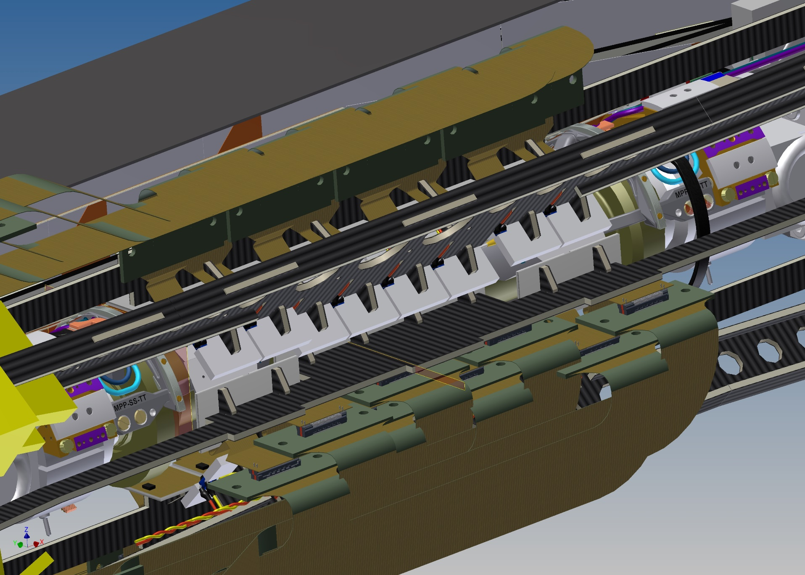
VXD Equipment during Phase 2

Slide 14
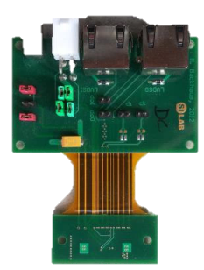
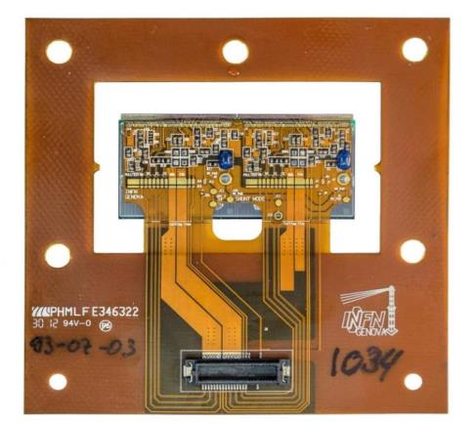
VXD Equipment during Phase 2
Hybrid planar sensor FE-I4 based
(used in ATLAS IBL upgrade project)
Pixel size: 50 x 250 µm²
Radiation tolerance: 300 Mrad
Hit-trigger association resolution: 25 ns
Double
chip
assembly
PCB
sensor
Support carbon plate, cooling by air (N2) flow

Slide 15
Further Components During Phase 2
PXD and SVD ladders are cooled by CO2
(need IBBelle operational, transfer lines to B1 and Belle II)
Need N2-flow system (N2 pre-cooled via CO2 flex lines)
Environmental sensors: temperature, humidity via
FOS (from Santander) + PT100’s)
Radiation monitors (CVD diamond sensors and radFETs)
(Trieste group + KEK)
“Cold” and “Warm” dry volumes
(is being exercised during DESY thermal mockup tests)

Slide 16
IBBelle Plant
ATLAS Version of IBBelle

Slide 17
Location: Alternative Arrangement
40’ Container, to be placed outside of Tsukuba hall
Advantage: unit can be assembled and commissioned at MPI, no need to take it apart for transport, no reassembly at KEK
This option is favored now

Slide 18
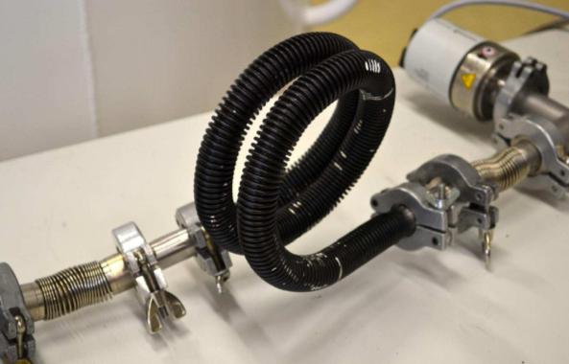
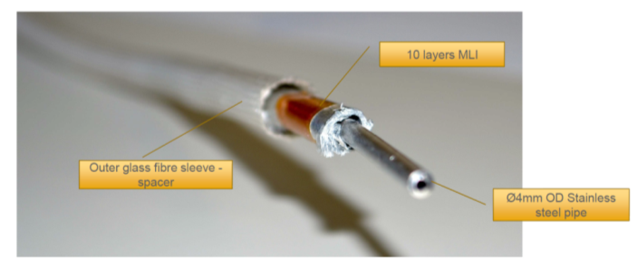
CO2 Vacuum Flex Lines
Flex line design (by CERN/NIKHEF)
MLI (super) insulation
~ 12m long
4 mm OD /
3 mm ID
outlet tube
1.6 mm OD /
1.0 mm ID concentric
inlet tube
18 mm OD corrugated vacuum tube
MLI
admissible bending radius:
~ 50 mm
CERN crew offers help building the tubes

Slide 19
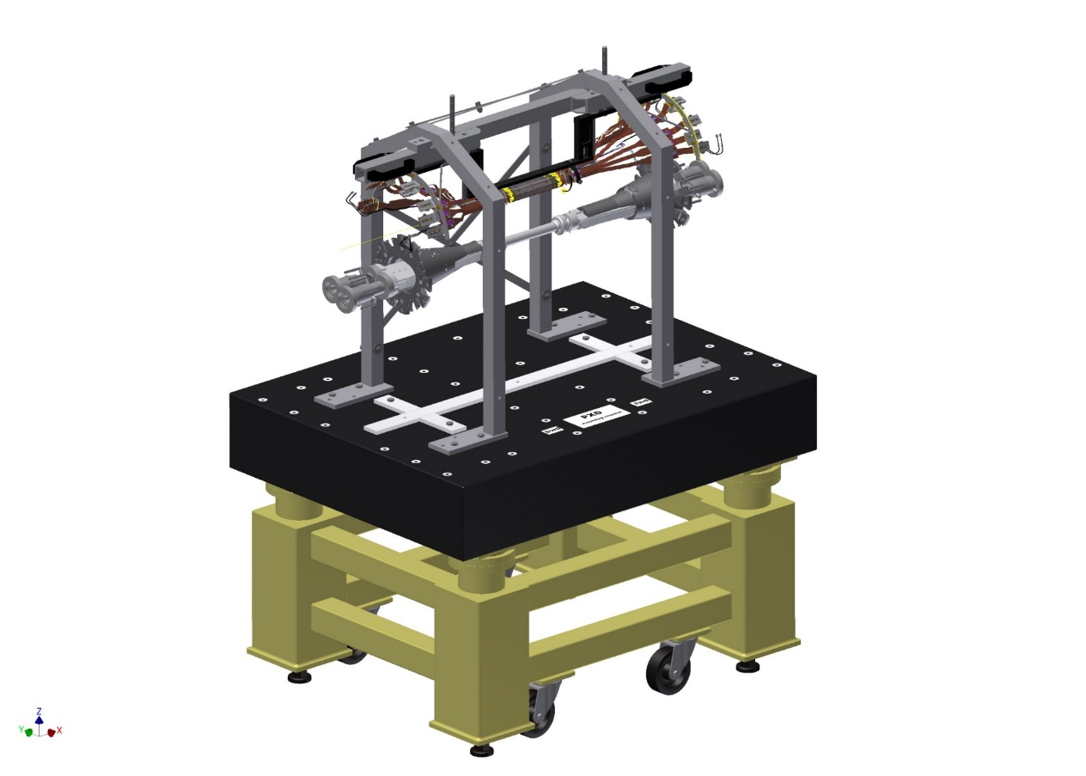
VXDP2 Integration
PXD part will be assembled at MPI
SVD part still to be decided
Both parts will be “added” and
tested in beam
at DESY in 2016, including
CO2 cooling
Mounting of VXDP2 components:
assemble from inside to outside (different from the “real” VXD case):
-CVD diamonds & radFETS
-PXD + End flange
-add SVD cartridge,
-add pixels and FE-I4,
-add scintillators and SiPM
-add BGO counters
-close two halves of
carbon shells
VXD assembly table
Any other component (such as “Plume”) must be added here

Slide 20
Phase 2 / VXDP2 Integration
VXD Assembly clean room in B1

Slide 21
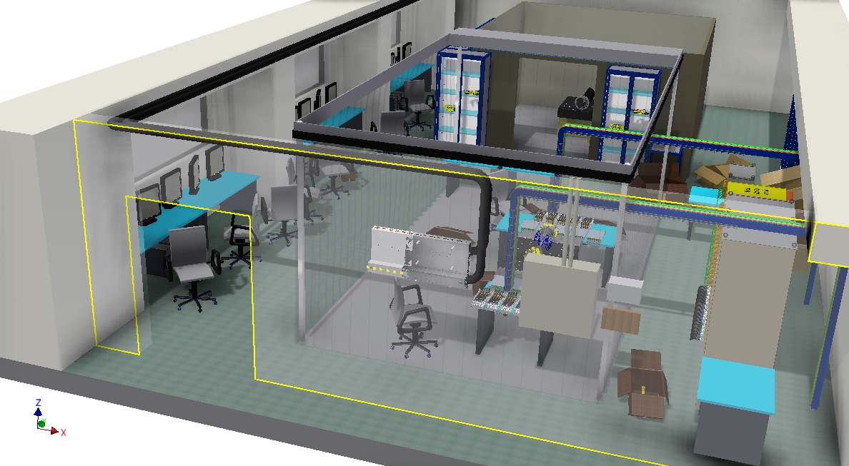
VXD Clean Room in B1
Should already be available for BEAST Phase 2 assembly
Tscharlie Ackermann

Slide 22
Various Assemblies, MPI, DESY, B1
DESY Test:
2 full ladders, mounted on SCB, 4 SVD layers in cartridge
(still decide on preassembly location)
Phase 2 (“VXDP2”):
Pre-assemble sensors at MPI (PXD, FE-I4, SiPM)
(PXD ans SVD ladders same as DESY test)
PXD / SVD (“VXD”):
pre-assemble half shells at MPI (including tests)
transport to KEK and mount on beampipe,
include SVD, add cosmic ray trigger, commission
Detailed procedure lists mandatory to organize assemblies,
including CO2 (IBBelle, transfer lines. flex lines), power etc.

Slide 23
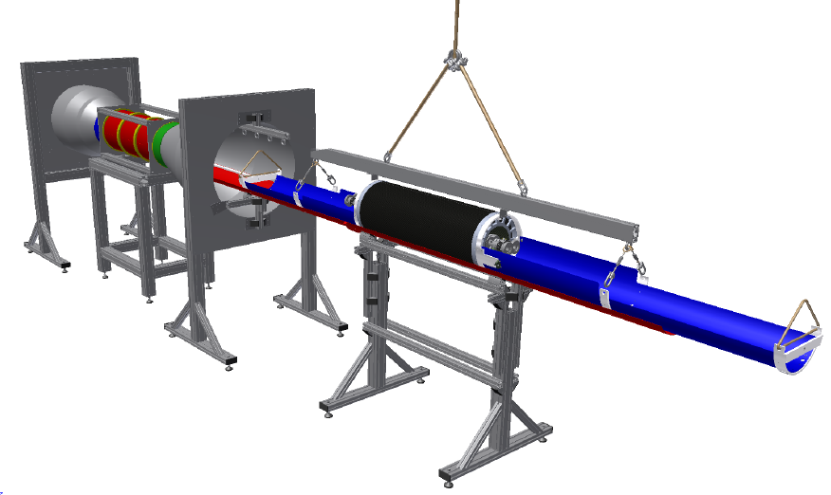
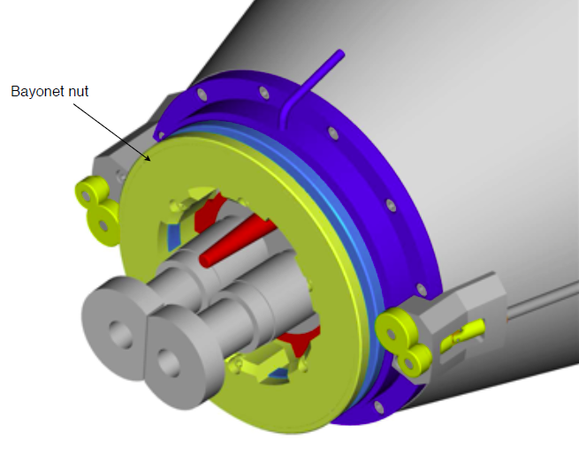
Installation of VXDP2
AIM (“Alternative Installation Method”) chosen for VXD insrallation
Method relies on the DESY Remote Vacuum Connection (“RVC”)
DESY RVC
AIM must be used also for
the VXD Phase 2 installation
VXDP2 has exactly the same outer dimensions as VXD
design by B. Müller (MPI)

Slide 24
Conclusion & Outlook
Phase 2 is crucial for the study and the optimization of background and luminosity. The VXD will not be installed in this phase.
Phase 2 will determine the operation mode of SuperKEKB for Belle II
(including the VXD)
Small part of solid angle will be nevertheless be equipped with PXD and SVD sensors
Rest of “PXD space” must be covered with detectors sensitive to the expected background (photons and charged particles) with adequate energy and time resolution (photon spectra, “noisy bunches” …)
ATLAS pixel (FE-I4) and ILC scintillators (SiPM) fulfill these requirements, Plume – to our knowledge – does not
Still, Plume may be useful at larger radii (to be studied in more detail).

Slide 25
Backup

Slide 26
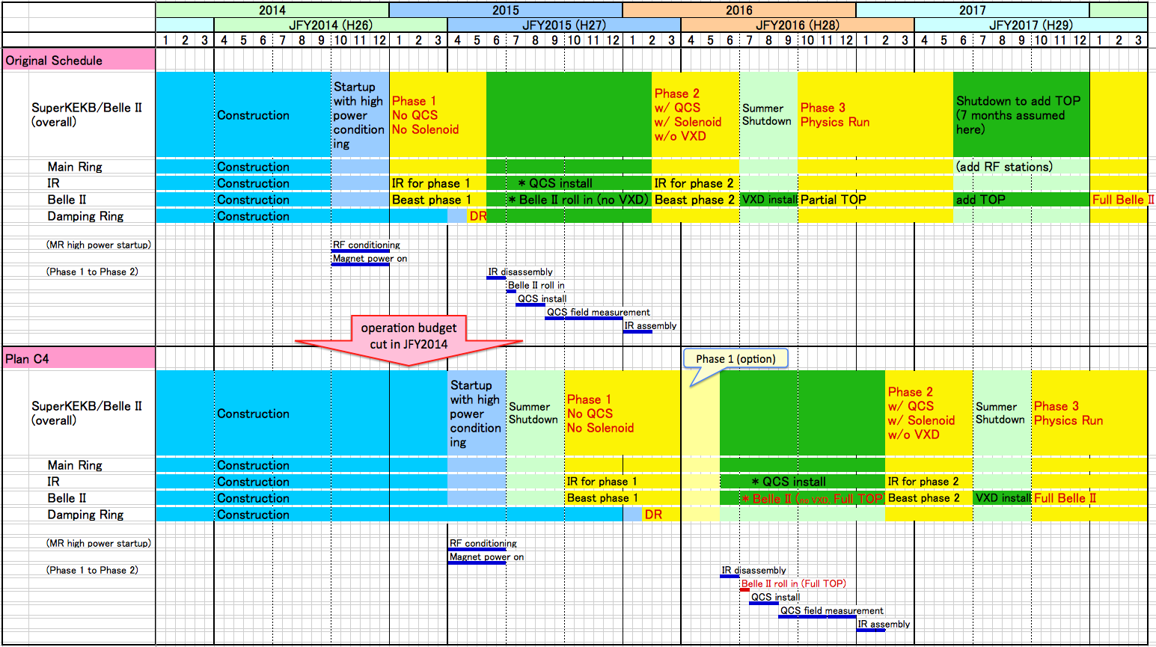
Plan “C4” (top: present baseline)
Beam Test @ DESY
PXD @ KEK
IBBelle @ KEK
Ph1
Ph2
w/ Full TOP
Plan C4
Installfull TOP
Physics Run with full TOP starts in 2017 autumn.
Belle II roll in only once.
VXD and Plan C4

Slide 27
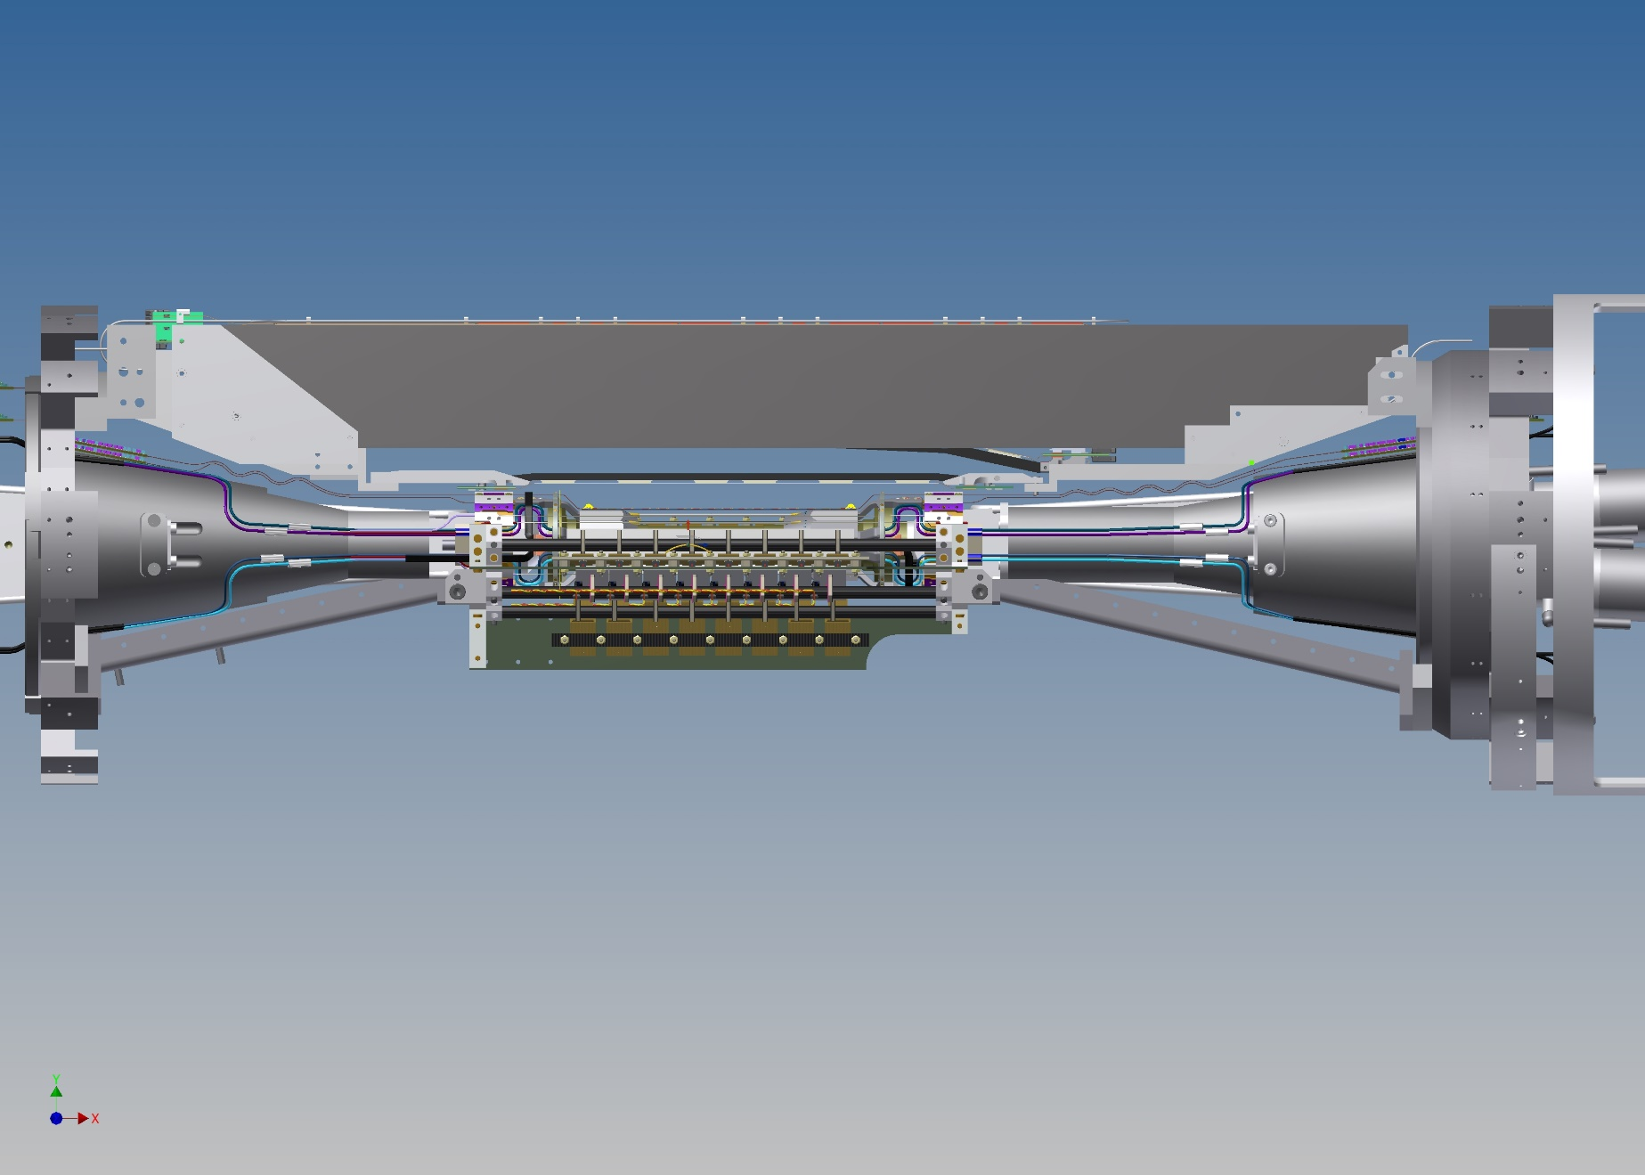
VXD Equipment during Phase 2
Alternative Assembly of ATLAS & ILC sensors:
preassemble at MPI & bring to KEK

Slide 28
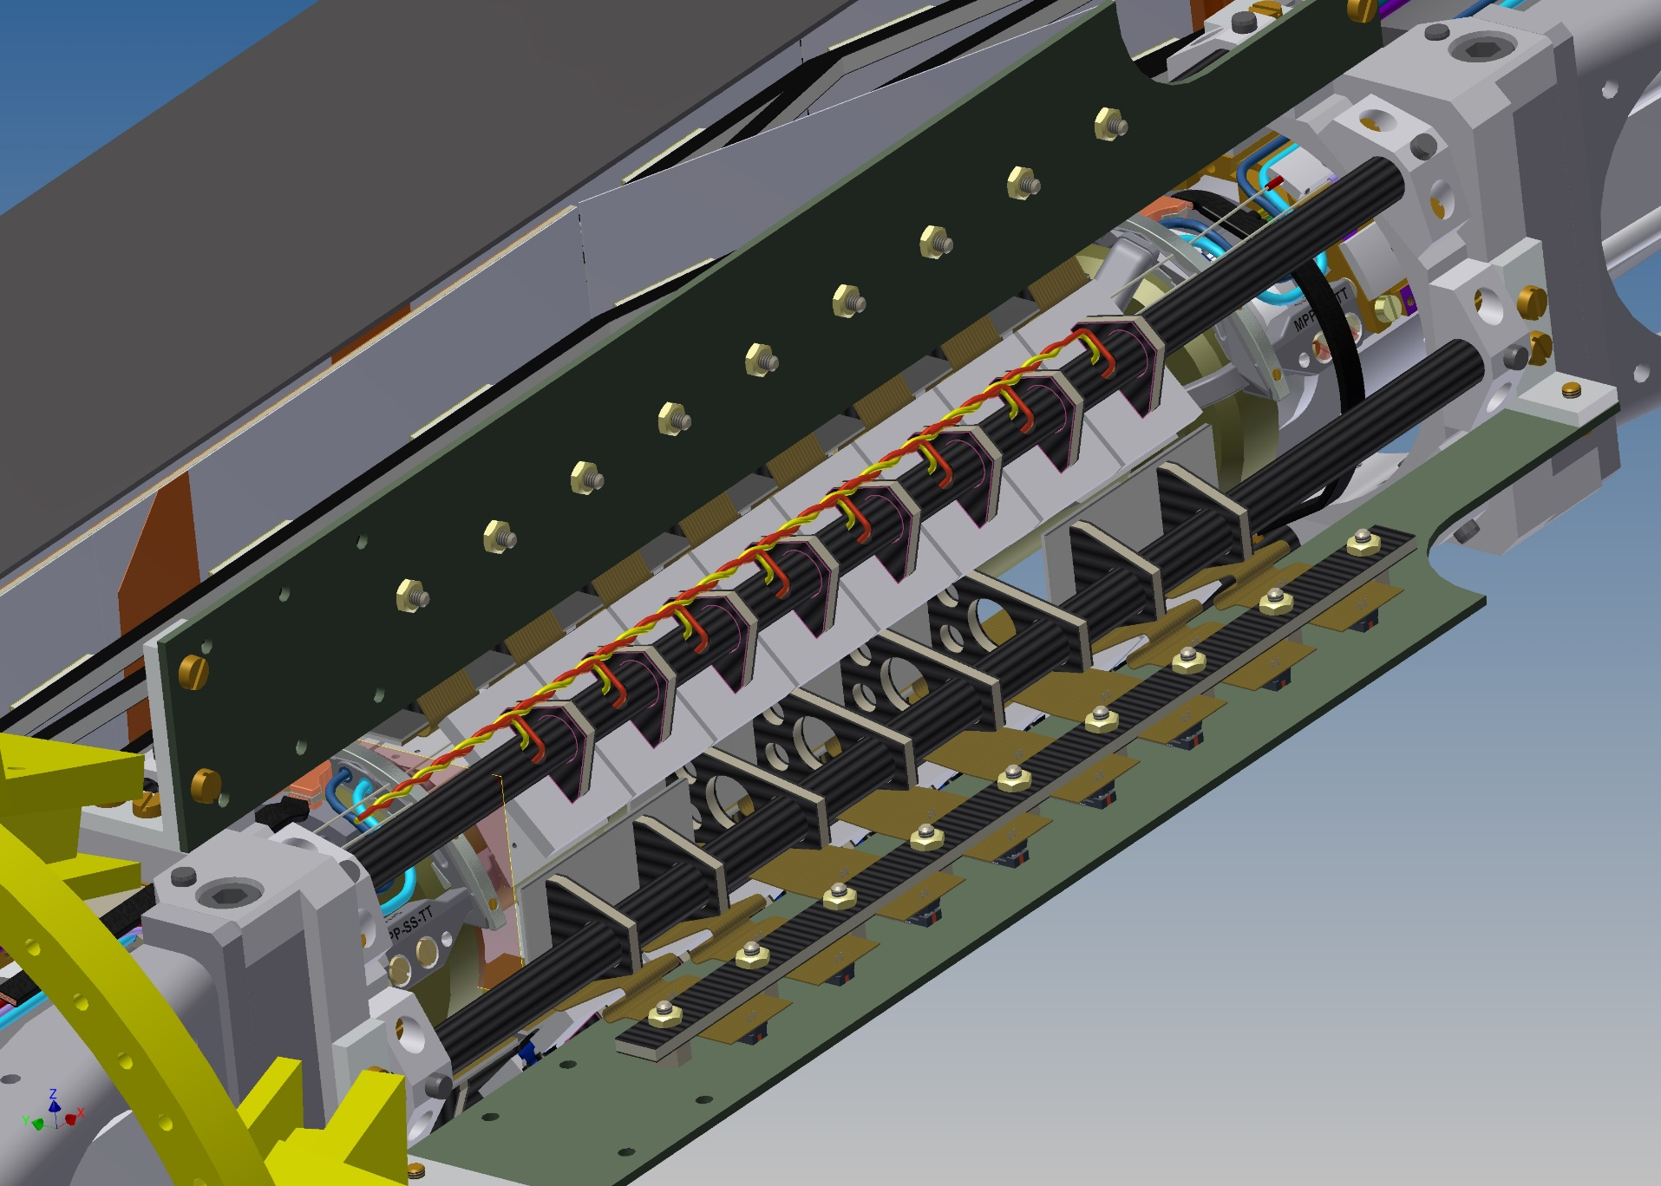
VXD Equipment during Phase 2
Integrated R/O
electronics
for ATLAS pixels

Slide 29
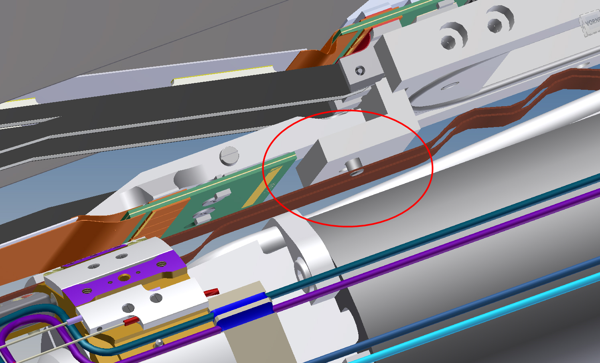
VXD Equipment during Phase 2
Some (smaller) issues with SVD layer 3 support

Slide 30
Services for IBBelle
European standard P/S at KEK, needs to be reactivated
Requirement: 400 [V] ± 10 % (filtering of V spikes)
Water for the chiller cooling: 20 l/min, room temp OK,
only filter needed, connections to be specified
N2: 50 l/min (Gas), room temp OK
Air conditioning: room temp ± 3°C, rel. humidity < 70 %
Transferlines & connection standards still need to be specified (depending on location of IBBelle)

