Slide 1
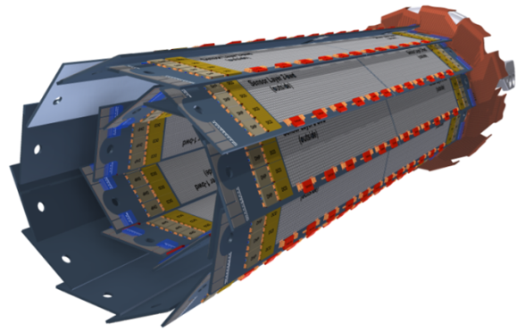
Updates of EMCM Testing
Jakob Haidl, Christian Koffmane,
Felix Müller, Martin Ritter, Manfred Valentan
Hardware
DHE (v3.2)
Setups
Software
Measurements
DHE current source
DCD current sources
ADC curves
Matrix / Switcher Sequence

Slide 2
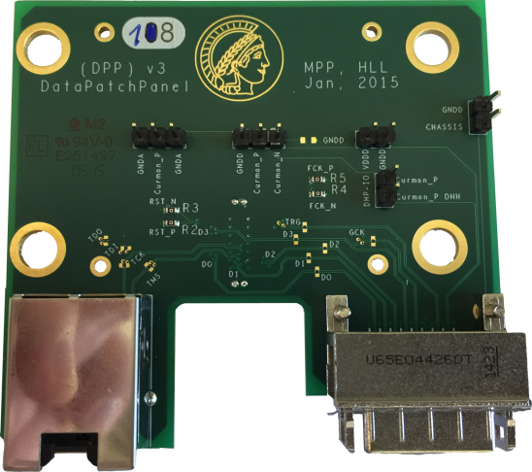
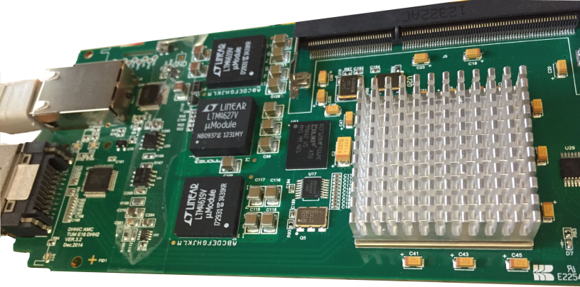
Hardware - DHE
Upgrade to DHEv3.2 (replacement of 1 Infiniband cable - 1x RJ45 & 1x Infiniband cable)
New DHE only works with DHPT (removed: FCK & RST (required for DHP0.2))
Current Source is integrated (problems occurred with external current source (connector)
New DataPatchPanel for EMCM equipped with DHPT
COOLING is
required
Description: http://twiki.hll.mpg.de/bin/view/DepfetInternal/EMCM_dpp
www.hephy.at/hephydb/cakephp/hephydb/db_files/view/1175/Item/13276

Slide 3
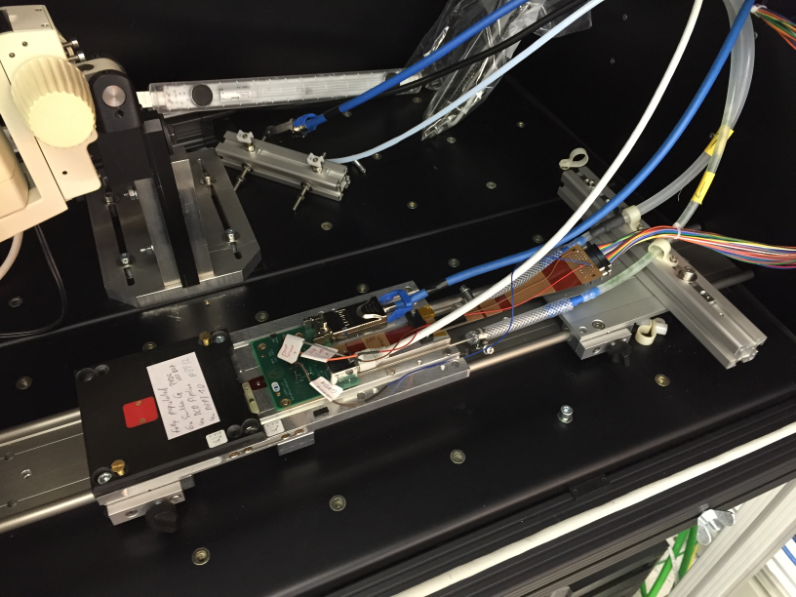
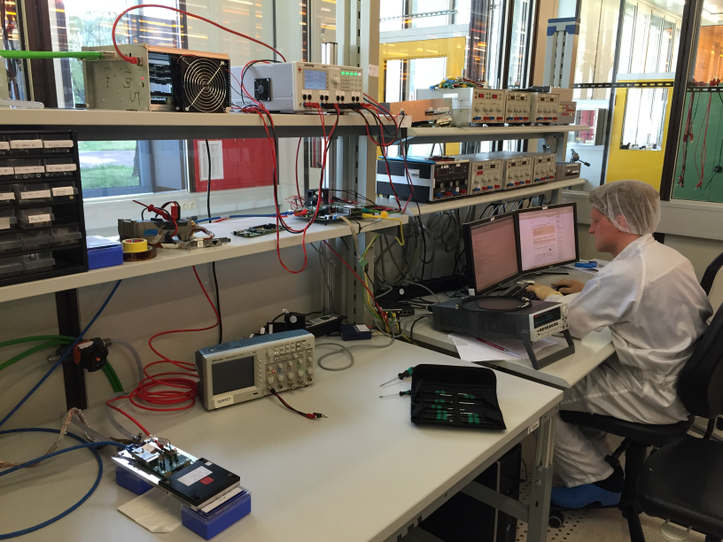
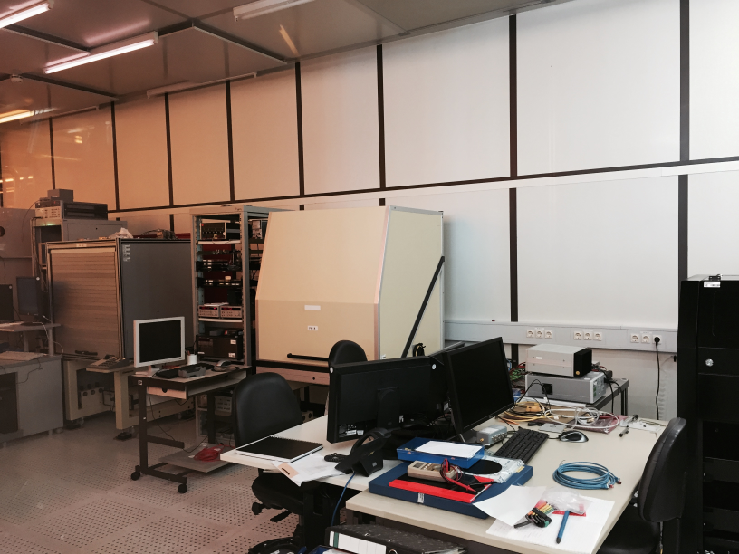
Setups in HLL
EMCM Setup (pxdtest2)
EMCM Setup (pxdtest3)
Probecard Setup

Slide 4
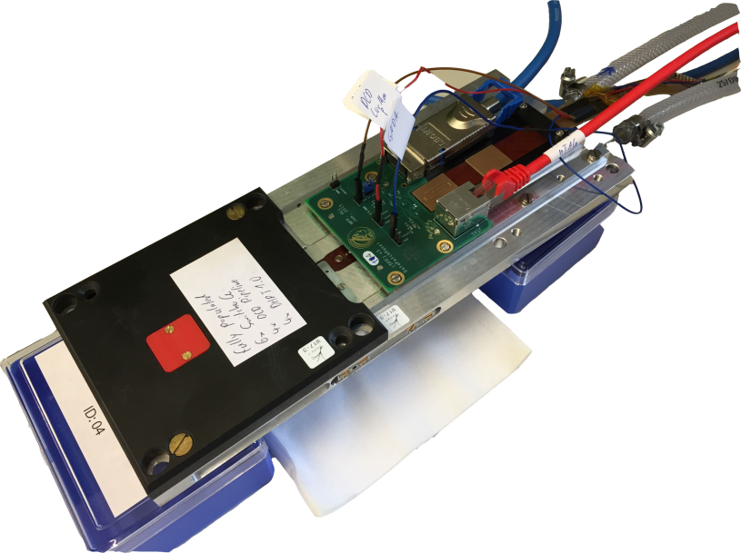
pxdtest3 @ HLL using W17-3
Infiniband
commercial RJ45 cable
PowerPatchPanel
DHP_IO
GNDA
Curmon_P
cooling
Mounting is currently prepared in the workshop
Do not use alcohol as cooling medium
glue dissolves
pipes are congested (no active cooling)
water drops from glue of the chamber
leaking

Slide 5
Software
Goal for all setups:
Common operating system
All PCs are running with Scientific Linux 6.x (HLL, MPP, Göttingen)
Common folder structure (~/cs-studio ~/epics ~/system-config ….)
Installation script: system-installation and system-configuration – settings for own PC can be easily set in an ini-file
svn: https://belle2.cc.kek.jp/svn/groups/pxdonline/epics/trunk/pxd-testsetup/system-config
Common connections (PS, DHE) – 1 PC for 1 setup
2 Network cards (Internet & Setup (SlowControl DHE,PS, HS-link)
Common Software / Measurements & Analysis
Python environment
svn: https://belle2.cc.kek.jp/svn/groups/pxdonline/epics/trunk/css/analysis
svn: https://belle2.cc.kek.jp/svn/groups/pxdonline/epics/trunk/css/dhh)
Keep track of devices (which device is used in which setup)
DataBase http://www.hephy.at/hephydb
(ask Manfred for access)
Issue Tracker (common discussions, bug report, information etc.)
https://belle2.cc.kek.jp/redmine/projects/pxdhardware
(ask Manfred for access)

Slide 6
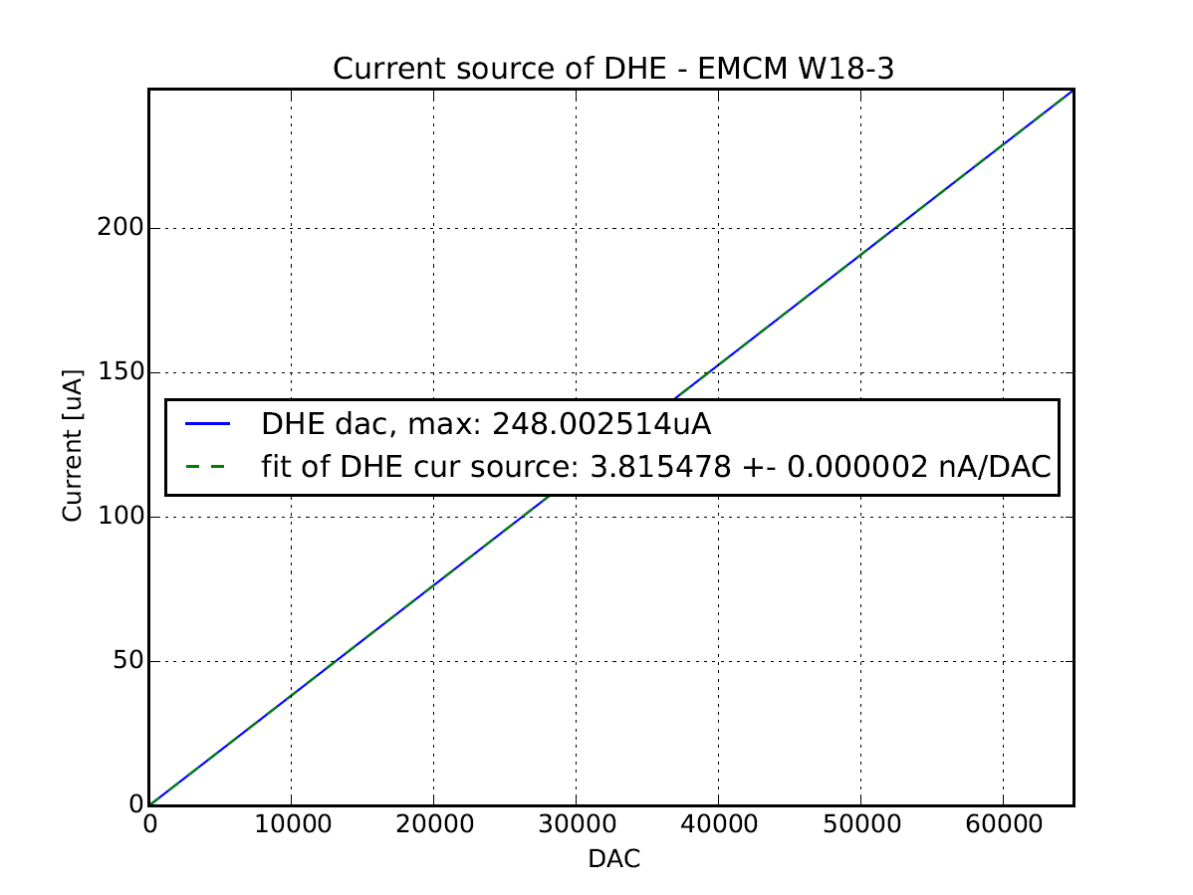
DHHv3.2 Internal Current Source
linear
low noise
248µA in 65536 steps
16-35 DACs (current settings) per ADU (gain G=1, G=4)

Slide 7
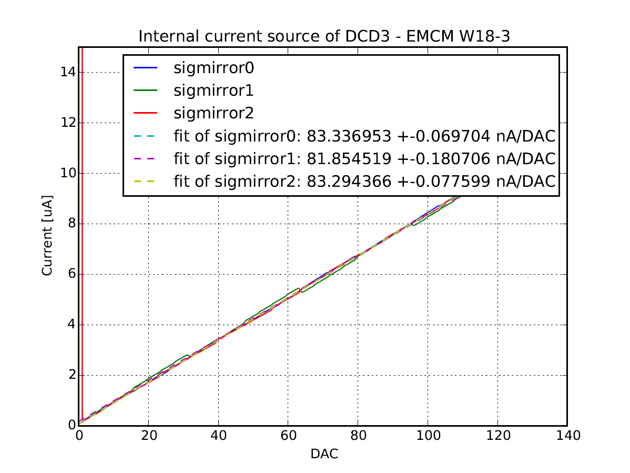
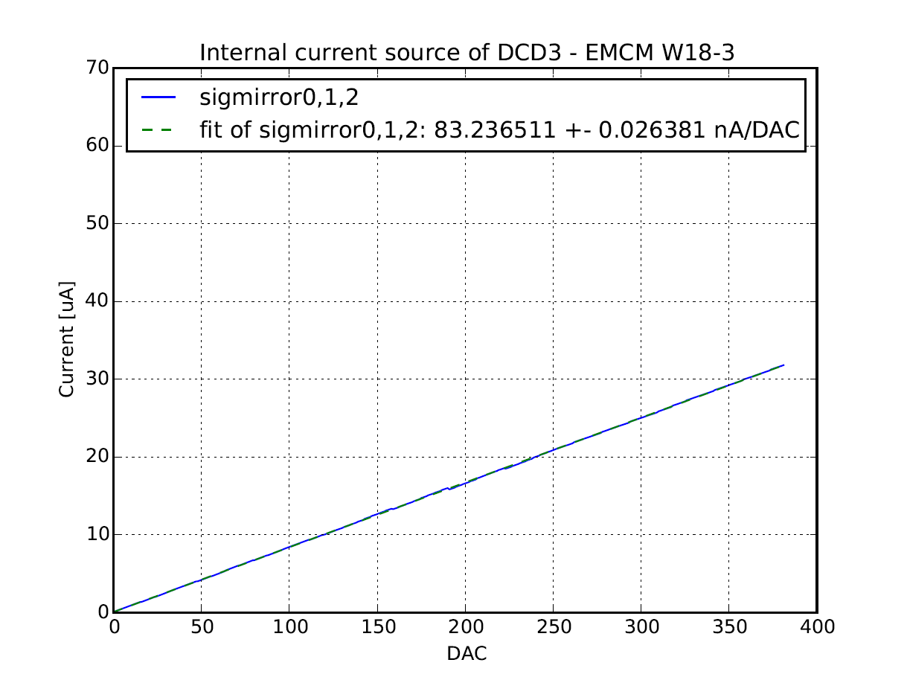
Internal Current Source of DCDs W18-3
Internal Current Source (sigmirror0,1,2) for calibration of ADCs / adc-curve
very „rough“ steps
DHE: 3,815 nA/DAC
DCD: ~80 ±4 nA/DAC
=> not every ADU can be measured

Slide 8
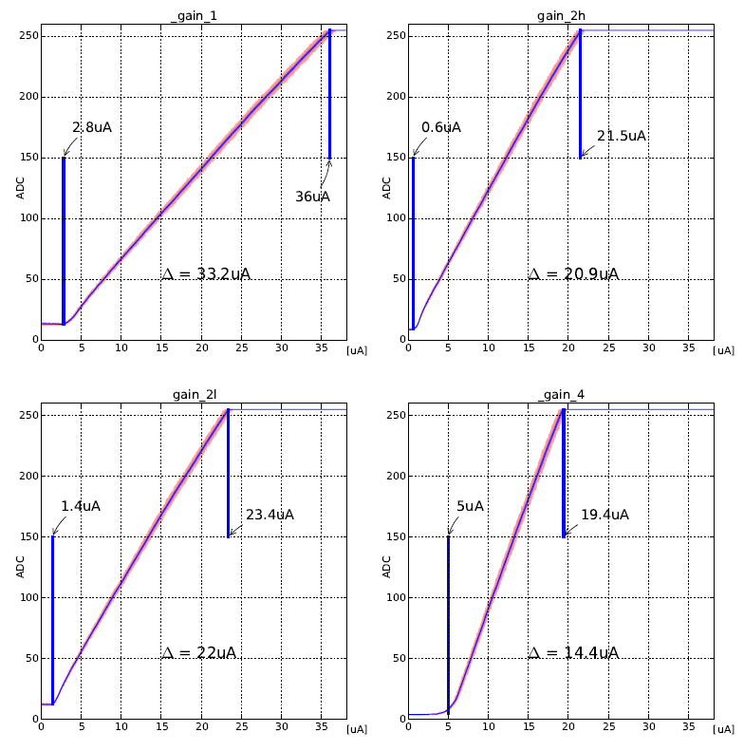
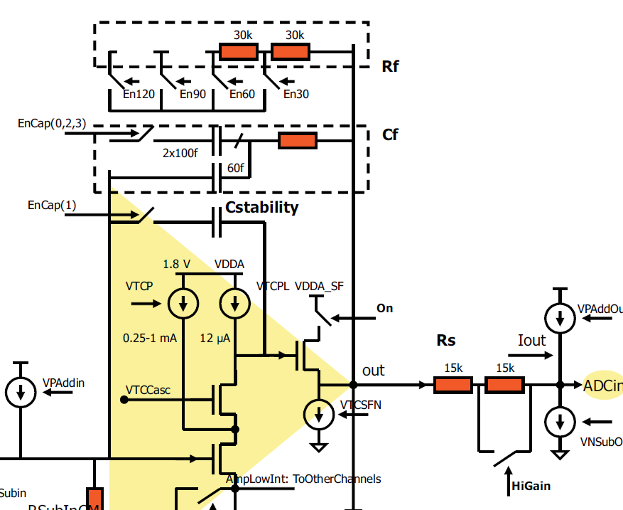
ADC-Curves: Gains (EMCM W17-3)
ΔI=33.2µA
ΔI=20.9µA
$$\text{134.4}\frac{\text{nA}}{\text{DAC}}$$
$$\text{8}\text{4.6}\frac{\text{nA}}{\text{DAC}}$$
source: DCD manual
$$G=\frac{R_{f}}{R_{s}}$$
Rf | Rs | Gain
En30 (30kΩ) | LowGain (30kΩ) | 1
En30 (30kΩ) | HighGain (15kΩ) | 2 (2h)
En60 (60kΩ) | LowGain (30kΩ) | 2 (2l)
En60 (60kΩ) | HighGain (15kΩ) | 4
ΔI=22µA
ΔI=14.4µA
$$\text{9}\text{0.}8\frac{\text{nA}}{\text{DAC}}$$
$$\text{6}\text{3.4}\frac{\text{nA}}{\text{DAC}}$$

Slide 9
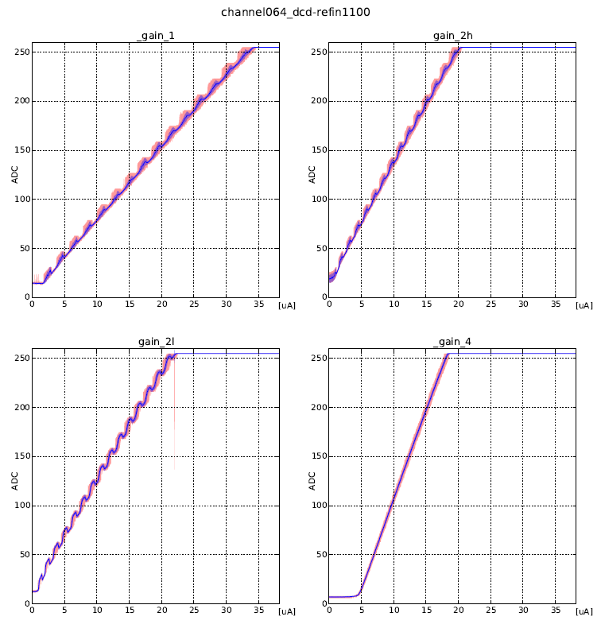
ADC curves
Channel 064
RefIn 1100mV
G=1
G=2
(HighGain)
blue: standard deviation
red: MIN, MAX
G=2
(LowGain)
G=4

Slide 10
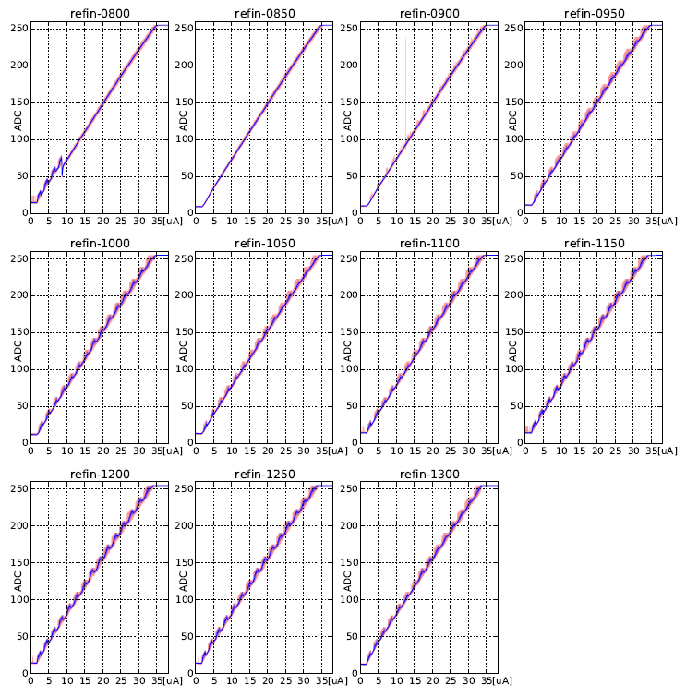
ADC curves
850 mV
Channel 064
RefIn scan

Slide 11
Matrix
EMCM W18-3
E07: ARR_128x16_ST_SD_SCG_Z075_TS
128 drains (electrical), 16 row (electrical), no capacitive coupled Cleargate, surrounding Cleargate, 75µm pixel size, Type save (referred to the p+ implant around the clear), 6µm gate length

Slide 12
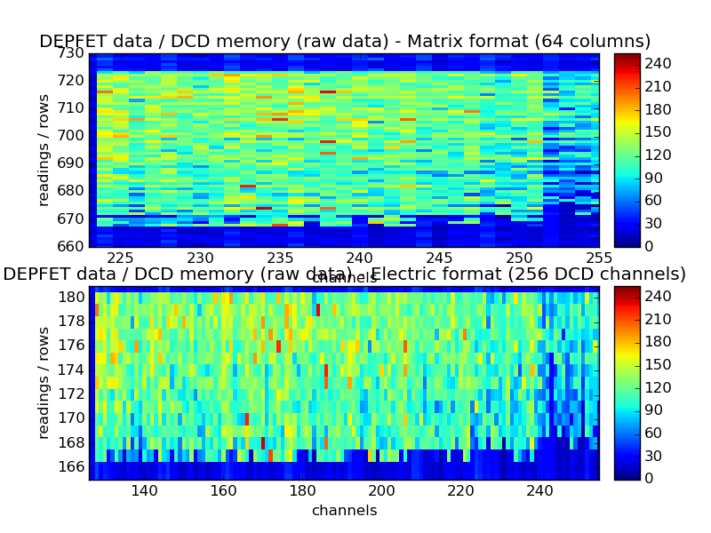
Matrix - Operation
32
14 rows:
167-180

Slide 13
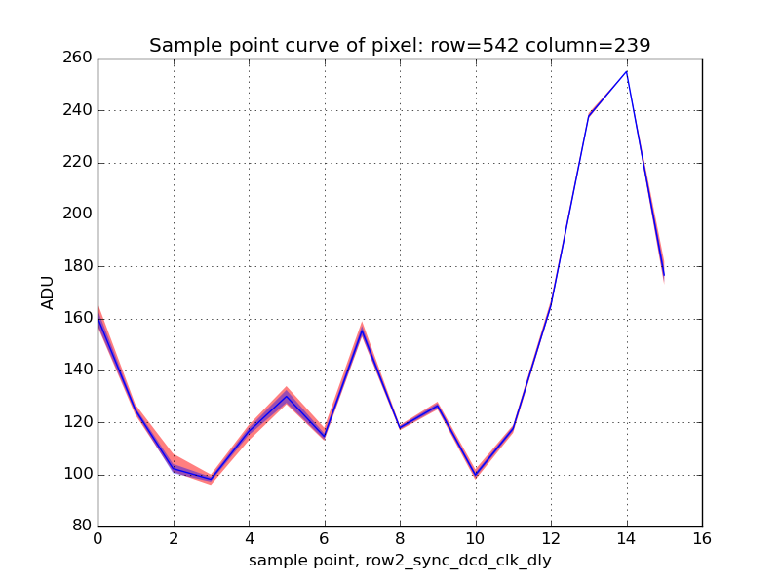
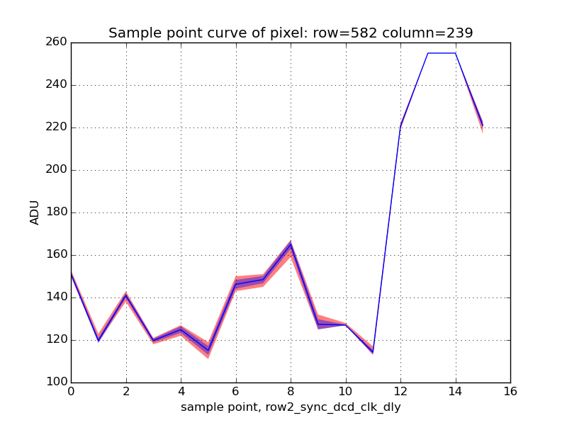
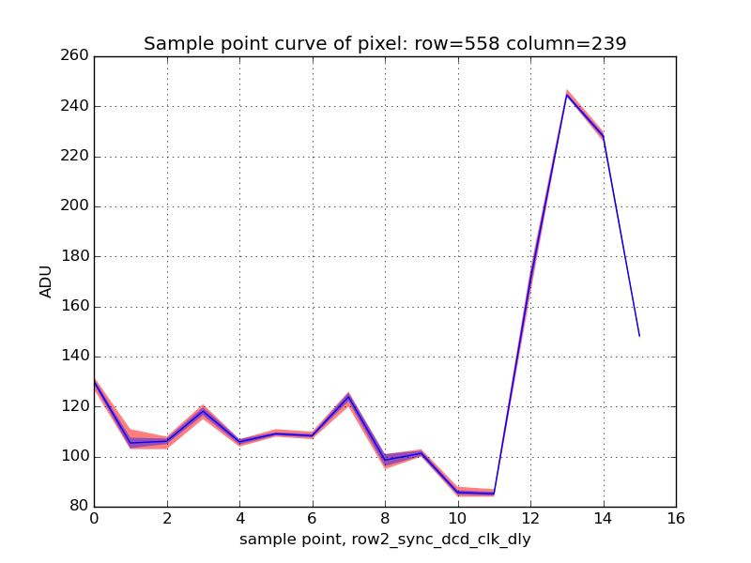
Sample Point Curve
Preliminary

Slide 14
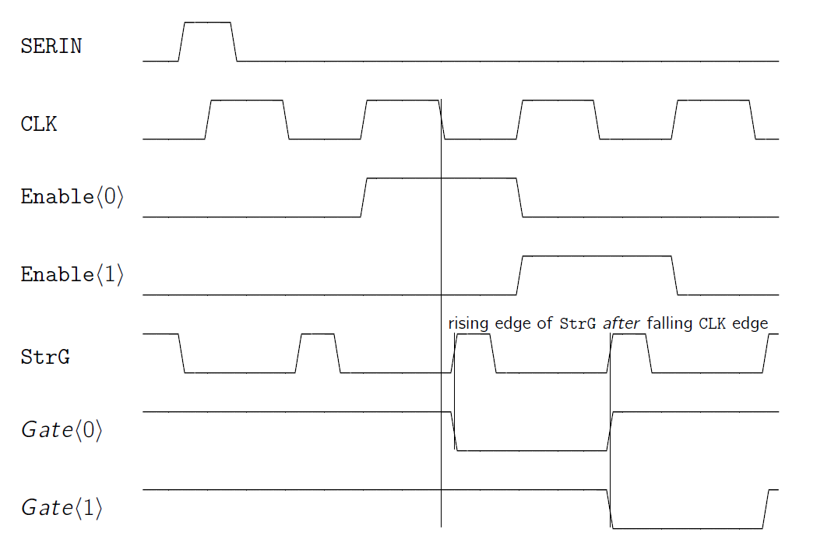
Matrix Switcher Sequence
sw_frame
source: Switcher manual

Slide 15
Switcher Sequence (1)
Step / memory | SerIn | StrC | StrG | CLK | Clear/ Gate
1 | Enable | Enable | Enable | Enable | Idle
2 |  | Enable | Enable | Enable | Idle
3 |  | Enable | Enable | Enable | Activated row1
4 |  | Enable | Enable | Enable
… |  | Enable | Enable | Enable
190 |  | Enable | Enable | Enable
191 |  | Enable | Enable | Enable
192 |  | Enable | Enable | Enable | Activate row 190
193 |  | Enable | Enable | Enable | Activate row 191
194 |  | Enable | Enable | Enable | Activate row 193
…
processing
time

Slide 16
Switcher Sequence (2)
Step / memory | SerIn | StrC | StrG | CLK | Clear/ Gate
1 | Enable | Enable | Enable | Enable | Idle
2 |  | Enable | Enable | Enable | Idle
3 |  | Enable | Enable | Enable | Activated row1
4 |  | Enable | Enable | Enable
… |  | Enable | Enable | Enable
190 |  | Enable | Enable | Enable
191 |  | Enable | Enable | Enable
192 |  | Enable | Enable | Enable | Activate row 190
193 |  | Enable | Enable | Enable | Activate row 191
194 |  | Enable | Enable | Enable | Activate row 193
…

Slide 17
Switcher Sequence (3)
Step / memory | SerIn | StrC | StrG | CLK | Clear/ Gate
1 | Enable | Enable | Enable | Enable | Idle
2 |  | Enable | Enable | Enable | Idle
3 |  | Enable | Enable | Enable | Activated row1
4 |  | Enable | Enable | Enable
… |  | Enable | Enable | Enable
190 |  | Enable | Enable | Enable
191 |  | Enable | Enable | Enable
192 |  | Enable | Enable | Enable | Activate row 190
193 |  | Enable | Enable | Enable | Activate row 191
194 |  | Enable | Enable | Enable | Activate row 193
…

Slide 18
Switcher Sequence (4)
Step / memory | SerIn | StrC | StrG | CLK | Clear/ Gate
1 | Enable | Enable | Enable | Enable | Idle
2 |  | Enable | Enable | Enable | Idle
3 |  | Enable | Enable | Enable | Activated row1
4 |  | Enable | Enable | Enable
… |  | Enable | Enable | Enable
190 |  | Enable | Enable | Enable
191 |  | Enable | Enable | Enable
192 |  | Enable | Enable | Enable | Activate row 190
193 |  | Enable | Enable | Enable | Activate row 191
194 |  | Enable | Enable | Enable | Activate row 193
…
+~210ns for frame readout
+~210ns for frame readout
find a solution

Slide 19
Switcher Sequence (5)
Step / memory | SerIn | StrC | StrG | CLK | Clear/ Gate
1 |  | Enable | Enable | Enable | Activated row1
2 |  | Enable | Enable | Enable | Activated row2
3 |  | Enable | Enable | Enable | Activated row3
4 |  | Enable | Enable | Enable | Activated row4
… |  | Enable | Enable | Enable
190 |  | Enable | Enable | Enable | Activated row190
191 | Enable | Enable | Enable | Enable | Activate row 191
192 |  | Enable | Enable | Enable | Activate row 192
…
processing
time

Slide 20
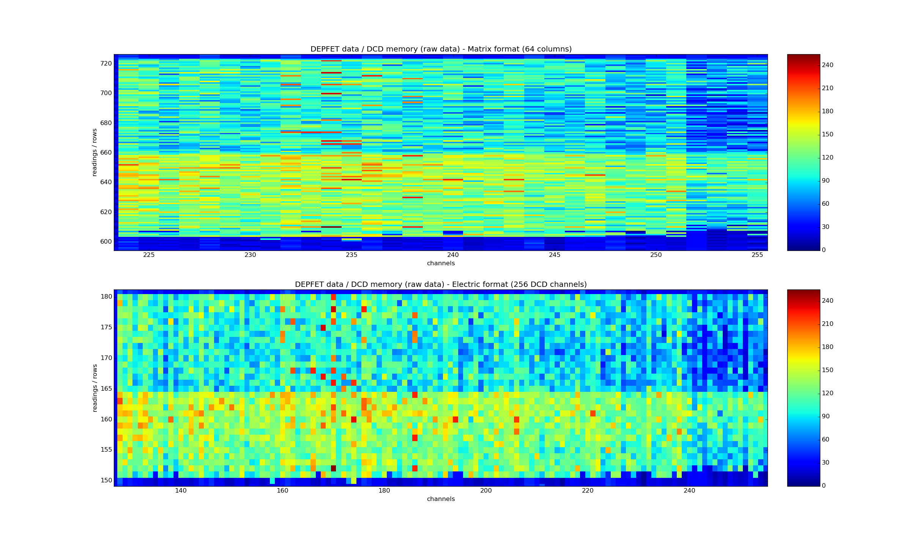
Matrix W22-E07
2 consecuitive readouts of the matrix at 320MHz
32
2nd reading
1st reading
16 rows:
165-180
2nd reading
14 rows:
151-164
1st reading

Slide 21
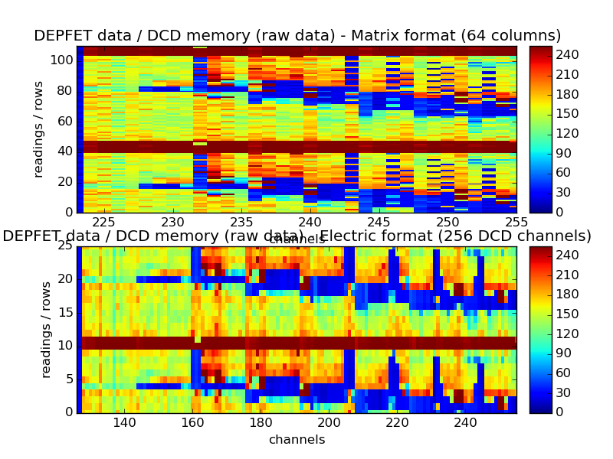
Consecutively Readout
Matrix is readout consecutively 12 times (frame readout time: 1,68µs)
Switch off Clear in one row => DCD needs „recovery time“
32
Row without
clear
Row without
clear
Preliminary

Slide 22
Summary & Outlook
Remarks:
Use water as cooling medium for EMCM
Cooling is essential (DHE) (cooling block must be removeable)
Data loss (5%-15%) )
Structure svn repository (discussion in Seeon)
Docstrings => Overview of existing functions
ADC curve analysis (find linear range, DNL, INL …)
Optimize Synchronization (switcher sequence, sampling point)
Adjust Sampling Point – take curve
Optimize DEPFET voltages
Record pedestals, noise
Matrix Pixel Mapping
Impinge with a laser (S/N - optimization)
Upload Pedestals for ZeroSuppressed Readout
More adc curves: https://hll.mpg.de/~fmu984/adc_curve/

Slide 23
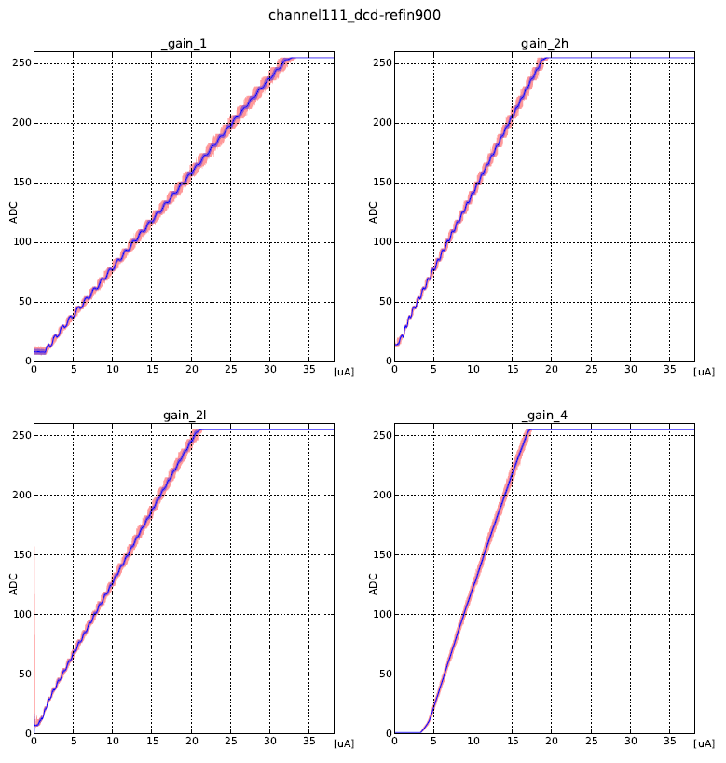
ADC curves
More adc curves: https://hll.mpg.de/~fmu984/adc_curve/

Slide 24
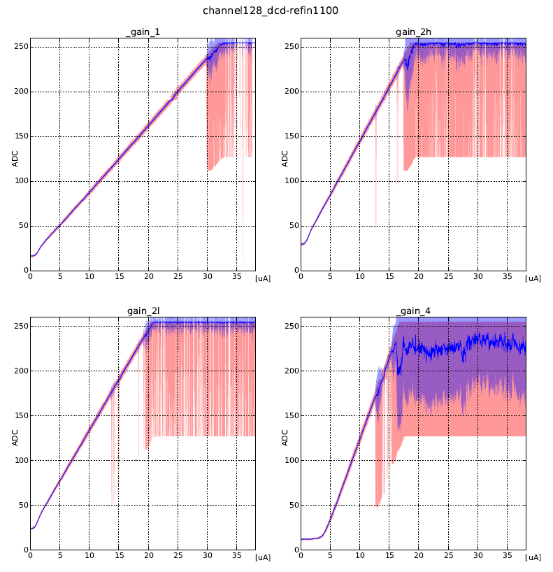
ADC curves
More adc curves: https://hll.mpg.de/~fmu984/adc_curve/

Slide 25
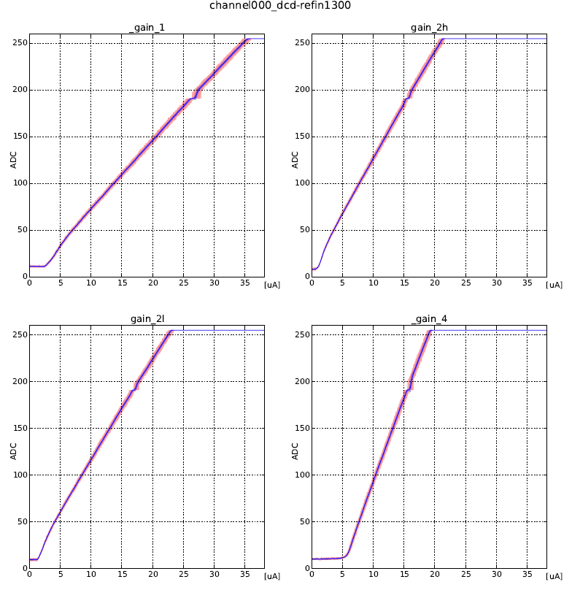
ADC curves
More adc curves: https://hll.mpg.de/~fmu984/adc_curve/

