Slide 1
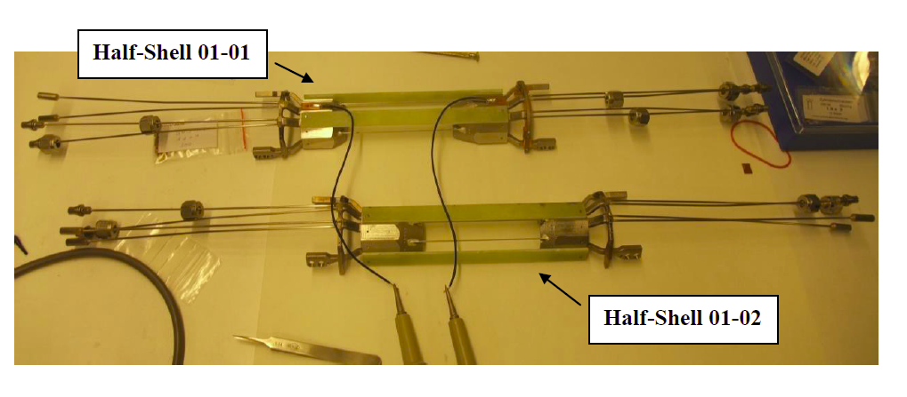
Mechanics & IBBelle
No news on PXD Mechanics in general
Cooling blocks for thermal mock up are at DESY
2 more blocks delivered (no surface treatment, for pressure tests)
8 more blocks in work (with surface treatment)
Some issues with electrical resistance between blocks (see next slides)

Slide 2
Cooling Blocks
Electrical connection between blocks:
4 carbon tubes (also for air cooling)
Al coated
Connected to block via silver loaded
Epoxy and silver loaded paint
For proper grounding: R < 0.5 Ω between blocks
(translates into < 1 Ω for half shelf)
1st shelf: 0.6 Ω
2nd shelf: 1Ω
Some variations (aging?) observed
(2.9Ω => 3.6Ω in 9 months for one tube)

Slide 3
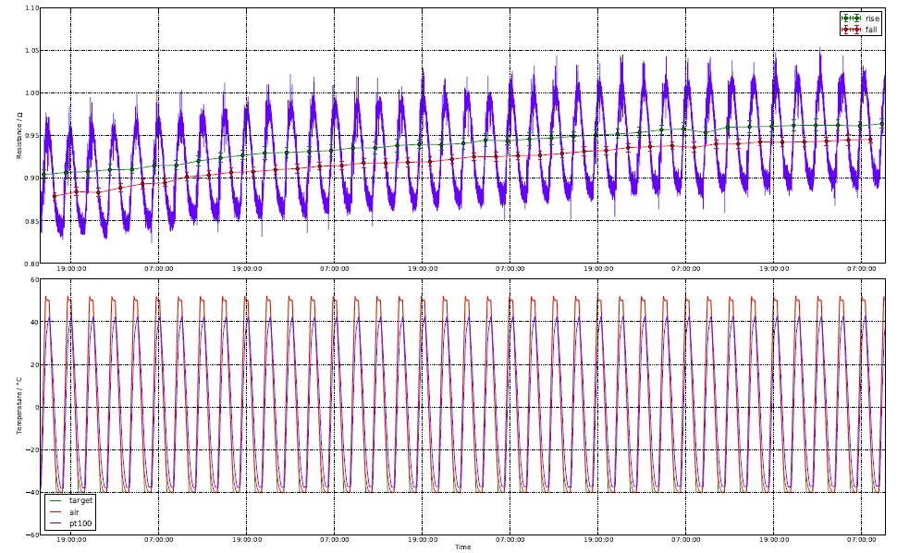
Thermal Cycling
Thermal cycling -40°C - +50°C
No dramatic changes, but slight increase of resistivity, seems to saturate…

Slide 4
Irradiations
Neutron irradiations: 2x10^12n/cm²: no or only slight changes (but some tracks broken)
Gamma Irradiations: 130kRad (Co60): slight increase of resistance (200Ω -> 250Ω)

Slide 5
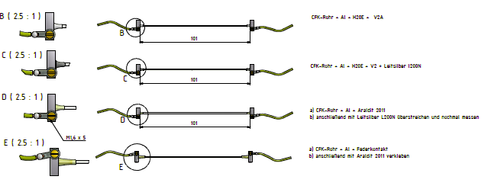
Test setups
Bare tube: ~0.8 Ω
~7.1 Ω
~4.5 Ω
~40 MΩ/220 kΩ −> 3−10 Ω
~1.3 Ω
Spring loaded contact has best conductivity and does not rely on conductive paint
Need to modify cooling blocks to integrate spring tube (to be studied)

Slide 6
IBBelle
Original plan: copy IBL unit, assembly in a 40’ container
However: no space in Tsukuba hall, extra building too expensive
=> Use only one unit to fit in 20’ container and in Tsukuba hall
Sven .Vogt
Tel.:+49 8932354336
E-Mail:vog@mpp.mpg.de

Slide 7
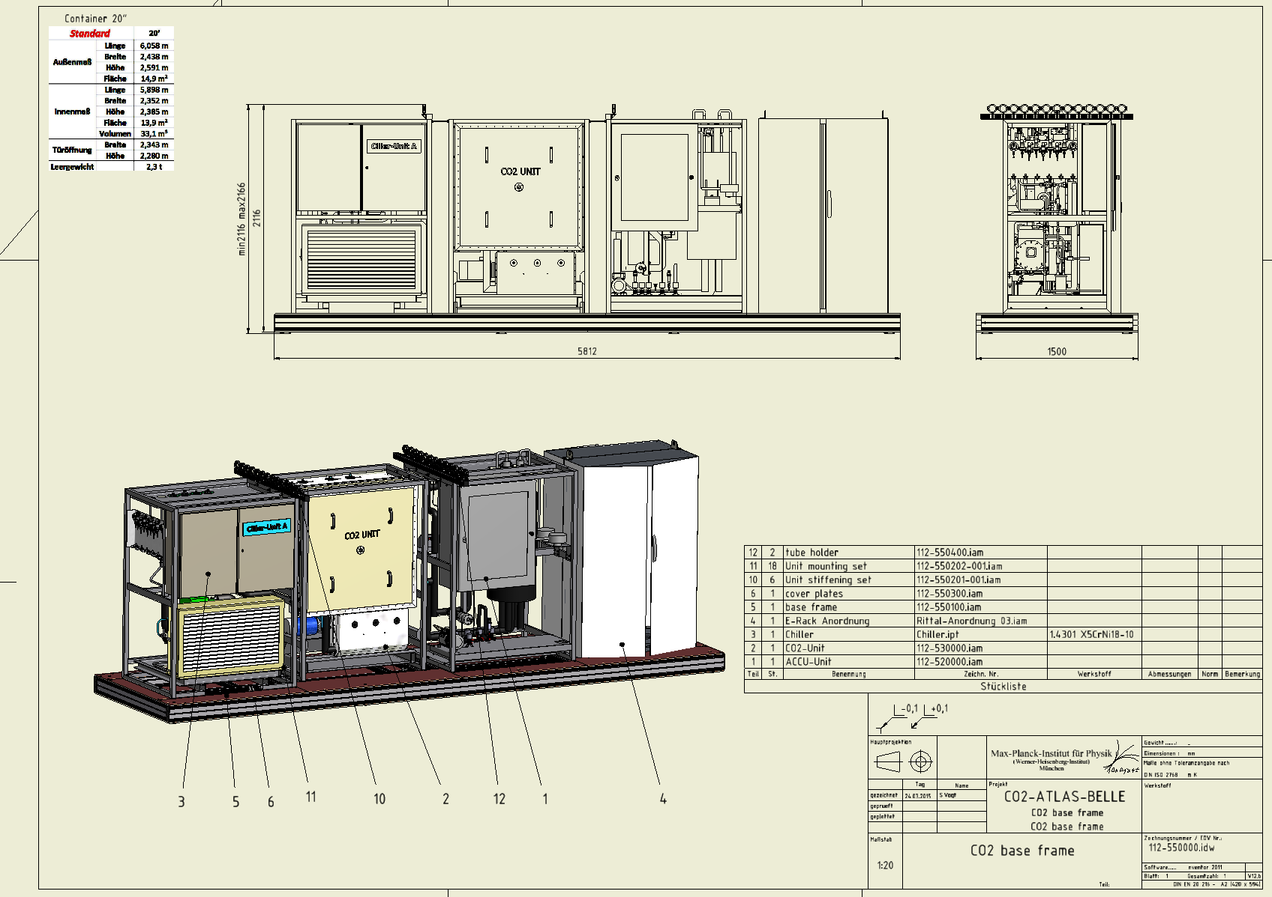
IBBelle for VXD option: add 2nd unit later
CO2 base frame für 1 Einheit

Slide 8
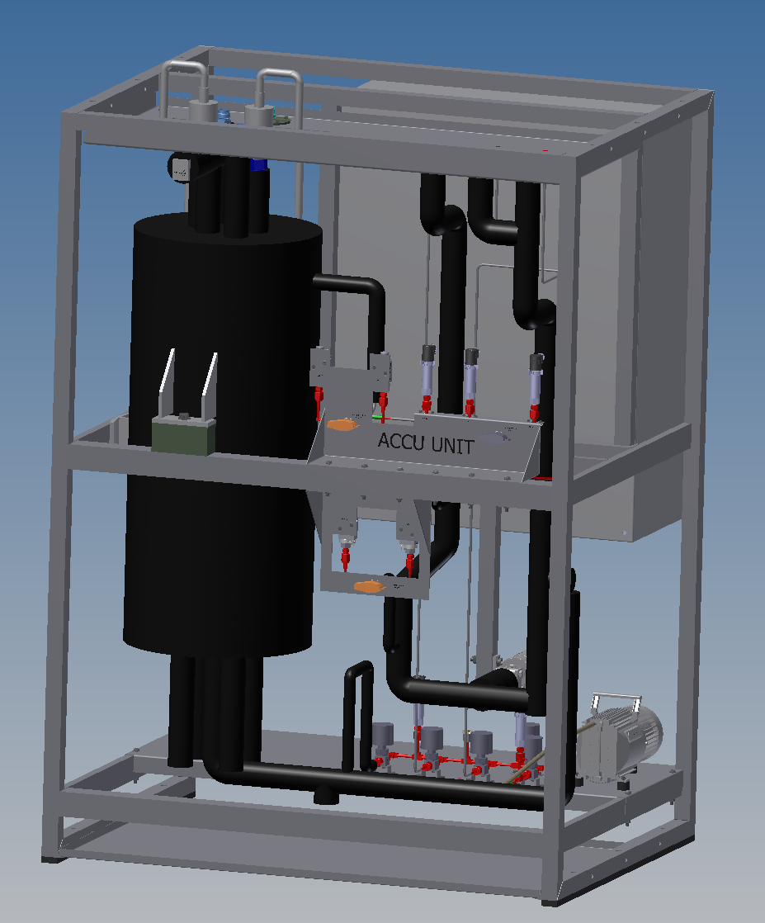
Akku Unit
Heat exchanger re-designed
Akku ordered
Frame in work

Slide 9
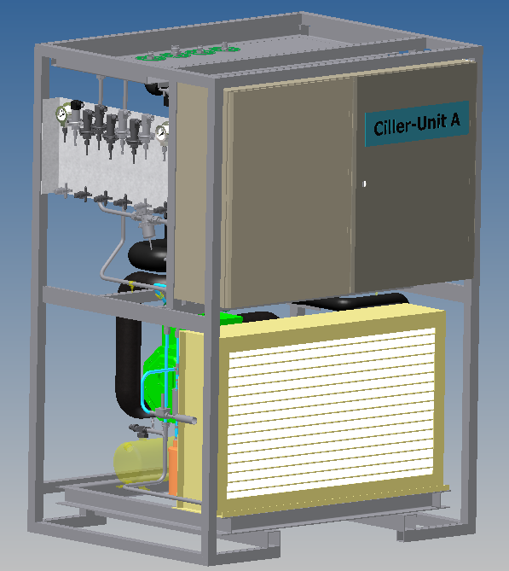
Chiller Unit
Chiller ordered
Frame in work

Slide 10
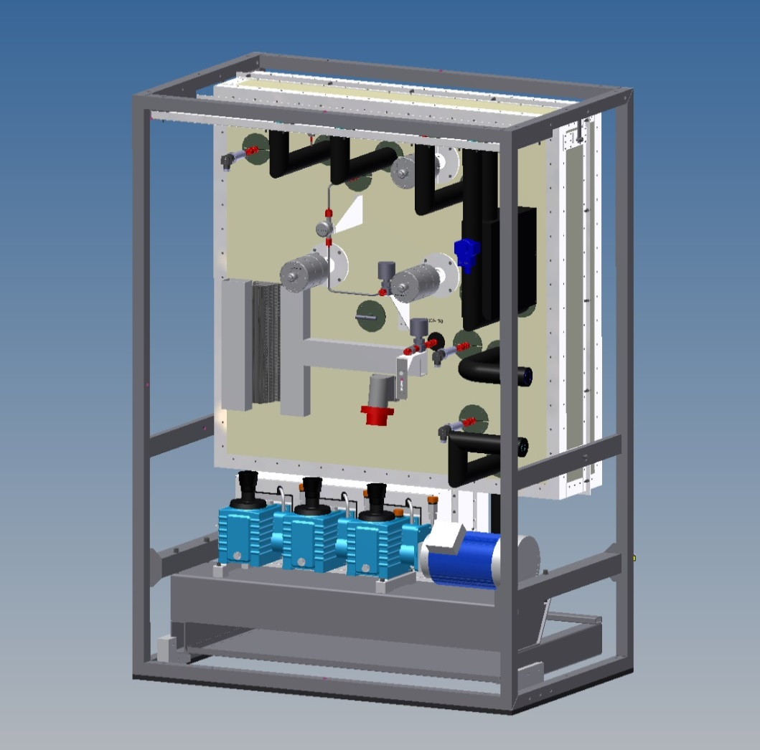
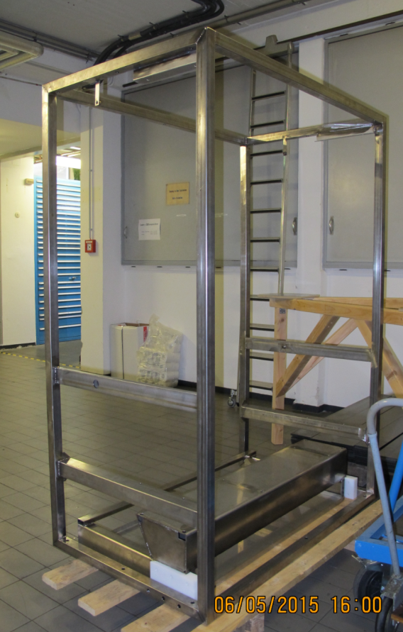
CO₂ Unit
Pumps delivered (2 sets)
Frame is ready
Assembly about to start

Slide 11
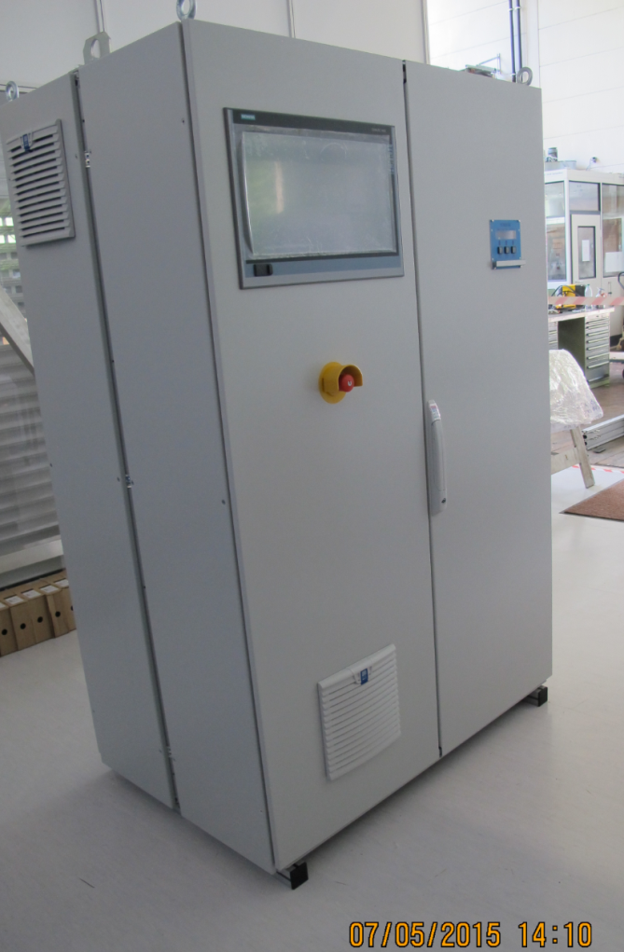
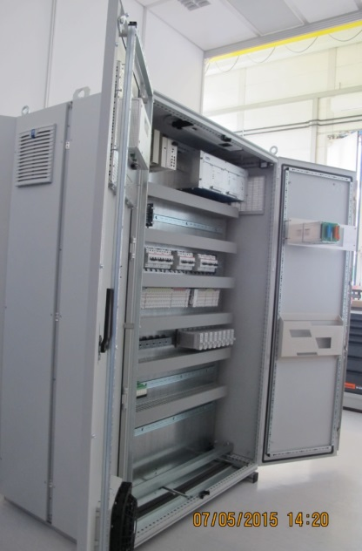
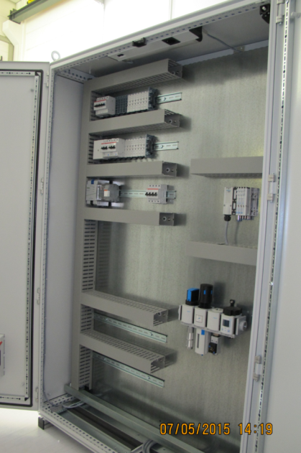
Control Cabinet
Cabinet ready
Next: cabling

Slide 12
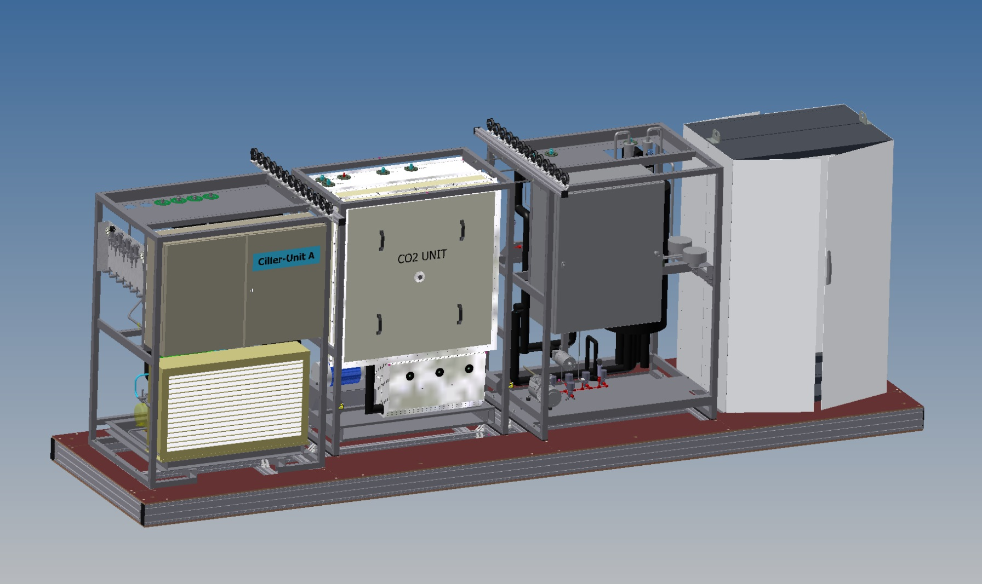
IBBelle base frame
Adjustable feet
Can be put on wheels (bogies)

Slide 13
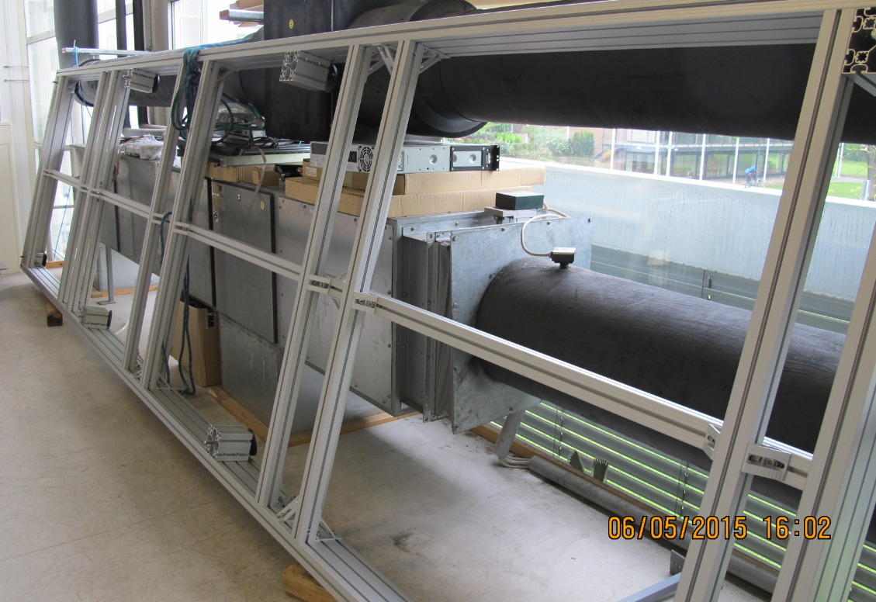
IBBelle base frame
Frame assemble
Wooden panels ordered
Next: put Cabinet and frames in poition

Slide 14
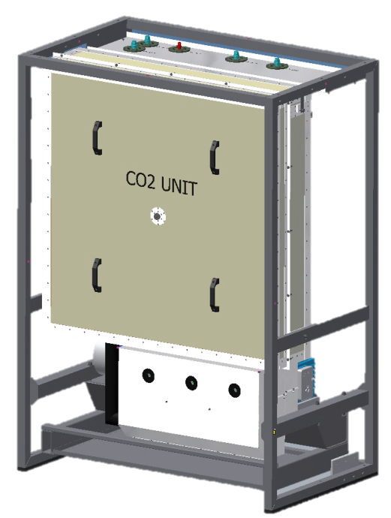
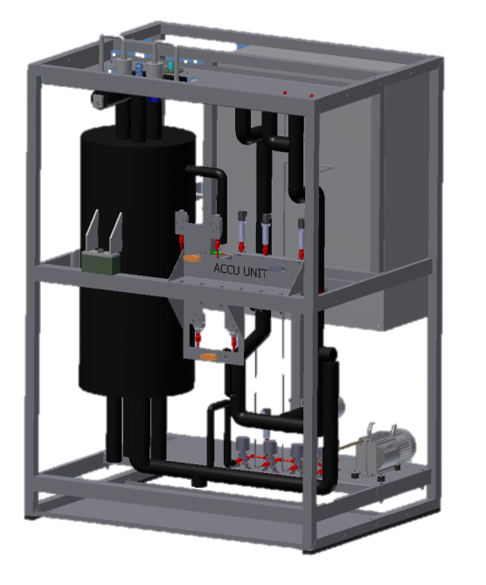
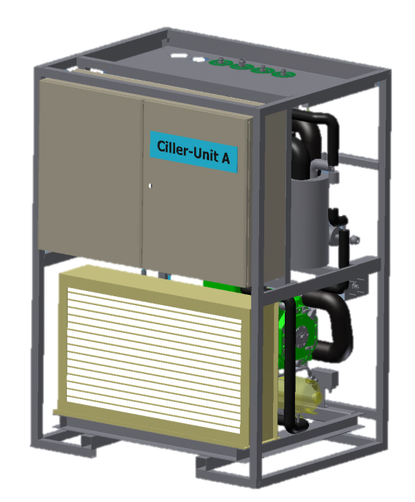
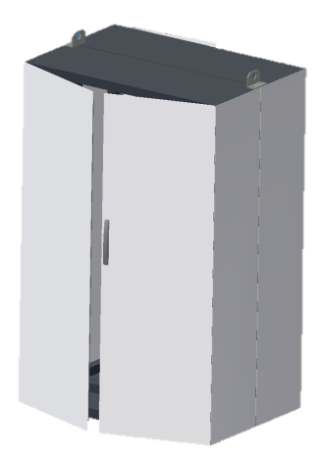
Weight: ~ 4t
ca. 600kg
ca.400kg
ca.800kg
ca. 500kg
ca. 1000kg
Crane at KEK: max load 4.5t + 25% (include support lever!)

Slide 15
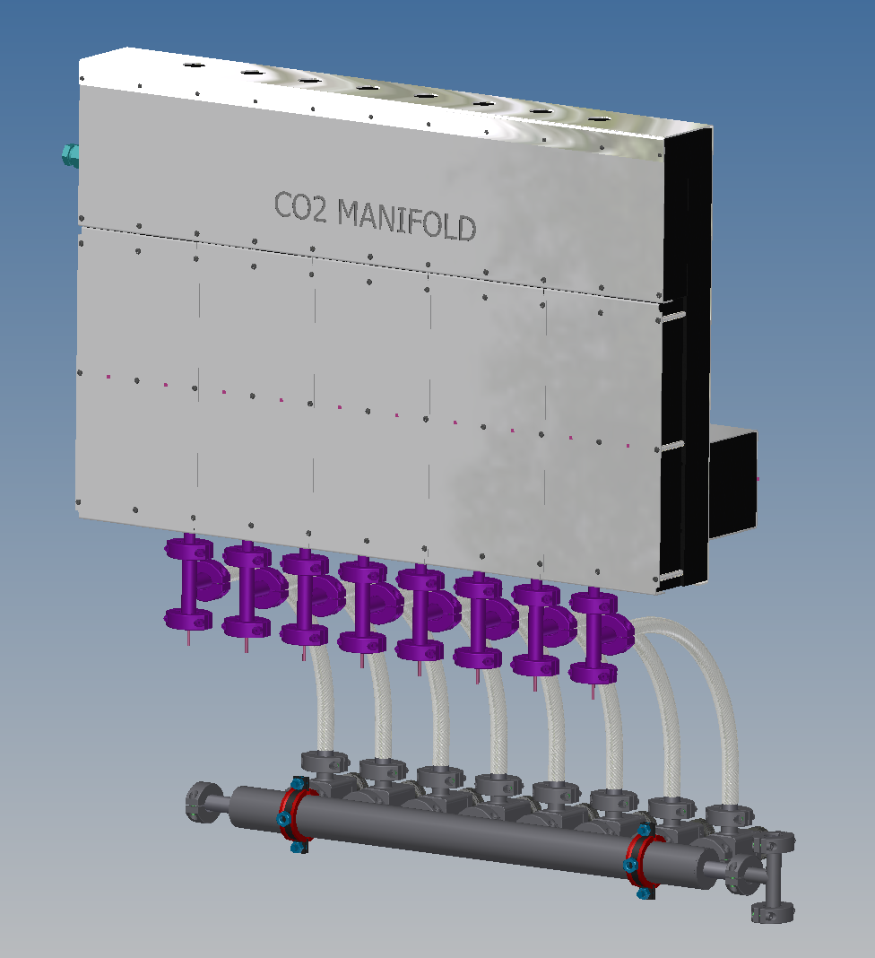
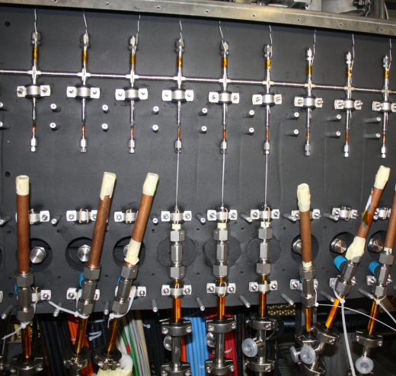
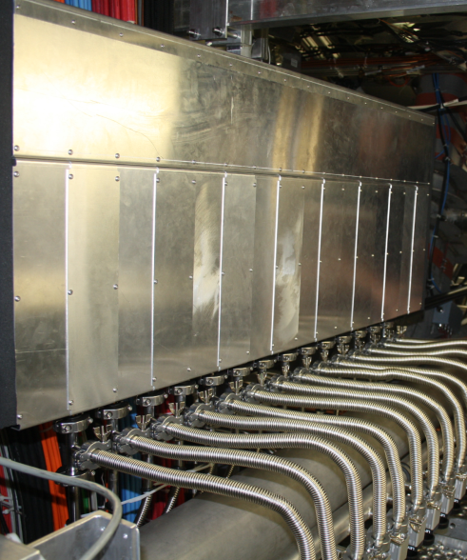
Other components
Manifold Boxes
In work

Slide 16
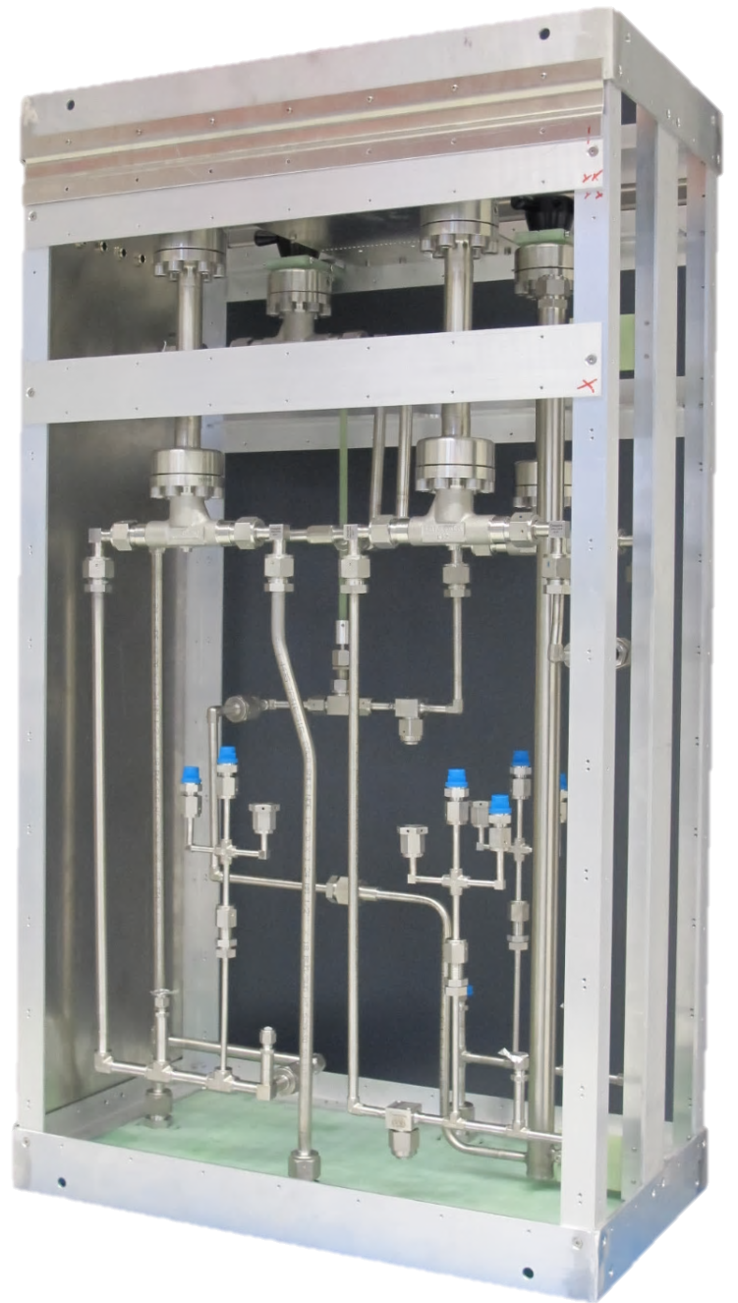
Junction box
In work

Slide 17
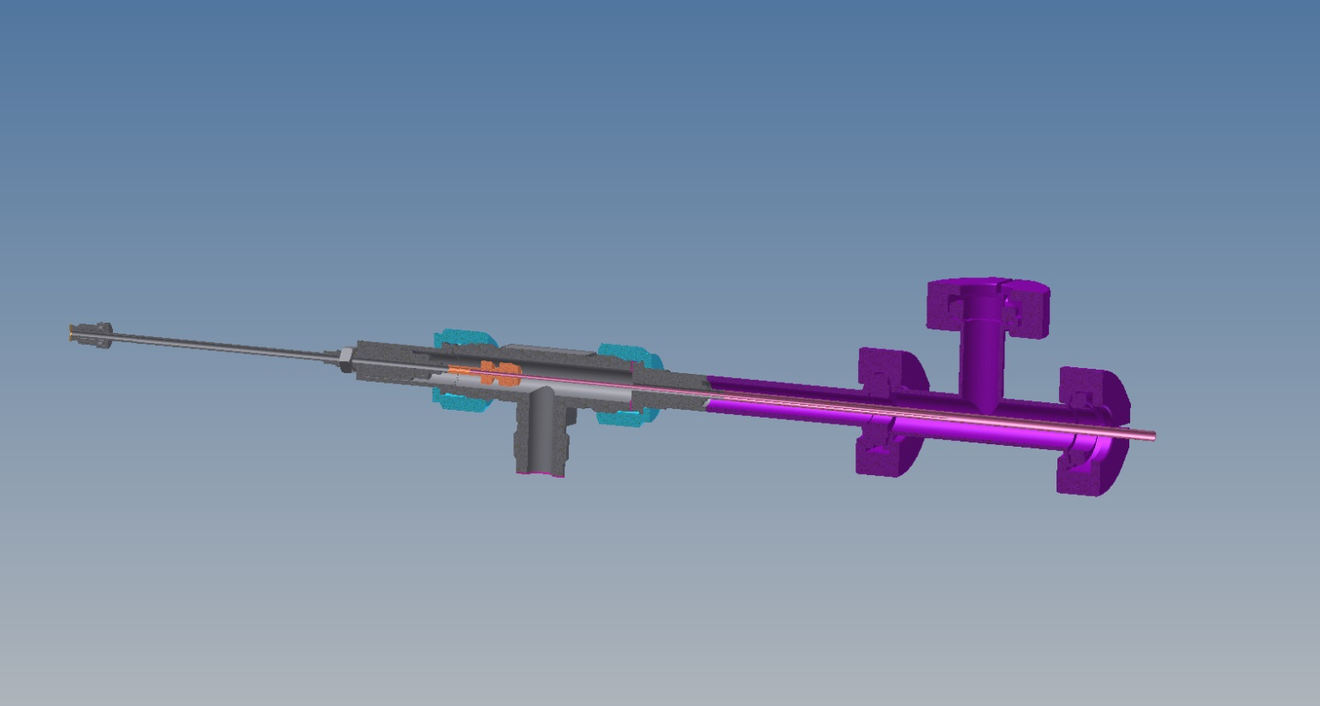
Components for flex tubes
Dismountable & rotatable concentric joint (at manifold)
- In work

Slide 18
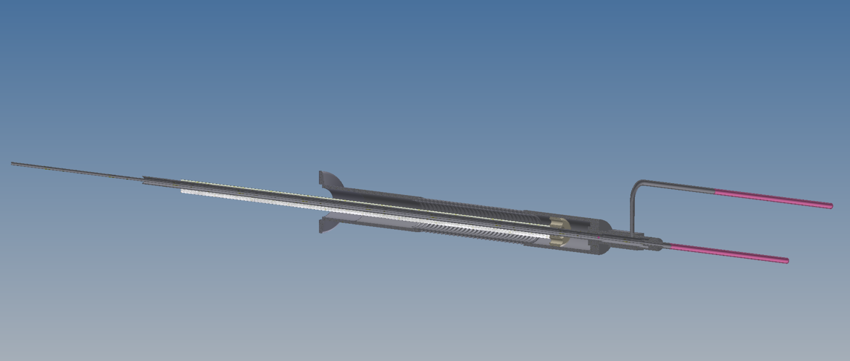
Components for flex tubes
Split (in-flow and return) at Belle side
- In work

Slide 19
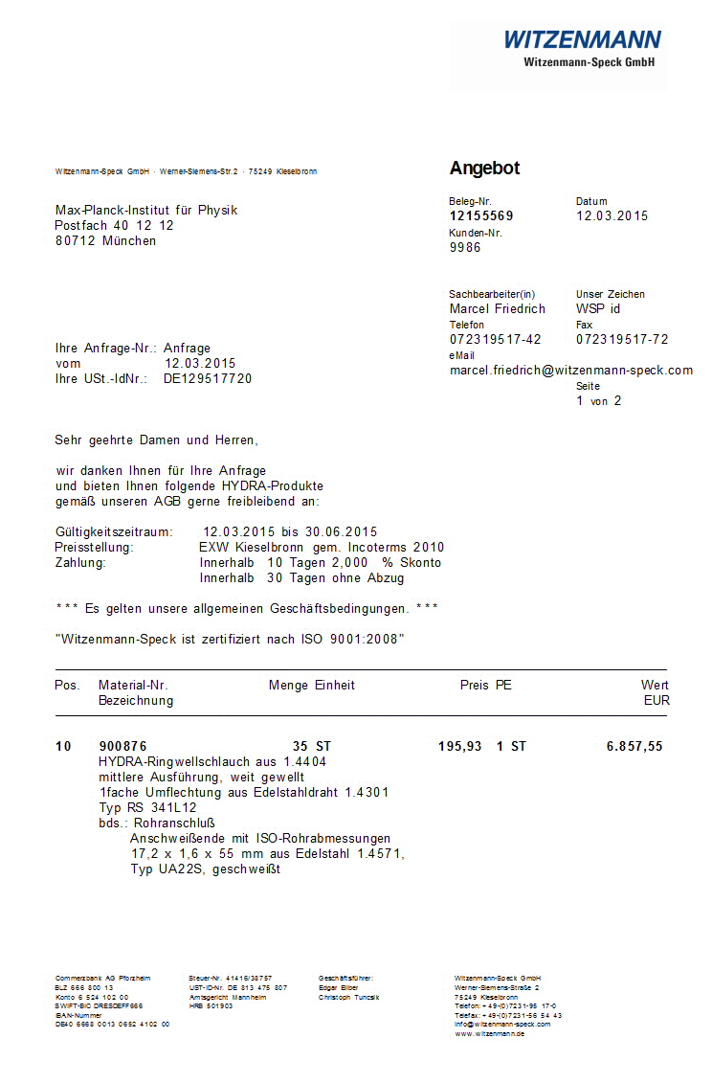
Flex Lines
Need to decide where to produce
CERN willing to help
But need manpower
To be discussed
Material can be ordered once exact length is known

Slide 20
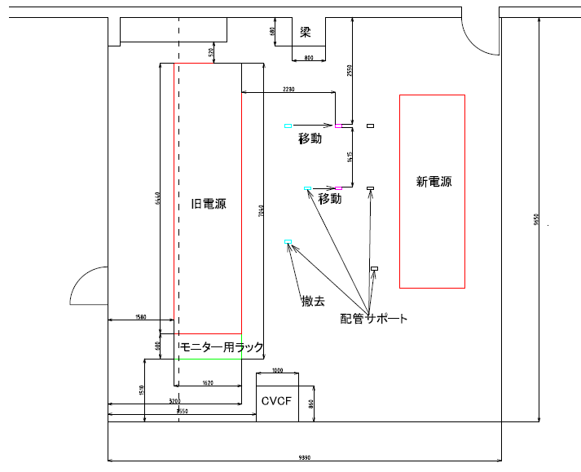
Location at KEK
Old PS, will be removed
Ok for IBBelle
New PS
Can these pillars/tubes be removed for 2nd unit?

Slide 21
Thanks

